Slide 1

Debugging and troubleshooting in R
Jorrit Mesman
Uppsala University
2023
Debugging
(verb) de-buhg-ing
> Being the detective in a crime movie where you are also the murderer
This project has received funding from the European Union’s Horizon 2020 research and innovation programme under grant agreement No. 101017861.

Slide 2
Workshop Outline
Presentation (30 min.)
A five-step strategy to deal with problems in your R code
Troubleshooting walkthrough + questions & discussion (45 min.)

Slide 3
Introduction
Dealing with unexpected problems and errors happens often
Usually not included in introductory courses
Everyone develops their own techniques
Here: a five-step approach to deal with errors
Little focus on specific errors, but rather a general strategy that can be applied to most code-related issues
Notes:
If you work with R, or any programming language, dealing with errors and other problems is an everyday issue. However, this aspect is not all too often covered in introductory courses, or really most courses, as the focus is often on learning new functions/applications. In general lines, the content of this presentation will be knowledge that’s spread widely throughout the data analysis world, but I had some issues with finding this information on the internet, and I notice that people often struggle with dealing with errors, which may be helped by following relatively simple strategies. I also think that, if we work enough with a programming language, we develop ways of dealing with errors by ourselves. This presentation is based on my own experiences and on several sources I found on the Internet, but at the end of this workshop I’d be interested in hearing your own experiences. This presentation doesn’t presume to have the best strategy (perhaps something else works better for you), but rather to share some common strategies that may be new to you and that can help you out.
In this presentation, I’ll outline five general steps on what to do when you encounter a problem in your code. There is not so much a focus on specific (or even common) errors, but I hope that the steps are general enough that you can apply them to almost any code-related issue. I’ll treat each of these point in detail, and then we try to apply these steps.

Slide 4
Troubleshooting strategy
(0. Double check your code)
1. Locate problem/error
2. Understand error message
3. Read documentation
4. Search help on the internet
5. Follow-up steps (reach out, try examples, or change approach)
Notes:
After each of these steps, you may have fixed your problem and you can move on.
0. This first line is not really part of the strategy, but it is a natural first thing to check if you made a typo or if there was some other slight oversight in the line you just wrote. I would usually assume that this step has already been taken when you try to memorise this presentation.
The real first step is locating your error. Sometimes the line you just wrote, but regularly you have to search for it. In fact, this is usually the most important step, but note that the line where your error occurs, may not be the actual source of your problem.
Understanding the error message (or understanding what is going on, in general); sometimes you can understand from the error message what the problem is
Reading the documentation is a step that’s often skipped, but is generally advised before you start looking on the internet. Functions may require different inputs than you expect.
Only now I’d say that you should start looking on the internet. Also here there are some techniques that you can follow
Lastly, if none of the previous things helped, you may want to contact other people, try examples from a specific package and, if they work, see how they differ from your inputs. And, if really nothing helped and no one had a similar problem, it is possible that you are approaching the issue in a wrong way, and you should consider changing your tactic.

Slide 5
Step 0 - Double check your code
Implied first step
Probably most mistakes are caused by small oversights
Forgotten brackets, commas, pipes, + signs, etc.
Forgetting to import a library or load a function
Referring to a wrong file or directory
Often creates hard-to-understand error messages

Slide 6
Step 1 - Locate the problem or error
Most important step – often immediately leads to solution
You need to know what the problem is to look for a solution
In general:
Run code step by step
Optionally using the Rstudio debugger mode
debug() and traceback() functions, if your problem relates to a function
The part where the error is created is not always the part where the real problem occurred. Try to trace back!
> if(Sys.Date() < as.Date("2022-10-01")){
values = c(1, 2 ,3)
}
> mean(values)
Error in mean(values) : object 'values' not found
“Finding your bug is a process of confirming the many things
that you believe are true — until you find one which is not true.”
- Norm Matloff

Slide 7
Step 1 - Locate the problem or error
Running code line by line, tracking your environment
You can implement some print() statements as well to find more quickly where the problem occurs
debug(function_name), browser(), and undebug(function_name)

Slide 8
Step 1 - Locate the problem or error
In case your problem is not related to an error:
Identify where the problem causing the faulty behaviour is located
Convert warnings to errors options(warn = 2)
You can use stop() in combination to an if-statement to generate an error when a certain condition is triggered (e.g. an empty data.frame is created)
Functions; work from inside to outside (or from top to bottom if it involves pipes)
Or click “Show traceback” in Rstudio (or traceback() outside Rstudio)
Loops; see at what step the problem occurs

Slide 9
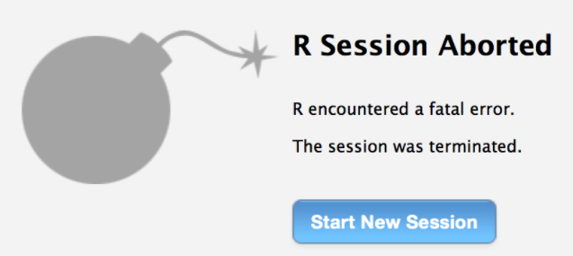
Step 1 - Locate the problem or error
What if your error only occurs sometimes
Empty your environment before you run your code, or even re-start R (to get rid of loaded packages)
If you interact with servers or websites, the problem may lay in an interrupted connection or a server that is down.
R Session Aborted, R encountered a fatal error (bomb message)
Often memory-related. Try to make your code use less memory.
Package installation errors
Not really considered here, but similarly, find the package that is causing the real problem (it may not be the one you’re trying to install)

Slide 10
Step 2 - Understand the error message
Ideally, an error message is informative, pointing you to a solution
Examples
read.csv("data_lake_temp.csv") -> cannot open file 'data_lake_temp.csv': No such file or directory
var / 2 -> non-numeric argument to binary operator
df[, z := x + y] -> Check that is.data.table(DT) == TRUE. Otherwise, := and `:=`(...) are defined for use in j, once only and in particular ways. See help(":=")
ggplot(df) + geom_line() -> `geom_line()` requires the following missing aesthetics: x and y
You may start to recognise common error messages over time
Works best in packages/functions that aim to “fail fast” (see recommendations at the end)

Slide 11
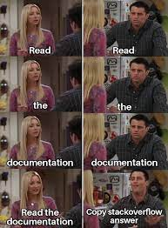
Step 3 - Read the documentation
?function_name
Often skipped, but advisable before looking on the Internet
Functions may require different inputs than you expect.
Look at the types/classes of the arguments
Documentations often contain an example; compare it to your own function call
Source: nixCraft

Slide 12
Step 4 - Search help on the internet
Important that you identified the cause of your problem (Step 1)
If an error message is generated, you can use this in your search
Suggestions for search query:
r *package_name* *error-message* *description*
StackOverflow often provides good suggestions, but there are other sources
ChatGPT (or alternatives)
Specific packages may have a dedicated vignettes/FAQ/Cheat Sheet/Github page
Notes:
Looking for things to help your code becomes harder when you want to do something new, rather than fixing something that’s broken.

Slide 13
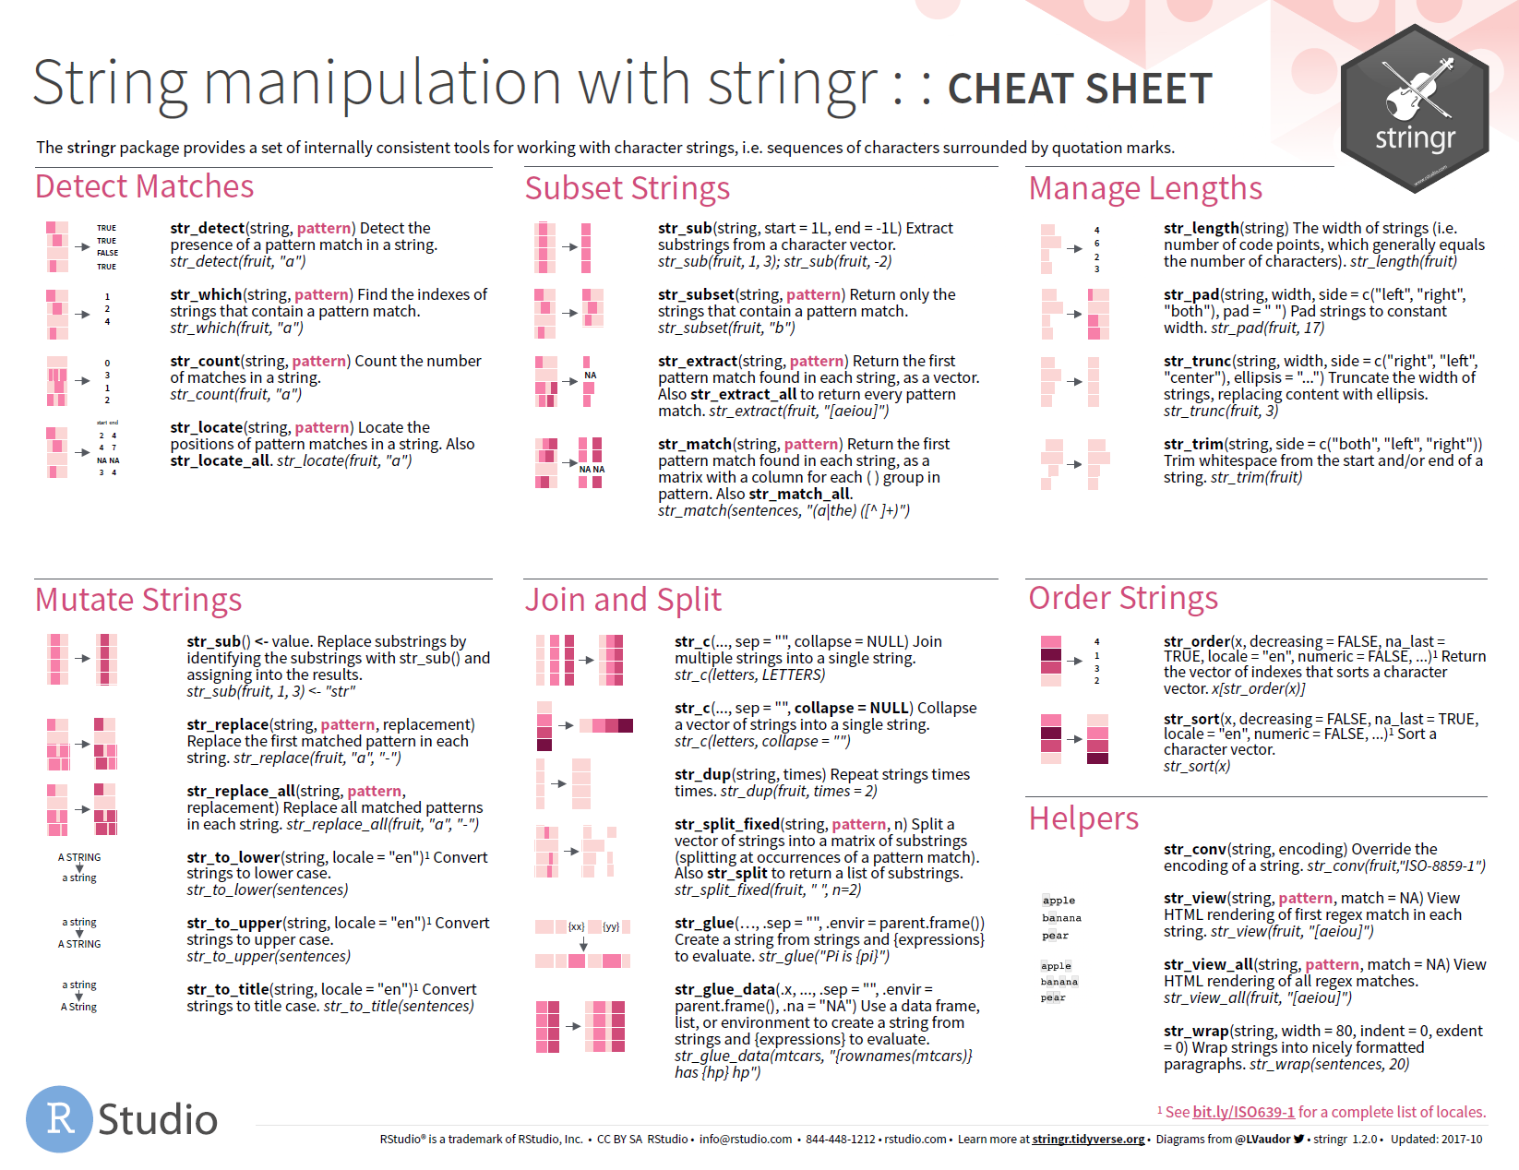
Step 4 - Search help on the internet

Slide 14

Step 5 - Follow-up steps
Contact colleagues
For complex workflows; go through example setups
Ask on the Internet
Use the right channel
If possible include a reproducible example (and perhaps sessionInfo())
https://stackoverflow.com/help/minimal-reproducible-example
Change approach
If your code doesn’t work, no one on the internet seems to have done something similar, and no one can help you, you might be using a wrong approach
When it’s been 7 hours and you still can’t understand your own code
Source: thecoderpedia.com

Slide 15
Troubleshooting strategy
(0. Double check your code)
1. Locate problem/error
2. Understand error message
3. Read documentation
4. Search help on the internet
5. Follow-up steps (reach out, try examples, or change approach)

Slide 16
Avoiding errors
Don’t do too much in one script – split up tasks
Comment your code
Try to copy as little code as possible within a script/project, instead use loops/apply functions, if needed
Build in exception handling or code that throws informative errors
Design to “fail fast”, e.g. check if the arguments into your function are correct
For packages: automated testing (e.g. testthat package)
Workflow management software (targets package)
Notes:
Not the main focus of this workshop, but a logical closing note

Slide 17
Thank you for your attention!
References
https://adv-r.hadley.nz/debugging.html
https://cosimameyer.com/post/mastering-debugging-in-r/
https://bookdown.org/yih_huynh/Guide-to-R-Book/trouble.html
Lake Erken data: https://data.fieldsites.se/portal/
This project has received funding from the European Union’s Horizon 2020 research and innovation programme under grant agreement No. 101017861.
This workshop has been made possible by the Swedish Infrastructure for Ecosystem Science (SITES), in this case by the Erken laboratory. SITES receives funding through the Swedish Research Council under the grant no 2017-00635.

