Slide 1


Introduction to data.table
Fast data handling and concise syntax in R
Jorrit Mesman
University of Geneva / Uppsala University
August 2021

Slide 2
Workshop Outline
Introductory presentation (20 min.)
What is data.table and why should you use it?
Questions (5 min.)
Walkthrough script – Part 1 (20 min.)
Break (10 min.)
Walkthrough script – Part 2 (20 min.)
Questions & Try it out yourself! (15 min.)

Slide 3
What is data.table?
CRAN R package
Main developer: Matt Dowle
First release: 2006
Active development
Extension to data.frame
Fast data handling
Main focus of the package
Reading, writing, selecting, joining, etc.
Consistent and concise syntax
Website: https://rdatatable.gitlab.io/data.table/
Twitter: @MattDowle, #rdatatable

Slide 4
Why this workshop?
One of the main packages in R, but little advertised
Can help you write clearer code and faster scripts
Faster data handling is particularly useful for GLEONites!
High-frequency data and long-term datasets
Modelling
Global analyses

Slide 5
Performance of data.table
It is often said that R is slow
Whether speed is relevant depends on the size of your data and how often you will call your function
Single use:
Small datasets (<10MB), speed is not so important
Large datasets (hundreds of MB), speed matters a lot
Repeated analyses:
Even small improvements in performance can save you hours
Indication of file sizes:
13 years of water temperature data, text format, 12 distinct depths
- Hourly: 11 MB
- 10 minutes: 85 MB
- 2 minutes: 387 MB

Slide 6
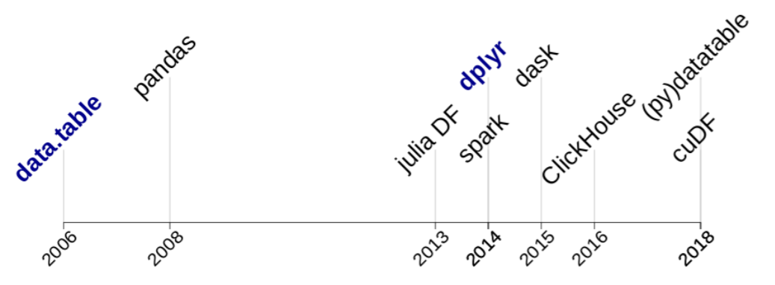
Performance of data.table
Source: Jan Gorecki, 2019

Slide 7
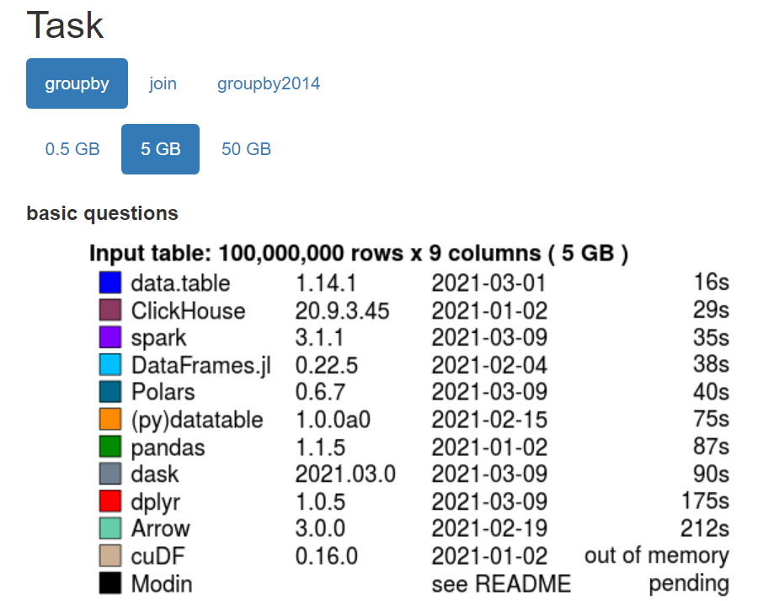
Performance of data.table
Data.table can be multiple factors faster than alternatives, even those in other languages!
https://h2oai.github.io/db-benchmark/, 2021-03-15

Slide 8
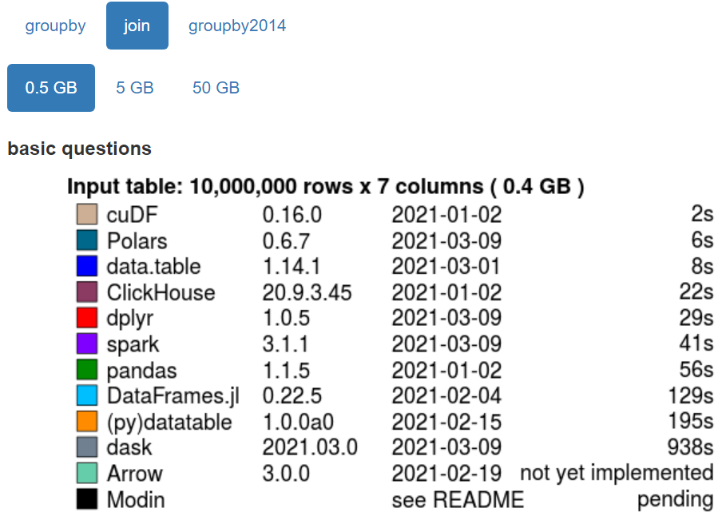
Performance of data.table
https://h2oai.github.io/db-benchmark/, 2021-03-15

Slide 9
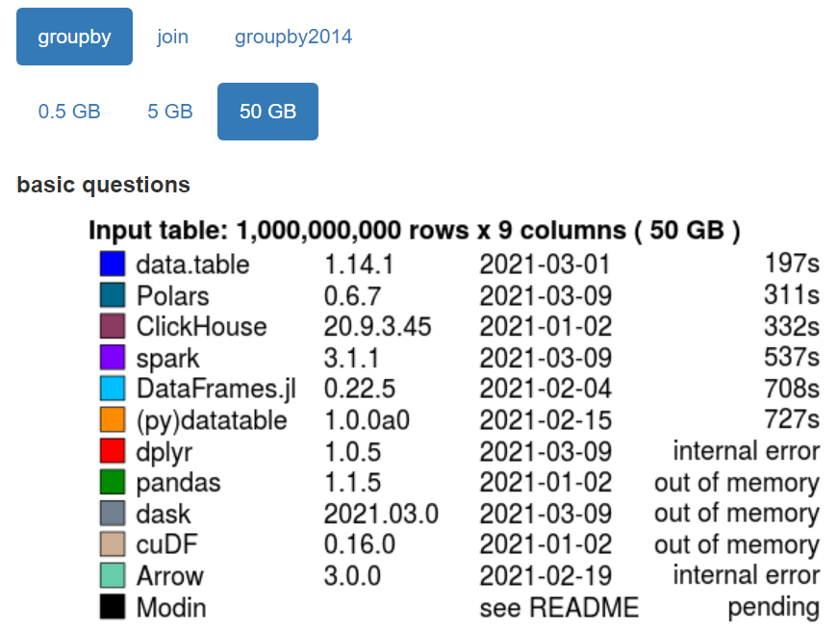
Performance of data.table
https://h2oai.github.io/db-benchmark/, 2021-03-15

Slide 10
Performance of data.table
for data.frame-like objects, R is not slow – if you’re using data.table!
https://h2oai.github.io/db-benchmark/, 2021-03-15

Slide 11
What makes data.table so fast?
Speed has been the main focus of data.table during its whole development
Efficient algorithms (C code)
Internal structure of data.tables
Less in-memory copying
Low-level multi-threading
When using data.table, most of this will happen internally, so you can code “normally” and still achieve a high efficiency

Slide 12
Not just fast, a clear syntax as well!
Data.table has a syntax that is different from base R
“Come for the performance, stay for the syntax” – Elio Campitelli, R blogger
Concise
Consistent
DT[i, j, by]
i: what rows
j: what to do
by: by what groups
More on this in the walkthrough...

Slide 13
Not just fast, a clear syntax as well!
Tidyverse also offers an alternative syntax to base R
Verbose
Verbs as functions
Pipes
Data.table
More alike query languages such as SQL
Closer to base-R
Which one is “better” ultimately comes down to preference, but to get optimal performance, you’ll have to use at least some of the data.table syntax
dtplyr package (https://cran.r-project.org/web/packages/dtplyr/index.html)

Slide 14
Short comparison syntax of data.table and tidyverse
Tidyverse DF %>% group_by(z) %>% summarise(sum(y)) ans <- DF %>% group_by(z) %>% mutate(y = cumsum(y)) DF %>% filter(x>2) %>% group_by(z) %>% summarise(sum(y)) ans <- DF %>% group_by(z) %>% mutate(y = replace(y, which(x > 2), cumsum(y))) | data.table DT[, sum(y), by = z] DT[, y := cumsum(y), by = z] DT[x > 2, sum(y), by = z] DT[x > 2, y := cumsum(y), by = z]
https://stackoverflow.com/questions/21435339

Slide 15
Short comparison syntax of data.table and tidyverse
Tidyverse diamondsDF %>% filter(cut != "Fair") %>% group_by(cut) %>% summarize( AvgPrice = mean(price), MedianPrice = as.numeric(median(price)), Count = n() ) %>% arrange(desc(Count)) | data.table diamondsDT[ cut != "Fair", .(AvgPrice = mean(price), MedianPrice = as.numeric(median(price)), Count = .N ), by = cut ][ order(-Count) ]
https://stackoverflow.com/questions/21435339

Slide 16
But combinations are possible!
data.table with pipes library(magrittr) library(ggplot2) temperature %>% .[level == 1000] %>% .[, mean(air), by = .(lat, lon)] %>% .[lat > 0] %>% ggplot(aes(lon, lat)) + geom_raster(aes(fill = V1), interpolate = TRUE)
https://eliocamp.github.io/codigo-r/en/2019/07/why-i-love-data-table/

Slide 17
Should you use data.table?
Is fast data processing important for you?
data.table might be interesting for you
Yes
No
Do you like the data.table syntax?
Yes
No
data.table won’t be very useful for you

Slide 18
In summary
data.table is very fast on especially large datasets
Significantly faster than many alternatives
File size needs to be large to notice difference
Consistent and concise syntax
We’ll learn how to work with this during the walkthrough
To the hands-on part!

Slide 20
Outline
What is data.table (extension to data.frame) Package creator Matt Dowle. Website link. Already in R for a long time.
Why this presentation: I like data.table a lot, helped me write better code, not advertised that much. But especially the speed argument may be very relevant for GLEON!
First presentation (15 min.), then walkthrough R script, then questions/exercises
Speed! Internal optimisation, update by reference. R still has the reputation of being a slow language, but actually...
Show benchmark website (faster than base R, Python, tidyverse...) Now the speed argument is important, but realise that you need to have data >100MB to actually notice anything, or many repeated operations.
Syntax (come for speed, stay for syntax) (quick comparison with tidyverse; concise and consistent vs. Verbose and accessible to non-coders) -> Comes down to preference

Slide 21
Outline
Syntax is consistent, as it is always i, j, by (some additional arguments possible)
Some like it, some prefer base R or tidyverse, and in that case, the syntax is a burden when you would like to use the fast computation of data.table. I hope that my walkthrough would in that case help (also consider dtplyr if you like the tidyverse syntax; not as fast as data.table, but it comes a long way)
Additional upsides: stable, rigorous testing, large community, updates
I like it a lot, but this is not a sales pitch; essentially, if you need the speed, check it out. If you like the syntax, also check it out.
I hope that my walkthrough script can simultaneously act as a “cheat sheet” when using data.table for the first time.

Slide 22
Speed is good, but you should focus on the bottlenecks

