Slide 1
antares load distributor
how it could work

Slide 2
premise
compute on 5 machines, each with 36 cores and sufficient RAM
do a 900 monte carlo year simulation
after that, parse the data of the entire simulation using one R readAntares request

Slide 3
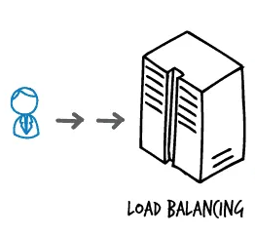

step 1: the set up
MAIN MACHINE:
the user prepares the antares model
the user sets up the load balancer
user wants to use 5 nodes
user wants to use 36 cores on each node

Slide 4
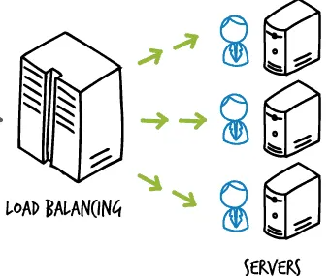
step 2: the mAIN-WORKER relationship
The load balancer (=driver) will create a scenario playlist per worker
Every worker node has a dedicated folder for work from another DRIVER
The load balancer zips the model intelligently and ships it to the workers using UNC paths configured by the user + it adds an instruction sheet for the client

Slide 5
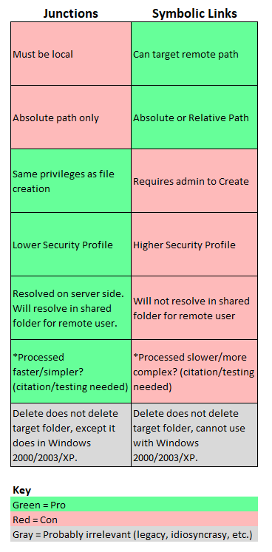
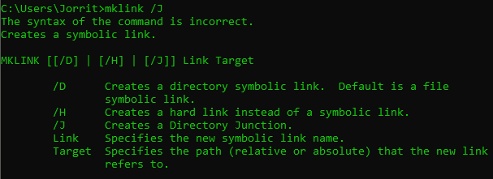
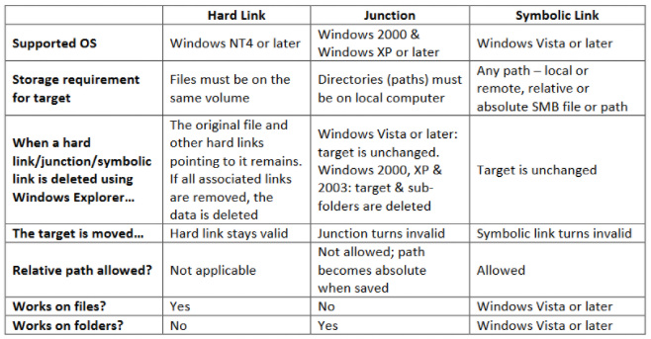
Symbolic links

Slide 6
STEP 3: the worker initiation
The client runs a daemon that monitors the DRIVER folders
If a new model + instruction sheet is uploaded it will
unpack the model
run the model according to the instructions
write a file when everything is done so the MAIN knows when to consolidate

Slide 7
STEP 4: MAIN consolidation
MAIN has routines to check if all clients have written their final logfile
on MAIN symbolic links to the output folders on the remote hard disks are generated (mklink /D)
The user can use R and antaresRead to read all monte carlo years at once (e.g. 1/5 from local disk, and 4/5 over the network).

