Slide 1
infovis project - group 2 - 2024 final presentation
Global wind power educational dashboard
Jorrit Vander Mynsbrugge
Ruth Vandeputte
Mishkat Haider Chowdhury
Notes:
Ruth
indicate that we also have open questions during our presentations which we want to discuss with beat / yoshi after the presentation

Slide 2

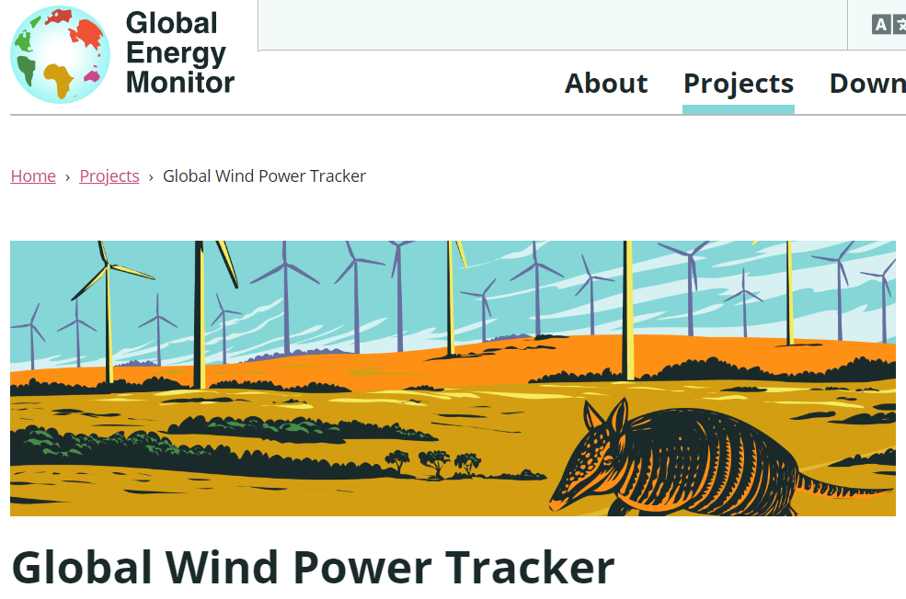
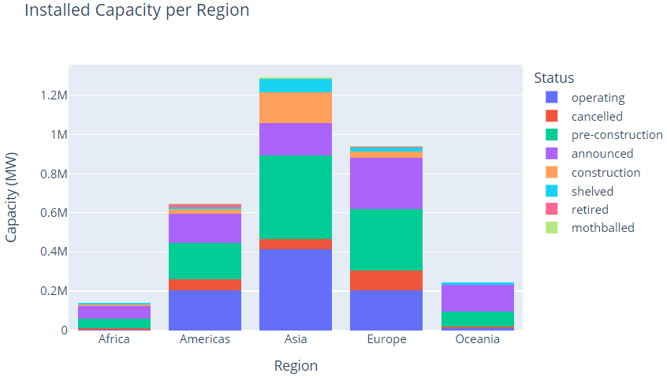
What-Why-How question
Quick reminder to set the context:
27.422 wind farm phases
155 countries
Latest release from December 2023
29 attributes: installation type, status, capacity, coordinates, start year…
Notes:
jorrit

Slide 3

What-Why-How question
These are the selected target tasks that can be solved with our current app:
How is offshore wind currently distributed across different continents?
In future years, will the world invest more in onshore or offshore wind?
Can you list the top 20 largest operating wind farms in India commissioned between 2010 and 2020?
Can you locate the 3rd largest operating onshore wind farm in South Africa and retrieve its capacity value?
video
demo
video
Analysis
Search
Query
Notes:
jorrit

Slide 4

What-Why-How question
Data preprocessing
Missing data inference (recall: missing start year for 36% of the records)
Attribute grouping to reduce complexity
Abbreviating text fields
Elaboration of the static prototype into an interactive visualization (cfr. demo)
Semantic zooming using our own defined clustering (for responsiveness and control reasons)
Adding interactivity by linking dashboard components (BAN’s, filters, map, bar chart)
Creating linked views (bar chart is clickable)
UI optimization (colour contrast, highlighting active BAN, unify status color, move legend, ...)
Evaluation (cfr. final part of this presentation)
Elaborate evaluation plan
Perform interviews and analyse results to extract potential improvements
Notes:
jorrit

Slide 5
LIVE DEMO
Notes:
ruth

Slide 6

Evaluation Process
Team Involvement: Each team member conducted one interview
Selection of canditate: Three canditates chosen from diverse background
Interview Setup: Four questions asked related to our wind data visualization
Questionnaoire Focus: We filled up a questionnaire while conducting the interview with the following focuses: 1. Understanding the question 2. Answering the question without support 3. Correctness of the answers 4. General Feedback
 | Age | Sex | Level of Education | Time taken
Canditate 1 | 36 | F | Masters | 7:10
Canditate 2 | 26 | F | Masters | 4:10
Canditate 3 | 28 | M | Masters | 9:27

Slide 7

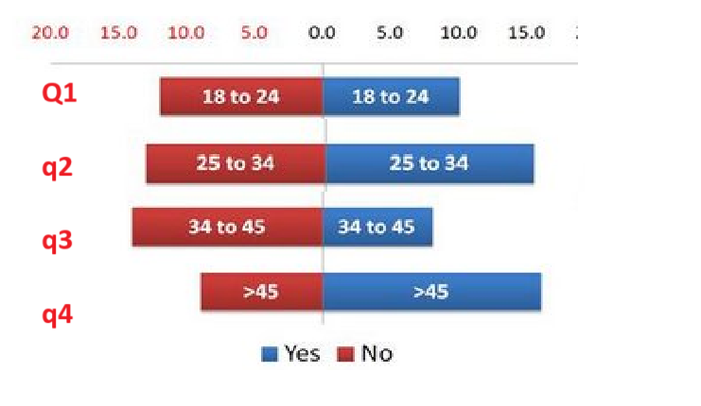
Answers summary
PROPOSAL viz
TASK: answer: was the interview well designed?

Slide 8
Question 1: How is offshore wind currently distributed across different continents?
 | Canditate 1 | Canditate 2 | Canditate 3
Understanding | Yes | Yes | Partly
Support Needed | Yes | No | Yes
Correct Answer | Yes | Yes | Partly
Feedback | Finding filter was not so obvious; one has to look at the BAN. | No feedback provided | Only issue was uncertainty about 'currently'; unclear that only 'operating' should be selected.
remove

Slide 9
Question 2: In future years, will the world invest more in onshore or offshore wind?
 | Canditate 1 | Canditate 2 | Canditate 3
Understanding | Yes | Partly | Yes
Support Needed | No | Yes | No
Correct Answer | Yes | Yes | Yes
Feedback | Started adding the BAN for different continents but did not immediately notice the 'total' BAN. | The answer can be given by using the 'status' filter or the timeslider; both give slightly different answers. | Only issue was uncertainty about 'currently'; unclear that only 'operating' should be selected.
remove

Slide 10
Question 3: Can you list the top 20 largest operating wind farms in India commissioned between 2010 and 2020?
 | Canditate 1 | Canditate 2 | Canditate 3
Understanding | Yes | Yes | Yes
Support Needed | Yes | No | Yes
Correct Answer | Yes | Yes | Yes
Feedback | Time slider obvious; finding country not obvious as you first have to select continent & subregion. | Subregion has to be chosen first in order to select a country; not everyone knows the subregions. | Unclear to first select a subregion before being able to select country; would be better to directly select a country.
remove

Slide 11
Question 4: Can you locate the 3rd largest onshore wind farm in South Africa and retrieve its capacity value?
 | Canditate 1 | Canditate 2 | Canditate 3
Understanding | Yes | Yes | Partly
Support Needed | No | No | Yes
Correct Answer | No | No | Yes
Feedback | Finding South Africa now was easy after having done Q3; ranked bar chart is obvious. | No feedback provided | Selecting country directly would be helpful.
remove

Slide 12

Evaluation takeaways
Positive feedback received:
Easy on the eyes
Intuitive F-shape layout
Colour channel consistency for status was highly appreciated
BAN’s are very usefull to extract the totals
Constructive feedback received is usefull for future iterations of the product:
Having empty filters when parent levels are not set is confusing to users
The slider could use a tooltip so users know what exactly is being filtered on
Users should know what time the data was ‘snapshotted’ to properly understand when a unit is in ‘future’ state
Notes:
mishkat

Slide 13
Time for questions!

