Slide 1
analysis on start & end year how to handle missing data
JVM

Slide 2
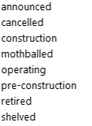
simplify status
all of these categories relate to units that will be operational some day in the future –
rename status to ‘future’
this is the only category where units are operational today
keep status ‘operating’
this constitutes units that once were operational but no more
rename status to ‘retired’
these units have no added value for the analysis
remove the units in the ETL

Slide 3
4 cases exist
Start year | Retired year | Analysis
Value | Value | Has mostly retired units except for 1-2 operating units that were set to retire in 2023
Value | NA | Has retired units Has operating units Has future units
NA | Value | Has retired units only
NA | NA | Has a few retired units Many operating units Many future units

Slide 4
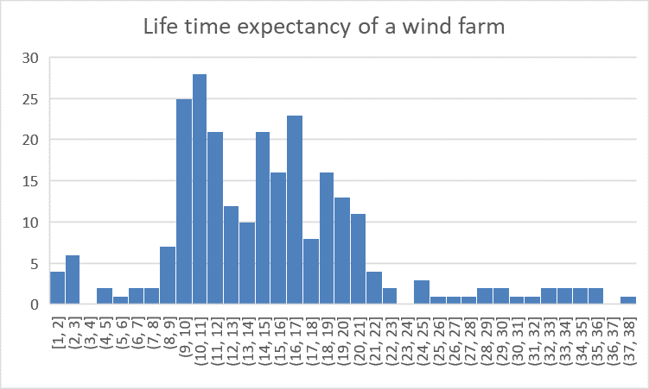
wind farm life span
From the V-V dataset we can deduce an median life span of 15(*1) years

Slide 5
proposal for imputing missing values
Start year | Retired year | Analysis
Value | Value | Has mostly retired units except for 1-2 operating units that were set to retire in 2023
Value | Min(Start_year + 15, 2023) Max(Start_year + 15, 2025) Start_year + 15 | Has retired units Has operating units Has future units
Retired_year - 15 | Value | Has retired units only
2008 2017 2025(*3) | 2023(*2) 2032 2040 | Has a few retired units Consider them retired in 2023 Many operating units Consider these half life in 2024 Many future units Consider them commissioned in 2025

Slide 6
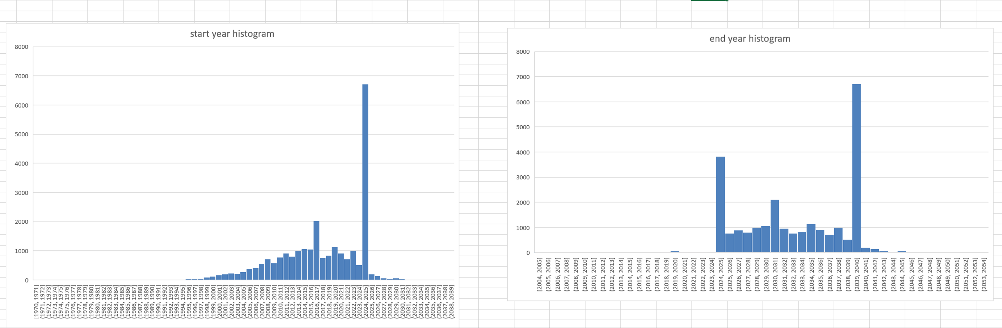

Slide 7
discussion
*1: instead of taking a fixed number of 15 we can build a statistical model (mu=15,4; sigma=6,5) to draw a lifespan from
*2: we could also model the time between today and already retired plants and sample that statistical model every time we need to obtain a past retire date value
*3: we could also model the time between today and future announced plants and sample that statistical model every time we need to obtain a future start year value
upside: no ‘jumps’ at Y – 7; Y – 1; Y + 1 ; Y + 7
downside: workload, added value for viz?

Slide 8
what does our time slider indicate?
TODAY
SIMPLEST APPROACH: it filter based on the start_year and not the retired year!!!
TIME WINDOW
2010 2020
we have to add a hover / note to the time slider explaining to the user that it is filtering the units by ‘comissioning date!’
if you want older units as well, you must lower the lower bound of the time window sliders...
TIME WINDOW
TIME WINDOW

