Slide 1
infovis project - group 2 - 2024 midterm presentation
Jorrit Vander Mynsbrugge
Ruth Vandeputte
Mishkat Haider Chowdhury

Slide 2



team presentation: group 2

Slide 3
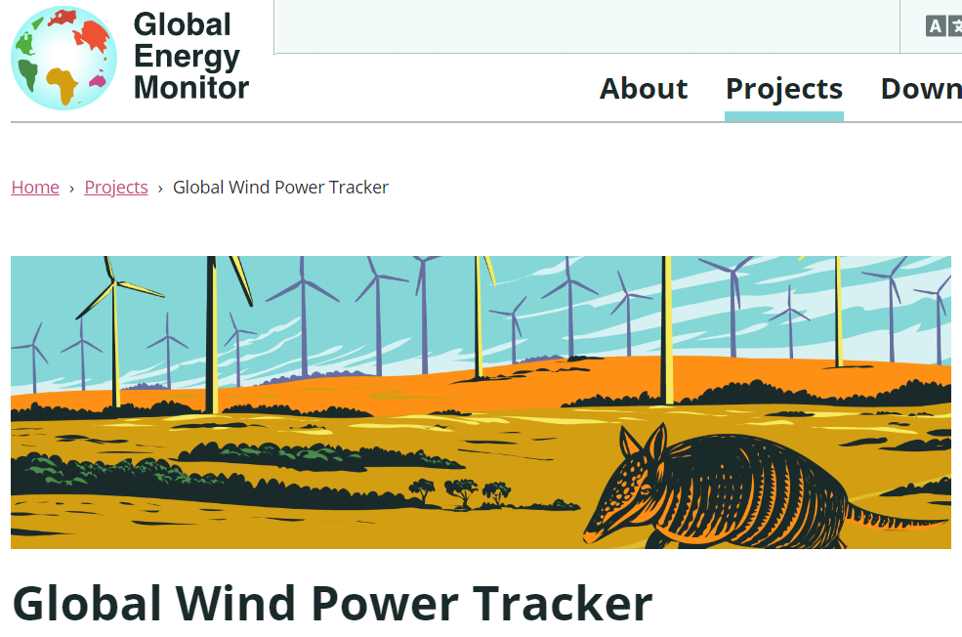
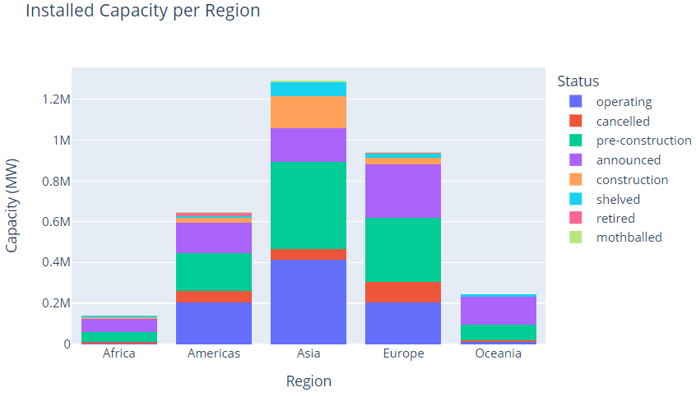
The dataset
27.422 wind pharm phases
155 countries
Latest release from December 2023
No missing values in key attributes

Slide 4
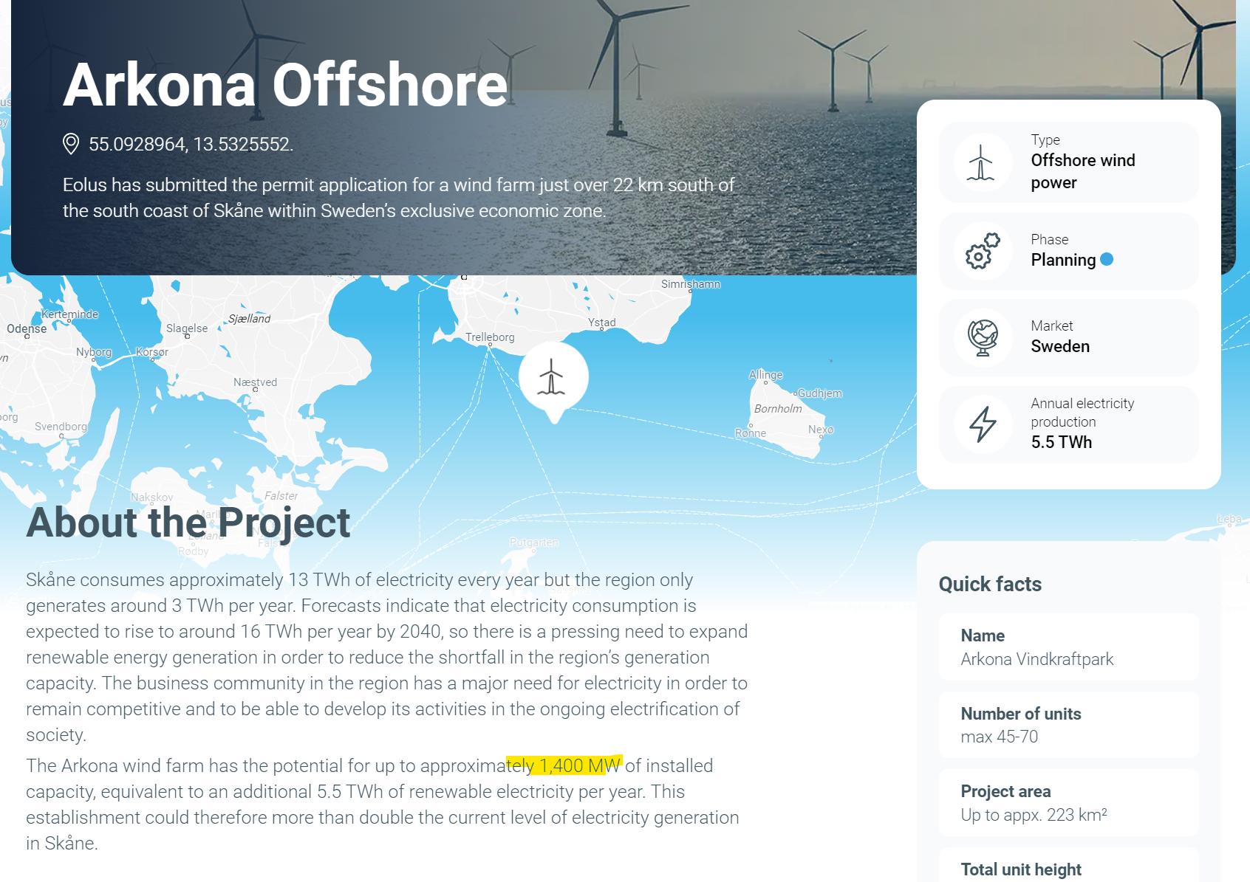
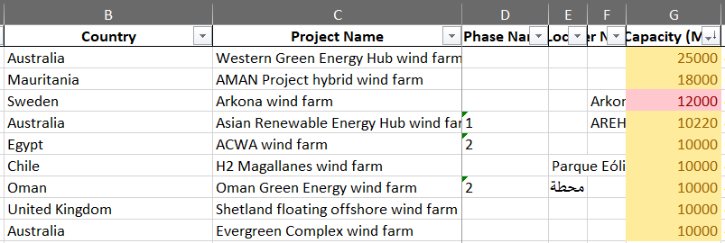
The dataset – quality issues
sample crosscheck done both on operating & announced projects
issues only exist with announced projects
capacities > 10GW will be removed from the dataset

Slide 5
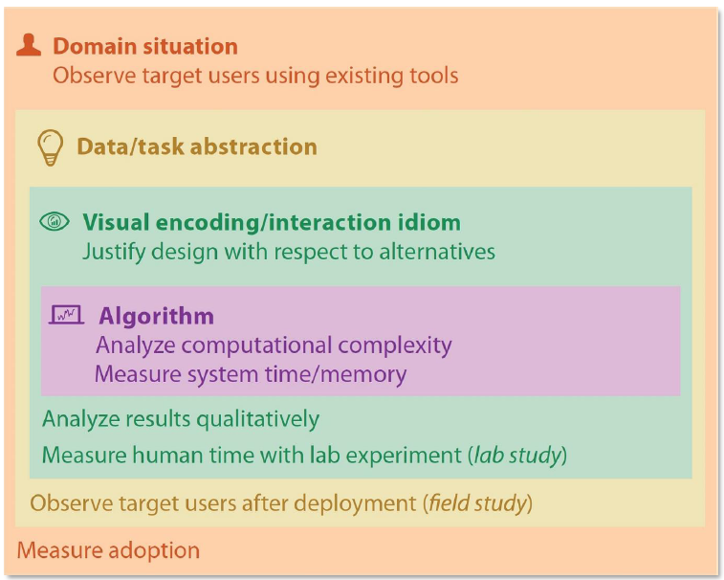
Validation: domain situation
Assessment:
Target user: high school STEM student. They know electrical power is expressed in Watt, they know the prefix M, they know a windmill produces electrical energy.
Key questions:
“how is offshore currently distributed over the different continents?”
“what continents are in the lead of renewable wind integration”
“can you find attribute X of the biggest windfarm in Europe?
“how is the installed capacity evolving over time?” (potentially excluded)
Validation:
no interviews
try to imagine yourself in the role of high school student
maybe ask a student? (not yet decided)

Slide 6
Validation: data/task abstraction
Assessment:
the data is hiërarchical, fine data can easily be bucketed into aggregate categories
questions 1 and 2 are ‘analyse’ questions.
question 3 combines both the ‘search’ with the ‘query’ aspect of a viz.
at first both location & power will be unknown
→ then you order by power → then you locate → then you query
question 4 is a ‘search’ by filtering on time and status (lookup) and a ‘query’ to compare the rates between regions
Validation:
this layer is the least ‘clear’ to us, can we discuss how to assess data/abstraction better and avoid jumping from domain -> idiom selection?

Slide 7
Validation: idiom selection (i)
Assessment:
filters:
alphabetical combo boxes for categorical values
multiple values can be selected
slider for time scale
BANs* for 1st hiërarchical level (e.g. continent) showing immediatly some summary statistics
geographical distribution:
map with dots
no choropleth – offshore concessions are often very small (area too small to use color/hue as channel)
size as channel for power rating
top stations:
horizontal bar chart
position as channel for power rating + maybe second channel (luminance?)
*“Big Aggregate Numbers” or “Big Actionable Numbers”

Slide 8
Validation: idiom selection (ii)
Assessment:
query:
pop-up table with relevant attributes
Validation:
mockup (see next slide)
mid-term feedback ;-)
*“Big Aggregate Numbers” or “Big Actionable Numbers”

Slide 9
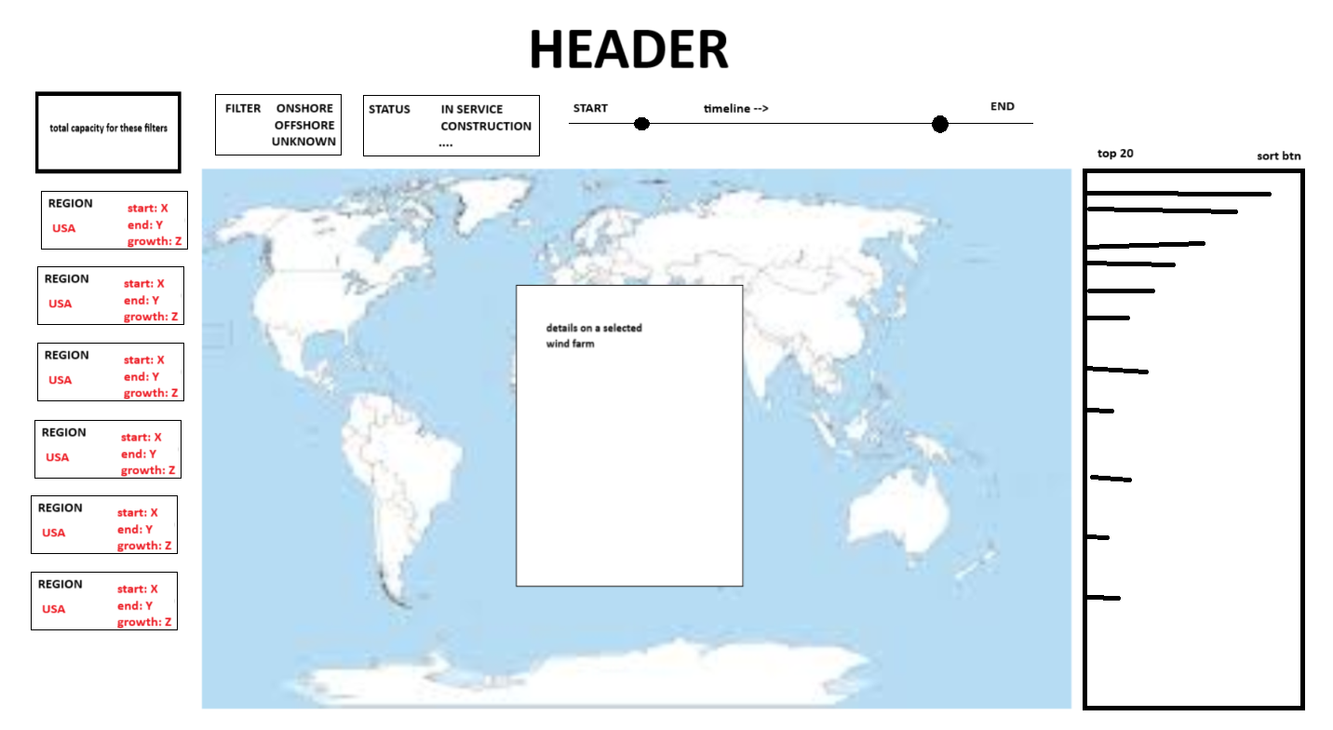
Mockups (3 iterations)
additional filters
(sub)total
Filters on top
BAN on the left that also filter the main viz
Main viz on the middle
Horizontal bar chart on the right
Popup in the middle (query result)
map updates / zooms according to filters
clicking a farm in map or rank shows all attributes
ranking updates according to filters
BAN serving as level 1 filter

Slide 10
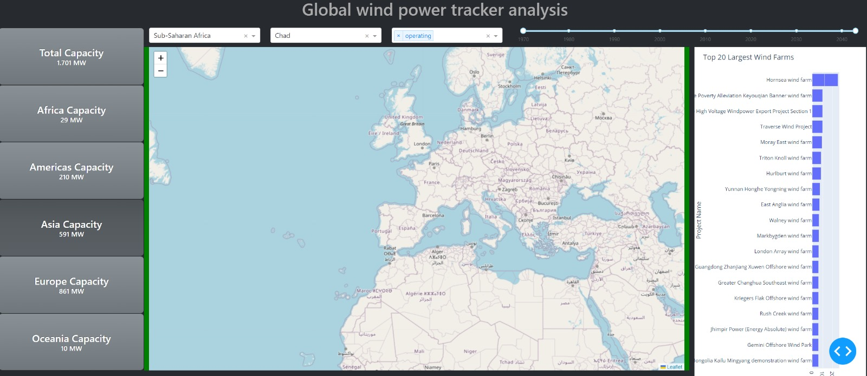
Fast prototyping

Slide 11
Validation: algorithm
Assessment:
dataset is static, non-streaming
query and summary statistics can be pre-computed
map viz will be slowest section → try second framework if first does not suffice
see next slide
Validation:
measure it
*“Big Aggregate Numbers” or “Big Actionable Numbers”

Slide 12










Tech stack
Product
Collaboration
or
https://github.com/jorritvm/infovis
source

Slide 13
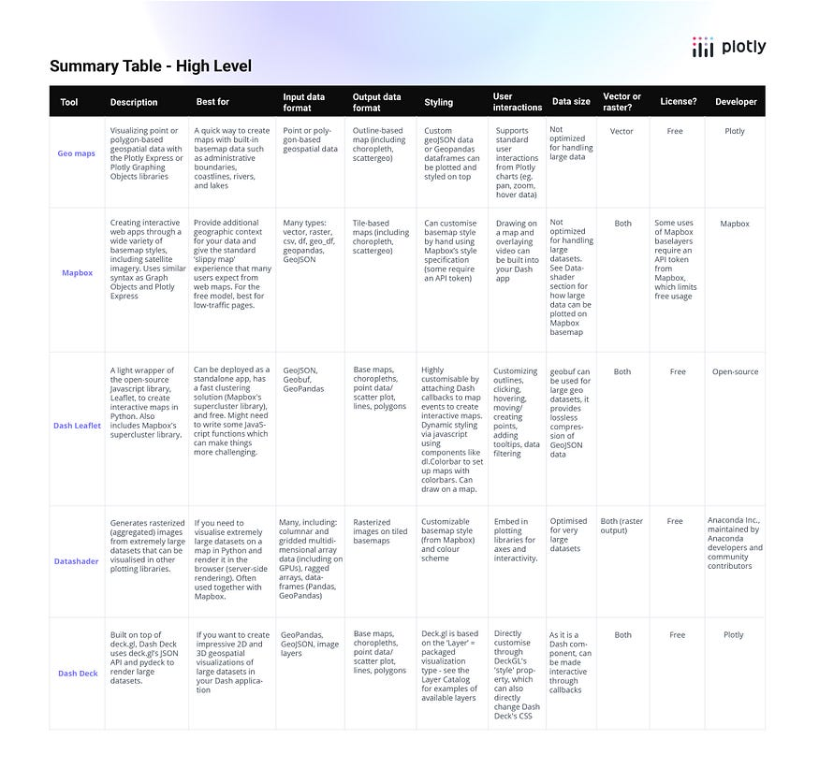
Map viz tech

Slide 14
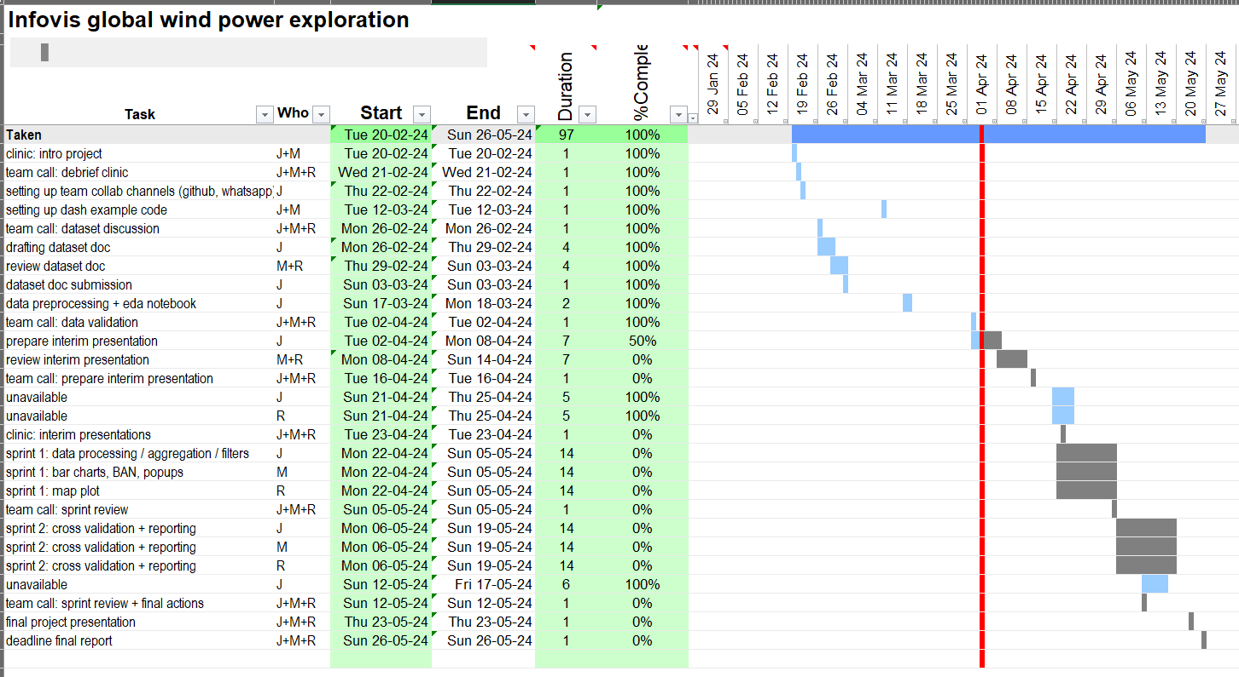
Project plan

