Slide 1
how to fetch data from growatt online platform into your own database

Slide 2
old platform (< 2023/08)

Slide 3
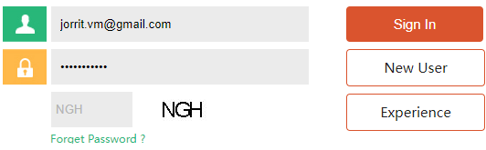
how to log in to download data
go to https://server.growatt.com/login.do
fill out credentials (bitwarden)

Slide 4
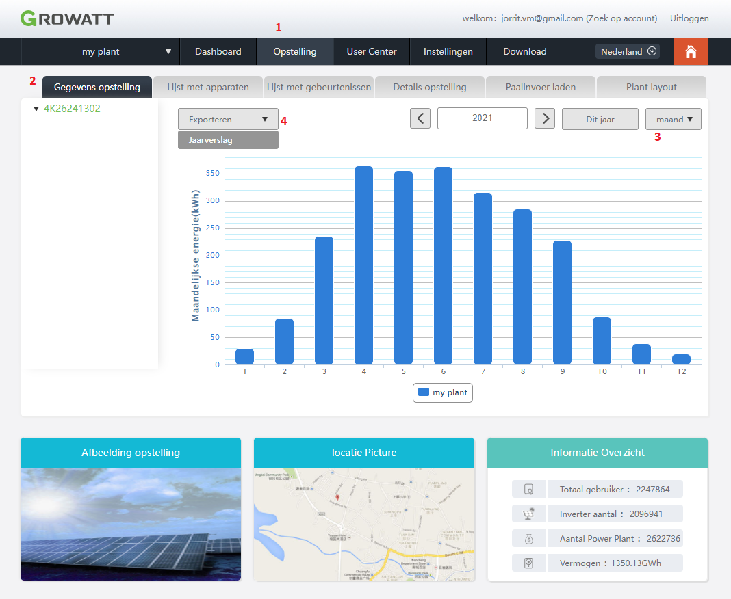
how to download yearly report

Slide 5
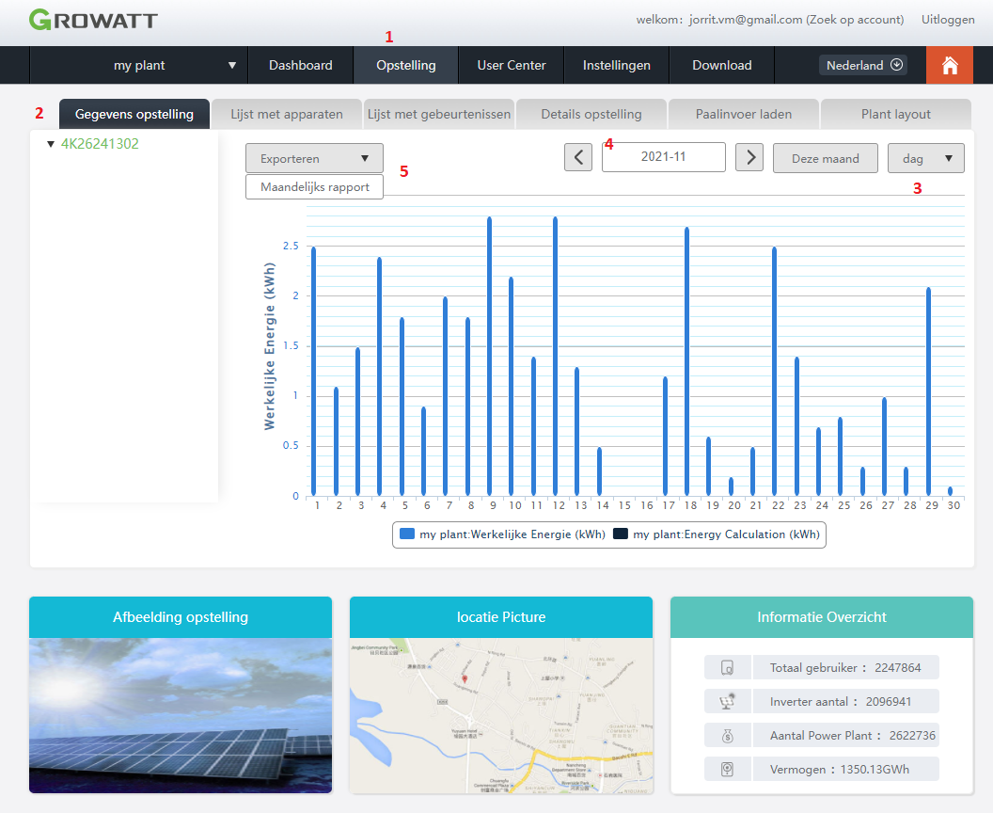
how to download monthly reports

Slide 6
new platform (> 2023/08)

Slide 7
new version of the platform
https://server.growatt.com/login

Slide 8
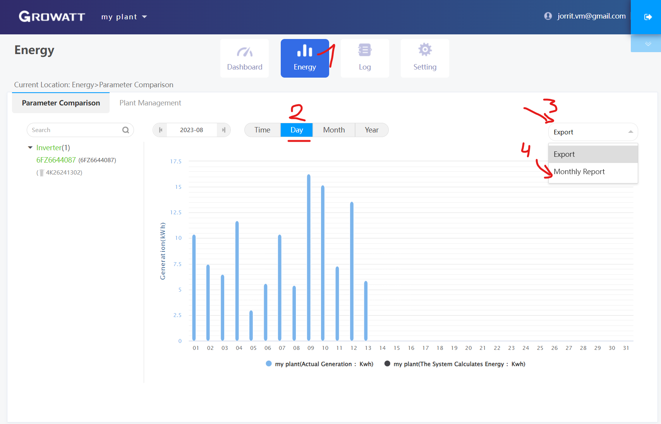
how to download monthly reports (value per day)

Slide 9
processing the data files

Slide 10
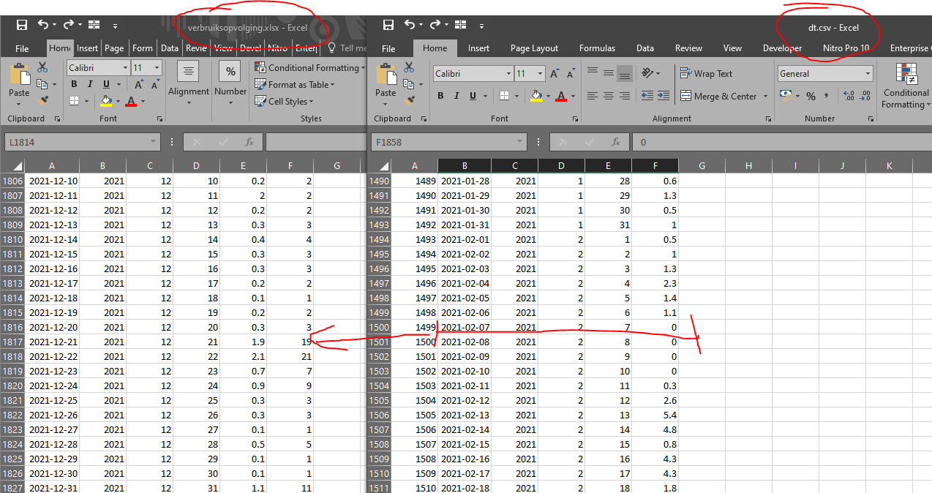
final steps
run r code
paste data into verbruiksopvolging.xlsx

