Slide 1
stock dashboard
main documentation

Slide 2
import

Slide 3
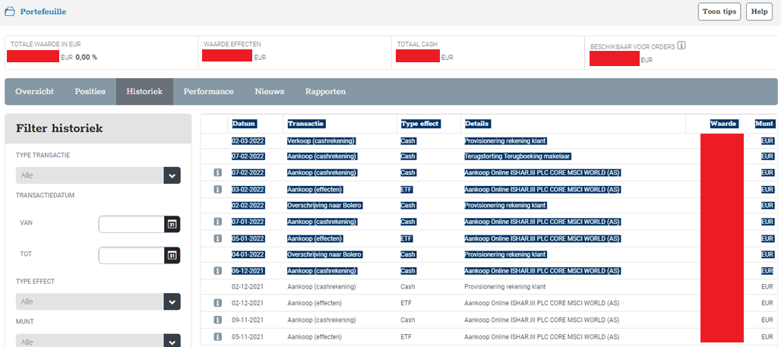
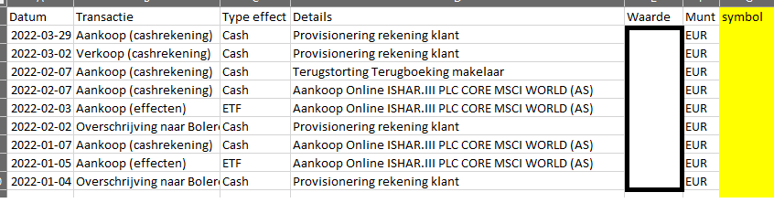
BOLERO import xlsx
log in op bolero
gaar naar portefeuille
dan naar historiek
selecteer data en plak het in excel (via notepad tussenstap wordt html formatting verwijderd)
voeg een symbol kolom toe
vul het RIC als symbol in (minstens 1x per nieuwe stock)
als er geen ‘nieuwe’ stocks zijn gekocht dan hoef je geen symbol in te vullen

Slide 4
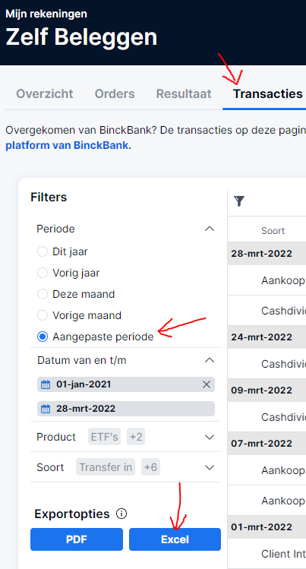
SAXO import xlsx
log in op Saxo Investor
gaar naar transacties
plaats aangepaste periode
exporteer als excel
voeg een symbol kolom toe
vul het RIC als symbol in (minstens 1x per nieuwe stock)
als er geen ‘nieuwe’ stocks zijn gekocht dan hoef je geen symbol in te vullen

Slide 5
db

Slide 6
DB schema
the 2 _map tables are related to imports where RIC codes are missing
the other 4 tables are core data tables

Slide 7
transactions description
possible types of transactions:
buy: buy N amount of shares at price P
sell: sell N amount of shares at price P
transfer_in: bring in N shares from another broker
transfer_out: transfer out N shares to another broker
cash_in: bring in M money in your broker’s cash account
cash_out: take out M money from your broker’s cash account
div: receive dividend

Slide 8
reactivity

Slide 9
reactives
use reactive expressions for calculations
- reactive expressions are recipes for how to calculate something, shiny will determine when it is required to execute
- can accept reactive input and deliver reactive output
- has a cached result
- make maximum use of this feature in shiny
cash_b_evol()
transactions
polling
tr()
tr_ext()
pos_sb_evol()
pos_sb()
stock_ohlc
ohlc()
polling
ohlc_euro()
fx_rates
polling
fx()
use observers for side effects
dealing with I/O (files / DB)
setting reactive values!
update input elements of the shiny app
stock_profiles
polling
profiles()

Slide 10
reactive values
rv$focus_stock
guarantees continuity between pages when selecting 1 stock
first lines sets the rv so that other selectinputs may update
second line updates this selectinput if somewhere else the rv was modified
rv$msgs
contains messages shown in notification corner as well as notification menu

Slide 11
performance

Slide 12
performance per stock
everything is shown in euro unless otherwise specified
for a stock we keep track of the mean acquire price, irrespective of time held, and compare that to the latest close price,
example:
buy 100 stocks at 10 EUR (1000EUR)
buy 100 stocks at 14 EUR (1400 EUR)
sell 50 stocks at 15 EUR (750 EUR)
buy 100 stocks at 16 EUR (1600 EUR)
current evaluation 18 EUR
holding
100
200
150
250
250
mean acquire price
10
(100x10 + 100x14) / 200 = 12
12
(150x12 + 100x16) / 250 = 13,6
13,6
mean acquire evaluation
1000
12 x 200 = 2400
12 x 150 = 1800
13,6 x 250 = 3400
3400
performance absolute
0
14x200 – 2400 = 400
15x150 – 1800 = 450
16x250 – 3400 = 600
18x250 – 3400 = 1100
performance relative
0
400 / 2400 = 16,66%
450 / 1800 =
25%
600 / 13,6 = 17,64%
1100 / 3400 = 32,4%

Slide 13
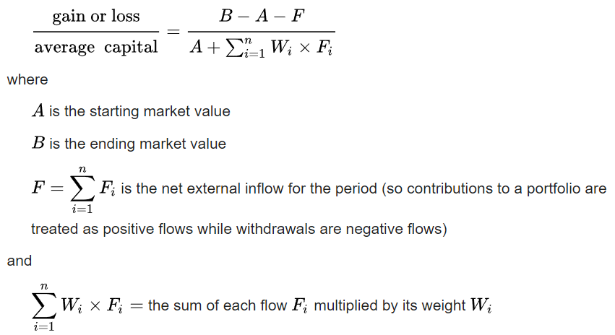
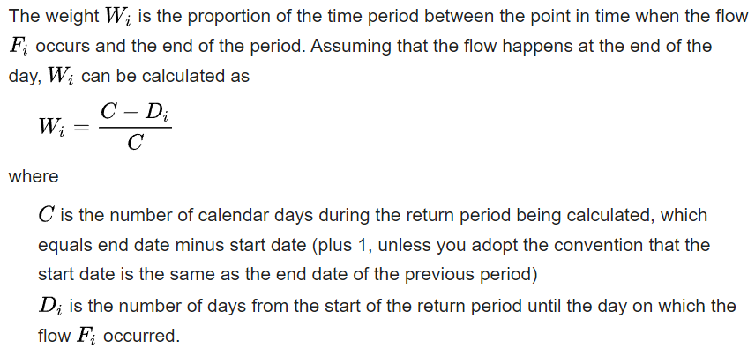
performance per portfolio
1234569

Slide 14
app

Slide 15
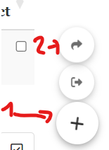
Shinymanager: authentication & site monitoring
Auth is done using shinymanager
https://datastorm-open.github.io/shinymanager/
Shinymanager can store credentials are stored in sqlite database
Shinymanager provides an admin console with an overview of the site usage, but only if you use the sqlite backend option.
The sqlite DB is protected with a symmetric AES encryption. To store the keys for this encryption it uses the keyring package. This makes use of the OS credential store: when you set a key using key_set it is stored securely on the local machine
Windows: It uses the Windows Credential Manager.
Linux: It may use the Linux keyring or other secure storage mechanisms.

Slide 16
Shinymanager: authentication & site monitoring
How to set it up locally:
Copy scripts/credentials_template.env to scripts/credentials.env
Modify credentials.env: configure shiny app username and password as well as sqlite encryption password
Run setup_credentials.R
Verify that db/credentials.db has been created
How to set it up in a docker image
Replace steps 1 & 2 above by setting up the environment variables through docker
Perform 3 & 4.

Slide 17
theory

Slide 18
transactions visualised
EXTERNAL WORLD
BROKER A
cash_in
CASH ACCOUNT
buy
STOCKS ACCOUNT
cash_out
sell
div_dist
div_acc
transfer_in
transfer_out
BROKER B
cash_in
CASH ACCOUNT
buy
STOCKS ACCOUNT
cash_out
sell

