Slide 1
stock dashboard
main documentation

Slide 2
content
terminology
how to run and use the app
data model
importing new data
internal data structures & reactivity
performance

Slide 3
terminology
foreign exchange rates = forex = fx
ohlc: open – high – low – close = daily values for stocks
ric: reuters instrument code (https://en.wikipedia.org/wiki/Refinitiv_Identification_Code)

Slide 4
how to run and use the app

Slide 5
Initial setup
Clone the repo: https://github.com/jorritvm/stocks_dashboard
Restore the RENV: renv::restore()
Build an empty db file: scripts\setup_db.R (link)
Setup authentication: scripts\setup_credentials.R (link)
Create config.env (using config_template.env) and set up desired host & port
Run app.R

Slide 6
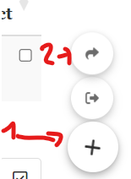
Shinymanager: authentication & site monitoring
Auth is done using shinymanager
https://datastorm-open.github.io/shinymanager/
Shinymanager can store credentials in sqlite database
Shinymanager provides an admin console with an overview of the site usage, but only if you use the sqlite backend option.
The sqlite DB is protected with a symmetric AES encryption. To store the keys for this encryption it uses the keyring package. This makes use of the OS credential store: when you set a key using key_set it is stored securely on the local machine
Windows: It uses the Windows Credential Manager.
Linux: It may use the Linux keyring or other secure storage mechanisms.
How to set it up locally:
Copy scripts/credentials_template.env to scripts/credentials.env
Modify credentials.env: configure shiny app username and password as well as sqlite encryption password
Run setup_credentials.R
Verify that db/credentials.db has been created
How to set it up in a docker image
Replace steps 1 & 2 above by setting up the environment variables through docker
Perform 3 & 4.

Slide 7
data model

Slide 8
DB schema
stock_profiles: contains profile information on each stock
stock_ohlc: contains OHLC data on each stock
fx_rates: contains foreign exchange rates
bolero_map = create a mapping between bolero identifier and yahoo RIC
saxo_map = create a mapping between saxo identifier and yahoo RIC
transactions: contains user transactions

Slide 9
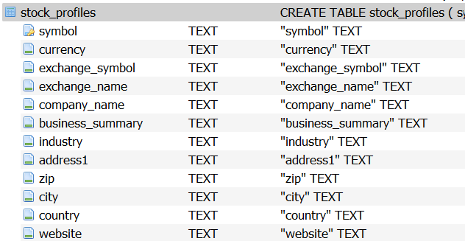
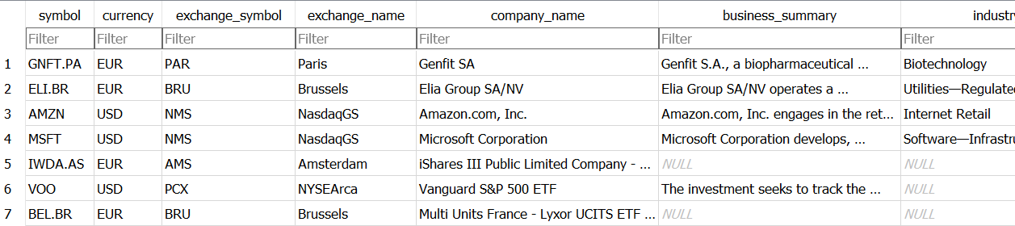
stock_profiles: schema

Slide 10
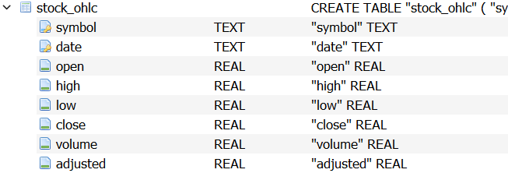
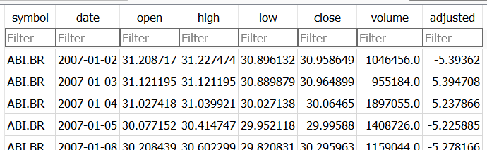
stock_ohlc: schema
quantmod getSymbols uses the yahoo API. This dataset already corrects for splits in the close price:
*Close price: adjusted for splits.
**Adjusted close price: adjusted for splits and dividend and/or capital gain distributions
https://eodhd.com/financial-academy/financial-faq/adjusted-close-and-close-whats-the-difference/
https://finance.yahoo.com/quote/MT/history?period1=1493596800&period2=1496275200&interval=1d&filter=history&frequency=1d&includeAdjustedClose=true
our transactions do have historical volumes based on historical prices, so once in a while we must manually modify the prices for stock splits!!!
e.g. arcelor mittal reverse stock split 1:3
UPDATE stock_ohlc
SET
open = open / 3,
high = high / 3,
low = low / 3,
close = close / 3,
volume = volume * 3
WHERE
symbol = 'MT.AS'
AND date < '2017-05-22';

Slide 11
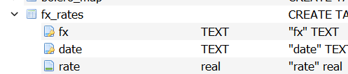
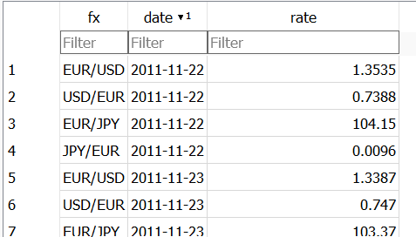
fx_rates: schema
fx_rates are stored with a daily interval
how to interpret EUR/USD = 1,1
wrong:
do not interpret / as a division, e.g. DO NOT read “euro PER usd”
correct:
interpret / as ‘to’, e.g. read from EUR to USD you multiply with 1,1
1 euro = 1,1 USD
You can think of it not as an exchange rate between currencies but as a comparison of the "strength" of one currency to the other.
So EUR/USD = 1.2 says with one EUR you can buy 1.2 times the consumer goods basket than you can buy with 1 USD.

Slide 12
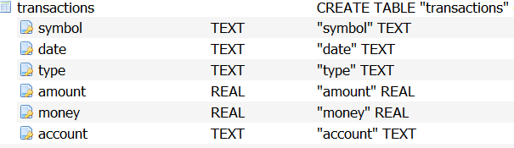
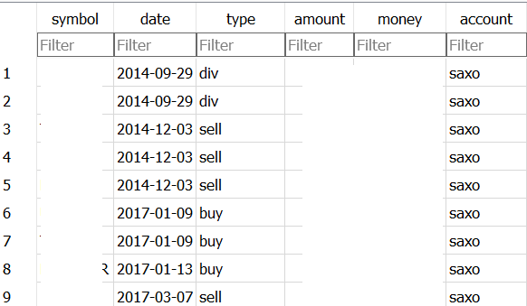
transactions: schema
all records are unique
possible types of transactions:
buy: buy N amount of shares at price P
sell: sell N amount of shares at price P
transfer_in: bring in N shares from another broker
transfer_out: transfer out N shares to another broker
cash_in: bring in M money in your broker’s cash account
cash_out: take out M money from your broker’s cash account
div: receive dividend
NULL values in records
for buy & sell: all fields mandatory
for cash_in and cash_out: symbol & amount = NULL
for transfer_in and transfer_out: money=NULL
for div: amount could be NULL
sign convention
all values are positive (so both cash_in and cash_out are positive)
currency convention
all ‘money’ amounts are in the stock’s native currency as listed in stock_profiles

Slide 13
transactions: flows visualised
EXTERNAL WORLD
BROKER A
cash_in
CASH ACCOUNT
buy
STOCKS ACCOUNT
cash_out
sell
div_dist
div_acc
transfer_in
transfer_out
BROKER B
cash_in
CASH ACCOUNT
buy
STOCKS ACCOUNT
cash_out
sell

Slide 14
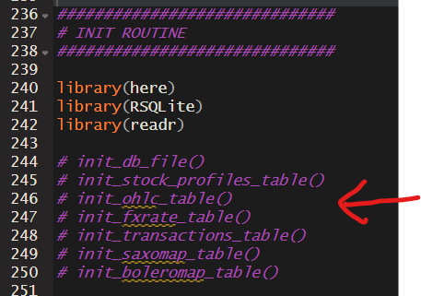
setup DB
Script to build an empty db file available at
scripts\setup_db.R
Make sure to uncomment the desired schema build calls before executing:

Slide 15
importing new data

Slide 16
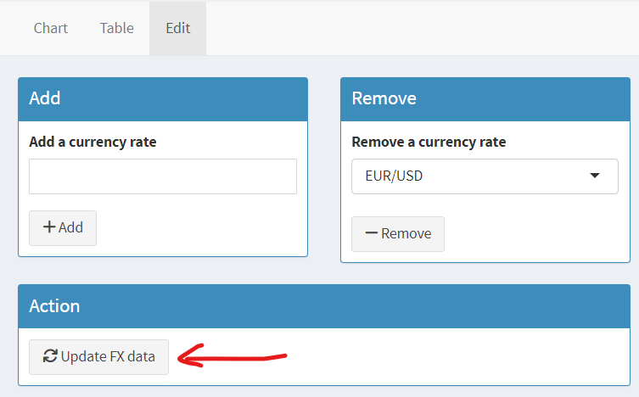
FX: import
manual update in the webapp
uses oanda API through the wrapper in the quantmod package
only 6 months history
manual data ingest via scripts: excelrates
scripts\forex_data_import\excelrates
website seems to be no longer working
manual data ingest via scripts: forexsb
scripts\forex_data_import\forexsb
parser for https://forexsb.com/historical-forex-data

Slide 17
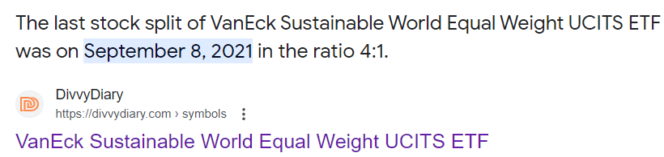
transactions: import
multiple ways
manual upload in the webapp
parsers are available for saxo & bolero output (see next slides)
manual work in excel to write sql statements in excel
write batch parsers from excel to db
stock splits: very annoying
often no data in the downloads

Slide 18
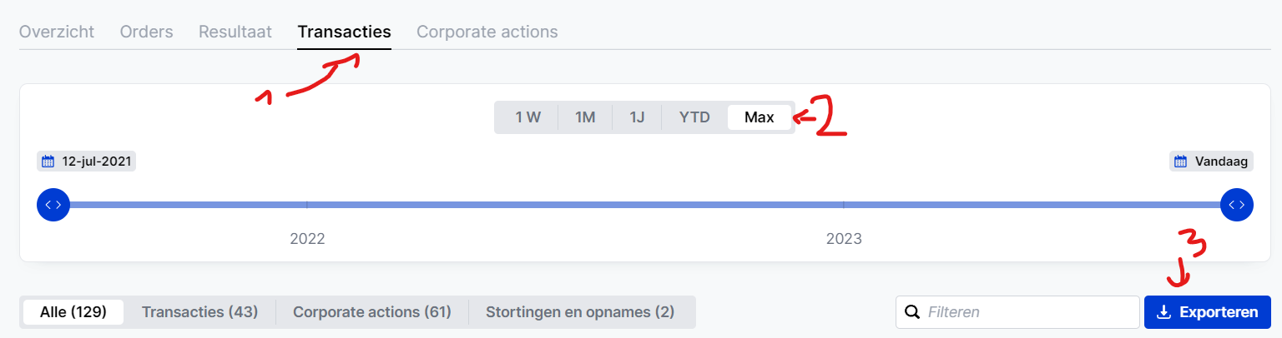
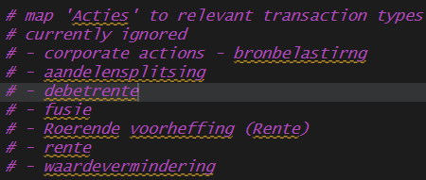
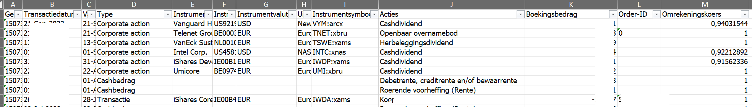
transactions: saxo import
log in op Saxo Investor
gaar naar transacties
plaats aangepaste periode
exporteer als excel
voeg een symbol kolom toe
vul het RIC als symbol in (minstens 1x per nieuwe stock)
als er geen ‘nieuwe’ stocks zijn gekocht dan hoef je geen symbol in te vullen
oude template
nieuwe template

Slide 19
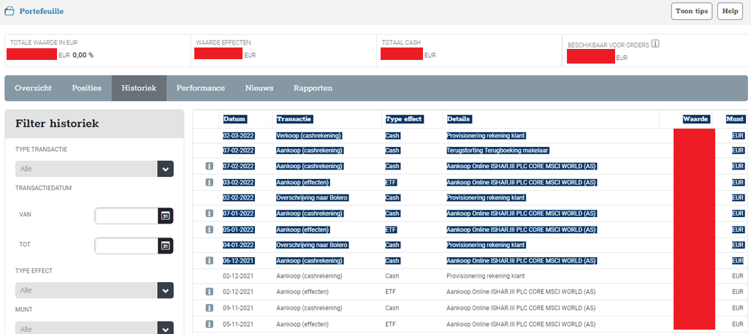
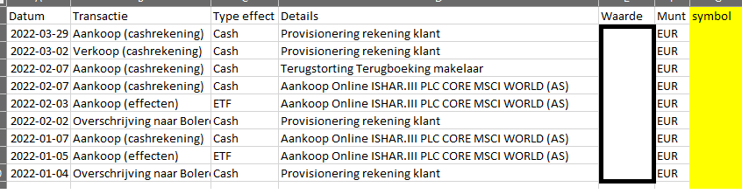
BOLERO import xlsx
log in op bolero
gaar naar portefeuille
dan naar historiek
selecteer data en plak het in excel (via notepad tussenstap wordt html formatting verwijderd)
voeg een symbol kolom toe
vul het RIC als symbol in (minstens 1x per nieuwe stock)
als er geen ‘nieuwe’ stocks zijn gekocht dan hoef je geen symbol in te vullen
gegokt aantal is soms verkeerd, best af en toe kijken in dashboard-orders-historiek en in dbbrowser de waarden juist zetten (todo ontwikkeling: excel van dit dashboard parsen)

Slide 20
internal data structures & reactivity

Slide 21
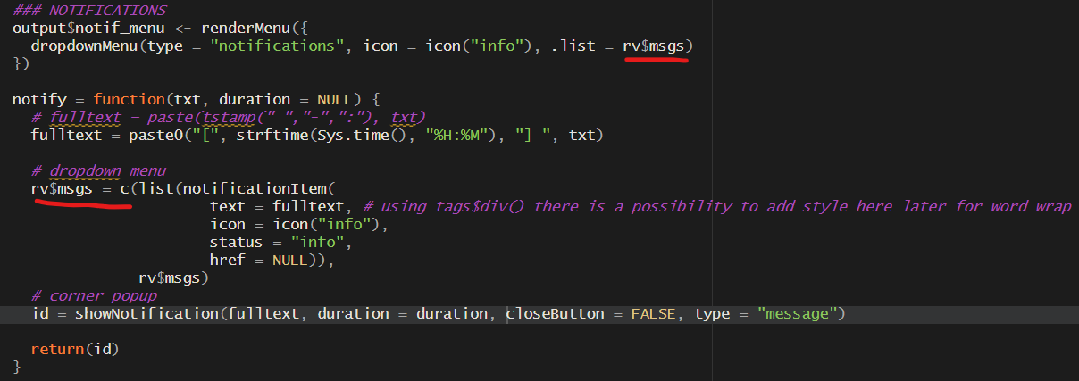
reactive values
rv$focus_stock
guarantees continuity between pages when selecting 1 stock
first lines sets the rv so that other selectinputs may update
second line updates this selectinput if somewhere else the rv was modified
rv$msgs
contains messages shown in notification corner as well as notification menu

Slide 22
reactives
use observers for side effects
dealing with I/O (files / DB)
setting reactive values!
update input elements of the shiny app
are always executed
cash_b_evol()
transactions
polling
tr()
tr_ext()
pos_sb_evol()
pos_sb()
stock_ohlc
ohlc()
polling
ohlc_euro()
fx_rates
polling
fx()
use reactive expressions for calculations
reactive expressions are recipes for how to calculate something, shiny will determine when it is required to execute
can accept reactive input and deliver reactive output
has a cached result
make maximum use of this feature in shiny
stock_profiles
polling
profiles()

Slide 23
reactives
read entire table into memory and do some type conversions
cash_b_evol()
transactions
polling
tr()
tr_ext()
pos_sb_evol()
pos_sb()
stock_ohlc
ohlc()
polling
ohlc_euro()
fx_rates
polling
fx()
see next slides
stock_profiles
polling
profiles()

Slide 24
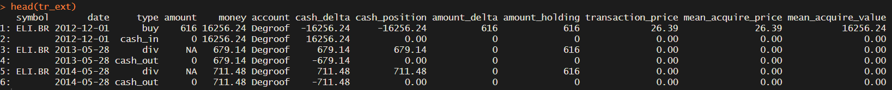
reactives: tr_ext()
extended tr() with
cash delta
cash_position
amount_holding
transaction_price
mean_acquire_price
mean_acquire_value

Slide 25
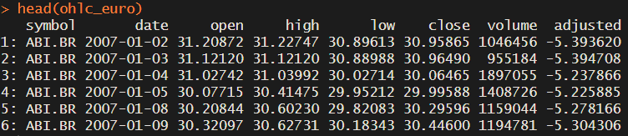
reactives: ohlc_euro()
same as ohlc() but all values are converted to EUR if they were in another currency to begin with:

Slide 26
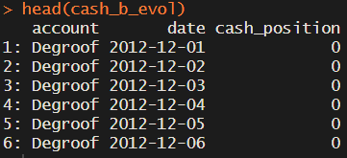
reactives: cash_b_evol()
cash per broker (=account) evolution over time

Slide 27
reactives: pos_sb_evol()
position of stock per broker (=account) evolution over time

Slide 28
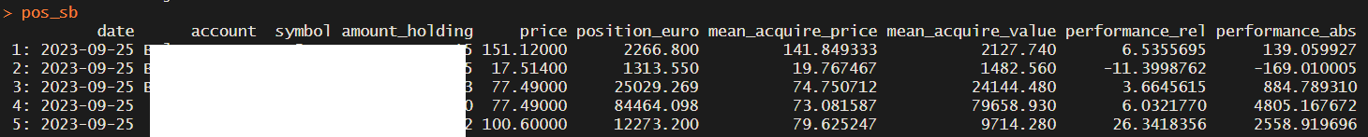
reactives: pos_sb()
shows the last known position per stock per broker (=account)

Slide 29
performance

Slide 30
performance per stock
everything is shown in euro unless otherwise specified
for a stock we keep track of the mean acquire price, irrespective of time held, and compare that to the latest close price,
example:
buy 100 stocks at 10 EUR (1000EUR)
buy 100 stocks at 14 EUR (1400 EUR)
sell 50 stocks at 15 EUR (750 EUR)
buy 100 stocks at 16 EUR (1600 EUR)
current evaluation 18 EUR
holding
100
200
150
250
250
mean acquire price
10
(100x10 + 100x14) / 200 = 12
12
(150x12 + 100x16) / 250 = 13,6
13,6
mean acquire evaluation
1000
12 x 200 = 2400
12 x 150 = 1800
13,6 x 250 = 3400
3400
performance absolute
0
14x200 – 2400 = 400
15x150 – 1800 = 450
16x250 – 3400 = 600
18x250 – 3400 = 1100
performance relative
0
400 / 2400 = 16,66%
450 / 1800 =
25%
600 / 13,6 = 17,64%
1100 / 3400 = 32,4%

Slide 31
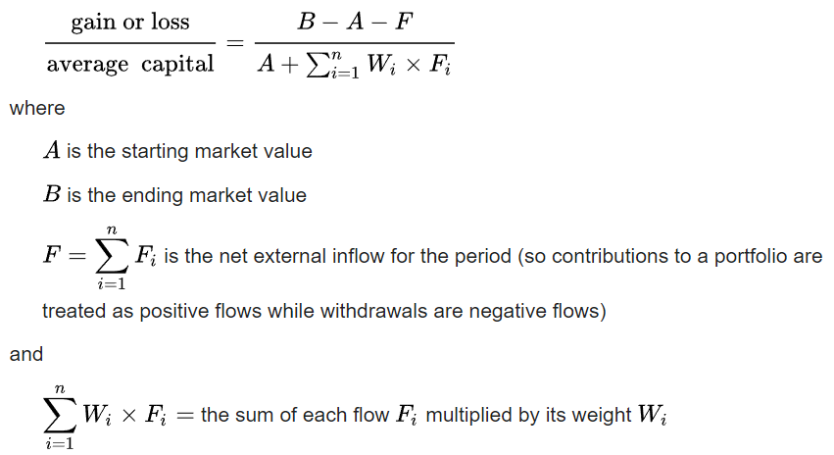
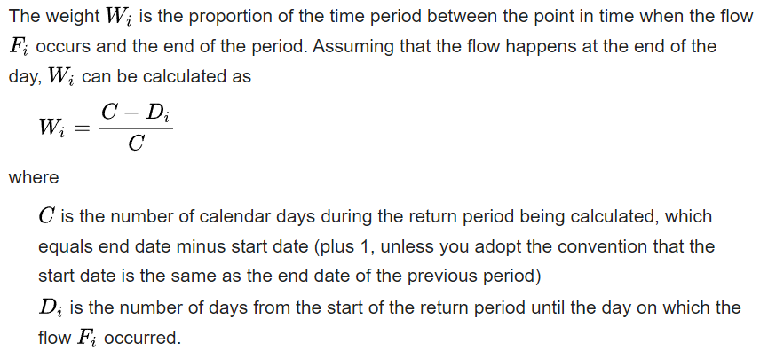
portfolio performance
Modified Dietz: theory
the modified Dietz method^{[1][2][3]} is a measure of the ex post (i.e. historical) performance of an investment portfolio in the presence of external flows.
https://en.wikipedia.org/wiki/Modified_Dietz_method

Slide 32
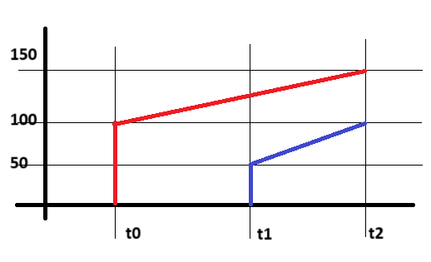
portfolio performance: example
return per stock
return_rood = 150/100 = +50%
return_blauw = 100/50 = +100%
return_year_rood = +25%
return_year_blauw = +100%
wat is nu return portfolio?
simpele benadering:
(150+100) / (100+50) =
1,666 = + 66%
geen impact van tijd voor blauwe stock
money-weighted average:
50% x 150/250 + 100% x 100/250 =
0,7 = + 70%
duurdere assets wegen meer door op finaal return
modified dietz:
B = 250 (at t2)
A = 0 (at time before t0)
F = adding 100 and 50 cash to the account at t0, t1
Wi = time weight: wi_rood = 2 ; wi_blauw = 1
MD = 250 – 0 - (100 + 50) = 100 = 0,4 = +40%
0 + (2 x 100 + 1 x 50) 250
takes into account cashflows

