Slide 1
Device Security Analyser
An Hierarchical Expert System Approach to Evaluate Security of Android Device
Project By:
Sahaj Gandhi
Pranav Rane

Slide 2
Security Aspects Considered
Project 3 - Questions 1 and 2
Device Security Analyser - Sahaj Gandhi and Pranav Rane
01
Network Status
Wifi Status
Airplane Status
02
Device Security
Device Lock Status
03
Software Security
Difference in Operating System Status
Root Status
Encryption Status
04
Application Security
Sideloaded App Status
High Risk Permission Status

Slide 3
Holistic Approach for Identifying Permission Status
Project 3 - Questions 3
Device Security Analyser - Sahaj Gandhi and Pranav Rane
Generally identifying controversial Permissions is a tedious process.
There are a lot of apps and all apps have their own permissions.
So it is best if there is a test that helps identify if a phone has too many apps with high risk permissions.
We run through apps and their respective permissions. We tag permissions with high, medium or low risk.
We then get overall score for the phone. If this score is higher than a specified benchmark, then it recommended that certain apps be removed.
The list of user installed apps with permissions is present in the app

Slide 4
Problems Identified but Not Solved
Project 3 - Questions 4 and 5
Device Security Analyser - Sahaj Gandhi and Pranav Rane
Description of Problem | How to solve it? | Challenges? | Does it Fit the current approach?
Consider the user rating of applications to determine the user trust level for apps | Build a crawler to fetch user review score from play store. | There are multiple stores of apps. Getting all scores from all stores can be tricky. | Yes. We can add new variable saying if all apps are reputed. This can be added to Application Security.
Recommend certain Applications for uninstallation based on Permission | Return the applications with the highest permission rating | The recommended applications could be very important to the user. There is no way to identify that. | Yes. It can be done, but this feature will not interact with the expert shell. The only utility to this test will be increasing the overall security score.

Slide 5
Reviewing the tool used for Hierarchical Evaluation
Project 3 - Questions 6
Device Security Analyser - Sahaj Gandhi and Pranav Rane
The tool used here is an expert shell developed by Ben Nappier and is available on Github
It is written in Java which allowed it to be used alongside the Android code as a library
The tool uses Forward chaining for our app, which allows us to use inferences as antecedents for new rules
It even allows the users to run Backward Chaining, in case it is needed.
Given our need to make an Android applications no other shell could have been used, unless we make one ourselves
This shell does have its share of flaws namely, Or and Negation functionalities do not work correctly
Nevertheless it works perfectly for our use case

Slide 6
Rules used for the Score Calculation by Expert System
Project 3 - Questions 6
Device Security Analyser - Sahaj Gandhi and Pranav Rane
WiFi_Off ^ Airplane => NWSEC
Lock => DEVSEC
OS_Diff ^ Root_Off ^ Encryption => SWSEC
Unknown_sources_absent ^ Permission => APPSEC
NWSEC => 1
DEVSEC => 1
SWSEC => 1
APPSEC => 1
SWSEC ^ APPSEC => 2
DEVSEC ^ APPSEC => 2
DEVSEC ^ SWSEC => 2
NWSEC ^ APPSEC => 2
NWSEC ^ SWSEC => 2
NWSEC ^ DEVSEC => 2
NWSEC ^ DEVSEC ^ SWSEC => 3
NWSEC ^ DEVSEC ^ APPSEC => 3
NWSEC ^ SWSEC ^ APPSEC => 3
DEVSEC ^ SWSEC ^ APPSEC => 3
NWSEC ^ DEVSEC ^ SWSEC ^ APPSEC => 4

Slide 7
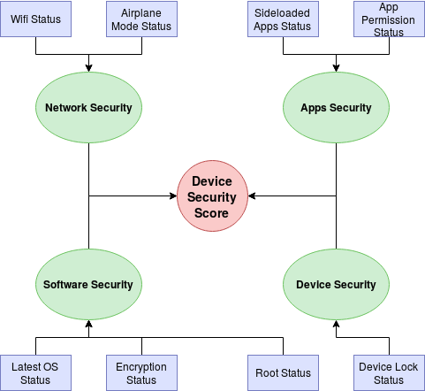
System Hierarchy
Project 3 - Questions 7
Device Security Analyser - Sahaj Gandhi and Pranav Rane
There are 4 major components namely Network Security, App Security, Software Security and Device Security
There are various tests that build up to each Security component

Slide 8
Limitations of Design
Project 3 - Questions 8
Device Security Analyser - Sahaj Gandhi and Pranav Rane
System Design is very high level
Due to restrictions of the expert system that we chose, we could not feed multiple values for a variable
The values could only be TRUE or FALSE
Similarly for WIFI status we are just simply checking for Wifi being ON or OFF
Ideally we should consider checking protocols like WPA/WPA2 and WEP and assign PASS, OK or FAIL based on that
Due to this oversimplification, a user can lose a lot of context to understand the system better
Assumptions Made for High Permissions Test
The threshold for clearing the test is 2.5 out of 5
It is our assumption that the benchmark we have used is good enough
We have no real data and expert advice to back it up

Slide 9
The most important results
Project 3 - Questions 9
Device Security Analyser - Sahaj Gandhi and Pranav Rane
Speaking purely mathematically , the Device Lock Screen test is most important result
If that is passed, the overall device security score jumps up by 25% directly
In terms of implications, the Permissions test has to be the best
It helps cut through a nuanced problem effectively
It gives the user good context to make an informed decision

Slide 10
Patentable Results
Project 3 - Questions 10
Device Security Analyser - Sahaj Gandhi and Pranav Rane
Although there is some nuance to the process we have used, there is not enough innovation done for the process to be patented
Keeping the process open-source will allow developers to pool in the resources and make it better over time

