Slide 1
Entity-relationship graphs to inform OLAP operations
Jorge Ortiz

Slide 2
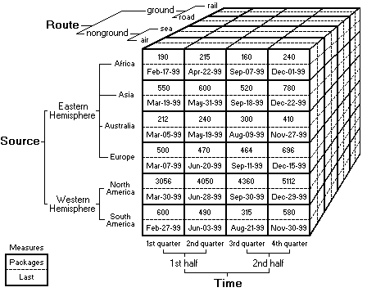
OLAP Data Cube

