Slide 1
Plug-loads consume 1/3 of building energy
73% of total energy produced, consumed in buildings
~30% is consumed by plug-loads
Plug-loads are
categorically fragmented
spread throughout the building
constantly changing
US Building Energy Use, 2010

Slide 2
Design goals
Make it easier to collect plug-load information, directly
Design for incremental deployment and scale
Derive continuous value from infrastructure
Leverage building occupants where possible

Slide 3
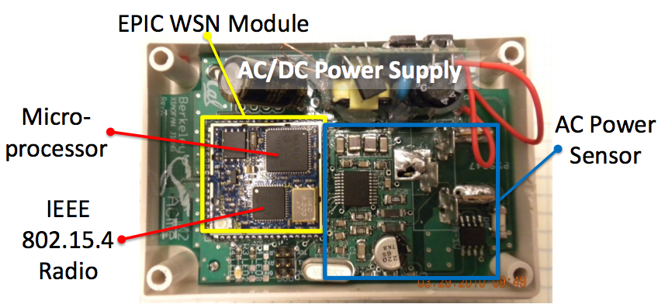
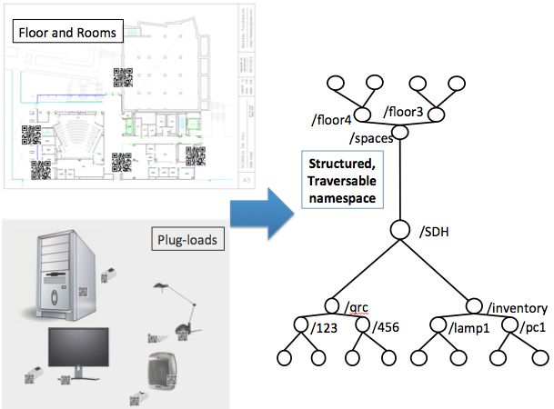
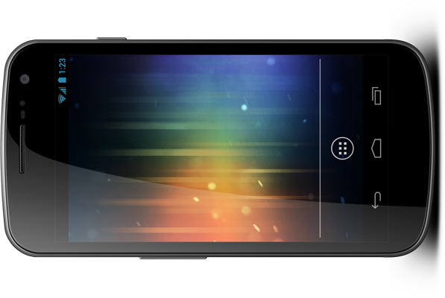
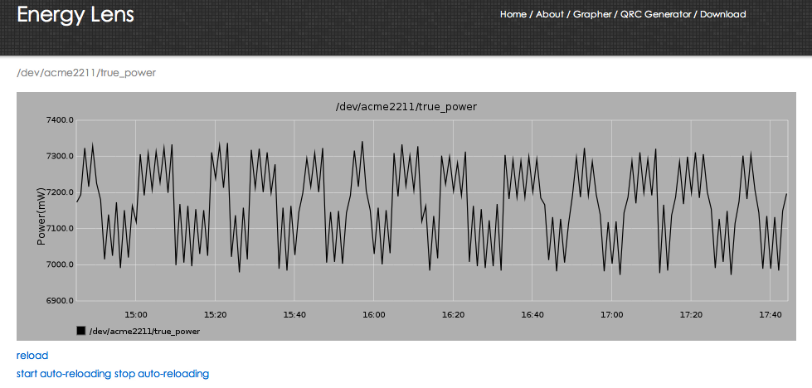

Energy Lens high-level architecture
ACme sensors
Cloud
sMAP, StreamFS
Mobile phones
Cheap tags
Incrementally
Deployable
Owned by occupants
Incrementally
Deployable
Accepts any streaming data
Notes:
QR codes are cheap, Acmes are $20-50 in bulk, Everyone has a phone

Slide 4
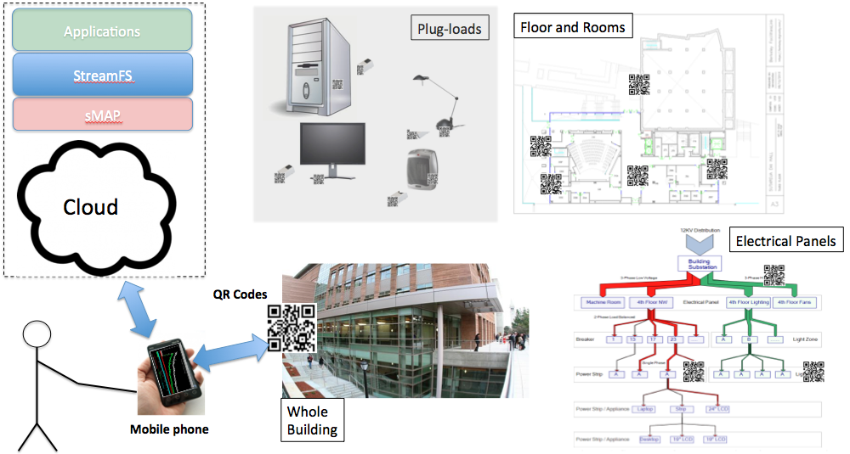
Metadata about physical deployment mandatory
Tag everything
Use phone to input information about things…
Classification, location, type, etc.
…and the relationship between things
Necessary to interpret context of streaming data
Notes:
What relationships are important to capture?
Location
Meter-to-load relationship (…over time)

Slide 5
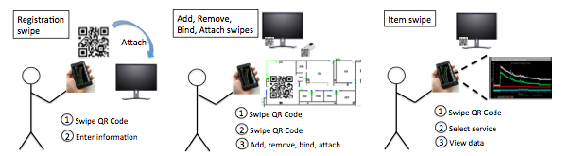
QR Swipes for information collection

Slide 6
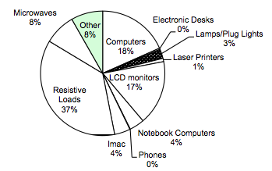
Results
Sutardja Dai Hall @UCB
141,000 sq. ft.
Registered and classified
20 meters
20 metered items
351 un-metered items
139 rooms
7 floors
Information collected in approx. 2-3 hours

Slide 7
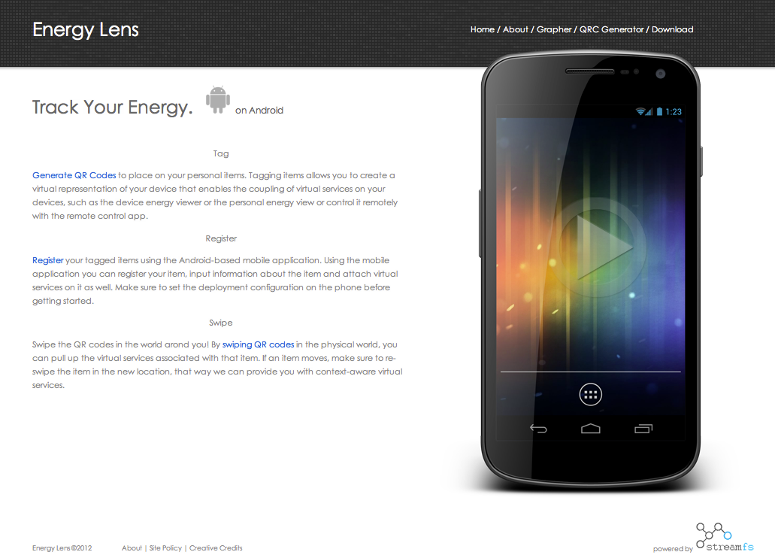
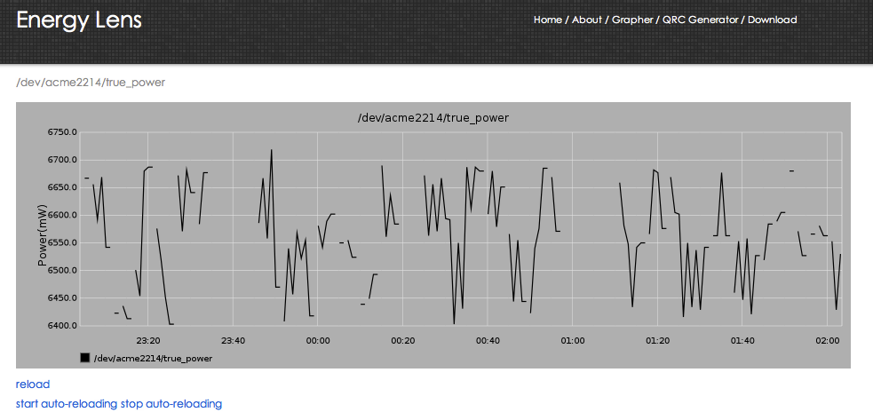
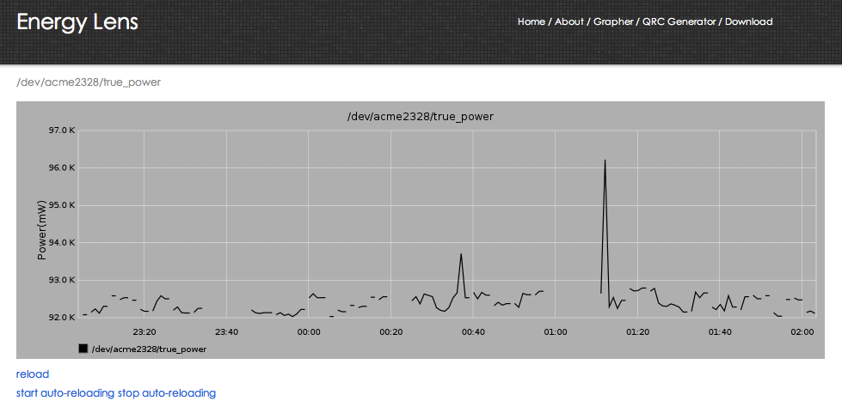
Energy Lens web site
energylens.is4server.com

