Slide 1
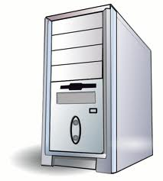
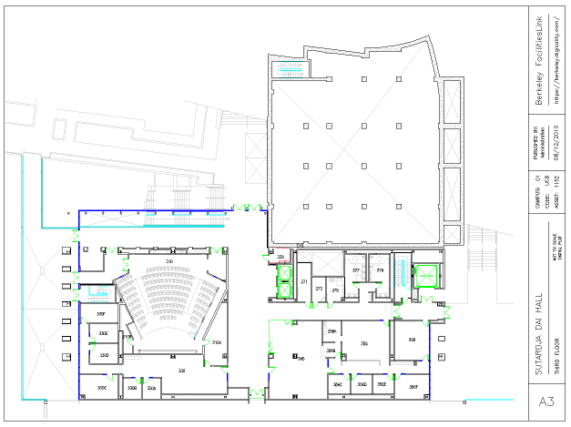
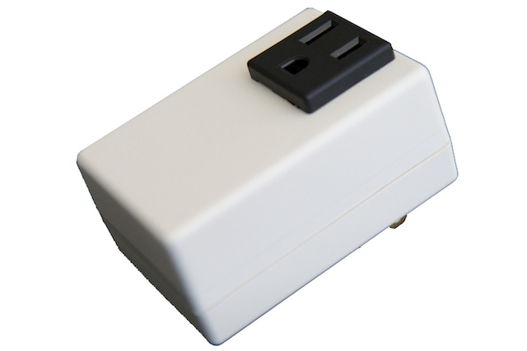

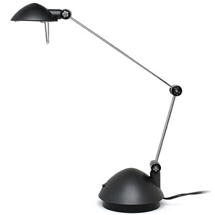
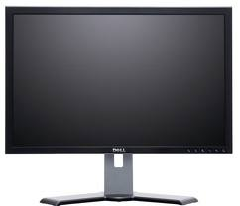

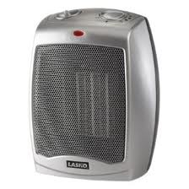
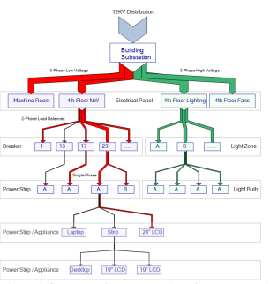

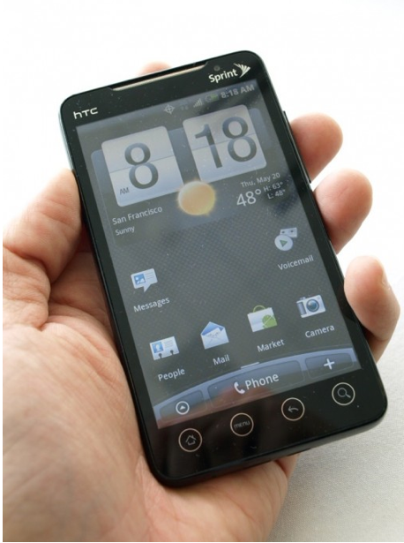
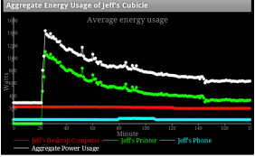
Applications
Plug-loads
Floor and Rooms
StreamFS
sMAP
Cloud
Electrical Panels
QR Codes
Whole
Building
Mobile phone

Slide 2
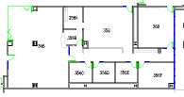
Registration
swipe
Add, Remove,
Bind, Attach swipes
Item swipe
Attach
1
Swipe QR Code
1
Swipe QR Code
1
Swipe QR Code
2
Swipe QR Code
2
Select service
2
Enter information
3
Add, remove, bind, attach
3
View data
(A)
(B)
(C)

Slide 3
space
Is-in
relationship
meter
item
Attach
Explicit
Bind
Implicit
Bind
item
meter
Attach
item
item
item

Slide 4
space
3
When buffer fills, interpolate,
aggregate and forward
power
meter
item
item
meter
2
Parent buffers data point
by SI unit
1
Stream nodes forward
data to parent
item
item
Temp
Power

Slide 5
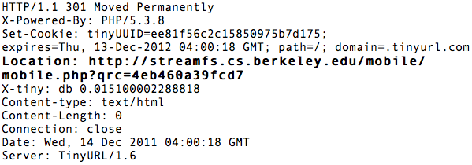

Slide 8
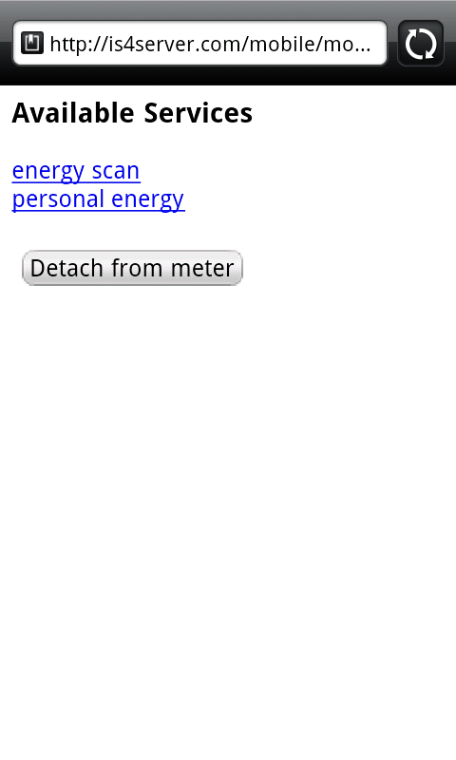
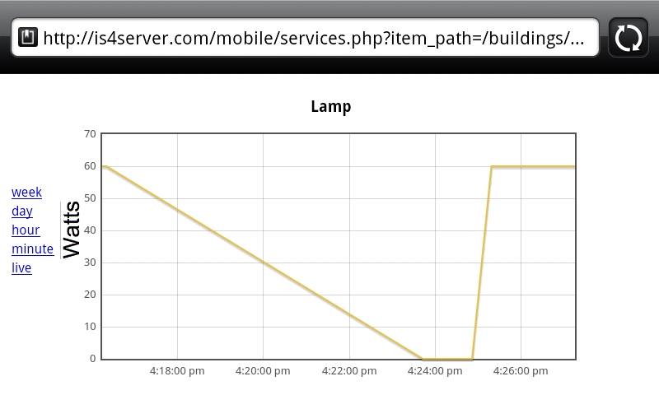

Slide 9
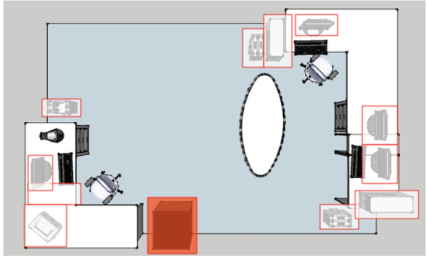
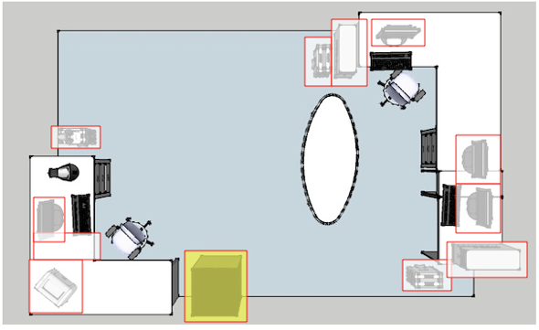
Fridge in cooling mode
Fridge in standby mode

Slide 10
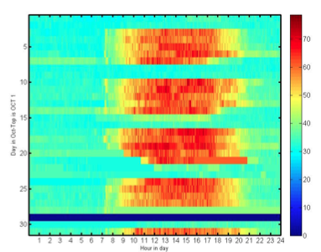
Day of month- October, 2011
kW
Hour of day

Slide 11
