Slide 1


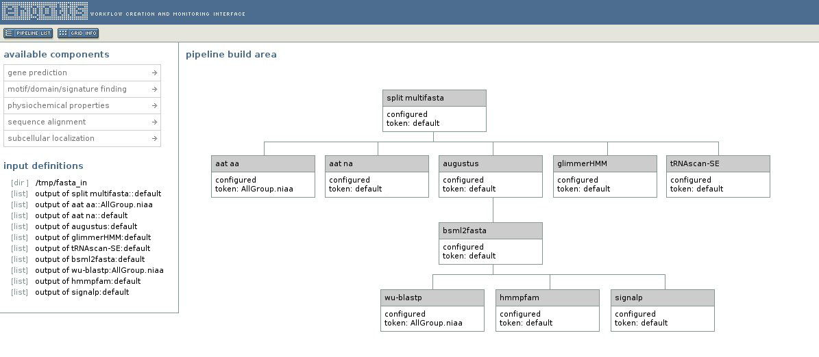
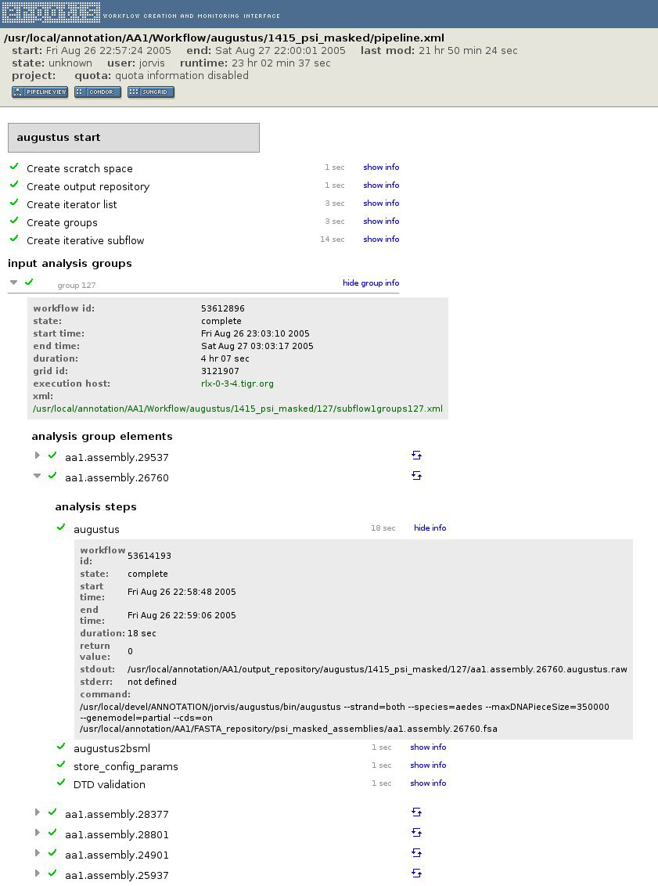
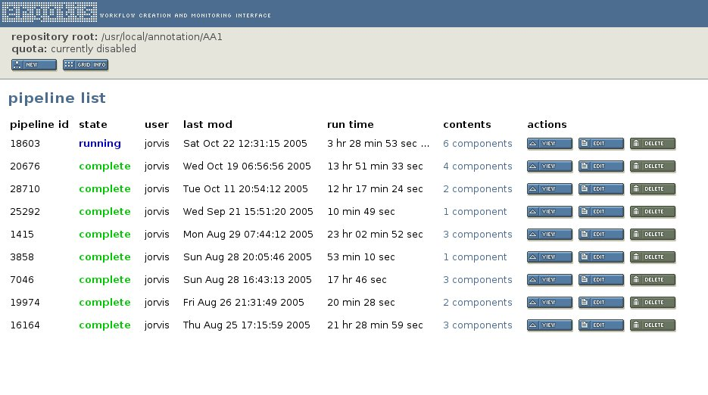
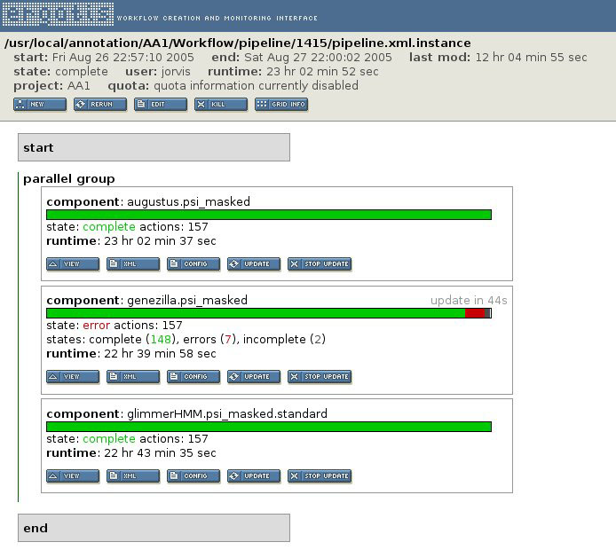
Workflow / Ergatis – A data management system for automated
genome annotation and comparative analysis.
Joshua Orvis, Sam Angiuoli, Anup Mahurkar, Jay Sundaram, Sreenath Nampally, Victor Felix, Jennifer Wortman, Owen White.
The Institute for Genomic Research (TIGR), Rockville, MD
Abstract
Pipeline Builder
Component detail
We present a set of applications used to create and manage highly-configurable, reusable automated genome annotation pipelines. These were developed in order to better address the challenge of data management, process control and auditing when running large datasets through a compute grid.
Workflow provides an XML language and processing engine for specifying the steps of a computational pipeline. It provides detailed execution status and logging for process auditing, facilitates error recovery from point of failure, and is highly scalable with support for distributed computing environments. The XML format employed enables commands to be run serially, in parallel, and in any combination or nesting level.
Ergatis is a web-based utility that is used to create, run, and monitor reusable computational analysis pipelines, utilizing the Workflow engine. It contains pre-built components for common bioinformatics analysis tasks. These components can be arranged graphically to form highly-configurable pipelines. Each analysis component supports multiple output formats, including Bioinformatic Sequence Markup Language (BSML). The current implementation includes support for data loading into project databases implementing the CHADO schema, a highly normalized, community-supported schema for storage of biological annotation data.
This framework has been employed in the annotation of several large, eukaryotic organisms, including Aedes aegypti and Trichomonas vaginalis.
Infrastructure Summary
Pipeline List
The graphical builder (above) utilizes a drag-and-drop interface to both accelerate and make more accessible the pipeline building process. Components laid out horizontally are configured to run in parallel.
Compute grid
Sun Grid Engine
queues
processes create
HTC server
BSML result files
requests
Available components (selected)
AAT, augustus, BER, clustalw, cogs, fgenesh, genemark, genewise, genezilla, genie, genscan, genscan+, glimmerHMM, hmmpfam, hmmpir, hmmsmart, hmmtigr, iprscan, jaccard, NCBI-blast, nucmer, pe, promer, repeatmasker, tRNAscan-SE, trf, wu-blast
loaded into
Workflow Engine
monitor
Sybase
processes
Ergatis
read
read
write
write
pipeline xml file
builds
web interface
Annotation Station
Apollo
Manatee
perl builder scripts
xml / ini components
Ergatis and Workflow are used to create, run and monitor pipeline processes on our compute grid, managed by the Sun Grid Engine. The results of each analysis are both written to BSML and database accessible using tools such as Apollo and Manatee.
View each of the pipelines within a given project, including those scheduled or currently running. Pipelines can be created and edited within the browser window.
Pipeline Overview
The view above provides detailed information on every command within a component workflow including start/stop time, return value, execution node and the exact command string executed.
Workflow XML & BSML
<command>
<name>augustus</name>
<id>53614193</id>
<configMapId>augustus</configMapId>
<startTime>2005-08-26T22:58:48.814-04:00</startTime>
<endTime>2005-08-26T22:59:06.088-04:00</endTime>
<state>complete</state>
<type>RunUnixCommand</type>
<retryCount>0</retryCount>
<retryAttempts>0</retryAttempts>
<timeOut>0</timeOut>
<status>
<retValue>0</retValue>
</status>
<param>
<key>--strand</key>
<value>both</value>
</param>
<param>
<key>command</key>
<value>/usr/local/devel/ANNOTATION/jorvis/augustus/bin/augustus</value>
</param>
<param>
<key>--species</key>
<value>aedes</value>
</param>
<param>
<key>stdout</key>
<value>/usr/local/annotation/AA1/output_repository/augustus/1415_psi_masked/127/aa1.assembly.26760.augustus.raw</value>
</param>
<param>
<key>--maxDNAPieceSize</key>
<value>350000</value>
</param>
<param>
<key>--genemodel</key>
<value>partial</value>
</param>
<param>
<key>--cds</key>
<value>on</value>
</param>
<arg>/usr/local/annotation/AA1/FASTA_repository/psi_masked_assemblies/aa1.assembly.26760.fsa</arg>
</command>
<Bsml>
<Definitions>
<Sequences>
<Sequence class="assembly" title="aa1.assembly.25470" id="aa1.assembly.25470" molecule="na">
<Link rel="analysis" href="#aat_aa_analysis"></Link>
</Sequence>
<Sequence class="polypeptide" title="GB|AAF56019.1|7300878|AE003739" id="GB_AAF56019.1_7300878_AE003739" molecule="aa">
<Cross-reference database="GB" identifier="AAF56019.1" id="_0" identifier-type="version"></Cross-reference>
<Cross-reference database="GB" identifier="7300878" id="_1" identifier-type="gi"></Cross-reference>
<Link rel="analysis" href="#aat_aa_analysis"></Link>
</Sequence>
[ one Sequence element for each subject and query sequence ]
</Sequences>
<Tables id="BsmlTables">
<Seq-pair-alignment refend="654704" compseq="GB_AAF56019.1_7300878_AE003739"
compxref="/usr/local/db/panda/AllGroup/AllGroup.niaa:GB_AAF56019.1_7300878_AE003739" refseq="aa1.assembly.25470"
refstart="0" reflength="654705" refxref=":aa1.assembly.25470" class="match">
<Attribute name="total_score" content="295"></Attribute>
<Seq-pair-run compcomplement="0" runlength="158" refpos="139562" comprunlength="53" refcomplement="1" runscore="64" comppos="0">
<Attribute name="chain_number" content="1"></Attribute>
<Attribute name="percent_identity" content="30.769231"></Attribute>
<Attribute name="segment_number" content="1"></Attribute>
<Attribute name="percent_similarity" content="46.153846"></Attribute>
</Seq-pair-run>
[ one Seq-pair-run for each ‘HSP’ in the alignment ]
<Link rel="analysis" href="#aat_aa_analysis"></Link>
</Seq-pair-alignment>
[ one Seq-pair-alignment for each Alignment in the analysis ]
</Tables>
</Definitions>
<Research>
<Analyses>
<Analysis id="aat_aa_analysis">
<Attribute content="-f 100 -i 30 -a 50000" name="dps_opts"/>
<Attribute content="/usr/local/db/panda/AllGroup/AllGroup.niaa" name="database_path"/>
<Attribute content="/usr/local/common/BS" name="matrix"/>
<Attribute content="-c 20" name="filter_opts"/>
<Attribute content="18603" name="pipelineid"/>
[ one Attribute for each attribute of the Analysis ]
</Analysis>
</Analyses>
</Research>
</Bsml>
AAT component run example
dps/nap search against NR
1.38 Gb query genome (Aedes aegypti)
465,600 commands
4,383 compute hours
150 grid nodes
29-hour component runtime
Source Code Available
Ergatis
http://ergatis.sourceforge.net
Workflow
http://sf.net/projects/tigr-workflow
BSML object layer
http://bsml.sourceforge.net
Sun Grid Engine
http://gridengine.sunsource.net
Commands can be grouped under CommandSet elements and run in serial or parallel, either locally or distributed on a compute grid. Detailed information about each command is stored including state, start and stop times, and return value. This format allows for even the largest pipelines to be resumed from the point of failure.
The Bioinformatics Sequence Markup Language files serve as an abstract layer between the analysis and database and can be used to load multiple database schemas. (DTD available at www.bsml.org)
Overview of the structure of a pipeline along with details and status of each analysis component within it. Runtime states are clearly indicated by color and can be viewed in finer detail.

