Slide 1
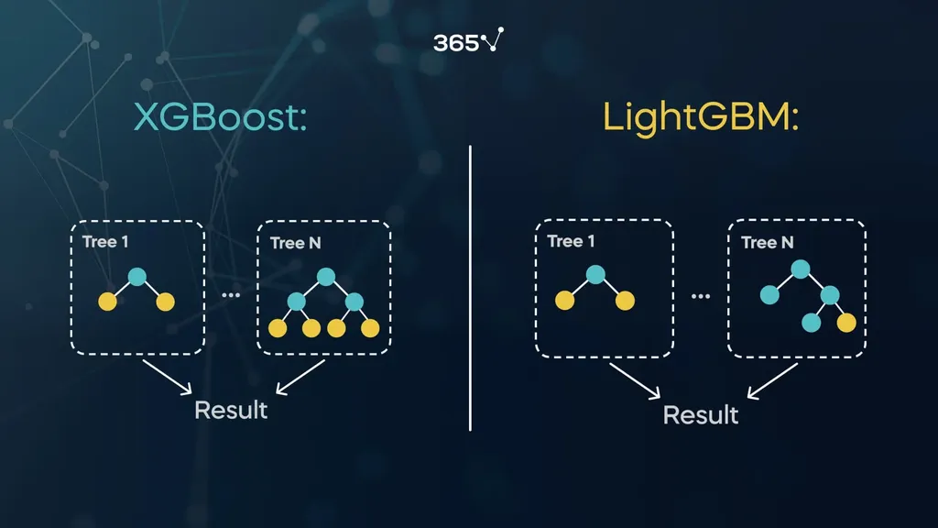

Slide 2
What is LGBM?
The light gradient boosting machine algorithm – also known as LGBM or LightGBM – is an open-source technique created by Microsoft for machine learning tasks like classification and regression. It is quite similar to XGBoost as it too uses decision trees to classify data.
One of the main differences between these two algorithms, however, is that the LGBM tree grows leaf-wise, while the XGBoost algorithm tree grows depth-wise:
In addition, LGBM is lightweight and requires fewer resources than its gradient booster counterpart, thus making it slightly faster and more efficient.

Slide 3
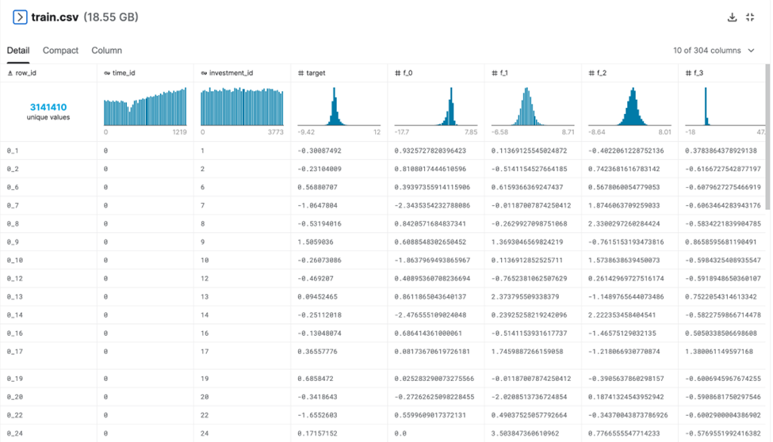
Gradient Boosting with LGBM and XGBoost: Practical Example The dataset we’ll use to run the models is called Ubiquant Market Prediction dataset. It was recently part of a coding competition on Kaggle – while it is now over, don’t be discouraged to download the data and experiment on your own! Please note that this dataset is quite large, thus you need to be patient when running the actual script as it may take some time. The Ubiquant Market Prediction file contains features of real historical data from several investments:

Slide 4
In this example, we have a couple of features that will determine our final target’s value. The main purpose is to predict the (output) target value of each row as accurately as possible. It is worth mentioning that this target value stands for an obfuscated metric relevant for making future trading decisions. We will do these predictions by running our .csv file separately with both XGBoot and LGBM algorithms in Python, then draw comparisons in their performance.
How to Run an LGBM Model in Python?
Let’s see how the LGBM algorithm works in Python, compared to XGBoost. You’ll note that the code for running both models is similar, but as mentioned before, they have a few differences.
Step 1: Import the Necessary Python Libraries
We will need to import the same libraries as the XGBoost example, just with the LGBMRegressor function instead:
from lightgbm import LGBMRegressor
Steps 2,3,4,5, and 6 are the same, so we won’t outline them here. Please ensure to follow them, however, otherwise your LGBM experimentation won’t work.
Step 7: Run the LGBM Model
Once all the steps are complete, we will run the LGBMRegressor constructor. You can also view the parameters of the LGBM object by using the model.get_params() method:

Slide 5
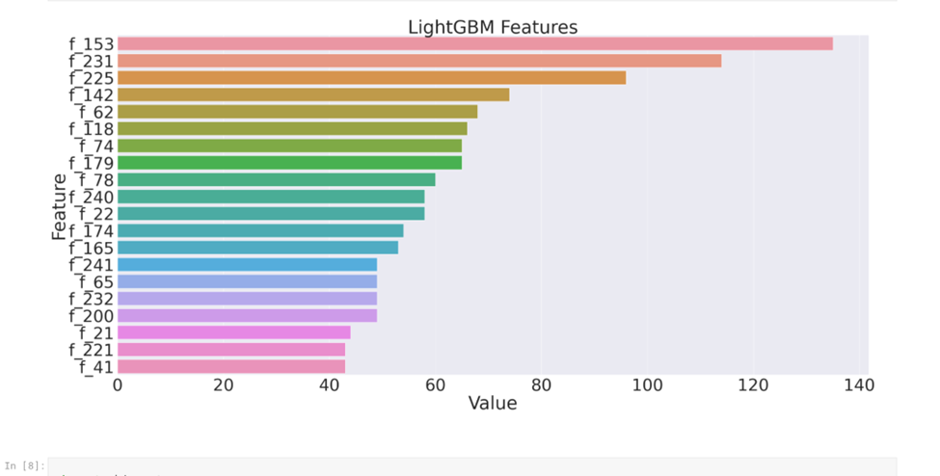
Step 8: Tune the LGBM Model As previously mentioned, tuning requires several tries before the model is optimized. Once again, we can do that by modifying the parameters of the LGBMRegressor function, including: objective: the learning objective of your model. boosting_type: the traditional gradient boosting decision tree as our boosting type. num_leaves: the maximum number of tree leaves model = LGBMRegressor( objective="regression", metric="l2", boosting_type="gbdt“, n_estimators=1400, num_leaves=100, max_depth=10, learning_rate=0.05, subsample=0.8)

