Slide 1
Project 18: LDR-Based Automatic Lighting Control System
CT 321: MICROCONTROLLER

Slide 2
09 — Test Results Summary
Test Case | Expected Output | Actual Output | Result
System Startup | SMART LIGHT / SYSTEM READY | SMART LIGHT / SYSTEM READY | PASS
ADC Reading | LDR value on LCD | ADC value displayed correctly | PASS
Bright Condition | Green LED ON, Lamp OFF | Green LED ON, Lamp OFF | PASS
Medium Condition | Yellow LED ON, Lamp OFF | Yellow LED ON, Lamp OFF | PASS
Low Condition | Red LED ON, Lamp ON | Red LED ON, Lamp ON | PASS
Very Low Condition | Red, Lamp ON, Buzzer beep | Red, Lamp ON, Buzzer beep | PASS
Manual Override | Lamp toggles manually | Lamp toggles on button press | PASS
Sensor Error | Error indication + buzzer | SENSOR ERROR! on LCD + buzzer | PASS
Reset Operation | Returns to automatic mode | System restarts, auto mode | PASS
Notes:
All 9 test cases passed. The system correctly classifies all light conditions and responds with the right outputs.

Slide 3
Table of Contents
01
Problem Statement
06
Firmware Architecture
02
System Overview & Block Diagram
07
KiCad Schematic & PCB
03
Hardware Components
08
SimulIDE Simulation
04
ATmega32 Pin Mapping
09
Test Results
05
ADC Threshold Classification
10
Conclusion
Notes:
Here is the outline of our presentation.

Slide 4
Students Name | Registration Numbers
GILBERT LUNYUNGU | T23-03-11601
ZUWENA SANIRA | T23-03-11707
IRENE KISABWE | T23-03-10157
JOSBERT BAINGANA | T23-03-13089

Slide 5
Table of Contents
01
Problem Statement
06
Firmware Architecture
02
System Overview & Block Diagram
07
KiCad Schematic & PCB
03
Hardware Components
08
SimulIDE Simulation
04
ATmega32 Pin Mapping
09
Test Results
05
ADC Threshold Classification
10
Conclusion
Notes:
Here is the outline of our presentation.

Slide 6
01 — Problem Statement
Manual Lighting Control
No Environmental Awareness
Traditional lighting systems require a person to manually switch lights on or off. This is inconvenient, error-prone, and leads to unnecessary energy consumption.
Systems without sensors cannot respond to changing ambient light — such as day-to-night transitions, cloud cover, or indoor dimming — without human intervention.
Energy Waste
Embedded Solution Needed
Lights left on during bright conditions waste electricity. Automatic sensing and switching can significantly reduce power consumption in homes, offices, and public spaces.
The ATmega32 ADC can read the analog voltage from an LDR voltage divider and make real-time decisions to control lighting outputs automatically without any human input.
Notes:
Many embedded systems must respond automatically to environmental light. Street lights, room lighting, and solar lamps all benefit from automatic control. An LDR in a voltage divider provides an analog voltage that the ATmega32 ADC can measure.

Slide 7
02 — System Overview & Block Diagram
Light Level → Analog Voltage → ADC Conversion → Threshold Decision → Output Control
ATmega32
ADC + Logic
16MHz
LDR + 10kΩ
Voltage Divider
Threshold
Decision
Green LED
(Bright)
Yellow LED
(Medium)
Red LED
(Low / Dark)
Relay
(Lamp ON/OFF)
Buzzer
(Very Dark)
LCD Display (16x2) — Shows ADC value + Light condition status on both lines in real time
Notes:
The system follows a simple chain: LDR produces analog voltage, ATmega32 ADC reads it, classifies light level, and drives the appropriate output. The LCD shows live ADC value and status.

Slide 8
03 — Hardware Components
ATmega32A
Main controller — 40-pin DIP, Harvard architecture, 16MHz
LDR (LDR03)
Light-dependent resistor — resistance changes with light intensity
Resistors
10kΩ voltage divider, 220Ω LED limiting, 1kΩ transistor base
BC547 NPN ×2
Transistor drivers for relay coil and buzzer activation
Relay SPDT 5V
Electrically isolates and switches the external lamp circuit
LEDs ×3
Green (bright), Yellow (medium), Red (low/dark) status indicators
AudioOut / Buzzer
Alerts on very low light condition — short 200ms beep
LCD WC1602A
16×2 character display — shows ADC value and light status
Push Buttons ×2
SW1: manual override toggle | SW2: hardware reset
Crystal 16MHz
External clock source with 22pF load capacitors
📸 Add photo of your actual components here
Capacitors 100nF ×4
Decoupling on VCC, AVCC, AREF, and reset pin
5V Power Supply
Regulated supply powering ATmega32 and all peripherals
Notes:
All components are standard through-hole parts used in both the KiCad schematic and SimulIDE simulation.

Slide 9
04 — ATmega32 Pin Mapping
ATmega32 Pin | Pin # | Direction | Connected To | Net Label
PA0 / ADC0 | 40 | Input | LDR Voltage Divider Output | LDR_ADC
PA1 | 39 | Input | Manual Override Button (SW1) | BTN_OVERRIDE
PB0 | 1 | Output | Red LED via 220Ω | LED_DARK
PB1 | 2 | Output | Yellow LED via 220Ω | LED_MEDIUM
PB2 | 3 | Output | Green LED via 220Ω | LED_BRIGHT
PB3 | 4 | Output | Lamp Relay via BC547 | LAMP_OUT
PB4 | 5 | Output | Buzzer via BC547 | BUZZER
PD2 | 16 | Output | LCD RS | LCD_RS
PD3 | 17 | Output | LCD EN | LCD_EN
PD4–PD7 | 18–21 | Output | LCD Data D4–D7 | LCD_D4–D7
RESET | 9 | Input | Reset Button (SW2) | —
Notes:
This table covers all ATmega32 pins used in the project. PORTA is configured as input (DDRA=0x00), PORTB as output (DDRB=0x1F), and PORTD as output (DDRD=0xFF) for the LCD.

Slide 10
05 — ADC Threshold Classification
ATmega32 ADC | 10-bit resolution | Range: 0 – 1023 | Reference: AVcc (5V) | Channel: ADC0 (PA0) | Prescaler: 64
BRIGHT
MEDIUM
LOW
VERY LOW
ADC Range:
ADC > 800
ADC Range:
ADC 601 – 800
ADC Range:
ADC 401 – 600
ADC Range:
ADC < 400
Voltage:
3.92V – 5.0V
Voltage:
2.94V – 3.91V
Voltage:
1.96V – 2.93V
Voltage:
0V – 1.96V
LED:
Green LED ON
LED:
Yellow LED ON
LED:
Red LED ON
LED:
Red LED ON
Lamp:
Lamp OFF
Lamp:
Lamp OFF
Lamp:
Lamp ON
Lamp:
Lamp ON
Buzzer:
OFF
Buzzer:
OFF
Buzzer:
OFF
Buzzer:
Short beep
Notes:
The 10-bit ADC gives values from 0 to 1023. Three thresholds divide the range into four regions. Higher ADC = brighter light. Thresholds are defined as #define constants in firmware for easy adjustment.

Slide 11
06 — Firmware Architecture
ADC Initialization
GPIO Configuration
ADMUX: AVcc reference, ADC0 channel
ADCSRA: Enable, prescaler 64
ReadADC(0) called every loop iteration
DDRA = 0x00 — PA0 ADC in, PA1 button in
DDRB = 0x1F — PB0–PB4 outputs
DDRD = 0xFF — Full PORTD for LCD
Threshold Logic
Manual Override
if (light > BRIGHT_TH) → Green LED, lamp off
if (light > MEDIUM_TH) → Yellow LED, lamp off
if (light > LOW_TH) → Red LED, lamp on
else → Red LED, lamp on, buzzer beep
Edge-detected PA1 button (debounced 20ms)
1st press: enters MANUAL MODE
Subsequent presses: toggle lamp ON/OFF
HW Reset (SW2): returns to AUTO MODE
Sensor Error Detection
LCD Output
ADC ≤ 5 or ADC ≥ 1018 → error state
Red LED + buzzer ON
LCD: SENSOR ERROR! / Check LDR
continue (skips threshold logic)
Line 1: ADC: [value]
Line 2: BRIGHT/MEDIUM/LOW/V.LOW LAMP:ON/OFF
Error state: SENSOR ERROR! / Check LDR
Manual: MANUAL MODE / LAMP: ON or OFF
Tools: MPLAB X IDE v6.25 | Compiler: AVR-GCC | Language: C | F_CPU: 16000000UL
Notes:
Firmware written in C using MPLAB X IDE v6.25 with AVR-GCC. The main loop continuously reads ADC, checks for errors, checks the button, then classifies light and controls all outputs accordingly.

Slide 12
06 — Firmware State Machine
STARTUP
Initialize
READ ADC
PA0 / ADC0
CHECK BUTTON
Edge detect PA1
ADC ≤5 or ≥1018
Button pressed
SENSOR ERROR
Buzzer + LCD
AUTOMATIC
Classify + Outputs
MANUAL MODE
Toggle Lamp
Loop every 500ms
Notes:
The firmware has three main states: Automatic (default), Manual Override (SW1), and Error. Hardware reset (SW2) returns to startup, clearing all state variables.

Slide 13
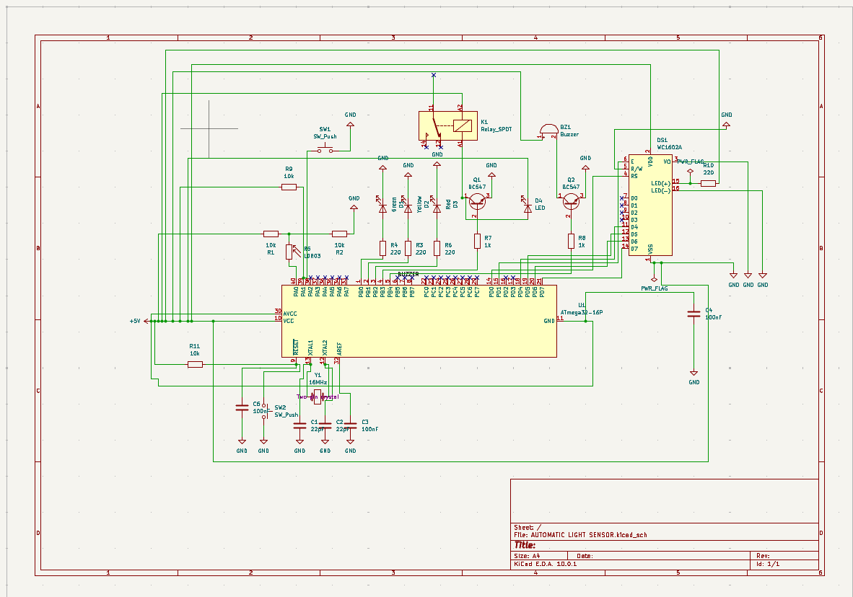
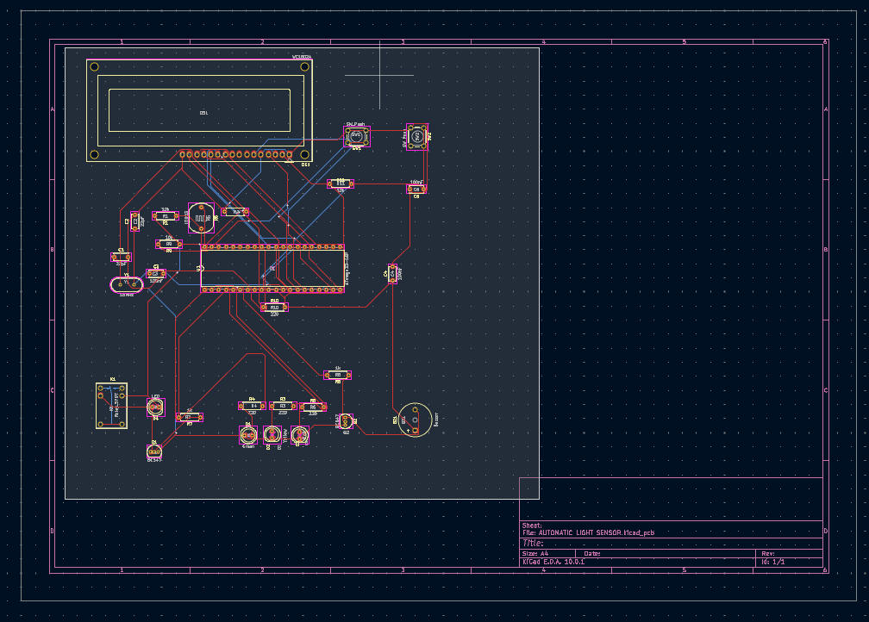
07 — KiCad Schematic & PCB Design
KiCad 10 — Schematic
KiCad 10 — PCB Layout
✓ ERC passed — 0 violations after no-connect flags placed on unused pins
✓ DRC passed — all clearance and routing rules satisfied
✓ All footprints assigned — THT packages for all components
✓ Gerber files generated — ready for PCB fabrication
✓ Net labels used — LDR_ADC, BTN_OVERRIDE, LAMP_OUT, BUZZER, LED_BRIGHT/MEDIUM/DARK
Notes:
Schematic designed in KiCad 10. All components from Device library. ERC and DRC passed. Gerber files exported for PCB fabrication.

Slide 14
08 — SimulIDE Simulation
System Startup
Bright Condition
LCD: SMART LIGHT / SYSTEM READY — 2 seconds then auto mode
Pot high → ADC > 800 → Green LED ON, Relay OFF, LCD: BRIGHT LAMP:OFF
Medium Condition
Low Condition
Pot mid-high → ADC 601–800 → Yellow LED ON, Relay OFF, LCD: MEDIUM LAMP:OFF
Pot mid-low → ADC 401–600 → Red LED ON, Relay ON, LCD: LOW LAMP:ON
Very Low / Dark
Manual Override
Pot minimum → ADC < 400 → Red LED, Relay ON, Buzzer beep, LCD: V.LOW LAMP:ON
SW1 press → MANUAL MODE. Next press toggles lamp ON/OFF independently
Sensor Error
Reset Operation
Disconnect ADC wire → ADC ≤ 5 → LCD: SENSOR ERROR! / Check LDR + buzzer
SW2 pressed → Hardware reset → Startup message → Returns to AUTO MODE
Note: A potentiometer was used in place of the LDR in SimulIDE, as the LDR03 model does not vary resistance with lux — this is permitted per the project brief.
Notes:
All 8 test cases verified in SimulIDE. Potentiometer used to simulate variable light levels. Screenshots for each test case saved in simulide/screenshots/ in the GitHub repository.

Slide 15
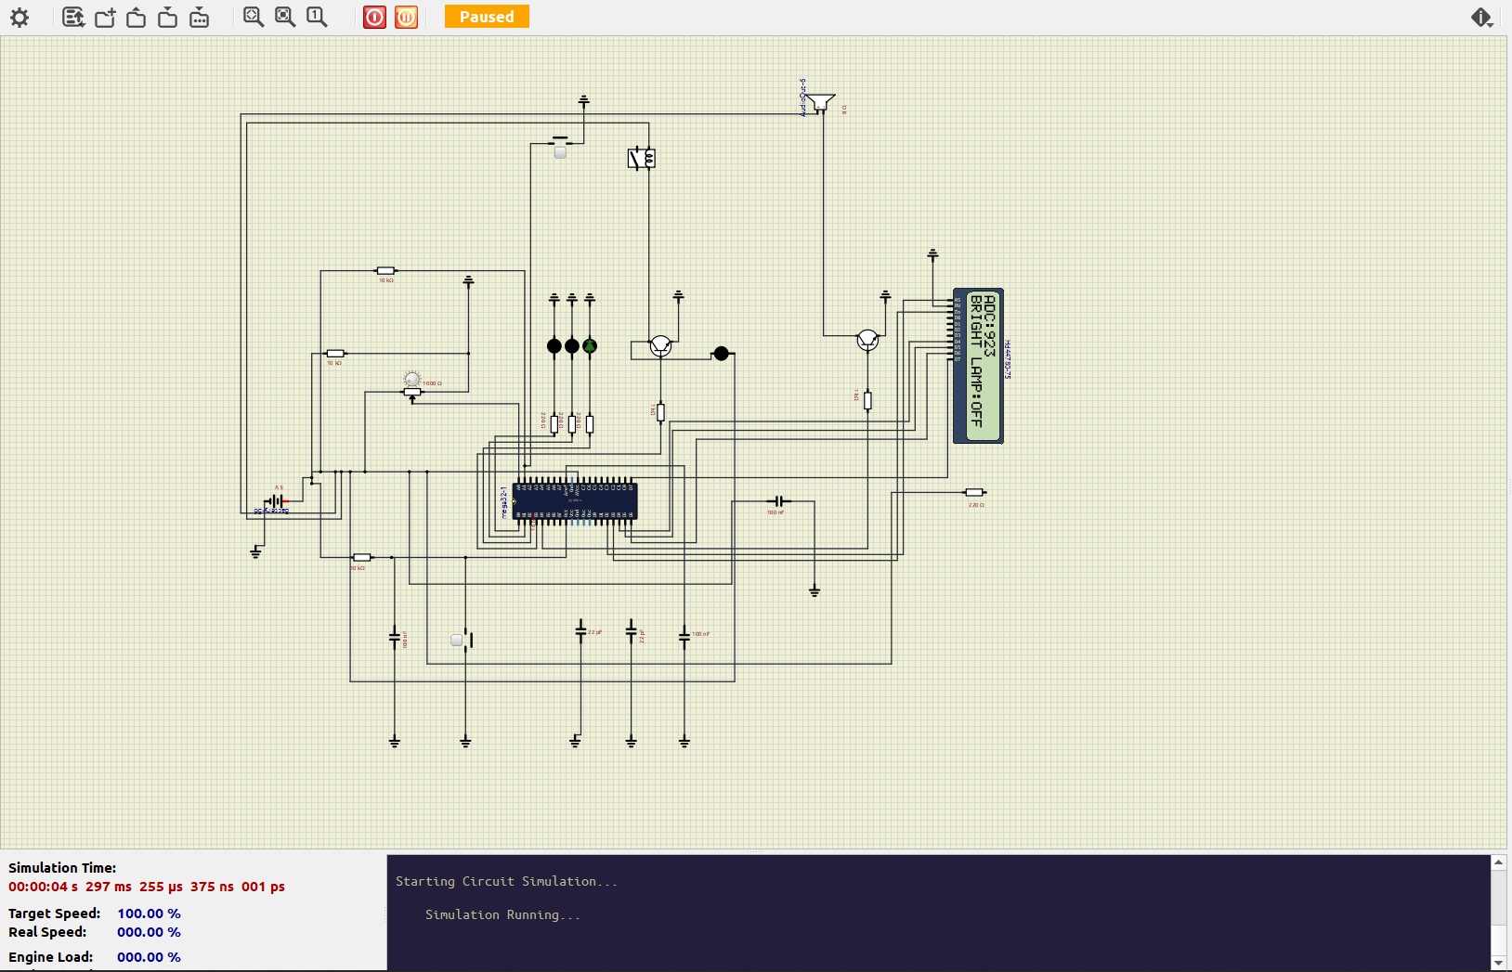
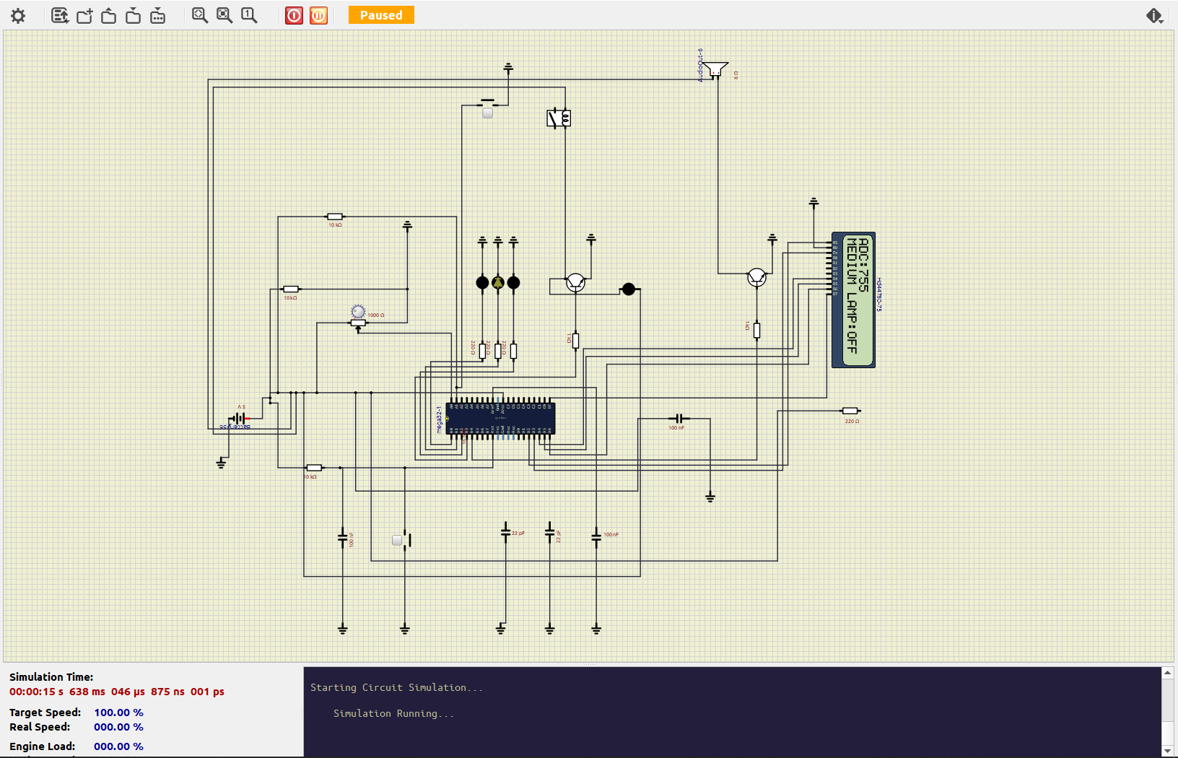
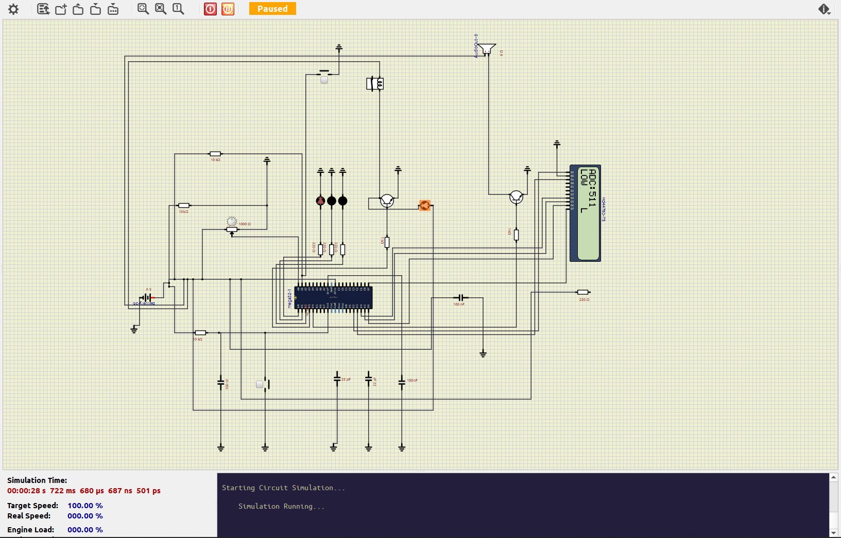
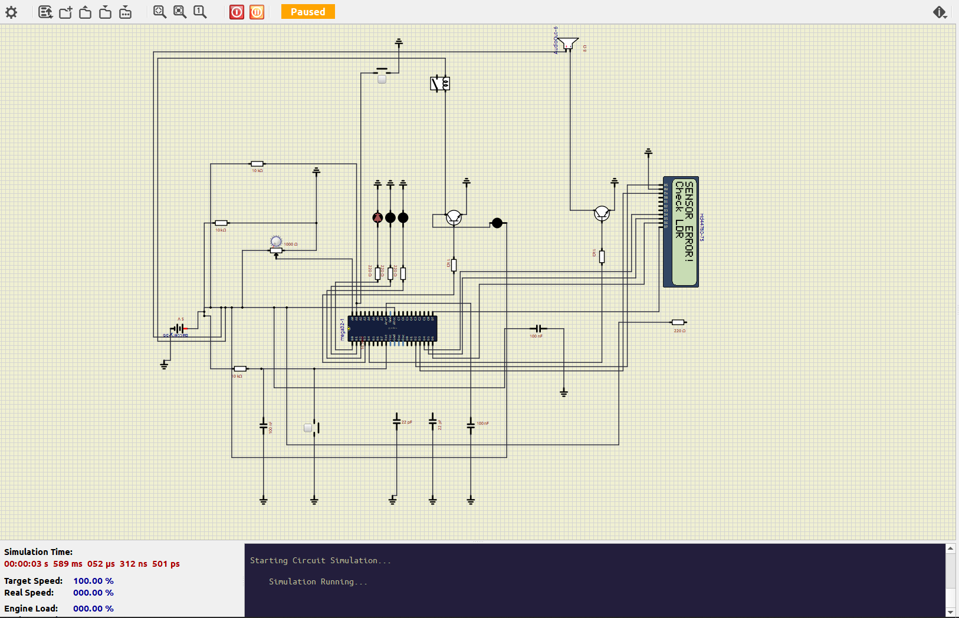
08 — Simulation Screenshots
Bright Condition
Medium Condition
Low Condition
Very Low + Buzzer
Notes:
Replace placeholders with actual SimulIDE screenshots for each test condition.

Slide 16
09 — Test Results Summary
Test Case | Expected Output | Actual Output | Result
System Startup | SMART LIGHT / SYSTEM READY | SMART LIGHT / SYSTEM READY | PASS
ADC Reading | LDR value on LCD | ADC value displayed correctly | PASS
Bright Condition | Green LED ON, Lamp OFF | Green LED ON, Lamp OFF | PASS
Medium Condition | Yellow LED ON, Lamp OFF | Yellow LED ON, Lamp OFF | PASS
Low Condition | Red LED ON, Lamp ON | Red LED ON, Lamp ON | PASS
Very Low Condition | Red, Lamp ON, Buzzer beep | Red, Lamp ON, Buzzer beep | PASS
Manual Override | Lamp toggles manually | Lamp toggles on button press | PASS
Sensor Error | Error indication + buzzer | SENSOR ERROR! on LCD + buzzer | PASS
Reset Operation | Returns to automatic mode | System restarts, auto mode | PASS
Notes:
All 9 test cases passed. The system correctly classifies all light conditions and responds with the right outputs.

Slide 17
GitHub Repository
Key Commits
ATmega32_LDR_Automatic_Lighting/
├── README.md
Initial project structure created
├── firmware/src/main.c | lcd.h
Added ADC firmware for LDR reading
│ hex/ATmega32_LDR.hex
Added threshold decision logic
├── kicad/schematic/ | pcb/ | gerber/
├── simulide/circuit/ | screenshots/
Added manual override function
├── documentation/pin_mapping_table.md
Added KiCad schematic design
│ adc_threshold_table.md
Added PCB layout and Gerber files
│ test_results.md
└── media/demonstration_video_link.txt
Added SimulIDE simulation
Added test results and documentation
Notes:
Repository follows the exact structure from the project brief. All files committed with meaningful commit messages. GitHub link shared with instructor.

