Slide 1
Lyrics-Based Song Genre Classification
Norwegian University of Science and Technology
Johannes Scherer
TDT4310 - Project Presentation

Slide 2
Lyrics-Based Song Genre Classification
Multi-class, single-label Text Classification
Song Lyrics
Genre
Rise up this mornin' Smiled with the risin' sun Three little birds Sit by my doorstep Singin' sweet songs Of melodies pure and true
Sayin', "This is my message to you-ou-ou:"
…
Rap
Reggae
Rock
…
Text
Classification

Slide 3
Objectives
Use traditional and machine learning approaches, compare performances
Traditional: Naïve Bayes (Bernoulli & Multinomial), SVM
ML: Averaged GloVe + Output Layer, LSTM, LSTM + GloVe
How do the models perform for an increasing number of included genres?

Slide 4
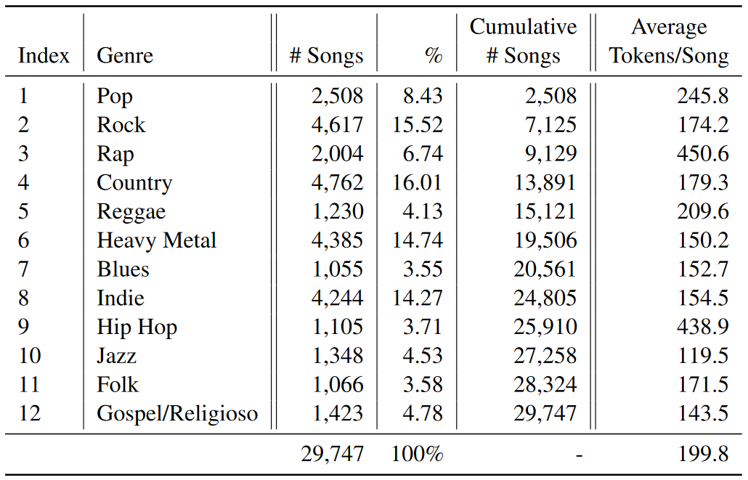
Dataset(s)
11 datasets containing between 2 and 12 musical genres
Train/test split: 0.7/0.3
Preprocessing
English lyrics only
Remove lines such as [Chorus] or (Drake)

Slide 5
Models
Preprocessing: lower case, remove symbols, resolve contractions,
remove stop words (not for Bernoulli NB, SVM)
Traditional Methods
Bernoulli Naïve Bayes (binary occurrence features)
Multinomial Naïve Bayes (with TF-IDF)
Support Vector Machine (SVM)
Machine Learning
GloVe + Output Layer (classify average GloVe vector of all lyrics words)
LSTM (bi-LSTM + Dropout + Hidden Layer + Dropout + Output layer)
LSTM + GloVe (same architecture, use GloVe vectors instead)

Slide 6
Hyperparameter Optimization
Each method potentially has different optimal parameters for each dataset
Grid search on the dataset that includes the song lyrics of 6 genres
Use the optimal hyperparameters for all datasets

Slide 7
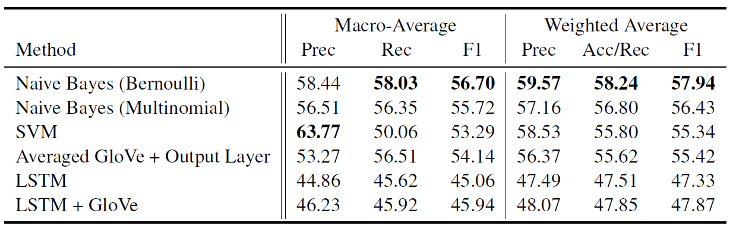
Results
Training and Evaluation on the complete dataset (i.e., consisting of song lyrics from 12 musical genres)

Slide 8
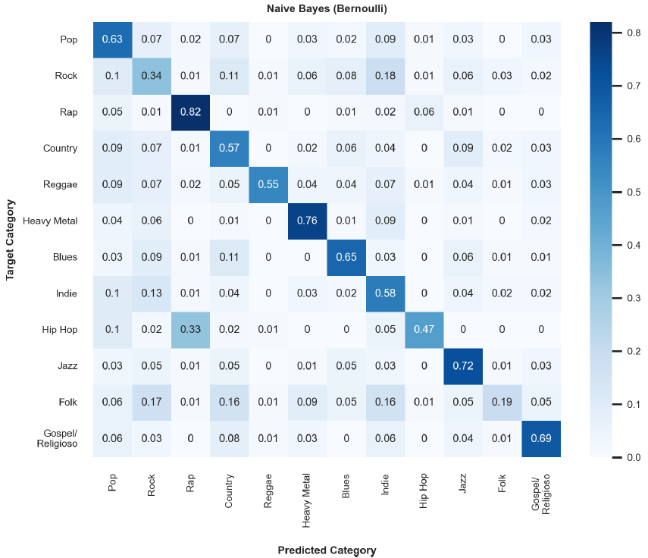
Results
Best Model
Bernoulli Naive Bayes

Slide 9
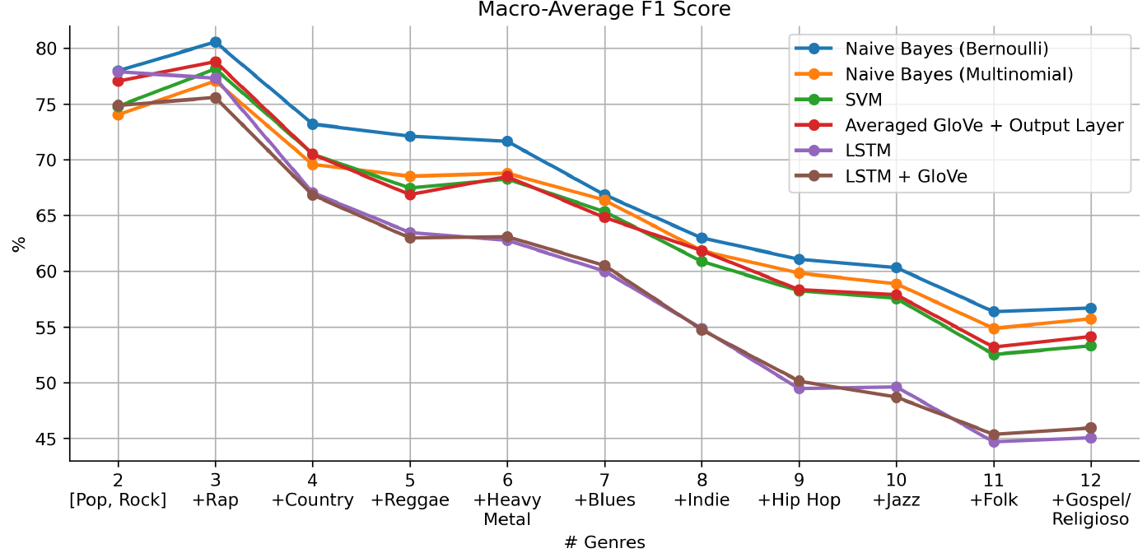
Results
Training and Evaluation on all 11 datasets

Slide 10
Conclusion
Traditional methods outperformed machine learning models
Bernoulli NB: simplest & fastest model is the best
Contextual information unimportant?
GloVe: No real improvement for LSTM
Classification performance of all methods degrades when considering more and more genres

