Slide 1

Classifying Emotions in Tweets
Jose Luis Estrada, Christopher Robinson, and Leonid Shpaner

Slide 2
Project Description
Several Twitter users have utilized the platform to influence actions or ideals on different topics such as finance, politics, etc. Given the recent violent events, this project aims to identify dangerous tweets to prevent future violent actions.
Problem Statement:
Identify dangerous tweets based on tweets with negative connotations and a predictive classification model that surpasses .70 precision, recall, and f-1 scores to mark red flags in the system.
Notes:
Suicide and violence are on the rise. In today’s world it has become increasingly important to try and identify red flags in social media. Our project will try to determine the emotional state of Twitter users based on their tweets to flag users which may be a threat to themselves or others using Natural Language Processing and sentiment analysis. The overarching goal of this project will be to classify these tweets by emotion types

Slide 3
Data Description
Source: Stanford Engineering: Computer Science Department
Train: 1.6 million records
Test: 500 records
Date range: April 2009 - May 2009
The data includes the following factors:
Polarity, Tweet ID, Date, Query Name, User, and Text

Slide 4
Data Preprocessing -Tokenization
Replaced usernames for USERNAME
Replaced https urls for URL

Slide 5
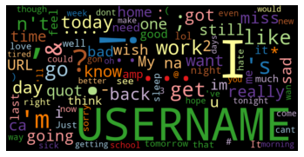
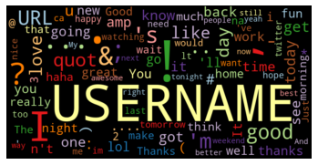
Data Preprocessing - Normalization
Word Cloud of Top 50 Negative Tokens
Word Cloud of Top 50 Positive Tokens

Slide 6
Descriptive Statistics
8.6M
Tokens
420K
Unique Tokens
43M
Characters
0.048
Lexical Diversity
Notes:
Sample of 1M

Slide 7

Classification Model – Logistic Regression
Positive Tweet
+ 1
Independent
Variables
- 1
Negative Tweet

Slide 8
Logistic Regression Performance
 | Precision | Recall | F1-score
Negative | .75 | .73 | .74
Positive | .49 | .88 | .63

Slide 9
Topic Model
Topic 00:
good
day
http
work
go
Topic 01:
http
com
twitpic
ly
bit
Topic 02:
thanks
quot
love
know
much
Topic 03:
quot
love
back
like
lol
Topic 04:
quot
good
day
luck
morning

Slide 10
Results
Not Dangerous Tweets
Hello big beautiful world
I hate this stupid world!
The movie killed me! It was great
Dangerous Tweets
Just got out of shooting practice
I’m bringing my AR15 to hurt everyone
I was going shooting tomorrow but I hurt my hand

Slide 11
Next-Steps and Conclusion
Increase the number of dangerous tags in the model
1
Improve accuracy by changing hyperparameters or exploring other predictive models
2
Deploy model to suspend accounts or notify the police if necessary
3

Slide 12
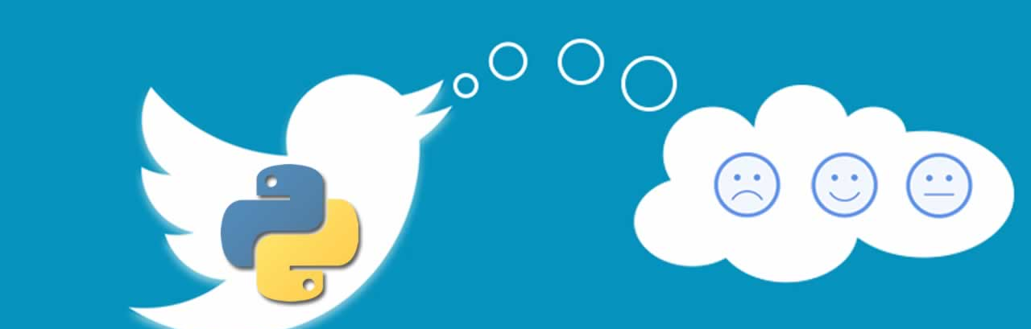
Thank you!

