Slide 1
“Don’t let the stack get stuck”: A novel approach for designing efficient stackable routers
Marvell Israel and EE Technion
IEEE HPSR 2015
Yoram Revah, Jose Yallouz,
Aviran Kadosh, Gideon Blocq, Ariel Orda

Slide 2
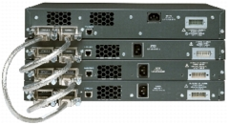
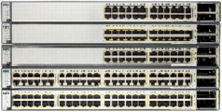
Stackable Router
Stackable Routers - a class of standalone routers operating together to establish the characteristics of a single unit yet possessing the capacity of all devices.
Cisco Catalyst 3750 Series Switches Topology
Up to 9 switches
Connected in a Dual-Ring Topology
16 Gbps at each direction (total 32 Gbps)
24/48 100 Mbps ports (total 2.4/4.8 Gbps each switch)

Slide 3
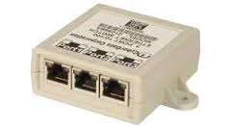

How to connect the Stackable Router?
Given 8 instances of a internal switches with 3 ports.
X8
How to connect them to minimize the diameter?
Notes:
האם ניתן לחבר את הפיצה בוקס בצורה יותר יעילה מרינג?
מדד היעילות הדיאמטר.
לדוגמא: 8 פיצה בעלי 3 פורטים

Slide 4

How to connect the Stackable Router?
Ring Topology
7
8
6
1
5
2
4
3
$$Diameter=4$$
Notes:
האם ניתן לחבר את הפיצה בוקס בצורה יותר יעילה מרינג?
מדד היעילות הדיאמטר.
לדוגמא: 8 פיצה בעלי 3 פורטים

Slide 5

How to connect the Stackable Router?
Hypercube Topology
4
1
7
2
5
3
6
8
$$Diameter=3$$
Notes:
האם ניתן לחבר את הפיצה בוקס בצורה יותר יעילה מרינג?
מדד היעילות הדיאמטר.
לדוגמא: 8 פיצה בעלי 3 פורטים

Slide 6
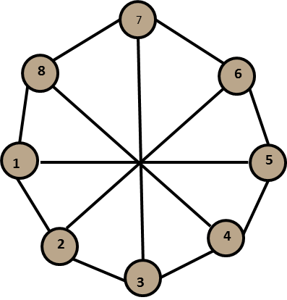

How to connect the Routers?
Octal Topology
$$Diameter=2$$
Notes:
האם ניתן לחבר את הפיצה בוקס בצורה יותר יעילה מרינג?
מדד היעילות הדיאמטר.
לדוגמא: 8 פיצה בעלי 3 פורטים

Slide 7

Model Formulation
A stackable router is represented by a connected graph G(V,E)
$V$- the set of internal switches
$E$- the set of connections
Note $p(v)≥deg⁡(v)$

Slide 8
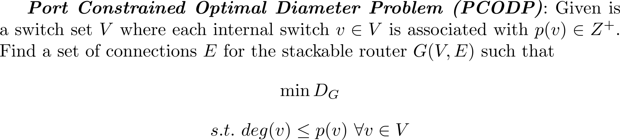
Model Formulation

Slide 9
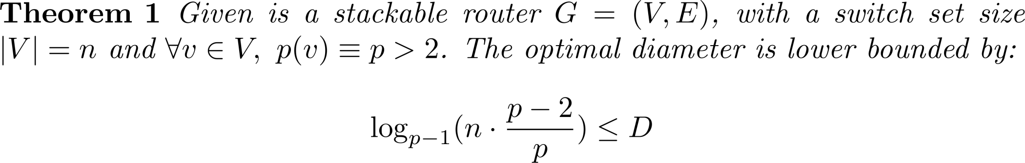
Constructing the Stackable Router Topology
The PCODP problem is intractable!
Diameter Lower Bound:

Slide 10
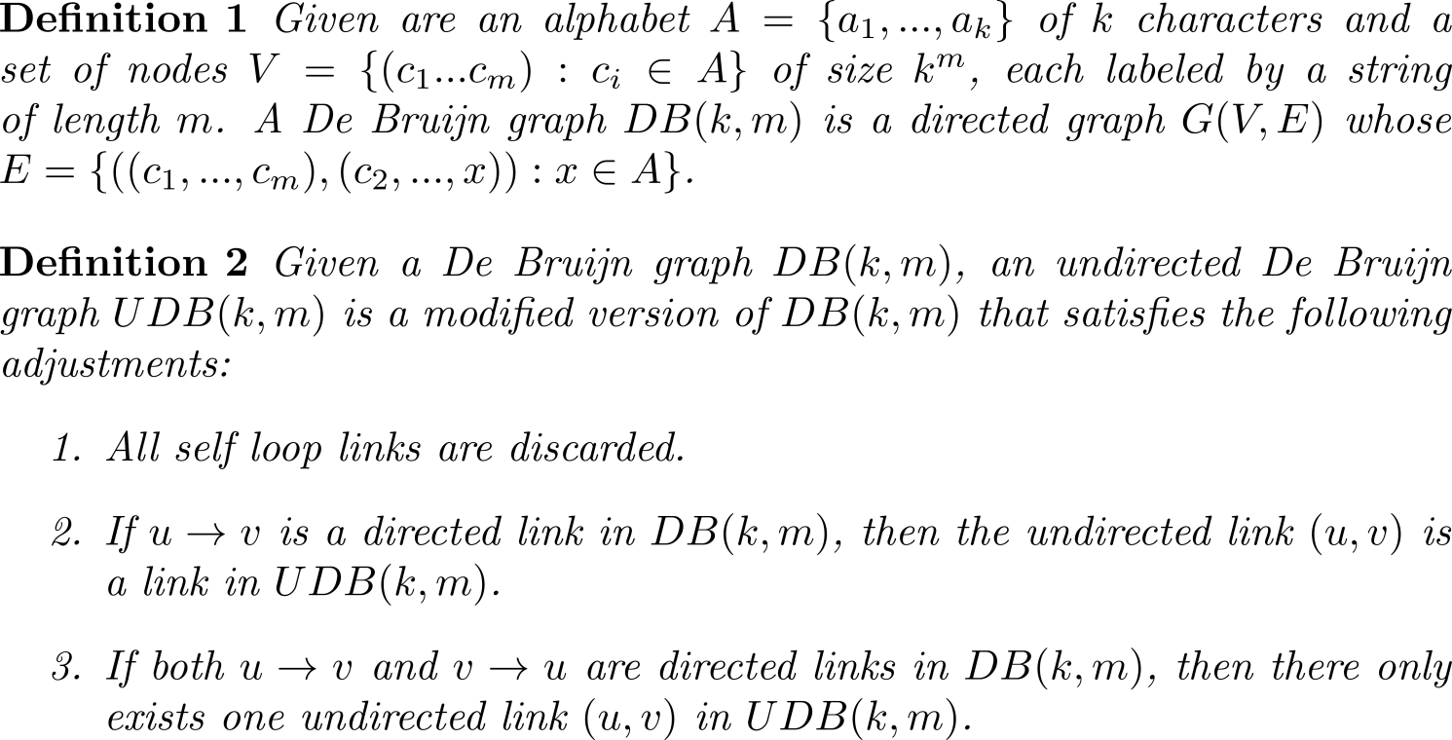
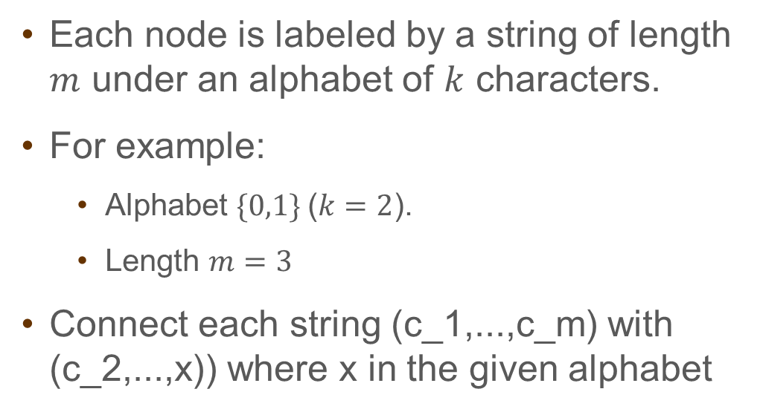
De-Bruijn Approach
Each node is labeled by a string of length $m$ under an alphabet of $k$ characters.
For example:
Alphabet $\{0,1\}$($k=2$).
Length $m=3$
Connect each string (c_1,...,c_m) with (c_2,...,x)) where x in the given alphabet
000
001
100
010
101
011
110
111

Slide 11
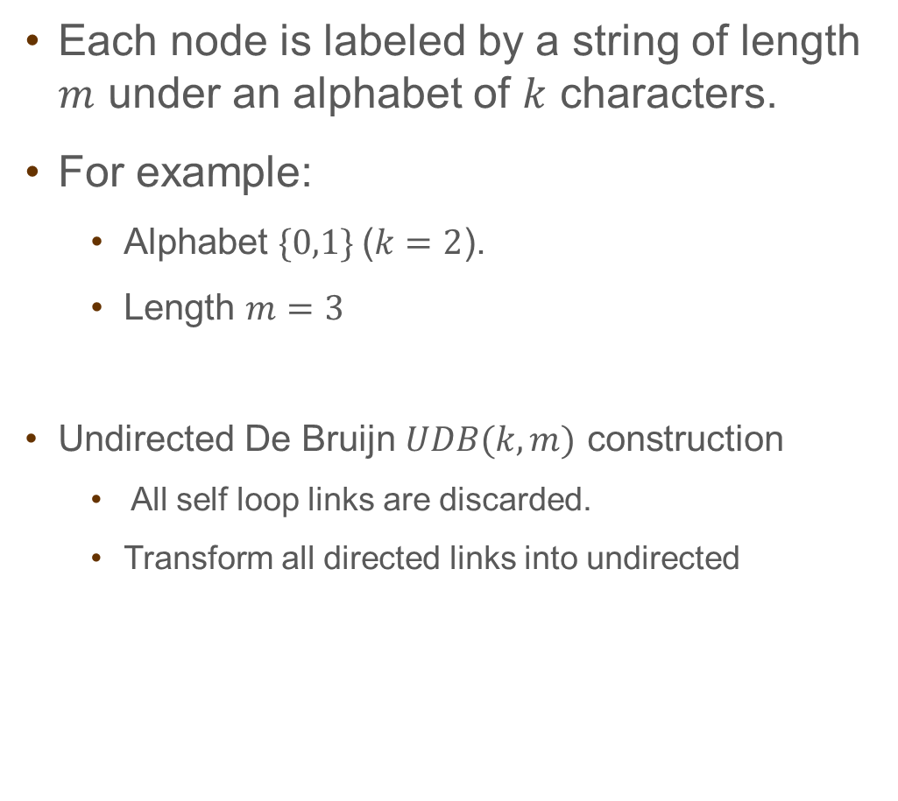
De-Bruijn Approach
Each node is labeled by a string of length $m$ under an alphabet of $k$ characters.
For example:
Alphabet $\{0,1\}$($k=2$).
Length $m=3$
Undirected De Bruijn $UDB(k,m)$ construction
All self loop links are discarded.
Transform all directed links into undirected
000
001
100
010
101
011
110
111

Slide 12
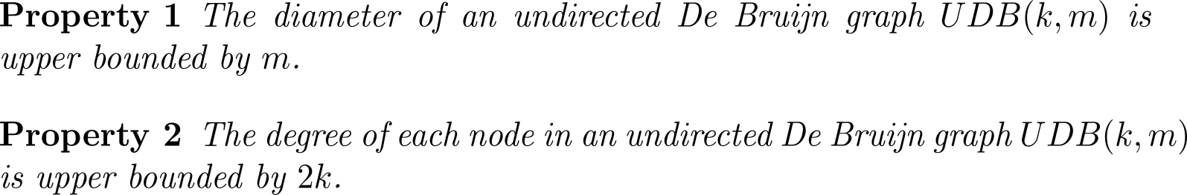
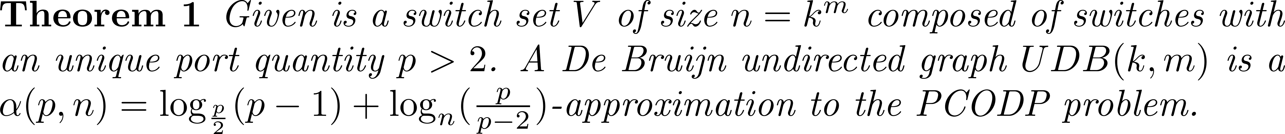


De-Bruijn Approach
000
001
100
010
101
$p→∞$ $α(p,n)$ does not depend on $n$
011
110
Even for small $p$ $α\left(p,n\right)→1$
Diameter Approximation Factor:
111
Notes:
ביטוי השני בקושי משפיע על יחס.
עבור p קטן מקבלים יחס קרוב ל-1

Slide 13

Simulation Results
We perform simulation on a random topology with different number of nodes and port quantity.
Port quantity $p=3$

Slide 14
Simulation Results
Comparison with the traditional ring topology.

Slide 15
Simulation Results
Approximation ratio of a random topology

Slide 16
Agenda
Stackable Router Overview
Diameter Problem
Throughput Problem
Conclusion

Slide 17
Throughput Problem Formulation
Notes:
$f(C)$ try to define the function

Slide 18
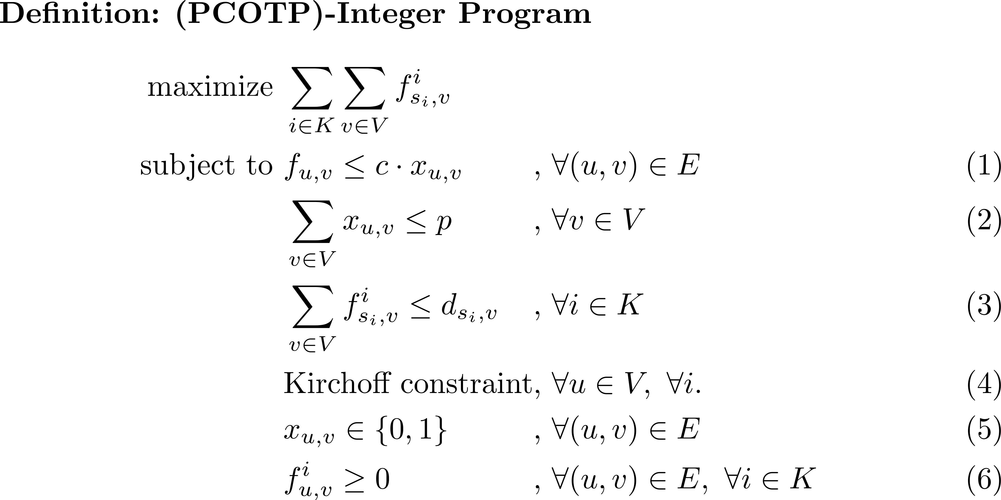
Throughput Problem Formulation
Notes:
$f(C)$ try to define the function

Slide 19
Conclusion
We investigated several design considerations in the construction of stackable routers.
Formalized an optimization problem for the diameter consideration (PCODP) :
Lower bound for the optimal diameter
De Bruijn approximation
Simulations show that a random graph results in a close-to-optimal solution
Formalized an optimization problem for the throughput consideration (PCOTP) :
Formalize the problem as an ILP
Derive the integrality gap

Slide 20
Thank you!

