Slide 1
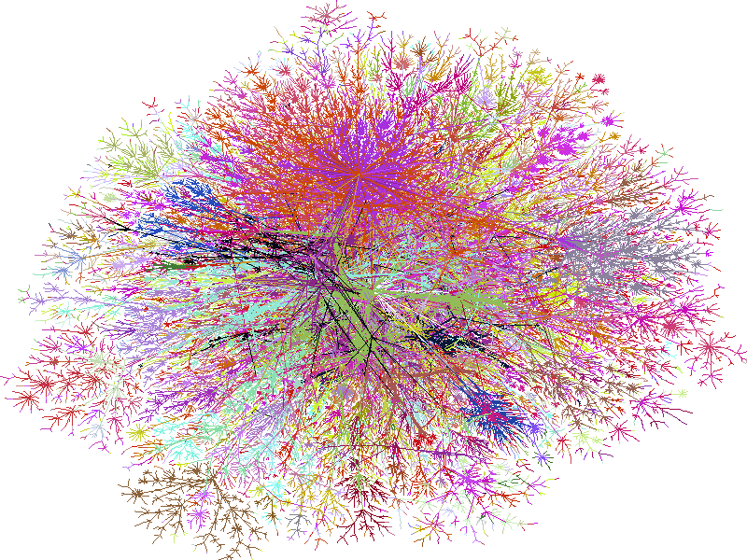

Tunable QoS-Aware Network Survivability
Jose Yallouz
Joint work with Ariel Orda
Department of Electrical Engineering, Technion

Slide 2
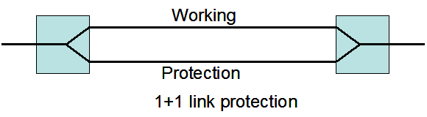
Introduction
Survivability – the capability of the network to maintain service continuity in the presence of failures.
Single Link Failure Model assumes that at most one link failure should be handled in the network.
Protection is a type of pre-planning process established before a failure occurs.
Notes:
A network which contains many network components of both hardware and software can incur failures due to one (or even multiple) of its contained components incurs a failure. Ranging from the largest to the smallest and from hardware to software, network failures can be divided into the following categories:
Control plane failure: this type of failure is mainly related to software, i.e., network control plane software. For example, in a GMPLS-based network which is made up of a control plane and data plane, the control plane failure would lose the control of the data plane, which means that we cannot establish new service connections, or terminate or modify an existing service connections within the data plane, even though the existing connections can still perform normally to carry user’s data. In other type of networks such as IP networks, the control plane failure can be even more serious. For example, the pollution of IP lookup tables at some routers would cause all the IP traffic on these nodes difficult to be forwarded. Similar stories occur for viruses attacking IP routers. They disable the IP networks through disabling IP network control plane. Subnetwork failure: this is a type failure occurred with a regional subnetwork that commonly shares a risk, e.g., a region that has high occurring frequency of earthquake. In addition, some large disasters such as flooding, tsunami, etc. can also disable a regional subnetwork. Node failure: this is a type of failure occurred with a single network node. The reasons for this kind of failure include accidents or disasters at a network operational center, such as power shutdown due to fire, flooding, etc. Network card failure: network card failure is a type of failure under the umbrella of the node failure type. Rather than the shutdown of the whole switch node, sometimes a failure can occur only with a network interface card. For example, the failures or faults such as a laser outage, fault of a circuit board, or software bugs, etc. can also contribute to a network card failure. Link failure: link failure in general is the most common network failure that occurs due to fiber cut. SRLG failure: SRLG failure is a generic concept to define all types of network failures whenever a common SRLG incurs a failure. Here a SRLG can be a fiber link, node, subnetwork, or control plane, etc.

Slide 3


Tunable survivability
Full survivability - (100%) protection against network single failures.
Establishment of pairs of disjoint paths.
This scheme is often too restrictive.
Tunable survivability allows any desired degree of survivability in the range 0% to 100%.
Increase the space of feasible solutions.
In our work, we focus on the combination of survivability and other QoS additive criteria.
delay, jitter, cost.
common link
$S$=0.99
$p_{e}$=0.01
Notes:
Full survivability - (100%) protection against network single failures.
based on the establishment of pairs of disjoint paths.
This scheme is often too restrictive.
Tunable survivability allows any desired degree of survivability in the range 0% to 100%.
Can substantially increase the space of feasible solutions.
Enables to consider & quantify valuable tradeoffs (e.g., survivability vs. delay, survivability vs. jitter, survivability vs. bandwidth…)
The link failure probabilities are estimated out of the available failure statistics of each network component.

Slide 4
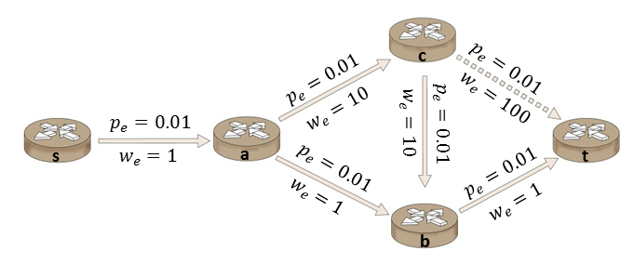


Model Formulation
Network represented by a directed graph, G = (V, E)
$w_{e}$: additive QoS target on link e (such as delay, cost, etc)
$p_{e}$: failure probability of link e
Given a pair of source and target nodes s and t, a survivable connection is a pair of paths $\left(π_{1},π_{2}\right)$ (not necessarily disjoint).
The survivability level of $(π_{1},π_{2})$ is defined:
The probability that all common links are operational
$\prod_{e∈π_{1}∩π_{2}}{\left(1−p_{e}\right)}$ ($π_{1}∩π_{2}≠∅$)
1 ($π_{1}∩π_{2}=∅$)
1-0.01=(0.99)-survivability level
Notes:
May to add a graph

Slide 5



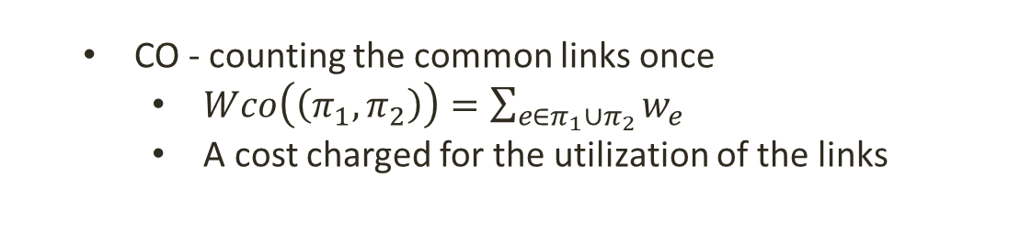
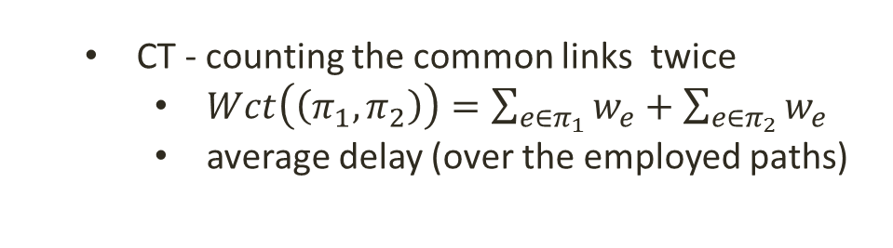
Model Formulation
The weight of $(π_{1},π_{2})$ can be defined in 2 forms:
CO - counting the common links once
$Wco\left(\left(π_{1},π_{2}\right)\right)=\sum_{e∈π_{1}∪π_{2}}{w_{e}}$
A cost charged for the utilization of the links
CT - counting the common links twice
$Wct\left(\left(π_{1},π_{2}\right)\right)=\sum_{e∈π_{1}}{w_{e}}+\sum_{e∈π_{2}}{w_{e}}$
average delay (over the employed paths)
CO-Weight: 1+10+100+1+1=113
CT-Weight: 100+10+1+1+2=114
$$w_{e}$$
$$2∙w_{e}$$
Notes:
Given a survivable connection $(π_{1},π_{2})$, depending on the QoS metric that $w_{e}$ represents, the weight of $(π_{1},π_{2})$ can be defined by 2 forms:

Slide 6
Problem Illustration
(1-0.01)²=(0.99)²-survivability level
CT-Weight: 10+10+1+1+1=24
1-0.01=(0.99)-survivability level
CT-Weight: 100+10+1+1+1=114
Transmission delay can be reduced drastically by slightly alleviating the survivability requirement of the connection.

Slide 7
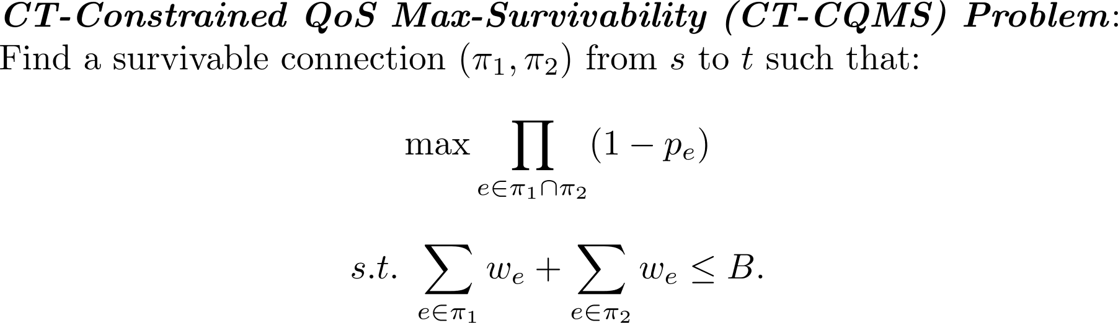
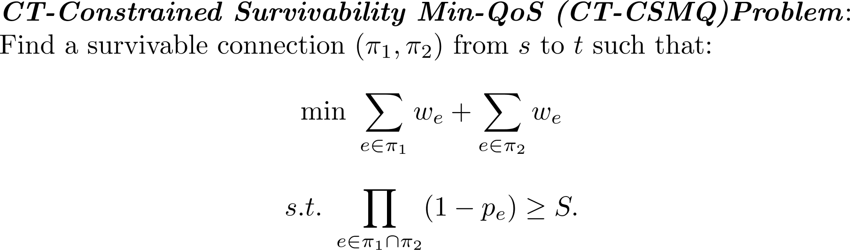
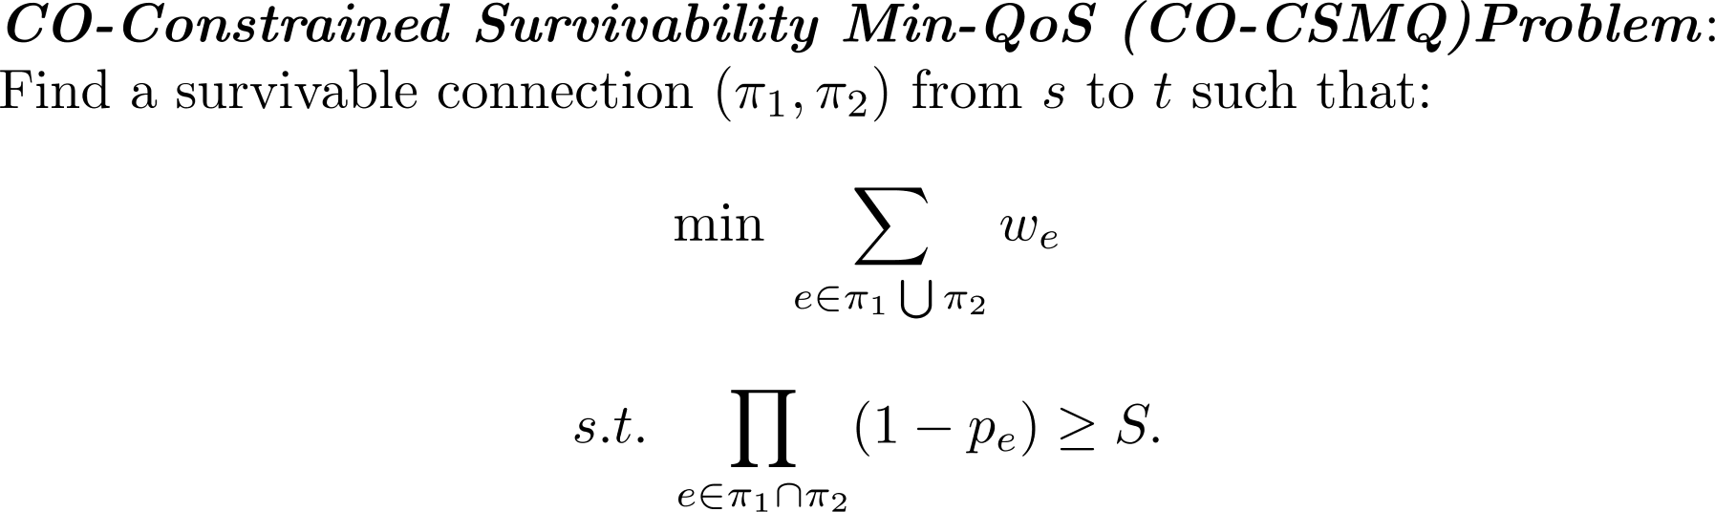
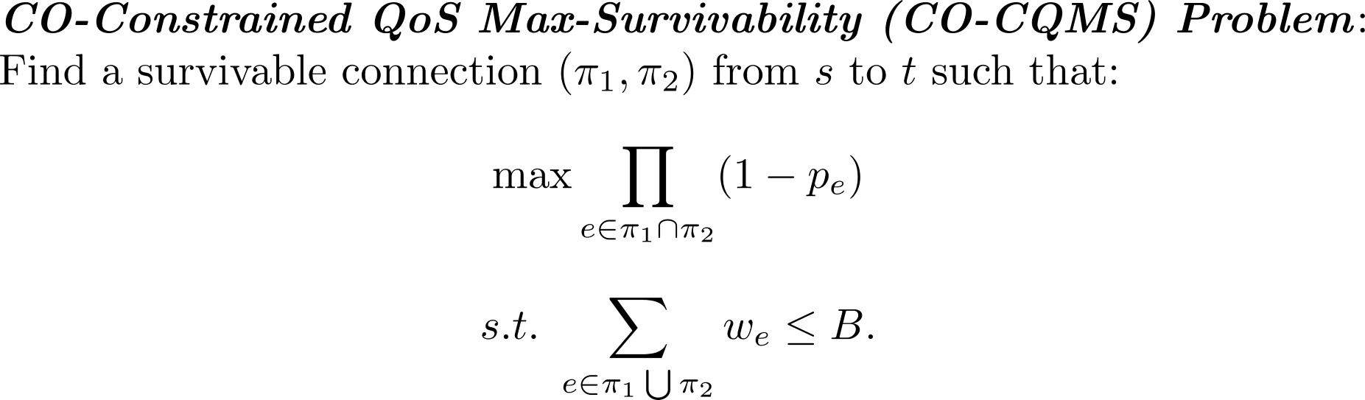
Optimization Problems

Slide 8



The Structure of CT Solutions
Definition 1: Given a survivable connection $(π_{1},π_{2})$ a critical link is a link that is common to both paths $π_{1}$ and $π_{2}$.
The set of critical links of a survivable connection
$C\left(π_{1},π_{2}\right)=\{{e|e ∈ π}_{1} ∩ π_{2}\}$.
$$π_{1}$$
critical
link
S
v_{i}
v_{j}
t
$$π_{2}$$

Slide 9

The Structure of CT Solutions
Definition 1: WS(s,t) is the set of all the weight-shortest paths between s and t .
Definition 2: An in-all-weight-shortest-paths link is a link e that is common to all paths in WS(s,t).
The set of in-all-weight-shortest-paths links
$L=\{e|e∈\bigcap_{π∈WS\left(s,t\right)}{π}\}$
In-all-weight-shortest path links
S
t

Slide 10



The Structure of CT Solutions
Theorem: Any survivable connection $(π_{1},π_{2})$ that is an optimal solution of the respective CT-Constrained QoS Max-Survivability Problem is such that all its critical links are in-all-weight-shortest-paths links.
$C(π_{1},π_{2})⊆L$
In-all-weight-shortest path links
$$π_{1}$$
critical
link
v_{j}
v_{i}
v_{j}
S
v_{i}
S
t
t
$$π_{2}$$

Slide 11
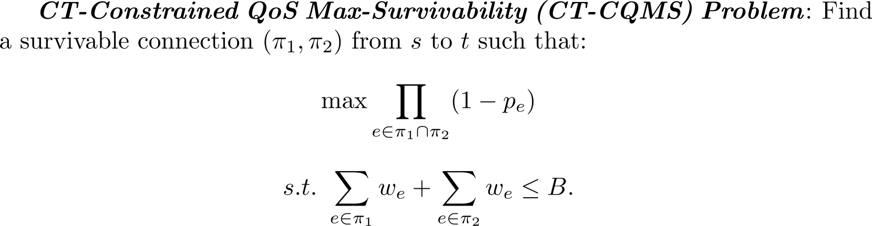
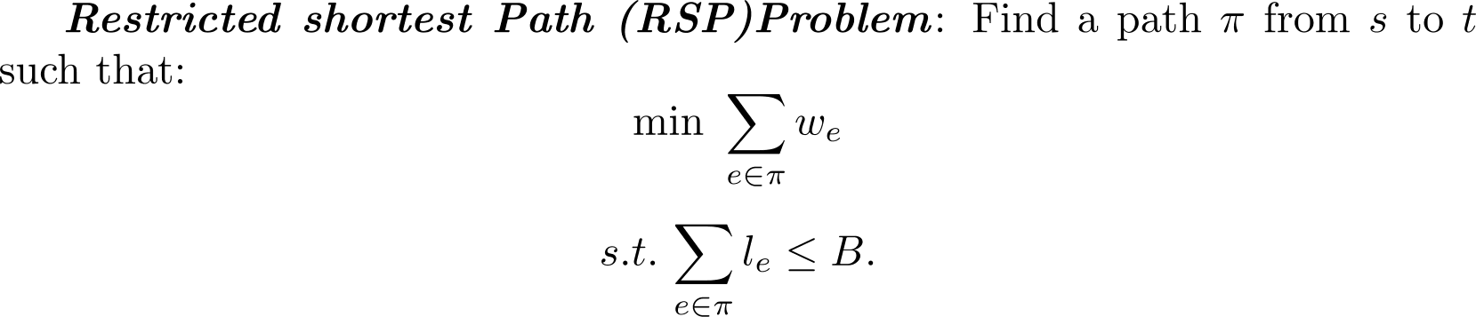
Algorithmic Scheme
Problem CT-CQMS is NP-Hard.
A reduction from the Partition Problem (PP)
Pseudo polynomial and Fully Polynomial Time Approximation Scheme (FPTAS) solutions are proposed

Slide 12

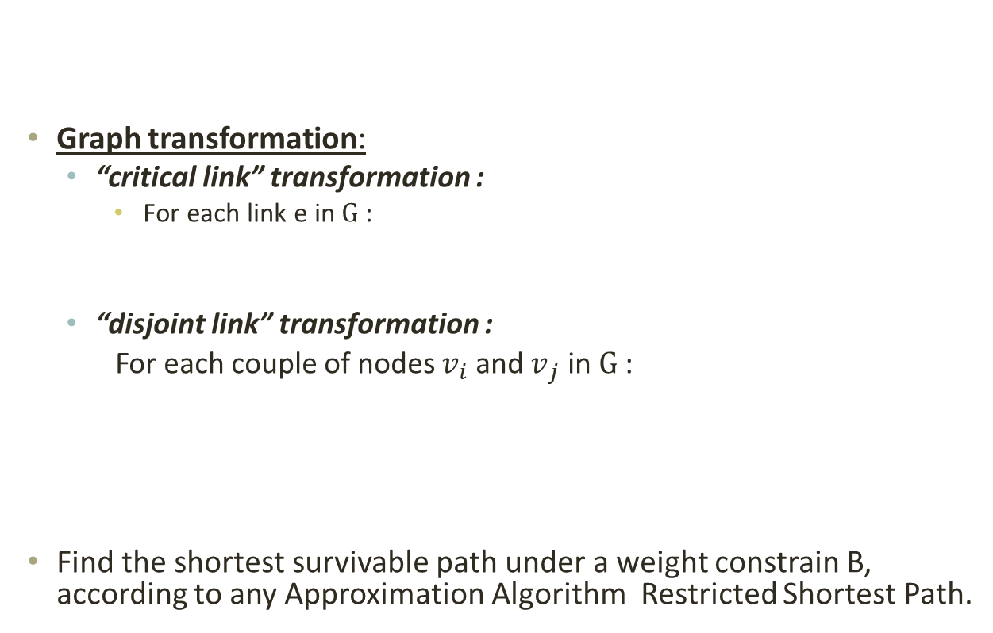




Algorithm for the CT Problem– Establishing QoS Aware p-survivable connection
survivable connection
Graph transformation:
“critical link” transformation :
For each link e in $G$ :
“disjoint link” transformation :
For each couple of nodes $v_{­­i}$ and $v_{­­j}$ in $G$:
Find the shortest survivable path under a weight constrain B, according to any Approximation Algorithm Restricted Shortest Path.
s
_{t}
$$(\text{W}\text{e}\text{, }\text{P}\text{e})$$
$$\check{\text{S}\text{e}}=−ln(1−\text{P}\text{e})$$
$$\check{W\text{e}}=2We$$
$$W\left(π1\right)$$
$$\check{\text{S}\text{e}}=0$$
$$\check{W\text{e}}=W\left(π1\right)+W\left(π2\right)$$
$$W\left(π2\right)$$
Notes:
Note: There are maximum $\frac{|V|(|V|−1)}{2}$ links added to the new graph.
Note that the transformation reduces the problem to well-known algorithms which can solve our program.

Slide 13
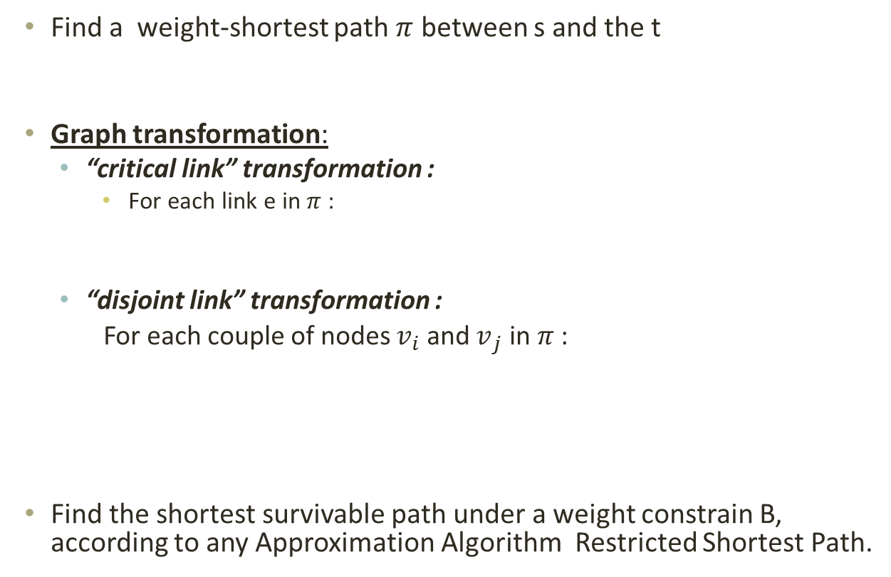


Algorithm for the CT Problem– Establishing QoS Aware p-survivable connection
Find a weight-shortest path $π$ between s and the t
Graph transformation:
“critical link” transformation :
For each link e in $π$ :
“disjoint link” transformation :
For each couple of nodes $v_{­­i}$ and $v_{­­j}$ in $π$:
Find the shortest survivable path under a weight constrain B, according to any Approximation Algorithm Restricted Shortest Path.
$$(\text{W}\text{e}\text{, }\text{P}\text{e})$$
$$\check{\text{S}\text{e}}=−ln(1−\text{P}\text{e})$$
$$\check{W\text{e}}=2We$$
$$W\left(π1\right)$$
$$\check{\text{S}\text{e}}=0$$
$$\check{W\text{e}}=W\left(π1\right)+W\left(π2\right)$$
$$W\left(π2\right)$$
Notes:
Note: There are maximum $\frac{|V|(|V|−1)}{2}$ links added to the new graph.
Note that the transformation reduces the problem to well-known algorithms which can solve our program.

Slide 14
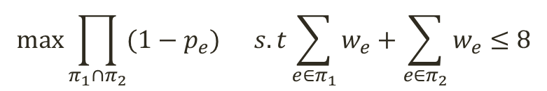
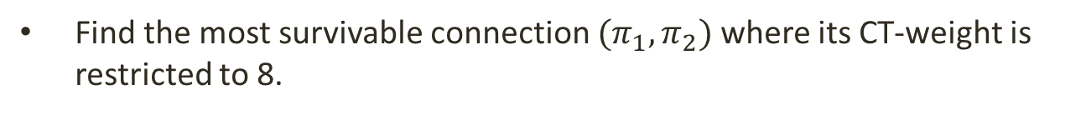
Algorithm for the CT Problem
Find the most survivable connection $(π_{1},π_{2})$ where its CT-weight is restricted to 8.
$$max\prod_{π_{1}∩π_{2}}{(1−p_{e})} s.t\sum_{e∈π_{1}}{w_{e}}+\sum_{e∈π_{2}}{w_{e}}≤8$$
P=0.01
W=4
P=0.03
W=1
P=0.02
W=1
P=0.01
W=1
S
T
P=0.01
W=3

Slide 15
Algorithm for the CT Problem
Find a minimum weight shortest path $π$ between s and t.
P=0.01
W=4
P=0.03
W=1
P=0.02
W=1
P=0.01
W=1
S
T
P=0.01
W=3

Slide 16

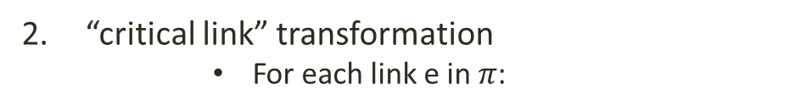
Algorithm for the CT Problem
“critical link” transformation
For each link e in $π$:
$$(\text{W}\text{e}\text{, }\text{P}\text{e})$$
$$\check{\text{P}\text{e}}=−ln(1−\text{P}\text{e})$$
$$\check{W\text{e}}=2We$$
P=0.01
W=4
P=0.03
W=1
P=0.02
W=1
P=0.01
W=1
S=-ln0.97
W=2
S=-ln0.98
W=2
S=-ln0.99
W=2
S
T
P=0.01
W=3

Slide 17
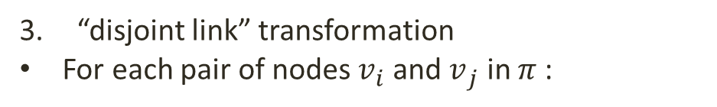
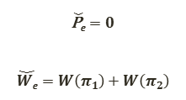
Algorithm for the CT Problem
$$W\left(π1\right)$$
“disjoint link” transformation
For each pair of nodes $v_{­­i}$ and $v_{­­j}$ in $π$:
$$\check{\text{P}\text{e}}=0$$
$$\check{W\text{e}}=W\left(π1\right)+W\left(π2\right)$$
P=0
W=6
$$W\left(π2\right)$$
P=0.01
W=4
P=0.03
W=1
P=0.02
W=1
P=0.01
W=1
S
T
P=0.01
W=3
P=0
W=5
P=0
W=9

Slide 18
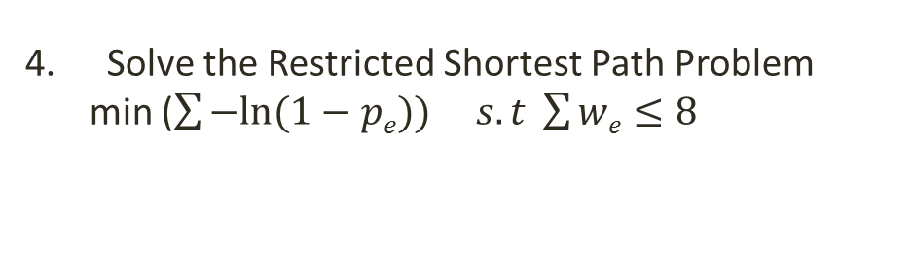
Algorithm for the CT Problem
Find the most survivable connection where its weight is restricted to 8
Solve the Restricted Shortest Path Problem
min ($\sum{−ln⁡(1−pe})) s.t \sum{we}≤8$
P=0
W=6
S=-ln0.97
W=2
S=-ln0.98
W=2
S=-ln0.99
W=2
S
T
P=0
W=5
P=0
W=9

Slide 19
Algorithm for the CT Problem
Find the most survivable connection $(π_{1},π_{2})$ where its CT-weight is restricted to 8.
$$max\prod_{π_{1}∩π_{2}}{(1−p_{e})} s.t\sum_{e∈π_{1}}{w_{e}}+\sum_{e∈π_{2}}{w_{e}}≤8$$
P=0.01
W=4
P=0.03
W=1
P=0.02
W=1
P=0.01
W=1
S
T
P=0.01
W=3

Slide 20
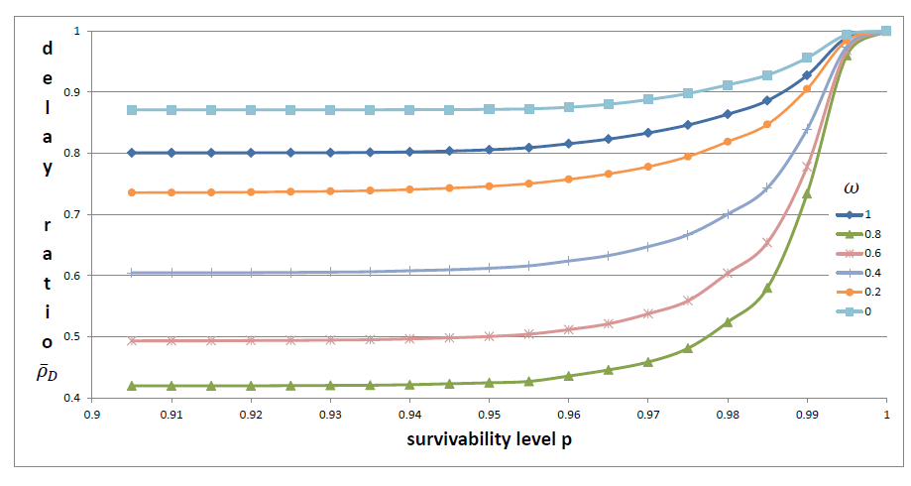

Simulation
Assuming different ratios of “slow” and “fast” delay links.
Delay improved by 50%
Power Law simulations for different
values of $ω$(percentage of “fast” links).
Notes:
The transmission delay would be reduced drastically by slightly alleviating the survivability requirement of the connection.

Slide 21

Conclusion
Optimization problems combining the survivability level and an additive QoS criteria.
Characterized fundamental properties of CT-problems.
Established algorithmic schemes.
Comprehensive simulations show the advantage of tunable survivability.
Our scheme can be implemented in state of the art architectures such as MPLS.
Notes:
We presented the work “Tunable QoS-Aware Network Survivability”.

Slide 22
THANKS!!

