Slide 1
Tunable Survivable Spanning Trees
Jose Yallouz, Ori Rottenstreich and Ariel Orda
Department of Electrical Engineering
Technion, Israel Institute of Technology
Proceedings of ACM Sigmetrics 2014
Notes:
Hello, my name is Jose Yallouz from the Technion – Israel Institute of Technology
Today, I will present a joint work with Ori Rottenstreich an Ariel Orda
Named “Tunable survivable spanning Trees”.

Slide 2
Quality of Service (QoS)
Introduction
The Internet was developed as a Best Effort network.
What is Quality of Service (QoS)?
“The collective effect of service performance which determines the degree of a user satisfaction of the service.” (ITU)
QoS common criteria:
Delay
Jitter
Bandwidth
QoS metric classification:
Bottleneck
Additive
Packet loss
Out of order
Survivability
Notes:
In the beginning the internet was created as a Best Effort network without any QoS guarantees for its traffic.
What is QoS?
The ITU organization defines QoS ….
This degree of satisfaction can be measured by various criteria such as
….
And , finally, our known survivability metric.
Most of these metrics can be classified into 2 classes:
Bottleneck which includes the bandwidth
Additive which includes the Delay

Slide 3
Survivability
Introduction
Survivability – The capability of the network to maintain service continuity in the presence of failures.
Recovery Schemes
Restoration is a post-failure operational process, i.e. a backup solution is calculated only after the failure occurrence.
Typical recovery times range from seconds to minutes.
Protection is a pre-failure planning process, i.e. a backup solution is calculated in advance before the failure occurrence.
Typical recovery times are in the range of milliseconds.
According to many standards, a single failure recovery operation must be performed within 50 ms.
These two techniques are often implemented together.
“First Failure Protection, Next Failures Restoration”
Notes:
We define Survivability as…
Nowadays, there are 2 main recovery schemes for coping with failures:
The first named “restoration” ….
The second named “protection” …
Furthemore, many standards require a single failure recovery to be performed within 50ms…
Turning the restoration approach into unsuitable.
…. Can be implemented together in a (FFPNFR) policy

Slide 4
Single Failure Model
Introduction
Single Failure Model: assumes that at most one failure can be handled in the network
Under the single link failure model, only the links that are common to all paths can fail the connection.
common link
Notes:
In this work, we assume the widely employed single failure model in which at most one failure can be handled at the network in a specific time.
You might ask yourself why to use a single failure model?
I see 3 reasons for that:
1) For the first one I have a joke. Anybody is familiar with the bomb and the airplane joke?
A professor and his student are flying in a airplane. Suddenly, the student discover that the professor is carrying a bomb in his suitcase. Therefore, the student ask the professor why is he carrying a bomb? Prof answers: “Oh my dear, don’t worry. I have calculated the probability for 2 bombs on the plane and its converges to zero.”
Therefore, multiple failures are rare.
2) The simplicity of the model.
3) As already mentioned in many case we employ a “First Failure Protection, Next Failures Restoration”(FFPNFR) policy

Slide 5
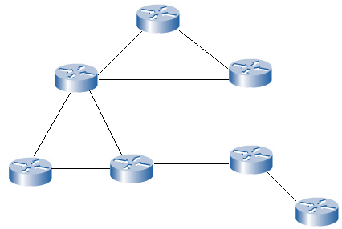
Broadcasting Methods
Motivation
Broadcasting - a method of transferring a message to all recipients simultaneously.
Flooding Broadcast
Spanning-Tree Broadcast
Notes:
The main motivation for this work is to provide a reliable broadcasting.
The literature provides various methods for broadcasting such as:
Flooding the message via all network links.
However, this approach might be too costly.
We can save the transmission cost on these links by first establishing a spanning tree and then transmitting the messages through the tree links.

Slide 6


Tunable Survivability
Motivation
Full survivability - (100%) protection against network single failures.
Establishment of link-disjoint spanning trees.
This scheme is often too restrictive.
common link
$S$=0.99
$p_{e}$=0.01
Tunable survivability allows any desired degree of survivability in the range 0% to 100%.
Notes:
A traditional approach for reliable broadcasting is to establish 2 FULLY link disjoint spanning trees. This approach supply (100%) protection against network single failures.
However, the disjointness requirement is often too restrictive since:
-It is not always possible to find two disjoint spanning trees
-Sometimes the solution is too costly.
Therefore, we suggest to tune the disjointness requirement by considering also common links with a certain level of failure probability.
For example, in this case the common link p_e=0.01 resulting in a survivability level of 0.99.
This new approach is named tunable survivability and it allows any desired degree of survivability in the range 0% to 100%.

Slide 7

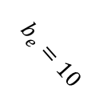
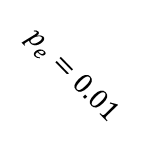


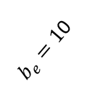
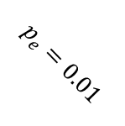
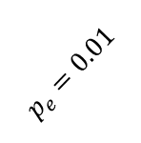
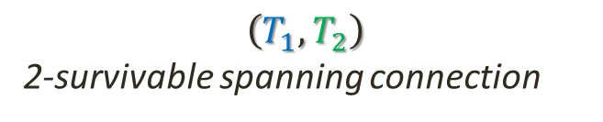
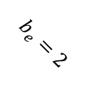

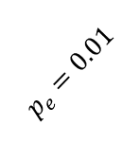




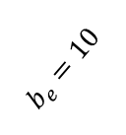
Model Formulation
Formulation
Network represented by an undirected graph $G(V,E)$
$b_{e}$: bandwidth of link e
$p_{e}$: independent failure probability of link e
Given a network $G\left(V,E\right)$, a k-survivable spanning connection is a tuple of k spanning trees $(T_{1},…,T_{k})$ (not necessarily disjoint).
$$T_{1}$$
a
$\left(T_{1},T_{2}\right)$
2-survivable spanning connection
$$p_{e}=0.01$$
$$p_{e}=0.01$$
$$b_{e}=10$$
$$b_{e}=10$$
$$b_{e}=10$$
$$p_{e}=0.01$$
$$p_{e}=0.01$$
$$p_{e}=0.01$$
b
c
d
$$b_{e}=5$$
$$b_{e}=5$$
$$T_{2}$$
$$p_{e}=0.01$$
$$p_{e}=0.01$$
$$b_{e}=2$$
$b_{e}=1$0
e
Notes:
Lets define our working model.
A Network …
Each link is associated with a failure probability value and a bandwidth value.
Given a network, such this one, ….
For example T_1 and T_2 which contains the common link ad forms the 2-survivable spanning connection (T1,T2)

Slide 8
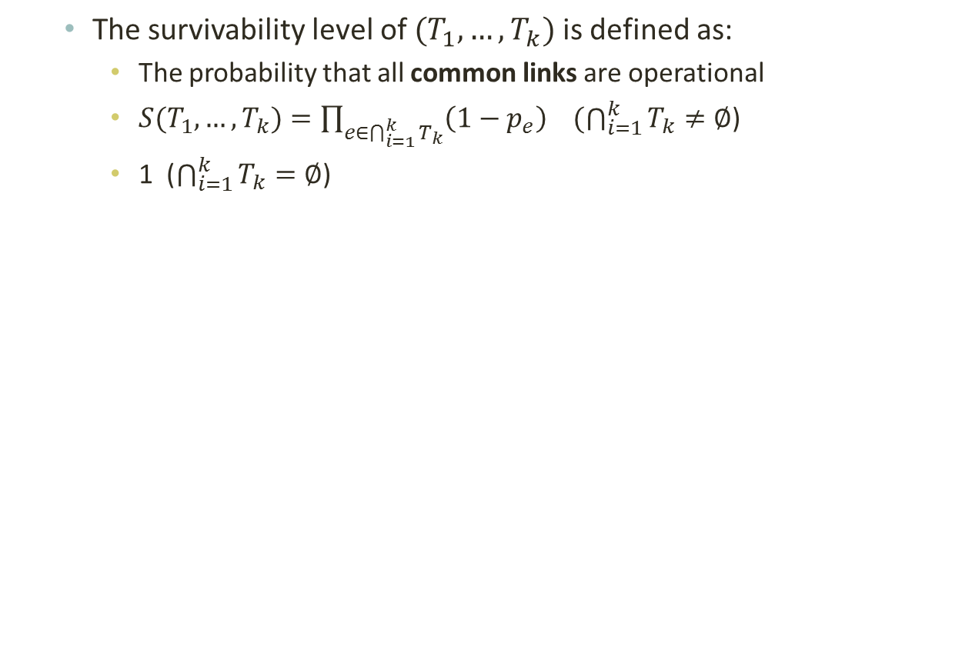


Model Formulation
Formulation
The survivability level of $(T_{1},…,T_{k})$is defined as:
The probability that all common links are operational
$S(T_{1},…,T_{k})=\prod_{e∈\bigcap_{i=1}^{k}{T_{k}}}{\left(1−p_{e}\right)}$ $(\bigcap_{i=1}^{k}{T_{k}}≠∅$)
1 ($\bigcap_{i=1}^{k}{T_{k}}=∅$)
$$T_{1}$$
a
$$S\left(T_{1},T_{2}\right)=1−0.01=(0.99)$$
$$p_{e}=0.01$$
$$p_{e}=0.01$$
$$b_{e}=10$$
$$b_{e}=10$$
$$b_{e}=10$$
$$p_{e}=0.01$$
$$p_{e}=0.01$$
$$p_{e}=0.01$$
b
c
d
$$b_{e}=5$$
$$b_{e}=5$$
$$T_{2}$$
$$p_{e}=0.01$$
$$p_{e}=0.01$$
$$b_{e}=2$$
$b_{e}=1$0
e
Notes:
The survivability level of a k-survivable spanning connection is defined as:
….
Mathematically, it is calculated by the multiplication of the success probability of the common links to all trees in the k-survivable spanning connection tuple.
In case of no such common link the survivability level is defined to 1 by definition.
For example, the previous mentioned 2-survivable spanning connection which contain the common link ab with a failure probability of 0.01 has a survivability level of 0.99

Slide 9
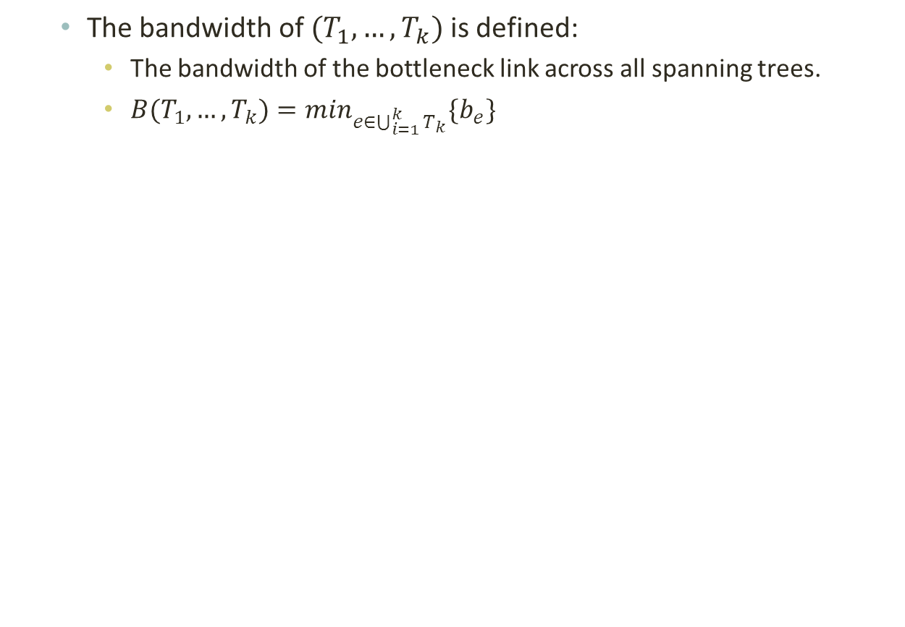


Model Formulation
Formulation
The bandwidth of $(T_{1},…,T_{k})$is defined:
The bandwidth of the bottleneck link across all spanning trees.
${B(T_{1},…,T_{k})=min}_{e∈\bigcup_{i=1}^{k}{T_{k}}}\{b_{e}\}$
$$B\left(T_{1},T_{2}\right)=2$$
$$T_{1}$$
$$S\left(T_{1},T_{2}\right)=0.99$$
a
$$p_{e}=0.01$$
$$p_{e}=0.01$$
$$b_{e}=10$$
$$b_{e}=10$$
$$b_{e}=10$$
$$p_{e}=0.01$$
$$p_{e}=0.01$$
$$p_{e}=0.01$$
b
c
d
$$b_{e}=5$$
$$b_{e}=5$$
$$T_{2}$$
$$p_{e}=0.01$$
$$p_{e}=0.01$$
$$b_{e}=2$$
$b_{e}=1$0
e
Notes:
The bandwidth of a k-survivable spanning connection is defined as:
….
Mathematically, it is calculated by the minimum bandwidth of links that all threes in the tuple (k-survivable spanning connection) covers .
For example, the previous mentioned 2-survivable spanning connection has bandwidth equals to bandwidth of bottleneck link (be) which is 2.

Slide 10
Optimization Problems
Formulation
Constrained Bandwidth Max-Survivability (CBMS) Problem:
Find a k-survivable spanning connection $(T_{1},…,T_{k})$such that:
$$\max{ }S(T_{1},…,T_{k})$$
$$B(T_{1},…,T_{k})≥B_{0}$$
Constrained Survivability Max-Bandwidth (CSMB) Problem:
Find a k-survivable spanning connection $(T_{1},…,T_{k})$such that:
$$\max{ }B(T_{1},…,T_{k})$$
$$S(T_{1},…,T_{k})≥S_{0}$$
Notes:
We are ready to define the following optimization problems:
The first named …. aims to find … maximizes its survivability level and its bandwidth satisfies a B_0 lower bound.
The second named …. aims to find … maximizes its bandwidth and its survivability level satisfies a S_0 lower bound.
Before we present a solutin to the following problems. Lets try to understand the …

Slide 11

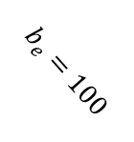
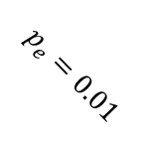

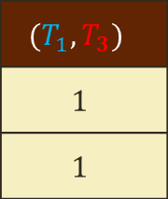
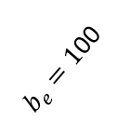
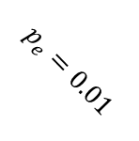
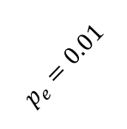
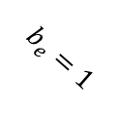

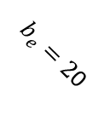

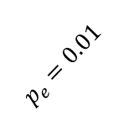
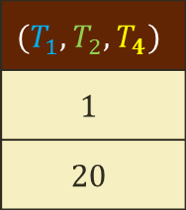




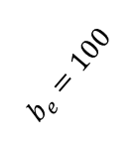
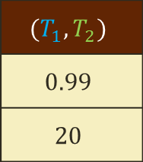
Example
Characterization
$$T_{1}$$
a
$$T_{3}$$
$$p_{e}=0.01$$
$$p_{e}=0.01$$
$$b_{e}=100$$
$$b_{e}=100$$
$$b_{e}=100$$
$$p_{e}=0.01$$
$$b_{e}=1$$
$$p_{e}=0.01$$
$$p_{e}=0.01$$
b
c
d
$$b_{e}=50$$
$$T_{4}$$
$$b_{e}=50$$
$$T_{2}$$
$$p_{e}=0.01$$
$$p_{e}=0.01$$
$b_{e}=2$0
$b_{e}=1$00
e
 |  |  | Survivability
 |  |  | Bandwidth
$$(T_{1},T_{3})$$
$$1$$
$$1$$
$$(T_{1},T_{2})$$
$$0.99$$
$$20$$
$$(T_{1},T_{2},T_{4})$$
$$1$$
$$20$$
Notes:
Lets try to understand the trade-off between the survivability level, the bandwidth and the number of spanning trees. Through the following example.
In case we employ the survivable spanning connection (T1,T3) , we will have a survivability level of 1 since its trees are fully disjoint and a bandwidth of 1 since link ae has a bandwidth of 1.
However, by relaxing a little the survivability requirement to 0.99, the employment of the survivable spanning connection (T1,T2) results in a bandwidth of 20.
-Moreover, the 3-survivable spanning connection (T1,T2,T4) maintains the bandwidth of 20 and improve the survivability level to 1.
-Clearly, for a certain bandwidth requirement employing more spanning trees might increase the survivability level till a maximum survivability level. In this example, we need 3 spanning trees in order to achieve the maximum survivability level.

Slide 12


How Many Spanning Trees?
Characterization
What is the maximum level of survivability which can be achieved for a given a network $G\left(V,E\right)$?
A bridge is a link $e$ whose deletion increases the number of connected components.
$Bridge(G)$ is the set of all bridges in the network.
Theorem: The maximum level of survivability of $G(V,E)$ satisfies $opt\left(G\right)=\prod_{e∈ Bridge\left(G\right)}{\left(1−p_{e}\right) }$.
$Bridge(G)$
Notes:
We proceed to ask some fundamental questions about this maximum survivability level.
First, What is the maximum level of survivability which can be achieved for a given a network?
To answer this question lets define some definitions:
A bridge …
Bridge(G) is the set …
Theorem:…The maximum level of survivability which can be achieved in a network satisfies the multiplication of the success probability of its bridges.

Slide 13
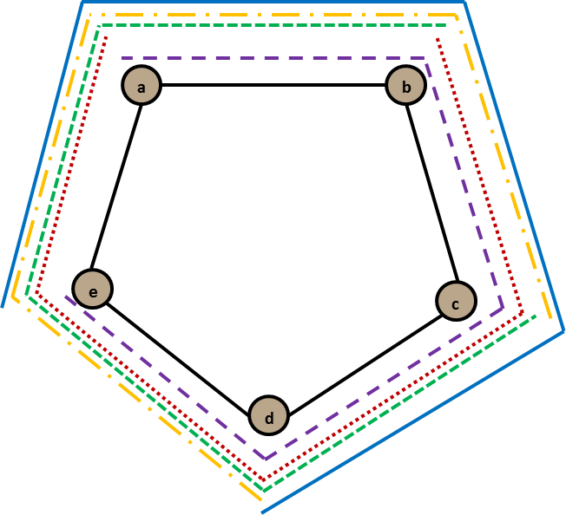
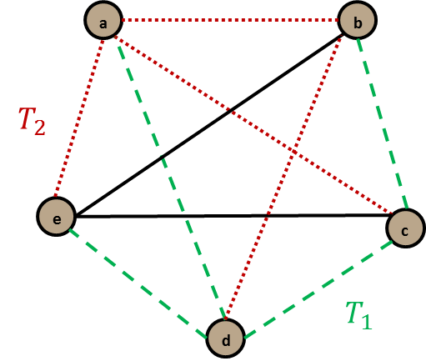

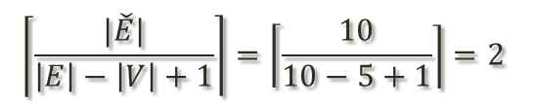

How Many Spanning Trees?
Characterization
How Many Spanning Trees are necessary in order to achieve this maximum level of survivability?
Theorem: Let $\tilde{E}= E∖Bridge(G)$, the number of sufficient spanning trees $φ\left(G\right)$ which satisfies maximum level of survivability is bounded by $\left\lceil \frac{\left|\tilde{E}\right|}{\left|E\right|− \left|V\right|+ 1}\right\rceil ≤φ\left(G\right)≤ |V|.$
$$\left\lceil \frac{|\check{E}|}{\left|E\right|−\left|V\right|+1}\right\rceil =\left\lceil \frac{10}{10−5+1}\right\rceil =2$$
$$|V|=5$$
(b) A clique demonstrating a tight lower bound example
(a) A cycle demonstrating an tight upper bound example
Notes:
You might ask: How many ….
Theorem: By defining E-tilda…
A tight example for the lower bound is a clique …
A tight example for the upper bound is a cycle. Here we have a cycle of 5 nodes and only by establishing the 5 colored (path) trees the maximum survivability level of 1 will be achieved.
Although, the establishment of |V| spanning trees can be very costly, in the continue, we will show through simulations that only few spanning trees are necessary to achieve the maximum survivability level.

Slide 14
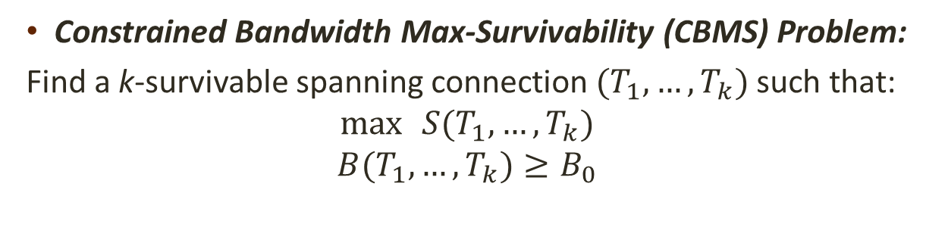
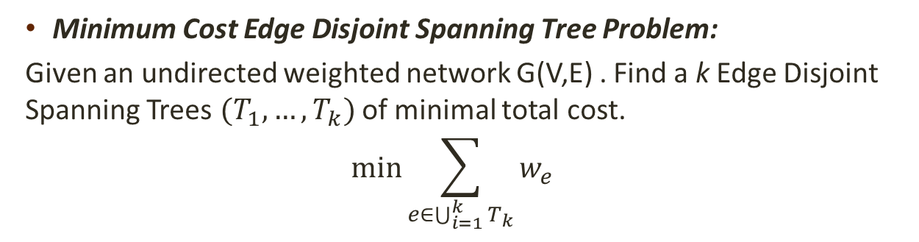
Algorithmic Scheme
Optimization
Constrained Bandwidth Max-Survivability (CBMS) Problem:
Find a k-survivable spanning connection $(T_{1},…,T_{k})$such that:
$$\max{ }S(T_{1},…,T_{k})$$
$$B(T_{1},…,T_{k})≥B_{0}$$
Minimum Cost Edge Disjoint Spanning Tree Problem:
Given an undirected weighted network G(V,E) . Find a k Edge Disjoint Spanning Trees $(T_{1},…,T_{k})$of minimal total cost.
$$\min{\sum_{e∈\bigcup_{i=1}^{k}{T_{k}}}{w_{e}}}$$
Polynomial solution by Roskind and Tarjan –
“A note on finding minimum-cost edge-disjoint spanning trees”, 1985.
Notes:
Backing to our optimization problem:
….
Maximize its survivability level and its bandwidth is lower bounded by some B0 constrained.
We proceed to present polynomial algorithmic solution for solving this problem.
The algorithm is based on a transformation to the minimum cost edge disjoint tree problem.
…., where the cost is defined as the sum of the weights of all links of the trees.
This specific problem has polynomial time solution presented by Roskind and Tarjan at 1985.

Slide 15

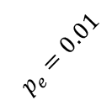
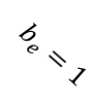
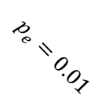

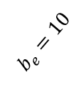

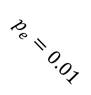

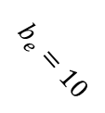

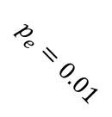
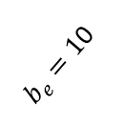
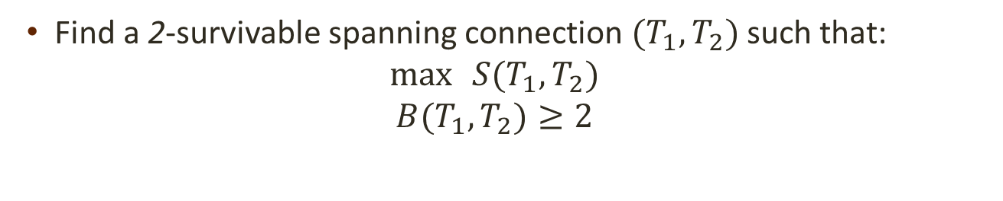

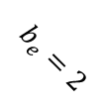
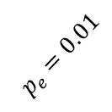
Algorithmic Solution
Optimization
Find a 2-survivable spanning connection $(T_{1},T_{2})$such that:
$$\max{ }S(T_{1},T_{2})$$
$$B(T_{1},T_{2})≥2$$
a
$$p_{e}=0.01$$
$$p_{e}=0.01$$
$$p_{e}=0.01$$
$$b_{e}=10$$
$$b_{e}=10$$
$$b_{e}=10$$
$$p_{e}=0.01$$
$$b_{e}=1$$
$$p_{e}=0.01$$
$$p_{e}=0.01$$
b
$$b_{e}=5$$
c
$$b_{e}=5$$
d
$$p_{e}=0.01$$
$$p_{e}=0.01$$
$$b_{e}=2$$
$b_{e}=1$0
e
Notes:
We will illustrate the algorithm steps by solving the following particular example in which we aim to find a 2-survivable spanning connection whose survivability is maximized and its bandwidth is greater than 2.

Slide 16
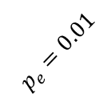
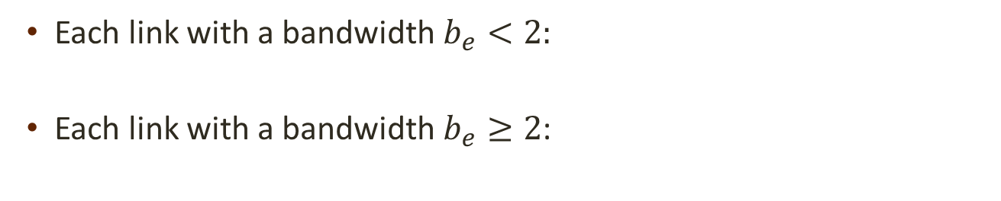
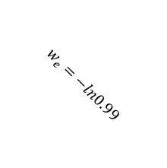
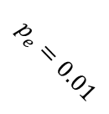

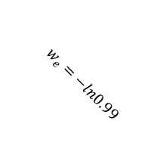
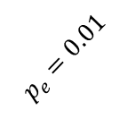
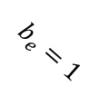






















Algorithmic Solution
Optimization
$$b\text{e} , p\text{e}$$
Each link with a bandwidth $b_{e}<2:$
Each link with a bandwidth $b_{e}≥2$:
Discard the link
$$w_{e_{1}}=−ln(1−p\text{e})$$
$b\text{e} , p\text{e}$
$$w_{e_{2}}=0$$
$$w_{e_{k}}=0$$
Original Network
Auxiliary Network
a
a
$$p_{e}=0.01$$
$$p_{e}=0.01$$
$$w_{e}=−ln0.99$$
$$w_{e}=−ln0.99$$
$$b_{e}=10$$
$$p_{e}=0.01$$
$$w_{e}=−ln0.99$$
$$b_{e}=10$$
$$b_{e}=10$$
$$p_{e}=0.01$$
$$b_{e}=1$$
$$w_{e}=0$$
$$w_{e}=0$$
$$w_{e}=0$$
$$p_{e}=0.01$$
$$p_{e}=0.01$$
$$w_{e}=−ln0.99$$
$$w_{e}=−ln0.99$$
b
$$b_{e}=5$$
c
$$b_{e}=5$$
d
b
c
d
$$w_{e}=0$$
$$w_{e}=0$$
$$p_{e}=0.01$$
$$p_{e}=0.01$$
$$w_{e}=−ln0.99$$
$$w_{e}=−ln0.99$$
$$b_{e}=2$$
$b_{e}=1$0
$$w_{e}=0$$
$$w_{e}=0$$
e
e
Notes:
We begin with the construction of an auxiliary network,
Discarding each link whose does not satisfy the bandwidth requirement of 2.
In our example the link ae is discarded.
Next, in case the link satisfies the bandwidth requirement, we duplicate the link.
The weight of one of them is set to –ln(sucees probability) and the other to 0.

Slide 17
Algorithmic Solution
Optimization
In the Auxiliary Network, find 2 Edge Disjoint Spanning Trees utilizing the minimum cost edge disjoint spanning tree algorithm.
Original Network
Auxiliary Network
a
a
$$p_{e}=0.01$$
$$p_{e}=0.01$$
$$p_{e}=0.01$$
$$w_{e}=−ln0.99$$
$$w_{e}=−ln0.99$$
$$b_{e}=10$$
$$b_{e}=10$$
$$p_{e}=0.01$$
$$b_{e}=1$$
$$w_{e}=−ln0.99$$
$$b_{e}=10$$
$$w_{e}=0$$
$$w_{e}=0$$
$$w_{e}=0$$
$$p_{e}=0.01$$
$$p_{e}=0.01$$
$$w_{e}=−ln0.99$$
$$w_{e}=−ln0.99$$
b
$$b_{e}=5$$
c
$$b_{e}=5$$
d
b
c
d
$$w_{e}=0$$
$$w_{e}=0$$
$$p_{e}=0.01$$
$$p_{e}=0.01$$
$$w_{e}=−ln0.99$$
$$w_{e}=−ln0.99$$
$$b_{e}=2$$
$b_{e}=1$0
$$w_{e}=0$$
$$w_{e}=0$$
e
e
Notes:
Now, given the auxiliary graph, we found 2 minimum cost edge disjoint spanning trees according to tarjan algotithm.
Such as the following edge disjoint spanning trees.
From these trees, we can derive the survivable spanning connection in the original network.

Slide 18



Simulation
Simulation
$opt_{B_{0}}\left(k\right)$- maximum survivability level that can be obtained by a $k$-survivable spanning connection $\left(T_{1},…,T_{k}\right)$ with a bandwidth requirement of $B_{0}$
$opt_{B_{0}}$- maximum survivability level of the network with a bandwidth requirement of $B_{0}$
$Survivability Ratio_{B_{0}} (k)=\frac{opt_{B0}\left(k\right)}{opt_{B_{0}}}$
$$k$$
Maximum survivability level ratio versus the number of spanning trees k for different bandwidth requirements
Notes:
We perform simulation in 2 well-known random topologies, namely waxman and power-law.
We first check the effect of the number of spanning trees on the survivability level for different bandwidth constraints.
-For this purpose we define the survivability ratio as the ratio between
….
-Consequently, we check the survivability ratio as a function of the number k of spanning trees for different bandwidth constraint values.
-From the graph we can conclude that:
1) a 2-spanning connection supply a high survivability level. (at the worst case 0.993)
2) 4 spanning trees are enough to achieve the maximum level of survivability for all cases.
-Although we have a high upper bound (as the number of nodes in the graph), in practice, is enough to employ only a few spanning trees.

Slide 19



Simulation
Simulation
$B(S_{0})$- maximum bandwidth of a $2$-survivable spanning connection with a survivability level of at least $S_{0}$
$B(1)$ - maximum bandwidth of a fully disjoint spanning connection
$Bandwidth Ratio\left(S_{0}\right)=\frac{B\left(S_{0}\right)}{B\left(1\right)}$
X12 times improvement
$$S_{0}$$
Bandwidth ratio versus the survivability level requirement
Notes:
Given that 2-spanning trees result in close to optimal solution, we proceed to check the effect of the survivability level constraint on the bandwidth of a 2-survivable spanning connection.
For this purpose, we define the bandwidth ratio as the ratio between
B(S0)-…
B(1)-…
Consequently, we check the bandwidth ratio as a function of the survivability level constraint for 2 simulated topologies.
By slightly alleviating the survivability requirement, a major improvement of (12 times) on the bandwidth ratio can be achieved.

Slide 20
Conclusion
Conclusion
The establishment of a comprehensive methodology for efficiently providing tunable survivability.
Ron Banner and Ariel Orda. “The power of tuning: A novel approach for the efficient design of survivable networks”. In IEEE/ACM Trans. Networking, 2007.
Jose Yallouz and Ariel Orda. “Tunable QoS-aware network survivability”. In IEEE Infocom, 2013.
Jose Yallouz, Ori Rottenstreich and Ariel Orda. “Tunable Survivable Spanning Trees”. In ACM Sigmetrics, 2014.
Notes:
We see this work as continuity of our effort to establish ….
An effort which results in the following publications:
…
Finally, I hope I have whet your appetite to read our paper.

Slide 21

Thank You!
Question?
Introduction
Optimization
Motivation
Characterization
Formulation
Simulation

