Slide 1

HCLTech
| Supercharging Progress™
DUPE Desarrollos Inmobiliarios
Agentic Business Platform
Multi-agent architecture and ROM estimate
ROM ESTIMATE
14–18
pod days · ~7–8 elapsed weeks
3-role agentic pod · MVP Solution
Jose Paulino · Senior AI Solution Architect, HCLTech AI Labs · June 2026 · CONFIDENTIAL
Copyright © 2026 HCLTech | Confidential
HCLTech

Slide 2
HCLTech
| Supercharging Progress™
The Opportunity
Two modules. One agentic platform. Zero manual chasing.
"We manage everything in Excel — budgets, cash flow, collections — and there is no real-time visibility into our projects."
Problem Today
Agentic Approach
Value Delivered
◆ Budget & cash flow tracked in disconnected Excel workbooks
◆ Orchestrator coordinates Finance + Collections modules end-to-end
◆ Officer time freed from manual data entry to exception review only
◆ Bank reconciliation is 100% manual — transactions assigned by hand
◆ Reconciliation Agent auto-matches bank transactions with rule learning
◆ 90%+ transaction auto-match target from learned reconciliation rules
◆ Collections officers track due dates individually and send messages manually
◆ Collections Notification Agent dispatches WhatsApp + email on schedule
◆ Zero missed payment reminders — every installment tracked automatically
◆ No automated delinquency escalation to management or legal
◆ Escalation logic at Day +1, +6, and +16 overdue — no manual tracking
◆ Management notified before portfolio health deteriorates
◆ Weekly management report compiled manually from multiple spreadsheets
◆ Reporting Agent compiles and sends weekly PDF report automatically
◆ Real-time executive dashboard replaces end-of-week report compilation
User Story
As a DUPE finance officer, I want the system to reconcile bank transactions and send payment reminders automatically so that I can focus on exceptions and client relationships.
2
Copyright © 2026 HCLTech | Confidential
HCLTech

Slide 3
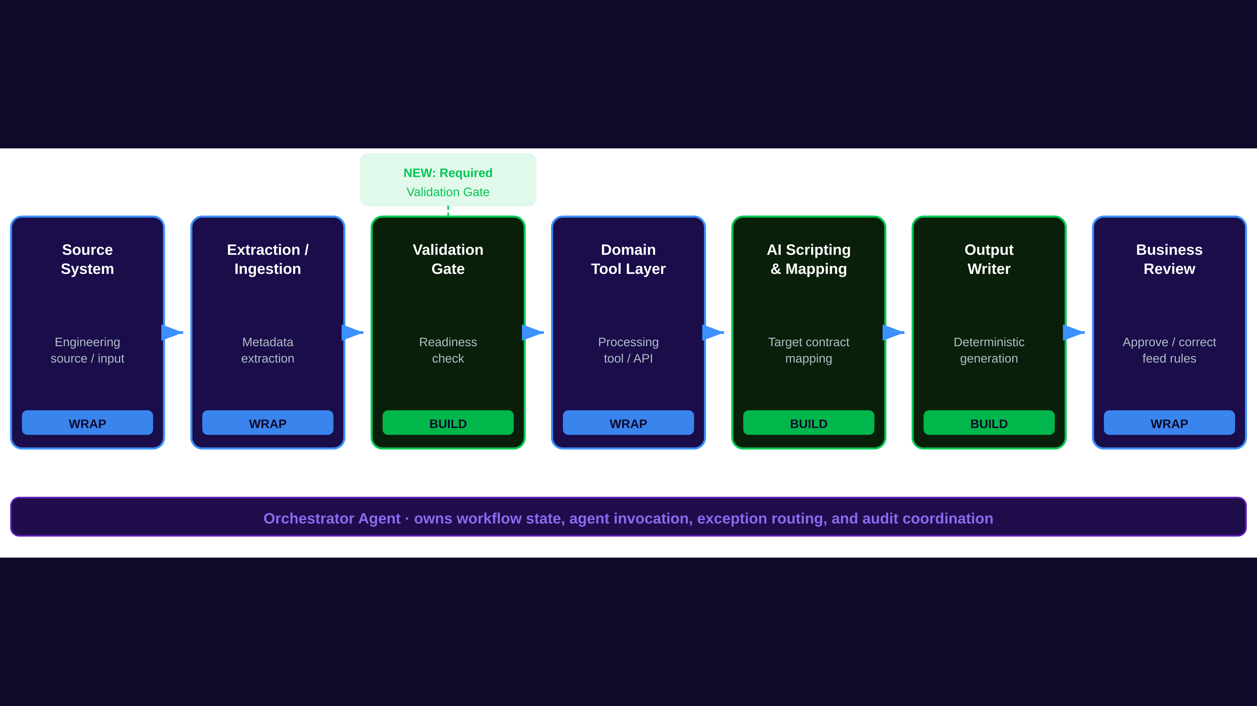
HCLTech
| Supercharging Progress™
End-to-End Process Flow
From source to business output — build vs. wrap boundaries
3
Copyright © 2026 HCLTech | Confidential
HCLTech

Slide 4
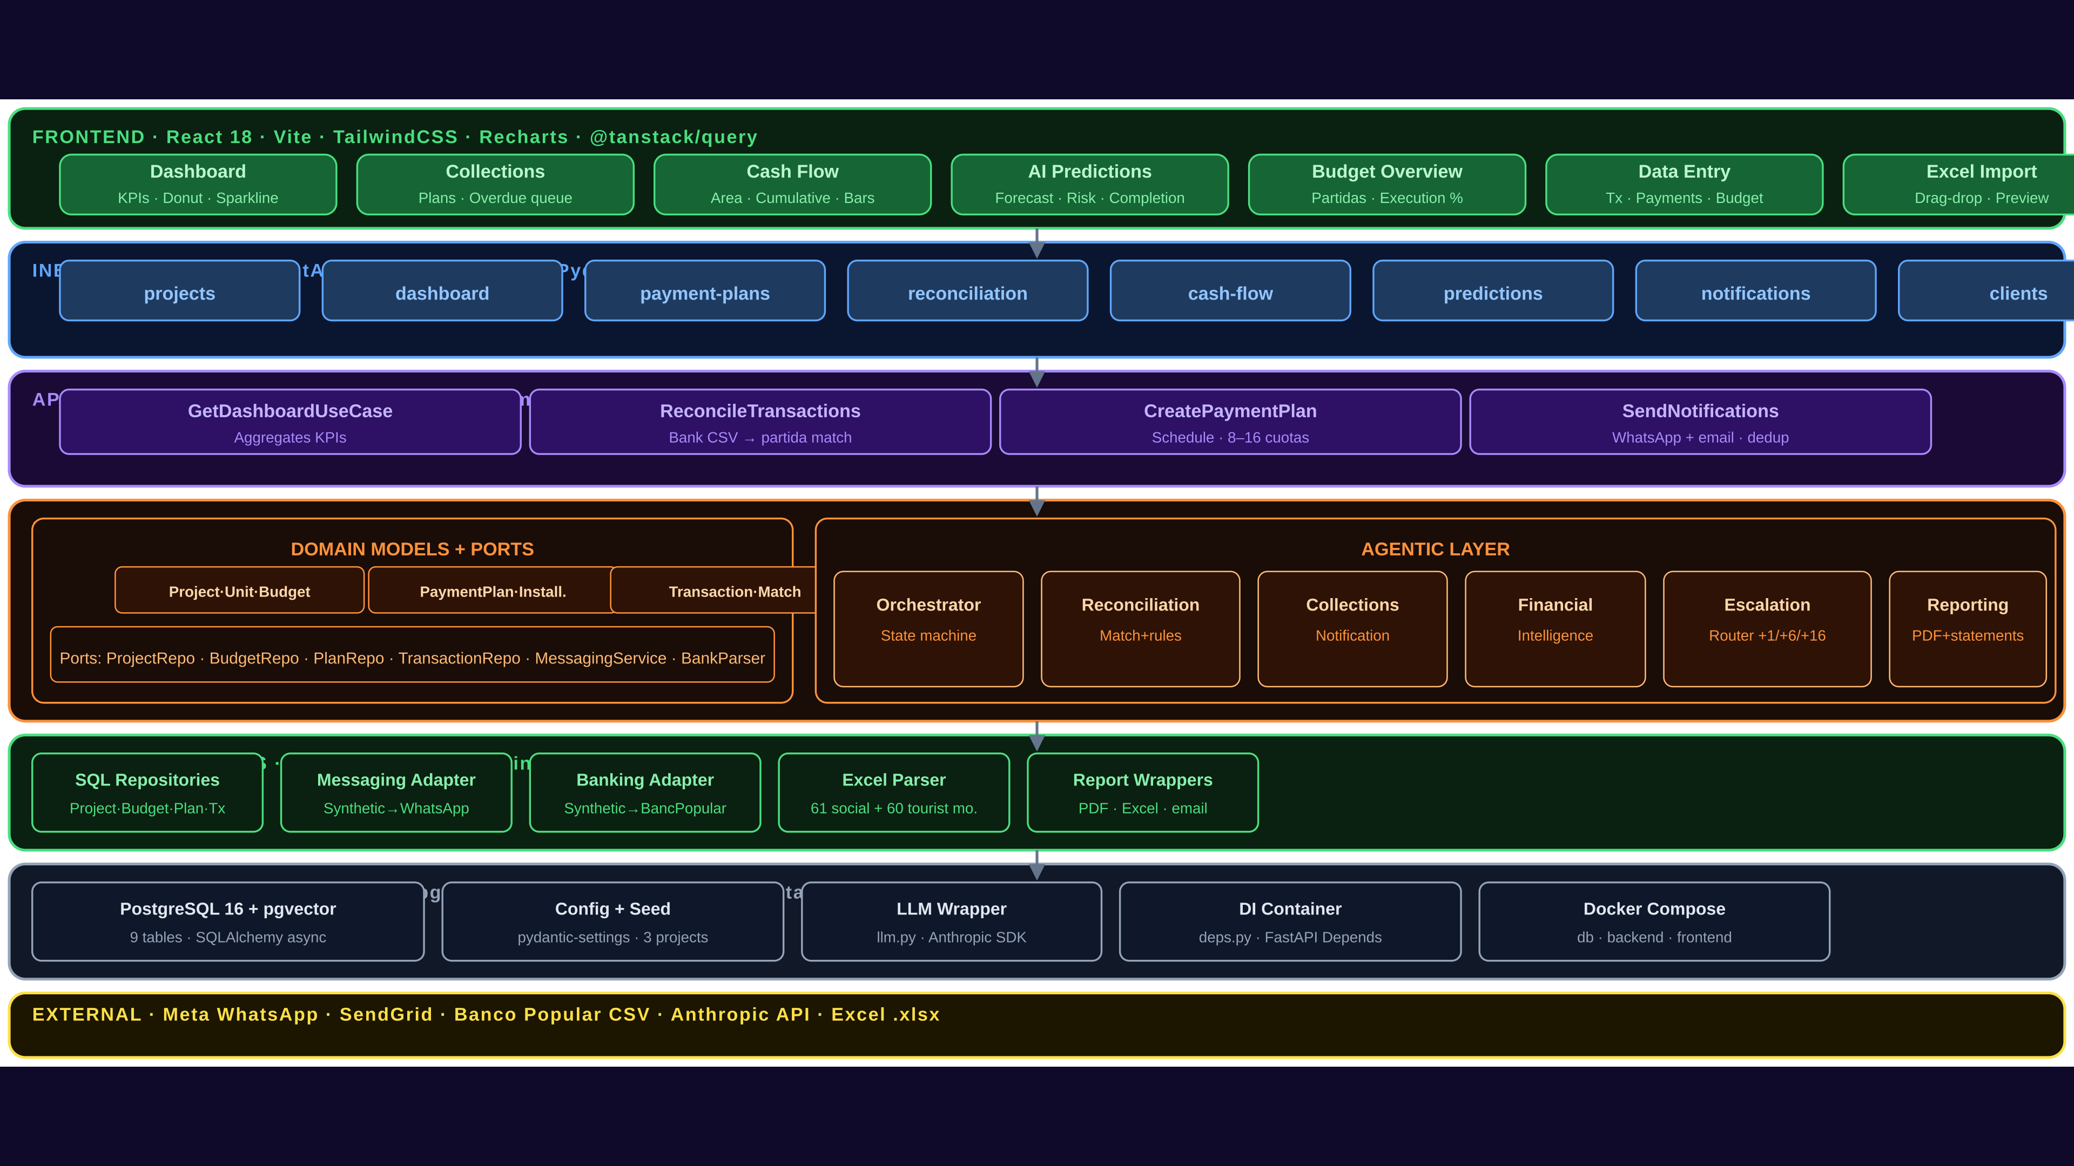
HCLTech
| Supercharging Progress™
Platform Architecture
7-layer hexagonal design — domain isolated from frameworks and databases
4
Copyright © 2026 HCLTech | Confidential
HCLTech

Slide 5
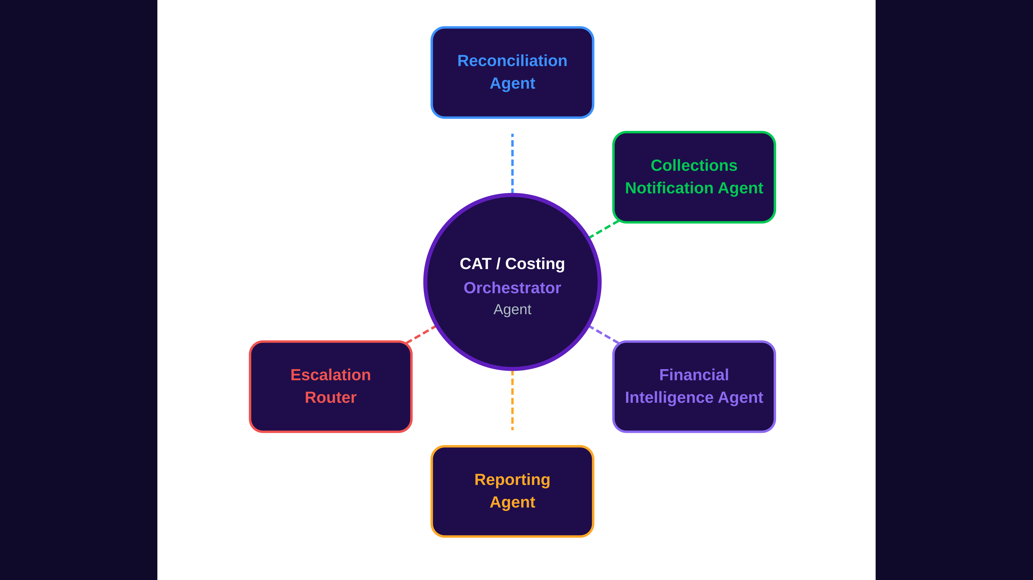
HCLTech
| Supercharging Progress™
Multi-Agent Orchestration Model
Specialist agents invoked as callable tools by the Orchestrator
Agent Responsibilities
Reconciliation Agent
Auto-matches bank transactions to budget partidas; scores confidence; builds rule store from officer-accepted matches
Collections Notification Agent
Scans payment plans daily; dispatches WhatsApp + email notifications; captures delivery status and client replies
Financial Intelligence Agent
Monitors budget execution vs. projected; computes deviation metrics; raises traffic-light alerts on dashboard
Reporting Agent
Compiles weekly management PDF report; generates Balance General, Estado de Resultados, Flujo de Efectivo on demand
Escalation Router
Triggers officer dashboard alerts at Day +1, management notifications at Day +6, legal referral flag at Day +16 overdue
5
Copyright © 2026 HCLTech | Confidential
HCLTech

Slide 6
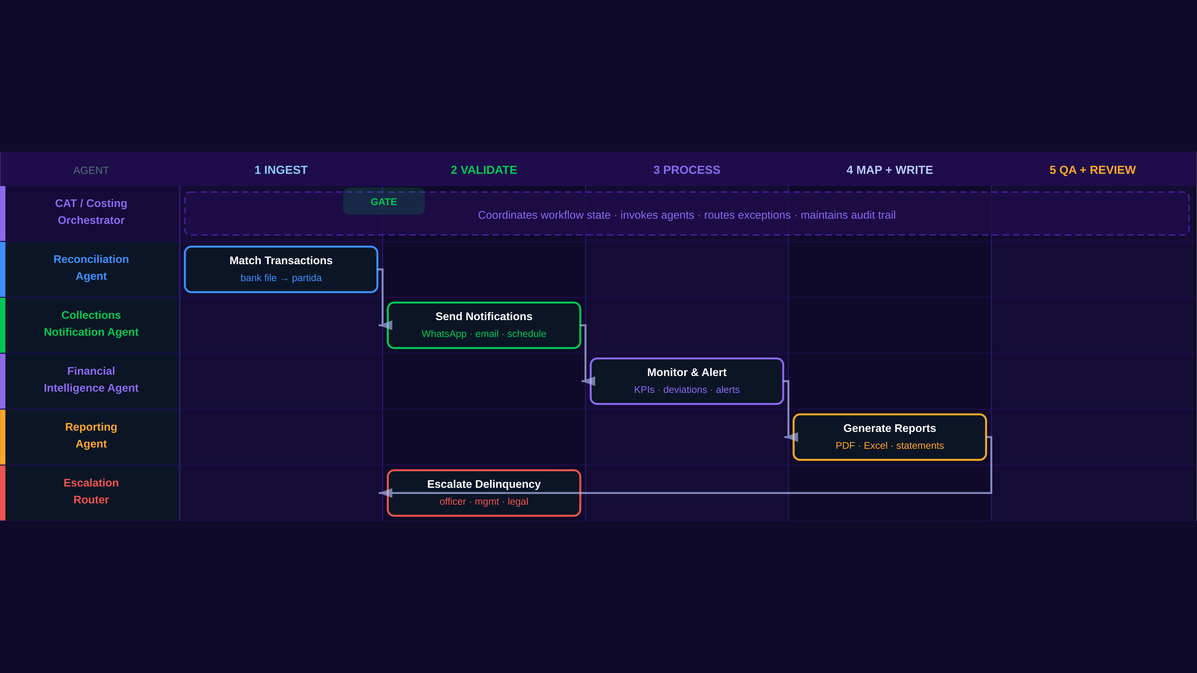
HCLTech
| Supercharging Progress™
Agentic Architecture — Data Flow
Each specialist agent operates in its lane; artifacts hand off through the Orchestrator
5
Copyright © 2026 HCLTech | Confidential
HCLTech

Slide 7
HCLTech
| Supercharging Progress™
Specialist Agent Responsibilities
Each agent has a defined role, bounded tools, and structured output schema
Agent
Role / Purpose
Primary Outputs
Agentic
Orchestrator
Owns workflow state for both modules; routes events to specialist agents; manages exception queues and audit trail.
State transitions, agent schedule, exception routing, audit log.
Reconciliation
Agent
Parses uploaded bank statement files; scores transaction-to-partida match confidence; routes low-confidence items to officer queue; learns from officer decisions.
Match decisions, exception queue, updated rule store.
Collections
Notification Agent
Reads payment plan schedules daily; determines which notifications are due (pre-due, overdue); dispatches WhatsApp + email; logs delivery and read status.
Sent notifications, delivery receipts, two-way message log.
Financial
Intelligence Agent
Compares executed spend and income vs. projected budget and cash flow; computes deviation metrics; assigns traffic-light status per partida.
Dashboard KPIs, partida alerts, deficit forecasts, milestone alerts.
Escalation
Router
Monitors overdue installment age; triggers escalation at defined thresholds: officer dashboard (Day +1), management notification (Day +6), legal flag (Day +16).
Escalation events, management alerts, legal referral flags.
Reporting
Agent
Assembles financial statements and weekly management report from structured data; formats and dispatches PDF on schedule or on demand.
Weekly PDF report, Balance General, Estado de Resultados, Flujo de Efectivo.
6
Copyright © 2026 HCLTech | Confidential
HCLTech

Slide 8
HCLTech
| Supercharging Progress™
Required Validation Step
Replace this slide with engagement-specific content
[ Deep-dive diagram for: Required Validation Step ]
Adapt this slide with the specific SVG diagram or content for your engagement.
See references/deck-structure.md for what each slide should contain.
7
Copyright © 2026 HCLTech | Confidential
HCLTech

Slide 9
HCLTech
| Supercharging Progress™
Should Costing Tool Adapter Layer
Replace this slide with engagement-specific content
[ Deep-dive diagram for: Should Costing Tool Adapter Layer ]
Adapt this slide with the specific SVG diagram or content for your engagement.
See references/deck-structure.md for what each slide should contain.
8
Copyright © 2026 HCLTech | Confidential
HCLTech

Slide 10
HCLTech
| Supercharging Progress™
AI Scripting, Mapping, and Output
Replace this slide with engagement-specific content
[ Deep-dive diagram for: AI Scripting, Mapping, and Output ]
Adapt this slide with the specific SVG diagram or content for your engagement.
See references/deck-structure.md for what each slide should contain.
9
Copyright © 2026 HCLTech | Confidential
HCLTech

Slide 11
HCLTech
| Supercharging Progress™
Controlled Orchestration Workflow
Replace this slide with engagement-specific content
[ Deep-dive diagram for: Controlled Orchestration Workflow ]
Adapt this slide with the specific SVG diagram or content for your engagement.
See references/deck-structure.md for what each slide should contain.
10
Copyright © 2026 HCLTech | Confidential
HCLTech

Slide 12
HCLTech
| Supercharging Progress™
Build vs. Wrap — Scope Boundary
HCLTech builds the agentic control layer; enterprise tools are wrapped
BUILD — HCLTech Develops
WRAP — Orchestrated via Tool Adapters
◆ Agentic Orchestrator
◆ WhatsApp Business API (Meta Cloud)
◆ Reconciliation Agent + Rule Store
◆ Transactional Email (SendGrid)
◆ Collections Notification Agent
◆ Bank netbanking (manual CSV/TXT upload)
◆ Financial Intelligence Agent
◆ PDF / Excel generation libraries
◆ Escalation Router
◆ DR bank statement file formats
◆ Reporting Agent
◆ Bank Statement Parser (deterministic)
◆ Multi-tenant PostgreSQL data store
HCLTech builds this boundary →
← These are orchestrated, not replaced
◆ Role-based dashboards (officer + management)
11
◆ Audit / lineage store
HCLTech
Copyright © 2026 HCLTech | Confidential

Slide 13
HCLTech
| Supercharging Progress™
ROM Estimate — MVP Solution
14–18 pod days · ~7–8 elapsed weeks · 3-role agentic pod
14–18
~7–8
3-role
+3–5 pod days
Full Pod Days
Elapsed Weeks
Agentic Pod
If Complexity Triggered
Workstream
Weight
Gravel track — environment, schema, CI/CD
Medium
Financial Module — budget, cash flow, reconciliation, accounting
High
Collections Module — payment plans, notifications, escalation
High
Dashboards — officer queue, mgmt portal, financial statements
High
Integration wrappers — bank parser, WhatsApp, email, PDF/Excel
Medium
Validation, testing, SME review, demo hardening
High
Recommended MVP Baseline
14–18 full pod days
ROM basis: one bounded MVP Solution path · agentic pod commercial unit · not a production commitment
12
Copyright © 2026 HCLTech | Confidential
HCLTech

Slide 14
HCLTech
| Supercharging Progress™
Assumptions and Decisions Needed
Items to confirm before MVP Solution sprint planning begins
Key Assumptions
Decisions Needed
✔ Bank statements available as CSV/TXT download from DR netbanking
◆ Provide sample bank statement file (actual format) — Day 1 requirement
✔ Single WhatsApp Business number used across all projects (recommended)
◆ Register WhatsApp Business Account with Meta — initiate immediately
✔ Email sent from shared domain (cobros@dupedesa.com) via SendGrid
◆ Confirm project type scope: social interest only, or tourist too in MVP?
✔ Chart of accounts defined by HCLTech; approved by management in Week 1
◆ Confirm whether legal firm notification is automated or manual flag
✔ MVP scoped to social interest project type (RD$); tourist type in Pilot
◆ Name DUPE product owner, collections officer SME, and management sponsor
✔ Physical construction progress entered manually as % milestone completion
◆ Confirm cloud environment (HCLTech-provisioned VPS vs. DUPE cloud account)
Next Step: Confirm scope and engagement classification · Name the agentic pod · Schedule kick-off · Jose Paulino · Senior AI Solution Architect, HCLTech AI Labs
14
Copyright © 2026 HCLTech | Confidential
HCLTech

