Slide 1

HCLTech
| AI Labs · Cloud Native · Supercharging Progress™
Boeing
AI Adoption Advisory
Partnership Engagement Proposal
Your investments in Claude, Gemini, Amazon Q, and Amazon Kero are the foundation.
HCLTech AI Labs provides the advisory layer, agentic orchestration, and governance to put them into production.
Jose Paulino · Senior AI Solution Architect, AI Labs & Cloud Native · June 2026 · CONFIDENTIAL
Copyright © 2026 HCLTech | Confidential
HCLTech

Slide 2
HCLTech
| Supercharging Progress™
The Starting Point
Boeing has the tools. The gap is adoption at scale — and a structured path to production.
"Begin creating SOPs and Agents leveraging current investments to drive AI adoption." — Boeing EAID Leadership
Where Boeing Is Today
Where the Gap Is
What HCLTech Brings
◆ Active AI investments: Claude, Gemini, Amazon Q, Amazon Kero
◆ AI tools operating in silos — no coordinated workflow
◆ Advisory-led adoption path across four phases
◆ EAID team driving AI adoption across enterprise
◆ No structured AI adoption path or maturity baseline
◆ Agentic orchestration over your existing AI tools
◆ Use cases identified but not yet in production
◆ Governance and responsible AI controls not yet embedded
◆ Responsible AI and governance from Day 1
◆ No unified agentic orchestration layer
◆ Use case prioritisation not formally scoped
◆ Targeted first use case to prove value fast
◆ SOPs and agent workflows yet to be formalised
◆ No agentic pod delivering durable, production-ready code
◆ Reusable patterns that compound with each cycle
2
Copyright © 2026 HCLTech | Confidential
HCLTech

Slide 3
HCLTech
| Supercharging Progress™
Advisory Lifecycle — Designed for Boeing
Each phase closes with something running in your environment, not just a deck describing it.
01
Assess & Align
02
Govern & Architect
03
Build & Accelerate
04
Scale & Operate
Day 0–30
Day 30–60
Day 60–90
Day 90+
› AI maturity baseline across 6 dimensions
› Responsible AI framework and policy spine
› Fixed-scope Gold PoC on targeted use case
› Enterprise agent rollout via additional pods
› Use case prioritisation (value × feasibility)
›
› Agentic orchestration architecture blueprint
›
› Agentic Engineering Pod (3-role delivery)
›
› Continuous governance KPIs and model health
› Existing tool inventory and gap analysis
› Office of AI operating model
› Governance controls embedded from Day 1
› IP reuse: patterns, agents, evals across LOBs
› Quick-wins lane + strategic bets roadmap
› Integration design with Claude, Gemini, Amazon Q
› ROI baseline and capability handover
› Platform economics fall with every cycle
OUTPUT
OUTPUT
OUTPUT
OUTPUT
Maturity scorecard · Use case backlog · Roadmap
RAI policy · Architecture blueprint · Operating model
Working agentic system · ROI baseline · Handover
Digital workforce · KPI dashboard · Pattern library
Maturity Journey: 1 · Experimenting (isolated pilots) → 2 · Industrialising (shared platform, measurable ROI) → 3 · AI-native (embedded in operating model)
3
Copyright © 2026 HCLTech | Confidential
HCLTech

Slide 4
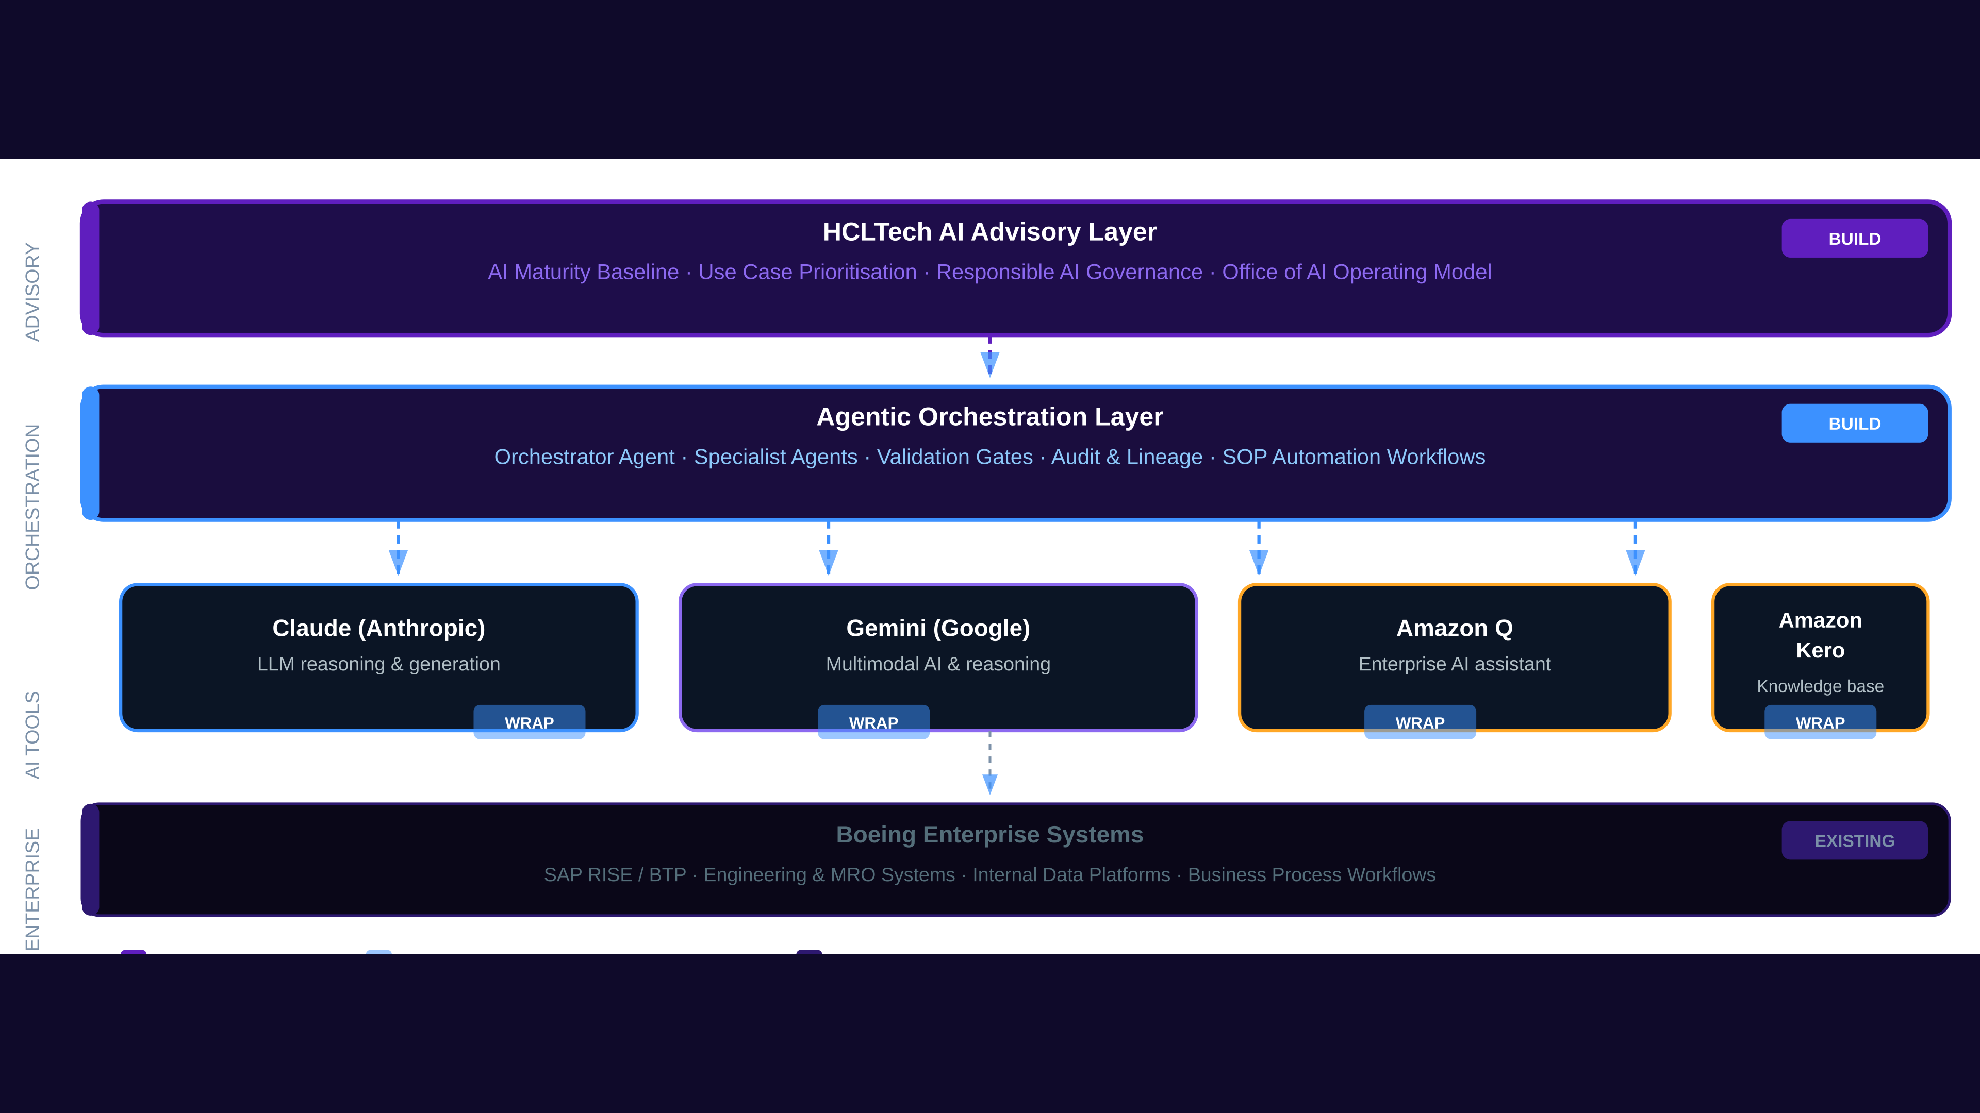
HCLTech
| Supercharging Progress™
Your AI Stack — Our Agentic Advisory Layer
HCLTech orchestrates your existing investments. We build the layer above, not on top of it.
4
Copyright © 2026 HCLTech | Confidential
HCLTech

Slide 5
HCLTech
| Supercharging Progress™
How We Start — Targeted First Use Case
One agentic workflow. Proven on real data. Foot in the door.
How We Choose the Right Use Case
Delivery Model — Gold PoC
Technically Attainable
Gold PoC — 5 Pod Days
Feasible with your current AI tools — no new platform required
› 5 days · timeboxed · secure sandbox environment
› Representative synthetic or demo data
Administratively Clear
› Executive-ready demo + recording at end
No hidden policies, security blockers, or compliance unknowns
› MVP approval pack with build plan if success
Measurable Value
3-Role Agentic Pod
Clear before/after metric — time saved, errors reduced, throughput
Context Architect
Outcome, constraints, solution shape
Reusable Pattern
Value Engineer
First use case produces a pattern we replicate across the estate
Orchestration, agent direction, delivery
Quality Engineer
Validation, safety, release confidence
ROM: 5 pod days (Gold PoC) → MVP Solution: 10–14 pod days over ~5–6 elapsed weeks if PoC succeeds
5
Copyright © 2026 HCLTech | Confidential
HCLTech

Slide 6
HCLTech
| Supercharging Progress™
Six Advisory Services Available to Boeing
Enter at any phase. Each service compounds the one before it.
01
Journey to Production
02
Agentic Engineering
03
AI Transformation Advisory
PoC to MVP to first production deployment. Working agentic system in Boeing's environment with ROI baseline and handover.
Agent architecture design and implementation. 3-role agentic pod ships working code every two weeks on Boeing use cases.
Operating-model strategy across the enterprise. Role redesign and change management blueprint for Boeing's digital workforce.
Phase: All phases
Phase: Build & Accelerate · Scale & Operate
Phase: Assess & Align · Scale & Operate
04
Office of AI
05
Red Teaming
06
RAI Advisory
Lean central AI CoE, governance, and operating model. Portfolio governance, intake process, and decision rights framework.
AI risk and adversarial testing. Vulnerability findings, severity classification, and remediation roadmap with go/no-go gates.
Ethics, compliance, and guardrails. RAI policy, EU AI Act posture, audit framework embedded from Day 1 — not bolted on.
Phase: Govern & Architect · Scale & Operate
Phase: Govern & Architect · Scale & Operate
Phase: All phases (standing capability)
6
Copyright © 2026 HCLTech | Confidential
HCLTech

Slide 7
HCLTech
| Supercharging Progress™
Next Steps — Let's Help You Help Boeing
We are ready to move. Here is what we need to get started.
What We Need From Boeing
Proposed Timeline
1. Identify 1–2 candidate use cases from the EAID team backlog
Week 1
Use Case Workshop
30–60 min: select one use case, confirm data, name the team
2. Confirm relevant Boeing AI tools per use case (Claude / Gemini / Amazon Q / Kero)
Week 2
Architecture Alignment
3. Name a Boeing product owner, technical owner, and business SME for the PoC
Share draft orchestration architecture and get Boeing sign-off
4. Confirm any data governance, security, or clearance constraints
Week 3–4
Gold PoC Sprint
5 pod days in secure sandbox — build, demo, handover
5. Provide representative sample data or synthetic equivalent for the PoC sandbox
Week 5–6
MVP Decision Gate
6. Agree on success criteria and acceptance definition before Day 1
PoC debrief → go/no-go for MVP Solution (10–14 pod days)
Start the conversation: Half-day Executive Briefing · 2-Week Maturity Assessment · 30-Day Use Case Discovery
7
Copyright © 2026 HCLTech | Confidential
HCLTech

