Slide 1
Data Science Capstone project
<José Cáceres>
<27/08/2021>

Slide 2

Outline
Executive Summary
Introduction
Methodology
Results
Conclusion
Appendix

Slide 3










Executive Summary
This project consists of the prediction of the successful landing of stage 1 on the Falcon 9 rocket.
One of the main reasons why the launch costs of the Space X company are lower than the rest is due to the correct landing of stage 1 of its rockets. This strategy allows a cost reduction of up to 100 million dollars.
In order to predict the successful landing of stage 1 of the falcon 9 rocket, the first step is the collection, cleaning and organization of data, followed by different visualizations that allow a deeper understanding of the data.
Finally, a machine learning model is developed capable of performing the task of predicting the success or otherwise of the landing of stage 1 of the rockets.
That is why it is of the utmost importance for the company to be able to determine whether the landing of phase one of the rockets will end in success or failure.

Slide 4

Introduction
The costs of rocket launches are extremely high in part due to the loss of the stage 1 of the rockets.
The costs of the spaceX Falcon 9 rocket launches are considerably lower than the rest because they can recover stage 1 of the rockets.
In order to keep the costs of rocket launches low, it is important to be able to predict the success of the Falcon 9 stage 1 rocket landing.

Slide 5

Methodology
Perform data wrangling
Describe how data were processed
Perform exploratory data analysis (EDA) using visualization and SQL
Perform interactive visual analytics using Folium and Plotly Dash
Perform predictive analysis using classification models
How to build, tune, evaluate classification models

Slide 6
Methodology

Slide 7
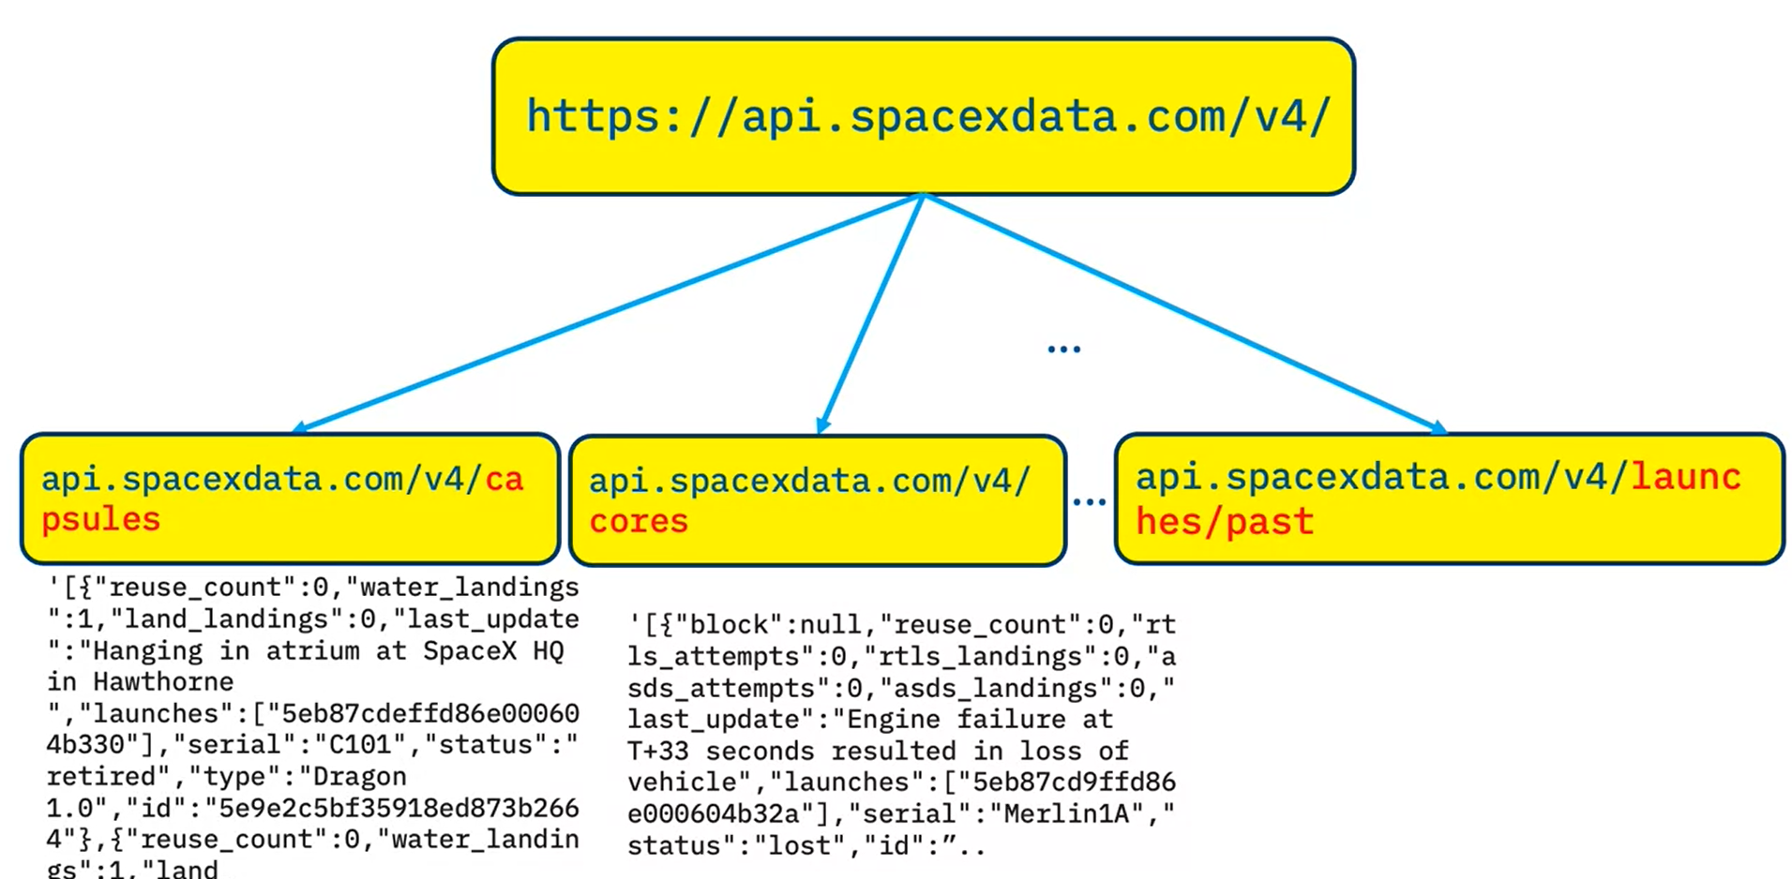
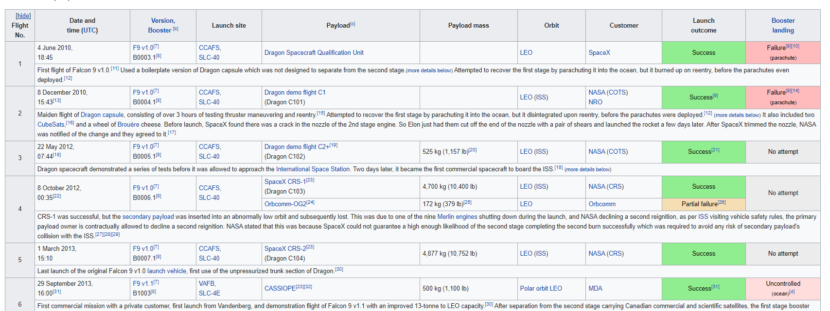
Data collection
The information used for this project corresponds to the data obtained from the SpaceX API together with the Wikipedia data on the falcon 9 launches collected using the WebScrapping method.

Slide 8
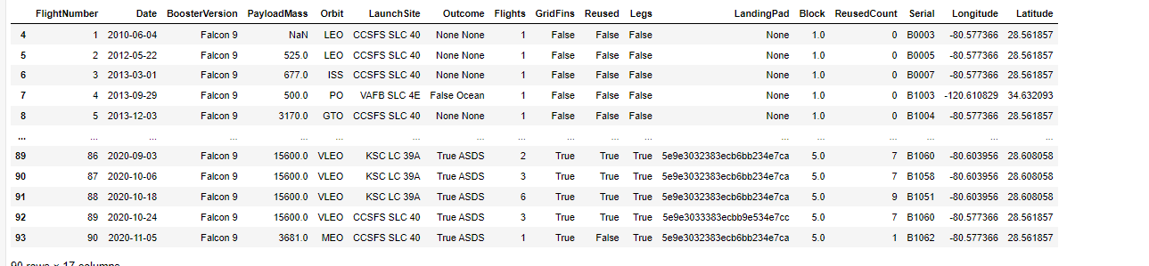
Data collection – SpaceX API
Information and details on Falcon 9 rocket launches are obtained from the SpaceX API.
As seen in the figure, this api contains multiple endpoints that provide different information about Falcon 9 launches, using the beautifulsoup and python requests libraries it is possible to extract this data and structure it for later analysis.
Finally, the data obtained from the API corresponds to: booster name, the mass of the payload, the orbit that it is going to, the name of the launch site and its position, the outcome of the landing, the type of the landing, number of flights and the core information.
https://github.com/joseMCV/space-y/blob/e289e099c77fd5a5aba82732517da419df227843/space_y_api.ipynb

Slide 9
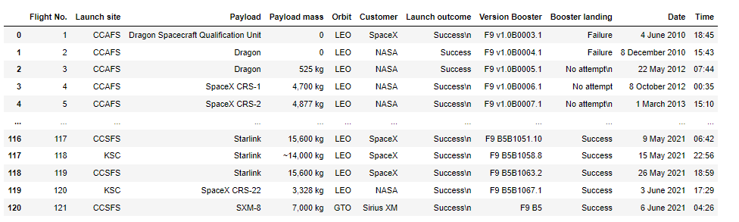
Data collection – Web scraping
To extract the data from wikipedia, first the raw page must be read, for this the python requests library is used, once the page has been read, BeautifulSoup is used to find the specific information that is required from this page.
requested corresponds to the following: Flight number, date and time, place of launch, payload, orbit to which the launch is directed, client and final status of the operation (success or failure)
https://github.com/joseMCV/space-y/blob/e289e099c77fd5a5aba82732517da419df227843/space_y_webscrapping.ipynb

Slide 10
Data wrangling
To make the prediction about the success or failure of the Falcon 9 rocket stage 1 landing, it is important to label the data, that is, to be able to determine if the rocket stage 1 landed successfully or not.
In this stage, different columns of the data were analyzed to understand the relevance of each one with respect to the final objective of the mission, that is, how each column affects the success in the landing of stage 1.
https://github.com/joseMCV/space-y/blob/e289e099c77fd5a5aba82732517da419df227843/space_y_wrangling.ipynb

Slide 11
EDA with data visualization
The first visualizations generated correspond to scatter graphics, this is to visualize the relationships between the different variables, the relationships plotted were:
FlightNumber vs. PayloadMass.
FlightNumber vs LaunchSite.
LaunchSites vd PayloadMass.
FlightNumber and Orbit type.
Payload vs. Orbit type.
It should be noted that all the visualizations are contrasted with the success or not of the landing, so thanks to these it can be determined whether the graphed variables influence the success of the launch.
https://github.com/joseMCV/space-y/blob/e289e099c77fd5a5aba82732517da419df227843/space_y_visualizationseda.ipynb

Slide 12
EDA with data visualization
After making the scatter graphs, a line graph was made to determine the behavior of the success of the launches over time, from this graph it appears that since 2013, the success in the landings of stage 1 of the Falcon 9 have been increasing.
https://github.com/joseMCV/space-y/blob/e289e099c77fd5a5aba82732517da419df227843/space_y_visualizationseda.ipynb

Slide 13
EDA with SQL
To obtain relevant information on the data, various SQL queries listed below were performed:
SELECT DISTINCT LAUNCH_SITE FROM SPACEXTBL
SELECT * FROM SPACEXTBL WHERE LAUNCH_SITE LIKE 'CCA%’ LIMIT 5
SELECT customer, SUM(payload_mass__kg_) as total_payload FROM SPACEXTBL WHERE customer = 'NASA (CRS)’ GROUP BY customer
SELECT BOOSTER_VERSION, AVG(payload_mass__kg_) as avg_payload FROM SPACEXTBL WHERE BOOSTER_VERSION = 'F9 v1.1’ GROUP BY BOOSTER_VERSION
SELECT MIN(DATE) FROM SPACEXTBL WHERE MISSION_OUTCOME LIKE '%Succ%’
SELECT DISTINCT BOOSTER_VERSION FROM SPACEXTBL WHERE MISSION_OUTCOME LIKE '%Succ%’ AND payload_mass__kg_ >6000
SELECT MISSION_OUTCOME, COUNT(*) FROM SPACEXTBL GROUP BY MISSION_OUTCOME
SELECT DISTINCT BOOSTER_VERSION FROM SPACEXTBL WHERE payload_mass__kg_ = (SELECT MAX(payload_mass__kg_) FROM SPACEXTBL)
SELECT DATE, BOOSTER_VERSION, LAUNCH_SITE FROM SPACEXTBL WHERE LANDING__OUTCOME = 'Failure (drone ship)’ AND YEAR(DATE) = 2015
SELECT LANDING__OUTCOME, COUNT(*) AS outcome_counts FROM SPACEXTBL WHERE DATE BETWEEN '2010-06-04' AND '2017-03-20’ GROUP BY LANDING__OUTCOME ORDER BY count(*) DESC
https://github.com/joseMCV/space-y/blob/e289e099c77fd5a5aba82732517da419df227843/space_y_sqleda.ipynb

Slide 14
Build an interactive map with Folium
To better understand the location of the launches, the visualizations of the python folium library are used, in which markers are used to understand where the launches occurred, these in turn are decorated with an icon that indicates whether or not that launch was successful. It is important to note that the markers were clustered so that the visualization was not overloaded, finally, lines were added to calculate the distances between the launches and the nearest cities.
https://github.com/joseMCV/space-y/blob/e289e099c77fd5a5aba82732517da419df227843/space_y_dash.ipynb

Slide 15
Build a Dashboard with Plotly Dash
For the designed dashboard, two interactions and two different graphics were implemented, the interactions consisted of selecting a launch site through a dropdown and selecting the payload at launch through a range slider.
The graphs designed were linked to the previously mentioned interactions, the pie graph when all the launch sites were selected, showed the total of successful launches for each launch site, however, if a specific launch site was selected, the graph it showed the number of times it had successful and failed landings. On the other hand, the Scatter chart was linked to both interactions where both were used as filters for the chart.
These visualizations were added in order to improve the understanding of the data and the relationships that showed a greater correlation with the output of each landing of each launch.
https://github.com/joseMCV/space-y/blob/1b40332acda4b2b22836d24fb7303c06f0ccbda9/spacey_dash_app.py

Slide 16
Predictive analysis (Classification)
The sklearn library was used to create 4 different models that would allow to perform the designated classification task, that is, to predict whether the Falcon 9 rocket phase one landing status.
The four selected models were KNN, Logistic Regression, SVM and decision tree, for these four models a gridsearch method was used to find the hyperparameters that could deliver the best results over the training set, 10 iterations of cross validation were used to find the best parameters.
Finally, the models were tested on the test set to determine their performance on data they had never "seen" before.
The models used present an identical behavior with respect to the general precision, that is, the ability to predict whether stage 1 of the rocket will successfully land or not.

Slide 17
Results
Exploratory data analysis results
Interactive analytics demo in screenshots
Predictive analysis results

Slide 18
EDA with Visualization

Slide 19
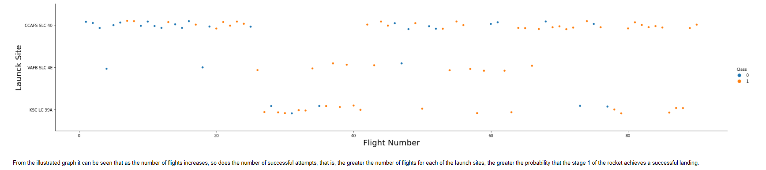
Flight Number vs. Launch Site

Slide 20
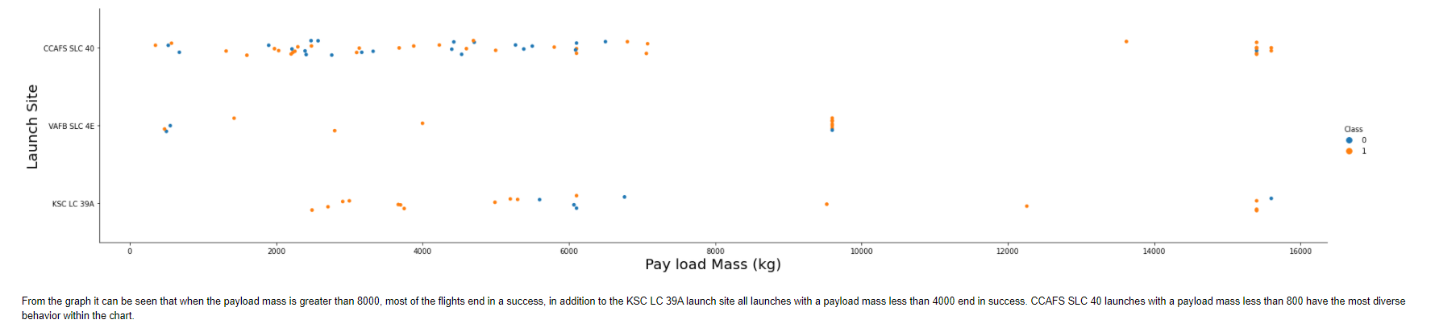
Payload vs. Launch Site
Show a scatter plot of Payload vs. Launch Site
Show the screenshot of the scatter plot with explanations

Slide 21
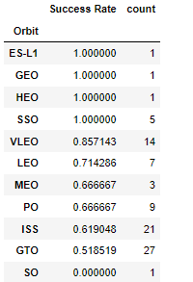
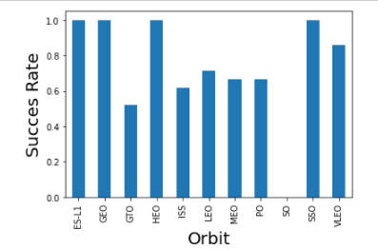
Success rate vs. Orbit type

Slide 22
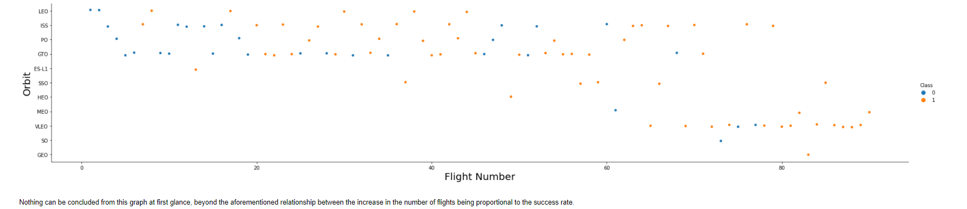
Flight Number vs. Orbit type
Show a scatter point of Flight number vs. Orbit type
Show the screenshot of the scatter plot with explanations

Slide 23
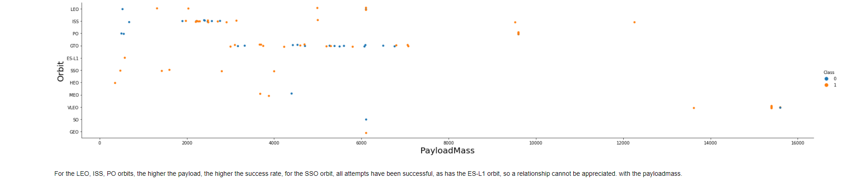
Payload vs. Orbit type
Show a scatter point of payload vs. orbit type
Show the screenshot of the scatter plot with explanations

Slide 24
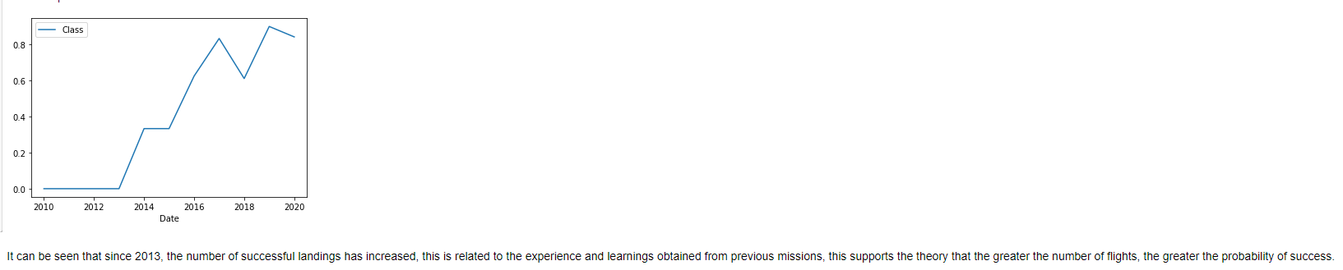
Launch success yearly trend
Show a line chart of yearly average success rate
Show the screenshot of the scatter plot with explanations

Slide 25
EDA with SQL

Slide 26
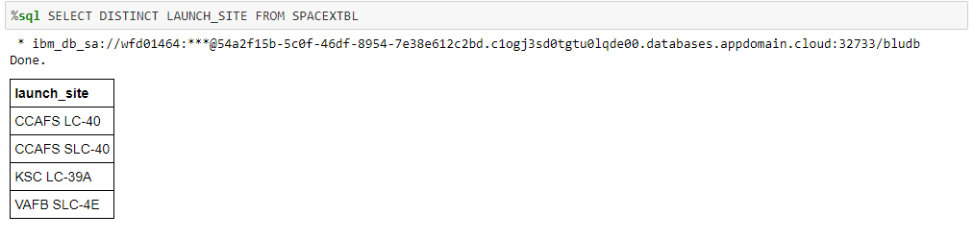
All launch site names
The "DISTINCT" function is used to find the unique values ​​in the requested column

Slide 27
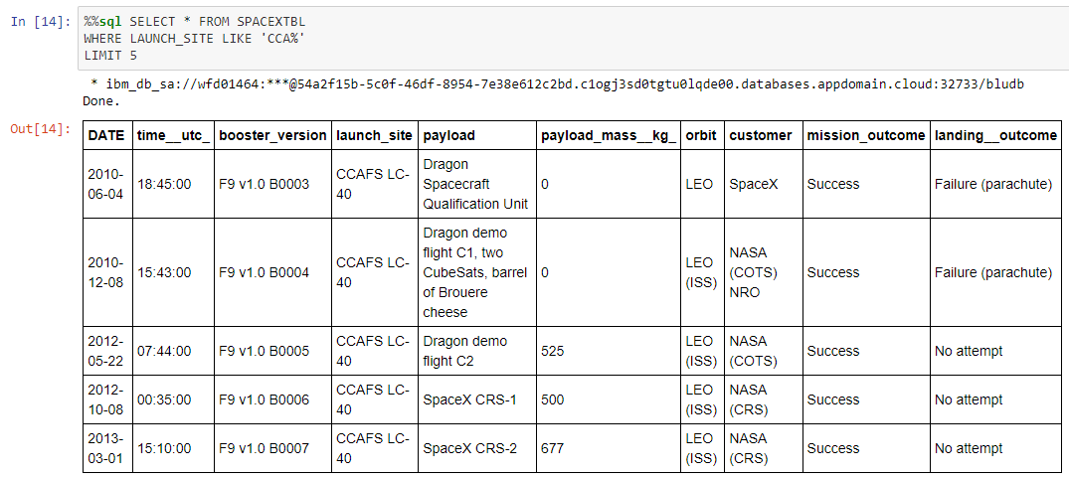
Launch site names begin with `CCA`
The combination of the "WHERE" and "LIKE" functions is used to make sure we obtain the records of the release sites that begin with CCA, also the "LIMIT" function is used to only obtain 5 records.

Slide 28
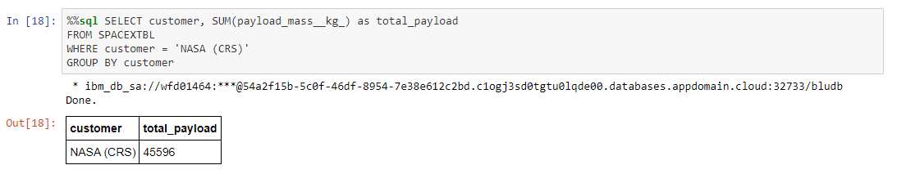
Total payload mass
The "SUM" function is used to obtain the sum of the payload, and the "WHERE" function is used to specify the customer. The "GROUP BY" function is used to make the SUM function work.

Slide 29
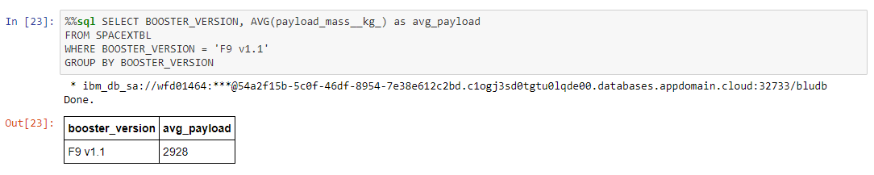
Average payload mass by F9 v1.1
The "AVG" function is used to obtain the average of the payload and the "WHERE" function is used to specify the customer, the "GROUP BY" function is used to make the "AVG" function work.

Slide 30
First successful ground landing date
The "MIN" function is used to find the minimum date, and the where function to fulfill the condition of successful landing.

Slide 31
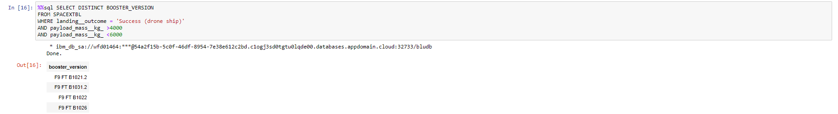
Successful drone ship landing with payload between 4000 and 6000
The "DISTINCT" function is used to find the unique values ​​in the requested column, along with this the "WHERE" function is used both to ensure the specified landing condition and to find the payload within the requested range, it should be noted that this is the same could be achieved using the "BETWEEN" function

Slide 32
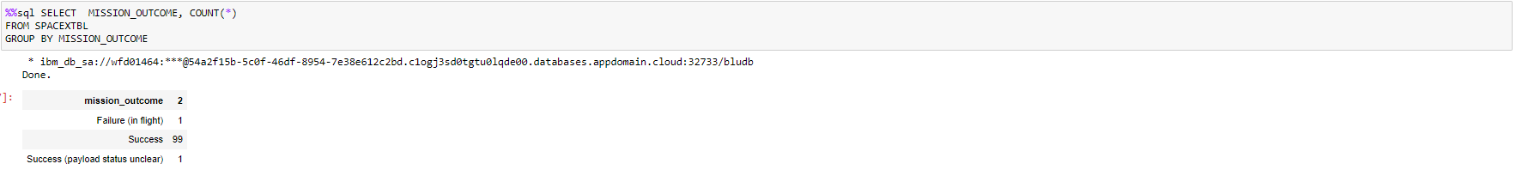
Total number of successful and failure mission outcomes
The "COUNT" function is used to count the number of landings in each category (successful or failure)

Slide 33
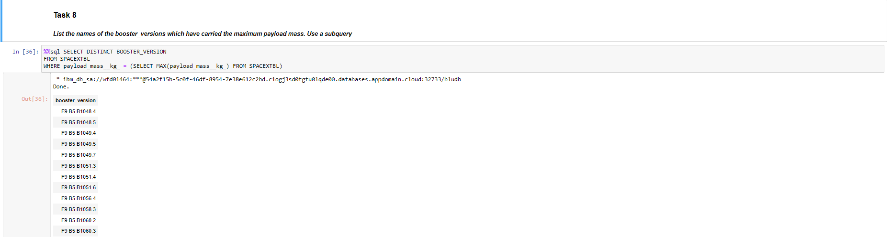
Boosters carried maximum payload
In this case, a sub-query must be used to find the maximum payload condition, then the "WHERE" function is used to find the BOOSTER_VERSIONS that meet the maximum payload condition.

Slide 34
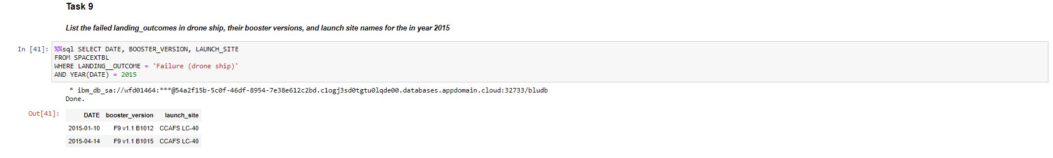
2015 launch records
In this query the "WHERE" function is used to fulfill the landing_outcome condition, and the "WHERE" and "YEAR" function for the condition about the year 2015

Slide 35
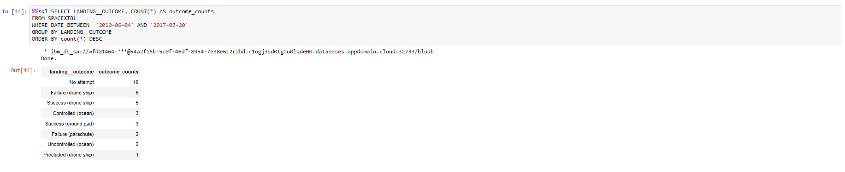
Rank success count between 2010-06-04 and 2017-03-20
The "COUNT" function is used to be able to do a proper ranking, together with a "WHERE" and "BETWEEN" function to meet the established requirements.

Slide 36
Interactive map with Folium

Slide 37
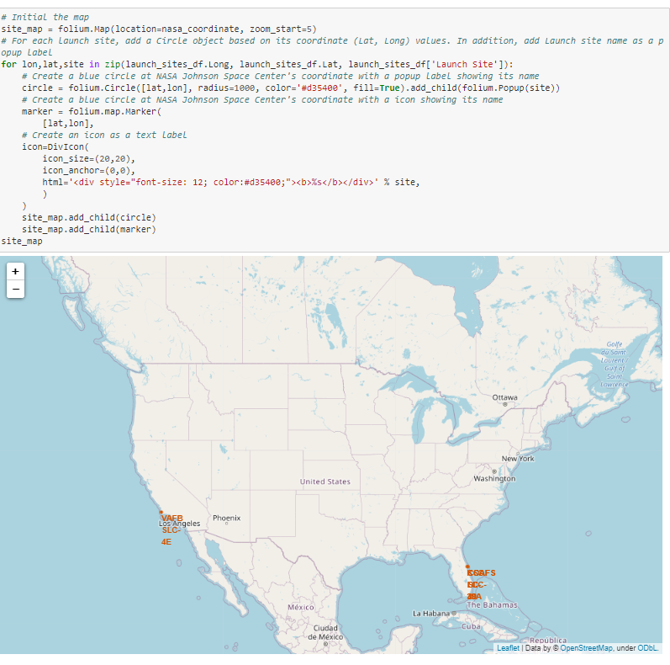
Launch Sites
In this map you can see the launch sites studied and their geographic distributions.
As can be seen, they are all found in the United States, specifically in Los Angeles and Florida, in both cases areas that allow landings in the ocean.

Slide 38
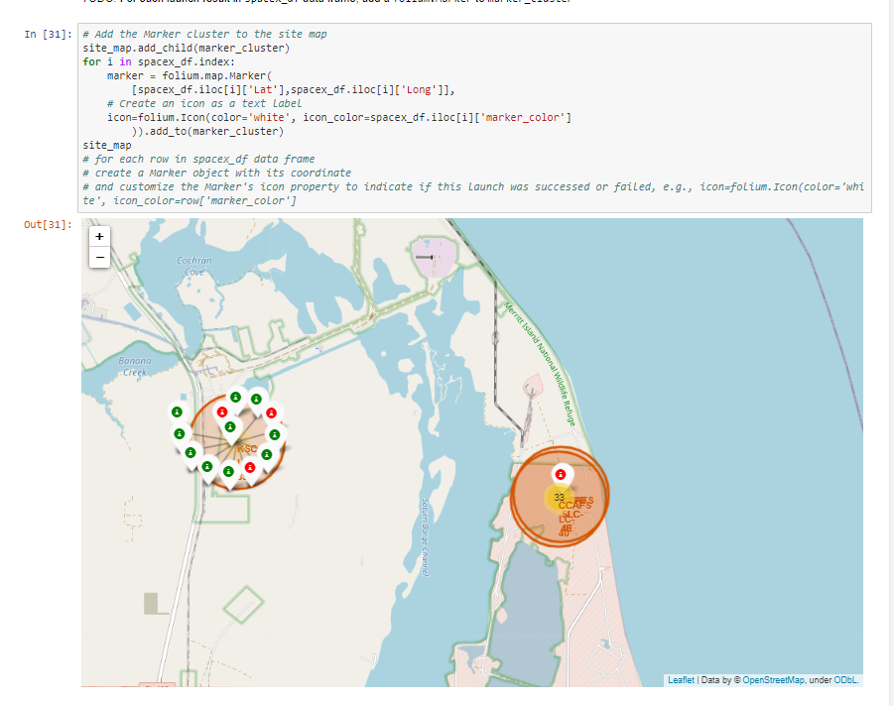
Launch Site Outcomes
In this map, in addition to being able to see the geographical distribution of the launch sites, it is also possible to observe the number of successful and failed launches in each one, these are observed in the colors of the icons indicated in each launch site, where the icons Green symbolizes a successful launch, and a red icon symbolizes a failed launch.

Slide 39
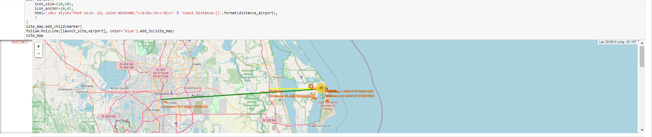
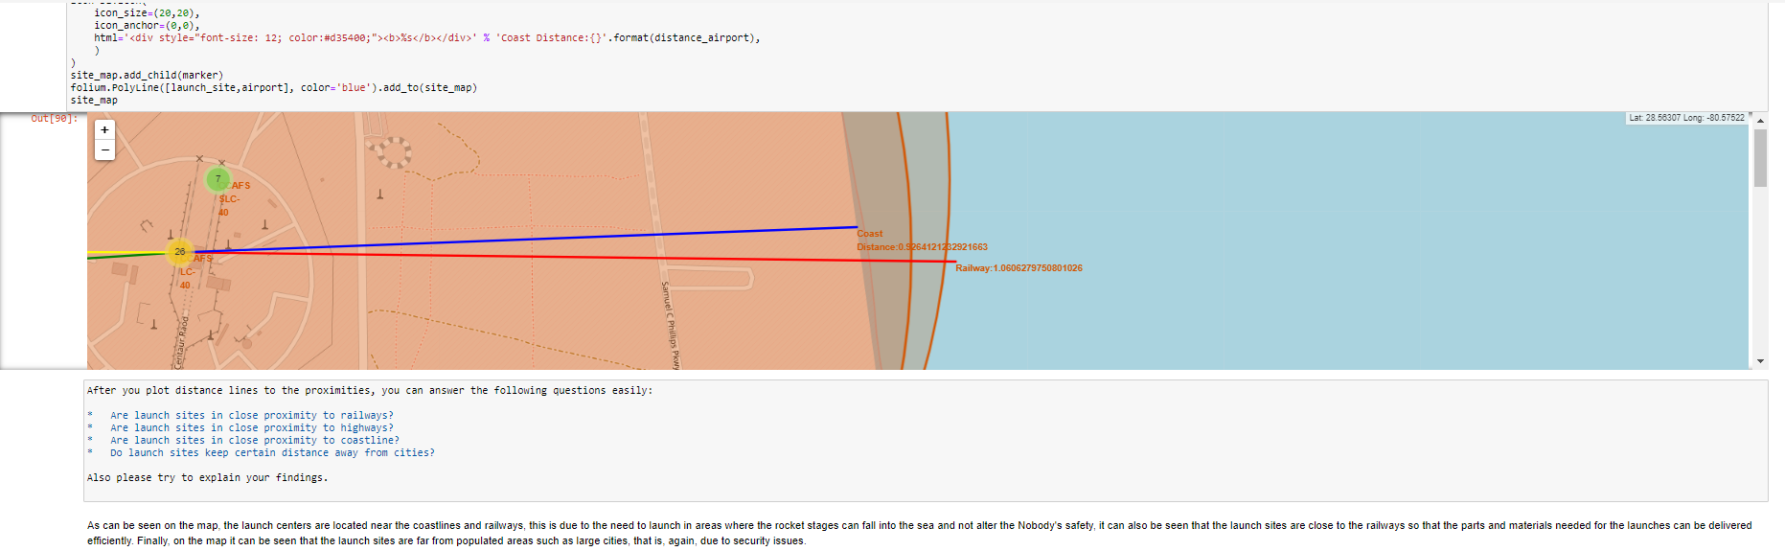
<Folium map screenshot 3>
In the graphical map you can see relevant areas near the launch site, where it is identified that the populated areas are far from it due to security issues, also it is distinguished that the launch sites are in coastal areas so that the remnants rockets can land or fall directly into the ocean and cause no collateral damage.

Slide 40
Build a Dashboard with Plotly Dash

Slide 41
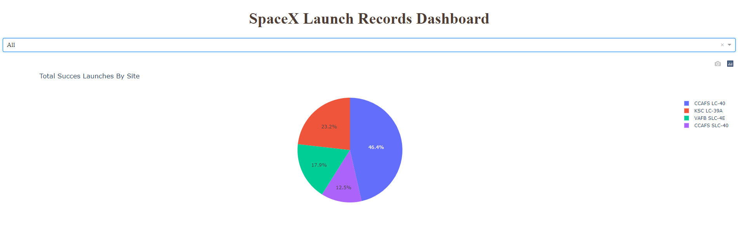
SPACEX Launch Dashboard – Pie Chart
This graph tells us directly which are the launch sites that show the highest number of successful launches, and their proportion with respect to the total number of successful launches.

Slide 42
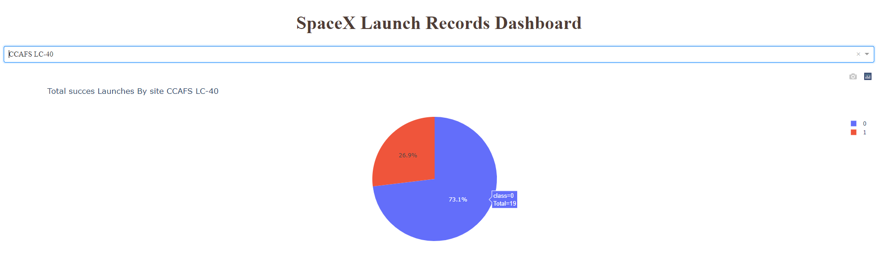
SPACEX Launch Dashboard – Most Successful Launch Site
From the illustrated figure it is distinguished that the CCAFS LC-40 launch site has a success rate of 73.1% with a total of 19 launches with successful results.

Slide 43
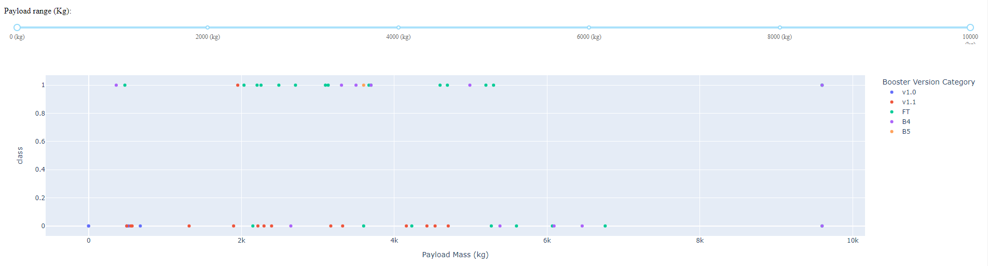
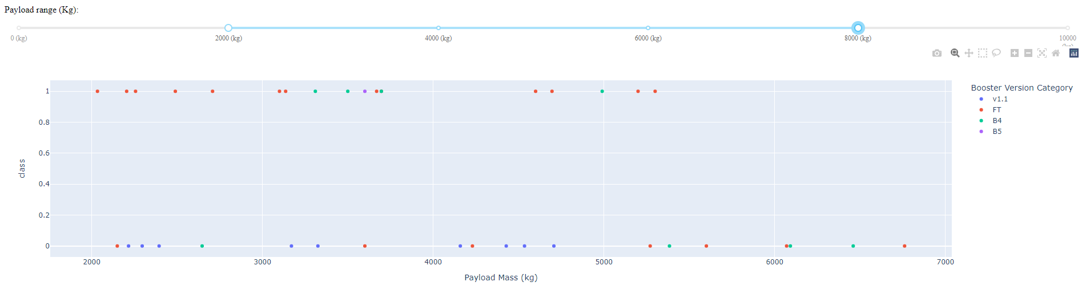
SPACEX Launch Dashboard – Scatter Plot
It can be determined that for all launch sites, if the payload is between 6000 and 9000 kg, the mission is very likely to be a success.
For the versions of Booster v1.0 and v1.1, it is distinguished that most missions were a failure, regardless of the mission payload, for the FT version, most missions with payloads between 2000 and 4000 kg were successful , while when the payload was outside these ranges, its behavior was varied. For the version of Booster B4, it is observed that it has a favorable behavior between 3000 and 5000 kg of payload, while for the rest of the range of payloads, it shows a rather negative behavior, finally, the version of booster B5 has only one launch, so not much can be concluded from its behavior.

Slide 44
Predictive analysis (Classification)

Slide 45
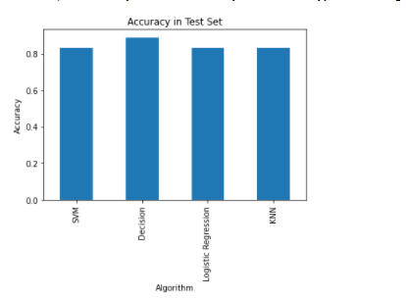
Classification Accuracy
As seen in the image, the model with the best performance in the test set corresponds to a decision tree, so this is the selected model.

Slide 46
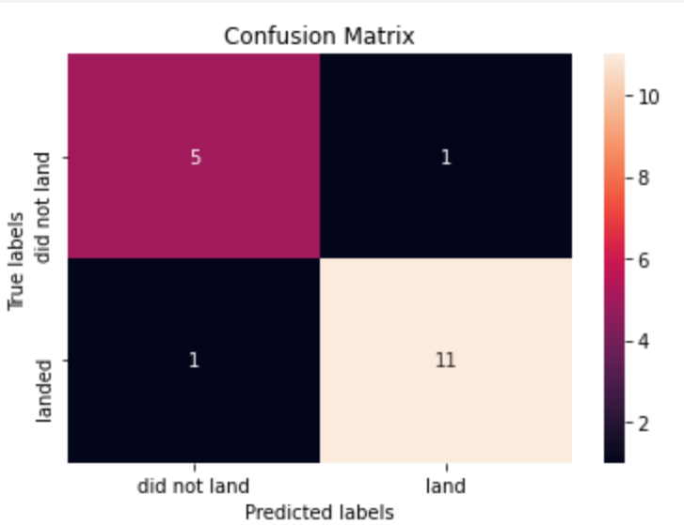
Confusion Matrix
As can be seen in the confusion matrix, the algorithm is able to correctly determine the classes 88% of the time, however, in the cases where it is wrong (2), it shows a false positive and a false negative, where the The first of these is the most dangerous case, since the algorithm indicates that the landing would be successful, and finally it is not, which would cause millions of dollars in losses.

Slide 47

CONCLUSION
It is possible to determine whether the Falcon 9 phase 1 landing will end successfully with reasonably high precision.
Many of the variables obtained from various data sources were used to make the prediction of the selected model more accurate.
Although the developed model presents good results, these could always be improved by adding various variables and sources of information, such as the weather on the day the launch was made, or the wind speed.
The visualizations made were of the utmost importance to understand the behavior of the variables and their relationship with the dependent variable to be predicted.

Slide 48

APPENDIX: Git Repository
The link to the repository is at the link below.
https://github.com/joseMCV/space-y

Slide 49
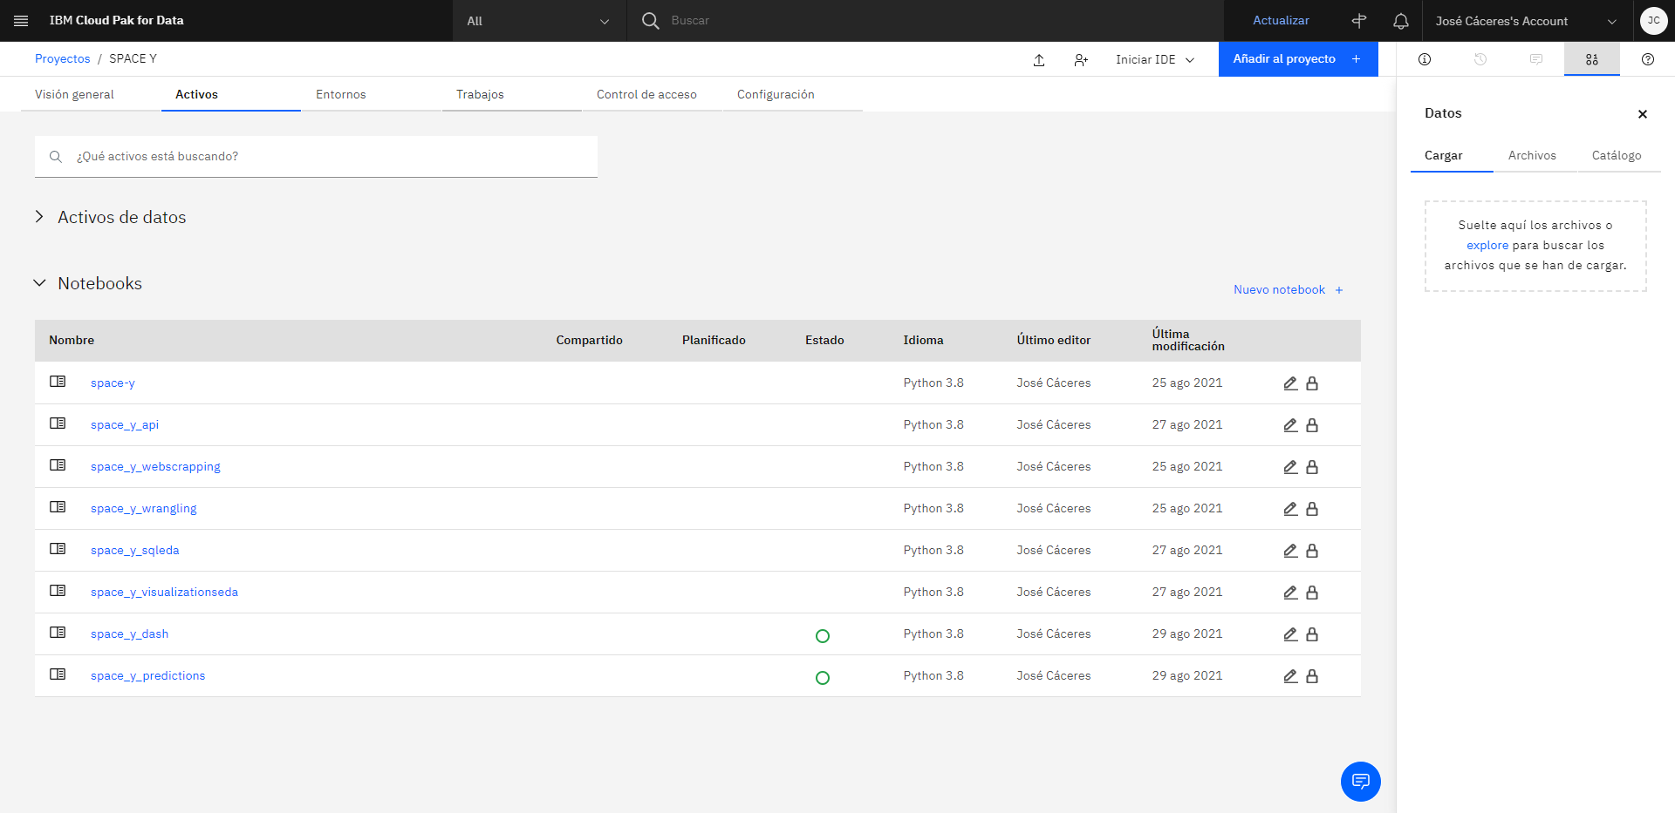
APPENDIX: Plataform
All the codes created for this work were developed on the IBM platform, in the Watson Studio tool.

Slide 50
APPENDIX: Libraries
The python libraries used for this project are listed below:
Pandas
Numpy
Sklearn
Folium
Dash
Requests
BeautifullSoup
Matplotlib
Plotly

