Slide 1
Strategic portfolio
Germán Jácome Arévalo, Jose Ayala Montoya, Rodrigo Castilla Espinoza

Slide 2
Structure
Introduction
Data Analysis: Normality and Diversification
Simulation and the Efficient Frontier: Pursuing Markowitz’s Legacy
Sharpe Ratio and the Tangency Portfolio: When Efficiency Meets Return
CAPM Regression: Uncovering the DNA of Portfolio Returns
Expected vs. Realized Portfolio Performance
Conclusion

Slide 3
Introduction
Can a portfolio thrive through boom and bust?
6 diversified, resilient assets: MSFT, DE, COST, BYDDY, AMD, GLD
Diversification benefits plateau beyond 6–10 assets
Period: Jan 2018 – May 2025 (calm, COVID-19, recovery)
Tests long-term durability

Slide 4
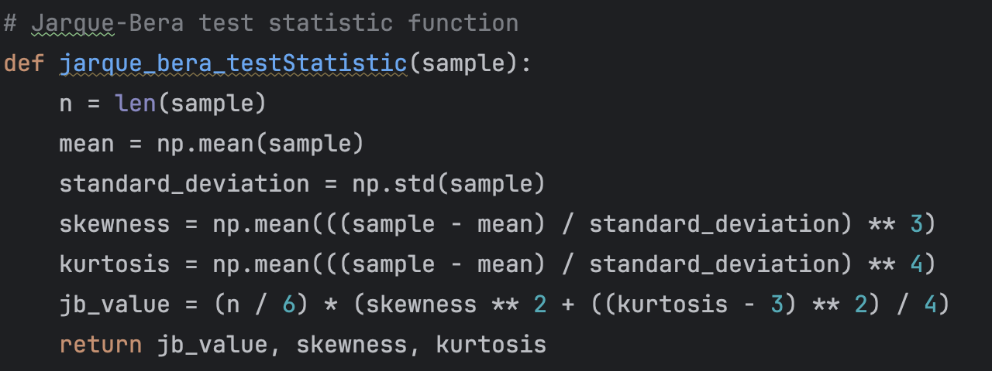
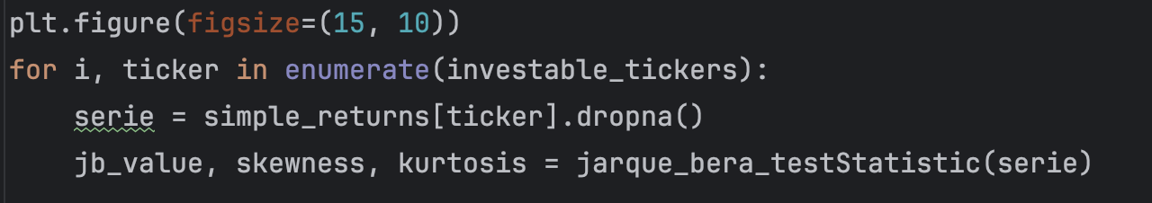
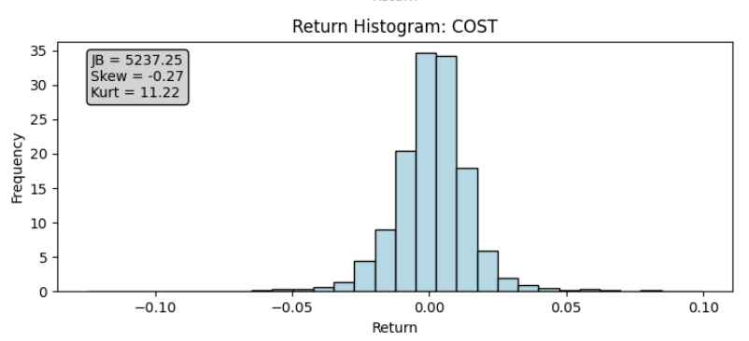
Data Analysis: Normality
Analyzed if returns follow a normal (Gaussian) distribution
Jarque-Bera (JB) test measures deviations in skewness (S) and kurtosis (K) from normal (S=0, K=3)
A JB value near zero supports normality; large values indicate non-normal returns
Findings: None of the assets pass the JB test
Example: COST’s JB > 5,000, indicating heavy tails & skewness
Conclusion: Assuming normality underestimates risk

Slide 5
Data Analysis: Correlation
Diversification isn’t about holding multiple assets but combining them effectively.
Correlation governs effectiveness: Lower correlation between assets means greater risk reduction potential.
Our portfolio emphasizes sectoral, geographical, and structural diversity to maximize diversification benefits.
The correlation matrix shows GLD (Gold) with notably low correlations across all other assets, including AMD, BYDDY, COST, DE, and MSFT.
GLD acts as a strategic counterweight: Its low correlation with market-driven assets boosts portfolio resilience and shifts the efficient frontier leftward.
Correlation is a design tool for building robust portfolios with improved risk-return profiles.

Slide 6
Simulation and the Efficient Frontier: Pursuing Markowitz’s Legacy
10,000 simulated portfolios reveal the empirical efficient frontier, where return is maximized per unit of risk.
Markowitz’s optimization minimizes variance for a target return, with weights summing to one.
Constraints added: no short-selling and max 50% weight per asset.
Comparing constrained and unconstrained frontiers shows the cost of constraints and the benefit of diversification.
Diversification is mathematically and visually compelling.

Slide 7
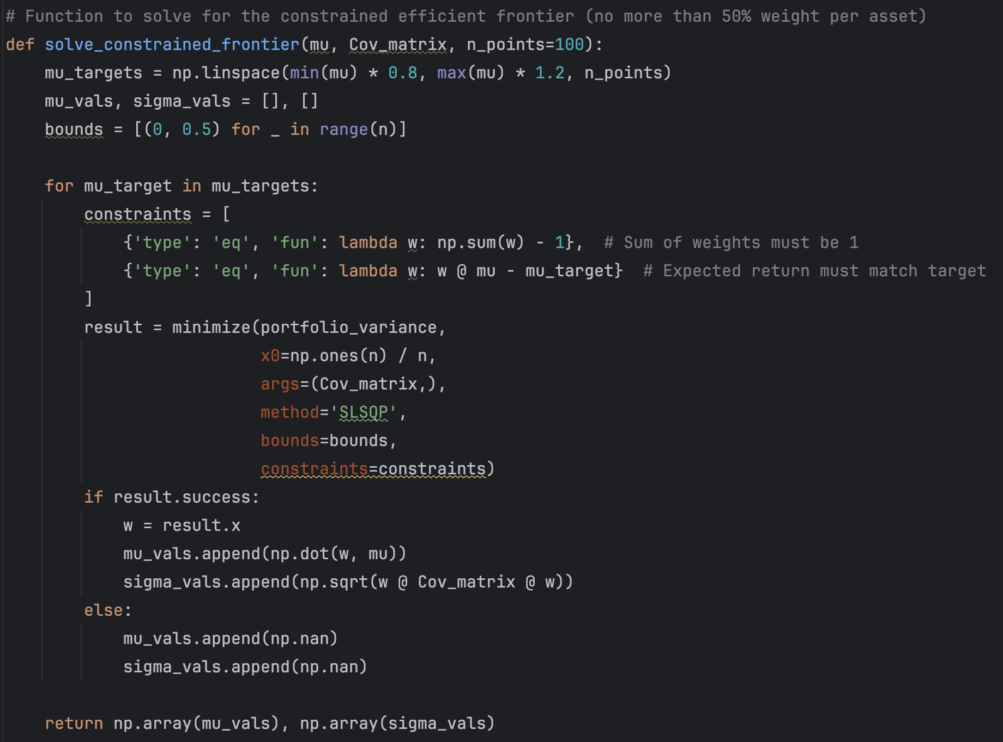
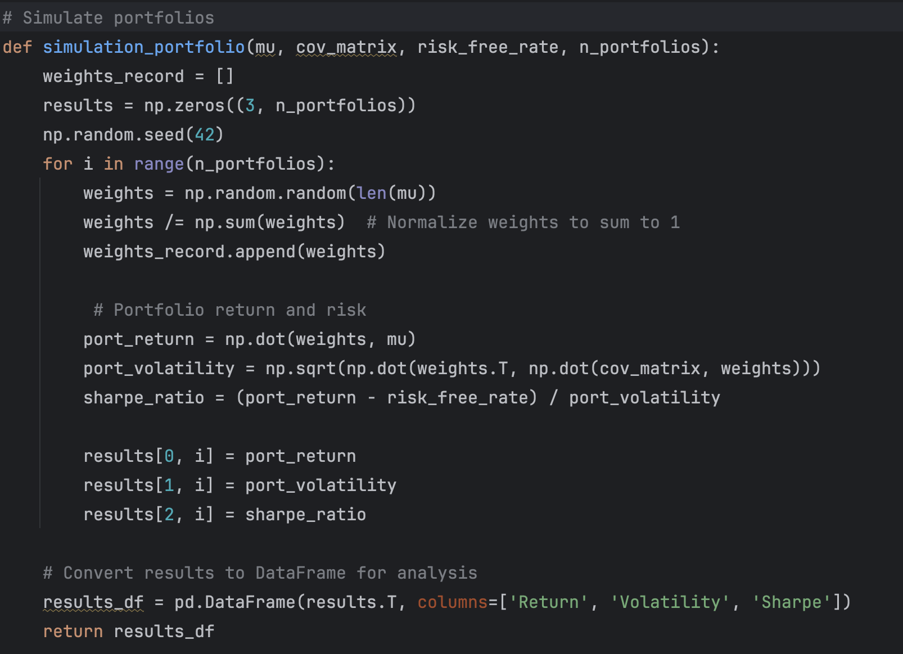
Efficient Frontier implemented in Python

Slide 8
Sharpe Ratio and the Tangency Portfolio: When Efficiency Meets Return
The Sharpe Ratio measures excess return per unit of risk
Maximizing the Sharpe Ratio identifies the tangency portfolio, lying at the intersection of the Capital Market Line (CML) and the efficient frontier.
The tangency portfolio offers the best risk-return trade-off and serves as a robust benchmark.
While we don’t model individual preferences, the tangency portfolio provides a universal reference point for portfolio selection.

Slide 9
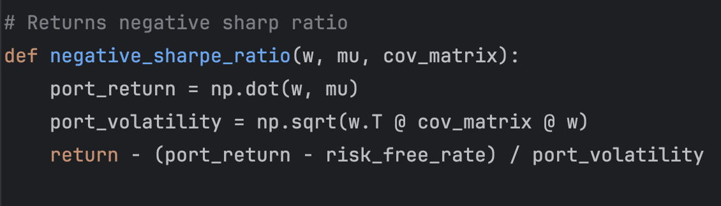
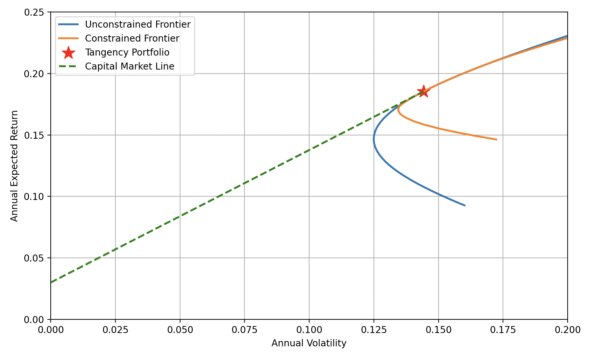
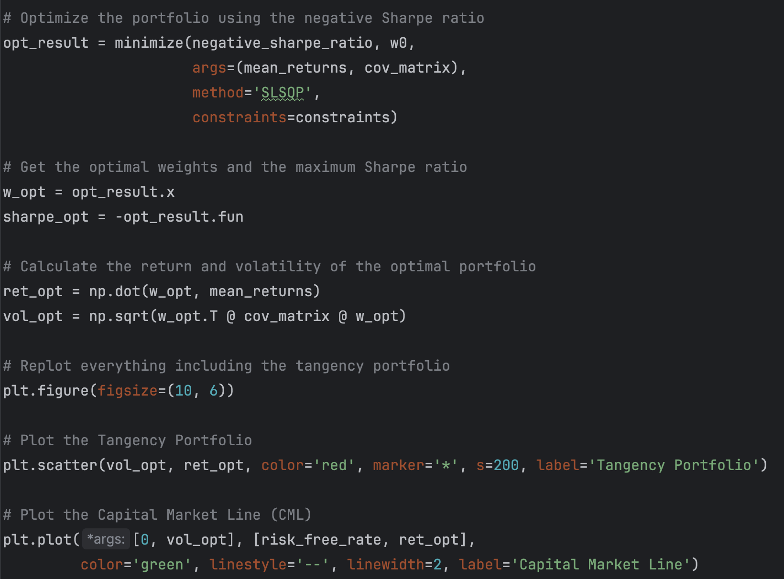
Implementation of Sharpe Ratio and Tangency Portfolio in Python

Slide 10
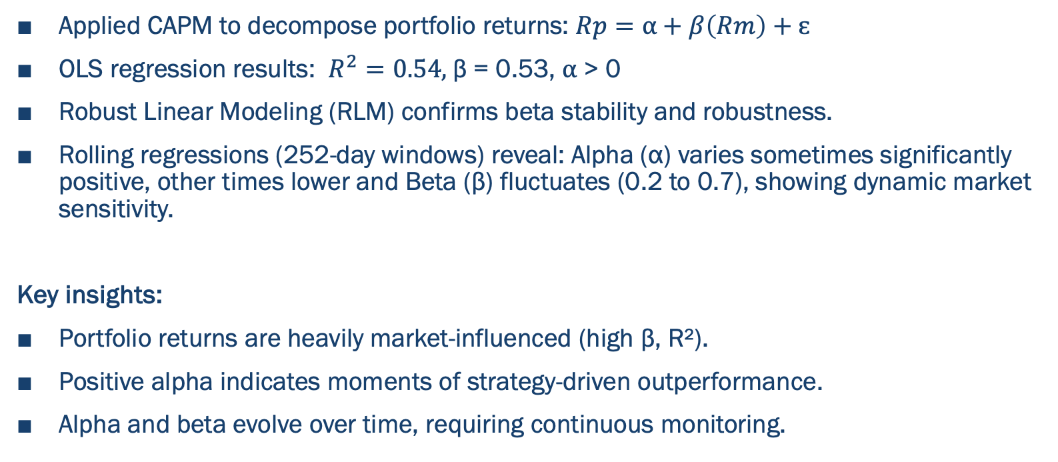
CAPM Regression: Uncovering the DNA of Portfolio Returns
Applied CAPM to decompose portfolio returns: $Rp=⍺+β\left(Rm\right)+ɛ$
OLS regression results: $R^{2}=0.54,$β = 0.53, ⍺ > 0
Robust Linear Modeling (RLM) confirms beta stability and robustness.
Rolling regressions (252-day windows) reveal: Alpha (α) varies sometimes significantly positive, other times lower and Beta (β) fluctuates (0.2 to 0.7), showing dynamic market sensitivity.
Key insights:
Portfolio returns are heavily market-influenced (high β, R²).
Positive alpha indicates moments of strategy-driven outperformance.
Alpha and beta evolve over time, requiring continuous monitoring.

Slide 11
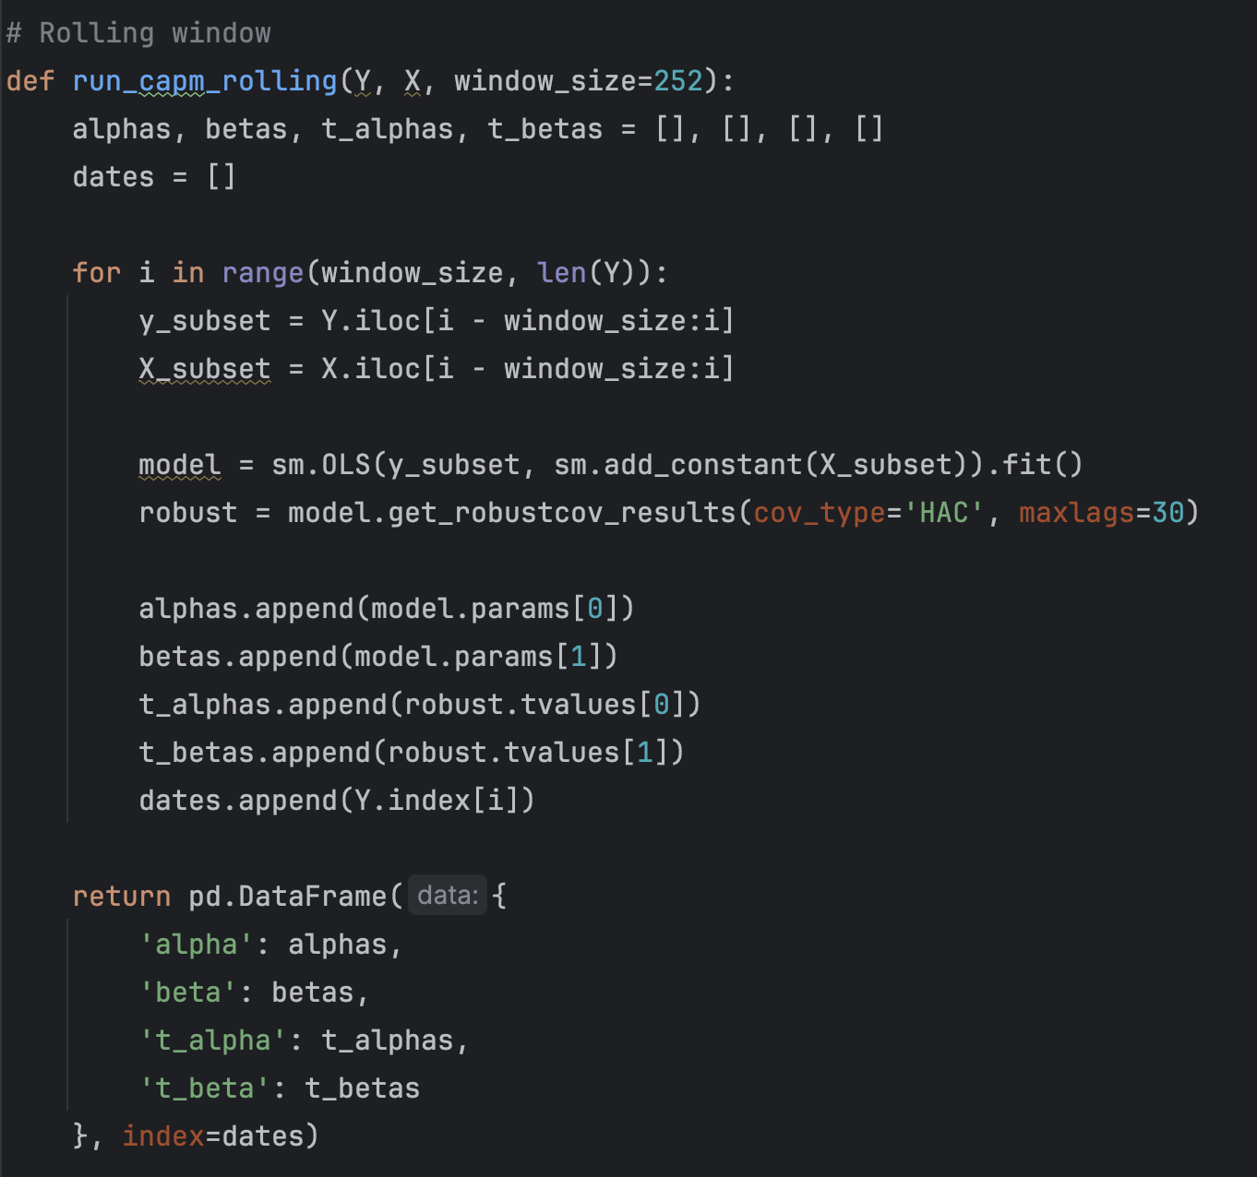
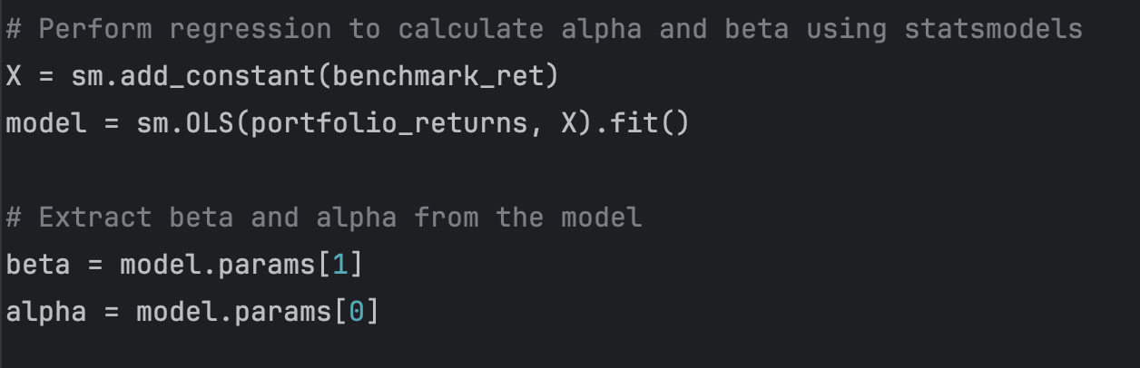
Implementation CAPM Regression in Python.

Slide 12
Expected vs. Realized Portfolio Performance
Expected Annual Return: 22.88%
Realized Annualized Return: 24.23%
CAGR: 24.18%, highlighting strong long-term growth.
Cumulative growth chart: Portfolio consistently outperformed expectations, growing to over 5x initial capital.
Success driven by optimized asset allocation and high-growth assets (e.g., AMD, BYDDY).
COVID-19 resilience: Moderate drawdown during the 2020 crash, rapid recovery and resumed growth. Demonstrates portfolio robustness against market shocks.

Slide 13
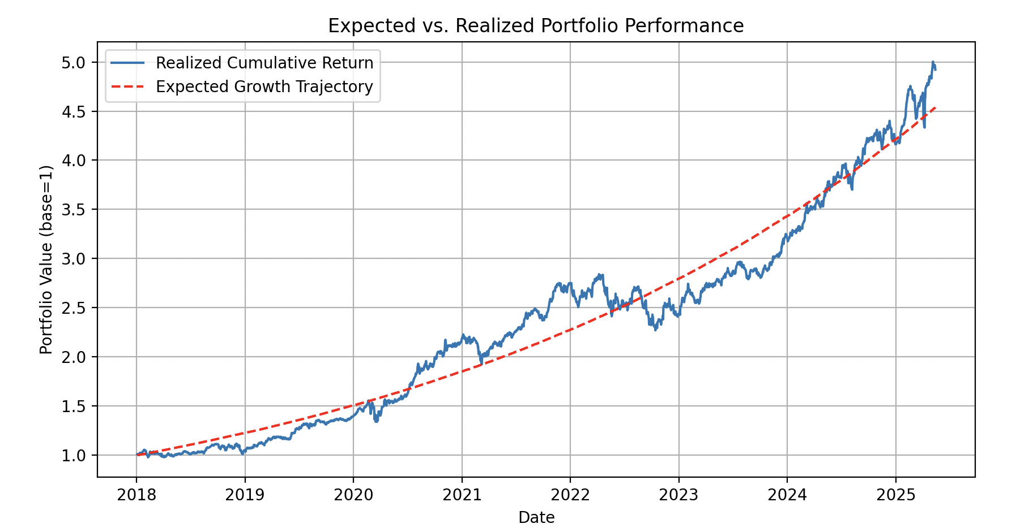
Conclusion
Close alignment between expected and realized returns.
CAGR exceeding 24%, highlighting strong growth.
Strong crisis performance confirms resilience.
The strategy: Aligns with theoretical efficiency, proves empirical robustness in real markets.
Positions the portfolio as a compelling choice for investors seeking growth and disciplined risk management.

