Slide 1
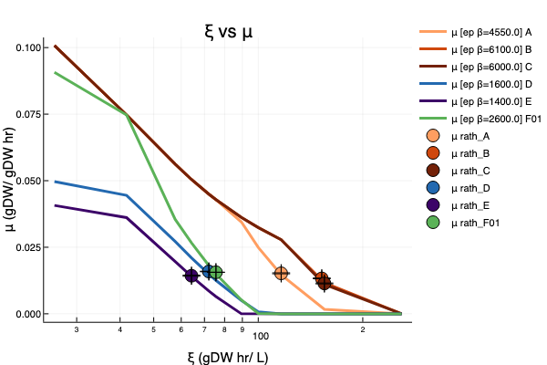
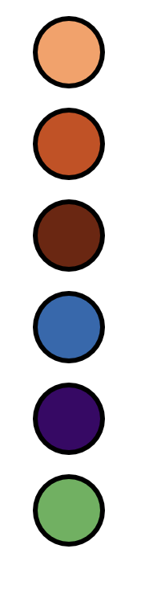
μ (gDW/ gDW hr)
ξ (gDW hr/ L)

Slide 2
Rich Medium

Slide 3
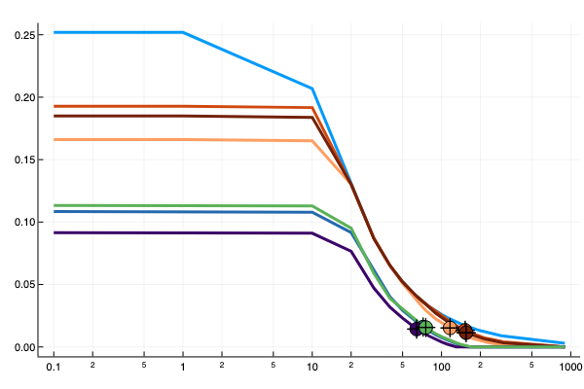
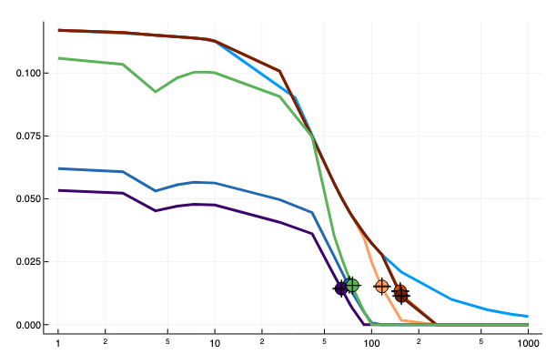
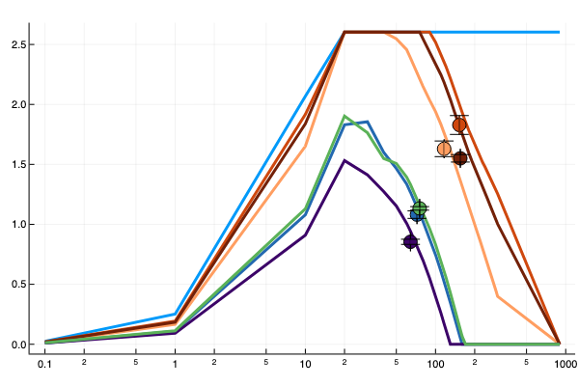
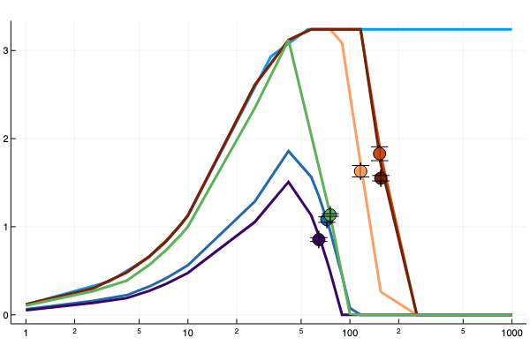
Rich
EP_FBA
Recon3d
CHO
μ (gDW/ gDW hr)
Xv (gDW/ L)
ξ (gDW hr/ L)

Slide 4
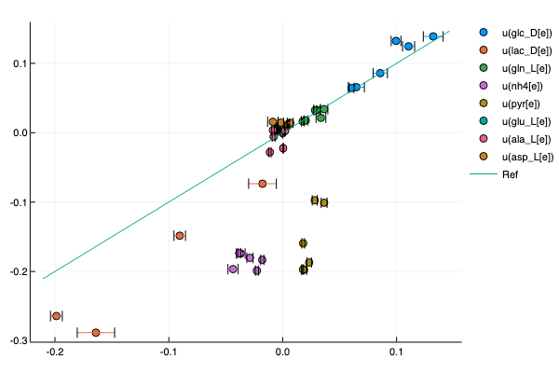
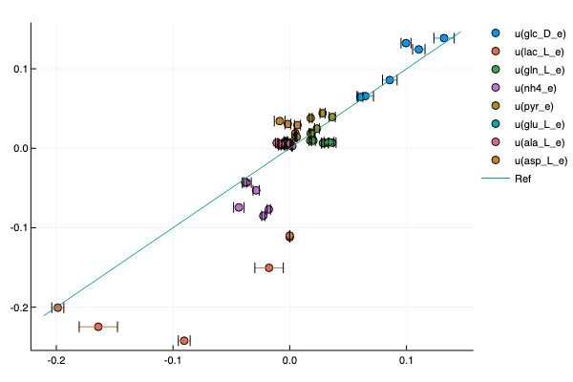
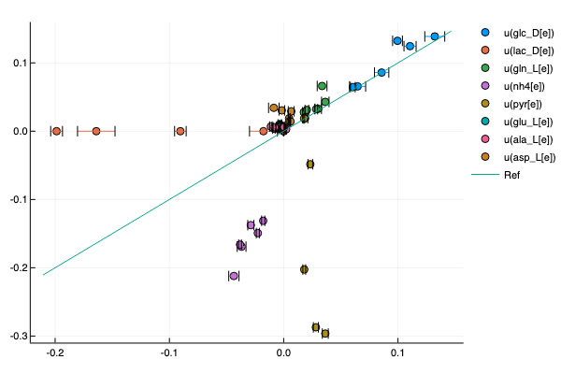
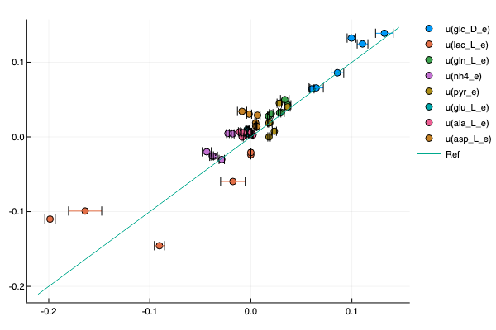
Recon3d
CHO
EP
EP
Model u(mmol/ gDW hr)
FBA
FBA
Experimental u(mmol/ gDW hr)

Slide 5
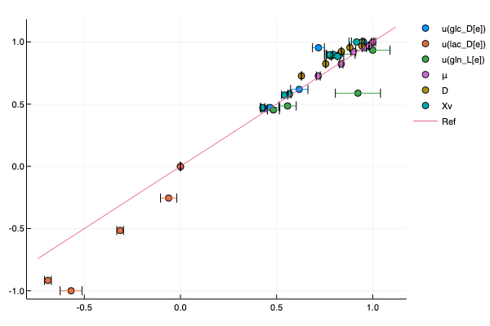
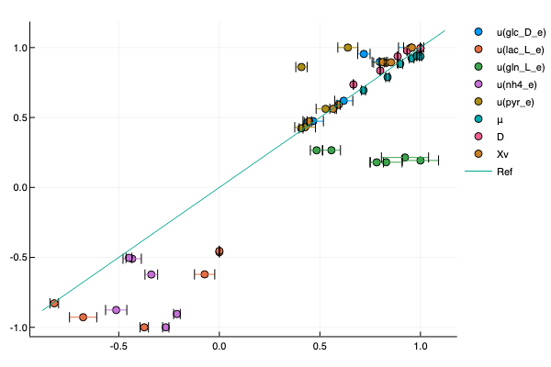
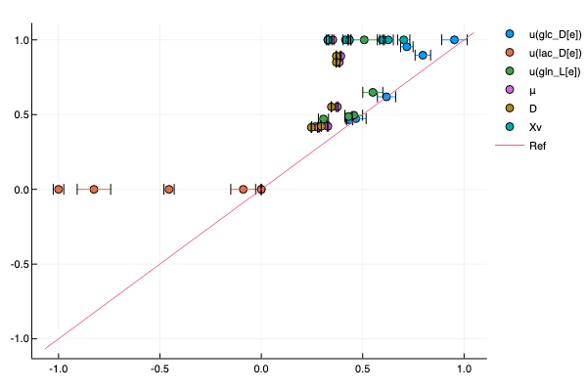
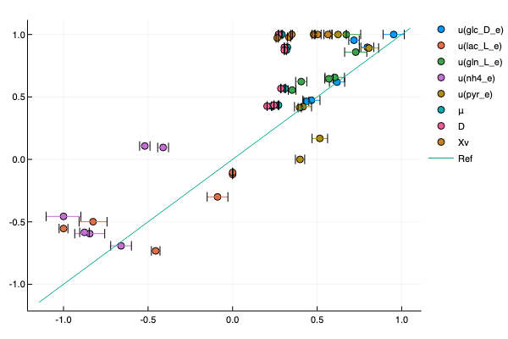
Recon3d
CHO
EP
EP
Model
FBA
FBA
Experiment

Slide 6
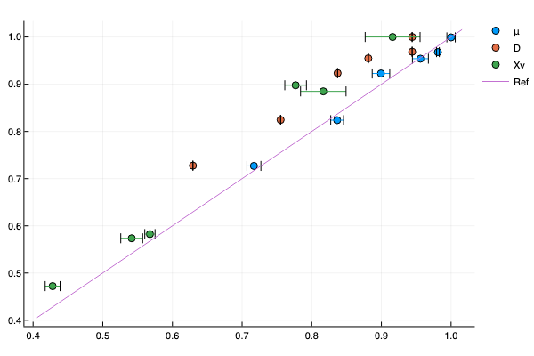
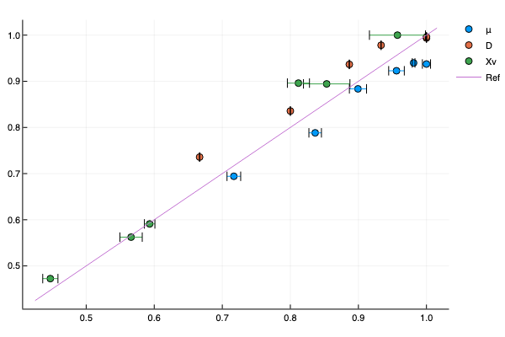
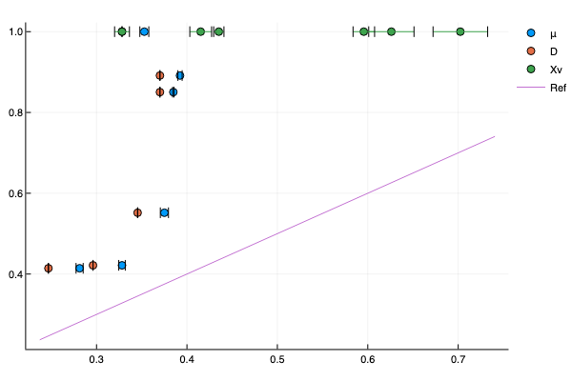
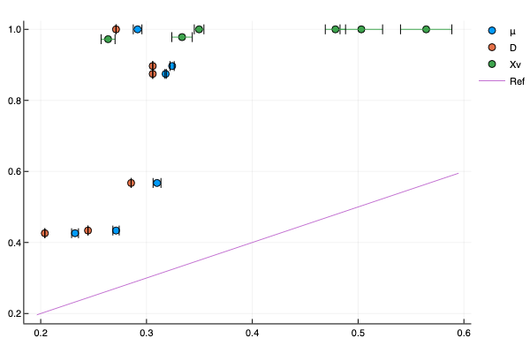
Recon3d
CHO
EP
EP
Model
FBA
FBA
Experiment

Slide 7
Low

Slide 8
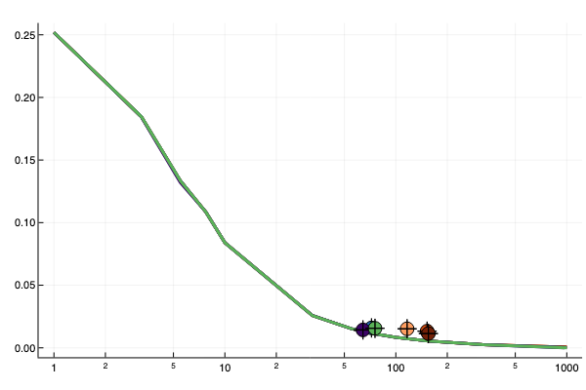
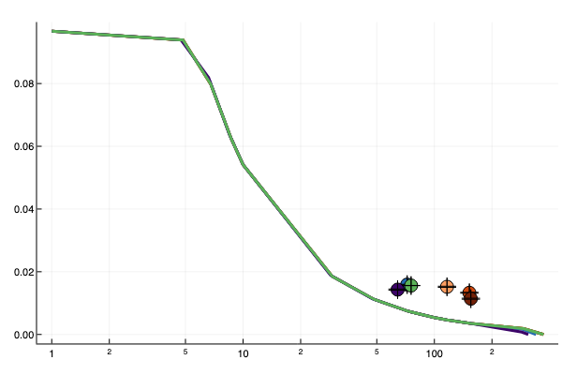
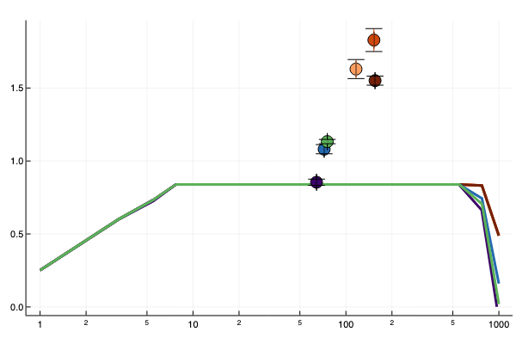
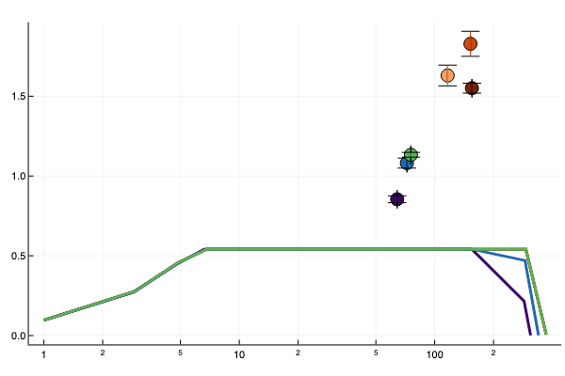
Low
Recon3d
CHO
FBA
μ (gDW/ gDW hr)
Xv (gDW/ L)
ξ (gDW hr/ L)

Slide 9
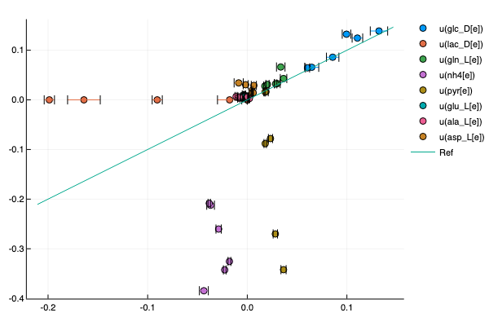
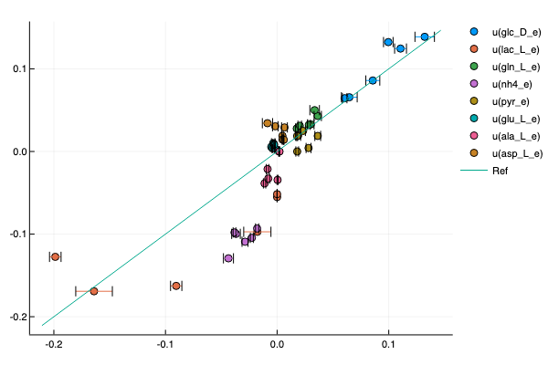
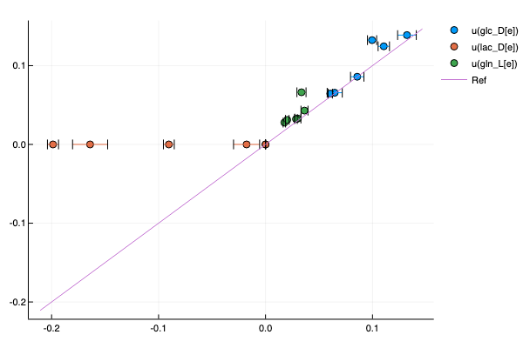
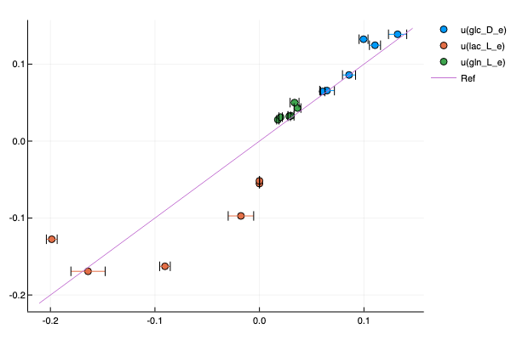
Recon3d
CHO
Model u(mmol/ gDW hr)
Experimental u(mmol/ gDW hr)

Slide 10
Recon3d
CHO
EP
EP
Model
FBA
FBA
Experiment

Slide 11
cul A
cul B
cul C
cul D
cul E
cul F01
Cul A
Cul B
Cul C
Cul D
Cul E
Cul F01

Slide 12
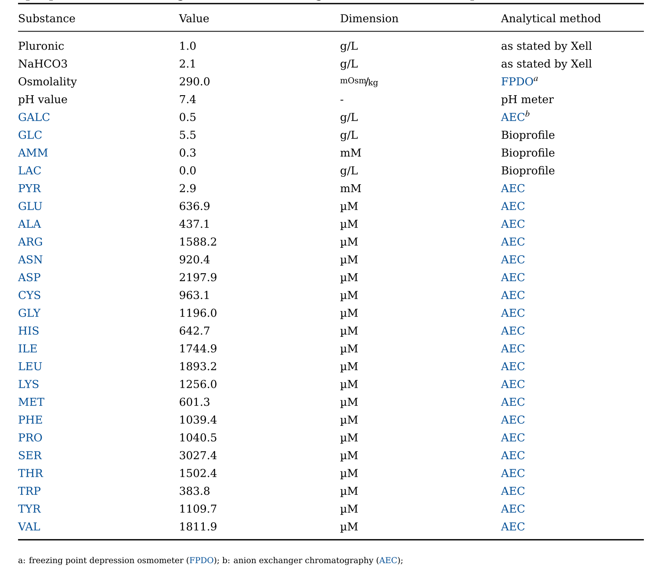

Slide 13
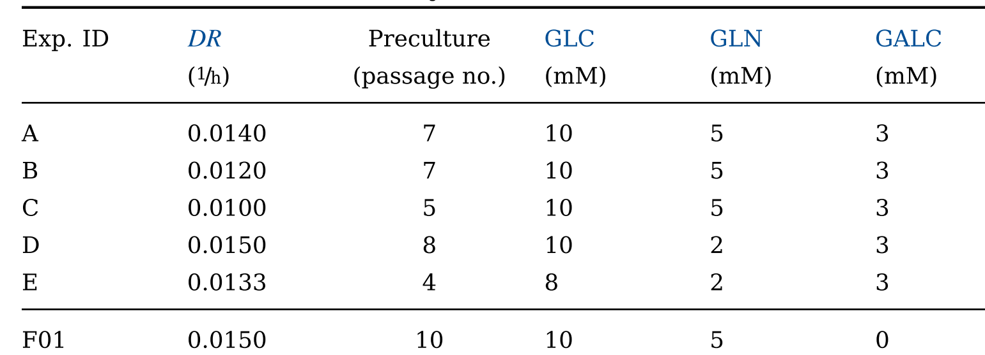

Slide 14
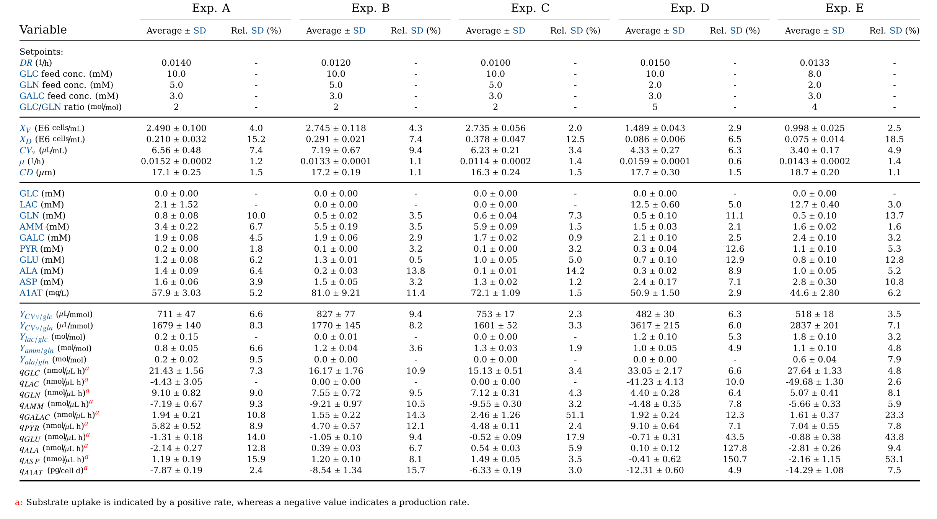

Slide 15
