Slide 1
# DIY Chemostat
Our aim is to fabricate a small chemostat (working volume ~ 20 ml) able to read the cellular density (DO) in real time and having a "well enough" control over the dilution rate.
It is also desirable to have some multiplexing capacities (multiple culture chambers) for running parallel replicas.

Slide 2
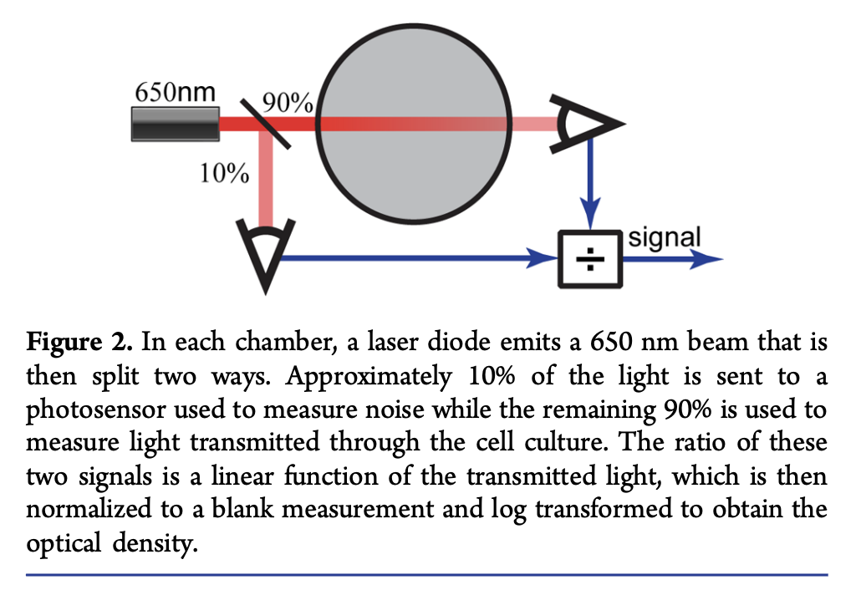
# DO measurement
The DO system that will be used to measure in real time the growth rate is inspired (Figure) in the system described at 10.1021/sb500165g.
I also want to implement this simple signal processing model described at 10.1371/journal.pone.0181923.
"The employed Kalman filtering approach based on a very general state model retains the flexibility of the used control type and can be easily adapted to other bioreactor designs. Within several minutes it can converge to robust, accurate growth rate estimates"
# Required Parts (Per culture chamber) - 1 unit | Laser module 1 mW LFD650 | ~€10.0 | link - 2 units | light-to-frequency converter TSL | ~€4.0 | link

Slide 3
# Pump system
The second important feature we want to address is a good control of the chemostat dilution rate.
There are two main options for pumping systems. Peristaltic pumps and syringe pump.

Slide 4
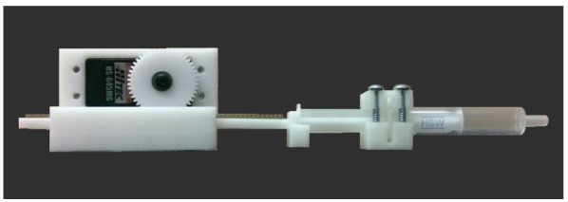
# Syringe pump
I do prefer the syringe pump because (compared with the peristaltic pump) it can be used for liquids and/or gasses, it developed higher pressures, it allows to reliably compute the flow by counting the number of cycles (the volume of the syringe is known and constant) and finally, by using different syringes we can change the working volume range with the same motor and control systems. The main disadvantage is that it additionally requires the uses of pitch valves, although I am exploring using one way check valves instead.
Image taken from (dx.doi.org/10.1021/sb500165g)
# Required Parts (per pump)
- 1 unit | Reversible High torque Turbo Worm Gear Motor DC 12V 10RPM | ~ 15.00 USD | link - (Alternatively) Servo | ~ 15.00 USD | link - Plastic Rack & Pinion Gears | ~ 5.00 USD | link ,link

Slide 5
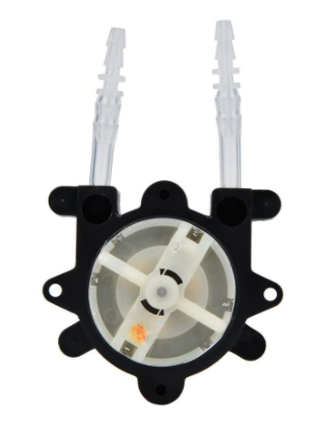
# Peristaltic Pump
This pump system have the advantage of being simpler, but it is harder to control the dilution rate without having a feedback system and it is mainly for liquids.
# Required Parts (per pump)
- 1 unit | Peristaltic Pump | ~ 10.00 - 30.00 USD | link

Slide 6
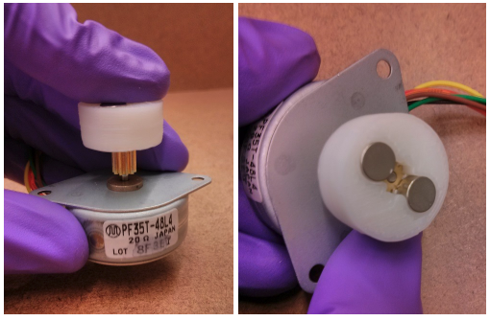
# Magnetic stirrer
We need to provide a well mixing environment in the culture chamber. In order to provide that we can use a magnetic stirrer
# Required parts (per stirrer)
- 2 units | magnets | ~ 10.0 USD | link - 1 unit | 12V DC motor | link - 1 unit | Magnetic Spin bar | ~ 10.0 USD | link

Slide 7
# DIY Pinch valve
The pinch valve allows to use a single pump to feed several cultures.
Those are required for multiplexing and the syringe pump system.
# Design examples
1. example link 2. example link 3. example link
# Required Parts (per valve)
- servo motor | ~ 4.00 USD | link

Slide 8
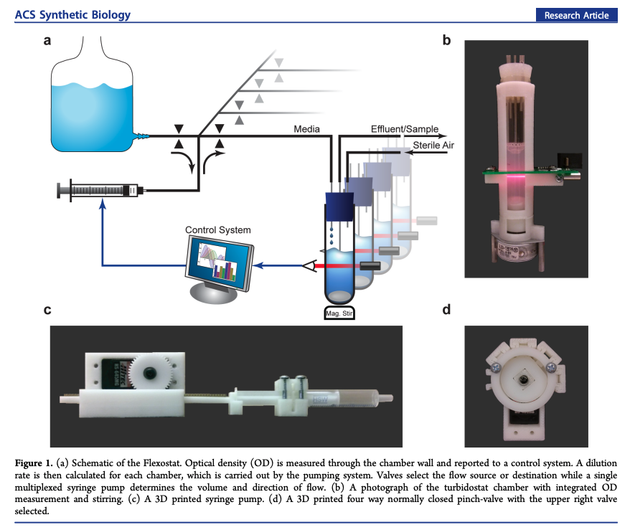
# Chemostat Examples
DOI: 10.1021/sb500165g

Slide 9
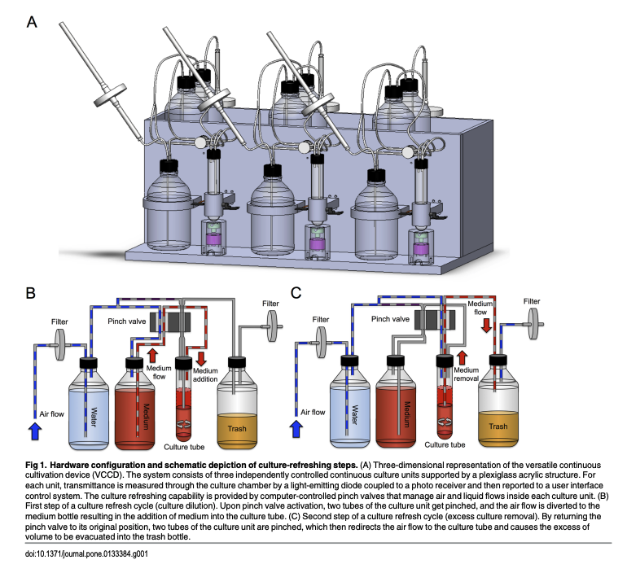
# Chemostat Examples
10.1371/journal.pone.0133384

Slide 10
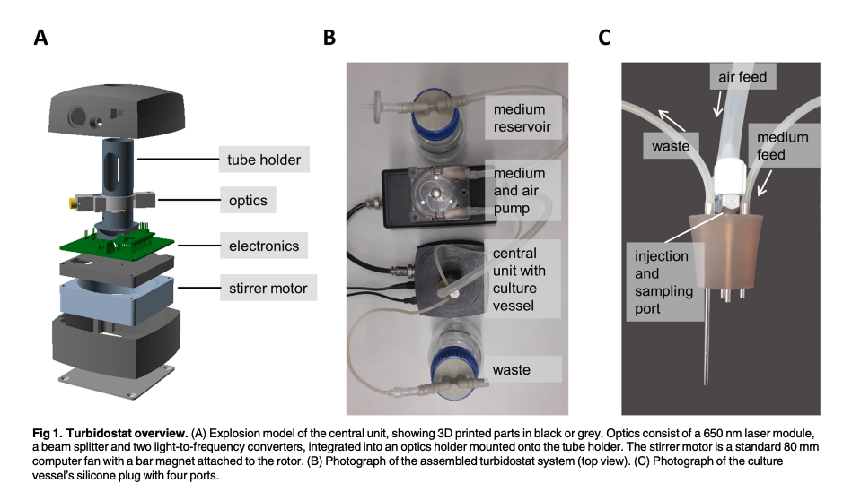
# Chemostat Examples
10.1371/journal.pone.0181923

Slide 11
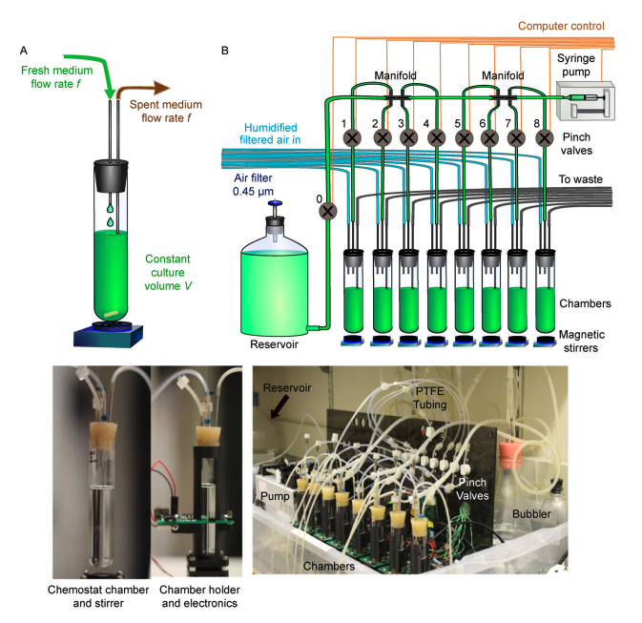
# Chemostat Examples
10.1007/s40484-018-0143-8

Slide 12
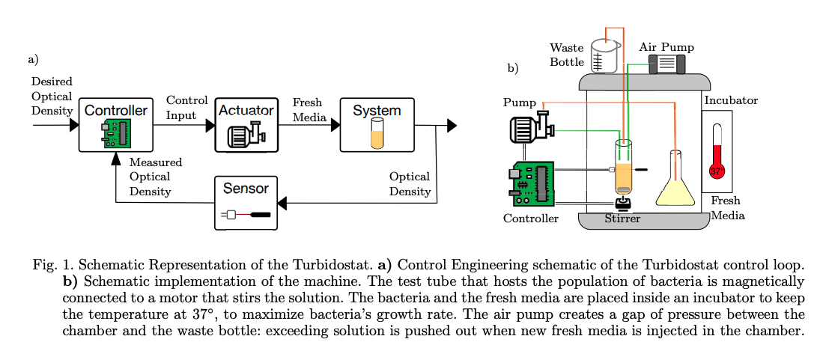
# Chemostat Examples
10.1016/j.ifacol.2019.12.265

