Slide 1


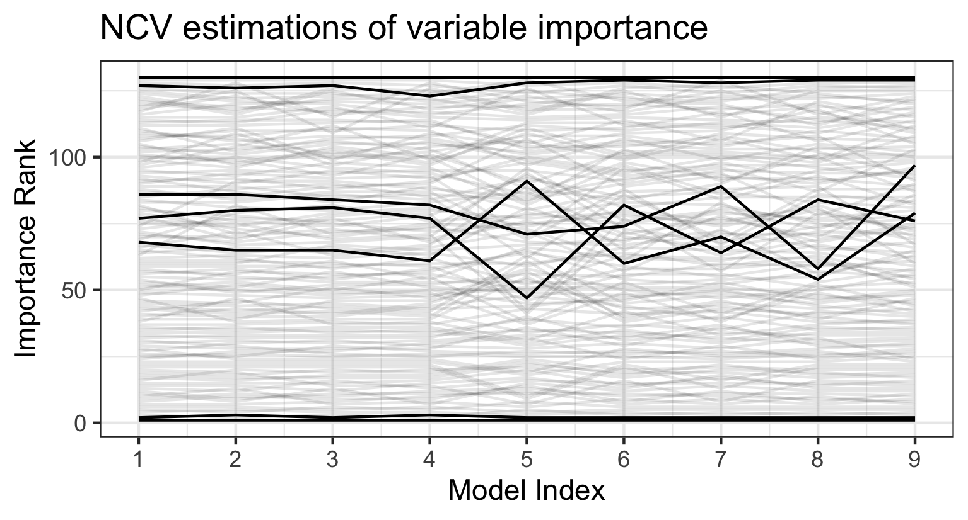

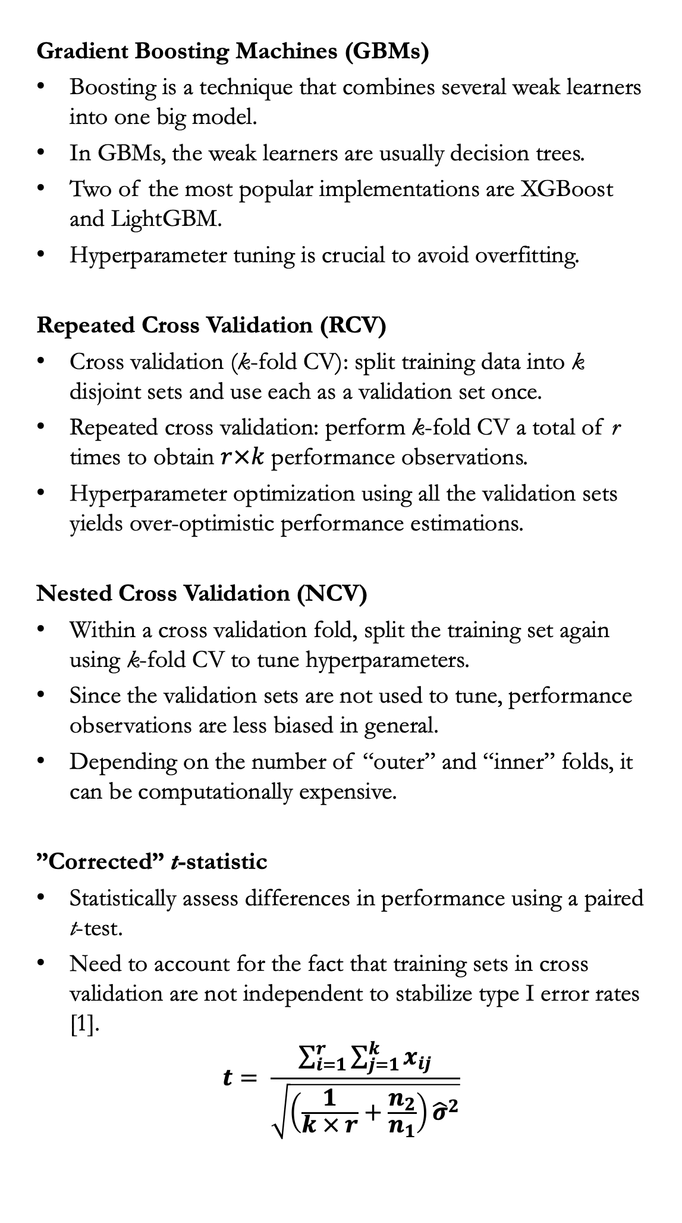
Testing Differences in Performance of Pricing Models
Jose Pliego San Martin
Duke University, Department of Statistical Science
INTRODUCTION & MOTIVATING EXAMPLE
MODELS & METHODS
CASE STUDY (I)
CASE STUDY (II)
Accurately pricing policies is key for insurance companies. Under-pricing policies results in losses for the company, while over-pricing policies may result in customers turning to competitors for a better quote or even sanctions from regulatory authorities. Gradient Boosting Machines (GBMs) have shown great predictive performance in this setting; however, they tend to be unstable since they have a lot of hyperparameters and are prone to overfitting without adequate tuning.
Example. New regulation states that insurance companies cannot use certain client characteristics in pricing models. How does the removal of these predictors affect model performance?
Gradient Boosting Machines (GBMs)
Boosting is a technique that combines several weak learners into one big model.
In GBMs, the weak learners are usually decision trees.
Two of the most popular implementations are XGBoost and LightGBM.
Hyperparameter tuning is crucial to avoid overfitting.
Repeated Cross Validation (RCV)
Cross validation (k-fold CV): split training data into k disjoint sets and use each as a validation set once.
Repeated cross validation: perform k-fold CV a total of r times to obtain $r×k$ performance observations.
Hyperparameter optimization using all the validation sets yields over-optimistic performance estimations.
Nested Cross Validation (NCV)
Within a cross validation fold, split the training set again using k-fold CV to tune hyperparameters.
Since the validation sets are not used to tune, performance observations are less biased in general.
Depending on the number of “outer” and “inner” folds, it can be computationally expensive.
”Corrected” t-statistic
Statistically assess differences in performance using a paired t-test.
Need to account for the fact that training sets in cross validation are not independent to stabilize type I error rates [1].
$$t= \frac{\sum_{i=1}^{r}{\sum_{j=1}^{k}{x_{ij}}}}{\sqrt{\left(\frac{1}{k × r}+\frac{n_{2}}{n_{1}}\right){\hat{σ}}^{2}}}$$
Claim severity data from a Kaggle competition [2].
The goal is to predict the severity associated with each claim (continuous response, MAE loss).
194,000 claims, 116 categorical predictors, 14 numerical predictors.
How does the model perform on a real Kaggle submission?
Final Test Score | Public Kaggle Score | Private Kaggle Score | Kaggle Winning Score
1127.47 | 1122.27 | 1134.54 | 1109.71
The test set accuracy overestimates the public Kaggle score and underestimates the private Kaggle score.
The public score is calculated on 30 % of a holdout set, the private score is calculated on the other 70 %.
Comparing two cross validation approaches.
Cross Validation | Avg. MAE | SD MAE | Time*
Nested RCV | 1149.73 | 10.52 | 2h 35m
Non-nested RCV | 1148.85 | 9.69 | 1h 2m
* Tested using 5 cores in parallel on a 2022 MacBook Air with 8 GB RAM and M2 chip (MacOS Ventura 13.1).
CONCLUSIONS
Both methods yield similar results, the non-nested approach seems to be slightly optimistic.
The nested procedure requires considerably more computation time.
Multiple measurements obtained with repeated cross validation yield a more robust estimation of model performance.
Differences can be statistically assessed using an adjusted paired t-test.
Repeated (nested or not) cross validation allows for easy parallelization. The number of repeats and folds can be adjusted to optimally use computational and time resources.
+
Training Data
Validation Data
REFERENCES
OBJECTIVES
[1] Nadeau, C., & Bengio, Y. (2003). Inference for the generalization error. Machine Learning, 52(3), 239-281. https://doi.org/10.1023/A:1024068626366
[2] Allstate Insurance (2016). Allstate claims severity. Kaggle. Retrieved from https://www.kaggle.com/competitions/allstate-claims-severity
Transform the model training pipeline so that it:
Allows for a more robust estimation of model performance.
Implements a procedure to test if differences in model performance are statistically significant.
Effectively adapts to different computational and time resources.
Does removing the two least important predictors affect performance?
Model | Avg. MAE | SD MAE | Avg. Diff. | t-statistic
Full | 1146.34 | 9.46 | 2.35 | 2.06
Reduced | 1143.99 | 8.51
p-value = 0.0507, obtained with a $t_{r×k−1}$ distribution.
ACKNOWLEDGEMENTS
The reduced model shows better predictive performance!
The difference in performance is not significant at a 5 % level.
This project was developed during the Summer of 2022, while the author was working as an intern Data Scientist at Liberty Mutual Insurance.

