Slide 1
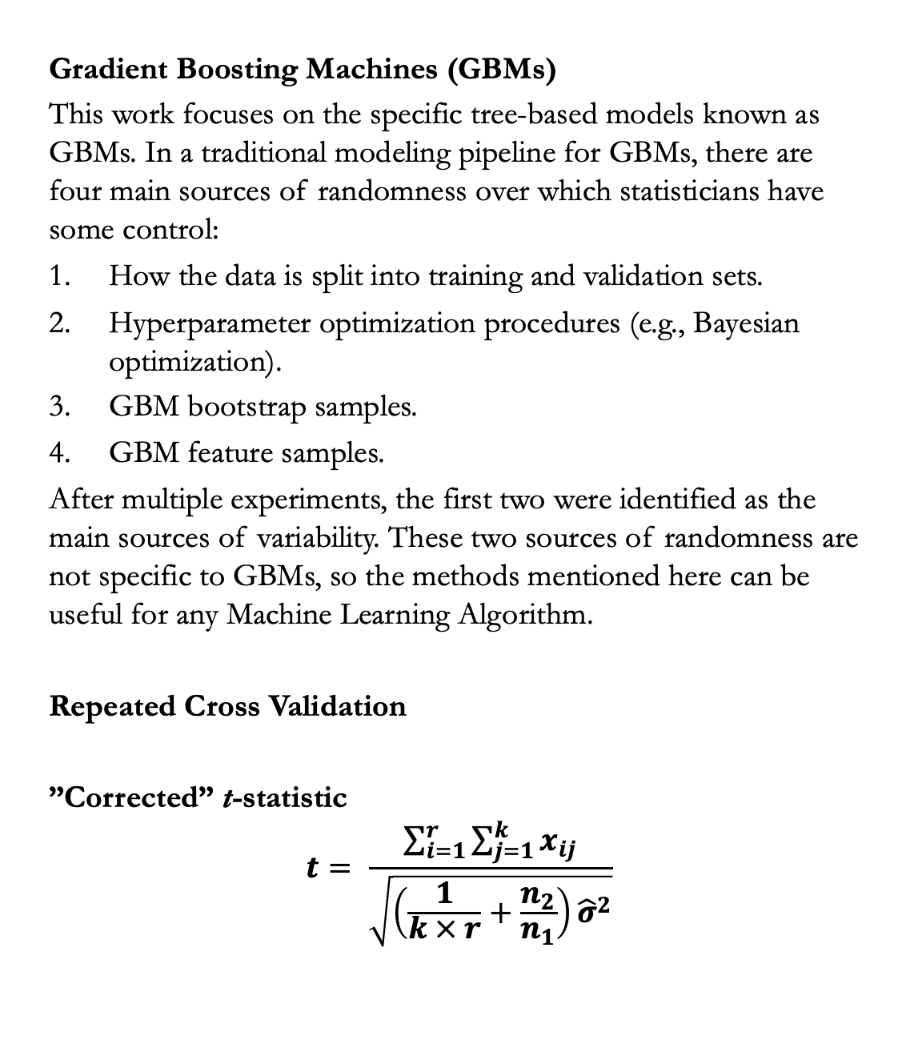
Testing Differences in Performance of Pricing Models
Jose Pliego San Martin
Duke University, Department of Statistical Science
INTRODUCTION & MOTIVATING EXAMPLE
MODELS & METHODS
CONCLUSIONS
Accurately pricing policies is key for insurance companies. Under-pricing policies results in losses for the company, while over-pricing policies may result in customers turning to competitors for a better quote or even sanctions from regulatory authorities. Tree-based models have shown great predictive performance in this setting; however, they tend to be unstable in the sense that optimal hyperparameters, the effect of different features on the response, and often predictive performance are very sensitive to changes in the training data.
EXAMPLE/FIGURE
Gradient Boosting Machines (GBMs)
This work focuses on the specific tree-based models known as GBMs. In a traditional modeling pipeline for GBMs, there are four main sources of randomness over which statisticians have some control:
How the data is split into training and validation sets.
Hyperparameter optimization procedures (e.g., Bayesian optimization).
GBM bootstrap samples.
GBM feature samples.
After multiple experiments, the first two were identified as the main sources of variability. These two sources of randomness are not specific to GBMs, so the methods mentioned here can be useful for any Machine Learning Algorithm.
Repeated Cross Validation
”Corrected” t-statistic
$$t= \frac{\sum_{i=1}^{r}{\sum_{j=1}^{k}{x_{ij}}}}{\sqrt{\left(\frac{1}{k × r}+\frac{n_{2}}{n_{1}}\right){\hat{σ}}^{2}}}$$
Write conclusions
OBJECTIVES
Design a modeling pipeline that:
Allows for a more robust estimation of model performance.
Implements a procedure to test if differences in model performance are statistically significant.
Can be easily adapted to different amounts of computational resources.
Can be used to study various model characteristics (e.g., feature importance).
REFERENCES
CONTACT INFORMATION

