Slide 1





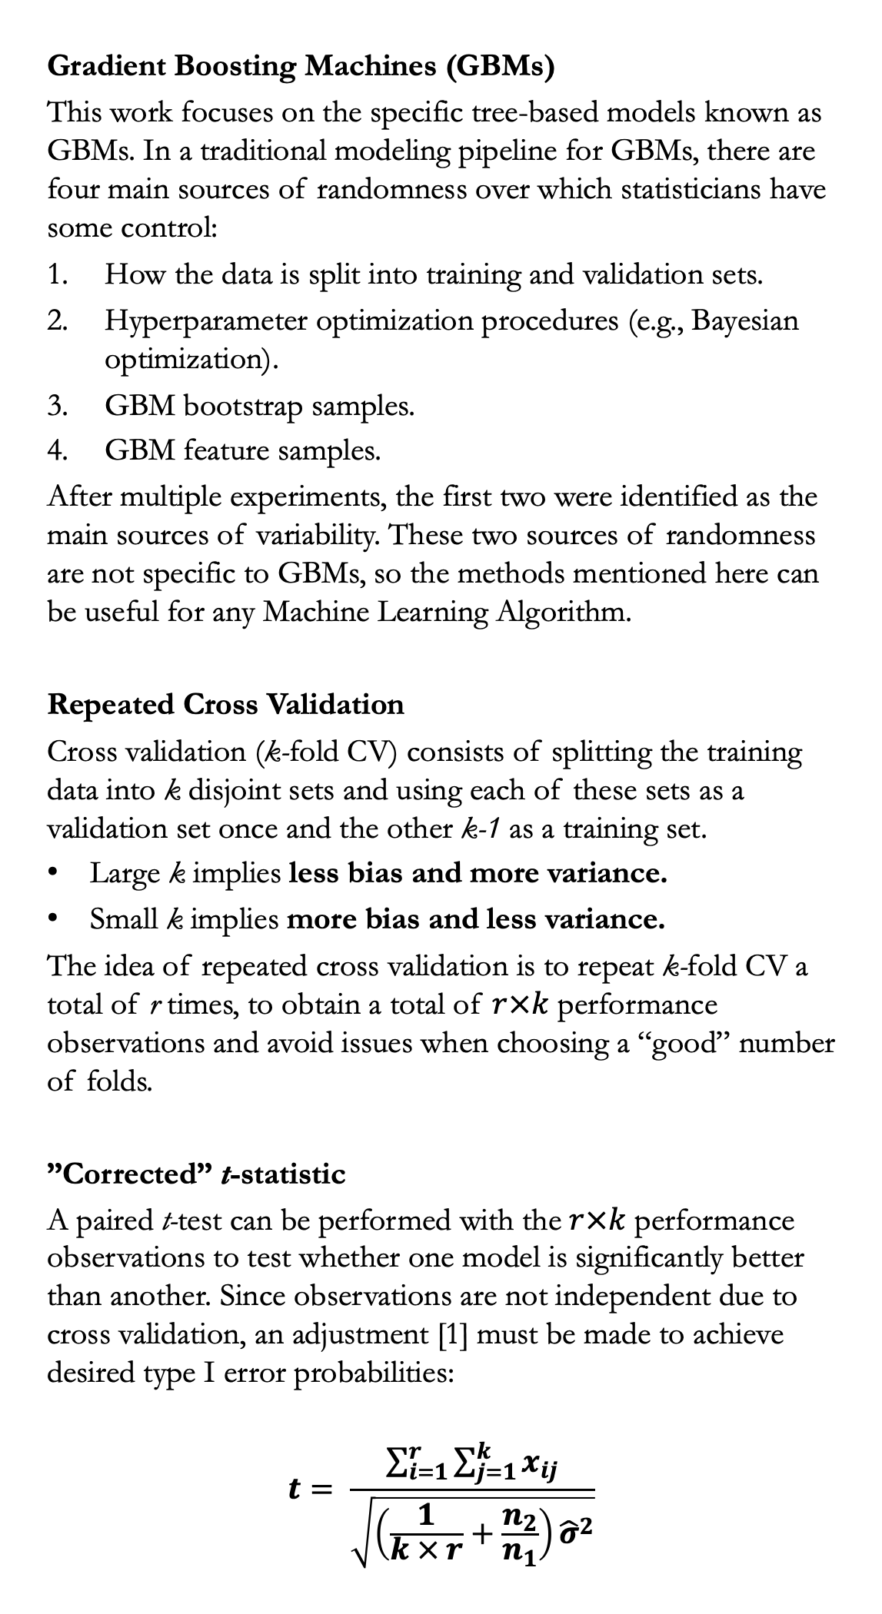
Testing Differences in Performance of Pricing Models
Jose Pliego San Martin
Duke University, Department of Statistical Science
INTRODUCTION & MOTIVATING EXAMPLE
MODELS & METHODS
CASE STUDY
CONCLUSIONS
Accurately pricing policies is key for insurance companies. Under-pricing policies results in losses for the company, while over-pricing policies may result in customers turning to competitors for a better quote or even sanctions from regulatory authorities. Gradient Boosting Machines (GBMs) have shown great predictive performance in this setting; however, they tend to be unstable since they have a lot of hyperparameters and are prone to overfitting without adequate tuning.
Example. New regulation states that insurance companies cannot use a certain client characteristic in pricing models. How does the removal of this predictor affect model performance?
Gradient Boosting Machines (GBMs)
This work focuses on the specific tree-based models known as GBMs. In a traditional modeling pipeline for GBMs, there are four main sources of randomness over which statisticians have some control:
How the data is split into training and validation sets.
Hyperparameter optimization procedures (e.g., Bayesian optimization).
GBM bootstrap samples.
GBM feature samples.
After multiple experiments, the first two were identified as the main sources of variability. These two sources of randomness are not specific to GBMs, so the methods mentioned here can be useful for any Machine Learning Algorithm.
Repeated Cross Validation
Cross validation (k-fold CV) consists of splitting the training data into k disjoint sets and using each of these sets as a validation set once and the other k-1 as a training set.
Large k implies less bias and more variance.
Small k implies more bias and less variance.
The idea of repeated cross validation is to repeat k-fold CV a total of r times, to obtain a total of $r×k$ performance observations and avoid issues when choosing a “good” number of folds.
”Corrected” t-statistic
A paired t-test can be performed with the $r×k$ performance observations to test whether one model is significantly better than another. Since observations are not independent due to cross validation, an adjustment [1] must be made to achieve desired type I error probabilities:
$$t= \frac{\sum_{i=1}^{r}{\sum_{j=1}^{k}{x_{ij}}}}{\sqrt{\left(\frac{1}{k × r}+\frac{n_{2}}{n_{1}}\right){\hat{σ}}^{2}}}$$
The models and methods introduced are applied in a real-life scenario using insurance data from a Kaggle competition [2]. The goal is to predict the severity of claims for multiple policies issued by the company.
The training data set consists of 194,000 policies. The columns are an ID column, a continuous response column (average claim severity for each policy), 116 categorical predictors, and 14 numerical predictors.
The multiple measurements obtained with repeated cross validation yield a more robust estimation of model performance.
Differences in performance can be statistically assessed using an adjusted t-test that accounts for the fact that cross validation folds are not independent.
Repeated cross validation allows for easy parallelization over multiple cores. Furthermore, the number of repeats and folds are not fixed, allowing for adaptation to different amounts of computational resources.
Since repeated cross validation fits multiple models, all of them can be used to study certain characteristics like feature importance or Shapley values (for model interpretability).
+
Training Data
Validation Data
REFERENCES
[1] Nadeau, C., & Bengio, Y. (2003). Inference for the generalization error. Machine Learning, 52(3), 239-281. https://doi.org/10.1023/A:1024068626366
[2] Allstate Insurance. Allstate claims severity. Retrieved January 2023, from https://www.kaggle.com/competitions/allstate-claims-severity/data
OBJECTIVES
Transform the model training pipeline so that it:
Allows for a more robust estimation of model performance.
Implements a procedure to test if differences in model performance are statistically significant.
Effectively adapts to different computational and time resources.
ACKNOWLEDGEMENTS
This project was developed during the Summer of 2022, while the author was working as an intern Data Scientist at Liberty Mutual Insurance.

