Slide 1
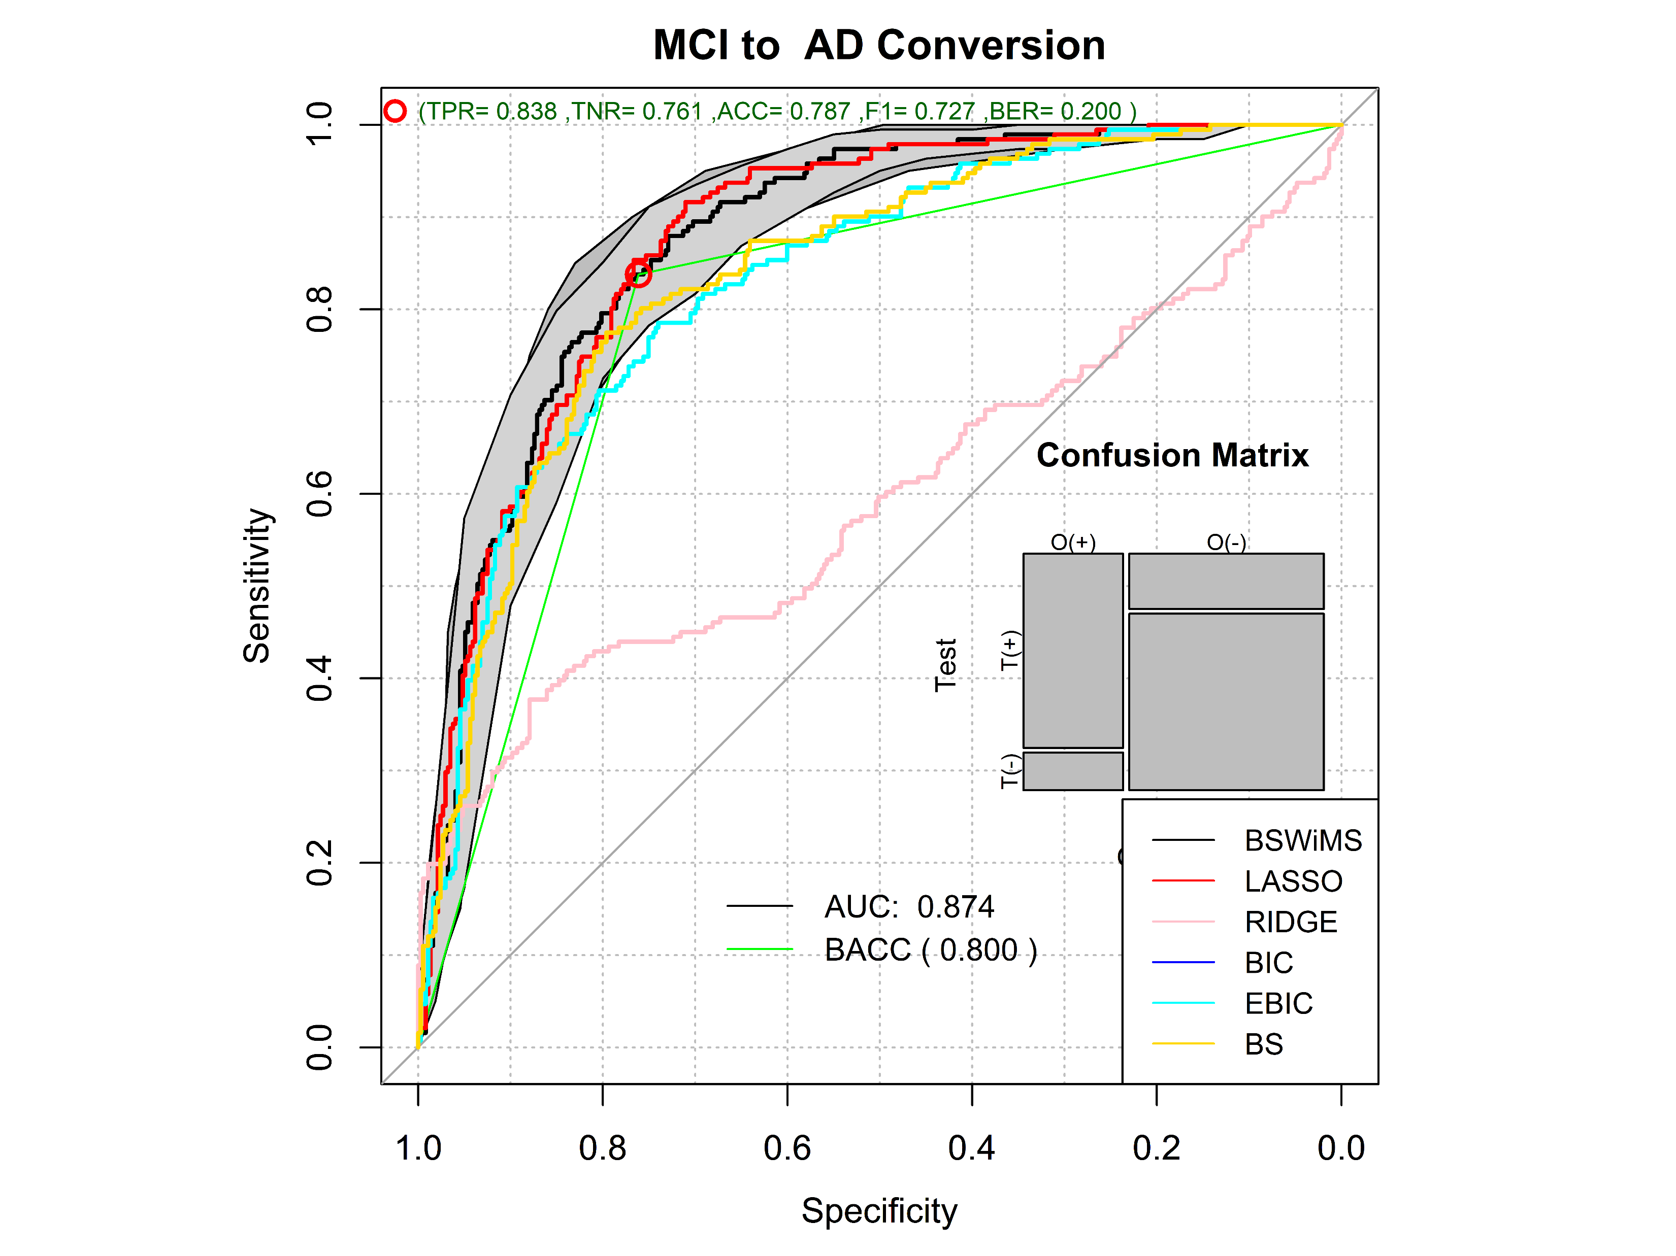
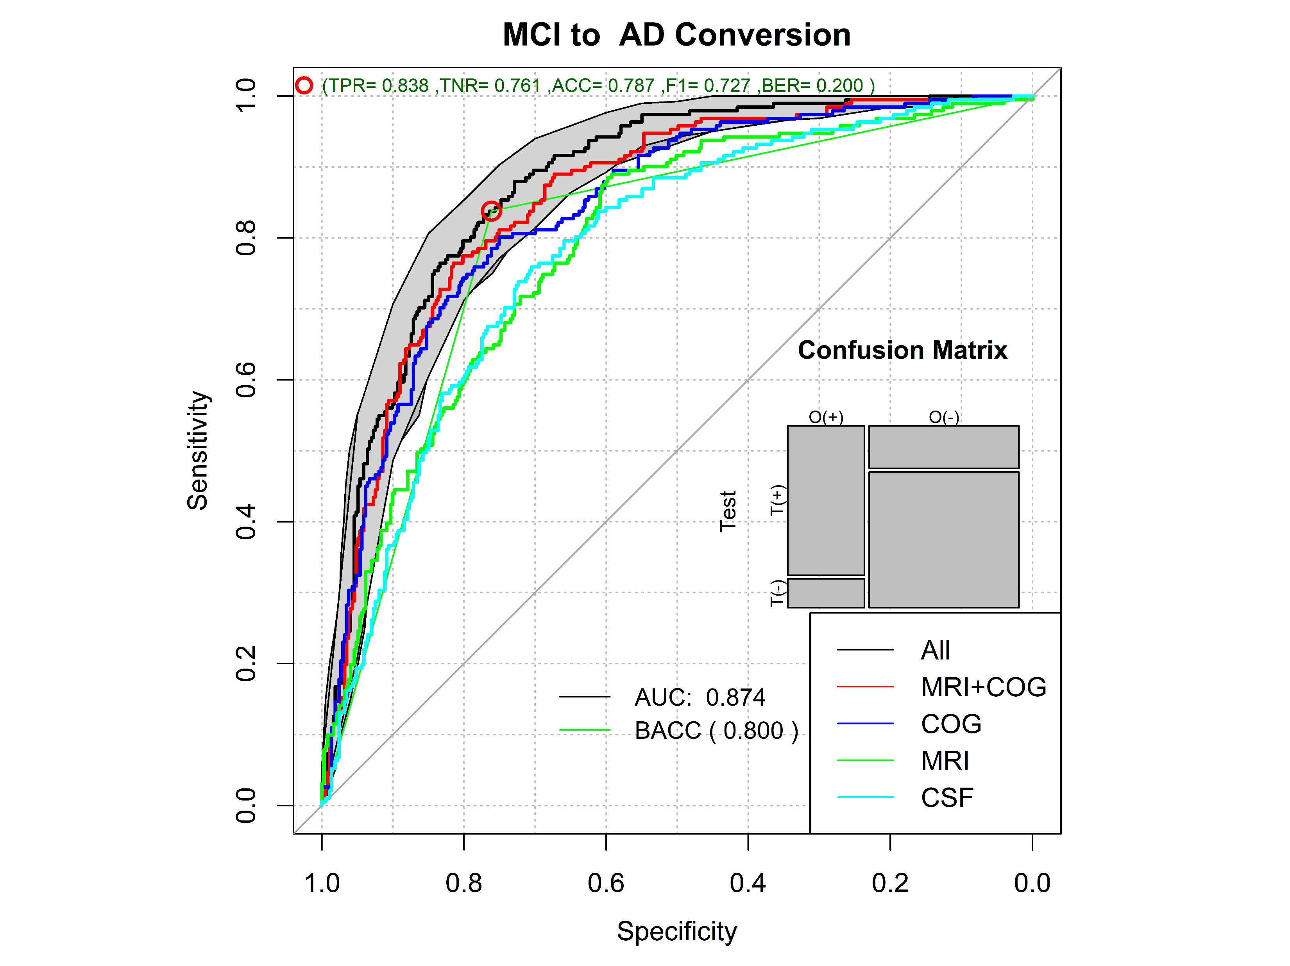
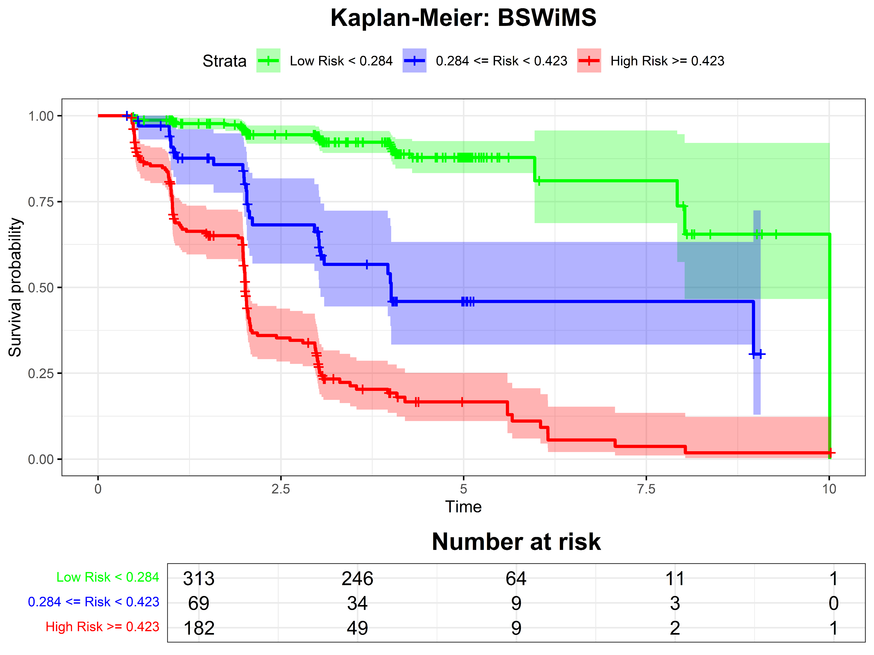
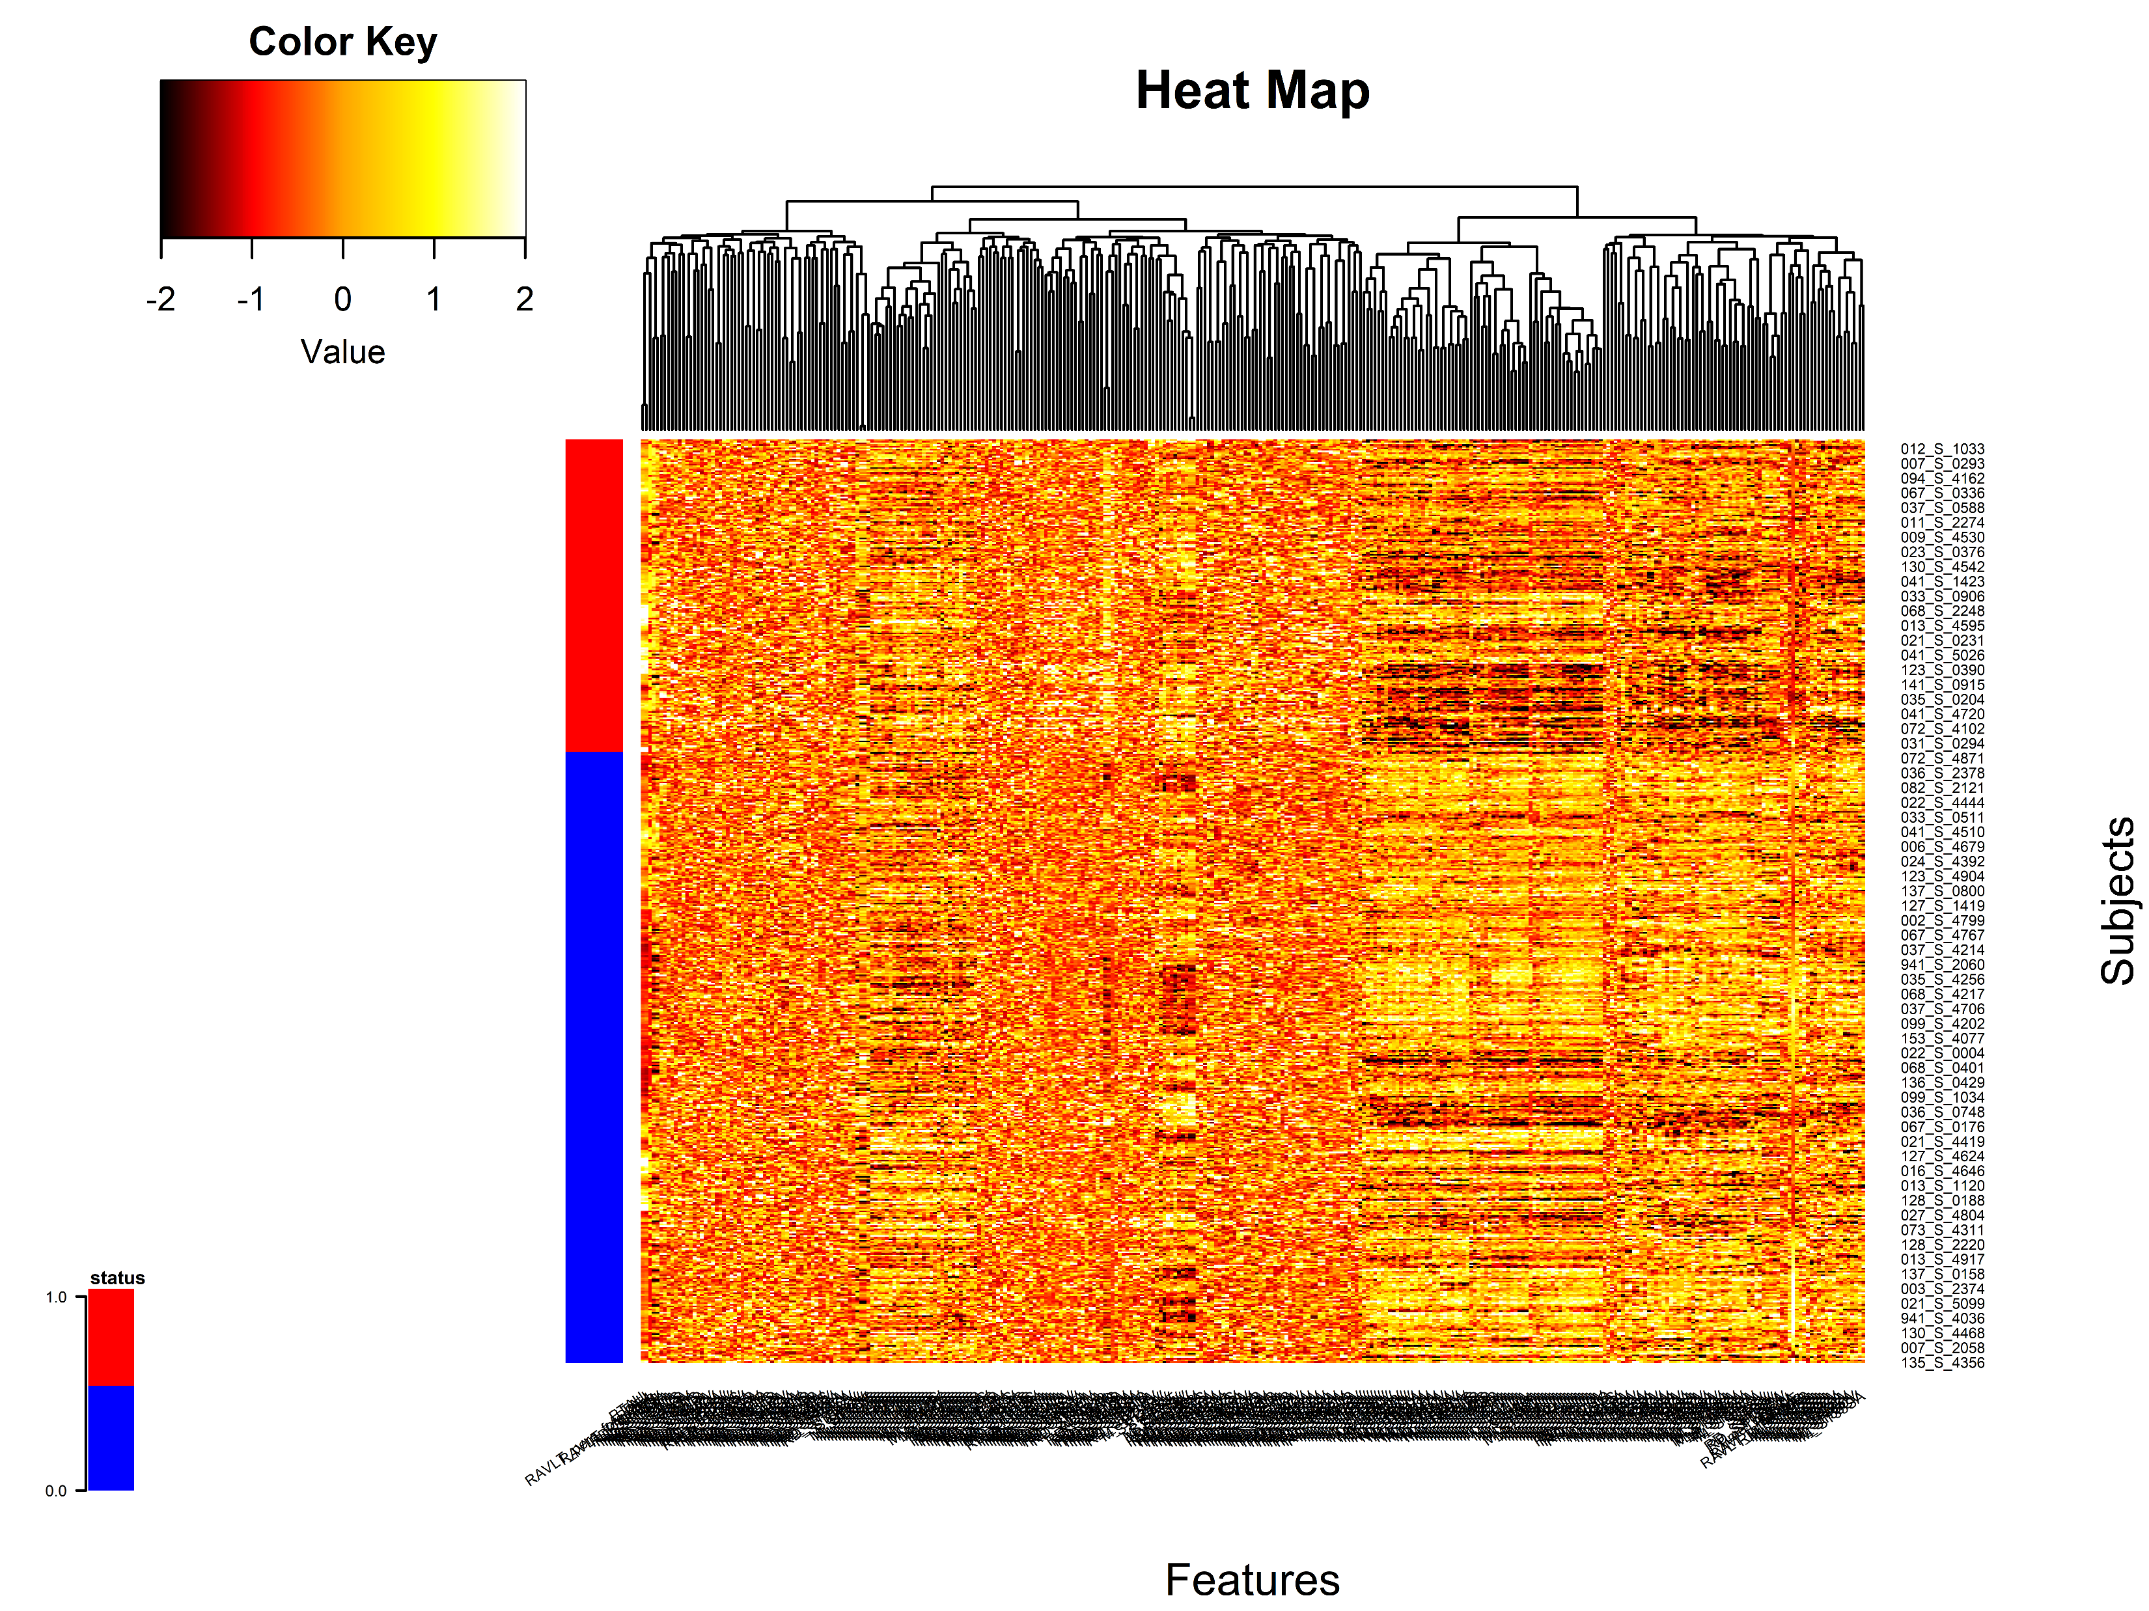
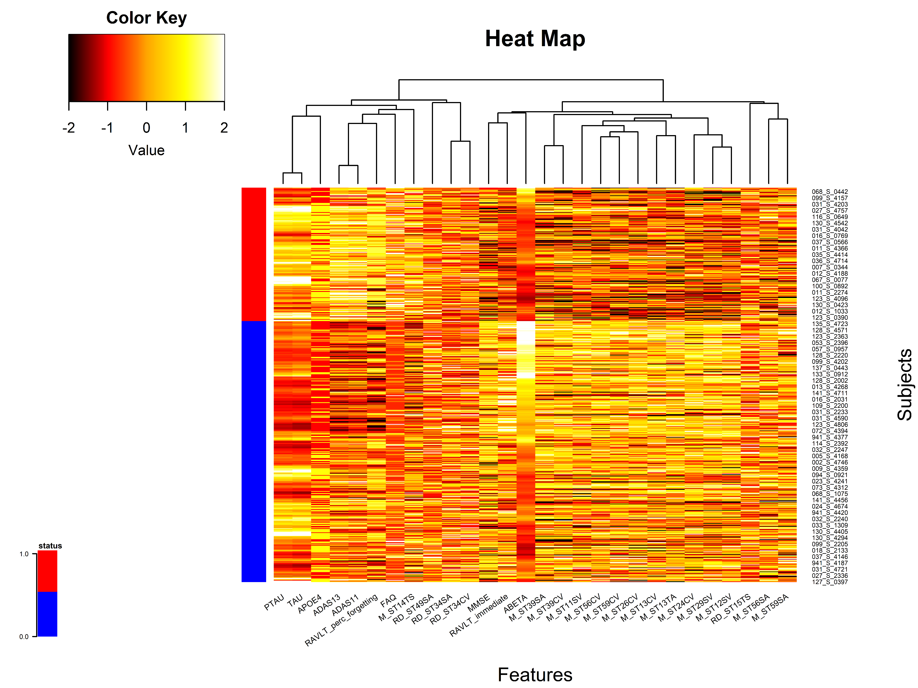
ADNI
MCI Included: 564
-Converted: 191
-No-Converted: 373
#Features: 330
Preprocessing
ML Method Comparison
LASSO
BSWiMS
BESS: BIC
BESS: EBIC
BESS: GS
RIDGE
Data Source Analysis
CSF+APOE4
Cognitive
MRI+APOE4
Cognitive + MRI
All Sources
Model/Biomarker Evaluation

