Slide 1

WELCOME, SCOTT + MATT
Operations Coordinator Onboarding
AUGUST 2026
Learn the business. Master the workflow. Own the outcome.
Notes:
Welcome Scott and Matt and explain that this is a practical introduction to how InterWork operates.
Set the expectation: business and workflow come before systems and AI.
[Sources]
- User-provided visual reference: AtlantaProject_Presentation (4).pdf, slide 1.
- C:/Users/AlejandroAcosta/Documents/ai-workstation/docs/onboarding/operations_coordinator/README.md

Slide 2
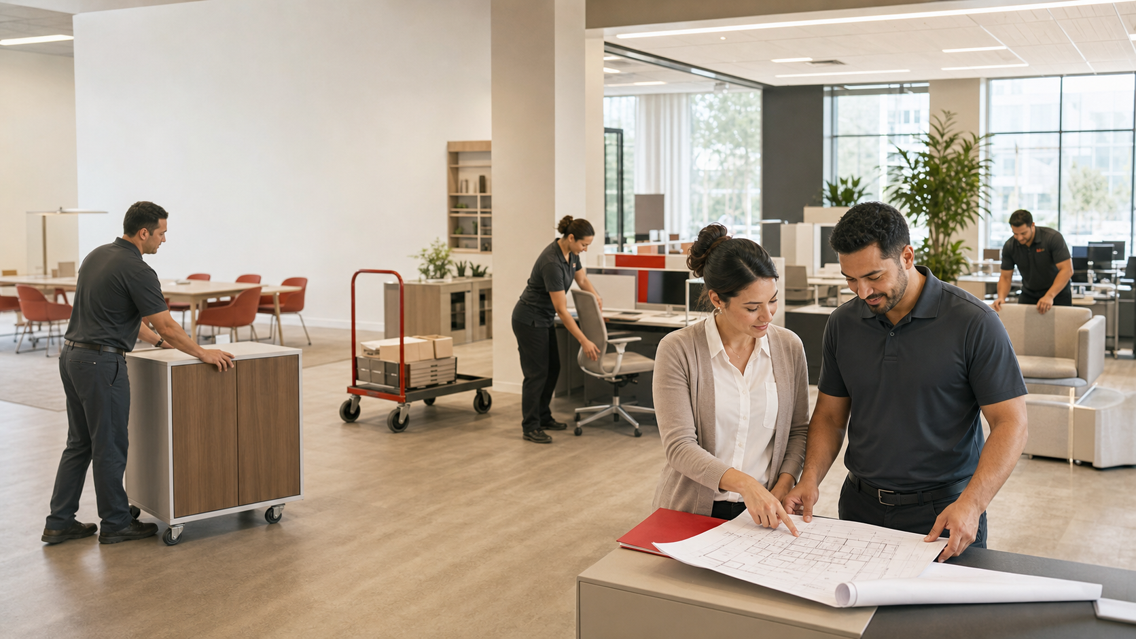
WE MAKE WORKPLACE
CHANGE HAPPEN
From planning to closeout, InterWork coordinates the people, places and details that keep projects moving.
MOVE
Relocations + restacks
REMOVE
Decommissions + disposal
INSTALL
Furniture + service calls
REPORT
Field evidence + closeout
» INTERWORK OFFICE SOLUTIONS
THE COMPANY
02
Notes:
Describe InterWork as a commercial furniture moving, installation and project-coordination company.
Explain that clients are usually facilities and real-estate teams managing workplace change.
Use one personal example of a project that went well because coordination was strong.
[Sources]
- C:/Users/AlejandroAcosta/Documents/ai-workstation/docs/onboarding/operations_coordinator/01_MODULE1_INTERWORK_FUNDAMENTALS.md
- AI-generated visual created for this deck; no external visual source.

Slide 3
EVERY PROJECT IS A TEAM SPORT
Clear ownership keeps information, commitments and field execution aligned.
AM
OP
FP
POC
Account Manager
Office PM
PROJECT
Field PM
Client / Building
Quote + client relationship
Schedule + coordination
On-site execution
Access + decisions
#
one shared identifier
TEAM
SCOTT + MATT: OPERATIONS
FRANCISCO: FIELD ESCALATION
Crew / Partner
Physical work + evidence
» INTERWORK OFFICE SOLUTIONS
WHO IS WHO
03
Notes:
Explain each role using a current project example.
Account Manager owns the quote and client relationship. Office PM owns administrative coordination. Field PM leads execution.
Client and building contacts may be different people. Crew or vendor details remain internal in client-facing communication.
The project number connects every role and every source.
[Sources]
- C:/Users/AlejandroAcosta/Documents/ai-workstation/docs/onboarding/operations_coordinator/01_MODULE1_INTERWORK_FUNDAMENTALS.md
- C:/Users/AlejandroAcosta/Documents/ai-workstation/memory/references/interwork_people_map.md

Slide 4
ONE PROJECT NUMBER. SIX CONTROL POINTS.
The workflow protects the client experience before, during and after execution.
01
02
03
04
05
06
QUOTE
SCHEDULE
ASSIGN
CONFIRM
EXECUTE
CLOSE
Scope + project number
Calendar + record
Office PM + field team
Client + access + crew
Field PM + FastField
WC report + completion
CONFIRMED FACTS MOVE FORWARD. OPEN QUESTIONS STAY VISIBLE.
» INTERWORK OFFICE SOLUTIONS
THE WORKFLOW
04
Notes:
Walk through the six stages in order.
Emphasize that scheduled does not mean fully confirmed.
FastField is submitted by the field PM after execution. Closeout includes the work-completion report and completion communication.
[Sources]
- C:/Users/AlejandroAcosta/Documents/ai-workstation/docs/onboarding/operations_coordinator/02_MODULE2_PROJECT_LIFECYCLE_AND_EXAMPLES.md
- C:/Users/AlejandroAcosta/Documents/ai-workstation/memory/company_knowledge/OPERATING_WORKFLOW.md

Slide 5
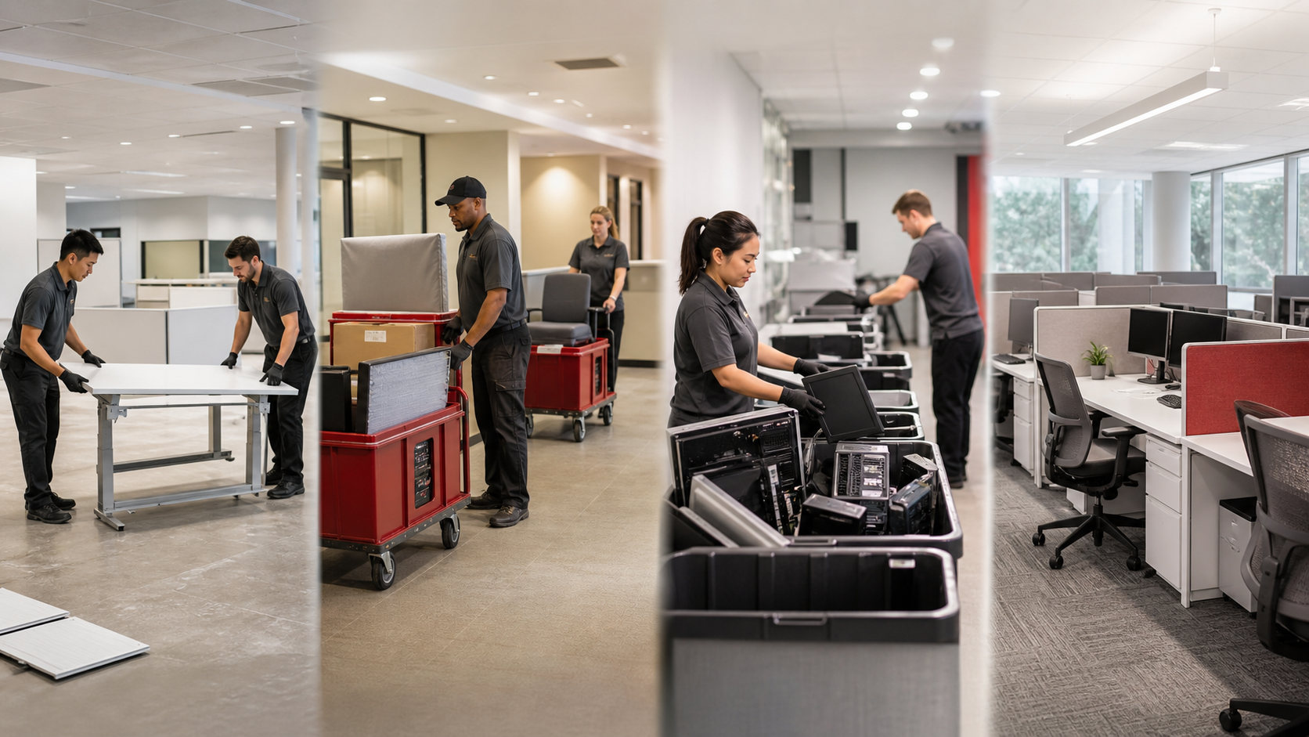
THE WORK CHANGES. THE COORDINATION DISCIPLINE DOESN'T.
Four project types show the range Scott and Matt will learn to manage.
DECOMMISSION
RELOCATION
E-WASTE
INSTALLATION
#7492
#7350
#7594
#7547
Remove + recycle
Move + reinstall
Sort + dispose
Deliver + complete
Different scope. Same habits: verify • confirm • communicate • document
» INTERWORK OFFICE SOLUTIONS
PROJECT EXAMPLES
05
Notes:
Use the four examples as short stories, not detailed case studies.
Call out one coordination judgment from each: separate internal issues from client communication; use the latest confirmed scope; keep excluded scope excluded; resolve drawing/access discrepancies before field work.
[Sources]
- C:/Users/AlejandroAcosta/Documents/ai-workstation/docs/onboarding/operations_coordinator/02_MODULE2_PROJECT_LIFECYCLE_AND_EXAMPLES.md
- AI-generated project collage created for this deck; no external visual source.

Slide 6





EACH SYSTEM HAS ONE CLEAR JOB
Scott and Matt will learn what to trust, where to work and when to escalate.
Q
✓
CC
FF
QuickQuo
Smartsheet
Command Center
Supabase
FastField
Quote + project #
Schedule
Operational view
Operational truth
Field evidence
Outlook
Teams
GitHub
Claude
Client communication
Internal coordination
Shared memory
Research + drafting
» INTERWORK OFFICE SOLUTIONS
SYSTEMS
06
Notes:
QuickQuo creates the quote and project number. Smartsheet is the schedule. Command Center displays Supabase. Supabase is operational truth. FastField captures field evidence.
Outlook and Teams are human communication tools. GitHub stores durable project memory. Claude helps research and draft, but does not replace operational judgment.
Do not teach passwords or administrative access on this slide; access is staged separately.
[Sources]
- C:/Users/AlejandroAcosta/Documents/ai-workstation/docs/onboarding/operations_coordinator/03_MODULE3_SYSTEMS_AND_SOURCES_OF_TRUTH.md
- C:/Users/AlejandroAcosta/Documents/ai-workstation/docs/onboarding/operations_coordinator/04_MODULE4_AI_AND_SHARED_KNOWLEDGE.md
- Supabase, GitHub and Anthropic marks: Simple Icons (cdn.jsdelivr.net/npm/simple-icons@v15).
- Teams and Outlook marks: Iconify icon catalog.

Slide 7
AI COMES AFTER THE FUNDAMENTALS
It helps Scott and Matt find, prepare and preserve the work—not guess or bypass the workflow.
1
2
3
4
5
FIND
UNDERSTAND
DRAFT
REVIEW
PRESERVE
Project number first
Live state + project context
Briefs, emails and dispatches
Human judgment before action
Update shared project memory
DRAFT FREELY
SEND / WRITE ONLY AFTER APPROVAL
No invented facts • No secrets in chat • No silent conflict resolution
» INTERWORK OFFICE SOLUTIONS
SHARED KNOWLEDGE
07
Notes:
This is the first AI-focused slide. Reinforce that the company and workflow were intentionally taught first.
Show the safe progression: find, understand, draft, review, preserve.
During onboarding, all sends and live writes remain routed through Alejandro. Week 2 determines any future authority individually.
[Sources]
- C:/Users/AlejandroAcosta/Documents/ai-workstation/docs/onboarding/operations_coordinator/04_MODULE4_AI_AND_SHARED_KNOWLEDGE.md
- C:/Users/AlejandroAcosta/Documents/ai-workstation/memory/company_knowledge/ACCESS_AND_SAFETY_RULES.md

Slide 8
TWO WEEKS: FROM CONTEXT TO CONTROLLED OWNERSHIP
Scott and Matt train together, practice independently and earn trust individually.
DAY 1
DAY 2
DAY 3
DAYS 4–7
DAYS 8–10
1
2
3
4
5
COMPANY
WORKFLOW
SYSTEMS
PRACTICE
OWNERSHIP
What we do + who is who
Lifecycle + real examples
Sources of truth + AI
Watch → do → reverse shadow
Small portfolio + review
DAY 10: INDIVIDUAL COMPETENCY + AUTHORITY DECISION
» INTERWORK OFFICE SOLUTIONS
TRAINING PLAN
08
Notes:
Explain that the plan deliberately moves from context to systems to controlled work.
Scott and Matt will be evaluated separately even when working on the same scenario.
All external communications and live updates remain reviewed during onboarding.
[Sources]
- C:/Users/AlejandroAcosta/Documents/ai-workstation/docs/onboarding/operations_coordinator/05_MODULE5_TRAINING_AGENDA.md
- C:/Users/AlejandroAcosta/Documents/ai-workstation/docs/onboarding/operations_coordinator/08_COMPETENCY_SIGNOFF_SCOTT.md
- C:/Users/AlejandroAcosta/Documents/ai-workstation/docs/onboarding/operations_coordinator/08_COMPETENCY_SIGNOFF_MATT.md

Slide 9
SUCCESS LOOKS LIKE...
FIND THE TRUTH
CONFIRM THE DETAILS
COMMUNICATE CLEARLY
PROTECT THE CLIENT
ESCALATE EARLY
LEAVE A CLEAN HANDOFF
Learn the business first. The systems will help you execute it.
WELCOME TO INTERWORK
» INTERWORK OFFICE SOLUTIONS
READY TO BEGIN
09
Notes:
Close by making success behavioral, not technical.
Invite questions and transition Scott and Matt to Module 1 and the detailed onboarding materials.
[Sources]
- C:/Users/AlejandroAcosta/Documents/ai-workstation/docs/onboarding/operations_coordinator/01_MODULE1_INTERWORK_FUNDAMENTALS.md
- C:/Users/AlejandroAcosta/Documents/ai-workstation/docs/onboarding/operations_coordinator/05_MODULE5_TRAINING_AGENDA.md

