Slide 1
Cluster analysis

Slide 2
AGENDA OF THIS SESSION
Cluster analysis – the basic concept
Conducting Cluster analysis – the steps involved
Case study

Slide 3
Cluster analysis – the basic concept

Slide 4
CLUSTER ANALYSIS IS AN INTERDEPENDENCE TECHNIQUE USED TO CLASSIFY OBJECTS INTO RELATIVELY HOMOGENEOUS GROUPS
What is Cluster analysis?
  An interdependence technique used to classify objects into relatively homogeneous groups called clusters
What are the similarities / differences between Factor analysis, and Cluster analysis?
  Similarity: Both techniques examine an entire set of interdependent relationships
  Difference: Cluster analysis is the obverse of Factor analysis since it reduces the number of objects not the number of variables

Slide 5
Conducting Cluster analysis – the steps involved

Slide 6
STEP-1: FORMULATE THE PROBLEM
Formulate the problem (Select variables that form the basis for clustering)
  Select variables describe the similarity between objects in terms that are relevant to the marketing problem
  Select variables based on past research, theory or consideration of hypotheses to be tested
  Consult experts in the category

Slide 7
STEP-2: SELECT A DISTANCE OR SIMILARITY MEASURE
Similarity between people, units, or objects can be quantified using either correlation metrics or distance metrics.
Select as distance or similarity measure
  Measure similarity in terms of distance between objects
    Similarity α 1/distance
    Measures of similarity:
      Euclidean distance {∑(V_{ai} – V_{bi})²}^{1/2}
      City block or Manhattan distance {∑|V_{ai} – V_{bi}|}
      Chebychev distance Max {|V_{ai} – V_{bi}|}
Similarity Measures for Categorical Variables
Pairs of items can be compared based on the presence or absence of
characteristics. Similar items have more characteristics in common than
dissimilar items.

Slide 8
Examples of Clustering Applications
Marketing: Help marketers discover distinct groups in their customer bases, and then use this knowledge to develop targeted marketing programs.
Land use: Identification of areas of similar land use in an earth observation database.
Insurance: Identifying groups of motor insurance policy holders with a high average claim cost.
City-planning: Identifying groups of houses according to their house type, value, and geographical location.
Earth-quake studies: Observed earth quake epicenters should be clustered along continent faults.

Slide 9
STEP-3: SELECT A CLUSTERING PROCEDURE
Select a clustering procedure
  Hierarchical (a procedure characterized by a tree-like structure)
  Non hierarchical (K-means clustering- a procedure that assigns a cluster center and groups all objects within a specified threshold)
Clustering procedures
Hierarchical
Non-hierarchical
Divisive
Agglomerative
Linkage
methods
Variance
methods
Centroid
methods
Sequential
threshold
Parallel
threshold
Optimizing
partitioning
Ward’s
method
Minimize within cluster variance
Minimum
distance
Maximum
distance
Single
linkage
Complete
linkage
Average
linkage
Select seed, and threshold
Combine all objects within the threshold
No reconsidering
Average
distance

Slide 10
HIERARCHICAL CLUSTERING PROCEDURES
Single linkage – (Minimum distance or Nearest neighbor rule)
Complete linkage – (Maximum distance or Farthest neighbor rule)
Average linkage – (Average of the distances between all pairs)
Ward’s method (Combine clusters with minimum increase in sum of distances of the objects within the cluster form the mean)
Centroid method (distance between clusters is distance between their centroids)
Cluster1
Cluster2

Slide 11
NON-HIERARCHICAL CLUSTERING PROCEDURES
Sequential threshold
  Select seed, and threshold
  Combine all objects within the threshold; Select new seed, and repeat the process for the unclustered objects (Objects clustered once, would not be considered for clustering again)
Parallel threshold
  Select several seeds, and a threshold
  Combine objects within the threshold value are grouped with the nearest center
Optimizing partitioning
  Differs from the foregoing methods by virtue of ‘Reassignment of objects to clusters’ to optimize an overall criterion like average Within cluster distance

Slide 12
STEP-3: SELECT A CLUSTERING PROCEDURE
Question: What are the advantages, and disadvantages of non-hierarchical clustering?
Answer:
  Advantages: Faster, and has merit when the number of objects is large
  Disadvantages: Number of clusters must be pre-specified
  Selection of cluster centers is arbitrary
  Clustering solution depends on order of objects
What is the practice? Obtain an initial clustering solution using a hierarchical procedure such as Ward’s, and use the number of clusters, and cluster centroids as inputs to the optimizing partitioning method

Slide 13
STEP-4: DECIDE ON THE NUMBER OF CLUSTERS
Decide on the number of clusters:
  Theoretical, conceptual or practical considerations might suggest a number
  In hierarchical clustering, distances at which clusters are combined can be used as a criteria – get this info from agglomeration schedule or dendrogram
  In non-hierarchical clustering, ratio of Within group variance to between group variance can be plotted against the number of clusters – point at which an elbow occurs indicates the number of clusters
  Relative sizes of the clusters should be meaningful

Slide 14
STEP-5: INTERPRET AND PROFILE THE CLUSTERS
Interpret, and profile the clusters
  Examine the cluster centroids – use Discriminant analysis for the centroids if the clustering algorithm does not indicate them
  Profile clusters based on variables that were not used for clustering
  Identify variables that significantly differentiate between clusters using Discriminant analysis or ANOVA
    Significant differences across not only Clustering variables but also Descriptive variables, indicates presence of Natural clusters

Slide 15
EXHIBIT2: DENDROGRAM
The dendrogram (or "tree diagram") shows relative similarities between cases
Notice how the "branches" merge together as you look from left to right in the dendrogram
Cases or clusters that are joined by lines "further down" the tree (near the left side of the dendrogram) are very similar
Cases or clusters that are joined by lines "further up" the tree (near the right side) are dissimilar
Cluster distances are rescaled so that they range from 0 to 25 in this plot
It can help to see different cluster solutions by imagining a vertical line through the dendrogram

Slide 16
CLUSTERS THAT ARE COMBINED AT EACH STAGE
Stage
At each stage, one case or cluster is joined with another case or cluster
1
2
7
2
2
3
3
4
11
4
1
12
When clusters or cases are joined, they are subsequently labeled with the smaller of the two cluster numbers.
5
4
9
…
1
10
2
11
1
4
1

Slide 17
STEP-6: ASSESS RELIABILITY, AND VALIDITY
Assess Reliability, and Validity
  Perform cluster analysis on the same data using different distance-measures, and compare the results across measures to determine stability of the solution
  Use different methods of clustering and compare the results
  Split the data randomly into two halves; Perform clustering separately on each half;
  Compare cluster centroids across the two sub-samples
  Delete variables randomly, and compare result of clustering of the reduced set of variables with that of the original set
  In case of non-hierarchical clustering, make multiple runs using different order of the cases until the solution stabilize
Note: Units of measurement of the variables influence the clustering solution
Standardize the variables Eliminate outliers

Slide 18
RECAP: STEPS INVOLVED IN CLUSTER ANALYSIS
Steps involved in Cluster analysis
  Formulate the problem
  Select a similarity measure
  Select a clustering procedure
  Decide on the number of clusters
  Interpret, and profile the clusters
  Assess Reliability, and Validity

Slide 19
Discriminant Analysis

Slide 20
Discriminant Analysis - Introduction
Discriminant analysis is a statistical technique used in marketing and the Social sciences.
It is applicable when there is only one dependent variable but multiple Independent variables (similar to ANOVA and Regression).
But unlike ANOVA and Regression Analysis, the dependent variable must be categorical.
Similar to Logistic regression, but Logistic Regression does not make any assumptions of normality, linearity, and homogeneity of variance for the independent variables.
When the variables satisfy the assumptions of normality, linearity, and homogeneity of variance, discriminant analysis is generally cited as the more effective statistical procedure for evaluating relationships with a non-metric dependent variable.

Slide 21
Discriminant Analysis – Various Definitions
Statistical technique for distinguishing between two groups on the basis of
their observed characteristics.
Discriminant analysis can be used only for classification (i.e., with a
categorical target variable), not for regression. The target variable may have
two or more categories.
Discriminant function analysis involves the predicting of a categorical
dependent variable by one or more continuous or binary independent
variables. It is useful in determining whether a set of variables is effective in
predicting category membership.
Notes:
Originally developed in 1936 by R.A. Fisher

Slide 22
Discriminant Analysis – Example
Suppose we want to know whether somebody has lung cancer.
Hence, we wish to predict a ‘yes’ or ‘no’ outcome.
Possible predictor variables:
a) Number of cigarettes smoked a day,
b) Coughing frequency and
c) Coughing Intensity etc.
Note: The criterion variable (also called grouping variable) is the object
of classification. This is ALWAYS a categorical variable!!!

Slide 23
Discriminant Analysis - Assumptions
The underlying assumptions of Discriminant Analysis (DA) are:
  Each group is normally distributed, Discriminant Analysis is relatively robust to departures from normality.
  The groups defined by the dependent variable exist a priori.
  The Predictor variable, X_{k} are multivariate normally distributed, independent, and non-collinear
  The variance/covariance matrix of the predictor variable across the various groups are the same in the population, (i.e. Homogeneous)
  The relationship is linear in its parameters
  Absence of leverage point outliers
  The sample is large enough say 30 cases for each Predictor Variable.

Slide 24
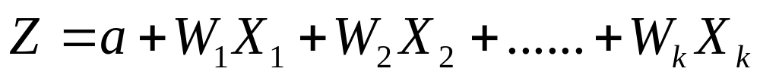
Discriminant Function
Linear discriminant analysis constructs one or more discriminant equations (linear combinations of the predictor variables X_{k}) such that the different groups differ as much as possible on Z.
Where,
Z = Discriminant score, a number used to predict group membership of a
case
a = Discriminant constant
W_{k} = Discriminant weight or coefficient, a measure of the extent to which variable X_{k} discriminates among the groups of the DV
X_{k} = An Independent Variable or Predictor variable. Can be metric or nonmetric.
Number of discriminant functions = min (number of groups – 1, k).
k = Number of predictor variables.

Slide 25
Discriminant Function : Interpretation
i.e., the weights are chosen so that were you to compute a discriminant score for each subject and then do an ANOVA on Z.
More precisely, the weights of the discriminant function are calculated in such a way, that the ratio (between groups SS)/(within groups SS) is as large as possible.
The value of this ratio is the eigenvalue
First discriminant function Z₁ distinguishes first group from groups 2,3,..N.
Second discriminant function Z₂ distinguishes second group from groups 3, 4…,N. etc
Note : Discriminant analysis uses OLS to estimate the values of the
parameters (a) and W_{k} that minimize the Within Group SS.

Slide 26
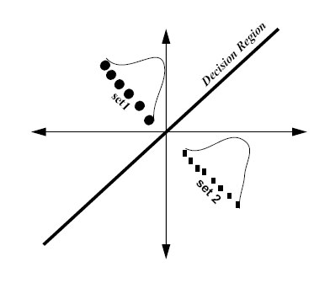
Visualization
Two outcomes
Three Outcomes

Slide 27
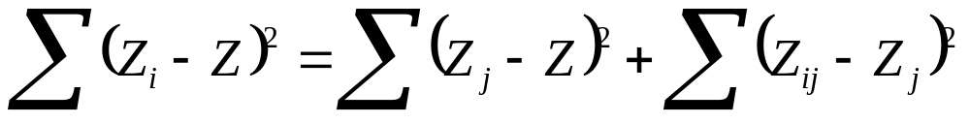
Partitioning Sums Of Squares in Discriminant Analysis
In Linear Regression:
Total sums of squares are partitioned into Regression sums of squares
and Residual sums of squares.
And Goal is to estimate parameters that minimize the Residual SS.
In Discriminant Analysis:
The Total sums of squares is partitioned into Between Group sums of squares and Within Groups sums of squares
Within Groups Sums of Squares
Total Sums of Squares
Between Groups sums of squares

Slide 28
Partitioning Sums Of Squares in Discriminant Analysis (Cont..)
Where,
i = an individual case,
j = group j
Z_{i} = individual discriminant score
Z = grand mean of the discriminant scores
Z_{j} = mean discriminant score for group j
Here, Goal is to estimate parameters that minimize the Within Group Sums of
Squares

Slide 29
Discriminant Analysis Vs Logistic Regression
Sr. No. | Logistic Regression | Discriminant Analysis
1. | Having a dummy coded dependent variable | Having a nonmetric dependent variable with 2 or more groups
2. | Limited to a binary nonmetric dependent variable | Not limited to a binary nonmetric dependent variable
3. | Makes relatively few restrictive assumptions | Makes several restrictive assumptions

Slide 30
Steps in Discriminant Analysis Process
Specify the dependent & the predictor variables
Test the model’s assumptions a priori
Determine the method for selection and criteria for entering the predictor variables into the model
Estimate the parameters of the model
Determine the goodness-of-fit of the model and examine the residuals
Determine the significance of the predictors
Test the assumptions
Validate the results

Slide 31
Factor analysis

Slide 32
AGENDA OF THIS SESSION
Factor-analysis – the basic concept
Conducting Factor analysis – the steps involved
Case-study

Slide 33
Factor analysis - the basic concept

Slide 34
FACTOR ANALYSIS IS AN INTERDEPENDENCE TECHNIQUE USED FOR DATA-REDUCTION AND SUMMARIZATION
What is Factor analysis?
  It is an interdependence technique used primarily for data-reduction and summarization
When is Factor analysis used?
  To identify underlying dimensions or factors that explain the correlations among a set of variables
  To identify a new, smaller set of uncorrelated variables to replace the original set of variables in subsequent analysis
  To identify a smaller set of salient variables from a larger set for use in subsequent analysis

Slide 35
Cont…
What is a factor*?
  It is an underlying dimension that explains the correlations among a set of variables
  * Please note that the term factor is being used interchangeably with a principal-component here; we will return to the distinction at a later stage

Slide 36
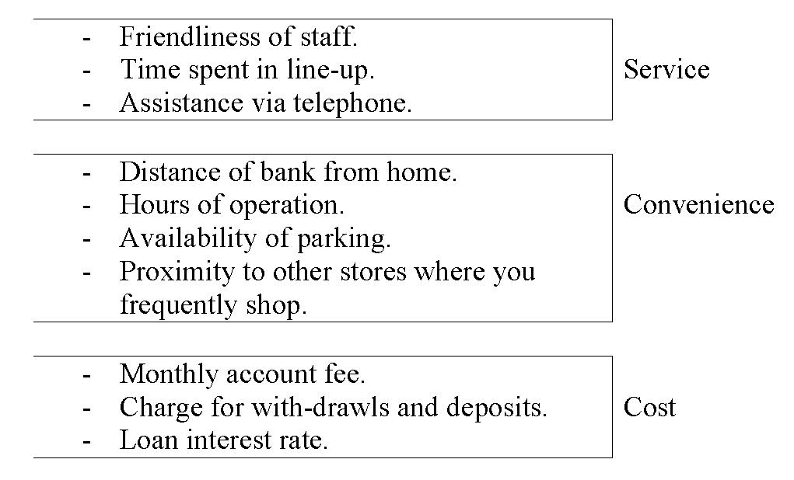
Factor Analysis - Example

Slide 37
Conducting Factor analysis – the steps involved

Slide 38
STEP-1: FORMULATE THE PROBLEM
Formulate the problem
  Select variables based on the following criteria
    Objective of the study
    Past research, theory, and expert opinion
  Ensure that the variables selected are measured on an interval or ratio scale
  Check if the sample-size is adequate
    A rough guideline: Sample-size ≥ 5 times the number variables
Exhibit-1: Variables short listed for factor-analysis

Slide 39
EXHIBIT-1: VARIABLES SHORT-LISTED FOR FACTOR ANALYSIS
Researcher wants to seek the underlying benefits consumers seek from the purchase of a toothpaste. Data has been collected from a sample of 30 respondents. Respondents were asked to indicate their degree of agreement with the following statements using a five point scale (1= Strongly agree, 5: Strongly disagree)
V₁: It is important to buy a toothpaste that prevents cavities
V₂: I like a toothpaste that gives shiny teeth
V₃: A toothpaste should strengthen your gums
V₄: I prefer a toothpaste that freshens breath
V₅: Prevention of tooth decay is not an important benefit offered by a toothpaste
V₆: The most important consideration in buying a toothpaste is attractive teeth

Slide 40
STEP-2: CONSTRUCT THE CORRELATION MATRIX, AND TEST APPROPRIATENESS OF THE FACTOR ANALYSIS
Construct the correlation-matrix
  Examine the correlations to get a preliminary idea of the appropriateness of the factor-analysis Exhibit-2a: Correlation-matrix
  Use formal statistical tests to determine appropriateness of factor-analysis
    H₀: Proportion of common-variance in the data is high
      Statistic: (Kaiser's )KMO MSA
      Accept H_{o} if KMO MSA ≥ 0.5
    H₀: Correlation matrix is an identity matrix (Bartlett’s test of sphericity)
      Statistic: Chi-square
      Reject H_{o} if p-value ≤ 0.05
  Exhibit-2b: KMO MSA test
  Bartlett’s test of sphericity

Slide 41
EXHIBIT 2a: CORRELATION-MATRIX
There are high correlations among variables, which suggests that factor analysis would be appropriate
There seem to be two factors
 |  | V₁ | V₂ | V₃ | V₄ | V₅ | V₆
Prevents cavities | V₁ | 1 | -0.05 | 0.87 | -0.09 | -0.86 | 0.004
Makes teeth shiny | V₂ | -0.05 | 1 | -0.16 | 0.57 | 0.02 | 0.64
Strengthens gums | V₃ | 0.87 | -0.16 | 1 | -0.25 | -0.78 | -0.02
Freshens breath | V₄ | -0.09 | 0.57 | -0.25 | 1 | -0.007 | 0.64
Not prevent tooth decay | V₅ | -0.86 | 0.02 | -0.78 | -0.007 | 1 | -0.14
Attractive teeth | V₆ | 0.004 | 0.64 | -0.02 | 0.64 | -0.14 | 1

Slide 42
EXHIBIT 2b: KMO MSA TEST, AND BARTLETT’S TEST OF SPHERICITY
Factor analysis would be appropriate
KMO Measure of sampling adequacy |  | 0.66
Bartlett’s test of sphericity | Approx. Chi-square | 111.31
 | Degrees of freedom | 5
 | p-value | 0.00000

Slide 43
STEP-3: DETERMINE THE METHOD OF EXTRACTION OF FACTORS
Determine the method of extraction of factors
  Use Principal components analysis when the primary concern is to determine minimum number of factors that account for maximum variance in the data, for use in subsequent analysis
    Total variance in the data is considered
    The factors are called Principal components
  Use Common factor analysis when the primary concern is to identify the underlying dimensions
    Common variance in the data is considered
  Use PCA instead of CFA if you are an inexperienced user

Slide 44
STEP-4: DETERMINE THE NUMBER OF FACTORS
Determine the number of factors using one of the following approaches:
  A priori determination
    Prior knowledge of the researcher
  Eigen value (Amount of variance explained by a factor in the total sample)
    Only factors with eigen values > 1.0 are retained
  Scree-plot
    Point where the Scree (tailing off of the eigen values associated with the latter factors) begins indicates the true number of factors – Elbow criterion
  Percentage variance
    Cumulative percentage of variance extracted by factors is satisfactorily high (Rough guideline: ≥60%)
  Exhibit-4a: Eigen values
  Exhibit-4b: Scree plot

Slide 45
EXHIBIT 4a: EIGEN VALUES
A good PCA would have few factors that explain substantial variance in the data
Initial Eigen values
Factor | Eigen Value | % of Variance | Cumulative % Variance
1 | 2.73 | 45.52 | 45.52
2 | 2.22 | 36.97 | 82.49
3 | 0.44 | 7.36 | 89.85
4 | 0.34 | 5.69 | 95.54
5 | 0.18 | 3.04 | 98.58
6 | 0.09 | 1.42 | 100.00
+
=
Rotation sums of squared loadings
Factor | Eigen Value | % of Variance | Cumulative % Variance
1 | 2.69 | 44.80 | 44.80
2 | 2.26 | 37.69 | 82.49
Amount of variance in the observed variables accounted for by each component
For the initial solution, there are as many components or factors as there are variables

Slide 46
EXHIBIT 4b: SCREE PLOT
Generally, the factors we want to retain are the ones on the steep slope
3.0
1
2.5
2
2.0
1.5
Eigen Value
Elbow
1.0
The ones on the shallow slope contribute relatively little to the solution, and can be excluded.
0.5
2
2
2
Scree
2
0.0
1
2
3
4
5
6
Component number

Slide 47
STEP-5: ROTATE THE FACTORS TO ENHANCE SIMPLICITY, AND INTERPRETABILITY
Rotate the factors
  Rotate the factors to be able to interpret the factors better
    Each variable loads on to just one factor
    Each factor has significant loadings for only some of the variables
  Different methods of rotation may result in the identification of different factors
    Rotation does not affect communalities, and percentage of total variance explained
    Variance explained by each individual factor is redistributed by rotation

Slide 48
Cont…
    Orthogonal rotation – results in uncorrelated factors
      Varimax type – minimizes number of variables with high loadings on a factor, thereby enhancing the interpretability of the factors
    Oblique rotation – results in factors that are correlated
  Exhibit-5: Component matrix
  Exhibit-6: Rotation

Slide 49
EXHIBIT 5: COMPONENT MATRIX
Factor loading: Is the correlation coefficient between the variables and factor.
Amount of variance in that variable is explained by the factor.
 |  | Component
 |  | 1 | 2
Prevents cavities | V₁ | 0.93 | 0.25
Makes teeth shiny | V₂ | -0.30 | 0.80
Strengthens gums | V₃ | 0.94 | 0.13
Freshens breath | V₄ | -0.34 | 0.79
Not prevent tooth decay | V₅ | -0.87 | -0.35
Attractive teeth | V₆ | -0.18 | 0.87
Sum of sq
loadings = Communality
+1
V₆
V₄
V₂
V₁
V₃
-1
+1
Component 2
V₅
V1 , V3 load highly only on to the first component
V6 loads highly only on to the second component
Though V2, V4, and V5 load highly on to one component, they also load on to the other component
Sum of sq
loadings = Eigen value
-1
When variables don’t lie near the axes (which represent components), it is difficult to assign meaning to the components.
Component 1

Slide 50
EXHIBIT 6: ROTATION
Unrotated solution
Rotated solution
+1
+1
V₆
V₆
V₄
V₂
V₂
V₄
V₁
V₃
-1
V₂
+1
-1
V₁
+1
Component 2
Component 2
V₅
V₃
V₅
-1
-1
Component 1
Component 1
the rotated solution is much more straightforward, allowing for easier interpretation

Slide 51
STEP-6: INTERPRET THE FACTORS
Interpret the factors
  Identify variables that load highly on to the factor
  Look for the theme suggested by these variables to name the factor
  Exhibit-7: Rotated Component matrix

Slide 52
EXHIBIT-7: ROTATED COMPONENT MATRIX
Rotated component plot
Rotated Component matrix
+1
 |  | Component
 |  | 1 | 2
Prevents cavities | V₁ | 0.96 | -0.03
Makes teeth shiny | V₂ | -0.06 | 0.85
Strengthens gums | V₃ | 0.93 | -0.15
Freshens breath | V₄ | -0.10 | 0.85
Not prevent tooth decay | V₅ | -0.93 | -0.08
Attractive teeth | V₆ | -0.08 | 0.89
V₂
V₆
V₄
-1
V₁
+1
Component 2 (Social image)
V₅
V₃
-1
Component 1 (Health)

Slide 53
STEP-7: CALCULATE FACTOR-SCORES OR
SELECT SURROGATE VARIABLES
Factor score are the scores of each case (row) on each factor (column).
Calculate Factor-scores if the purpose is to use factors in subsequent analysis
  Factor is a linear combination of the original set of variables
  (a) Factor-score for the j^{th} respondent is F_{j} = ∑ w_{i}z_{i}
  (b) W_{i} is the weight for the i^{th} variable; it is obtained form the factor score coefficient matrix
  In other words, to compute the factor score for a given case for a given factor, one takes the case’s standardized score on each variable, multiplies by the corresponding factor loading of the variable for the given factor, and sums these products.
Select surrogate variables if the purpose is to conduct subsequent analysis, yet interpret results using the original variables
  Select surrogate as the variable with the highest loading
  If two or more variables have high loadings,
    Select surrogate based on theoretical considerations
    Use an average-score of the variables
  Exhibit-8: Factor score coefficient matrix

Slide 54
EXHIBIT-8: COMPONENT SCORE COEFFICIENT MATRIX IS USED TO CALCULATE COMPONENT SCORES
 |  | Component
 |  | 1 | 2
w₁ | V₁ | 0.36 | 0.01
w₂ | V₂ | -0.001 | 0.38
w₃ | V₃ | 0.35 | -0.04
w₄ | V₄ | -0.02 | 0.38
w₅ | V₅ | -0.35 | -0.06
w₆ | V₆ | -0.05 | 0.40

Slide 55
STEP-8: DETERMINE MODEL FIT
Determine Model Fit
  Examine the residuals - Differences between observed correlations (as given in the input correlation matrix) and the reproduced correlations (as estimated from the factor matrix)
  Rough guideline: If there are not many residuals > 0.05, the model fits the data well
  Exhibit-9: Reproduced correlation matrix

Slide 56
EXHIBIT-9: REPRODUCED CORRELATION MATRIX
 |  | V₁ | V₂ | V₃ | V₄ | V₅ | V₆
Prevents cavities | V₁ | 0.93 | 0.02 | -0.03 | 0.03 | 0.04 | -0.05
Makes teeth shiny | V₂ | 0.08 | 0.72 | -0.02 | -0.16 | 0.04 | -0.11
Strengthens gums | V₃ | -0.90 | -0.18 | 0.89 | -0.03 | 0.08 | 0.03
Freshens breath | V₄ | -0.12 | 0.73 | -0.22 | 0.74 | -0.03 | -0.11
Not prevent tooth decay | V₅ | -0.90 | -0.02 | -0.86 | 0.02 | 0.88 | -0.02
Attractive teeth | V₆ | -0.06 | 0.75 | -0.05 | 0.75 | -0.15 | 0.79
Most of the residuals are close to zero, which indicates model fit

Slide 57
RECAP: STEPS INVOLVED IN CONDUCTING FACTOR ANALYSIS
Step-1: Formulate the problem
Step-2: Construct the correlation-matrix
Step-3: Determine the method of extraction of the factors
Step-4:Determine the number of factors
Step-5: Rotate the factors
Step-6: Interpret the factors
Step-7: Calculate factor-scores, and select surrogate variables
Step-8: Determine model fit

Slide 58
CASE: HOW DO CONSUMERS EVALUATE ANTI-PERSPIRANTS & DEODORANTS?
Business question:
  How do consumers evaluate APDO products?
Research context:
  Study conducted among 500 US males aged 18-55; Ten products were tested
  Each respondent was asked to rate the product used by him, on a set of 45 attributes
    How would you rate the [%product()%] you received from us for each of the following characteristics? (Select one response for each characteristic)
      Excellent, Very Good, Good, Fair, Poor

Slide 59
Cont…
Raju, an intelligent MBA who recently joined G&G - a global FMCG firm, was entrusted with the challenging task of providing counsel to G&G’s APDO brand team on how consumers evaluate APDO products; The results are to be used for product improvement/development by the R&D team. Raju was advised to conduct a factor-analysis of the 45 attributes to understand the different themes that exist in this category
If you were Raju, how would you go about doing this job?
Refer to the attached excel file: APDO.xls for the PCA output

