Slide 1

Statistical Inference

Slide 2
Statistical Inference
Statistical inference is inference about a population from a random sample drawn.
It includes-
  a) Estimation
  i) Point Estimation
  ii) Interval Estimation
  b) Hypothesis Testing
  Making inference about characteristics of population from information
  contained in sample

Slide 3
Inference on population parameters
So far we have determined the probabilities associated with individual observations or sample means when the true population parameters are known
In reality, the true population parameters are seldom known. We now learn how to infer levels of confidence, or a measure of accuracy on parameters, estimated using samples

Slide 4
Point Estimator
If we take a sample from a population, we can estimate parameters from the population, using sample statistics
Example:
The sample mean (x) is our best estimate of the population mean (μ)
Whereas, we really don’t know how close the estimate is to the true parameter

Slide 5
Interval Estimator
If we estimate a range or interval within which the true population parameter lies, then we are using an interval estimation method
This is the most common method of estimation. We can also apply a level of how confident we are in the estimate

Slide 6
Estimators (Cont.)
Point estimate-
  The mean annual rainfall of Melbourne is 620mm per year
Interval Estimate-
  In 80% of all years Melbourne receives between 440 and 800 mm rain

Slide 7
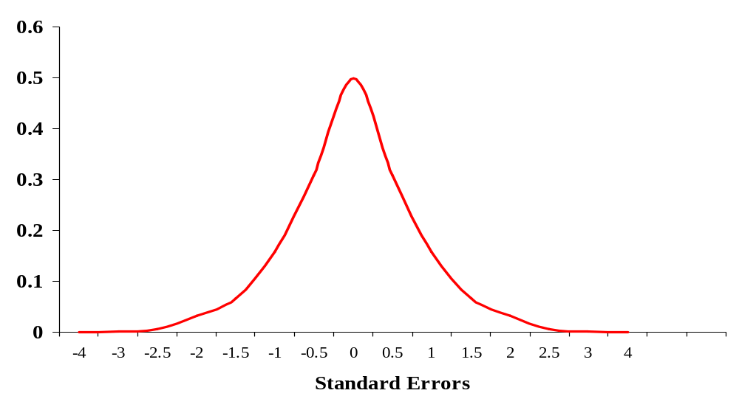
Confidence Intervals
Because we know the properties of the normal distribution so well, we can use these properties to assist us in applying confidence intervals to estimates
Example:
We know that 68.3 % of sample means lie within one standard error of the true population mean
μ
μ-se
μ+se
68.3%

Slide 8
Confidence Intervals (Cont.)
Therefore, if we know the true population variance, we can infer the range within which we can be 68.3% confident that the true population mean lies
Example:
X∼N(μ, 3.6²) grams, n = 36, x = 25.5
We can be 68.3% confident that μ is within the interval
x ± SE
= 25.5 ± 3.6/√36
= 25.5 ± 0.6
= (24.9 to 26.1) grams

Slide 9
Confidence Intervals (Cont.)
We can extend this principle further:
We can be 90% confident that the true population mean lies within
x ± 1.645(SE)
We can be 95% confident that the true population mean lies within
x ± 1.960(SE)
We can be 99% confident that the true population mean lies within
x ± 2.576(SE)

Slide 10
Confidence Intervals (Cont.)
Furthermore, the area outside the confidence interval is cumulatively known as α (alpha)
Confidence Interval = 1 - α
Example:
for 95% confidence interval, ∝=0.05
α/2 = 0.025
α/2 = 0.025

Slide 11
Confidence Intervals (Cont.)
The five most used confidence levels and α values
Confidence level
(1- α) | α | α/2 | z _{α /2}
0.8 | 0.2 | 0.1 | 1.28
0.9 | 0.10 | 0.05 | 1.645
0.95 | 0.05 | 0.025 | 1.96
0.98 | 0.02 | 0.01 | 2.33
0.99 | 0.01 | 0.005 | 2.576

Slide 12
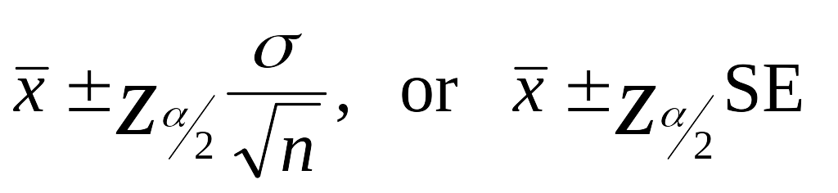
Confidence Intervals
The general formula for estimating confidence intervals is;

Slide 13
Confidence Intervals (contd.)

Slide 14
Student’s t distribution
If the population is normally distributed, the standardized ‘t’ statistics has a
‘t’ distribution with n-1 degrees of freedom.
The shape of ‘t’ sampling distribution is similar to that of the ‘z’ sampling
distribution in that it is
a) Symmetrical
b) Centered over a mean of zero
c) Variance depends on the sample size, more specifically on the degrees
of freedom (abbreviated as df)
‘t’ distribution is a family of distributions whose shapes depend on the
associated degrees of freedom

Slide 15
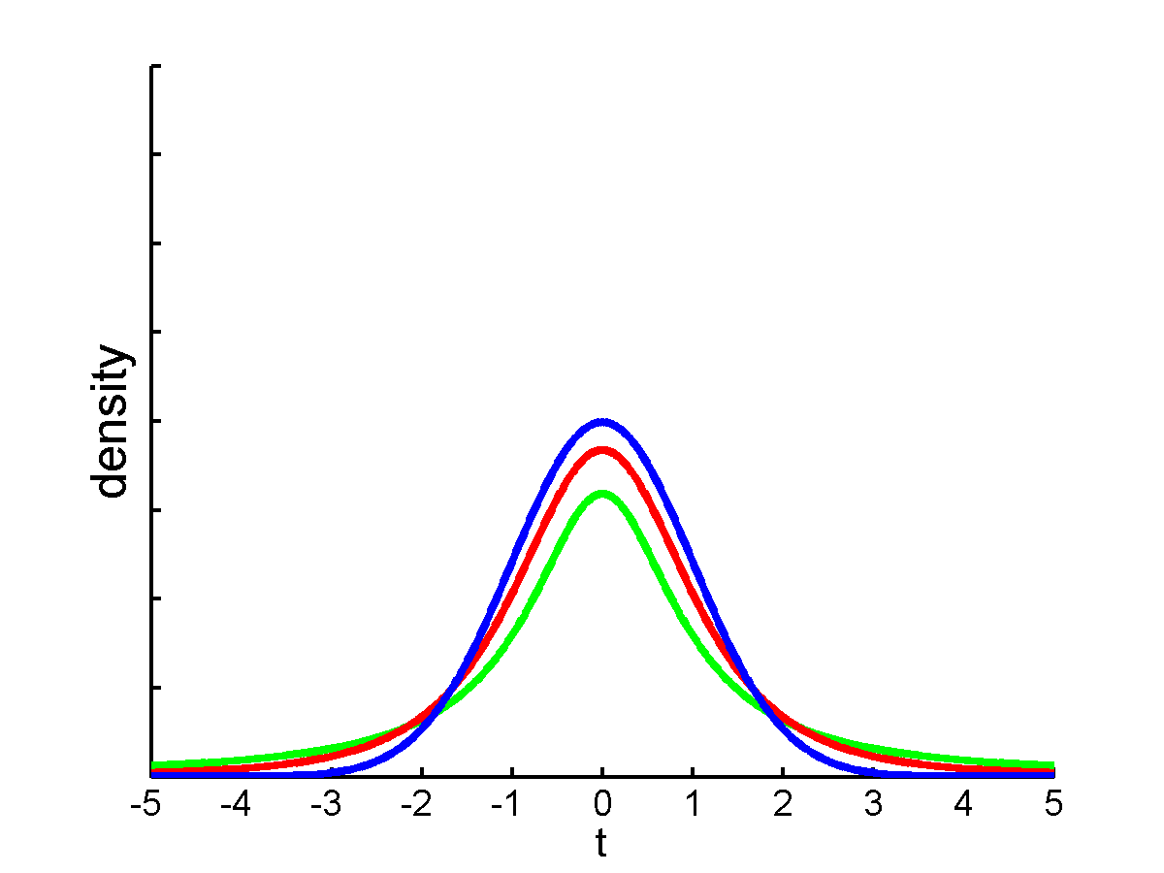
t - DISTRIBUTION
As the number of degrees of freedom increases , variance of the t distribution approaches more & more closely to that of z
For n ≥ 30, shapes are almost similar
For n of 30 taken as dividing point between small & large samples
df = ∞
df = 3
df = 1

Slide 16
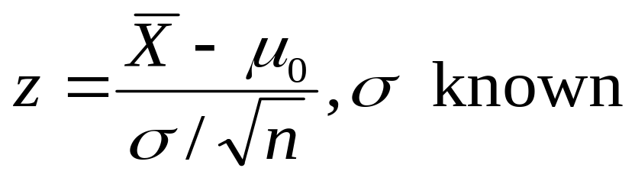
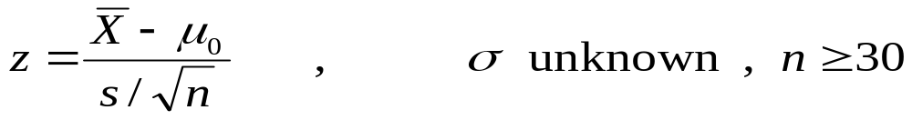
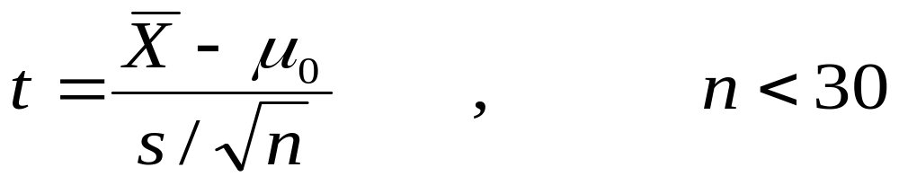
Test Statistics
Z-test for population mean
t-test for population mean

Slide 17
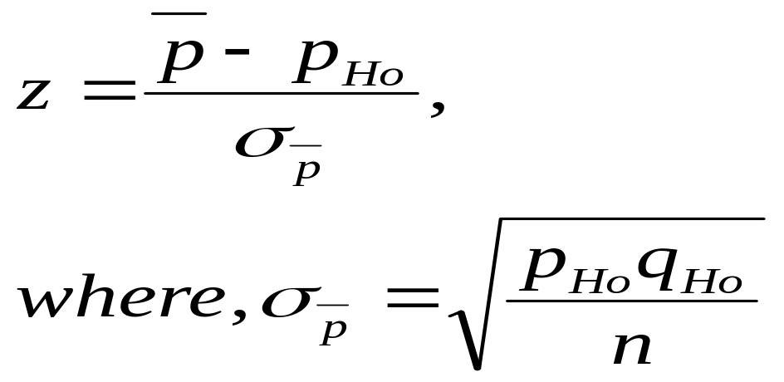
Test Statistics
Z-test for population proportion

Slide 18
When to use
z-test:
σ is known and the population is normal
σ is known and the sample size is at least 30. (The population need
not be normal)
t-test:
Whenever σ is not known
The population is assumed to be normal
And n<30
The correct distribution to use is the ‘t’ distribution with n-1 df

Slide 19
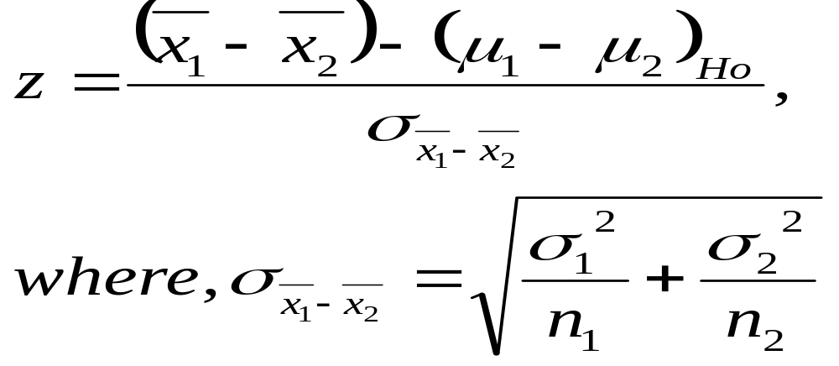
Other Confidence Intervals:
Difference between two population means
Where,
σ₁²/n₁ = estimated variance of population 1.
σ₂²/n₂ = estimated variance of population 2.

Slide 20
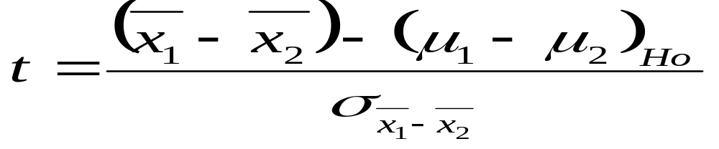
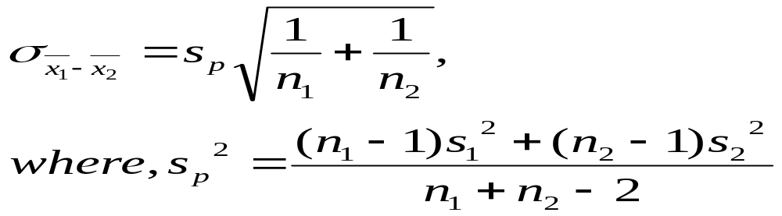
t-test for difference between means:
Where,
S_{p}² ⁼ pooled estimate of σ²
S₁² ⁼ estimated σ₁² and S₂² = estimated σ₂²

Slide 21
Hypothesis Testing

Slide 22
What is Hypothesis Testing?
A statistical Hypothesis is an assertion regarding the statistical distribution of the population.
It is a statement regarding the parameters of the population.
Testing of Hypothesis deals with the verification of validity of presumption regarding the parameters of the population using samples drawn from the population.
Statistical Hypothesis is denoted by H.
  ex: H: The population has mean m=25
  H: The population is normally distributed with mean m=25 and standard deviation s=2

Slide 23
Hypothesis Testing (cont..)
In a Test Procedure, to start with, a hypothesis is made.
The validity of the hypothesis is tested.
If the hypothesis is found to be true, it is accepted.
If it is found to be untrue, it is rejected.
The hypothesis which is being tested for possible rejection is called null hypothesis
Null hypothesis is denoted by H₀
The hypothesis which is accepted when null hypothesis is rejected is called Alternate Hypothesis H_{a}

Slide 24
Hypothesis Testing (cont..)
The alternative hypothesis is often the interesting one –and often the one that someone sets out to prove.
Ex. H_{o} : The drug works –it has a real effect.
H_{a} : The drug doesn’t work - Any effect you saw was due to chance.
Think of “null” as “there’s no real effect,” and “alternative” as “other than null.”
As we now know how to apply confidence intervals to population means, the next logical step is to infer about values outside this range…
We will learn an important technique known as hypothesis testing, where we hypothesise the true population parameter, and then use the confidence interval logic to test the probability of the hypothesis

Slide 25
Hypothesis Testing (cont..)
  Hypothesis tests consist of the following steps:
  Null hypothesis
  Alternative hypothesis
  Confidence level
  Decision Rule
  Test statistic
  Decision

Slide 26
Hypothesis Testing – Null Hypothesis H₀
In any hypothesis test, we must specify a null or ‘no effect’ hypothesis before we perform the test.
Example: If we measure the weight of 10 people before and after a diet, we may hypothesise that the average weight change was zero
    H_{o}: μ_{D} = 0
  Perhaps the hypothesis is that the average weight change was 2 kg's
    H_{o}: μ_{D} = 2
We always assume the null hypothesis is true, or at least is the most plausible explanation before we do the test
The test can only disprove the null hypothesis.

Slide 27
Hypothesis Testing – Alternate Hypothesis H_{a}
The alternative hypothesis is the hypothesis that we set out to test for. It is the hypothesis that we wish to prove
Example: If we measure the weight of 10 people before and after a diet, we may hypothesise that the average weight change was not zero
    H_{a}: μ_{D} ≠ 0
  Perhaps the hypothesis is that the average weight change was not 2 kg's
    H_{a}: μ_{D} ≠ 2

Slide 28
Null and Alternative Hypotheses
Testing a population mean
H₀: μ ≤ μ₀
H₁: μ > μ₀
H₀: μ ≥ μ₀
H₁: μ < μ₀
H₀: μ = μ₀
H₁: μ ≠ μ₀
(two-tailed)

Slide 29
Null and Alternative Hypotheses
Testing a population proportion
H₀: p ≤ p₀
H₁: p > p₀
H₀: p ≥ p₀
H₁: p < p₀
H₀: p = p₀
H₁: p ≠ p₀
(two-tailed)

Slide 30

Decision Rule
After we know the null and alternative hypotheses and the level of confidence associated with the test, we determine the points on the distribution of the test statistic where we will decide when the null hypothesis should be rejected in favour of the alternative hypothesis

Slide 31
Type-I and Type-II Error:
Process of testing a hypothesis indicates that there is a possibility of making
an error. There are two types of errors:
Type I error: The error of rejecting the null hypothesis H₀ even though H₀ was true.
Type II error: The error of accepting the null hypothesis H₀ even though H₀ was false.
For any given set of data, type I and type II errors are inversely related; the smaller the risk of one, the higher the risk of the other.
  P (type I error) = α
  P (type II error) = β

Slide 32
Level Of Significance:
The type I error just is the significance level of the test. In other words, The significance level is the fixed probability that the null hypothesis will be rejected when it is true
  Significance Level = P (type-I error) = α
In statistics, a result is called significant if it is unlikely to have occurred by chance.
Usually, the significance level is chosen to be 0.05 (or equivalently, 5%).

Slide 33
Rejection region
The rejection region is the area (s) determined by the decision rule
Say, we decide to perform a z test with 95% confidence (α = level of significance = 0.05)
We know that 95% of z values lie within 1.96 standard deviations of the mean. Therefore we may decide that observations outside this range are “statistically significant” at the 0.05 level
In other words, we will reject the null hypothesis if the test statistic z is > +1.96 or <-1.96
If the test statistic z is between -1.96 and +1.96, we would not reject the null hypothesis

Slide 34
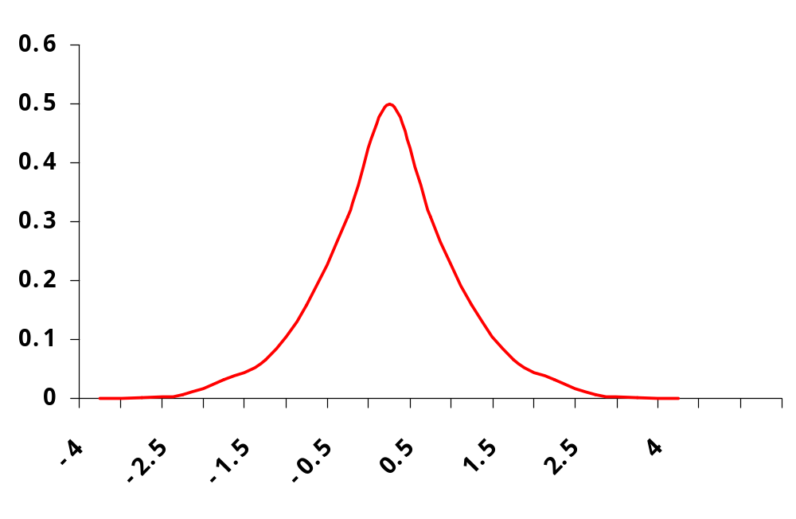
Rejection region – cont…
In this example, 1.96 is known as “the Critical Value of Z”
2.5%
95%
2.5%
Rejection
Region
Rejection
Region
Z= -1.96
Z= +1.96

Slide 35
Example 1
Suppose that we have been told that the price of petrol in Melbourne is normally distributed with a mean of 92 cents per litre, and a standard deviation of 3.1 cents/litre. To test whether this price is in fact true, we sample 50 service stations and obtain a mean of 93.6 cents/litre
Solution:
Step 1: State the null and alternative hypotheses
    Ho: μ = 92
    Ha: μ ≠ 92
Step2: Determine the appropriate test statistic and it’s distribution
    Because we know the population standard deviation,
    we can use the z distribution

Slide 36
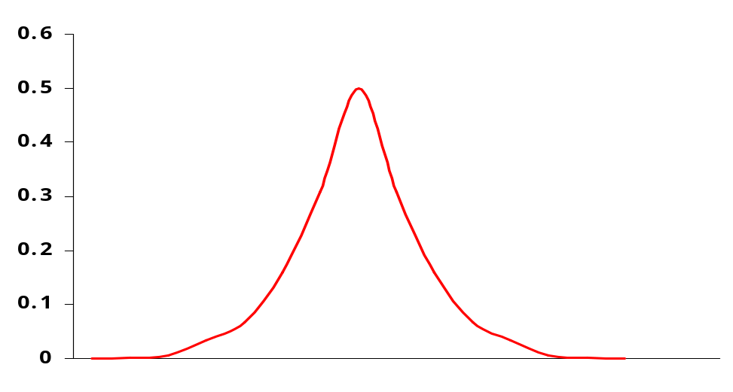
Example (cont…)
  Step3: Specify the significance level, Say α = 0.05
Step 4: Define the decision rule.
    Using a z distribution (from tables), if α = 0.05,
    the rejection region is > +1.96 and < -1.96
i.e., if the test statistic is > 1.96 or < -1.96,
we will reject H_{o} and accept H_{a}
Rejection
Region
Rejection
Region
+1.96

Slide 37
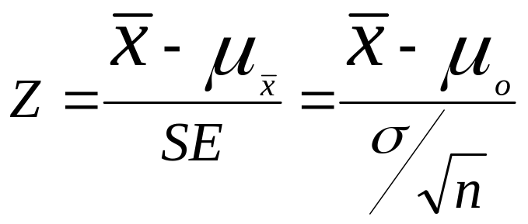
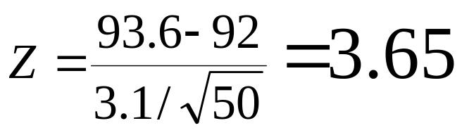
Example (Cont.)
Step 4: Calculate the test statistic

Slide 38
Example (Cont…)
Step 6: Make a decision and answer the question
As, 3.65 > 1.96, the test statistic is in the rejection region
Reject H_{o}, accept H_{a} as a more
plausible explanation
Step 7: Write your conclusion in the
context of the aims of the
study.
“The average
price of petrol in Melbourne was significantly different to 92 cents/litre”
Rejection
Region
Rejection
Region
-1.96
+1.96
3.65

Slide 39
Rejecting and Not rejecting the H_{o}
It is critical that you realise that a non significant test statistic doesn’t necessarily mean the null hypothesis is true.
In fact there may be a significant effect, it’s just that the sample size wasn’t large enough to find it
Use the terminology “ Reject H_{O}” or “Do not reject H_{o}”. Never say “Accept Ho”

Slide 40
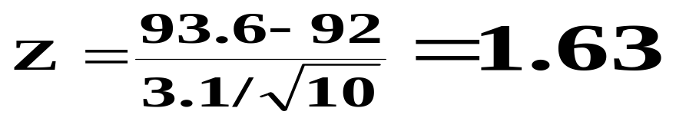
Not rejecting Ho
Eg, consider the petrol prices in Melbourne example. If the sample size we had used was only 10, rather than 50, the test statistic would have been;
In which case we would not have rejected the H_{o}

Slide 41
Example
A company pays production workers $630 per week. The union claims that these workers are paid below the industry average for their work. A sample of 15 workers from other sites gives a mean wage of $670/week with a standard deviation of $58/week. Is the unions claim justified?
Solution:
Step 1: Ho: μ =< $630 (industry weekly average is not significantly different to $630)
  Ha: μ > $630 (The industry weekly average is greater than $630)

Slide 42
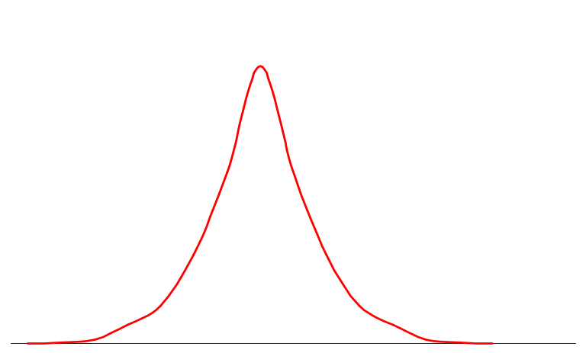
Example (Cont.)
  Step 2 :
  Test Statistic - As we don’t know the population variance, and the sample size is < 30, we shall use the t test.
Step 3 :
Significance level - We will use α = 0.10 (as we want to be liberal rather than conservative)
Step 4 :
Decision rule - From ‘t’ table,
t _{(0.1, 14df)} = 1.345
Non-Rejection
Region (1-α = 0.90)
Rejection
Region (α = 0.10)
1.345

Slide 43
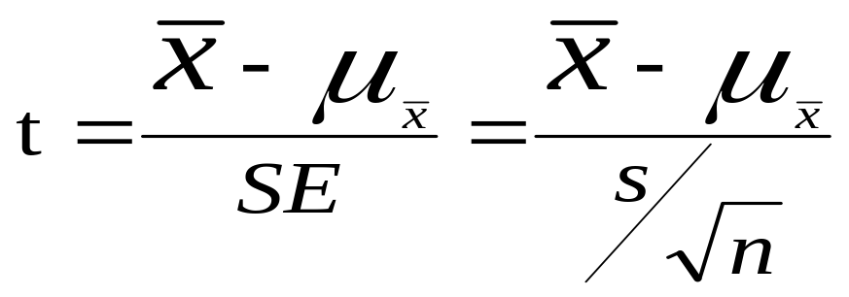
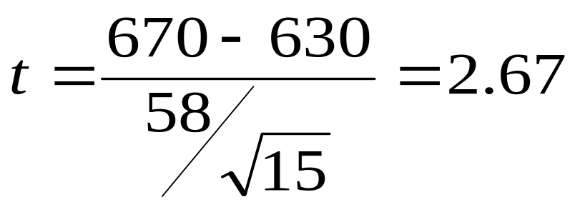
Example (Cont.)
Step 5 : Calculate test statistic;

Slide 44
Example (Cont.)
Step 6 :
Make a decision - As 2.67 is > 1.345, we will reject the H_{o}
  Step 7 :
  Conclusion - “Production workers at the company earn an average of $40 per week less than the industry standard
  (t = 2.67, df = 14, p < 0.1)”
Non-Rejection
Region (1-α = 0.90)
Rejection
Region
(α = 0.10)
1.345
2.67

Slide 45
P value
In fact, with the advent of computers it is simple to calculate the exact probability of a test statistics.
Example: P(t ≥ 2.67) = 0.00915
i.e. The area under the curve is 0.00915
With a z test, it is possible to determine the exact probabilities using the table in the text book
Ex.: What is the exact probability of obtaining a value of z ≤ 1.5?
From table, when z = 1.5, p = 0.5 + 0.4332,
P (z ≤ 1.5) = 0.9332
α = 0.00915
2.67

Slide 46
Comparison of two populations
Hypothesis testing for two samples:
Difference between independent samples & dependent samples
Two sample z test for means using independent samples
Two sample t test for means using independent Samples
Two sample t tests for means using dependent Samples

Slide 47
Independent & dependent samples
Independent samples:
Selection of elements in one sample not affected by the selection of samples in the other
Example: Samples randomly from two populations
Example: Uses random procedure to assign elements to two samples
Dependent samples:
Paired samples : Repeated measures on same respondent (before – after studies)
Matched samples: Matching respondents on some variable that is correlated to the dependent variable

Slide 48
Null and Alternative Hypotheses
Paired tests
μ₁ – μ₂ = D
μ₁ – μ₂ ≠ D
μ₁ – μ₂ ≥ D
μ₁ – μ₂ < D
μ₁ – μ₂ ≤ D
μ₁ – μ₂ > D

Slide 49
Small sample test
t-test for difference between means with dependent samples:
Example: Weights before and after a reducing program.
Conceptually, what we have is not two samples of before and after
weights, but rather one sample of weight losses.
Ho : μ1 – μ2 ≤ D vs H1 : μ1 – μ2 > D
Here, we are not interested in weights before and after, but their differences.
So, the hypothesis will be,
Ho : μ ≤ D vs H1 : μ > D
Note: Formulae is same as t-test for population mean

Slide 50
Assumptions for paired t test
The population of differences D_{i} , is approximately normally distributed
The population variance of the mean of the difference scores is unknown
Respondents are random samples from the population
Whenever the correlation between samples is positive, the t statistic for paired samples will be larger than that for independent samples. – Paired t test more powerful.

Slide 51
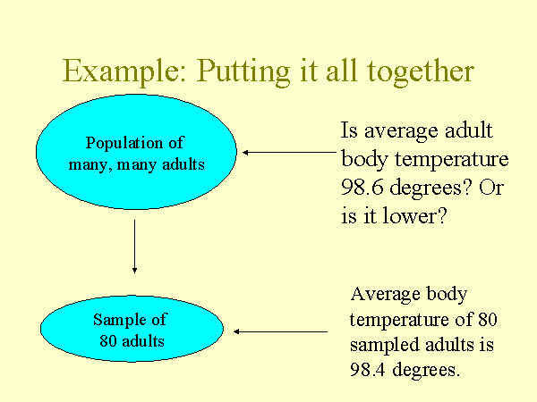
A Practical Example

Slide 52
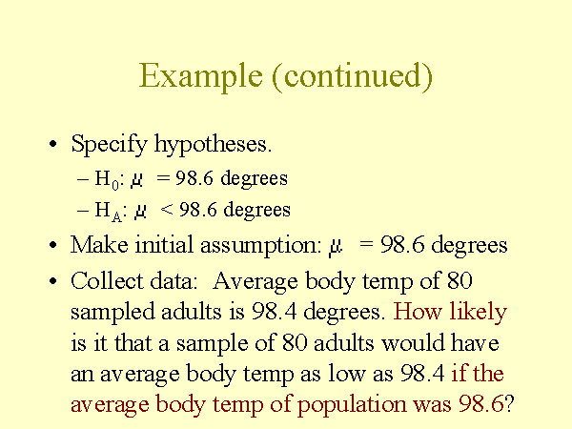
A Practical Example

Slide 53
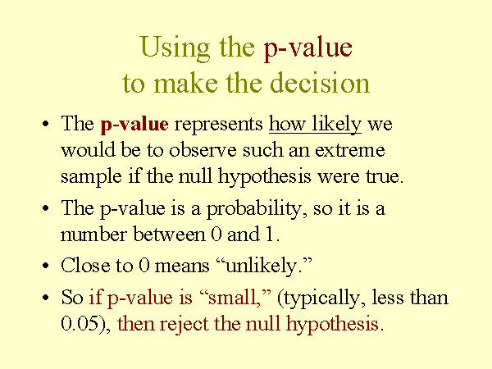
A Practical Example

Slide 54
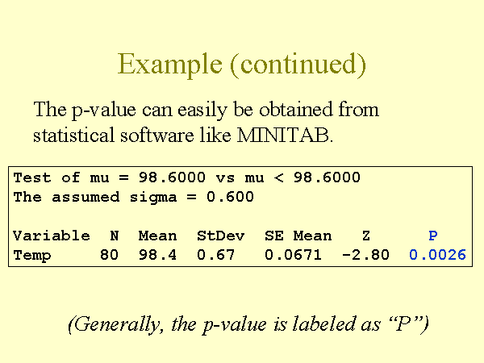
A Practical Example

Slide 55
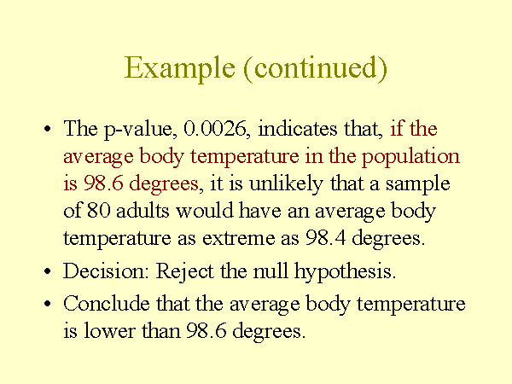
A Practical Example

Slide 56
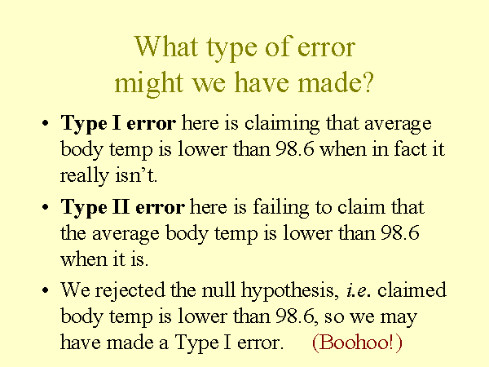
A Practical Example

Slide 57
Chi-Square Test

Slide 58
Chi squared test for independence in a contingency table
Two properties are associated if the probability of having one property affects the probability of having another.
For example:
The probability of passing an exam is increased by hard work. Also, it is generally agreed, as a matter of sociological observation, that the probability of having an income above the average is associated with your father's occupational background.
The opposite of association of properties is independence. Two properties are independent if having one property does not alter the probability of having the other.
For example: sex and intelligence are thought to be independent.

Slide 59
Chi squared test for independence Cont..
Sometimes it is not known whether two properties are associated or not.
What is required is a test of association, or, what is equivalent, a test of independence.
The χ 2 distribution can be used as a test of independence.

Slide 60
Example
A psychologist conducted a survey into the relationship between the way in which a calculator was held and the speed with which 10 arithmetical operations were performed. The calculator could be either placed on a table or held in the hand; the sums could be performed in either less than 2 minutes, between 2 and 3 minutes or more than 3 minutes.
The following results were obtained for a sample of 150 children between 12 and 13 years old.
 |  | Mode of Computation
 |  | On Table | Hand Held
Speed Of Computation | <2 | 28 | 12
 | 2-3 | 25 | 35
 | >3 | 21 | 29

Slide 61
Example Cont..
Test at the 5% significance level whether the mode of operation and speed of computation are associated.
This kind of table is called a contingency table. Since there are three rows and two columns it is a 3×2 contingency table.
H_{O} : Speed and mode are independent.
H₁ : Speed and mode are associated.

Slide 62
Example Cont..
In order to determine whether the two variables are associated it is necessary to calculate what the frequencies would be if there was absolutely no connection between them.
In other words,
we seek the expected frequencies. We can then compare these expected frequencies with the observed frequencies by means of a χ 2 test of goodness of fit.
Here, first find the row and column totals.

Slide 63
Example Cont..
The expected frequencies are:
 | Table | Hand
<2 | 40*74/150 = 19.73 | 40*76/150 = 20.27
2-3 | 60*74/150 = 29.60 | 60*76/150 =30.40
>3 | 50*74/150 =24.67 | 50*76/150 = 25.33

Slide 64
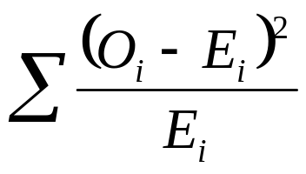
Example Cont..
Now we have to use the expected and observed frequencies to calculate a test statistic.
The χ 2 test statistic is determined by
In order to compare this with a critical value, we need to know the degrees of freedom of statistic.
The degrees of freedom of any row is constrained by one, because the last frequency is determined by the other entries in the row. Likewise the degrees of freedom of a column is the number of columns less one.
ν=degrees of freedom=( row number −1)⋅ (column number −1)
Note: The Σ symbol indicates that we make a total of all these entries.

Slide 65
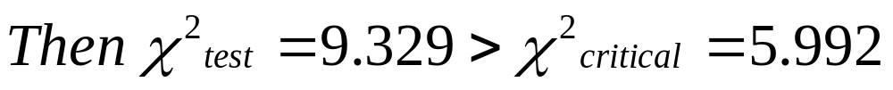
Example Cont..
Therefore, we reject H_{O} and accept H₁ .
The result is significant at the 0.05 or 5% level. This means that there is a 5 in 100
probability that the difference between the two conditions could have arisen by chance.
According to these results the way you use your calculator does affect the speed with which you do a calculation.

Slide 66
Chi-Square Test of Goodness of Fit

Slide 67
The Chi squared test for goodness of fit
We are concerned here with testing a hypothesis that a given population follows a particular distribution.
Up to now we have always assumed or been told that a particular variable follows a particular distribution.
Here we see how to test that assumption.
Thus we are testing a hypothesis that a variable X can be modeled as following a particular probability distribution.
To do this, we need to be able to answer the question:
What frequencies would we expect from X if X was distributed in the way described?

Slide 68
Example
The total weight of fish, in kilograms, caught by an experienced angler in a
Russian lake in one day during the summer of 1964 is denoted by the random variable X. 90 anglers were sampled and the results obtained and summarized below:
X | <12 | 12-24 | 24-36 | 36-48 | >48
No. Of Anglers | 10 | 14 | 30 | 23 | 13
It is thought that X is normally distributed by N(30, 122). Calculate the expected frequencies for each of the five classes. Carry out a chi-square goodness of fit test at the 5% level to test this hypothesis.

Slide 69
Example Cont..
Determining the contingency table and contributions to the test statistic together:-
Let X~N(30, 122)
Total number of observations = 90
X | <12 | 12-24 | 24-36 | 36-48 | >48
f(observed) | 10 | 14 | 30 | 23 | 13
f(expected) | 6.012 | 21.753 | 34.47 | 21.753 | 6.012

Slide 70
Example Cont..
Therefore, we reject H_{O} and accept H₁ .
Therefore, Fishing in Russian lakes is not normal!

Slide 71
ANOVA
(Analysis Of Variance)

Slide 72
The basic ANOVA situation
Analysis of variance is a statistical technique used for comparing the means of different samples and deciding whether they are drawn from the same population or different populations.
Two variables: 1 Categorical, 1 Quantitative
Main Question: Do the (means of) the quantitative variables depend on which group (given by categorical variable) the individual is in?
If categorical variable has only 2 values:
  2-sample t-test
ANOVA allows for 3 or more groups

Slide 73
One – Way ANOVA
Assumptions
Observations are drawn from normally distributed populations
  check this by looking at histograms and/or normal quantile plots, or use assumptions
  can handle some non-normality, but not severe outliers
Independent random samples from the populations
Variances of the populations are equal

Slide 74
The Composite Nature Of A Measure
The value of a score/measure is determined by a variety of variables
A score can be thought of as a composite, reflecting.
Example: the effects of the
Independent Variable
Individual Characteristics of the Respondent
Chance Fluctuations
Environmental and other uncontrolled conditions

Slide 75
Basic Concepts of ANOVA
Consider an experiment conducted to determine the effectiveness of three diets for obese teenage girls. Thirty girls who want to lose weight are randomly assigned to the three diets with the restriction that 10 girls are assigned to each diet. The independent variable is the type of diet and the dependent variable is weight loss in pounds after being on a diet for one month

Slide 76
Basic Concepts of ANOVA (Cont..)
Treatment Levels (Diets)
a₁ | a₂ | a₃
7 | 10 | 12
9 | 13 | 11
8 | 9 | 15
12 | 11 | 7
8 | 5 | 14
7 | 9 | 10
4 | 8 | 12
10 | 10 | 12
9 | 8 | 13
6 | 7 | 14

Slide 77
Linear model equation of a score:
Assume each of the 30 scores is the sum of three parameters in the equation
X_{ij} = μ +α _{j} + Є _{ij}
Partition of the Total Sum of Squares:
Sum of Squares (SS) measure variation within the data.
SST = Total amount of variation within the entire data set
Sum of Squares Total (SST) can be partitioned into 2
  a) Sum of Squares of Treatment (SSTR) or Treat Sum of Squares
  b) Sum of Squares of Error / Error Sum of Squares (SSE)

Slide 78
Sum of Squares of Treatment (SSTR) or Treat Sum of Squares
  That part of the variation within the data that is due to differences among the group
  Accounts for the differences due to the differences among the sample means for the treatments (levels of the independent variable)
  SSTR is sometimes called Sum of Squares Between Groups (SSBG) (variation between the groups).
  It also is equivalent to Regression sum of Squares (SSR)

Slide 79
Sum of Squares of Error / Error Sum of Squares (SSE)
  That part of the variation within the data that is due to error – the part that cannot be explained by the independent variables (treatments/ differences between groups)
  Represents the contribution of random error
  Sum of squared deviations of individual observations in a given sample from the mean of that sample, then summing these deviations over all observations in the entire data set
  Since this represents variation within each sample (treatment level) it is also called Within Groups Sum of Squares (SSWG)

Slide 80
Intuitive Logic:
If between group variance is about equal to within group variance - ?
If between group variance is more than within group variance - ?
Degrees of Freedom:
Mean Squares (MS)
Average of the squared error deviation (MSE)
  MSE = SSE/ df
  df = n – r ( n = total sample size; r = no. of sample means)
Average of the squared treatment deviation (MSTR)
  MSTR = SSTR / df
  df = r - 1

Slide 81
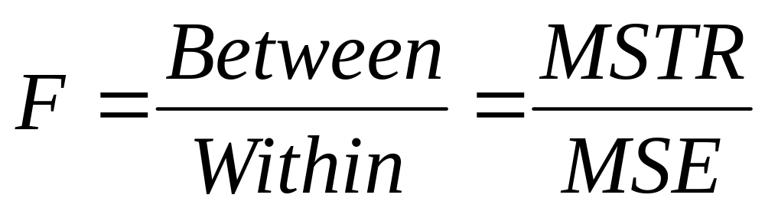
The F-Statistics
The ANOVA F-statistic is a ratio of the Between Group Variation divided by
the Within Group Variation:
A large F is evidence against H₀, since it indicates that there is more difference between groups than within groups.
F _{(CRITICAL)} = F _{( r-1, n-r)}

Slide 82
F-Distribution
Family of distributions
Shape dependent on degrees of freedom
Has 2 kinds of df – one for the numerator , one for the denominator
It is positively skewed
Shape approaches normal for very large values of df₁ and df₂
Because F is a ratio of non-negative numbers, it can take values only from 0 to infinity

Slide 83
PARAMETRIC
&
NON PARAMETRIC TESTS

Slide 84
Parametric tests vs. Non parametric tests
Parametric tests:
Necessary to assume that the sampled population had a probability distribution of a particular shape – usually normal or binomial
For many variables , such an assumption seems warranted
The procedures learnt also required other assumptions
Ex: ANOVA assumes that the population variances are equal
Parametric tests utilize the magnitude of information contained in observations
To use a parametric test one must have interval level data.

Slide 85
Parametric tests vs. Non parametric tests (Cont…)
Non-parametric tests:
Deals with enumerative data
Does not deal with specific population parameters
Does not require assumptions about specific population distributions (in particular , the assumption of normality)
Non-Parametric tests ignores the magnitude of information contained in observations
Use either frequencies or ranks (categorical or ordinal)

Slide 86
Non-Parametric (Cont..)
Non-parametric tests are called ''non-parametric'' because they do not make any assumption about a population parameter.
In other words, when we apply a non-parametric test we do not have to make assumptions about mean of a population, its variance or background probability distribution.
Thus, non-parametric tests are not as powerful as parametric tests they are of more general application and are available when the parametric tests fail.
Basically, there is at least one non-parametric equivalent for each parametric general type of test

Slide 87
Non-Parametric Test
Non-Parametric tests broadly fall into the following categories:
Tests of differences between independent samples
  The Mann-Whitney U test (t-test for independent samples)
  The Kruskal-Wallis H test (ANOVA)
  The Kolmogorov-Smirnov test (t-test for independent samples)
Tests of differences between dependent samples
- Wilcoxon Mann-Whitney Test (t-test for independent samples)
Note: Tests given in the bracket are alternative parametric tests.

Slide 88
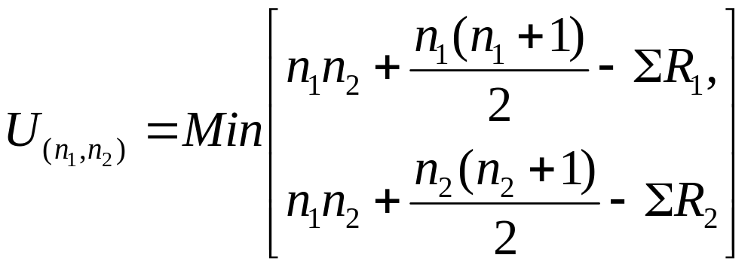
The Mann-Whitney U test
The Mann-Whitney U test is a non-parametric test for assessing whether two samples of observations come from the same distribution.
In other words, this is a method for the comparison of two independent random samples (x and y)
The Mann Whitney U statistic is defined as:
Where samples of size n₁ and n₂ are pooled and R_{i} are the ranks.

Slide 89
The Mann-Whitney U test (Cont..)
Tests of significance are used to tell us whether the differences between the two sets of sample data are truly significant or whether these differences could have occurred by chance.
This method is alternative to two sample t test when normality assumption not met.
Can be used when both samples are 20 or less
Only Assumptions required :Independent Random Samples

Slide 90
The Mann-Whitney U test (Cont..)
Example:
Group-I | 2 | 19 | 13 | 9 | 17 | 18 | 24 | 15 | 22 | 21
Group-II | 8 | 1 | 0 | 10 | 20 | 5 | 11 | 7 | 3 | 13 | 4
Method:
Combine two random samples in ascending order and rank all observations
from smallest to largest.
Sum all the ranks of the observations group wise.
The sum of the sample ranks is R₁ and R₂
Measure U statistic for each group, take the smaller of the two U values and
look up the probability value in the table.
This gives the percentage probability that the difference between the two
sets of data could have occurred by chance.

Slide 91
The Mann-Whitney U test (Cont..)
Group-I | 2 | 19 | 13 | 9 | 17 | 18 | 24 | 15 | 22 | 21
Rank | 3 | 17 | 12.5 | 9 | 15 | 16 | 21 | 14 | 20 | 19 |  | 146.5
Group-II | 8 | 1 | 0 | 10 | 20 | 5 | 11 | 7 | 3 | 13 | 4
Rank | 8 | 2 | 1 | 10 | 18 | 6 | 11 | 7 | 4 | 12.5 | 5 | 84.5
R₁=146.5 and R₂=84.5
Calculate U _{(n1,n2)} using previous formula and
U _{(critical),10,11} =26 (from table)
If U _{(critical)} < U _{(n1,n2)} , then Ho is accepted

Slide 92
The Kruskal-Wallis H test
The Kruskal-Wallis test is used to compare three or more samples in a completely randomized design.
Null hypothesis : All populations have identical distribution functions
Alternative hypothesis : At least two of the samples differ only with respect to location (median), if at all.
It is the analogue to the F-test used in Analysis of Variance.
While analysis of variance tests depend on the assumption that all populations under comparison are normally distributed, the Kruskal-Wallis test places no such restriction on the comparison.

Slide 93
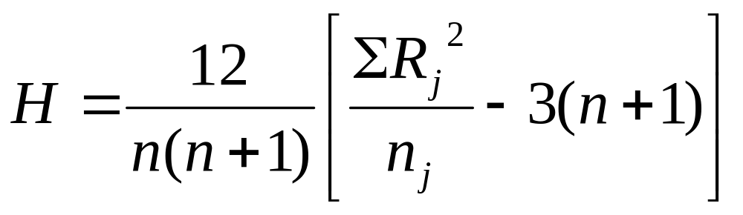
The Kruskal-Wallis H test (Cont..)
The kruskal-Wallis H statistics is defined as:
Where,
Rj = Rank sum of sample j
n = number of observations
Df = degrees of freedom = m-1,
m = no. of groups

Slide 94
The Kruskal-Wallis H test (Cont..)
Example:
To assess the effects of expectation on the perception of aesthetic quality, an investigator randomly sorts 24 amateur wine aficionado into three groups, A, B, and C, of 8 subjects each. Each subject is scheduled for an individual interview. Unfortunately, one of the subjects of group B and two of group C fail to show up for their interviews, so the investigator must make do with samples of unequal size: n _{a}= 8, n _{b}= 7, and n _{c}= 6, for a total of N=21.
The three wines are the same for all subjects. The only difference is in the texture of the interview, which is designed to induce a relatively high expectation of quality in the members of group A; a relatively low expectation in the members of group C; and a merely neutral state, tending in neither the one direction nor the other, for the members of group B

Slide 95
The Kruskal-Wallis H test (Cont..)
Method:
Begin by assembling the measures from all k samples into a single set of size N.
These assembled measures are rank-ordered from lowest (rank#1) to highest (rank #N), with tied ranks included where appropriate; and
The resulting ranks are then returned to the sample, A, B, or C, to which they belong and substituted for the raw measures that gave rise to them.
d) Thus, the raw measures that appear in the following table on the left are replaced by their respective ranks, as shown in the table given below.

Slide 96
The Kruskal-Wallis H test (Cont..)
Raw Measures |  |  | Ranked Measures
A | B | C
6.4 | 2.5 | 1.3 | 11 | 2 | 1 | A, B, C combined
6.8 | 3.7 | 4.1 | 12 | 3 | 4
7.2 | 4.9 | 4.9 | 13 | 5.5 | 5.5
8.3 | 5.4 | 5.2 | 17 | 8 | 7
8.4 | 5.9 | 5.5 | 18 | 10 | 9
9.1 | 8.1 | 8.2 | 19 | 14 | 15.5
9.4 | 8.2 |  | 20 | 15.5
9.7 |  |  | 21
sum of ranks |  |  | 131 | 58 | 42 | 231

Slide 97
The Kruskal-Wallis H test (Cont..)
And then, treating this result as though it were a value of chi-square, we can refer it to the sampling distribution of chi-square with df = 3-1=2.
The following graph gives the outlines of this particular chi-square distribution.
In brief: by the Kruskal-Wallis test, the observed aggregate difference among the three samples is significant a bit beyond the .01 level.

Slide 98
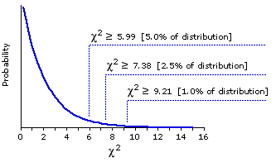
The Kruskal-Wallis H test (Cont..)
Theoretical Sampling Distribution of Chi-Square for df=2

Slide 99
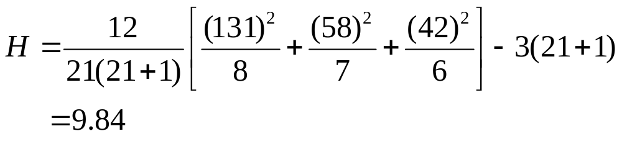
The Kruskal-Wallis H test (Cont..)
h) When H₀ is true, the test statistic H has an approximate chi-square
distribution with df = k-1. Use a right-tailed rejection region or p-value
based on the Chi-square distribution.
g) When H₀ is false, H will be unusually large, resulting in a one-tailed
test.
Here, H > 9.21 at 1% level of significance.
we reject H_{O}

Slide 100
The Kolmogorov-Smirnov test
For a single sample of data, the Kolmogorov-Smirnov test is used to test whether or not the sample of data is consistent with a specified distribution function.
In other words, it tests whether a given distribution is not significantly different from one hypothesized (ex., on the basis of the assumption of a normal distribution).
Continuous interval or ratio data are required for the Kolmogorov-Smirnov goodness-of-fit test for exact results
The Kolmogorov-Smirnov test does not require the assumption that the population is normally distributed.
Alternative to chi-square goodness-of-fit tests when its assumptions are met.

Slide 101
The Kolmogorov-Smirnov test
Method:
Find the observed distribution and the hypothetical distribution .
The observed distribution is the distribution of the variable in the sample
The hypothetical distribution is the expected distribution of a variable with the same parameters.
Calculate D which is the largest difference between one of these theoretical (observed) cumulative percentages and the corresponding empirical (hypothetical) cumulative percentage
The computed D is compared to a table of critical values of D in the Kolmogorov-Smirnov One-Sample Test, for a given sample size
For samples > 35, the critical value at the .05 level is approximately 1.36/SQRT(n), where n = sample size
If the computed D is less than the critical value, the researcher fails to reject the null hypothesis that the distribution of the criterion variable is not different from the hypothesized (ex., normal) distribution.

Slide 102
The Kolmogorov-Smirnov test
X | Observed Prob. distribution | Observed cumu. Prob. Distribution | Hypotheti.Prob. Distribution | Hypotheti. cumu. Prob. Distribution | Absolute deviation
13 | 13/50 = 0.26 | 0.26 | 1/5 = 0.20 | 0.20 | 0.06
12 | 0.24 | 0.26+0.24= 0.50 | 0.20 | 0.40 | 0.10
10 | 0.20 | 0.70 | 0.20 | 0.60 | 0.10
8 | 0.16 | 0.86 | 0.20 | 0.80 | 0.06
7 | 0.14 | 1.00 | 0.20 | 1.00 | 0
50 | 1.00 |  | 0.20
Largest absolute deviation = 0.10 and K-S at 0.20 = 1.07/√N = 0.15
Here, we accept Null hypothesis that the distribution of the criterion variable is not different from the hypothesized (ex., normal) distribution

Slide 103
Wilcoxon Signed Rank Test
Sometimes called the Wilcoxon matched-pairs test.
The paired values of each pair are randomly and independently drawn (i.e., each pair is drawn independently of all other pairs);
It is for two dependent samples where the variable of interest is interval.
Specifically, the Wilcoxon test factors in the size as well as the sign of the paired differences.

Slide 104
Wilcoxon Signed Rank Test
Method:
List the paired scores in two columns corresponding to the two dependent samples.
Subtract each score in the second column from its pair in the first column, creating a third column of differences.
Delete pairs with zero differences (ties).
Rank the differences from smallest (including negative) to largest absolute difference, from 1 to n, the sample size. Assign the average of ranks which would otherwise have been assigned in the cases of tied pairs.
Let T be the smaller of the sum of ranks for positive differences, or the sum of ranks for negative differences.
If computed T is equal to or less than the critical value of T in a table of the distribution of Wilcoxon's T, then the two samples can be said to differ significantly.

Slide 105
Wilcoxon Signed Rank Test - Example
System A | System B | Difference | Absolute | Rank | Signed Rank
97 | 96 | -1 | 1 | 1.5 | -1.5
88 | 86 | -2 | 2 | 3 | -3
75 | 79 | 4 | 4 | 4 | 4
90 | 89 | -1 | 1 | 1.5 | -1.5
85 | 91 | 6 | 6 | 6.5 | 6.5
94 | 89 | -5 | 5 | 5 | -5
77 | 86 | 9 | 9 | 8 | 8
89 | 99 | 10 | 10 | 9 | 9
82 | 94 | 12 | 12 | 10 | 10
90 | 96 | 6 | 6 | 6.5 | 6.5

Slide 106
Wilcoxon Signed Rank Test - Example
Let, Z₊ be the unsigned sum of the positive signed ranks obtained and
Z- be the sum of the negative signed ranks.
For this example,
Z₊ = 4 + 6.5 + 8 + 9 + 10 + 6.5
= 44.0
Z- = 1.5+3+1.5+5
=11
Min (Z+, Z-) = 11

Slide 107
Some Commonly Used Statistical Tests
Normal theory based test | Corresponding nonparametric test | Purpose of test
t test for independent samples | Mann-Whitney U test; Kolmogorov-Smirnov 2 sample test | Compares two independent samples
Paired t test | Wilcoxon matched pairs signed-rank test | Examines a set of differences
One way analysis of variance (F test) | Kruskal-Wallis analysis of variance by ranks | Compares three or more groups
Two way analysis of variance | Friedman Two way analysis of variance | Compares groups classified by two different factors

