Slide 1
Logistic Regression

Slide 2
Logistic Regression
Introduction to logistic regression (LR)
Business applications of LR
Why not OLS Regression?
The probability function
Maximum likelihood estimation
Likelihood function
Interpreting the coefficients
Goodness of fit measures

Slide 3
Logistic Regression
What is it?
  It is a multiple regression with an outcome variable (or dependent variable) that is a categorical dichotomy and explanatory variables that can be either continuous or categorical
  In other words, the interest is in predicting which of two possible events are going to happen given certain other information

Slide 4
Business applications of logistic regression
A leading telecom operator has a large customer base of which it knows a lot of information in terms of usage and demographics. The company is interested in knowing who amongst its customer base are likely to leave the network. (Churn prediction)
A large financial services organization is interested in understanding the risk profile of customers and would like identify potential defaulters well before the default happens. (Propensity to default)
A large credit card company is developing a marketing program and is interested in understanding who amongst the list of prospects are most likely to respond. (Propensity to respond)

Slide 5
Why Not OLS Regression?
If you use linear regression, the predicted values will become greater than one and less than zero if you move far enough on the X-axis. Such values are theoretically inadmissible.
Assumption of homoscedasticity
Assumption of errors being normally distributed
Notes:
One of the assumptions of regression is that the variance of Y is constant across values of X (homoscedasticity). This cannot be the case with a binary variable, because the variance is PQ. When 50 percent of the people are 1s, then the variance is .25, its maximum value. As we move to more extreme values, the variance decreases. When P=.10, the variance is .1*.9 = .09, so as P approaches 1 or zero, the variance approaches zero.
The significance testing of the b weights rest upon the assumption that errors of prediction (Y-Y') are normally distributed. Because Y only takes the values 0 and 1, this assumption is pretty hard to justify, even approximately. Therefore, the tests of the regression weights are suspect if you use linear regression with a binary DV.

Slide 6
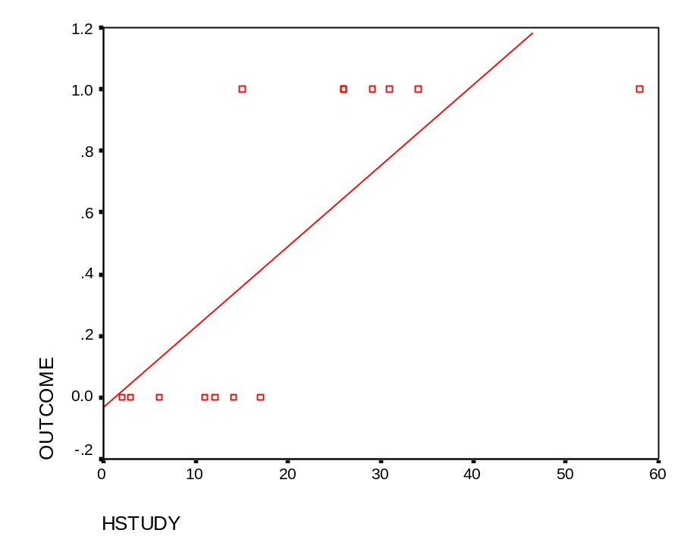
Why not OLS Regression?
Linear probability models (LPM) – what is wrong with them?
Let us do a scatter plot and insert the
regression line:
The probability of Outcome=1 can take values between 0 and 1
But we do not observe probabilities but the actual event happening
A straight line will predict values between negative and positive infinity, outside the [0,1] interval!
OUTCOME = 0.031861 + 0.026219 * HSTUDY
Notes:
As the dependent variable just takes value 1 or value 0, we have a bunch of observations aligned to value 0 and another bunch aligned to value 1. It can be seen that the observations which take value 1 for the variable ‘Outcome’ are associated with a larger number of study hours, while the observations taking value 0 are associated with a smaller number of study hours.
If the equation for this regression like was outcome = 0.031861 + 0.026219 * hrs_of_study, then what would the model predict if we studied 100 hours for the exam?
Regression?Linear Probability Models (LPM) – What is wrong with them?

Slide 7
Non Linear Probability Models
We want to be able to model the probability of the event occurring with an explanatory variable ‘X’, but we want the predicted probability to remain within the [0,1] bounds.
  There is a threshold above which the probability hardly increases as a reaction to changes in the explanatory variable.
Many functions meet these requirements (non-linearity and being bounded within the [0,1] interval).
We will focus on the Logistic.
The Logistic Curve will relate the explanatory variable X to the probability of the event occurring. In our example, it will relate the number of study hours with the probability of passing the exam.
Notes:
So maybe modelling probability with a linear regression model is not a good option. We need to acknowledge the fact that probability is bounded in the [0,1] interval and therefore, we need a function to express the relation between X and Y which is bounded in the [0,1] interval.
We also need a function that reflects this non-uniform relation between X and Y. There is a threshold above which the probability hardly increases as a reaction to changes in the explanatory variable. An increase in the number of hours of study from 0 to 5 will have a much greater impact on the probability of passing the exam than an increase from 50 to 55 hours, even when in both cases the increase was of 5 hours. We choose the Logistic function to express this relation.

Slide 8
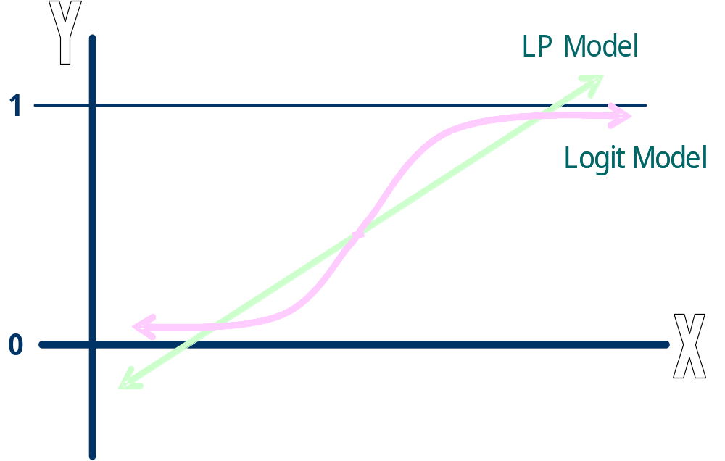
Comparing LPM and the Logistic Curve
Notes:
The form of the logistic curve is presented in this graph. It can be seen that it is bounded in the [0,1] interval while the Linear Best fit line is not! When the independent variable goes to infinity, the probability of the event occurring goes to one. When the independent variable goes to minus infinity, the probability of the event occurring goes to zero.

Slide 9
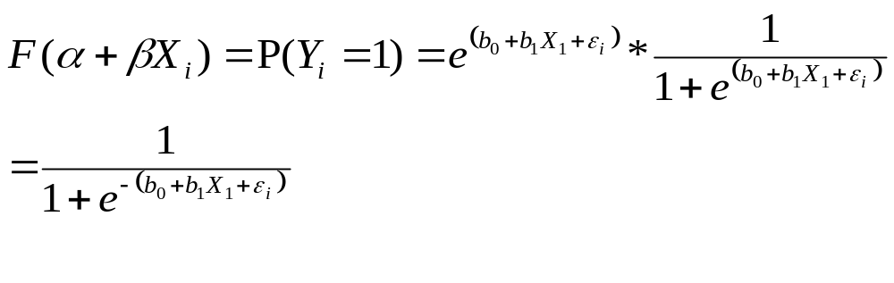
The Probability function
A Logit Model states that:
    Prob(Y_{i}=1) = F (α + βX_{i})
    Prob(Y_{i}=0) = 1 - F (α + βX_{i})
  Where, F(.) is the ‘Logistic Function’.
  So, the probability of the event occurring is a logistic function of the
  independent variables

Slide 10
The Probability function (cont…)
When there is only one explanatory variable (X₁), the Logistic Function is defined as above.
Therefore, we will be interested in finding estimates for b₀ and b₁ so that the Logistic Function best fits the data

Slide 11
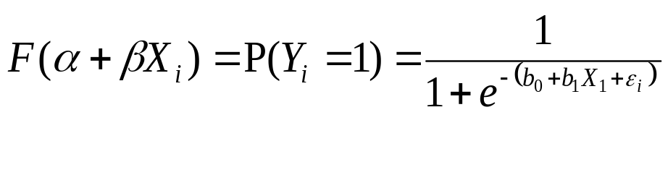
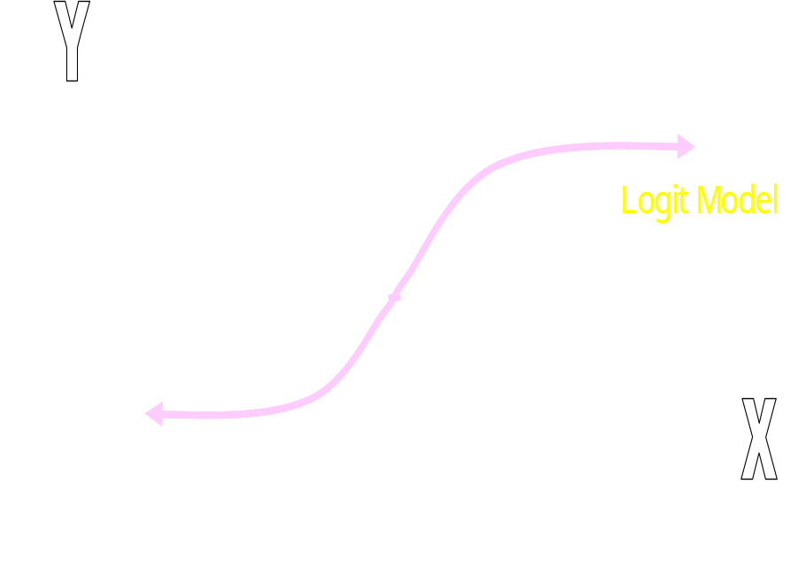
The probability function
The analytic form:
The graphic form:

Slide 12
Maximum likelihood estimation
It is in our interest to determine the values of b₀ and b₁.
The estimation of these variables in Logistic Regression Analysis is done through Maximum Likelihood Techniques
The idea behind the method is to find the parameters that make the observed values most likely to have occurred. i.e.: it maximises the probability of obtaining the sample we got.

Slide 13
Maximum likelihood estimation - The Principle
Assume X is a binary variable that adopts a value of either 0, when a company does not invest in R&D or 1 when it does.
  Prob(X=1) = λ
  Prob(X=0) = 1- λ
We may be interested in the population parameter λ, i.e.: in the probability of a firm investing in R&D
Suppose we take a random sample (with replacement) of 3 firms which yields the following set of observations: {1, 1, 0}
The Maximum Likelihood estimate of λ will be the value of λ that maximises the probability of obtaining that outcome ({1, 1, 0}).

Slide 14
Maximum likelihood estimation - The Principle
Concept of ‘joint’ probabilities:
  If the sample was drawn with replacement, as in this case, each outcome
  is independent from the other, so the joint probability will be equal to the
  product of the probabilities:
  Prob(X₁, X₂, …, X_{n})= Prob (X=X₁) * Prob ( X=X₂) *…* Prob (X=X _{n})
The joint probability of observing {1, 1, 0} will be:
  Prob(X₁=1)*Prob(X₂=1)*Prob(X₃=0)=λ* λ*(1- λ) [The Likelihood function]

Slide 15
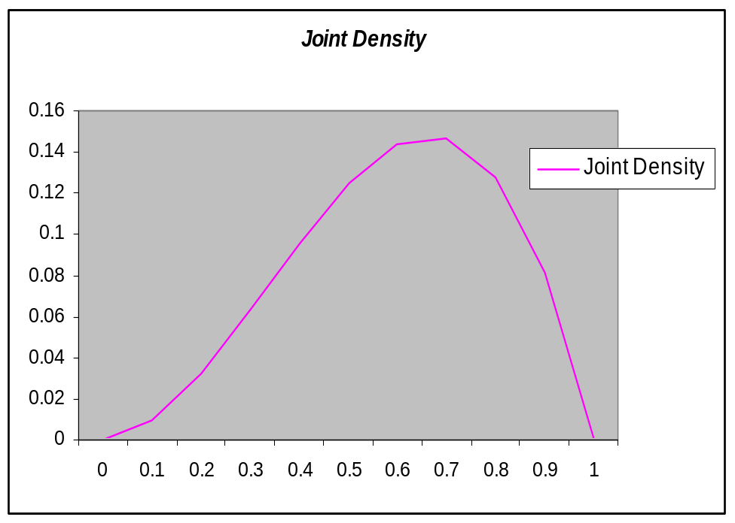
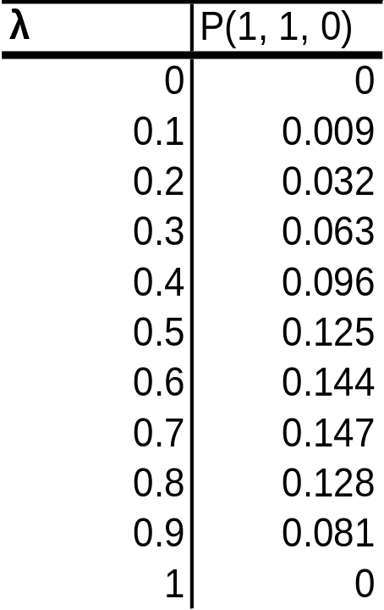
Maximum likelihood estimation - The Principle

Slide 16
Maximum likelihood estimation - The Principle
It is clear from the table and the graph that the value of λ maximising the probability of the outcome {1, 1, 0} occurring is between 0.6 and 0.7
This makes sense, as the average of the data series is 0.66 or 2/3!!
P(X₁=1, X₂=1, X₃=0) can be interpreted as a likelihood function

Slide 17
Likelihood Function
The joint probability distribution of the sample is called ‘Likelihood Function’ (and this is what we maximise to obtain the estimates of the parameters of interest!)
So if we obtained a sample {X₁, X₂, …, X _{n}}
L=P(X₁, X₂, …, X_{n}), and as each extraction is independent from the other, we can re-write L as:
L = P(X₁) * P(X₂) * … * P (X _{n})

Slide 18
Likelihood Function
The ML approach involves:
  Specifying the probability function as a function of the parameters
    e.g.: P(X₁=1, X₂=1, X₃=0)= λ* λ *(1- λ )= λ² – λ³
  Using partial differentiation to find the conditions for a maximum of the Likelihood function
    e.g.: ∂L/∂λ= 2 λ - 3 λ²
  Using the resultant equation of the partial derivatives to solve for the parameters
    e.g.: 2 λ - 3 λ² =0 → λ=2/3

Slide 19
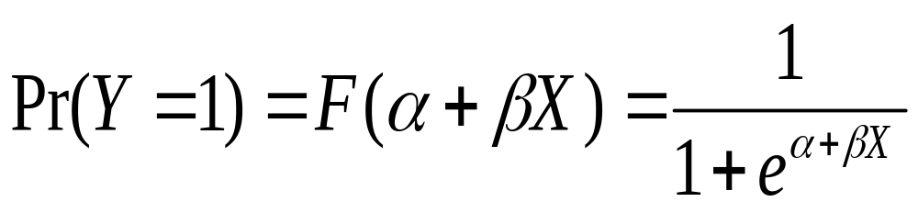
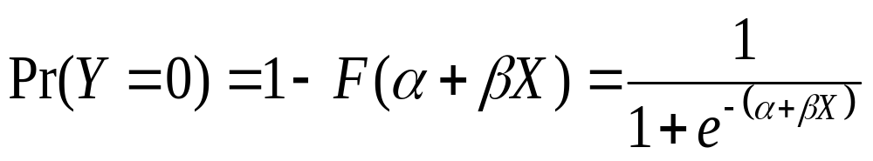
Likelihood Function - How would a Likelihood Function with Logistic Probability Functions look like?
Our focus is on maximising a Likelihood Function for a sample of observations following a Logistic Distribution.
Remember the Logistic Probability Function:

Slide 20
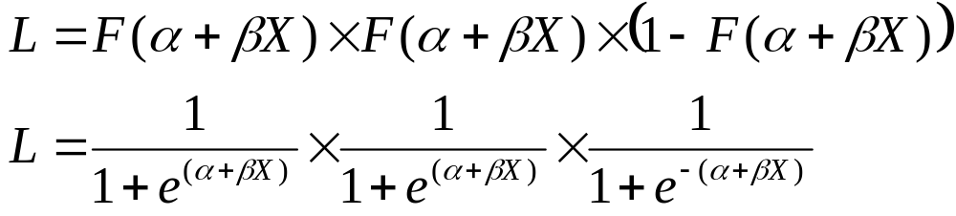
Likelihood Function - How would a Likelihood Function with Logistic Probability Functions look like? (cont..)
And suppose the sample was the one of the example: {1, 1, 0}, then, our
Likelihood Function can be expressed as:

Slide 21
Log Likelihood Function
So the maximised value of the Likelihood Function (L) is calculated using the estimated values of α and β and the values of the explanatory variable.
When we have many observations, as we are multiplying probabilities which are within the [0,1] interval, the value of the maximised L can be a very small number.
It is common to find the value of the Logarithm of the Likelihood Function (log L) instead. As the logarithm is a monotonic transformation of the L, the maximum of L corresponds to the maximum of log L.
As the L will take a value within the [0,1] interval (because we are multiplying probabilities), the log L will be a negative number.

Slide 22
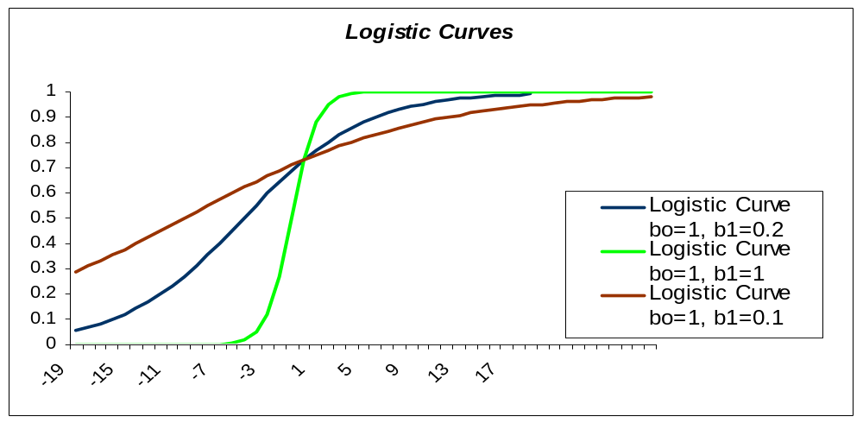
Understanding and interpreting the coefficients
Below, there are three Logistic Functions superimposed, with β=0.1, β=0.2 and β=1
As it can be seen in the graph, the larger the coefficient ‘β’ is, the steeper the logistic curve is.

Slide 23
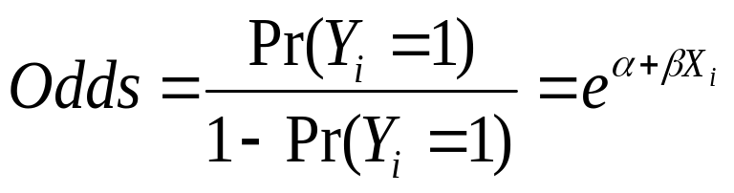
Understanding and interpreting the coefficients
The logistic model coefficients have an appealing interpretation in terms of odds
The odds of an event occurring are defined as the probability of an event occurring divided by the probability of that event not occurring: P(Y=1)/[1-P(Y=1)]
Using the logistic model, it can be shown that:

Slide 24
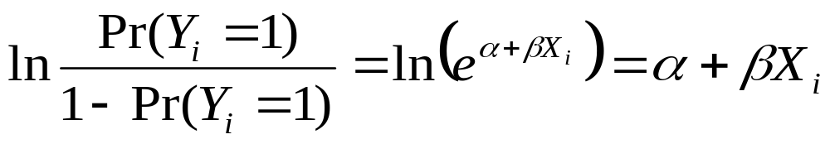
Understanding and interpreting the coefficients
If we take natural logarithms of the last expression:
The log odds ratio is a linear function of the explanatory variable
So the β coefficient gives you the effect of a unit change in X on the log odds of the event occurring.
The interpretation of the value of exp(β) is more ‘straightforward’, however. It is an indicator of the change in odds resulting from a unit change in the predictor.

Slide 25
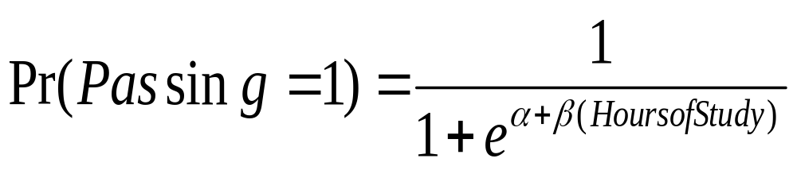
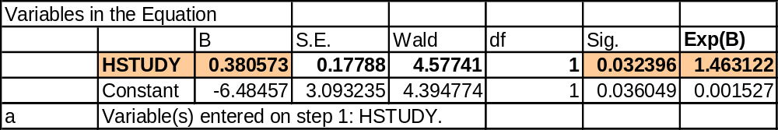
Understanding and interpreting the coefficients
We wanted to model the probability of passing an exam as a logistic function of the number of study hours.
For example, the logistic regression outputs for our model are as follows

Slide 26
Understanding and interpreting the coefficients– An Example
B, the estimate of β, equals 0.380573. This means that if a student studies one more hour, on average, the log of the odds will increase by 0.380573 – not really intuitive…
exp(b) = 1.463122.
= odds after a unit change in X/original odds
So, the percentage change in the odds given by an increase in 1 hour of study=(exp(b)-1)*100=46.31%
If exp(b)>1, then, as the explanatory variable increases, the odds of the outcome occurring increase.
If exp(b)<1, as the explanatory variable increases, the odds of the outcome occurring decrease

Slide 27
Goodness of fit measures
Hypothesis testing
We will want to test whether our model is jointly significant. i.e.: if our variables do a good job explaining the probability of passing an exam.
Our hypothesis will be:
  H_{o} : All coefficients =0
  H₁ : Ho not true
Estimate the unrestricted model and obtain the log likelihood value associated with it (L^{U})
Estimate the model with restrictions (reduced variables). Obtain the log likelihood value associated with it (L^{R})
Calculate the test statistic:
-2log(L^{R} - L^{U})

Slide 28
Goodness of fit measures - Others
There are a number of measures of goodness of fit:
  Percentage of Correct Predictions
  Hosmer Lemeshow statistic
  Percent concordance
  Percent discordance

Slide 29
Logistic Regression – Steps in SAS
Steps in the logistic regression is same as Multiple regression except the ‘proc reg’ we use here ‘proc logistic’.
Syntax:
proc logistic data = <libref dataset name>;
class
<Categorical Variable> (param = ref ref = <reference category>)
model <Dependent variables> =
<list of Independent variables> ;
run;

Slide 30
Modeling process
Define objectives
  Hypothesis testing
  Predictive model
  Detective (exploratory) model
Explore dataset
  Size; no. of variables; type of variables; missing values; distributions
Create DV and new variables (create categorical variables from numeric)
Clean Dataset – missing values, outliers, large number of 0’s, correlated variables

Slide 31
Modeling process
Run step wise regression – iterate to arrive at final model
Validate model on validation dataset
Score larger dataset

Slide 32
Convergence problems
Complete separation
  Deletion of individual variable or sets of variables
Quasi-complete separation
  Collapse categories
  Exclude cases

