Slide 1


Presentation
SQL Database Design
Jose Ayon Wu – Data Analytics | SQL | Power BI | Python | Tableau | Excel

Slide 2
Executive Overview
Centralized SQL Database Benefits Explained
KJ CORP is a Peruvian retail and distribution company specializing in solar systems, electronic locks, and hardware equipment.
The project aimed to replace manual spreadsheets with a centralized SQL database that improves efficiency, accuracy, and visibility across operations.
The database architecture ensures data integrity and enables advanced analytics for decision-making.
PROJECT SUMMARY
2

Slide 3
Business Problem & Objectives
Challenges
Manual data entry leads to errors and duplication. Limited reporting capabilities hinder decision-making, resulting in inefficiencies that affect overall business performance and operational accuracy.
Objectives
The goal is to implement a normalized SQL database with relational constraints that facilitate real-time sales and inventory analysis, improving data accuracy and operational efficiency.
Expected Value
By transitioning to an SQL database, the company anticipates faster decision-making processes and enhanced transaction traceability, ultimately driving improved business outcomes and customer satisfaction.
KEY INSIGHTS
3

Slide 4
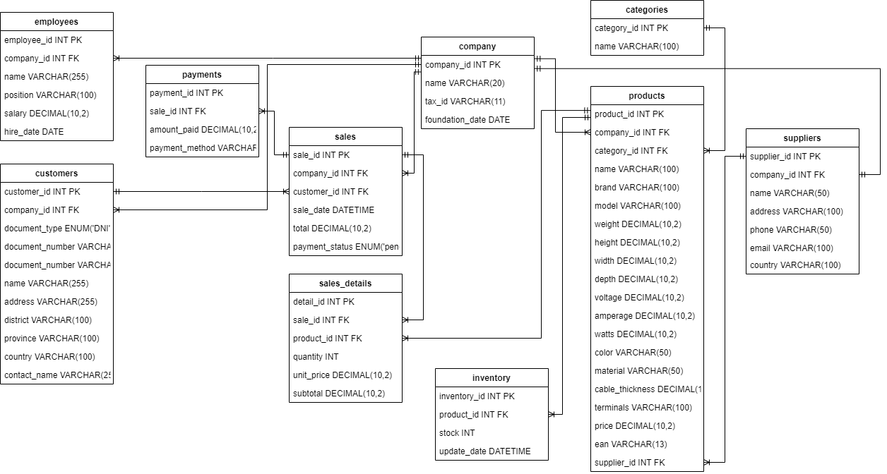
Database Architecture & Schema
Schema designed in Draw.io and implemented in MySQL 8.0.
SCHEMA DESIGN NOTES
4

Slide 5
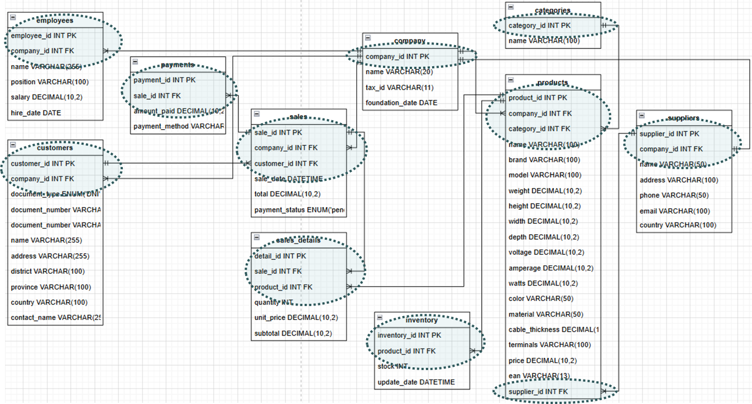
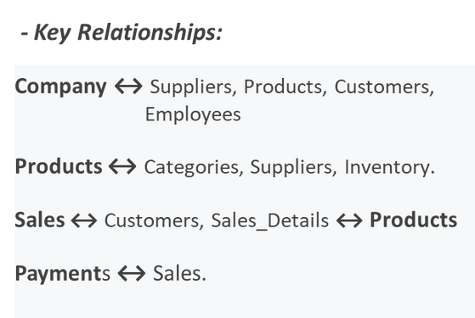
SQL Constraints Overview
Understanding Key SQL Constraints
SQL constraints such as PRIMARY KEY, FOREIGN KEY, UNIQUE, and NOT NULL ensure data integrity and establish relationships, crucial for effective database design and operational efficiency in business systems.
NOTES ON DATABASE DESIGN
5

Slide 6
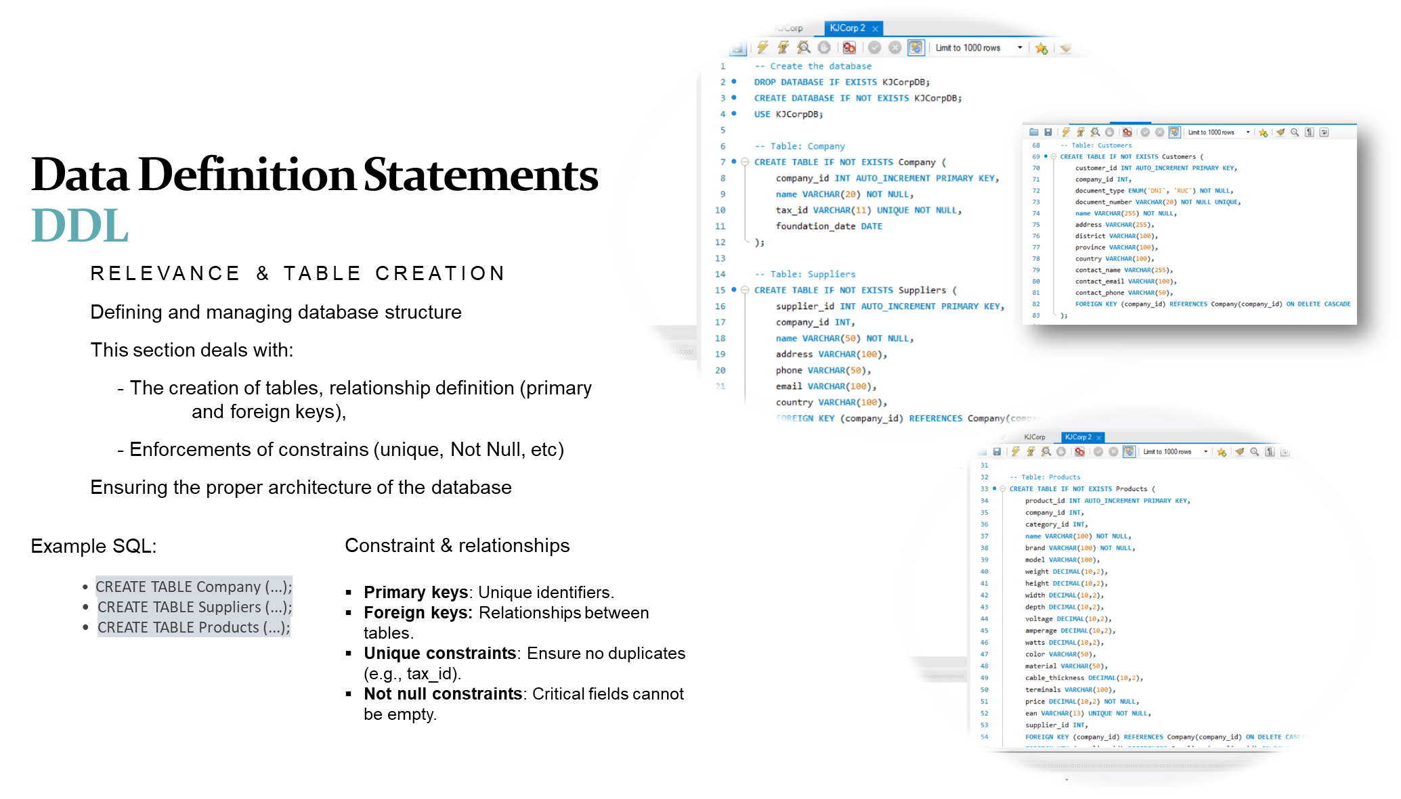
KEY INSIGHTS
6

Slide 7
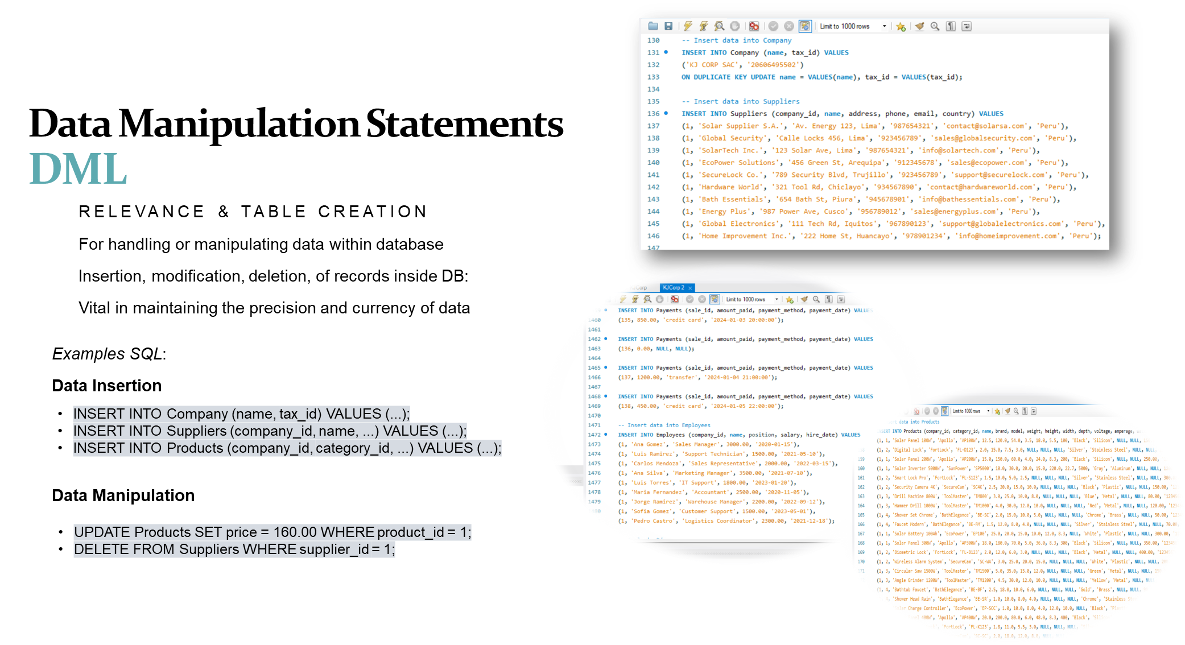
SCHEMA DESIGN NOTES
7

Slide 8
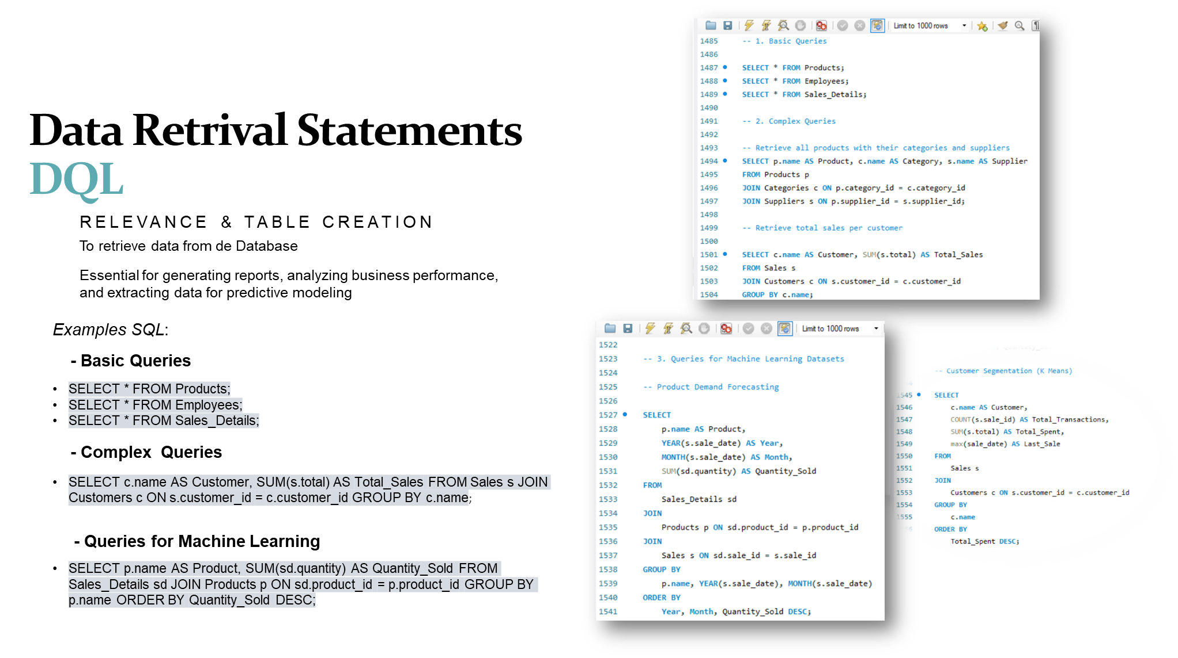
INSIGHTS AND ANALYTICS NOTES
8

Slide 9
Business Impact & Scalability
Operational Efficiency
Implementing a centralized SQL database has significantly eliminated redundancy, allowing team members to focus on value-added activities and increasing overall productivity across departments within KJ CORP.
Analytical Visibility
The new system offers real-time reporting capabilities, enabling data-driven decision-making and increased visibility into business operations, which contributes to more effective management and strategic planning.
Scalability
The database structure ensures future readiness, allowing KJ CORP to easily integrate new technologies and scale operations without compromising data integrity or performance as the business grows.
Lessons Learned
Ongoing iteration has shown the importance of normalization and indexing, resulting in enhanced query performance and efficiency, providing valuable insights that foster continuous improvement in our database practices.
KEY TAKEAWAYS
9

Slide 10
Contact Information
Let's Connect and Collaborate
Phone
(365) 855 - 5639
Email
joseayonwu@gmail.com
Linkedin
www.linkedin.com/in/joseayonwu/
Website
https://github.com/joseayonwu

