Slide 1
CYBERSECURITY · MACHINE LEARNING · MONITORING
IoT Intrusion
Detection
Streaming classification & live drift monitoring on the CICIoT2023 dataset
PROJECT TEAM
Jose Azzi · Maria Bouchi · Lynn Mechreck

Slide 2
THE PROBLEM
Why intrusion detection ≠ ordinary classification
A model that hits 95% accuracy can still be useless in security. Most traffic is benign, attack classes are heavily imbalanced, and every false alarm costs operator trust.
Class imbalance
8 classes, 69× ratio between majority & minority.
So we optimise and report:
Cost asymmetry
Macro F1, not raw accuracy
Per-class recall on minority attacks
False-positive rate on benign traffic
Drift over time once deployed
Missing a rare attack ≠ flagging a benign flow.
Distribution shift
Traffic patterns change — yesterday's model may not recognise today's attack.
IoT Intrusion Detection · CICIoT2023 · 2026
2

Slide 3
MILESTONE 1 · THE DATA
A realistic IoT security benchmark
We use a subset of CICIoT2023 — a large benchmark of benign IoT traffic and multiple attack captures. After duplicate removal we have one clean, labelled flow dataset to build on.
1.08M
39
8
190K
LABELLED FLOWS
NUMERIC FEATURES
TRAFFIC CLASSES
DUPLICATES REMOVED
8 CLASSES
BenignTraffic
DDoS-ICMP_Flood
DictionaryBruteForce
DoS-SYN_Flood
MITM-ArpSpoofing
Mirai-greeth_flood
Recon-PortScan
SqlInjection
IoT Intrusion Detection · CICIoT2023 · 2026
3

Slide 4
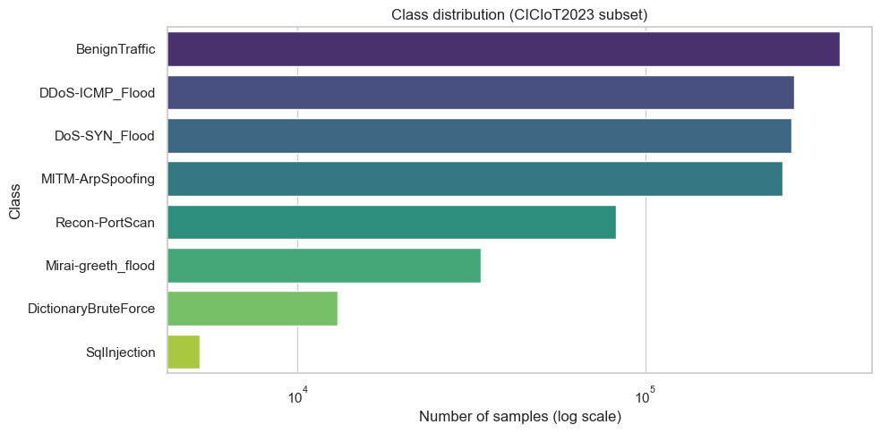
MILESTONE 1 · CLASS BALANCE
The imbalance that drives every later choice
Benign traffic is the largest class at ~362K rows; SqlInjection is the smallest at ~5K. A naive accuracy-optimised model can simply ignore the rare attacks and still look good on paper.
69×
BenignTraffic
362,361 samples
SqlInjection
5,245 samples
imbalance ratio
CONSEQUENCE
Every model is trained with class weighting, and model selection is based on macro F1 — not accuracy.
IoT Intrusion Detection · CICIoT2023 · 2026
4

Slide 5
APPROACH
Seven-step IDS pipeline — from raw CSVs to live monitoring
01
02
03
04
Ingest & validate
Train/val/test split
Prepare features
Baseline: LogReg
Load 8 CSVs, check schema & duplicates
70/15/15 stratified on label
Impute + scale on train only (no leakage)
Interpretable anchor for comparison
05
06
07
Stronger models
Deploy as API
Monitor drift
Random Forest, HGB, PyTorch MLP
FastAPI + streaming micro-batches
Features, class mix, alert rate
IoT Intrusion Detection · CICIoT2023 · 2026
5

Slide 6
MILESTONE 2 · PREPROCESSING
Leakage-safe preparation, fit once, reused at inference
Ordered per-class split
SAVED ARTIFACTS
Reused by the live API so inference matches training byte-for-byte
Train 70%
Val 15%
Test 15%
imputer.joblib
Mean imputation, fit on train
759,529
162,758
162,760
scaler.joblib
StandardScaler, fit on train
Leakage-safe by construction
label_encoder.joblib
Replace ∞ with NaN before splitting (structural, no stats)
Ordered chunks per class — adjacent flows stay together
Imputer + scaler — fit on train, transform val/test only
All artifacts saved as joblib for byte-exact inference
8-class index ↔ name mapping
feature_names.json
Column order for incoming JSON
IoT Intrusion Detection · CICIoT2023 · 2026
6

Slide 7
MILESTONE 3 · MODELS
Four classifiers, compared on macro F1 & benign FPR
BASELINE
SELECTED
BOOSTED
NEURAL
Logistic Regression
Random Forest
HistGradientBoosting
PyTorch MLP
Linear, class-balanced, 1,000 iterations. Anchors the comparison.
200 trees, class-balanced. Strong default for tabular data.
Gradient boosting with per-sample weights for class balance.
Hidden (128, 64), ReLU, Adam. Early stopping on a carved-out split.
class_weight='balanced'
n_estimators=200
max_iter=100
hidden=(128,64)
max_iter=1000
class_weight='balanced'
lr=0.1
patience=5
All four trained with class weighting; selection based on macro F1 on a held-out validation set.
IoT Intrusion Detection · CICIoT2023 · 2026
7

Slide 8
MILESTONE 3 · VALIDATION RESULTS
Random Forest wins on both F1 and benign FPR
MACRO F1 (↑) vs BENIGN FPR (↓)
VALIDATION METRICS
MODEL | ACC | F1 | FPR
Random Forest | 0.910 | 0.735 | 0.026
HistGradientBoost | 0.808 | 0.673 | 0.303
MLP (PyTorch) | 0.772 | 0.659 | 0.373
Logistic Regression | 0.685 | 0.612 | 0.532
VERDICT
RF leads on F1 and is the only model with ≲3% benign FPR.
IoT Intrusion Detection · CICIoT2023 · 2026
8

Slide 9
MILESTONE 3 · HELD-OUT TEST
Random Forest — final numbers on the untouched test set
91.6%
0.760
2.2%
TEST ACCURACY
MACRO F1
BENIGN FALSE-POSITIVE
Strong on floods
Solid on benign
Weak on rare attacks
DDoS / DoS / Mirai all ≥ 0.999 F1 — the model nails high-rate attacks.
98% benign recall with only 2.2% false positives — usable for alert routing.
SqlInjection recall is only 8% — the minority classes remain an open problem.
IoT Intrusion Detection · CICIoT2023 · 2026
9

Slide 10
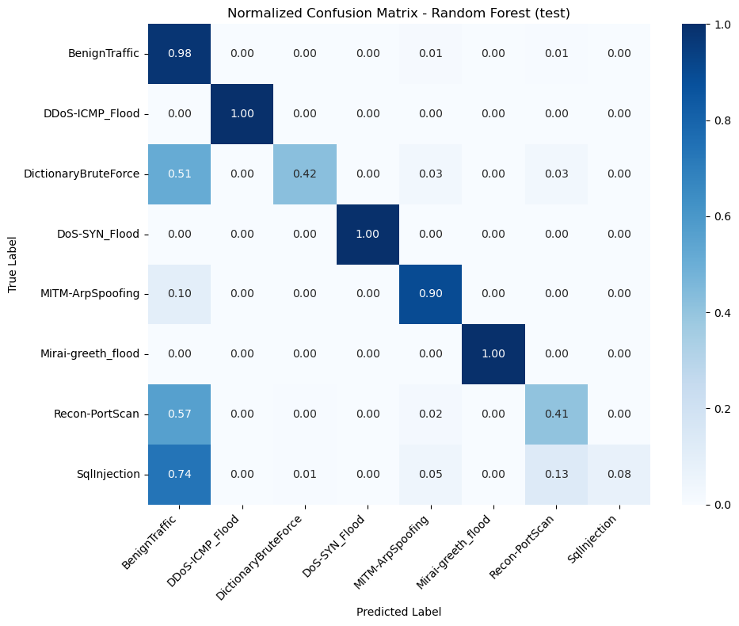
MILESTONE 3 · PER-CLASS
Where Random Forest hits — and where it misses
DIAGONAL READING
DDoS-ICMP_Flood
1.00
DoS-SYN_Flood
1.00
Mirai-greeth_flood
1.00
BenignTraffic
0.98
MITM-ArpSpoofing
0.90
DictionaryBruteForce
0.42
Recon-PortScan
0.41
SqlInjection
0.08
Rare attack classes collapse into BenignTraffic — the direction we'd target with resampling or threshold tuning next.

Slide 11
MILESTONE 4 · DEPLOYMENT
The trained model, wrapped as a live FastAPI service
Request flow
ENDPOINTS
Client
/health
POSTs feature JSON
GET
Model info, feature count, class list
Preprocessing
POST
/predict
Saved imputer + scaler reused verbatim
Single flow record → class + probabilities
POST
/predict/batch
Random Forest
Micro-batch for streaming simulation
predict_proba → class + probabilities
/monitoring
GET
Full drift & alert snapshot
Response + Log
JSON back · line written to predictions.jsonl
GET
/dashboard
Live HTML dashboard polling /monitoring
IoT Intrusion Detection · CICIoT2023 · 2026
11

Slide 12
MILESTONE 4 · MONITORING
Three drift signals over a rolling window of 500 predictions
01
02
03
Feature drift
Predicted class-mix drift
Alert-rate spike
|μ_window − μ_train| / σ_train > 2σ
max |share_window − share_train| > 0.10
rate_recent / rate_baseline > 2.0
Per-feature standardised mean shift against the training distribution. Any feature whose window mean is >2σ off its training mean is flagged.
Recent predicted-class histogram vs training class shares. Flagged when any class share shifts by more than 10 percentage points.
Share of non-benign predictions in the rolling window relative to the training baseline. Flagged when recent alert rate more than doubles.
Every /monitoring call writes a compact JSON line to drift.jsonl for post-hoc analysis.
IoT Intrusion Detection · CICIoT2023 · 2026
12

Slide 13
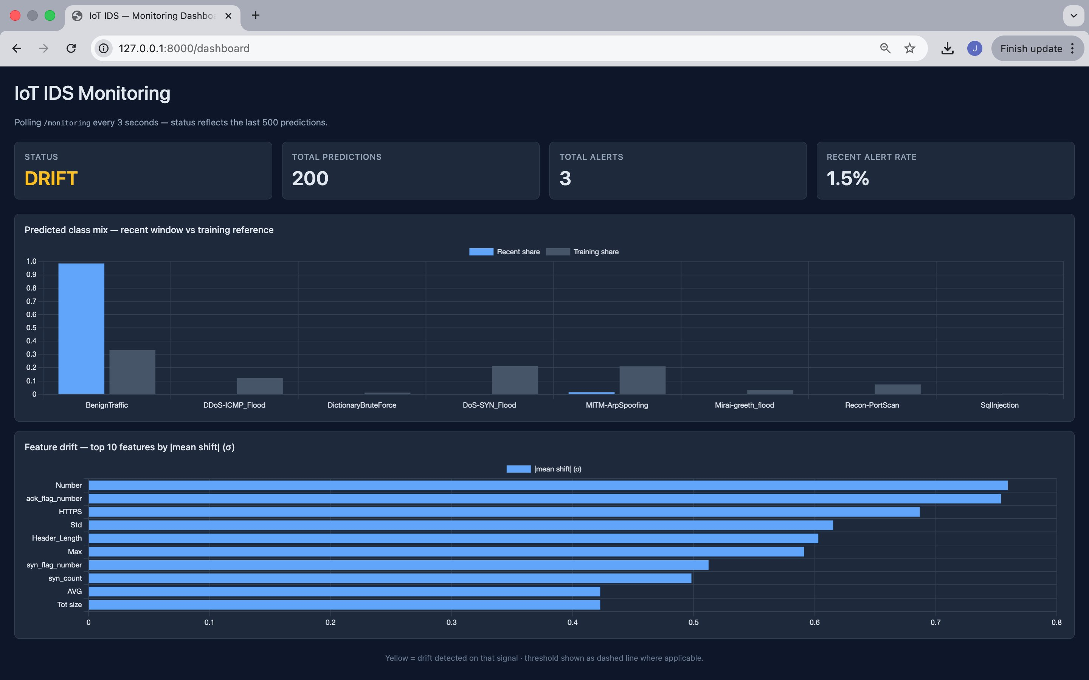
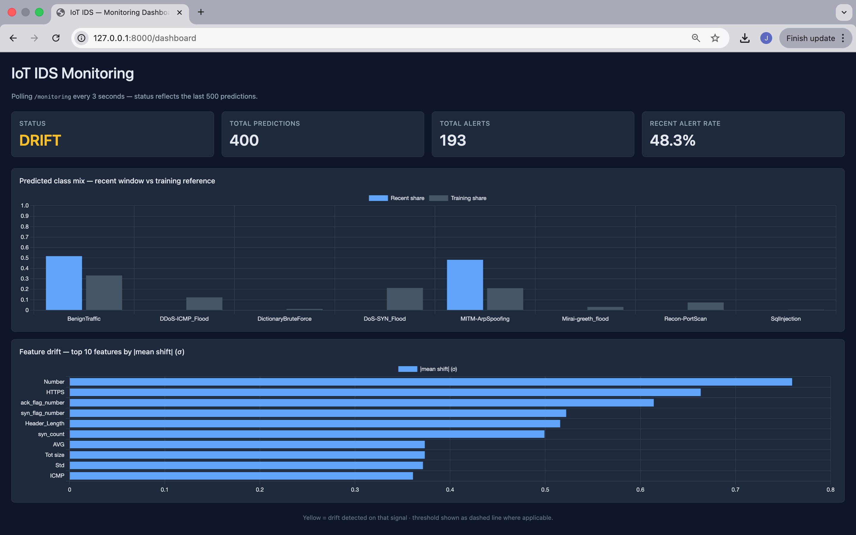
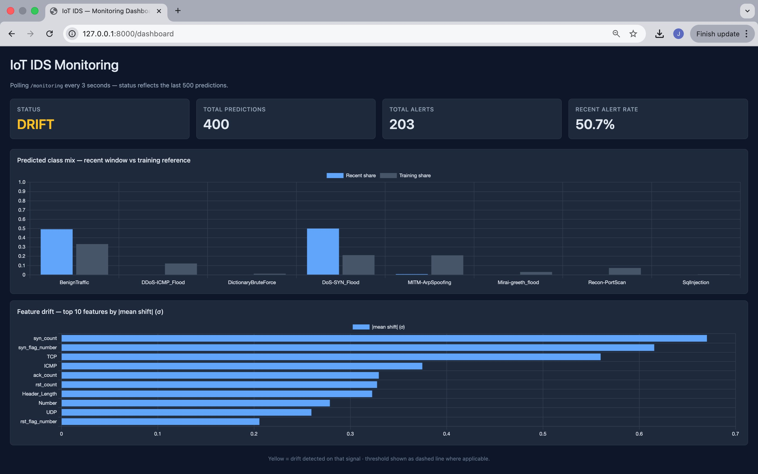
MILESTONE 4 · LIVE DEMO
Dashboard reacts to streamed micro-batches in real time
Streaming BenignTraffic
Streaming MITM-ArpSpoofing
Streaming DoS-SYN_Flood
1.5%
48.3%
50.7%
alerts ~ baseline, no class drift
class mix pivots to MITM, alerts spike
SYN-flood dominates, syn_count drifts
Status flips from OK → DRIFT as traffic shifts, with offending features and class shares visible live.
IoT Intrusion Detection · CICIoT2023 · 2026
13

Slide 14
CLOSING
Takeaways & what's next
WHAT WORKED
KNOWN LIMITATIONS
End-to-end pipeline — CSV → API → live dashboard
Random Forest: 91.6% test accuracy, 2.2% benign FPR
Leakage-safe preprocessing, saved & reused at inference
Three drift signals catch real distribution shifts
Ordered chunks ≠ true time-based split (no timestamps available)
No hyperparameter tuning or resampling (e.g. SMOTE)
SqlInjection recall is only 8% — needs extra work
Monitor state is in-memory only; resets on restart
NEXT STEPS
Time-based splits · richer drift tests (KS, PSI, χ²) · threshold tuning for rare classes · persistent monitor state
Thank you.
Jose Azzi · Maria Bouchi · Lynn Mechreck

