Slide 1
UNIT 8
PSYCHOLOGICAL TOLERANCE
TESKAL
Copyright © J. Arruza

Slide 2
SPORTS PERFORMANCE (1)
Sports Excellence Areas
  Motor
  Psychological
  Biomedical

Slide 3
SPORTS PERFORMANCE (2)
Motor Area
  Motor Expression
    Simulation.
    Masking.
  Motor Action
    Perceptual-Motor Factors.
    Neuro-Motor Factors.
    Physical Factors.
Psychological Area
  Emotional factors.
  Self-referred Processes.
  Mental Capacities.
Biomedical Area
  Biological V.C ..
  Recovery support.
  Nutritional factors.

Slide 4
RELEVANT ASPECTS
In search of optimal performance.
  Individual
  Collective
Coach and athlete.
“Non-explicit” Influence.
Integration in training plans.

Slide 5
PSYCHOLOGICAL TOLERANCE (1)
Maximal external demands.
Great personal meaning.
Limited duration.
Cognitive, emotional and behavioral.

Slide 6
PSYCHOLOGICAL TOLERANCE (2)
Emotional
  Tension.
  Hostility.
  Vigor.
  Fatigue.
  Anxiety.
Cognitive
  Perceived Difficulty.
  Degree of Confidence.
  Level of Importance.
  Range of perceived effort.
Behavioral
  Uncertainty of events.
  Adversity.
  Results more or less even.

Slide 7

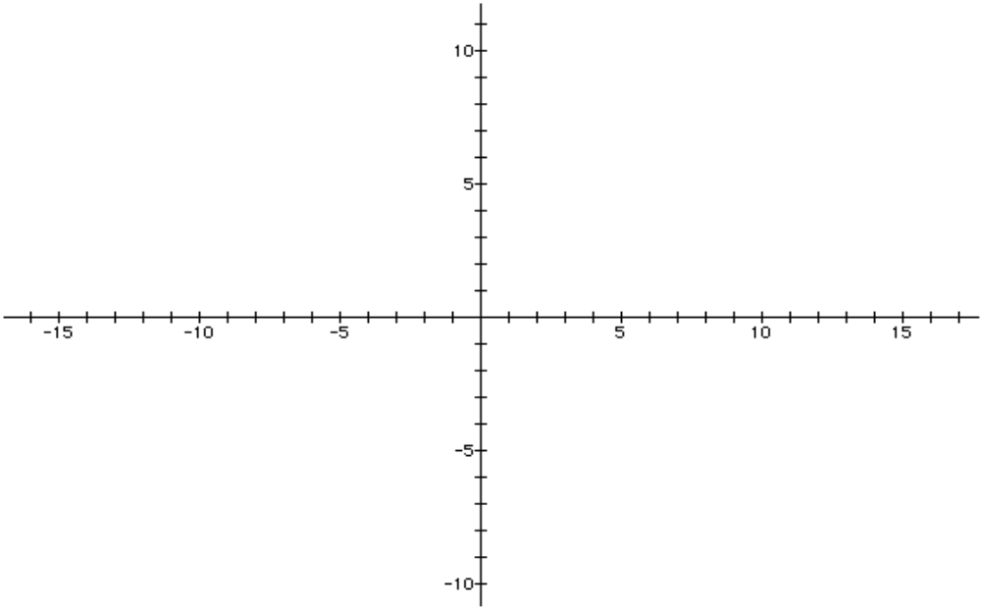
EMOTIONAL ACTIVATION AND SPORTS PERFORMANCE
Performance
R +
DEA -
R +
DEA +
DEA
R +
DEA -
R -
DEA +

Slide 8
EMOTIONAL
Vigor
Tension
Depression
Hostility
Fatigue

Slide 9
COGNITIVE
Estimate of Perceived Difficulty (EPD).
Degree of Confidence (DECO).
Level of Perceived Effort (LPE).
Degree of Importance (DOI).

Slide 10
BEHAVIORAL
Uncertainty of events.
Event Adversity.
Outcome Adversity.

Slide 11
OPTIMAL ZONE
Positive and pleasant sensations
Anticipation excitement.
Favorable outcome.
Extrinsic concentration.
Execution control
M.T. consolidated
Invulnerability
Optimism
Maximal degree of confidence.

Slide 12
UTP
Unpleasant sensations.
Nervousness.
Even-Favorable Outcome
Start of negative self-dialog.
Execution difficulties.
Vague M.T. or in early stages .
Personal Vulnerability.
Pessimism.
Pressure over confidence

Slide 13
COPING (C.I.P.)
Action Plan.
Situational Reevaluation.
Self-Efficacy.
Personal stabilizers.

Slide 14
ACTION PLAN
Game plan.
Ergogenic support.
Transitional periods.

Slide 15
SITUATIONAL REEVALUATION
Evaluation.
Acceptance.
Emotional rationalization.
Contextual Analysis.

Slide 16
SELF-EFFICACY
Relationship between perceived self-efficacy variables and athletic success.
Capacities of Yield
Expectations of Result
+% FAILURE
Learning by Observation
Execution
Verbal Persuasion
Expectations of Effectiveness
+% SUCCESS
Emotional Activation

Slide 17
PERSONAL STABILIZERS
Values and beliefs.
Positive experiences.

