Slide 1
UNIT 13
MOOD STATES
TESKAL
Copyright © J. Arruza

Slide 2
OVERVIEW
Host of temporary sensations, of varying duration and intensity. (Watson & Clark, 1997).
Useful in applied psychiatry with an outpatient population.
The Profile of Mood States (P.O.M.S.) was developed by McNair, Lorr y Dropplemasn (1971).

Slide 3
RELIABILITY (0, 69)
VALIDITY (0, 80)
Psychotherapy studies.
Controlled tests of medication with outpatient population.
Behavioral studies in emotion-inducing conditions.
Research on concurrent validity and other correlates.

Slide 4
INTERPRETATION (1)
Tension/Anxiety
  They describe the sensations of muscle tone and somatic tension.
Depression/Sadness
  Associated to sensations of isolation, sadness and uselessness.
Anger/Hostility
  They reflect feeling of anger, bad mood and irritation.

Slide 5
INTERPRETATION (2)
Vigor/Activity
  It describes a state of enthusiasm and energy. It is the positive dimension and has a negative correlation with the others.
Fatigue
  It describes sensations of low energy and fatigue.
Confusion
  It is related to situations of uncertainty, distraction and puzzlement.

Slide 6
TENSION
Restless........1
Agitated........6
Tense..........11

Slide 7
DEPRESSION
Vulnerable....2
Unhappy…....7
Sad………….12

Slide 8
HOSTILITY
Irritated……………5
Angry………………10
In a bad mood…..15

Slide 9
VIGOR
Full of pep…………4
Animated…………..9
Active………………14

Slide 10
FATIGUE
Weak………………..3
Tired…………………8
Fatigued…………..13

Slide 11

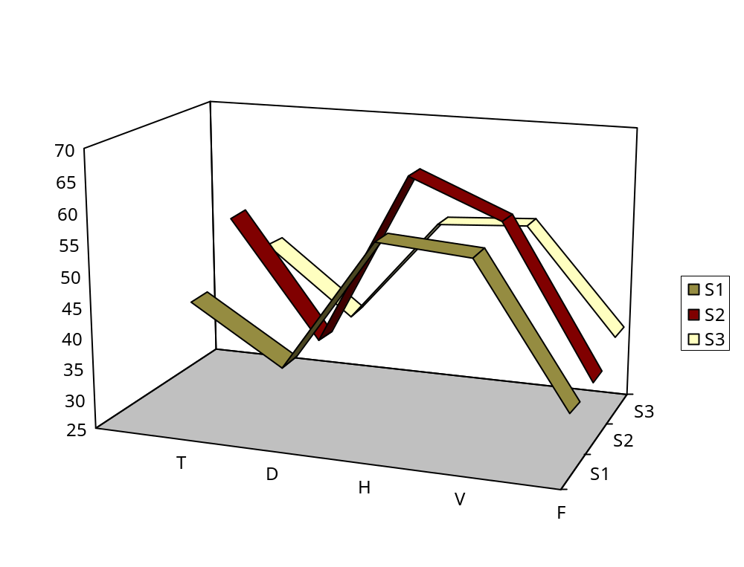
EXAMPLE
Example of 3 sportsmen related
with POMS dimensions

Slide 12
Use of the P.O.M.S
Prevention of Overtraining.
Detection of problems outside training
Optimization of coping responses.
Periodization.
  Period of Preparation.
  Competitive Period.

