Slide 1



Lecture: Methods to validate fair classifiers
Authors:
Jose Caloca - Senior Data Scientist, ING Hubs Poland
Karan Gupta - Senior Risk Modelling Specialist, ING Hubs Poland
Disclaimer: The views expressed in this presentation and on the subsequent slides solely belong to the presenters and do not necessarily reflect ING practices.

Slide 2
Agenda
Introduction: Blind model bias
Model fairness – General overview
Fairness metrics: Statistical non-discrimination criteria
Cut-off agnostic metrics
Legal considerations: 80% Rule
Development Lifecycle – Types of Biases
Approaches to Bias Mitigation: Pre-Processing
Approaches to Bias Mitigation: In-Processing
Approaches to Bias Mitigation: Post-Processing
2

Slide 3
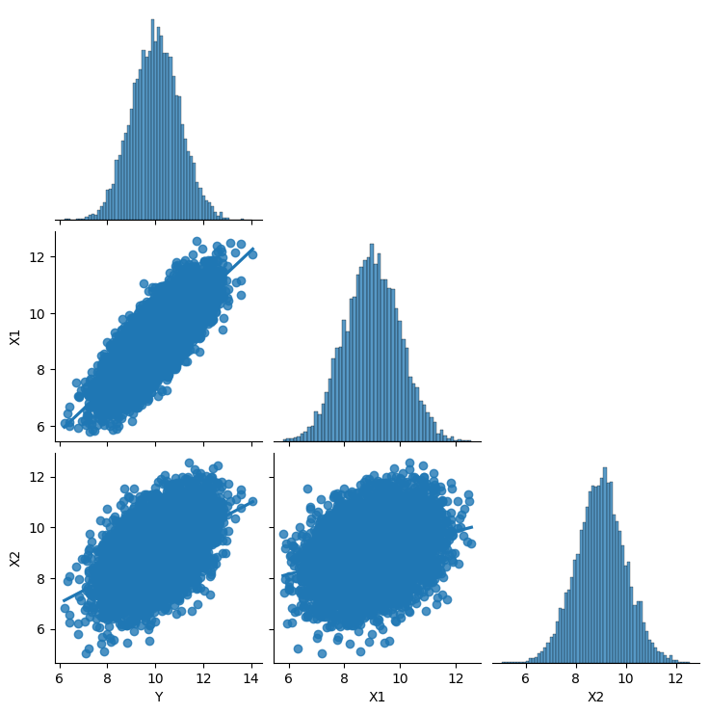
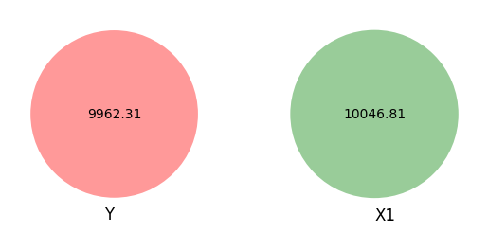
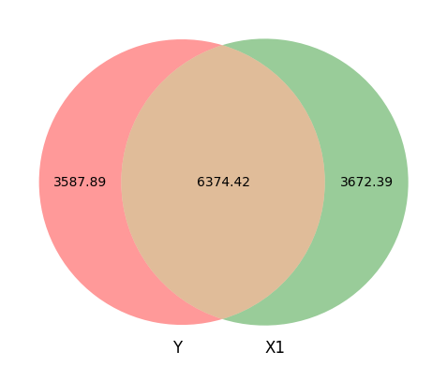

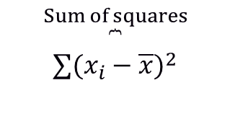
Introduction: Blind model bias – 2 variables model example
1. Let’s simulate some data
2. We create Venn diagrams with size equal to the sum of squares of the variables
3. We analyse the relationships between the variables
 | Sum of squares | df | F | PR(>F)
X1 | 6374.42 | 1 | 17762.94 | 0
Residual | 3587.88 | 9998 | - | -
$$\overset{Sum of squares}{\overset{⏞}{∑(x_{i}−\overline{x})^{2}}}$$
6374.42 (whatever units) are shared between Y and X1, with 3587.88 not shared (or residual). A Venn diagram helps us to visualise the covariance between these two variables.
These two variables are related to each other though and have some covariance. We can calculate the shared covariance using ANOVA
Y | X1 | X2
8.91 | 7.39 | 9.54
11.00 | 9.61 | 10.68
10.28 | 8.72 | 9.36
8.49 | 9.22 | 8.63
9.42 | 8.93 | 6.89
$$R^{2}=\frac{6374.42}{3587.89+6374.42}=0.639$$

Slide 4
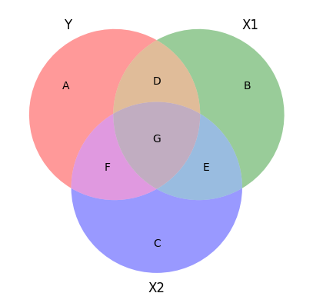
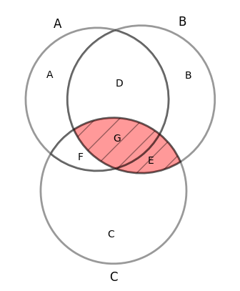
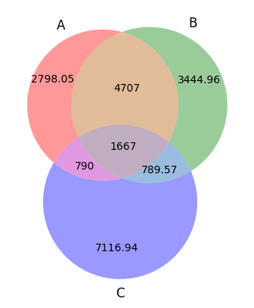
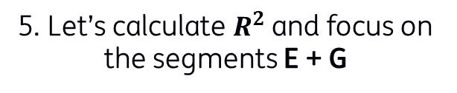
Introduction: Blind model bias – 3 variables model example
4. We build a model with 2 explanatory variables (X1 and X2)
5. Let’s calculate $R^{2}$and focus on the segments E + G
6. We analyse the shared area between X1 and X2. Spot Multicollinearity in the model
Segment | Explanation
A + D + E + G | Total variation in Y
B + D + F + G | Total variation in X1
C + E + F + G | Total variation in X2
A | Unexplained variation in Y after accounting for X1 and X2
B | Unexplained variation in X1 after accounting for Y and X2
C | Unexplained variation in X2 after accounting for Y and X1
D + G | Variance shared by Y and X1
F + G | Variance shared by Y and X2
E + G | Variance shared by X1 and X2
D | Variance only between Y and X1, without influence from X2
F | Variance only between Y and X2, without influence from X1
E | Variance only between X1 and X2, without influence from Y
G | Variance shared by Y, X1, and X2
$$R^{2}=\frac{D+G+F}{A+D+G+F}=\frac{4707+1667+790}{2798.05+4707+1667+790}=0.72$$
Area E shows the variation shared by both X1 and X2, and again it’s impossible to know which parts are unique. As a result, the area (E + G) represents the total multicollinearity in the model:

Slide 5
Model fairness – General overview
Machine learning models developed across different industries are becoming influential in people’s lives
What is a classifier?
Fairness through unawareness
Multiple views of fairness¹
Classifiers leverage the existence of patterns that connect the outcome of interest in a population to pieces of information that we can observe.
For example:
Risky loan applicants might have a track record of high credit utilization.
Removing or ignoring sensitive attributes can be ineffective and even harmful.
A model will discriminate when trained with covariates that are correlated with a protected attribute, even if this variable is removed from the model
Individual fairness ensures that people who are ‘similar’ with respect to the classification task receive similar outcomes
Group fairness ensures statistical parity for members of different protected groups (e.g. gender or race)
1. Bellamy et al. (2018)
2. High-Level Expert Group on Artificial Intelligence of the (European Commission, 2019)
5

Slide 6



Fairness metrics: Statistical non-discrimination criteria (1/2)
Absence of discrimination can be defined in terms of statistical expressions that equalise some group-dependent statistical quantity across different groups
Independence $\hat{Y}⊥A$
Separation $\hat{Y}⊥A∣Y$
Sufficiency $Y⊥A∣\hat{Y}$
Definition
The protected attribute is statistically independent of the model prediction.
The prediction is assumed to be independent of the protected attributes given the actual outcome
The protected attribute is statistically independent of the actual outcome given the model prediction
Common metrics
Statistical parity: Equal proportion of positive predictions in each group (acceptance rate)
Equalised odds: Equal error rates across groups
Predictive parity: Equal chances of success/fail in each group
Fairness for whom?
A third party (e.g. Society)
The lender (e.g. a Bank)
Credit applicant
The above metrics have a particular “relaxation” to achieve fairness
6

Slide 7





Fairness metrics: Statistical non-discrimination criteria (2/2)
Absence of discrimination can be defined in terms of statistical expressions that equalise some group-dependent statistical quantity across different groups
Independence $\hat{Y}⊥A$
Separation $\hat{Y}⊥A∣Y$
Sufficiency $Y⊥A∣\hat{Y}$
Definition
The protected attribute is statistically independent of the model prediction.
The prediction is assumed to be independent of the protected attributes given the actual outcome
The protected attribute is statistically independent of the actual outcome given the model prediction
Prevalence
TPR = $\frac{TP}{TP + FN}$
PPV = $\frac{TP}{TP + FP}$
$$\frac{TP+FN}{TP+FP+TN+FN}$$
FPR = $\frac{FP}{FP+TN}$
NPV = $\frac{TN}{TN+FN}$
Cut-off-dependent metrics
Confusion matrix to make things more confusing
Common metrics
Statistical parity: Equal proportion of positive predictions in each group (acceptance rate)
Equalised odds: Equal error rates across groups
Predictive parity: Equal chances of success/fail in each group
Actual
Good loan
Actual
Bad loan
Fairness for whom?
Predicted
Good loan
True Positives
False Positive
A third party (e.g. Society)
The lender (e.g. a Bank)
Credit applicant
Predicted
Bad loan
False Negative
True Negative
The above metrics have a particular “relaxation” to achieve fairness
7

Slide 8
Cut-off agnostic metrics
Model predictions can be challenged from a fairness perspective before they are used for classification. In this case, we pay attention to the distribution of the scores across groups.
Compare sub-groups score distributions
Difference
Central tendency comparison
Density
Female
Male
Cumulative distribution comparison
Distance between distributions
Decile comparison in scores
Scores
8

Slide 9











Legal considerations: 80% Rule
The rule states that the lenders should maintain a credit approval rate for protected classes that is at least 80% of that of privileged class.
What is adverse impact?
“Adverse impact is the negative effect an unfair and biased selection procedure has on a protected class. It occurs when a protected group is discriminated against during a selection process, like a hiring or lending decision.”
$$\frac{50}{100}=50\%$$
$$\frac{72}{100}=72\%$$
$$\frac{50\%}{90\%}=55.5 \%$$
$$\frac{72\%}{90\%}=80 \%$$
$$\frac{90}{100}=90\%$$
$$\frac{90}{100}=90\%$$
9

Slide 10
Development Lifecycle – Types of Biases
Justifiability
Group and Individual Fairness
Systematic Disadvantage
Justifications for
System Decisions
Use of Personal Attributes
!Sensitive Attributes
Accuracy and Bias
Regular Review (Accuracy, Relevance,
Alignment of Decisions with Model Design and Intent)
Minimize Unintentional Bias
Qualitative
Quantitative
1. Veritas Document 3A FEAT Fairness Principles Assessment Methodology (Monetary Authority of Singapore, 2021)

Slide 11
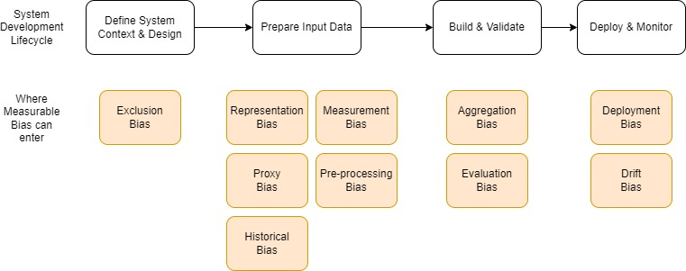
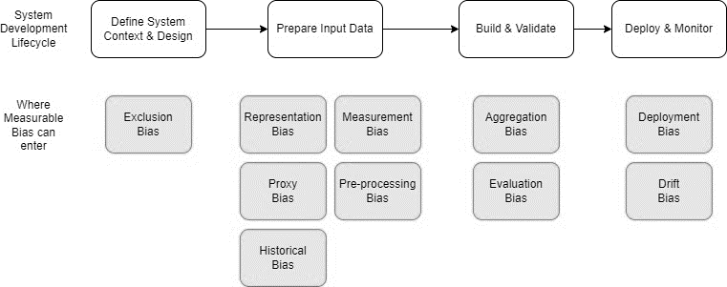
Development Lifecycle – Types of Biases
Justifiability
Group and Individual Fairness
Systematic Disadvantage
Justifications for
System Decisions
Use of Personal Attributes
!Sensitive Attributes
Accuracy and Bias
Regular Review (Accuracy, Relevance,
Alignment of Decisions)
Minimize Unintentional Bias
Qualitative
Quantitative
1. Veritas Document 3A FEAT Fairness Principles Assessment Methodology (Monetary Authority of Singapore, 2021)

Slide 12
Development Lifecycle – Types of Biases
Justifiability
Group and Individual Fairness
Systematic Disadvantage
Justifications for
System Decisions
Use of Personal Attributes
!Sensitive Attributes
Accuracy and Bias
Regular Review (Accuracy, Relevance,
Alignment of Decisions)
Minimize Unintentional Bias
Qualitative
Quantitative
1. Veritas Document 3A FEAT Fairness Principles Assessment Methodology (Monetary Authority of Singapore, 2021)

Slide 13
Development Lifecycle – Types of Biases
Justifiability
Group and Individual Fairness
Systematic Disadvantage
Justifications for
System Decisions
Use of Personal Attributes
!Sensitive Attributes
Accuracy and Bias
Regular Review (Accuracy, Relevance,
Alignment of Decisions)
Minimize Unintentional Bias
Qualitative
Quantitative
1. Veritas Document 3A FEAT Fairness Principles Assessment Methodology (Monetary Authority of Singapore, 2021)

Slide 14
Development Lifecycle – Types of Biases
Justifiability
Group and Individual Fairness
Systematic Disadvantage
Justifications for
System Decisions
Use of Personal Attributes
!Sensitive Attributes
Accuracy and Bias
Regular Review (Accuracy, Relevance,
Alignment of Decisions)
Minimize Unintentional Bias
Qualitative
Quantitative
1. Veritas Document 3A FEAT Fairness Principles Assessment Methodology (Monetary Authority of Singapore, 2021)

Slide 15
Development Lifecycle – Types of Biases
Justifiability
Group and Individual Fairness
Systematic Disadvantage
Justifications for
System Decisions
Use of Personal Attributes
!Sensitive Attributes
Accuracy and Bias
Regular Review (Accuracy, Relevance,
Alignment of Decisions)
Minimize Unintentional Bias
Qualitative
Quantitative
1. Veritas Document 3A FEAT Fairness Principles Assessment Methodology (Monetary Authority of Singapore, 2021)

Slide 16

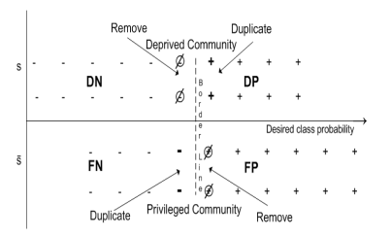
Approaches to Bias Mitigation: Pre-Processing
Remove bias from data – bring the diverse groups closer in representation
Sex | Default | Count | Class Prob.
Female | Y = 1 | 400 | 0.40
Female | Y = 0 | 600 | 0.60
Male | Y = 1 | 200 | 0.10
Male | Y = 0 | 1,800 | 0.90
Base Rate (+) $⇒ \frac{\left(600+1,800\right)}{\left(650+350+1,800+200\right)}=0.80$
Assign weights to bring the event rates to parity.
Suppression – Remove sensitive features and all the correlated ones.
Kamiran & Calders (2012)
Calmon et al. (2017)
Zemel et al. (2013)
Feldman et al. (2015)

Slide 17
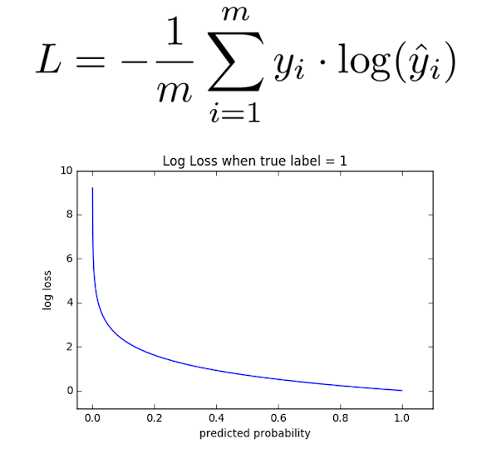
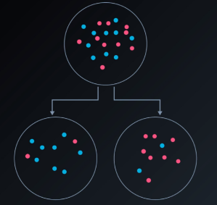
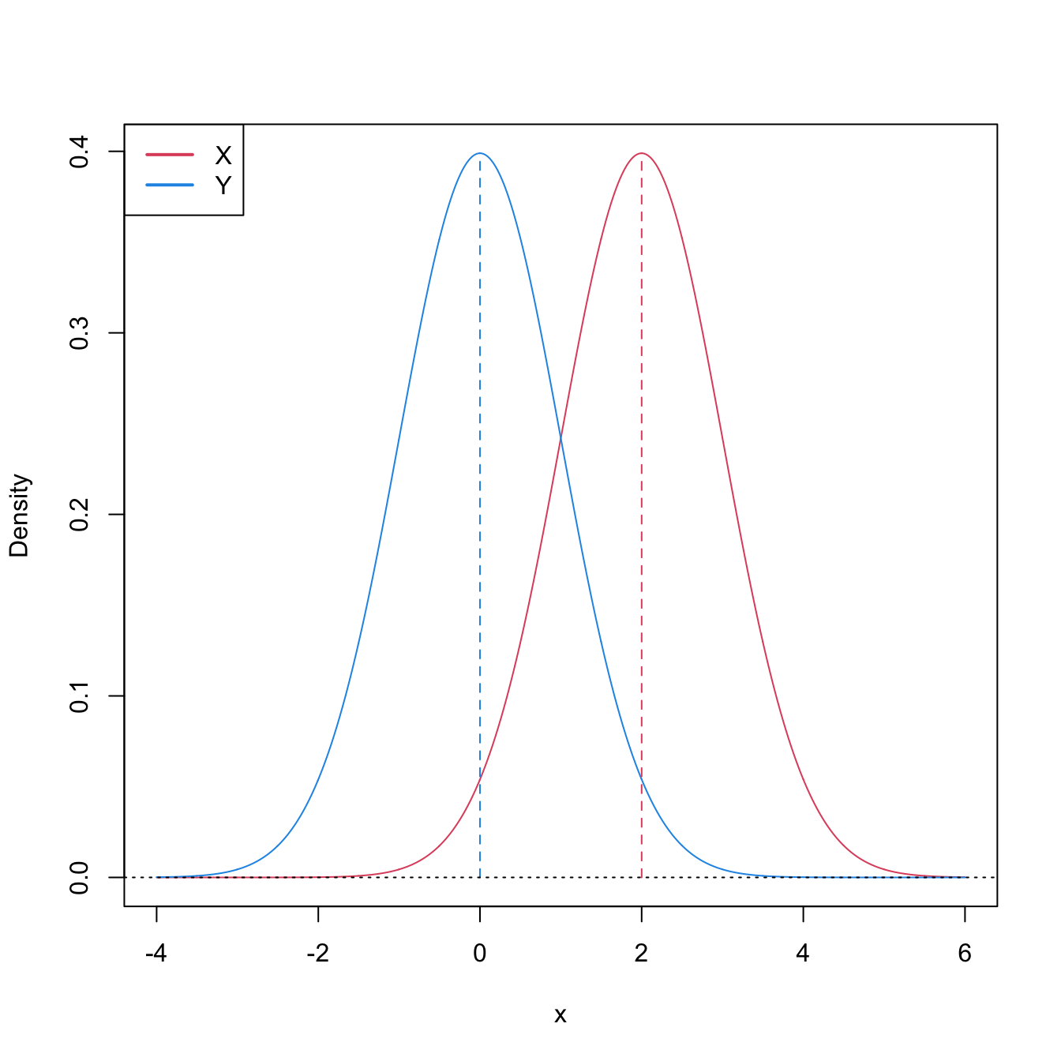
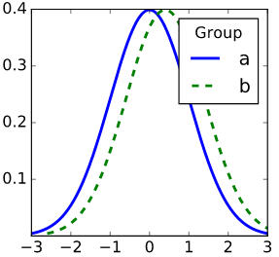
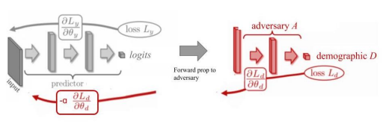
Approaches to Bias Mitigation: In-Processing (1/2)
Modify the training process to get a fair model (more or less)
How does training on biased data lead to a biased model?
Age of Credit History < 10 years
1. Biased Data
2. Train – Min Loss
3. Biased Features
4. Biased Model
What can we change?
Age of Credit History < 5 years
1. Biased Data
2. Dual Obj: Min Loss & learnt Bias
3. Un-Biased Features
4. Un-Biased Model

Slide 18
Approaches to Bias Mitigation: In-Processing (2/2)
Modify the training process to get a fair model (more or less)
How does training on biased data lead to a biased model?
Age of Credit History < 10 years
1. Biased Data
2. Train – Min Loss
3. Biased Features
4. Biased Model
What can we change?
Age of Credit History < 5 years
1. Biased Data
2. Dual Obj: Min Loss & learnt Bias
3. Un-Biased Features
4. Un-Biased Model
* Fair Adversarial Debiasing
1. Zhang et al. (2018)

Slide 19


Approaches to Bias Mitigation: Post-Processing
Transform the predicted labels of appropriately chosen samples to meet group fairness requirements
DIA: (2/6) / (6/9) = 50%
DIA: (3/6) / (5/9) = 90%
Privileged
Protected
* Reject Option Classification
Kamiran et al. (2018)
Hardt et al. (2016)
Pleiss et al. (2017)

Slide 20
Questions?
Let’s move to our practical exercises on the following Github repository:
github.com/josecaloca/validation-of-fair-classifiers

