Slide 1
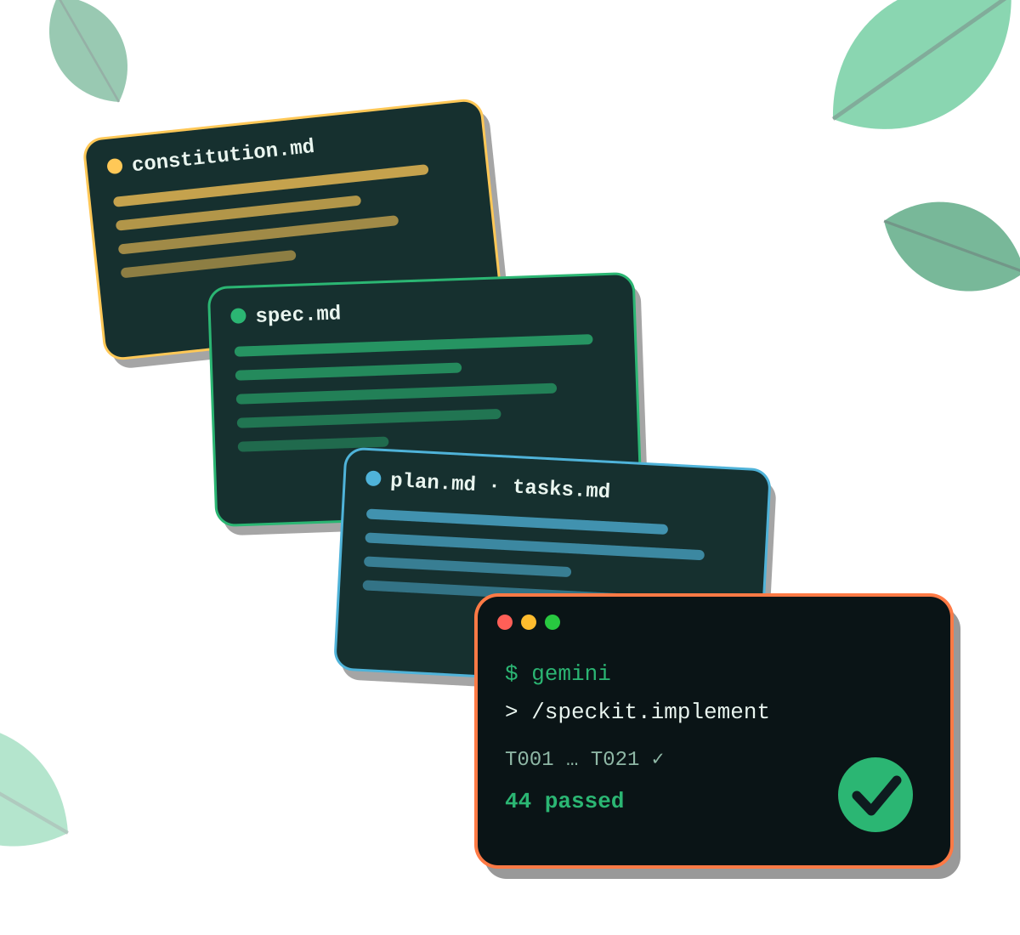
Spec-Driven Development
GDG PURA VIDA · LIGHTNING TALK
From vibe coding to agentic engineering
Tiger · SRE @ IBM · Prof. UNA
Notes:
Welcome. 15 minutes of ideas, 15 minutes of code. Everything you'll see is in a public repo with one git tag per step, so you can replay it at home with Gemini CLI.

Slide 2
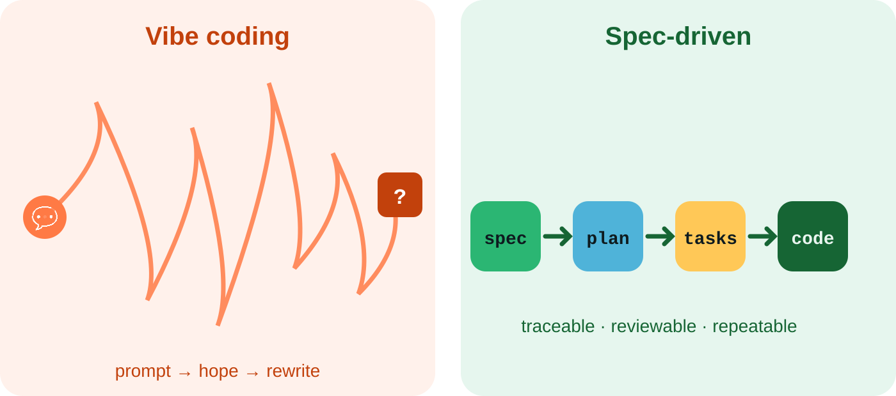



Vibe coding hits a wall
Context evaporates
The agent guesses
No audit trail
Decisions live in a chat log
Gaps get filled with defaults
Why does this code exist?
Notes:
Raise hands: who has asked an agent for a feature, got 500 lines, and then rewrote half of it? The problem isn't the model, it's that intent was never written down. The agent fills every gap with a guess, and nobody can tell later why a line exists.

Slide 3



SDD flips the source of truth
Code-first
Spec-first
Code is the truth
Docs written after — then rot
Prompts are disposable
Review = read the diff
Spec is the truth
Code is a regenerable output
Prompts become versioned artifacts
Review = read the intent
Notes:
SDD: you write the what and why first, in a structured spec. The agent derives plan, tasks and code from it. When requirements change, you change the spec and regenerate. The spec is executable intent.

Slide 4



Three levels of spec-driven
LEVEL 1
LEVEL 2
LEVEL 3
Spec-first
Spec-anchored
Spec-as-source
Write the spec before coding; use it to guide one task.
Keep the spec and evolve it with the feature for its whole life.
Humans edit only the spec; code is regenerated from it.
Spec may be thrown away after
Our demo repo lives here
Ambitious — still emerging
more rigor · more automation · more up-front thinking
Levels after Birgitta Böckeler, martinfowler.com
Notes:
SDD isn't one thing. Birgitta Böckeler (Thoughtworks) describes three levels. Spec-first: write a spec to guide a task, maybe discard it. Spec-anchored: the spec stays in the repo and evolves with the feature — that's what the demo shows. Spec-as-source: you only ever edit the spec and regenerate code; promising, but still emerging. Most teams should aim for level 2.

Slide 5
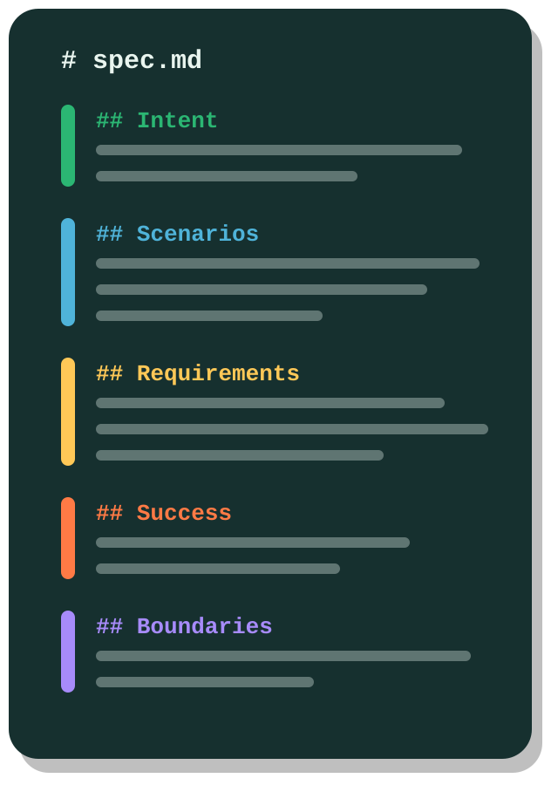
Anatomy of a good spec
Intent
Who it's for and why it matters
Scenarios
Prioritized stories · Given / When / Then
Requirements
FR-001 … each one testable, each one a MUST
Success criteria
Measurable: "p95 < 100 ms", not "fast"
Boundaries
Assumptions · non-goals · open questions
Notes:
A good spec has five parts. Intent, so the agent knows why. Scenarios in Given/When/Then — these become your tests almost mechanically. Requirements with IDs so you can trace them. Success criteria that are measurable. And boundaries: what's out of scope and what's still unknown. Notice what's missing: no frameworks, no databases.

Slide 6


Same feature, two specs
prompt.txt
spec.md
Build a URL shortener.
Make it fast and secure.
Support custom links.
Use FastAPI and Redis.
US3 (P2) Custom alias
Given an alias in use,
When it is requested again,
Then report a conflict.
FR-008 alias: 3–32 [a-z0-9-]
SC-003 p95 redirect < 100 ms
? Should links expire?
Vague goals, no tests, tech mixed in
Testable, measurable, honest about gaps
Notes:
Left: what most of us type into a chat. 'Fast' and 'secure' mean nothing to an agent, and the tech choice is mixed into the requirement. Right: one story with an acceptance scenario, a precise rule, a number, and — importantly — an explicit open question. An agent can't guess wrong on something that's written down.

Slide 7
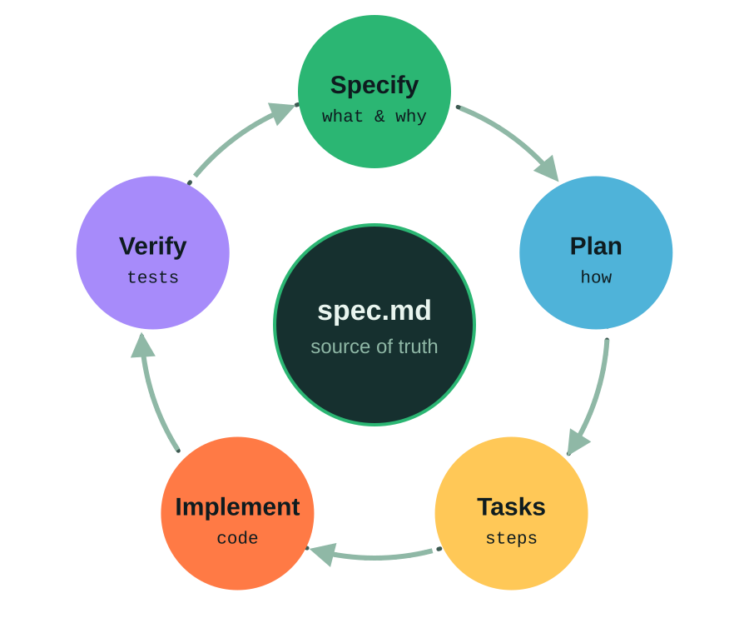
The SDD loop
Each arrow is a review — a human gate
Change the spec, not the code, then regenerate
Verify against the spec, not against vibes
Spec ≠ code? That drift is a bug
Notes:
Tool-agnostic loop. Specify the what, plan the how, break it into tasks, implement, verify against acceptance criteria. When requirements change you don't patch code — you go back to the spec. If code and spec disagree, that's a bug in one of them, and you decide which.

Slide 8



From autocomplete to agents
Autocomplete
Chat
Agent
finishes your line
writes a function
plans, edits files, runs tests, iterates
You type
You copy & paste
You define & review
Notes:
In a few years we went from tab-completion, to chat that writes a function you paste, to agents that take a task, edit many files, run the tests and iterate. Look at the bottom row: our job moved from typing, to pasting, to defining and reviewing. That shift is what 'agentic engineering' means.

Slide 9
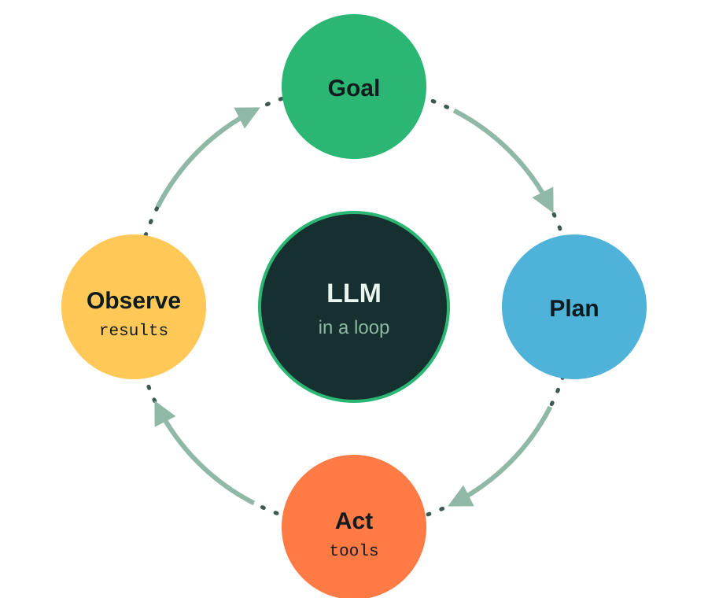




What an agent really is
Shell
Files
Tests
Web & APIs
An LLM in a loop with tools
Stops when the goal looks met — to it
Quality = context × feedback
Notes:
Demystify it: an agent is a language model in a loop. It plans, calls a tool — shell, file edit, test runner — reads the result, and repeats until it believes the goal is met. 'Believes' is the key word. Its output is only as good as the context you give it and the feedback signals, like tests, it gets back.

Slide 10


Agentic engineering: you lead, it executes
You
✓ spec
Agent
✓ plan
Set principles
Describe intent
Answer clarifications
Approve every gate
Drafts spec, plan, tasks
Asks instead of guessing
Writes tests, then code
Checks its own consistency
✓ tasks
✓ code
Notes:
Agentic engineering is not 'let the AI do it'. You're the architect and reviewer; the agent is a fast, tireless implementer. The middle column are the gates: you review each artifact before the next step runs.

Slide 11
Context engineering
Rules / constitution always loaded · GEMINI.md
Files, not chat — context survives sessions
Small & relevant beats big & noisy
Fresh session per phase
Spec what & why
Plan how · decisions
Tasks the next small step
Code & tests ground truth
Notes:
The model only knows what's in its context window. Chat history is fragile; files are durable and reviewable. Layer it: standing rules on top, then the spec, the plan, the current task, and finally the code and tests as ground truth. Keep each layer small and relevant — dumping the whole repo in makes results worse, not better.

Slide 12



Guardrails: verify, then trust
Tests are the oracle
Small, reviewable diffs
Written from the spec, before the code
One task, one commit, one review
Human gates
Sandbox + CI
Approve spec, plan and tasks
Least privilege, nothing merges red
Notes:
Agents are confident, not correct. So you build the guardrails an SRE would: tests as the oracle, small diffs you can actually review, explicit human approval on the artifacts, and a sandbox with least privilege plus CI so nothing red merges. The motto flips: verify first, then trust.

Slide 13




Skills that matter more, not less
Precise writing
“
requirements an agent can't misread
Decomposition
The work doesn't disappear — it moves up the stack: from writing code to specifying and verifying it.
big problems into testable slices
Designing verification
knowing what "done" means
Review & taste
architecture, security, trade-offs
Notes:
For students and for us: the fundamentals matter more. Writing precise requirements, decomposing problems, designing tests, and having the taste to review architecture and security. The work moves up a level of abstraction — it doesn't go away.

Slide 14
When SDD shines — and when it's overkill
Shines
Overkill
Greenfield features with real users
Teams — specs are reviewable PRs
Regulated or long-lived code
Brownfield: add one feature at a time
One-off scripts & spikes
Pure UI pixel-pushing
When you skip reviewing the artifacts
Specs that leak implementation
Notes:
Be honest: SDD adds ceremony. For a throwaway script just prompt. It pays off when code lives long, more than one person touches it, or you need to explain why it does what it does. Biggest anti-pattern: running all commands back-to-back without reading anything.

Slide 15



Demo · pura-vida-links
one git tag per slash command
Act 1 — walk the trail
$ git log --oneline --decorate
step-0-init
step-1-constitution
step-2-specify
step-3-clarify
step-4-plan
step-5-tasks
step-6-analyze
step-7-implement 44 passed
solution-002-click-stats
feature 001, tag by tag
Act 2 — live with Gemini
feature 002: click stats
Safety net
git checkout solution-002
Built with GitHub Spec Kit + Gemini CLI
Notes:
Tool for the demo: GitHub Spec Kit with Gemini CLI — specify init --integration gemini, then /speckit.* slash commands. Switch to terminal. Follow docs/DEMO.md: Act 1 is 8 minutes walking the tags, Act 2 is 6 minutes running a new feature live in Gemini. If the network fails, git checkout solution-002-click-stats.

Slide 16



¡Pura vida, specs!
Spec = source of truth
Agents ask, not guess
Write intent down. Let the agent build. Review every gate.
Traceable to the line
github.com/github/spec-kit · repo: pura-vida-links
Notes:
Three things to take home. Questions? The repo has every prompt in docs/PROMPTS.md so you can replay it tonight.

