Slide 1

Who Gains More From Sponsorship?
Jose Cervantez · Erika Kirgios · Rosalind Chow
April 10, 2026

Slide 2
Goals for this talk
Two things we'd love feedback on today:
Experimental design
anything to flag before we scale up and preregister?
Interpretation of our pilot data
we have a running theory, but alternatives are very welcome.

Slide 3
Department of Behavioral Science
To the Admissions Committee,
I am pleased to recommend Nick Calder for admission to your doctoral program in organizational behavior. In my seminar and as a research assistant, Nick distinguished himself through careful analytical reasoning, dependable follow-through, and a mature willingness to revise his views when the evidence changed. He writes clearly, collaborates well, and consistently raises the quality of the work around him. I recommend him with enthusiasm.
Sincerely,
Robert Keller

Slide 4
Department of Behavioral Science
To the Admissions Committee,
I am pleased to recommend Nick Calder for admission to your doctoral program in organizational behavior. In my seminar and as a research assistant, Nick distinguished himself through careful analytical reasoning, dependable follow-through, and a mature willingness to revise his views when the evidence changed. He writes clearly, collaborates well, and consistently raises the quality of the work around him. I recommend him with enthusiasm.
Sincerely,
Susan Keller

Slide 5
YEAR 1
YEAR 2
Department of Behavioral Science
Department of Behavioral Science
To the Admissions Committee,
I am pleased to recommend Nick Calder for admission to your doctoral program in organizational behavior. In my seminar and as a research assistant, Nick distinguished himself through careful analytical reasoning, dependable follow-through, and a mature willingness to revise his views when the evidence changed. He writes clearly, collaborates well, and consistently raises the quality of the work around him. I recommend him with enthusiasm.
To the Admissions Committee,
I am pleased to recommend Jose Cervantez for admission to your doctoral program in organizational behavior. In my seminar and as a research assistant, Jose distinguished himself through careful analytical reasoning, dependable follow-through, and a mature willingness to revise his views when the evidence changed. He writes clearly, collaborates well, and consistently raises the quality of the work around him. I recommend him with enthusiasm.
?
GOOD STUDENT ✓
one year later
how do you read this one?
Sincerely,
Robert Keller
Professor, Department of Behavioral Science
Sincerely,
Robert Keller
Professor, Department of Behavioral Science
How do you read the new letter after one successful outcome?

Slide 6
YEAR 1
YEAR 2
Department of Behavioral Science
Department of Behavioral Science
To the Admissions Committee,
I am pleased to recommend Nick Calder for admission to your doctoral program in organizational behavior. In my seminar and as a research assistant, Nick distinguished himself through careful analytical reasoning, dependable follow-through, and a mature willingness to revise his views when the evidence changed. He writes clearly, collaborates well, and consistently raises the quality of the work around him. I recommend him with enthusiasm.
To the Admissions Committee,
I am pleased to recommend Jose Cervantez for admission to your doctoral program in organizational behavior. In my seminar and as a research assistant, Jose distinguished himself through careful analytical reasoning, dependable follow-through, and a mature willingness to revise his views when the evidence changed. He writes clearly, collaborates well, and consistently raises the quality of the work around him. I recommend him with enthusiasm.
?
GOOD STUDENT ✓
one year later
how do you read this one?
Sincerely,
Susan Keller
Professor, Department of Behavioral Science
Sincerely,
Susan Keller
Professor, Department of Behavioral Science
Does one success buy Susan the same credibility it bought Robert?

Slide 7
What is sponsorship?
Sponsorship is support provided to influence other people's perceptions of a protégé's skills, abilities, performance, and potential, with the intention of helping the protégé in their career.
• Public advocacy and recommendations
• Endorsements to colleagues, clients, hiring committees
• Introductions to high-status others
• Vouching for skill, judgment, or fit

Slide 8
Sponsorship involves real risk for sponsors
When a sponsor stakes their reputation on a protégé:
When the protégé succeeds
→ Sponsor gains credibility
→ Reputation lifts with the protégé
→ Network ties strengthen
When the protégé fails
→ Sponsor loses credibility
→ Future endorsements are discounted
→ Network ties may weaken

Slide 9
Research questions
RQ1 Are male and female sponsors trusted equally before any outcome is observed?
RQ2 When a sponsor’s protégé succeeds or fails, does the sponsor’s gender shape how audiences react?
RQ3 Does it matter how confident the sponsor was when they made the endorsement?
Notes:
RQ3 is chronologically first

Slide 10
Three-stage lab experiment
Stage 1
Stage 2
Stage 3
Protégé performance
Sponsor endorsements
Audience evaluation
Real participants take three performance tasks (Barron et al., 2025). We use the posted scores to build candidate profiles.
Real sponsors view candidate pairs and rate which one will perform better, and how confident they are.
Evaluators bet on a sponsor's endorsement, see the outcome, then bet on a second endorsement from the same sponsor.

Slide 11
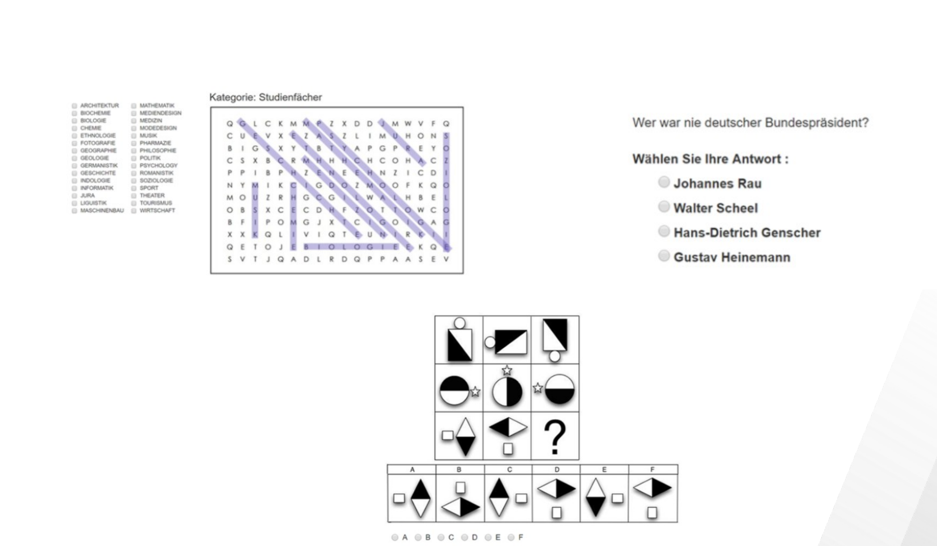
Stage 1: Where do the candidates come from?
Real participants completed three professional-ability tasks (Barron et al., 2025).
Word search · General-knowledge quiz · Logical-reasoning (Raven's matrices)

Slide 12
Three-stage lab experiment
Stage 1
Stage 2
Stage 3
Protégé performance
Sponsor endorsements
Audience evaluation
Real participants take three performance tasks (Barron et al., 2025). We use the posted scores to build candidate profiles.
Real sponsors view candidate pairs and rate which one will perform better, and how confident they are.
Evaluators bet on a sponsor's endorsement, see the outcome, then bet on a second endorsement from the same sponsor.

Slide 13
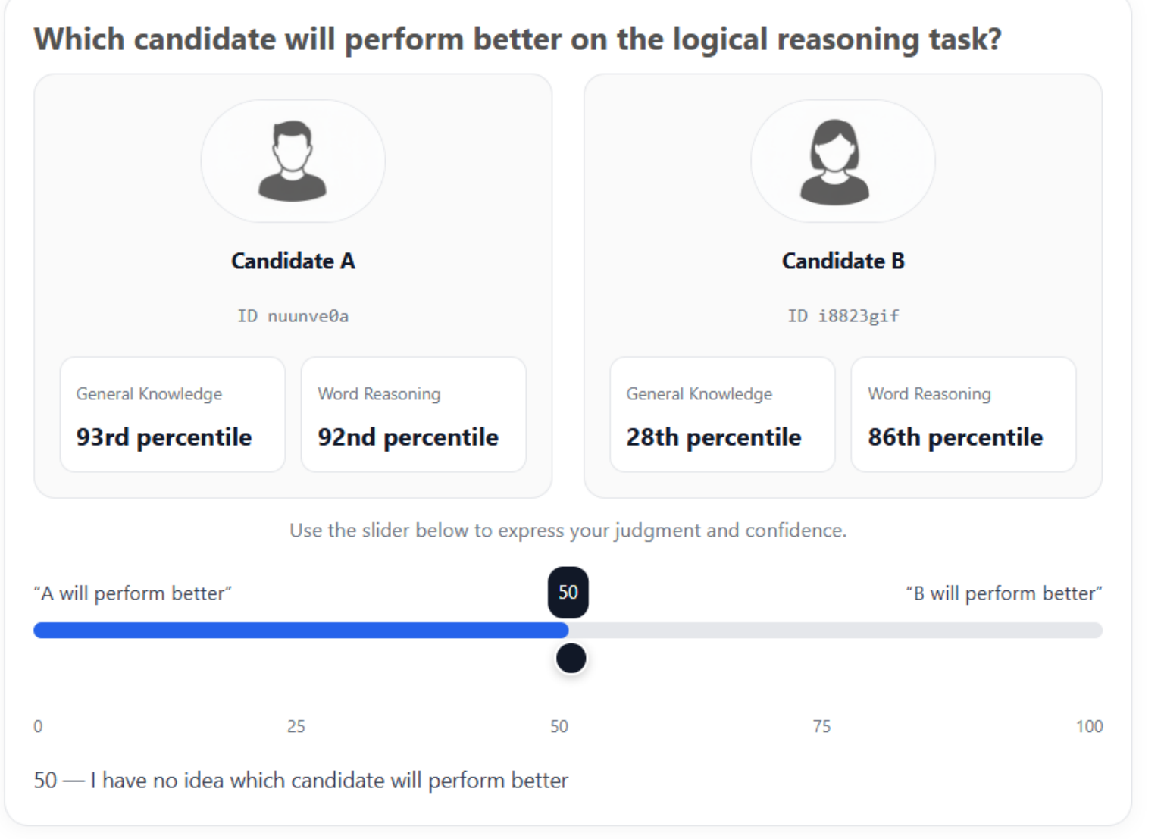
Stage 2: Sponsors made decisions on two candidates
• Each sponsor sees 10 candidate pairs and makes 10 endorsements
• Sponsor moves a slider to express which candidate they favor and how confident they are
• Their sliders become the endorsements that Stage 3 evaluators see
• We created a lot of comparisons to increase the variance in sponsor decisions
Notes:
Incentive compatible

Slide 14
Stage 2 incentive
Each sponsor earns $1 flat plus up to $3 bonus per session.
The bonus is based on ONE randomly selected endorsement, paid only if the endorsed candidate actually scored higher, scaling with how much a downstream evaluator wagered on it.
n = 200 sponsors · 10 endorsements each
If right → $3 × evaluator's wager
If wrong → no bonus
evaluator wagers 50%
0%
100%
right: $1.50
wrong: $0
wager
0%
50%
100%
if right
$0
$1.50
$3.00
if wrong
$0
$0
$0

Slide 15
Three-stage lab experiment
Stage 1
Stage 2
Stage 3
Protégé performance
Sponsor endorsements
Audience evaluation
Real participants take three performance tasks (Barron et al., 2025). We use the posted scores to build candidate profiles.
Real sponsors view candidate pairs and rate which one will perform better, and how confident they are.
Evaluators bet on a sponsor's endorsement, see the outcome, then bet on a second endorsement from the same sponsor.

Slide 16
Stage 3 setup
n = 403 Prolific evaluators (passed 5/5 comprehension checks and gender manipulation check)
Each evaluator is randomly assigned to ONE sponsor and sees:
• the sponsor's name + colored avatar (signals gender)
• that sponsor's endorsement of one candidate from a pair
• how confident the sponsor was on that endorsement (Strong / Weak)
• a slider to wager part of a $0.50 bank on the endorser being right
Each evaluator sees TWO decisions back-to-back, with the SAME sponsor on different candidate pairs:
First wager
outcome revealed
Second wager
trust change = (Second wager) − (First wager)
Notes:
Provide a little more setup in terms of the decisions that they are making

Slide 17
Stage 3 incentive
For each decision, you start with a $0.50 bank.
You wager part of your bank on the endorser being right.
If right → bank + your wager
If wrong → bank − your wager
evaluator wagers 50%
0%
100%
right: $0.75
wrong: $0.25
wager
0%
50%
100%
if right
$0.50
$0.75
$1.00
if wrong
$0.50
$0.25
$0.00
One randomly selected decision determines the bonus.

Slide 18
Stage 3: Evaluators wager on sponsorship decisions from the previous stage
WE VARY THREE THINGS
1. Sponsor gender
2. Endorsement strength
3. Outcome
The sponsor's first name + colored avatar signal their gender.
Sponsors used a 0–100 slider to choose a candidate. Pushed near one end = Strong (very sure), left near the middle = Weak (barely committed).
An endorsement was right if the endorsed candidate actually outscored the other on logical-reasoning.
Woman
CORRECT
ENDORSER CONFIDENCE
endorsement was right
0
100
Weak
Strong
Man
12–23
77–88
WRONG
endorsement was wrong

Slide 19
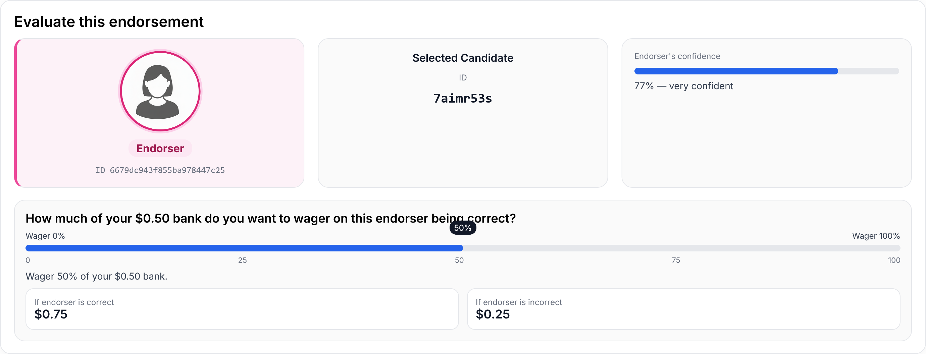
Step 1: Initial wager
An evaluator sees one sponsor's confident endorsement and bets a fraction of their $0.50 bank.

Slide 20
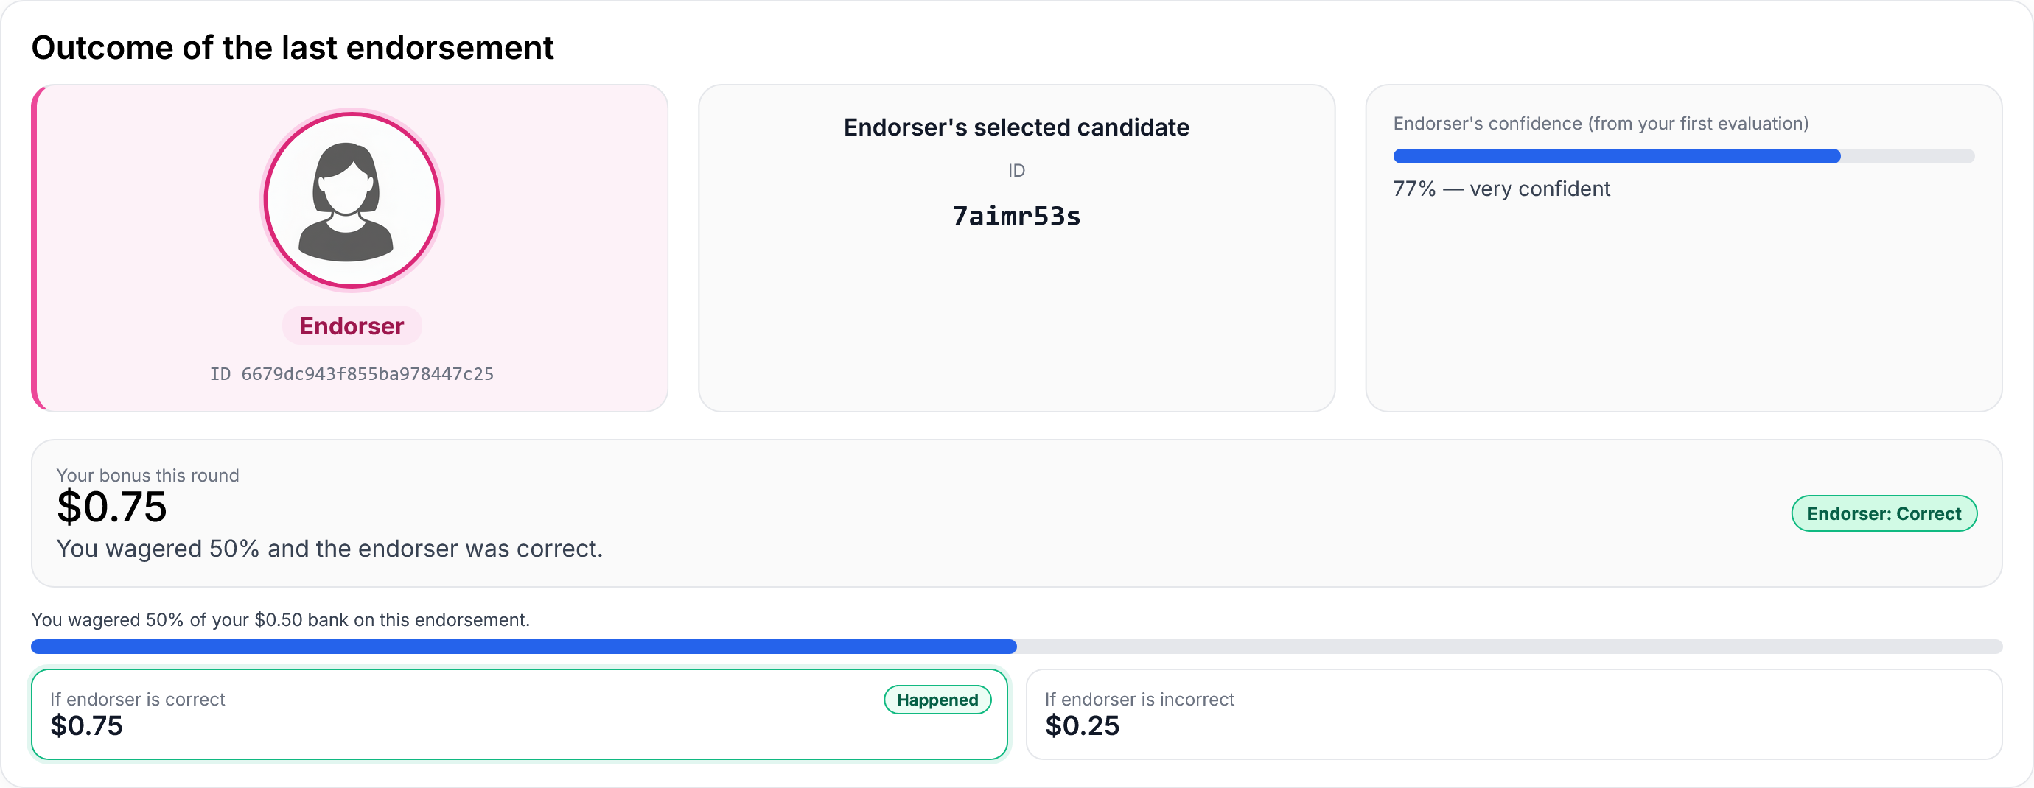
Step 2: Outcome reveal
The endorser was CORRECT. The evaluator's bank goes up. (We also run a 'wrong' variant.)

Slide 21

Step 3: Second wager
The same sponsor, a different candidate pair. How much does the evaluator wager now?

Slide 22
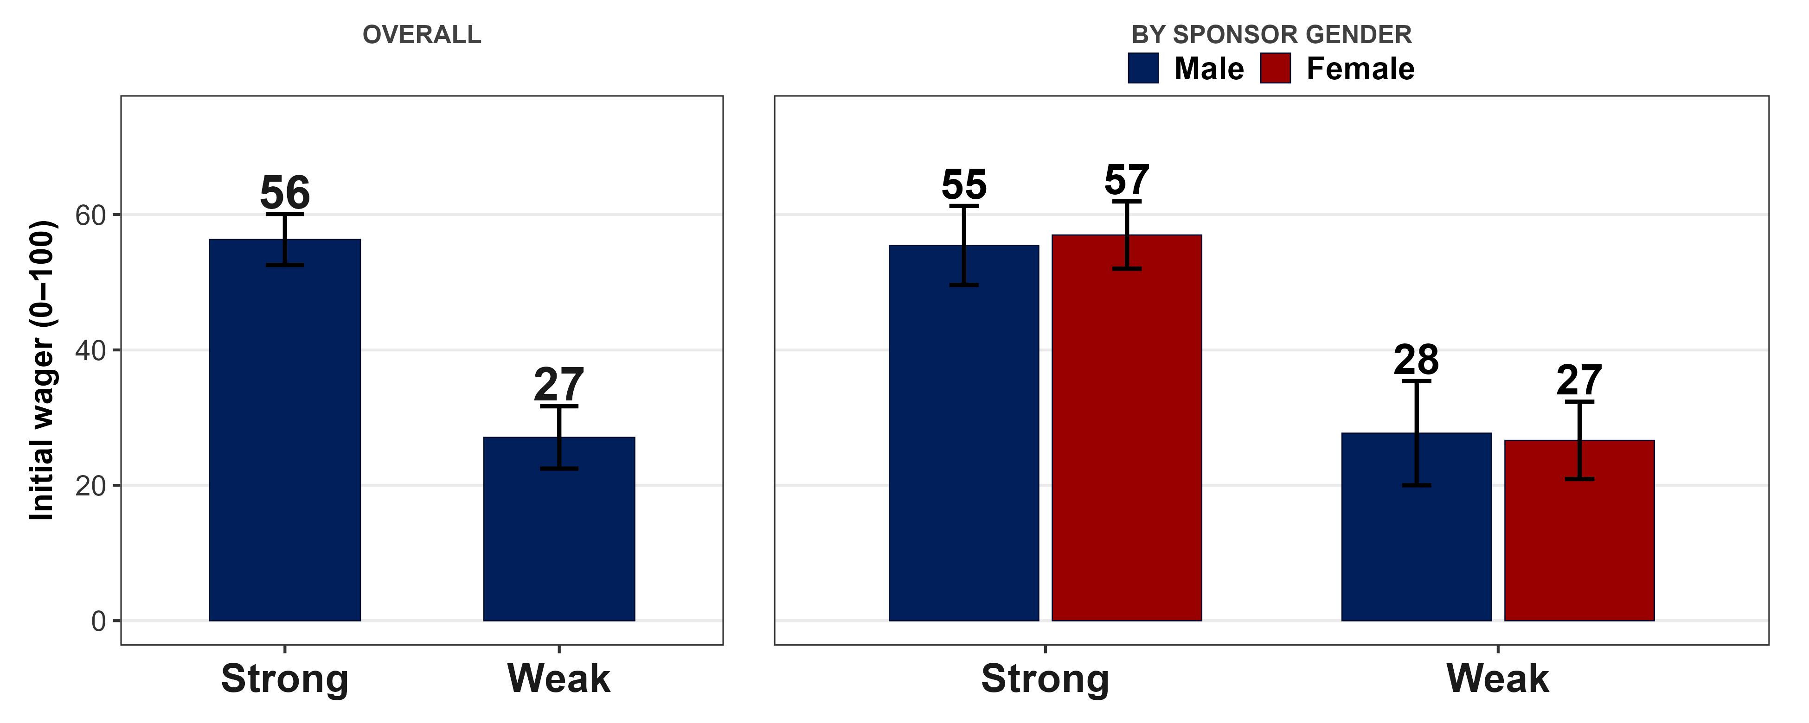
RQ1:
How much did evaluators wager on the first decision?
b gender -1.06
p = .812
no gender effect

Slide 23
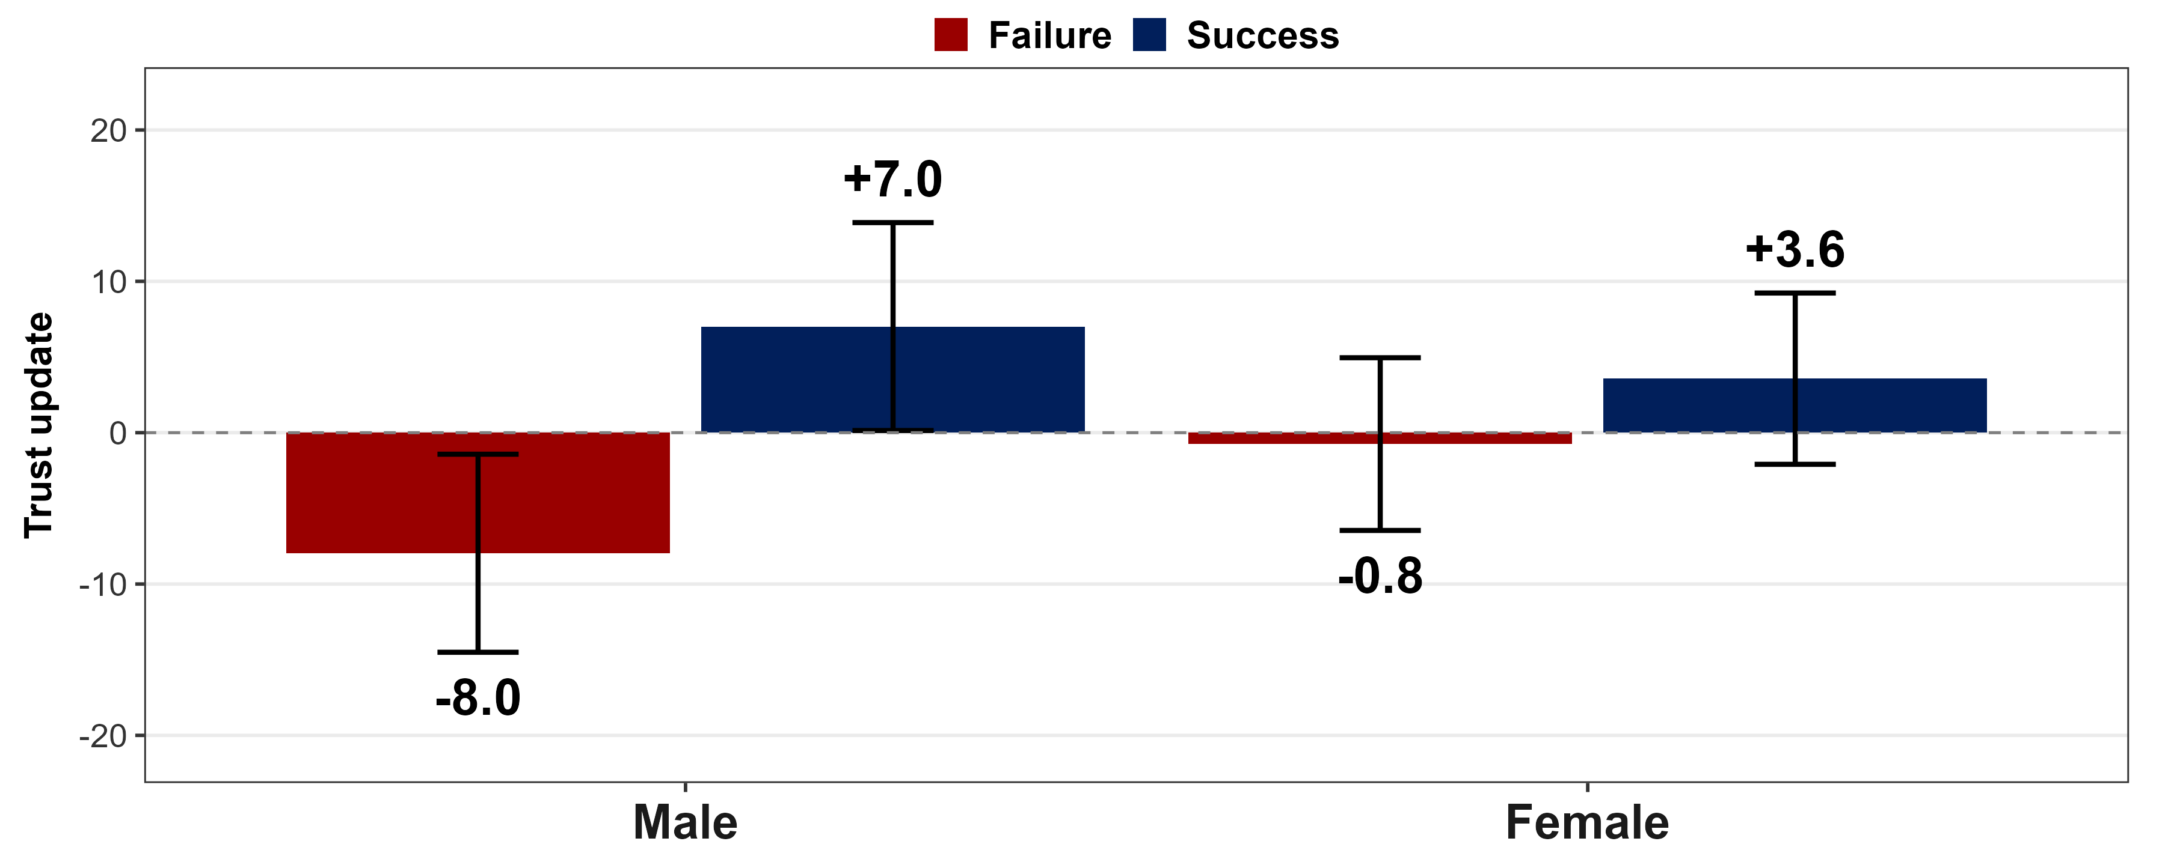
RQ2:
How much did one outcome change evaluator wagers?
Δ Male +15.0
Δ Female +4.3
b -11.60
p = .062
Notes:
Flip the axes between male and female manipulation check endowed them with money

Slide 24
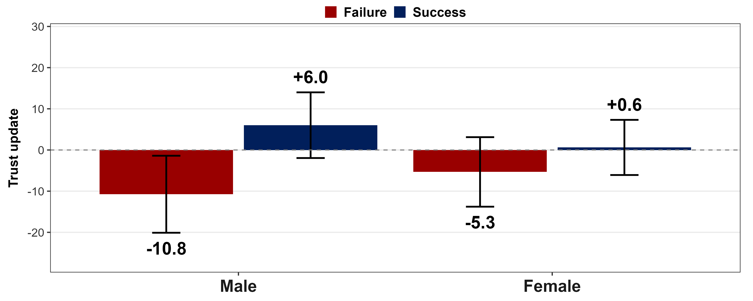
RQ3:
Strong endorsements: how did one outcome shift wagers?
ENDORSER CONFIDENCE
Δ Male +16.8
Δ Female +6.0
b -13.01
p = .113
0
100
Strong
77–88
Notes:
Male and female

Slide 25
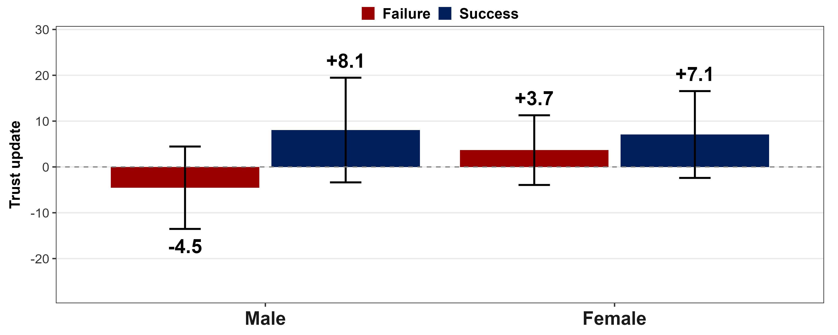
RQ3:
Weak endorsements: how did one outcome shift wagers?
ENDORSER CONFIDENCE
Δ Male +12.6
Δ Female +3.4
b -9.50
p = .322
0
100
Weak
12–23

Slide 26
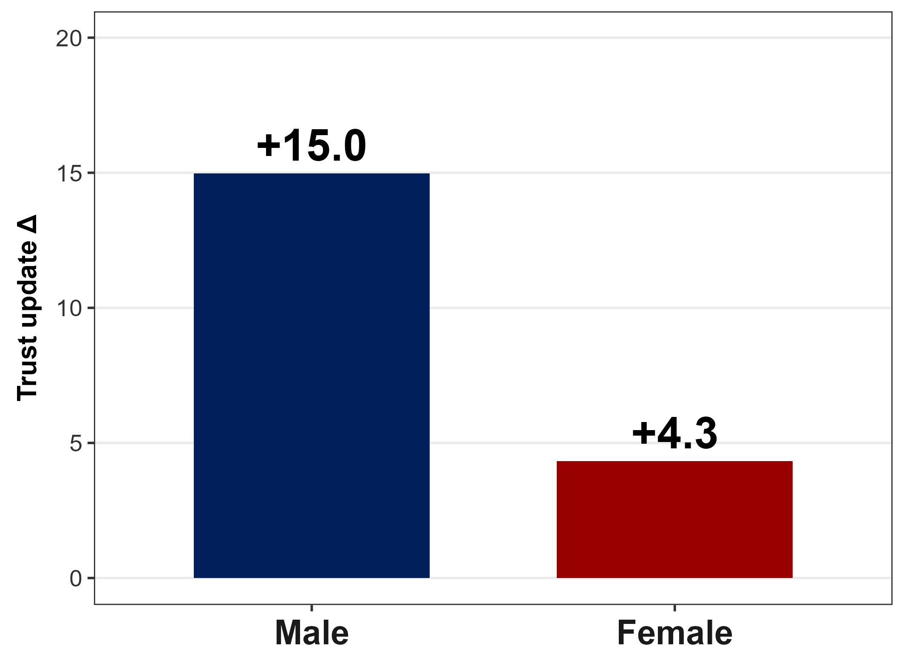
Summary
• Male and female sponsors are trusted equally at baseline
• Men's endorsements move trust by Δ = +15.0
• Women's endorsements move trust by Δ = +4.3
• Stronger endorsements amplify the asymmetry

Slide 27
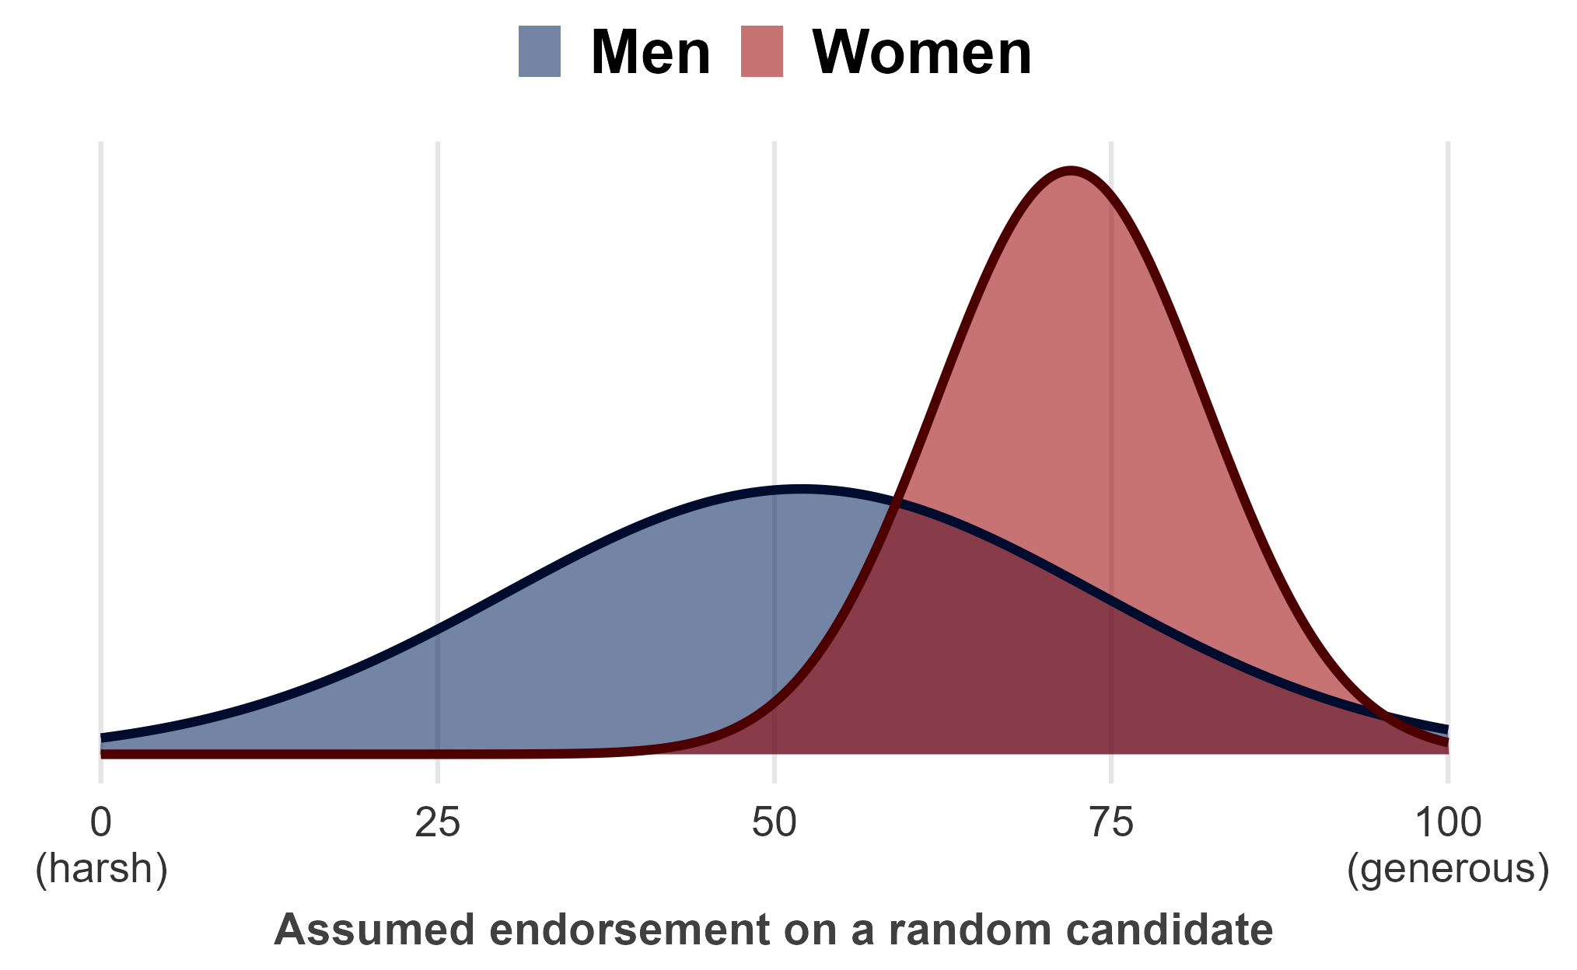
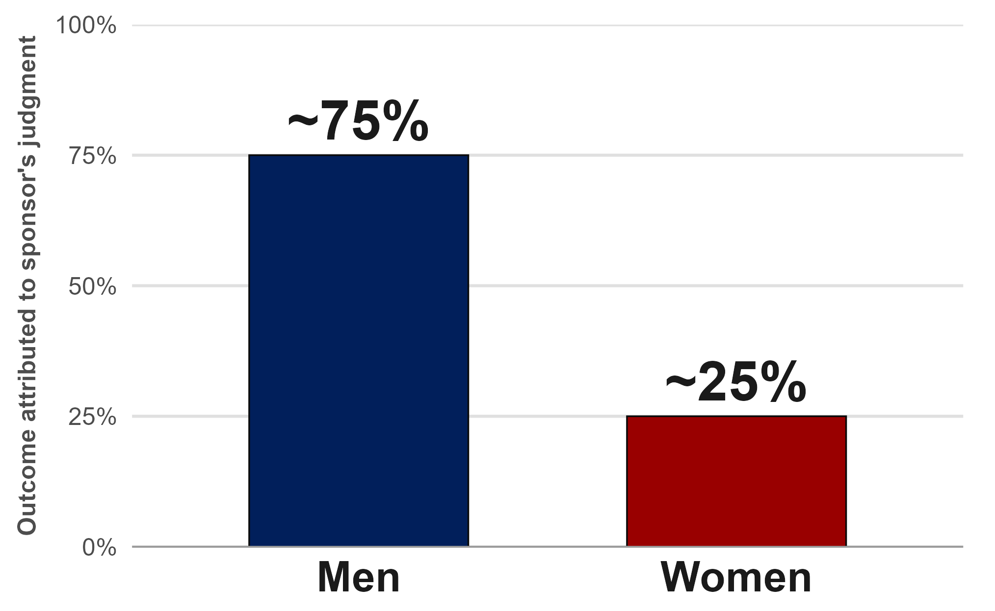
Running story
The prior leaks in once there's an outcome to read.
Without a track record, people stay reserved.
RQ1 is null (b = -1.06, p = .81). With nothing but a strength label, there's no basis to discriminate yet. Unlike most discrimination findings, the gap leaks in only at the outcome.
Women's endorsements are assumed high + narrow.
Once the outcome arrives, "she would have said it either way" makes it barely informative, so trust barely moves (consistent with the muted effects in the stronger confidence cells).
Men's endorsements are assumed to spread wide.
Evaluators read men's confident calls as carrying information that can be both praised or penalized, so trust moves accordingly.
Hypothesized prior distributions
Next direction: telegraph their standards.
Signaling "I only recommend the top 10%" breaks the assumed clustering, so the outcome can be re-read as informative.

Slide 28
Thank you

Slide 29
Appendix
Instruction screens from the Stage 2 & Stage 3 Qualtrics surveys

Slide 30
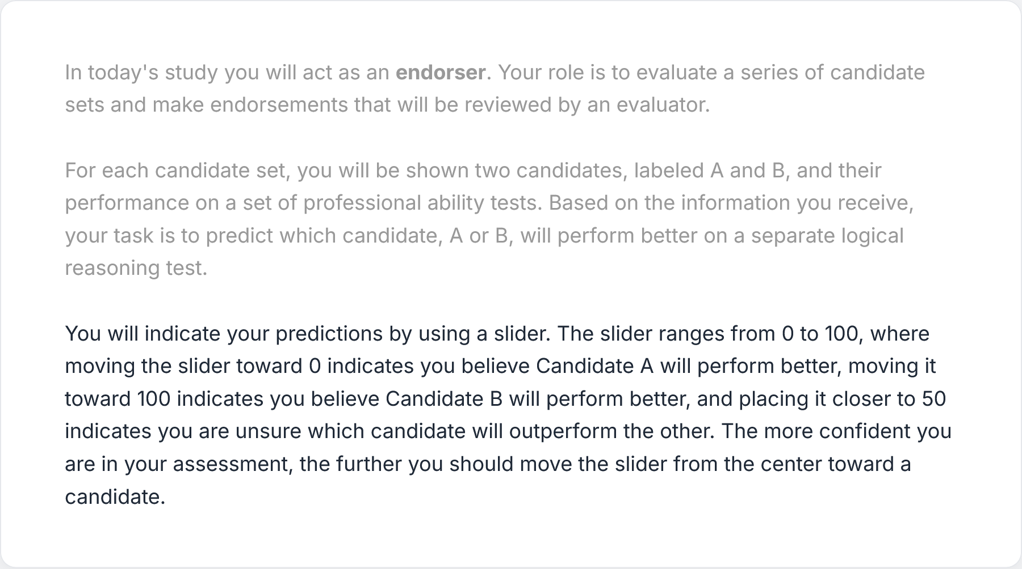
Stage 2 · Endorser role

Slide 31
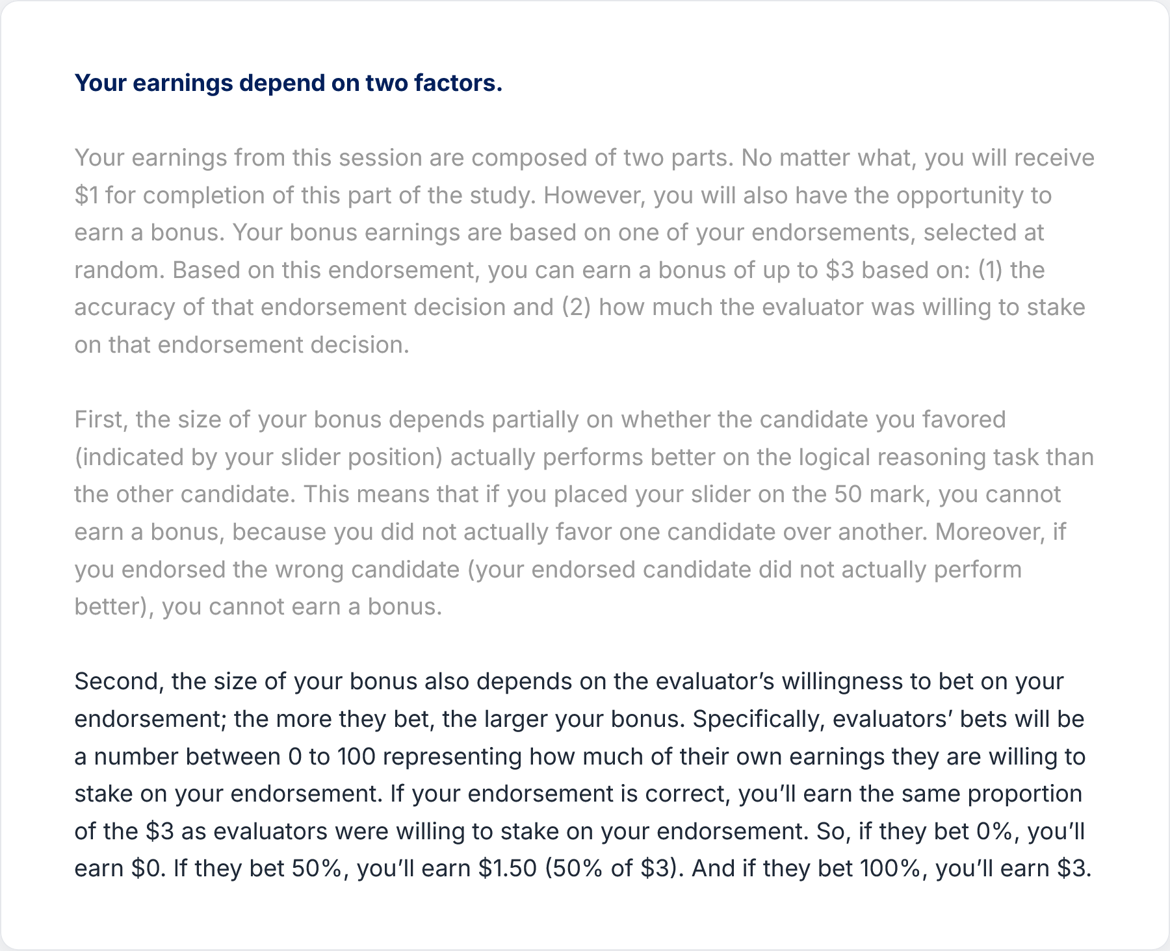
Stage 2 · Earnings ($1 flat + $3 bonus)

Slide 32
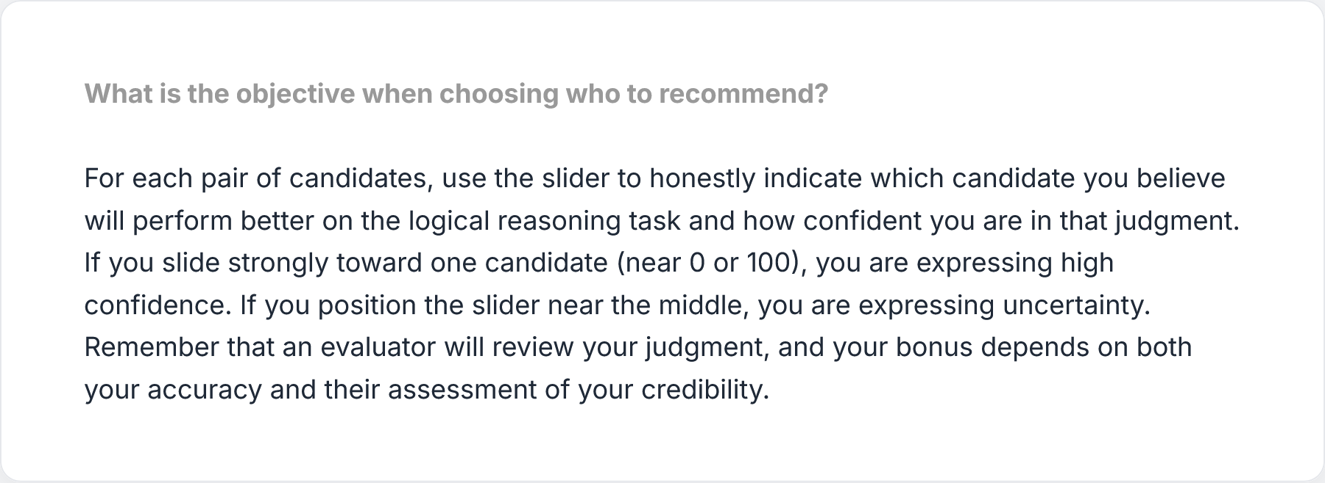
Stage 2 · Task objective + slider

Slide 33
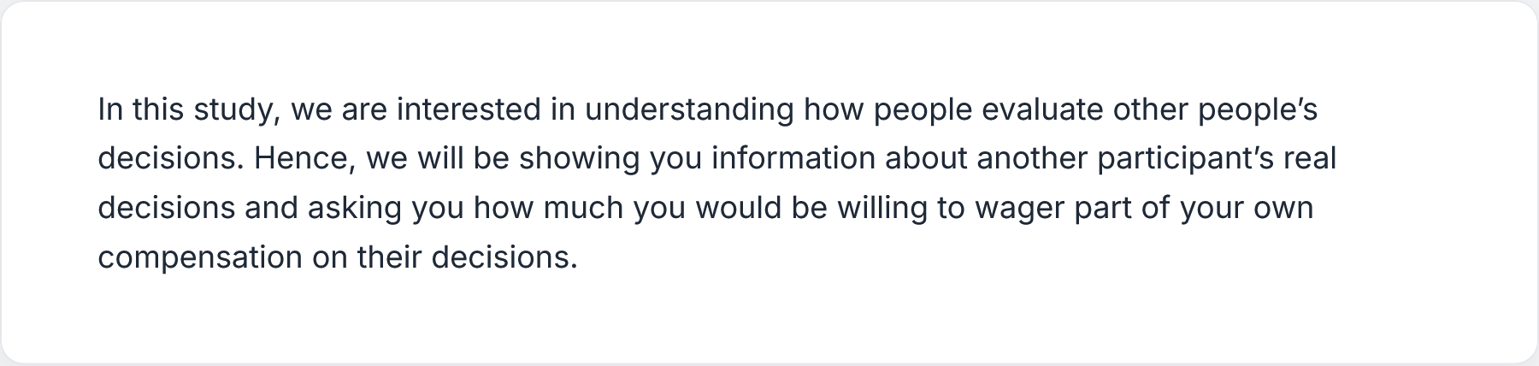
Stage 3 · Study purpose

Slide 34
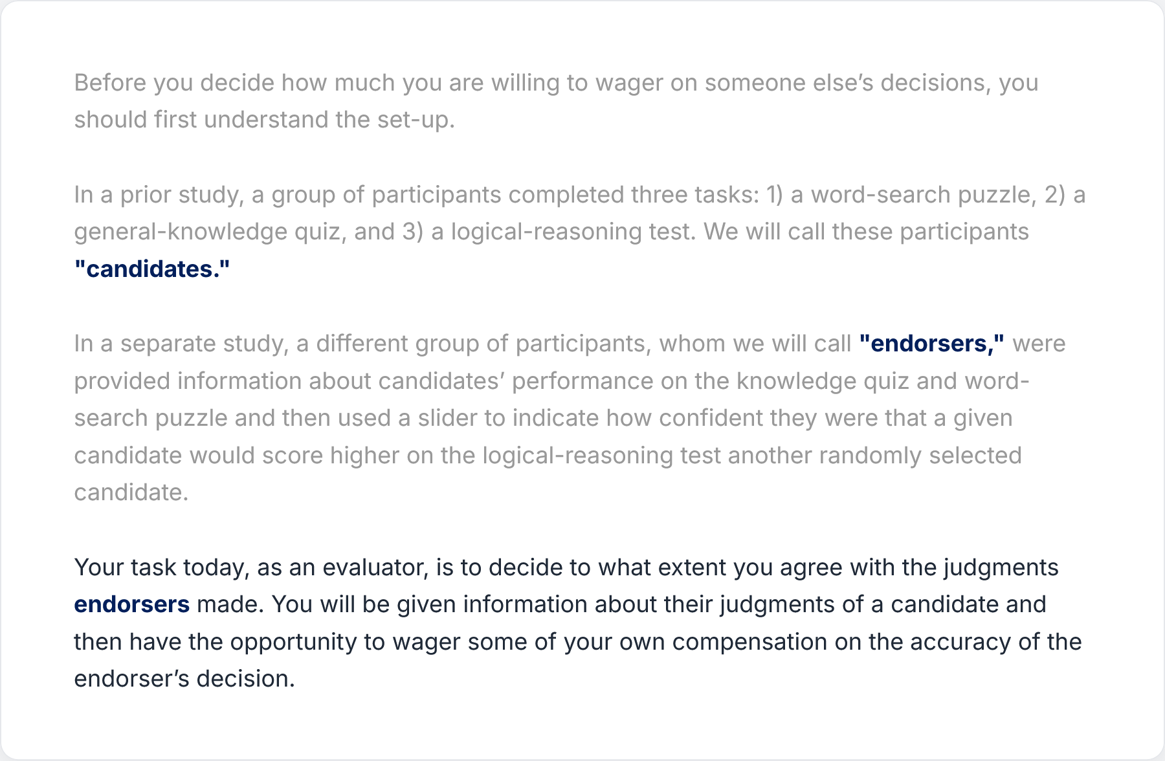
Stage 3 · What evaluators see

Slide 35
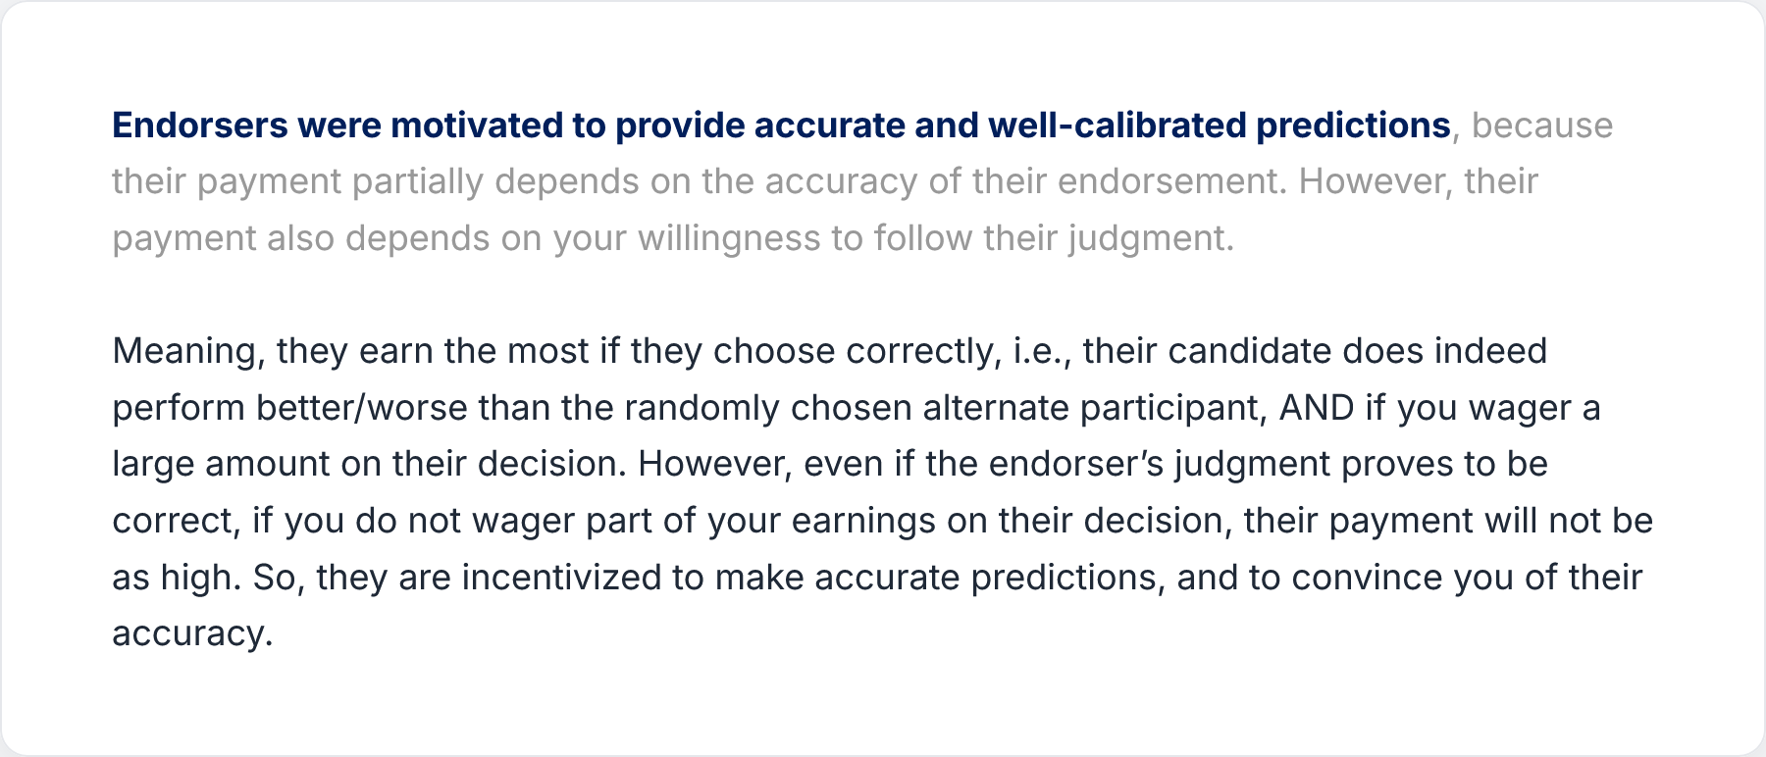
Stage 3 · Endorser motivation

Slide 36
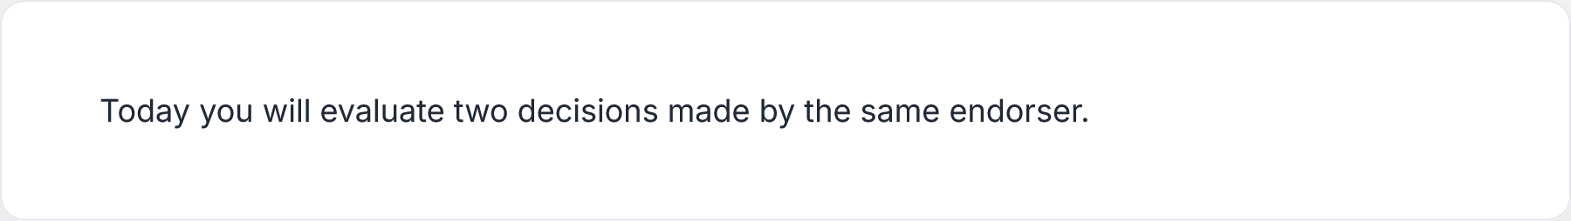
Stage 3 · Two-decision framing

Slide 37
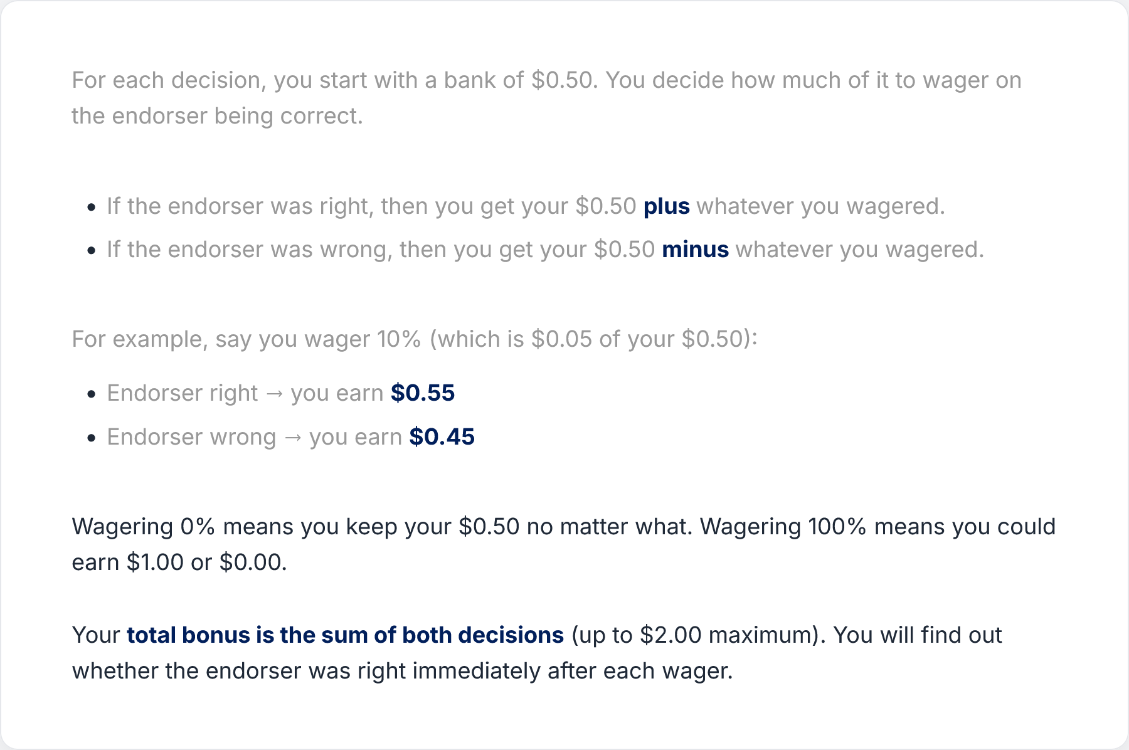
Stage 3 · $0.50 bank wager mechanics

Slide 38
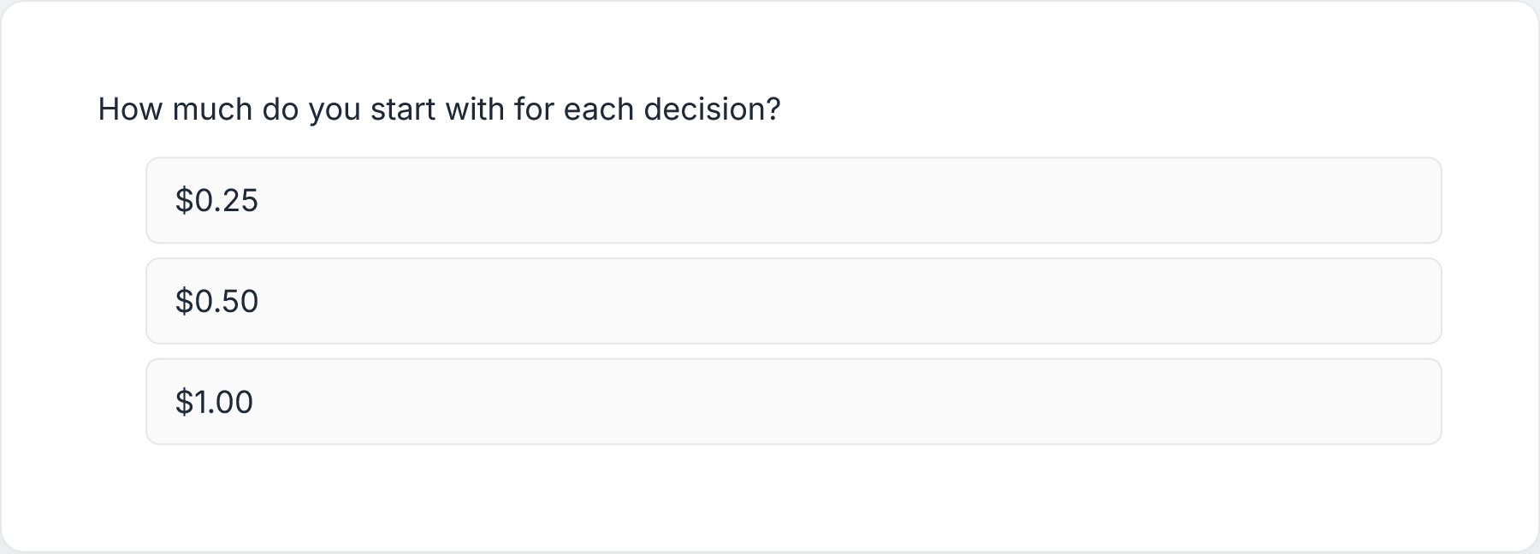
CQ1 · Bank amount

Slide 39
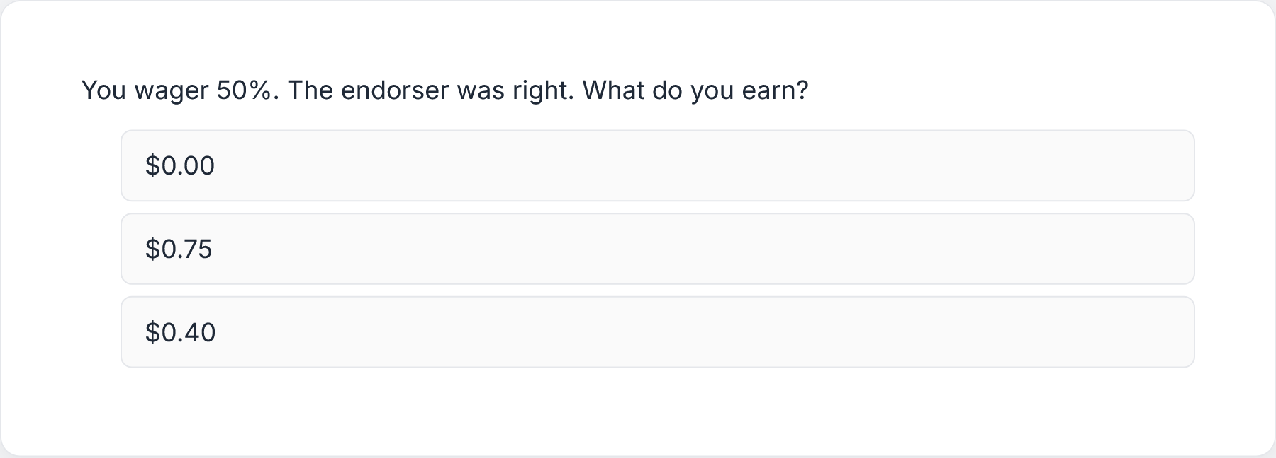
CQ2 · Wager calculation

Slide 40
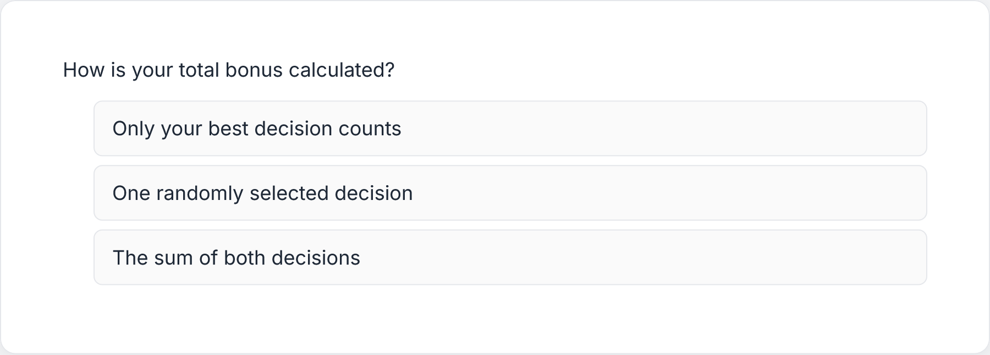
CQ3 · Bonus calculation

Slide 41
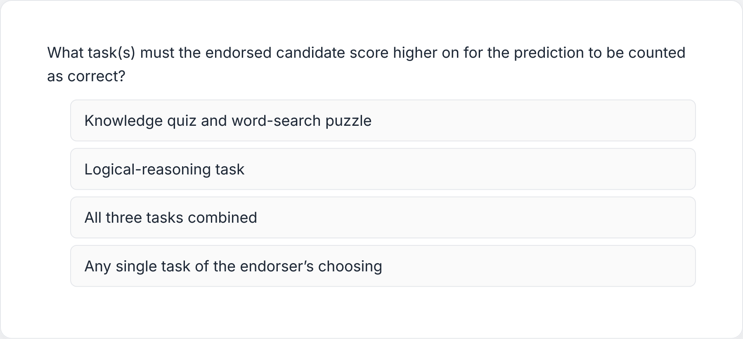
CQ4 · Task question

Slide 42
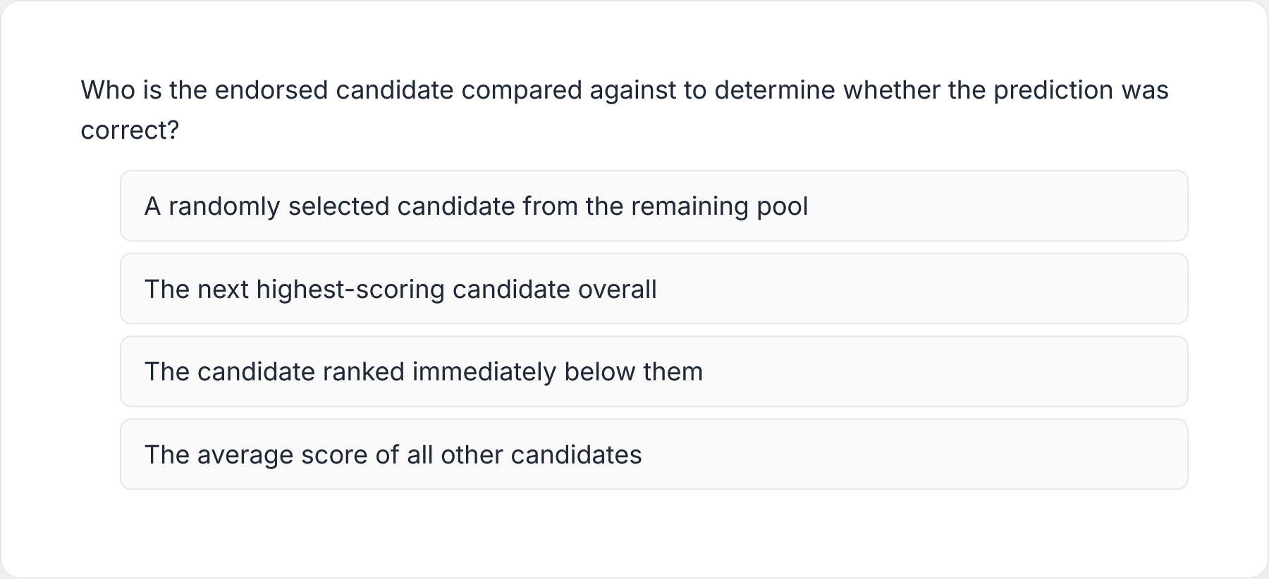
CQ5 · Comparison question

