Slide 1
Who Builds Social Capital Through Sponsorship?
Jose Cervantez, Erika Kirgios, Rosalind Chow
November 13, 2025

Slide 2





He’s AMAZING!
He’s good!

Slide 3
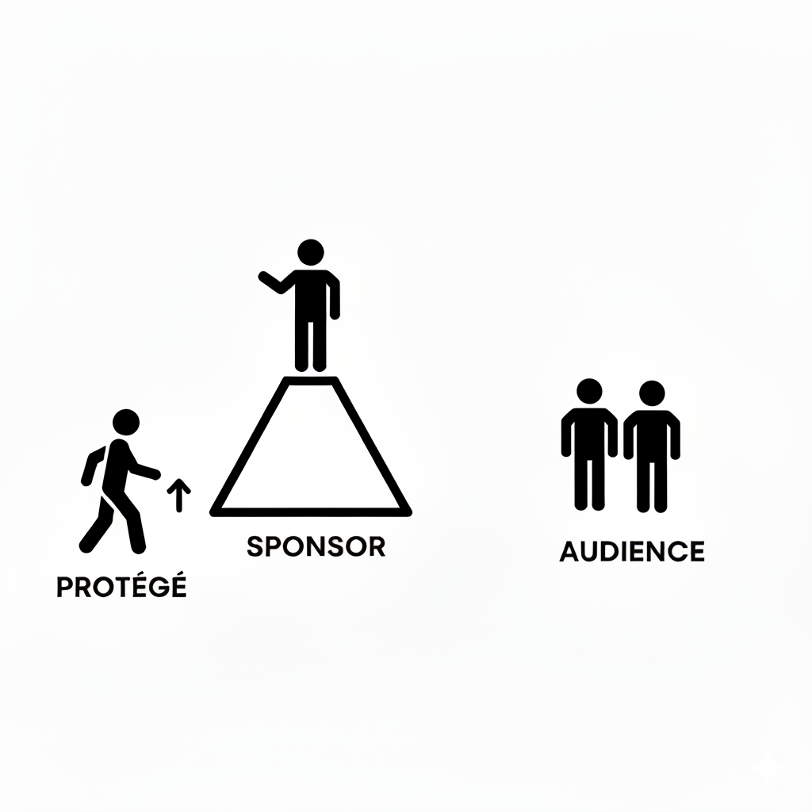
What is sponsorship?
Support provided to influence other people’s perceptions of a protégé’s skills, abilities, performance, and potential with the intention of helping the protege in their career, specifically by enhancing positive perceptions or reducing negative perceptions.
Some examples include:
Advocating for protégés for specific opportunities (presentations, positions, projects)
Drawing attention to protégés’ skills and achievements
Making strategic introductions to influential individuals

Slide 4
The decision to sponsor has several tradeoffs
Sponsorship involves significant risk for sponsors:
When a protégé succeeds | When a protégé fails
Sponsor enhances their reputation | Sponsor’s credibility is damaged
Seen as having good judgment | Reputation for poor judgment
Strengthens network relationships | Network relationships may suffer
Social capital is gained | Social capital is lost

Slide 5
More importantly, how do these tradeoffs influence sponsor perceptions as a function of gender?
How does protégé outcome influence a sponsor’s social capital?
Are women punished more harshly for their protégé’s failures? Are they rewarded, less?
Do women sponsors hedge their endorsements (lower confidence) relative to men?
Do audiences hold women sponsors to different credibility standards?

Slide 6
Multi-stage lab experiment
Stage 1 (Protégé Performance)
Data from Barron et al., 2025 Tasks: Word search puzzles General knowledge quiz Logical reasoning test (Raven’s matrices)
Stage 2 (Sponsor Endorsements)
Sponsors evaluate two candidates and provide an endorsement. Goal: Predict which candidate will perform better on logical reasoning, based on their performance on word search puzzle and/or general knowledge quiz.
Stage 3 (Audience Evaluation)
An evaluator (i.e., the audience) will assess multiple endorsements from same sponsor. Goal: Evaluate the sponsor’s predictions and decide how much to trust each endorsement on being correct.

Slide 7
Multi-stage lab experiment
Stage 1 (Protégé Performance)
Data from Barron et al., 2025 Tasks: Word search puzzles General knowledge quiz Logical reasoning test (Raven’s matrices)
Stage 2 (Sponsor Endorsements)
Sponsors evaluate two candidates and provide an endorsement. Goal: Predict which candidate will perform better on logical reasoning, based on their performance on word search puzzle and/or general knowledge quiz.
Stage 3 (Audience Evaluation)
An evaluator (i.e., the audience) will assess multiple endorsements from same sponsor. Goal: Evaluate the sponsor’s predictions and decide how much to trust each endorsement on being correct.

Slide 8
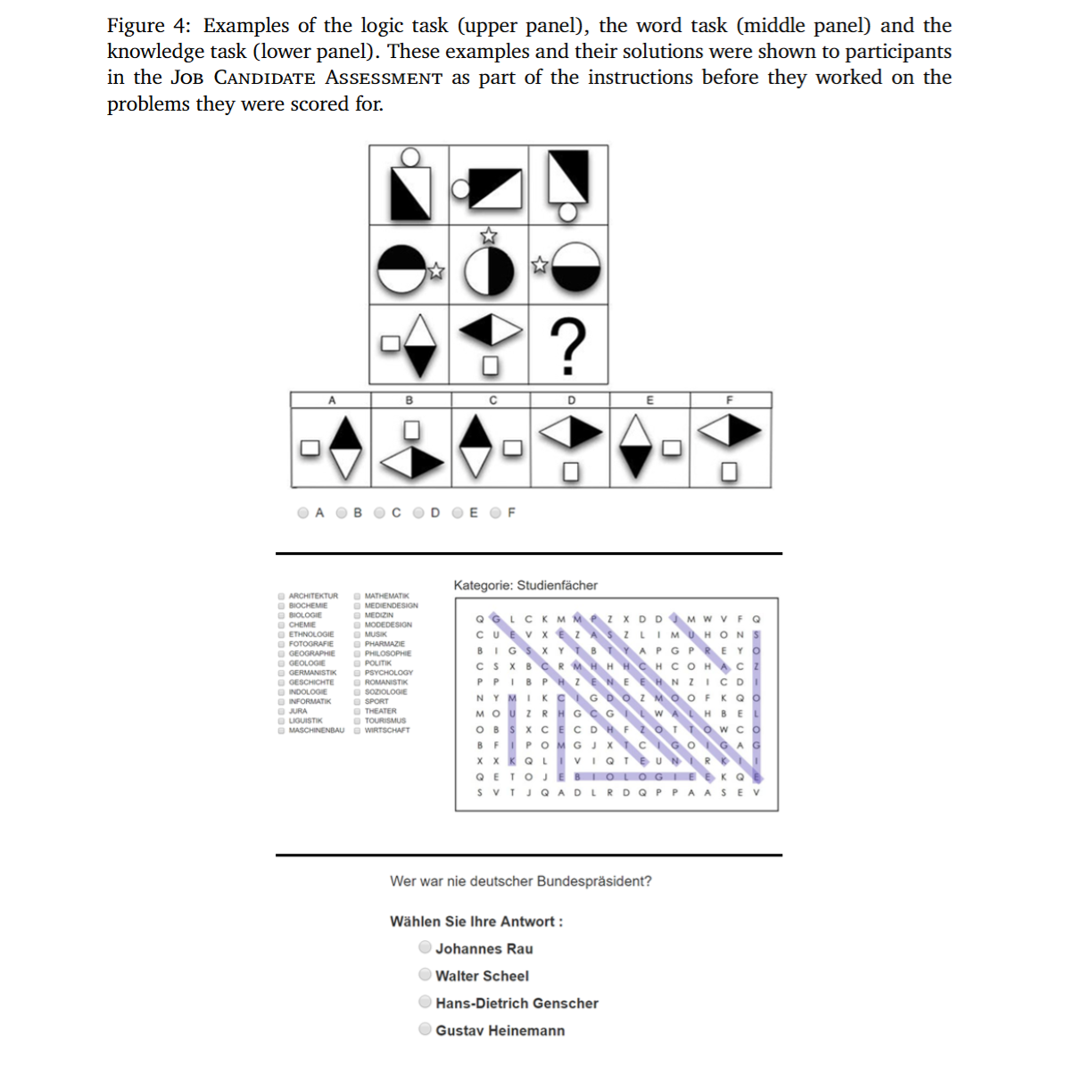

Slide 9
Multi-stage lab experiment
Stage 1 (Protégé Performance)
Data from Barron et al., 2025 Tasks: Word search puzzles General knowledge quiz Logical reasoning test (Raven’s matrices)
Stage 2 (Sponsor Endorsements)
Sponsors evaluate two candidates and provide an endorsement. Goal: Predict which candidate will perform better on logical reasoning, based on their performance on word search puzzle and/or general knowledge quiz.
Stage 3 (Audience Evaluation)
An evaluator (i.e., the audience) will assess multiple endorsements from same sponsor. Goal: Evaluate the sponsor’s predictions and decide how much to trust each endorsement on being correct.

Slide 10
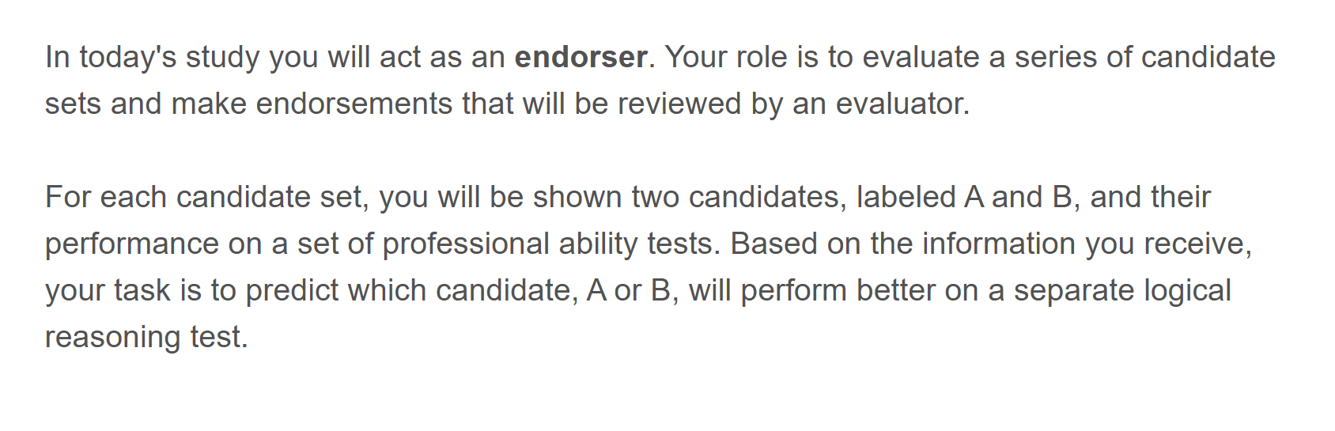

Slide 11
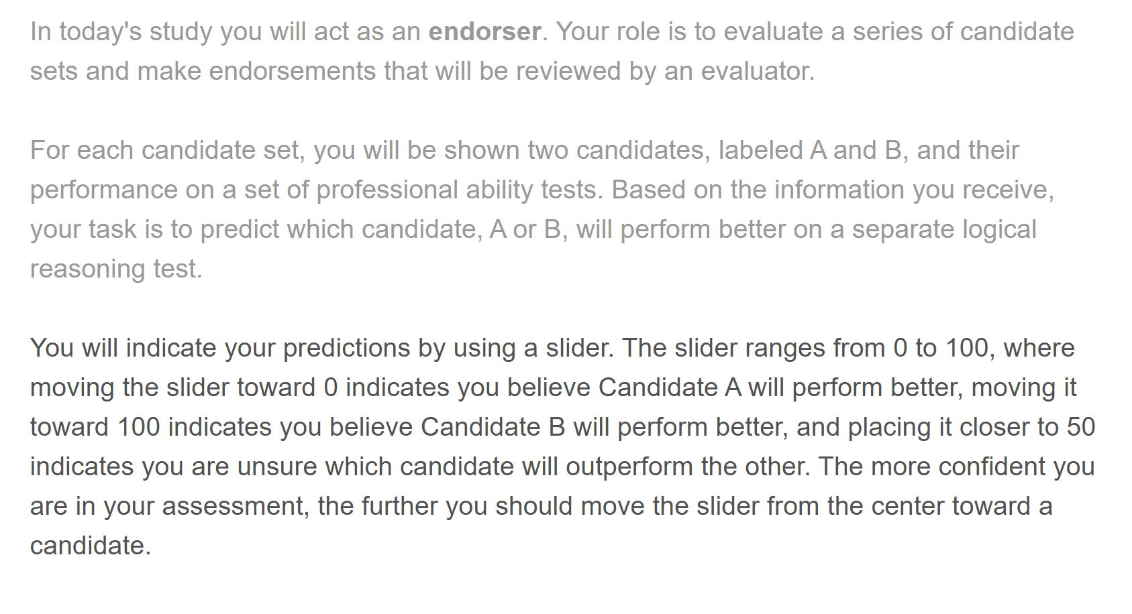

Slide 12
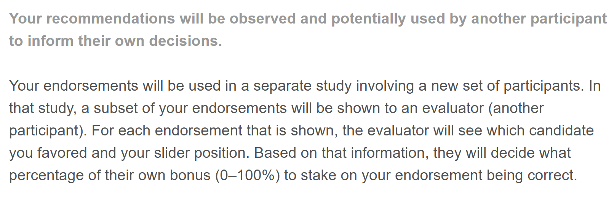

Slide 13
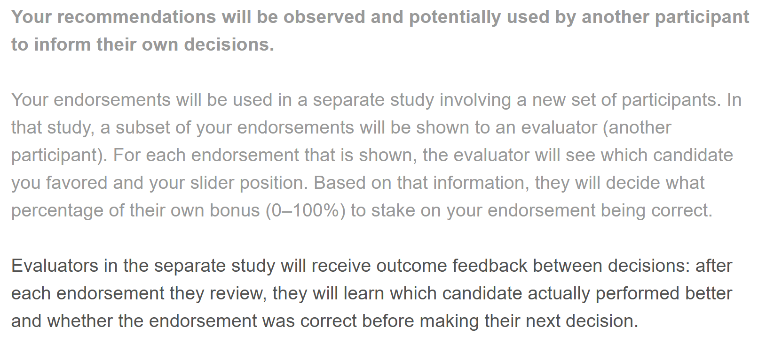
* Feedback on whether telegraphing this information would be helpful?

Slide 14
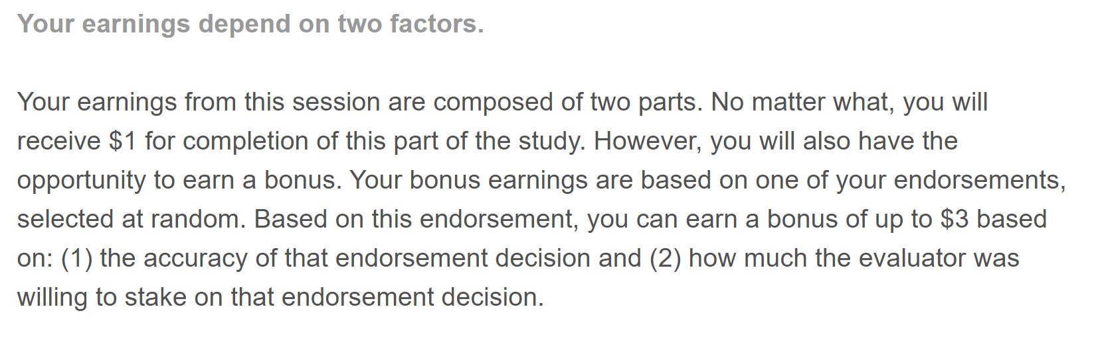

Slide 15
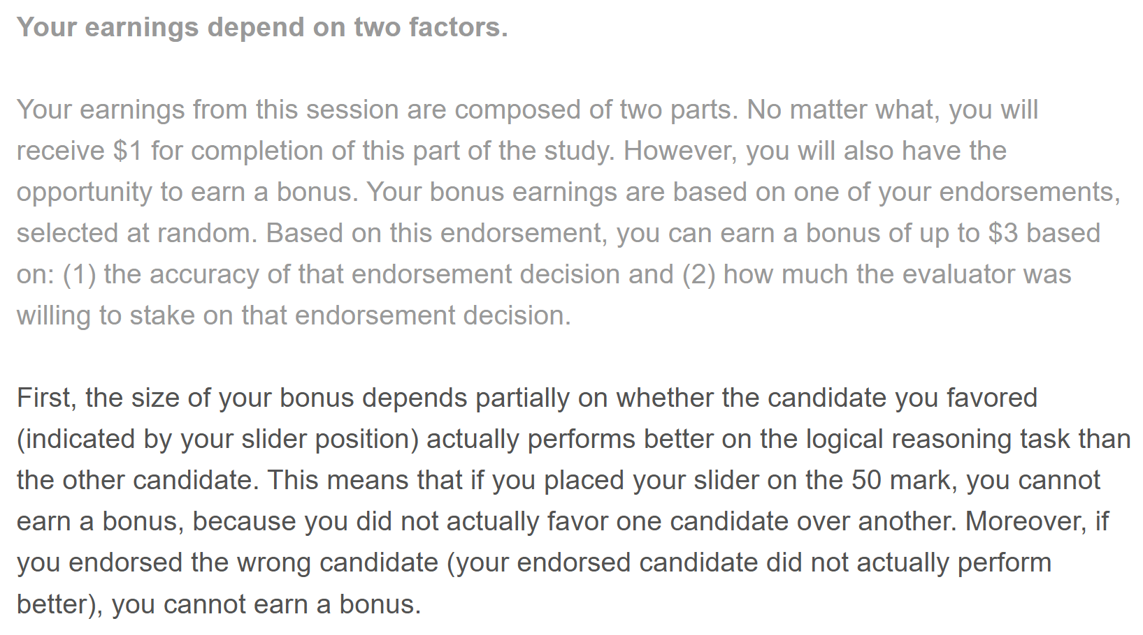

Slide 16
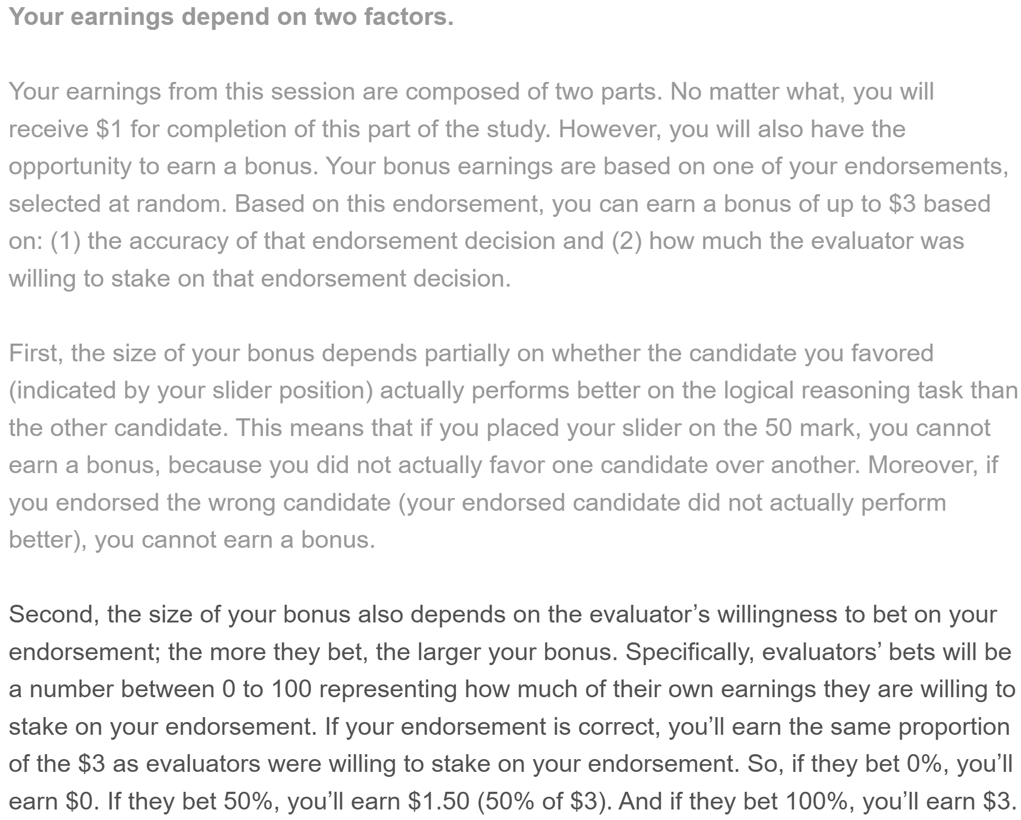
* Feedback on whether telegraphing this information would be helpful?

Slide 17
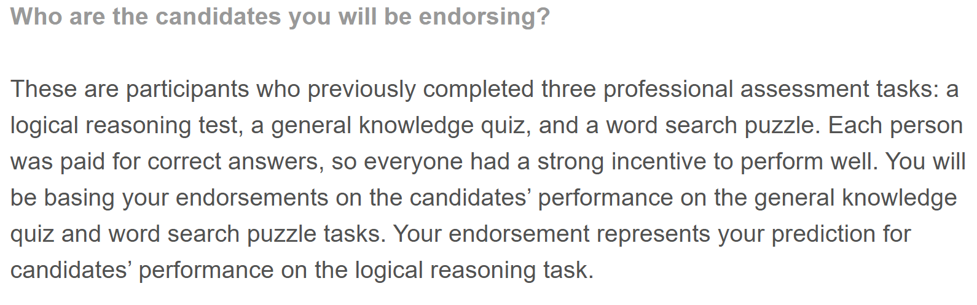

Slide 18
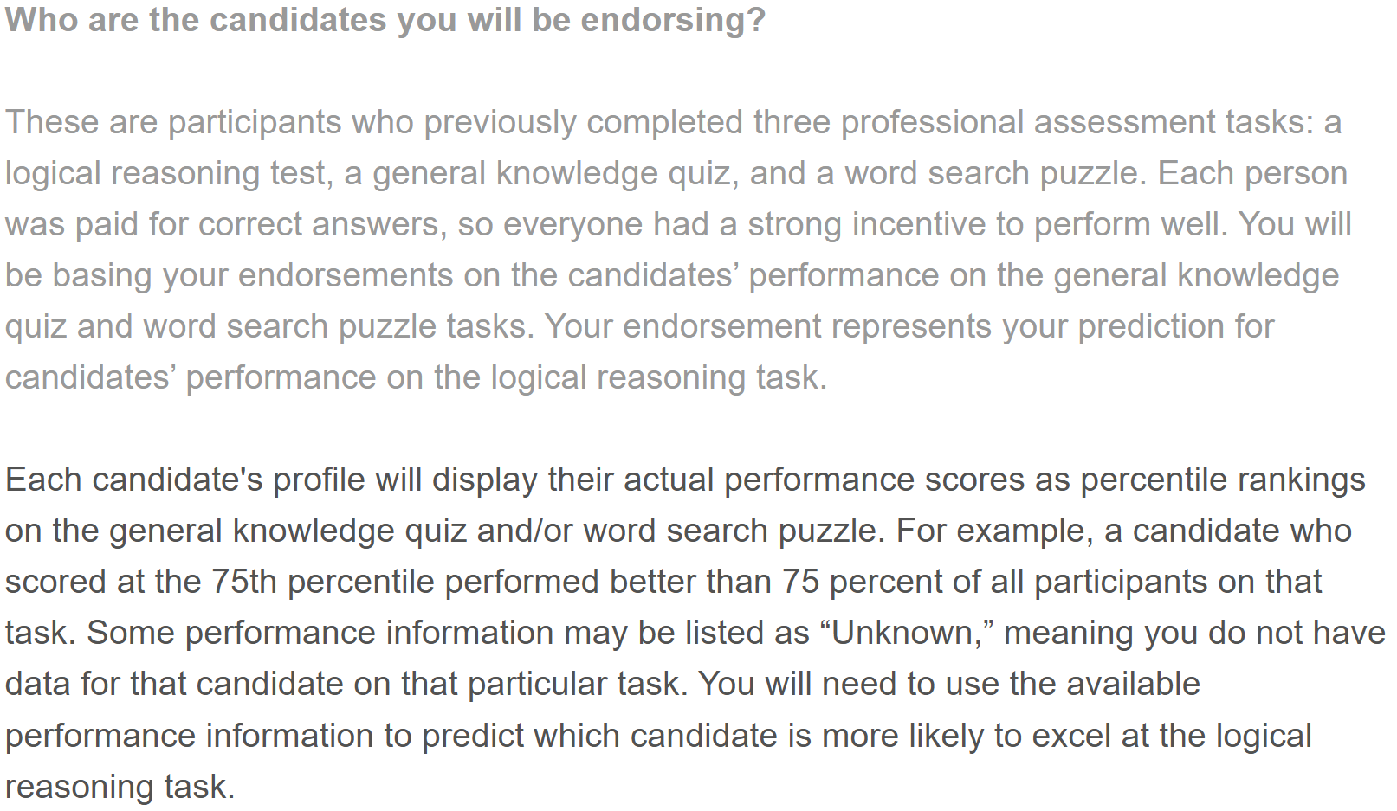

Slide 19
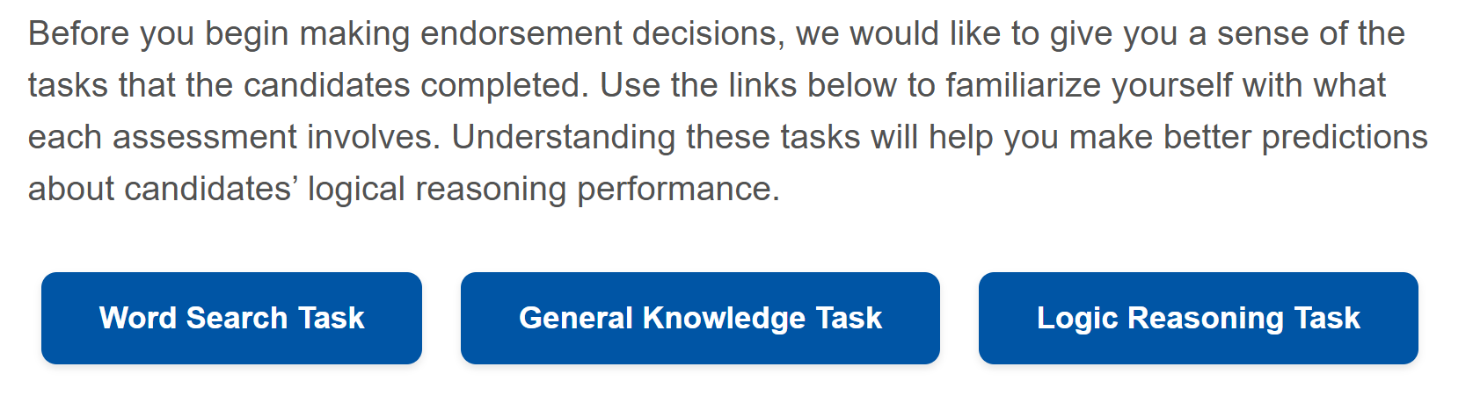

Slide 20
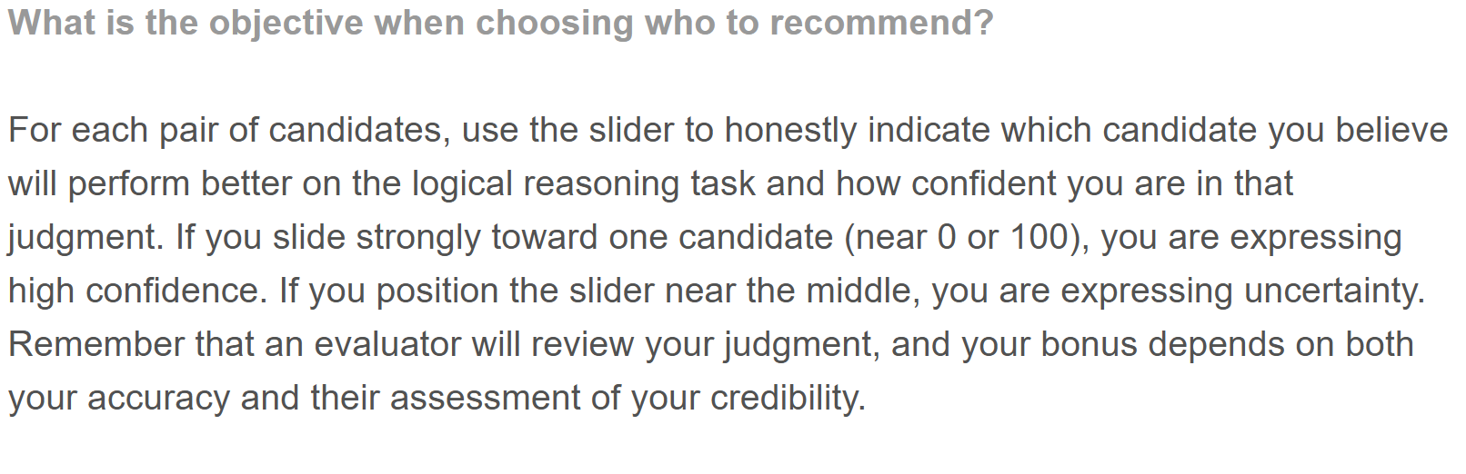

Slide 21
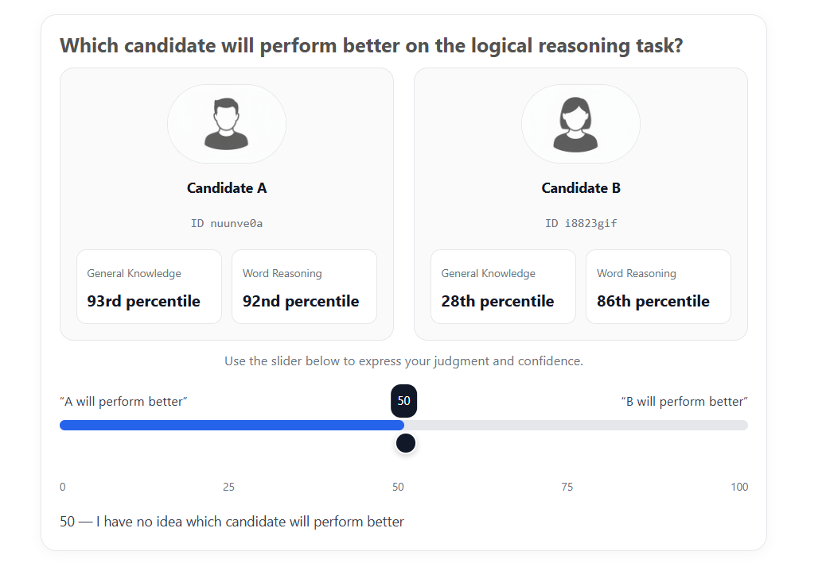
Survey Link
A Dominant
(B Wins)

Slide 22
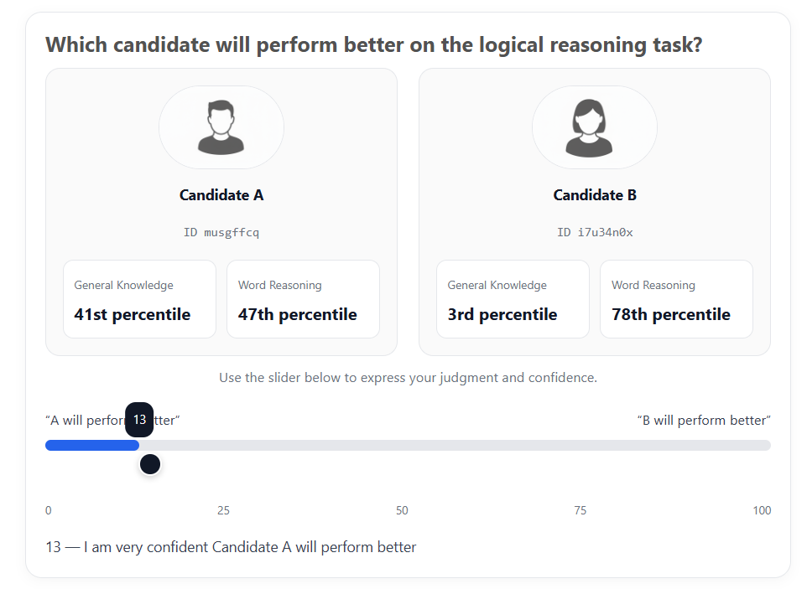
Survey Link
Uncertain
(A Wins)

Slide 23
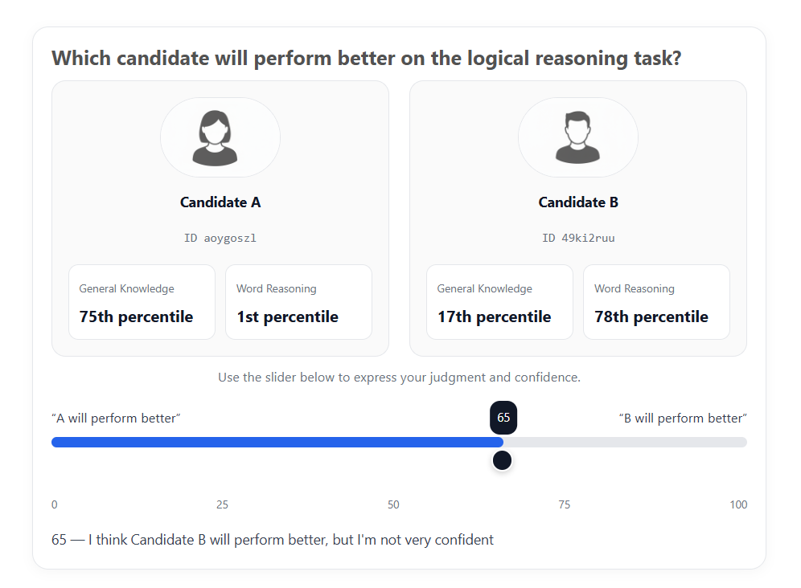
Survey Link
B Slightly Better
(B Wins)

Slide 24
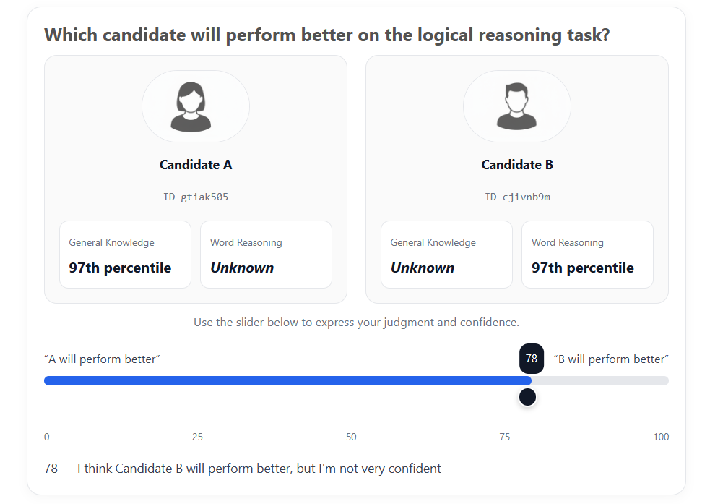
Survey Link
Uncertain
(B Wins)

Slide 25
Multi-stage lab experiment
Stage 1 (Protégé Performance)
Data from Barron et al., 2025 Tasks: Word search puzzles General knowledge quiz Logical reasoning test (Raven’s matrices)
Stage 2 (Sponsor Endorsements)
Sponsors evaluate two candidates and provide an endorsement. Goal: Predict which candidate will perform better on logical reasoning, based on their performance on word search puzzle and/or general knowledge quiz.
Stage 3 (Audience Evaluation)
An evaluator (i.e., the audience) will assess multiple endorsements from same sponsor. Goal: Evaluate the sponsor’s predictions and decide how much to trust each endorsement on being correct.

Slide 26
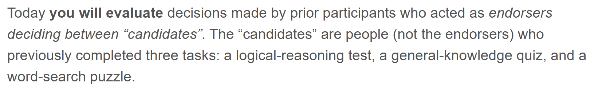

Slide 27
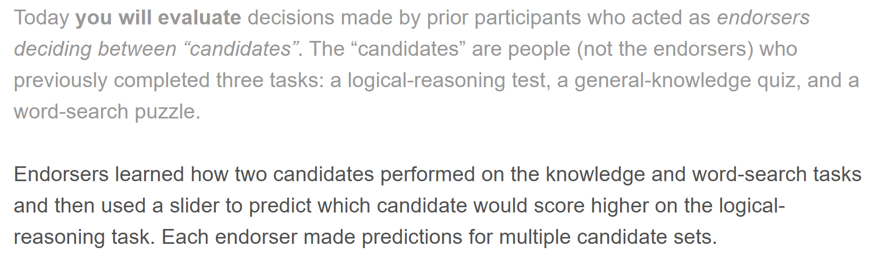

Slide 28
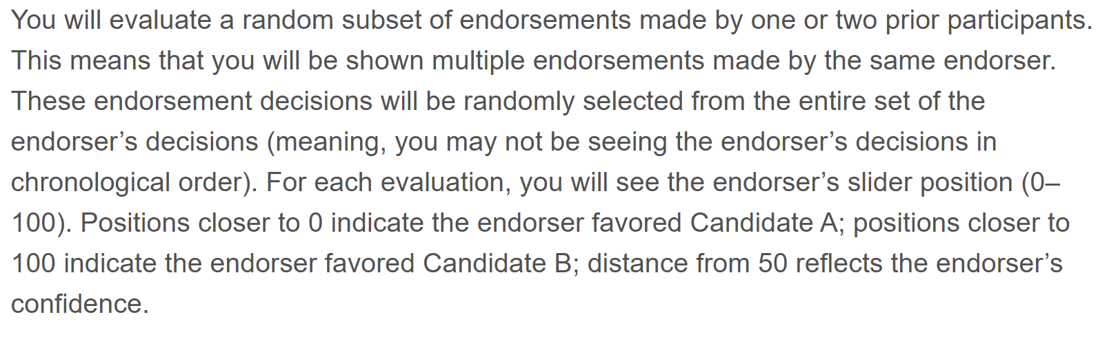

Slide 29
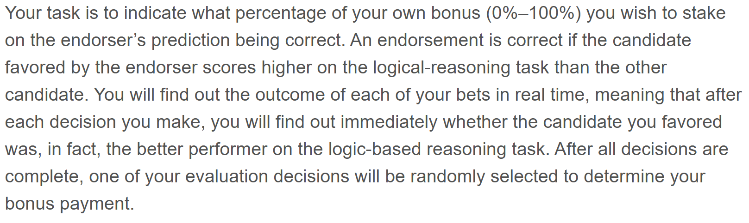

Slide 30
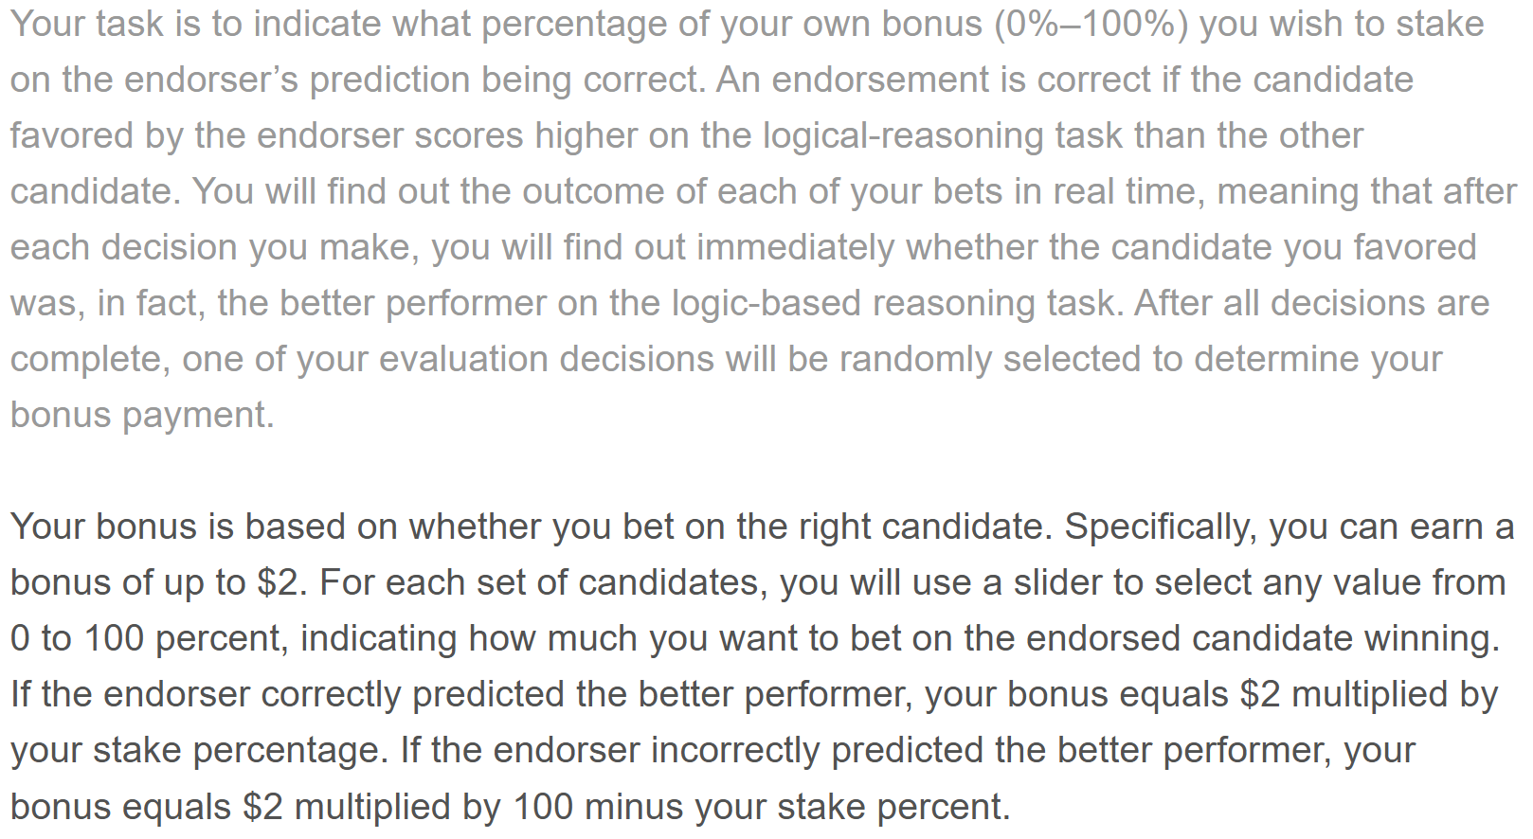

Slide 31
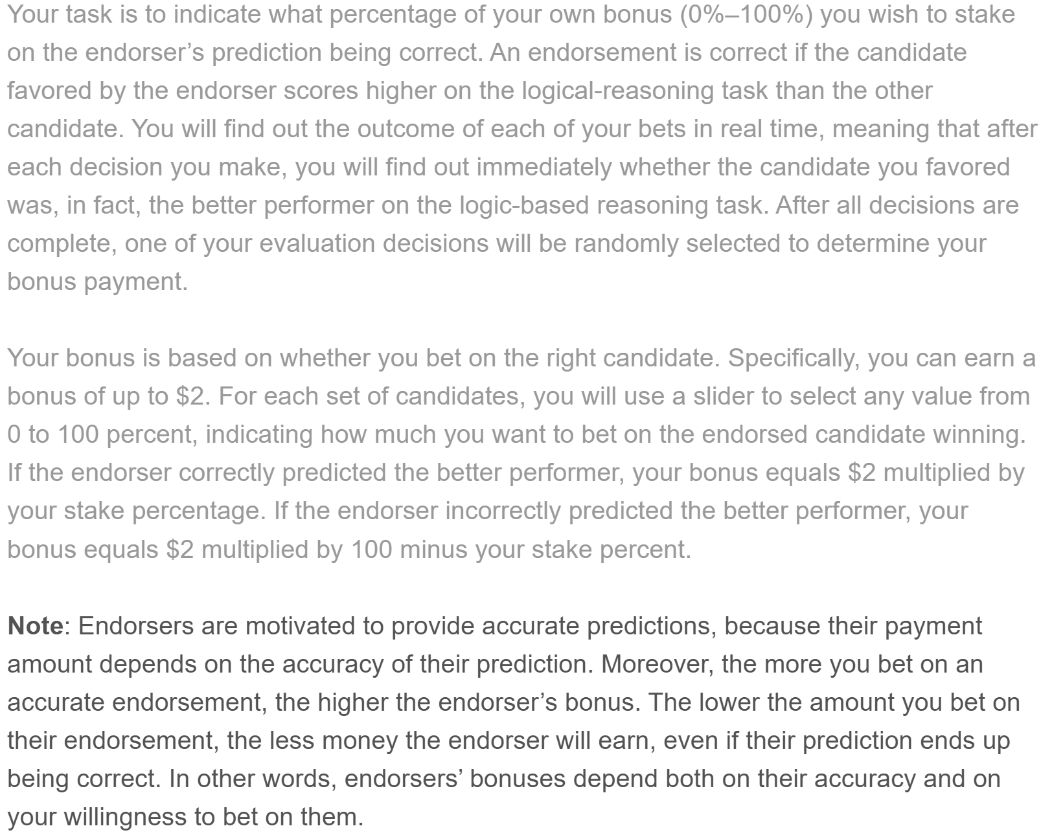

Slide 32
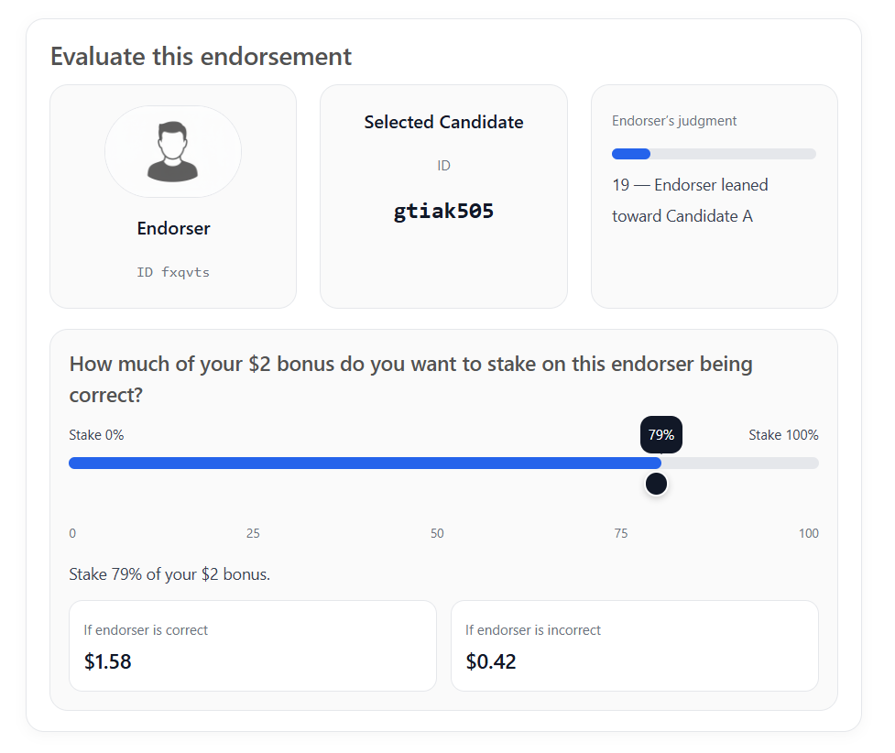

Slide 33
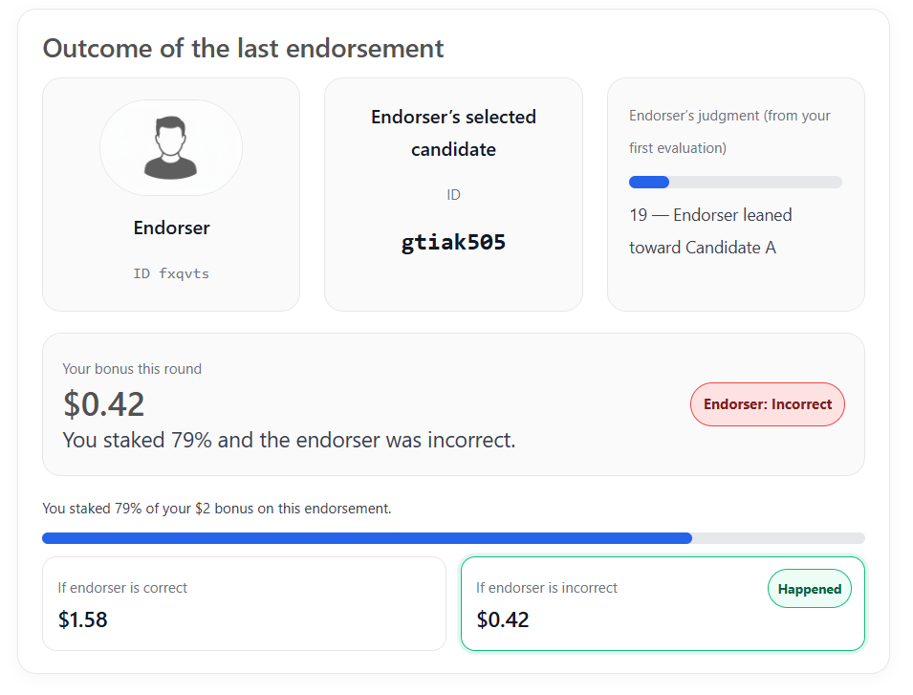

Slide 34
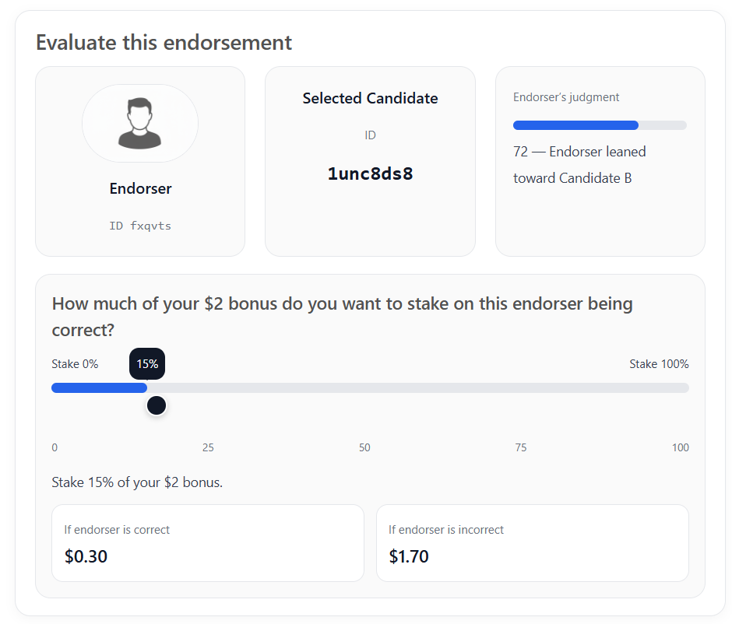

Slide 35
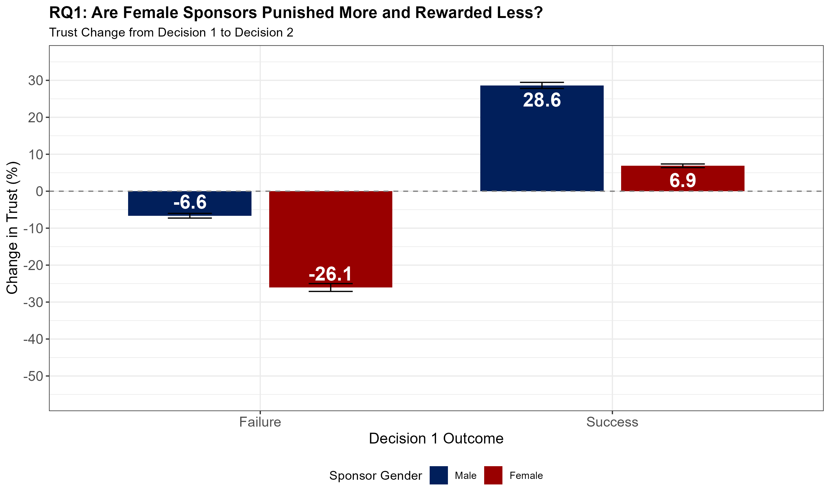
Predictions

Slide 36
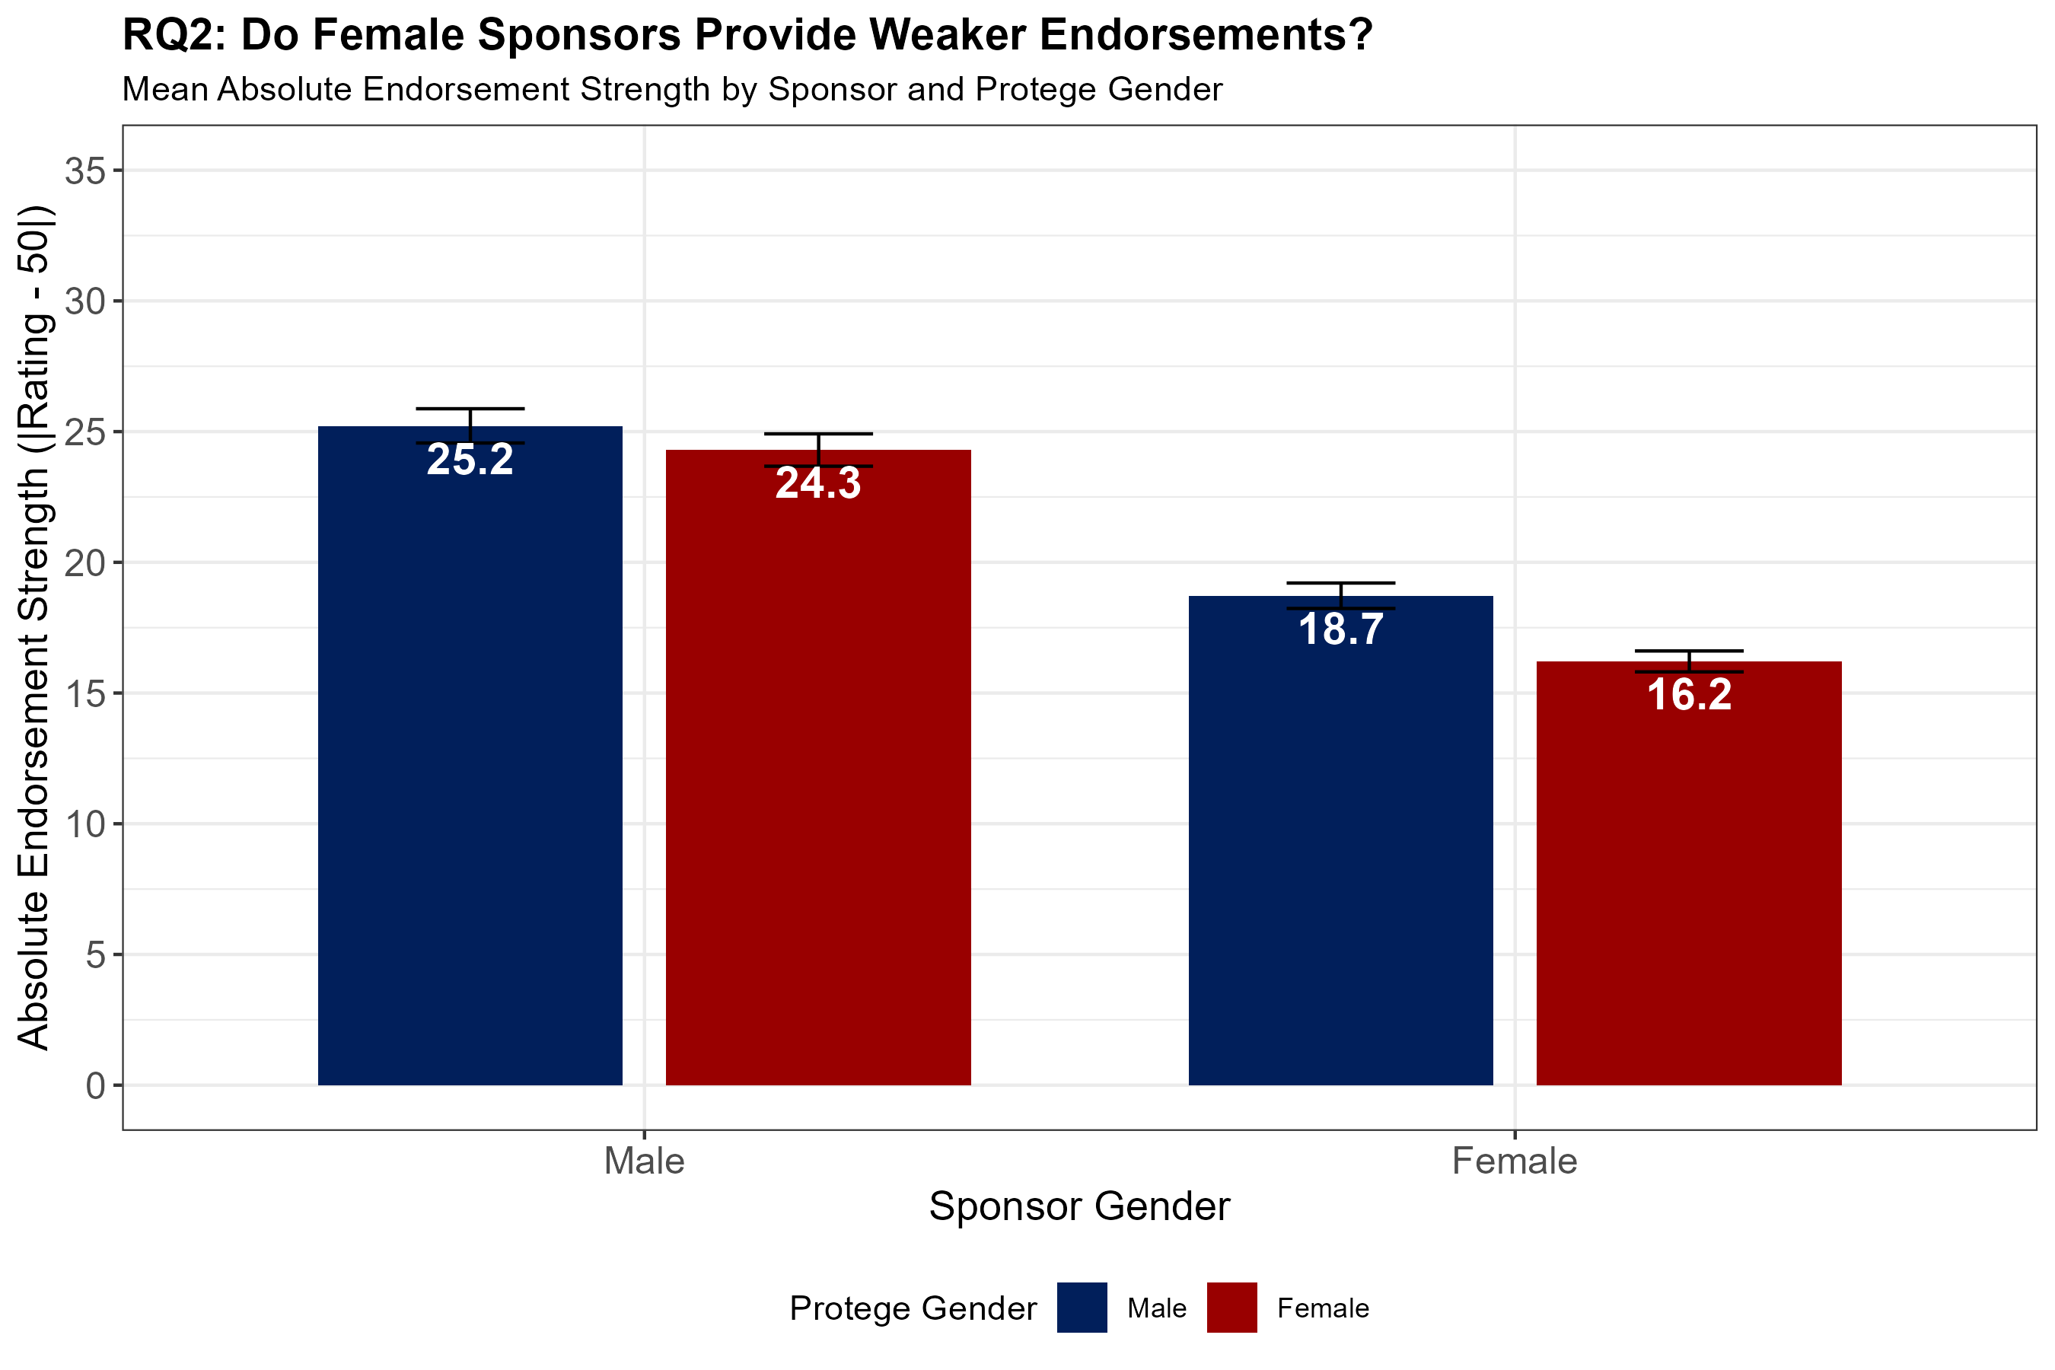
Predictions

Slide 37
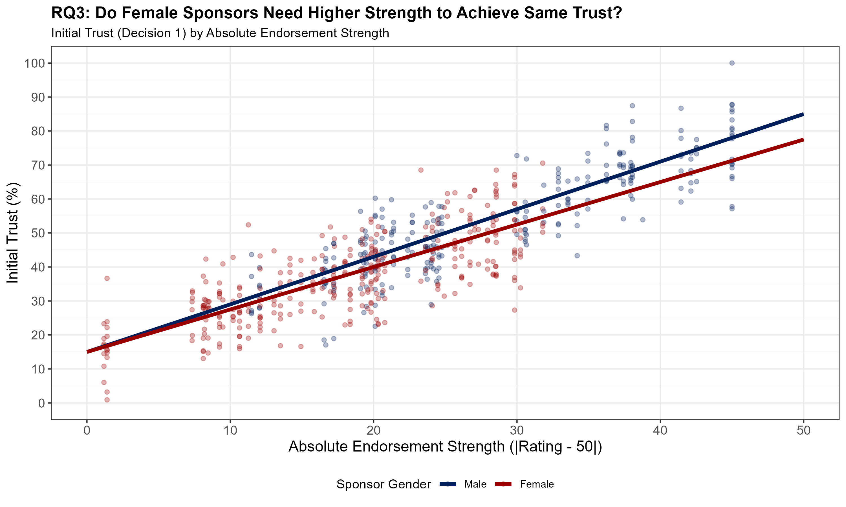
Predictions

Slide 38
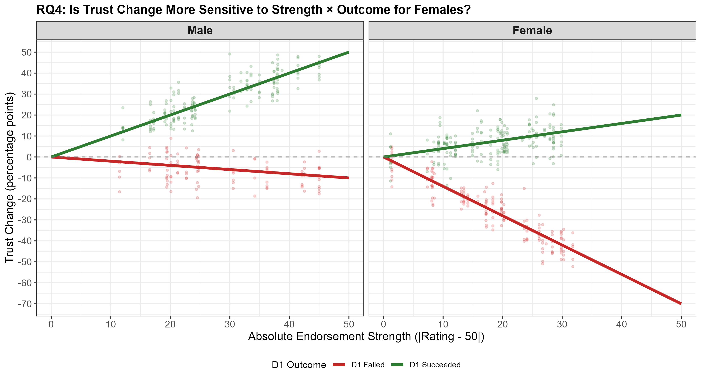
Predictions

Slide 39



