Slide 1

Instructor Kick-off
Analyze A/B Test Results
© 2019 Udacity. All rights reserved.

Slide 2
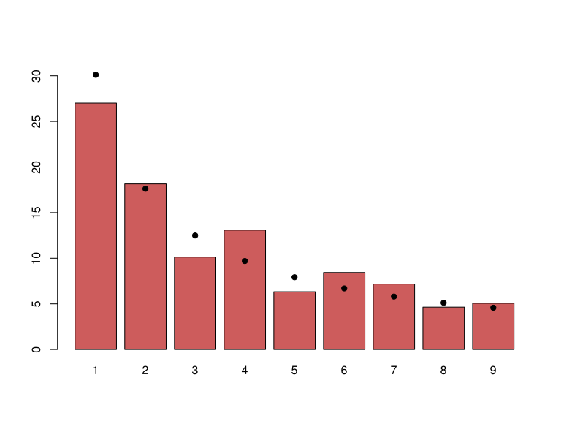
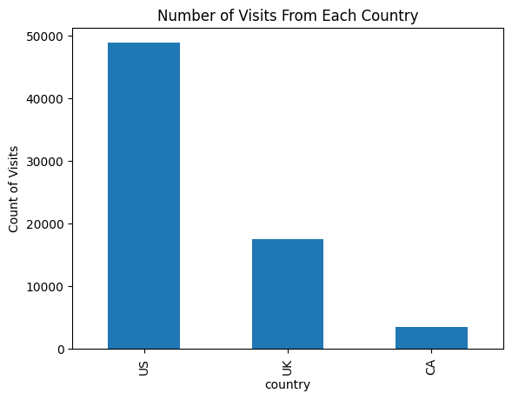
How Was The Experiment Implemented?​
Total Variant Visitors: 35211
Total Control Participants:​ 34678​
[Update the Below Chart With Your Chart of Where Users Are From]

Slide 3
Conversion Rates
 | U.S. | U.K. | CA
Control | 10.7% | 10.16% | 9.44%
Treatment | 15.8% | 14.86% | 15.40%
Executive Summary: We can be in average of 5.25% more sure that Treatment sells more

Slide 4
Country Results
Conclusion:​
"It can be said that there are relatively significant differences, but it's also important
to consider the proportions of each country. In other words, not all countries have th
e same number of visits or conversions, but we can reach the conclusion that the trea
tment is better in the version, with an average of 5.25% across the countries."

Slide 5
Experiment Results
Treatment Conversion Rate: 15.5321%
Control Conversion Rate:​ 10.5254%
Delta in Treatment vs. Control Conversion Rate:5.0067%
p-value:​ 0.514
Conclusion:​ we don’t have the enough statistical evidence to conclude that the difference in conversion rates between the treatment group and the control group is statistically significant.

