Slide 1
CS 3753 & 5163 Introduction to Data Science
Part 3: Numpy and basic linear algebra

Slide 2
Numpy
Numpy array creation
Array access and operations
Basic linear algebra
Disclaimer: I used an older version of spyder which imported many modules including numpy by default.
You can do the following if some code in the slides does not run. (import * not recommended in practice.)
import numpy as np
from numpy import *
from numpy.random import rand, randint

Slide 3
Numpy
Stands for Numerical Python
Is the fundamental package required for high performance computing and data analysis
It provides
ndarray for creating multiple dimensional arrays
Standard math functions for fast operations on entire arrays of data without having to write loops
Tools for reading/writing array data
Linear algebra tools
etc.

Slide 4
ndarray vs list of lists
Say you have grades of three exams (2 midterms and 1 final) in a class of 10 students.
grades =
How to get final exam grade of student 0?
grades[0][2]
How to get grades of student 2?
grades[2]
How to get grades of all students in midterm 1?
How to get midterm grades of the first three students (or all female students, or those who failed final)?
How to get mean grade of each exam?
How to get (weighted) average exam grade for each student?
[[79, 95, 60],
[95, 60, 61],
[99, 67, 84],
[76, 76, 97],
[91, 84, 98],
[70, 69, 96],
[88, 65, 76],
[67, 73, 80],
[82, 89, 61],
[94, 67, 88]]

Slide 5
ndarray vs list of lists
In [5]: gArray[0,2]
Out[5]: 60
In [7]: gArray[2,:]
Out[7]: array([99, 67, 84])
In [8]: gArray[:, 0]
Out[8]: array([79, 95, 99, 76, 91, 70, 88, 67, 82, 94])
In [9]: gArray[:3, :2]
Out[9]:
array([[79, 95],
[95, 60],
[99, 67]])
gArray = np.array(grades)
In [3]: gArray
Out[3]:
array([[79, 95, 60],
[95, 60, 61],
[99, 67, 84],
...,
[67, 73, 80],
[82, 89, 61],
[94, 67, 88]])

Slide 6
ndarray
ndarray is used for storage of homogeneous data
i.e., all elements must be the same type
Every array must have a shape
And a dtype
Supports convenient slicing, indexing and efficient vectorized computation
Avoid for loops, and much more efficient
In [15]: type(gArray)
Out[15]: numpy.ndarray
In [16]: gArray.ndim
Out[16]: 2
In [17]: gArray.shape
Out[17]: (10, 3)
In [18]: gArray.dtype
Out[18]: dtype('int32')

Slide 7
Creating ndarrays
In [65]: np.array([[0,1,2],[2,3,4]])
Out[65]:
array([[0, 1, 2],
[2, 3, 4]])
In [66]: np.zeros((2,3))
Out[66]:
array([[ 0., 0., 0.],
[0., 0., 0.]])
In [67]: np.ones((2,3))
Out[67]:
array([[ 1., 1., 1.],
[1., 1., 1.]])
In [69]: np.eye(3)
Out[69]:
array([[ 1., 0., 0.],
[ 0., 1., 0.],
[ 0., 0., 1.]])
In [70]: np.arange(0, 10, 2)
Out[70]: array([0, 2, 4, 6, 8])
np.array
np.zeros
np.ones
np.eye
np.arange
np.random
In [295]: np.random.randint(0, 10, (3,3))
Out[295]:
array([[8, 7, 6],
[0, 8, 9],
[9, 0, 4]])

Slide 8
Numpy data types
In [34]: gArray.astype(np.float64)
Out[34]:
array([[ 79., 95., 60.],
[ 95., 60., 61.],
...,
[ 82., 89., 61.],
[ 94., 67., 88.]])
int8, int16, int32, int64
float16, float32, float64, float128
bool
object
String
Unicode
gArray.astype
64 bits
In [79]: num_string = np.array(['1.0', '2.05', '3'])
In [81]: num_string
Out[81]:
array(['1.0', '2.05', '3'],
dtype='<U4')
In [82]: num_string.astype(np.float)
Out[82]: array([ 1. , 2.05, 3. ])

Slide 9
Array operations
In [87]: arr = array([[0,1,2],[3,4,5]])
In [88]: arr * 2
Out[88]:
array([[ 0, 2, 4],
[ 6, 8, 10]])
In [90]: arr ** 2
Out[90]:
array([[ 0, 1, 4],
[ 9, 16, 25]])
In [91]: 2 ** arr
Out[91]:
array([[ 1, 2, 4],
[ 8, 16, 32]], dtype=int32)
Between arrays and scalars
Between equal-sized arrays: elementwise operation
In [94]: arr * arr
Out[94]:
array([[ 0, 1, 4],
[ 9, 16, 25]])
In [95]: arr / (arr+1)
Out[95]:
array([[ 0. , 0.5 , 0.66666667],
[ 0.75 , 0.8 , 0.83333333]])

Slide 10
Speed difference between for loop and vectorized computation
def mySum(inputList):
s = 0
for i in range(len(inputList)):
s += inputList[i]
return s
In [118]: a = np.random.rand(1000000,1)
...: %timeit a**2
...: %timeit [a[i]**2 for i in range(1000000)]
100 loops, best of 3: 4.02 ms per loop
1 loop, best of 3: 1.25 s per loop
Vectorization is more than 300 times faster!
In [148]: %timeit mySum(a)
1 loop, best of 3: 605 ms per loop
In [149]: %timeit np.sum(a)
1000 loops, best of 3: 1.15 ms per loop
In [150]: %timeit reduce(lambda x, y: x+y, a)
1 loop, best of 3: 791 ms per loop
Vectorization is 500 times faster than for loop.
Reduce is even slower than for loop here.
In [151]: %timeit map(lambda x: x**2, a)
1000000 loops, best of 3: 270 ns per loop
map appears to be very fast, but it is just because it is lazy – actual calculation has not been done yet.

Slide 11
Array indexing and slicing
Somewhat similar to python list, but much more flexible
In [152]: gArray
Out[152]:
array([[79, 95, 60],
[95, 60, 61],
[99, 67, 84],
...,
[67, 73, 80],
[82, 89, 61],
[94, 67, 88]])
In [153]: gArray[0]
Out[153]: array([79, 95, 60])
In [154]: gArray[1:3]
Out[154]:
array([[95, 60, 61],
[99, 67, 84]])
In [155]: gArray[0][2]
Out[155]: 60
In [156]: gArray[0,2]
Out[156]: 60
In [157]: gArray[:, 2]
Out[157]: array([60, 61, 84, 97, 98, 96, 76, 80, 61, 88])

Slide 12
Array indexing and slicing (cont’d)
In [152]: gArray
Out[152]:
array([[79, 95, 60],
[95, 60, 61],
[99, 67, 84],
...,
[67, 73, 80],
[82, 89, 61],
[94, 67, 88]])
In [160]: gArray[:2, [0, 2]]
Out[160]:
array([[79, 60],
[95, 61]])
In [175]: gArray[[0, 2], :]
Out[175]:
array([[79, 95, 60],
[99, 67, 84]])
In [200]: gArray[[0,2]][:,[0,2]]
Out[200]:
array([[79, 60],
[99, 84]])
In [177]: gArray[[0, 2], [0, 1, 2]]
Traceback (most recent call last):
...
IndexError: shape mismatch: ...
In [178]: gArray[[0, 2], [0, 2]]
Out[178]: array([79, 84])
In [272]: gArray[np.ix_([0, 2], [0, 2])]
Out[272]:
array([[79, 60],
[99, 84]])
list

Slide 13
Array slices are views
(list slices are copies)
In [202]: gArray[0,:]=100
In [203]: gArray
Out[203]:
array([[100, 100, 100],
[ 95, 60, 61],
[ 99, 67, 84],
...,
[ 67, 73, 80],
[ 82, 89, 61],
[ 94, 67, 88]])
In [56]: a = np.array([1, 2, 3])
...: b = a[:2]
...: b[0]=10
...: a
...:
Out[56]: array([10, 2, 3])
In [254]: arr2 = gArray.copy()
In [255]: arr2 is gArray
Out[255]: False
In [258]: arr2[1,:]=100
In [260]: gArray[1,:]
Out[260]: array([95, 60, 61])
Use .copy() to make a copy of an array explicitly.

Slide 14
Boolean indexing
# select record for those who had # <= 70 in final
In [265]: gArray[gArray[:, 2]<70,:]
Out[265]:
array([[95, 60, 61],
[82, 89, 61]])
# select record for female students
In [262]: female = [ True, False, True, True, False, True, False, False, False, False]
In [263]: gArray[female, :]
Out[263]:
array([[100, 100, 100],
[ 99, 67, 84],
[ 76, 76, 97],
[ 70, 69, 96]])
# anything < 70 is changed to 70
In [267]: gArray[gArray < 70] = 70
In [268]: gArray
Out[268]:
array([[100, 100, 100],
[ 95, 70, 70],
[ 99, 70, 84],
...,
[ 70, 73, 80],
[ 82, 89, 70],
[ 94, 70, 88]])

Slide 15
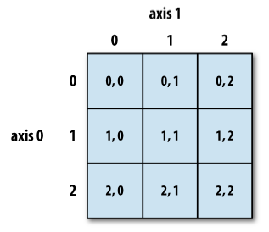
Reshaping and transposing
In [280]: np.arange(6).reshape((2,3))
Out[280]:
array([[0, 1, 2],
[3, 4, 5]])
In [281]: np.arange(6).reshape((2,3), order='F')
Out[281]:
array([[0, 2, 4],
[1, 3, 5]])
In [290]: np.arange(6).reshape(2,3).T
Out[290]:
array([[0, 3],
[1, 4],
[2, 5]])
Reshape and transpose only changes the view – still pointing to the same object!

Slide 16
Reshape and transpose only changes view!
In [100]: c = b.transpose()
In [101]: b
Out[101]:
array([[10, 1, 2],
[ 3, 4, 5]])
In [102]: c
Out[102]:
array([[10, 3],
[ 1, 4],
[ 2, 5]])
In [103]: c[0,0]=6
In [104]: b
Out[104]:
array([[6, 1, 2],
[3, 4, 5]])
In [89]: a = np.arange(6)
In [90]: a
Out[90]: array([0, 1, 2, 3, 4, 5])
In [91]: b = a.reshape((2,3))
In [92]: a
Out[92]: array([0, 1, 2, 3, 4, 5])
In [93]: b
Out[93]:
array([[0, 1, 2],
[3, 4, 5]])
In [94]: b[0,0]=10
In [95]: b
Out[95]:
array([[10, 1, 2],
[ 3, 4, 5]])
In [96]: a
Out[96]: array([10, 1, 2, 3, 4, 5])

Slide 17
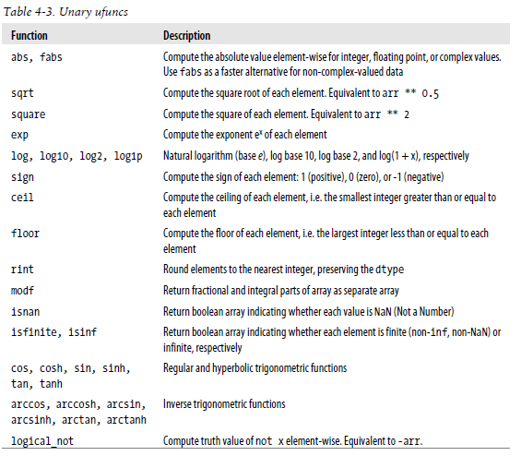
Fast element-wise functions

Slide 18
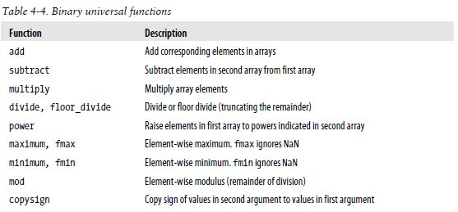
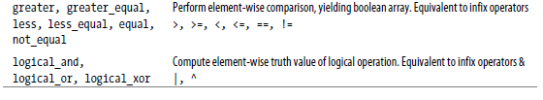
https://docs.scipy.org/doc/numpy/reference/

Slide 19
Useful numpy reference webpages
Array manipulation routines: reshaping, converting to/form lists, combining, splitting, adding/removing, etc.
Input and output: reading/saving table-like data files (binary/text)
Mathematical functions: rounding, sums, products, logarithms, etc.
Sorting, searching, and counting: sort, argsort (indirect sorting), etc
Statistics: mean, median, quantile, std, min, max, (and the corresponding NaN versions – where missing values are ignored), correlation, histogram
Indexing: numpy array indexing and slicing operations

Slide 20
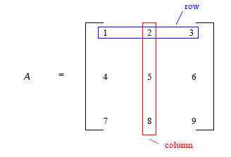
Matrix
A matrix is a rectangular array of numbers organized in rows and columns
If a matrix A has m rows and n columns, then we say that A is an m x n matrix

Slide 21
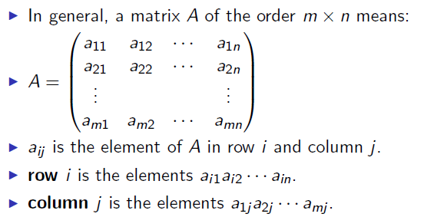
Matrix

Slide 22
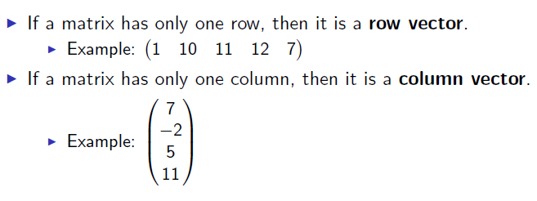
Vectors

Slide 23
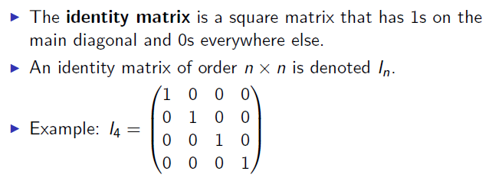
Identity matrix

Slide 24
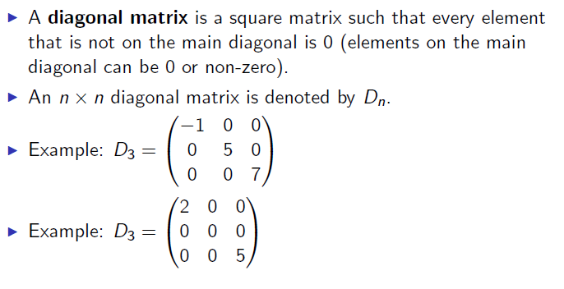
Diagonal matrix

Slide 25
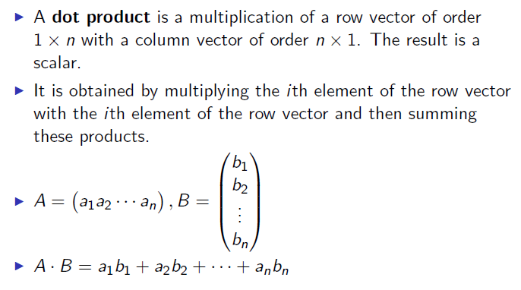
Dot product
In [303]: a = b = np.arange(5)
In [305]: a
Out[305]: array([0, 1, 2, 3, 4])
In [306]: b
Out[306]: array([0, 1, 2, 3, 4])
In [307]: a.dot(b)
Out[307]: 30

Slide 26
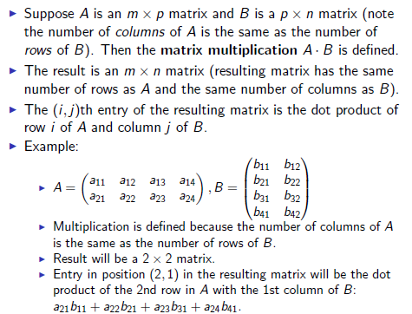
Matrix multiplication

Slide 27
In [152]: gArray
Out[152]:
array([[79, 95, 60],
[95, 60, 61],
[99, 67, 84],
...,
[67, 73, 80],
[82, 89, 61],
[94, 67, 88]])
79 | 95 | 60
95 | 60 | 61
99 | 60 | 61
…
67 | 73 | 80
82 | 89 | 61
94 | 67 | 88
76.2
70.9
83.4
…
74.0
75.7
83.5
0.3
0.3
0.4
x
=
In [321]: gArray.dot([0.3, 0.3, 0.4])
Out[321]: array([ 76.2, 70.9, 83.4, 84.4, 91.7, 80.1, 76.3, 74. , 75.7, 83.5])
What is being calculated here?

Slide 28
In [152]: gArray
Out[152]:
array([[79, 95, 60],
[95, 60, 61],
[99, 67, 84],
...,
[67, 73, 80],
[82, 89, 61],
[94, 67, 88]])
In [329]: scaling = [1.1, 1.05, 1.03]
In [330]: diag(scaling)
Out[330]:
array([[ 1.1 , 0. , 0. ],
[ 0. , 1.05, 0. ],
[ 0. , 0. , 1.03]])
In [331]: gArray.dot(diag(scaling))
Out[331]:
array([[ 86.9 , 99.75, 61.8 ],
[ 104.5 , 63. , 62.83],
[ 108.9 , 70.35, 86.52],
...,
[ 73.7 , 76.65, 82.4 ],
[ 90.2 , 93.45, 62.83],
[ 103.4 , 70.35, 90.64]])
What are we doing here?

Slide 29
In [152]: gArray
Out[152]:
array([[79, 95, 60],
[95, 60, 61],
[99, 67, 84],
...,
[67, 73, 80],
[82, 89, 61],
[94, 67, 88]])
In [337]: gArray.max(axis=0)
Out[337]: array([99, 95, 98])
In [338]: maxInExam = gArray.max(axis=0)
In [339]: gArray.dot(diag(100/maxInExam)).round()
Out[339]:
array([[ 80., 100., 61.],
[ 96., 63., 62.],
[ 100., 71., 86.],
...,
[ 68., 77., 82.],
[ 83., 94., 62.],
[ 95., 71., 90.]])
What are we doing here?

Slide 30
Speed difference between for loop and matrix multiplication
In [361]: maxInCol = a.max(axis=0)
In [362]: maxInCol.shape
Out[362]: (100,)
In [363]: timeit [[a[j,i]*100/maxInCol[i] for i in range(100)]
for j in range(10000)]
1 loop, best of 3: 673 ms per loop
In [355]: a = np.random.rand(10000, 100)
In [356]: timeit a.dot(100/a.max(0))
100 loops, best of 3: 1.77 ms per loop
In [357]: timeit [a[:,i]*100/max(a[:,i]) for i in range(100)]
10 loops, best of 3: 72.9 ms per loop
In [358]: timeit [[a[j,i]*100/max(a[:,i]) for i in range(100)] for j in range(10000)]
Ctrl-C

Slide 31
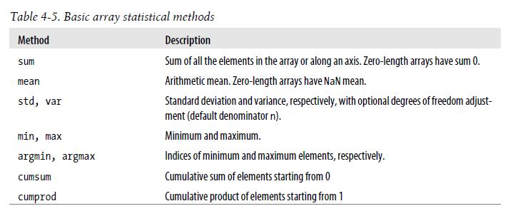
In [394]: a=randint(0, 5, size=(2,3))
In [395]: a
Out[395]:
array([[4, 1, 2],
[1, 3, 4]])
In [396]: a.sum()
Out[396]: 15
In [397]: a.sum(axis=0)
Out[397]: array([5, 4, 6])
In [398]: a.sum(1)
Out[398]: array([7, 58])
In [405]: (a > 3).any(0)
Out[405]: array([ True, False, True], dtype=bool)

Slide 32
numpy.sort() and numpy.argsort()
In [161]: a = np.array([[4, 1, 2], [3, 1, 4]])
In [162]: a
Out[162]:
array([[4, 1, 2],
[3, 1, 4]])
In [163]: ind = a.argsort(axis=-1)
In [164]: ind
Out[164]:
array([[1, 2, 0],
[1, 0, 2]], dtype=int64)
In [165]: a[:, ind[0]]
Out[165]:
array([[1, 2, 4],
[1, 4, 3]])
In [166]: a[:, ind[1]]
Out[166]:
array([[1, 4, 2],
[1, 3, 4]])
In [134]: b = a.copy()
...: c = b.sort()
...:
In [135]: b
Out[135]:
array([[1, 2, 4],
[1, 3, 4]])
In [136]: c
In [137]: a
Out[137]:
array([[4, 1, 2],
[1, 3, 4]])
In [138]: b = a.copy()
...: b.sort(axis=0)
...: b
...:
Out[138]:
array([[1, 1, 2],
[4, 3, 4]])
np.sort(a): won’t change a.
a.sort(): changes a.

Slide 33
any, all, where, nonzero
See the jupyter notebook

Slide 34
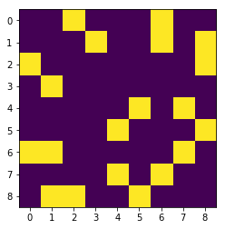
Adjacency matrix for a graph
In [603]: n=friends.max()
...: frdGraph = zeros((n+1,n+1))
...: frdGraph[friends[:,0],friends[:,1]]=1
...: frdGraph[friends[:,1],friends[:,0]]=1
...: imshow(frdGraph)
...: xticks(range(9))
In [604]: friends
Out[604]:
array([[0, 2],
[0, 6],
[1, 3],
...,
[4, 7],
[5, 8],
[6, 7]], dtype=int64)

Slide 35
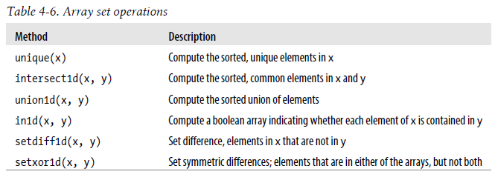
In [654]: edgeList
Out[654]:
array([['Amy', 'Frank'],
['Amy', 'Katy'],
['Emma', 'James'],
...,
['Cindy', 'Rose'],
['Tim', 'John'],
['Katy', 'Rose']],
dtype='<U5')
In [676]: names, indices = unique(edgeList, return_inverse=True)
In [677]: names
Out[677]:
array(['Amy', 'Cindy', 'Emma', 'Frank', 'James', 'John', 'Katy', 'Rose', 'Tim'], dtype='<U5')
In [678]: indices
Out[678]: array([0, 3, 0, ..., 5, 6, 7], dtype=int64)
In [715]: reshape(indices,(-1, 2)).T
Out[715]:
array([[0, 0, 2, ..., 1, 8, 6],
[3, 6, 4, ..., 7, 5, 7]], dtype=int64)

Slide 36
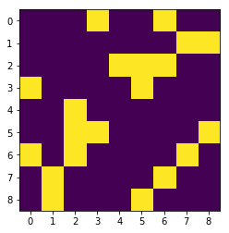
In [654]: edgeList
Out[654]:
array([['Amy', 'Frank'],
['Amy', 'Katy'],
['Emma', 'James'],
...,
['Cindy', 'Rose'],
['Tim', 'John'],
['Katy', 'Rose']],
dtype='<U5')
In [676]: names, indices = unique(edgeList, return_inverse=True)
In [677]: names
Out[677]:
array(['Amy', 'Cindy', 'Emma', 'Frank', 'James', 'John', 'Katy', 'Rose', 'Tim'], dtype='<U5')
In [710]: n = indices.max()
...: frdGraph2 = zeros((n+1,n+1))
...: frdGraph2[indices[::2], indices[1::2]] = 1
...: frdGraph2[indices[1::2], indices[::2]] = 1
...: imshow(frdGraph2); xticks(range(n+1))

Slide 37
Sparse matrix support
In scipy.sparse
Necessary for larger sparse graphs (e.g. social networks)
Most real world networks are sparse
Memory efficiency is crucial for applications
https://docs.scipy.org/doc/scipy/reference/index.html

Slide 38
Ravel, flatten, flat, squeeze
#%% b is a view
a = np.arrange(9).reshape(3,3)
b = a.ravel()
#%% c is a copy
c = a.flatten()
#%% d is like an iterator on a (in 1-d, row-major by default)
d = a.flat
#%% remove single dimensional entries
e = a.reshape((9, 1))
s = e.squeeze()
s.shape

