Slide 1
CS 3753 & 5163 Introduction to Data Science
Part 4: More statistics and some probability
4.1 SEM, CI, Correlation, PMF, PDF, CDF

Slide 2
Table of contents
Central limit theorem, error bar, standard error of the mean, confidence interval, z-score page 3
Correlation page 8
PMF and CDF page 15
PDF and normal distribution page 20
Other continuous distribution page 33

Slide 3
Functions imported for this slide
import numpy as np
import matplotlib.pyplot as plt
from matplotlib.pyplot import errorbar, hist, scatter, xticks
from numpy import mean, std, sort, argsort, corrcoef, arange
from numpy.random import rand, randn, randint, choice, lognormal
from scipy.stats import norm, lognorm, expon, pareto
from math import sqrt

Slide 4
Histogram
Summary statistics of data: mean, variance, std, median, quartile, etc.
Histogram: Graphical summary, usually in the form of a bar chart, that shows how often different (approximate) values in a set of data occur
Basic procedure:
Determine # of bins and the range of values covered (typically from lowest to highest value in the dataset);
Create bins that cover the range of values with equal intervals: each bin will cover (high – low) / #bins
Count the frequency of values falling into each bin
Make a bar chart with the bin center as x-axis and frequency as y-axis
Sometimes a line graph instead of bar chart is used
Sometimes probability (i.e., frequency / total counts) instead of frequency is plotted.

Slide 5
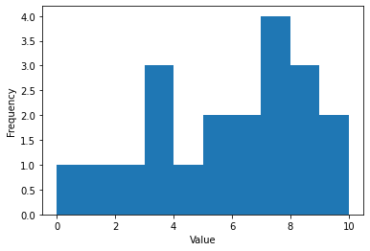
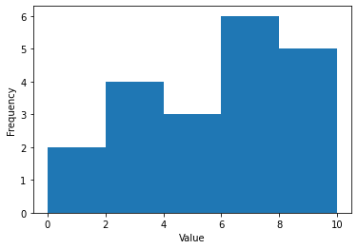
a =[0, 1, 2, 3, 3, 3, 4, 5, 5, 6, 6, 7, 7, 7, 7, 8, 8, 8, 9, 10]
[counts, bin_bounds, _] = plt.hist(a, bins=10)
plt.xlabel('Value')
plt.ylabel('Frequency')
print(counts)
print(bin_bounds)
[1. 1. 1. 3. 1. 2. 2. 4. 3. 2.]
[ 0. 1. 2. 3. 4. 5. 6. 7. 8. 9. 10.]
[counts, bin_bounds, _] = plt.hist(a, bins=5)

Slide 6


Central limit theorem
Central limit theorem: The mean of a large number of independently and identically distributed (iid) random variables (with mean μ and standard deviation σ) is approximately normally distributed, with mean μ and standard deviation σ/sqrt(n), where n is the sample size.

Slide 7
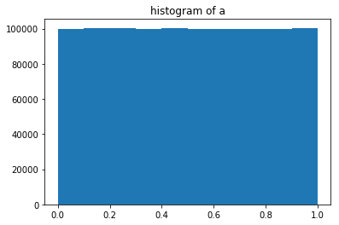
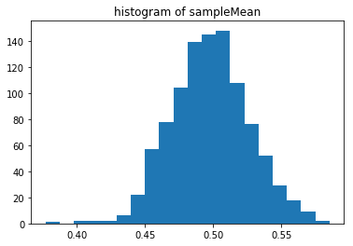
Simulation using uniform distribution
In [947]: a = np.random.rand(10**6)
...: print('population mean:’, np.mean(a))
...: print('standard deviation:’, np.std(a))
...: # now draw 100 samples, repeat 1000 times.
...: # save in a 100x1000 matrix
...: b = np.random.choice(a, (100,1000), replace=False)
...: # mean of each column
...: sampleMean = np.mean(b, axis=0)
...: plt.hist(sampleMean, 20)
...: print('mean of sampleMean:’, np.mean(sampleMean))
...: print('std of sampleMean:’, np.std(sampleMean))
...:
population mean: 0.500377047392
standard deviation: 0.288753616022
mean of sampleMean: 0.500392388908
std of sampleMean: 0.0286669247346

Slide 8
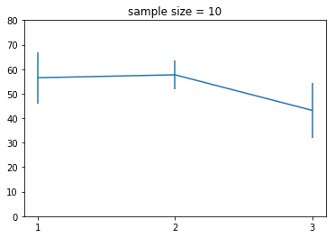
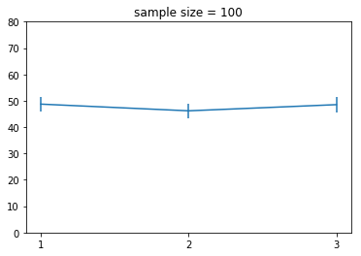
Errorbar and confidence interval
In [965]: measures = randint(0, 100, size=(10,3))
In [966]: measures
Out[966]:
array([[70, 54, 67],
[62, 24, 60],
[ 0, 61, 11],
...,
[78, 43, 94],
[45, 79, 81],
[54, 50, 29]])
In [968]: SEM = std(measures,0)/sqrt(measures.shape[0])
In [969]: errorbar([1,2,3], mean(measures,0),SEM); xticks([1,2,3])

Slide 9
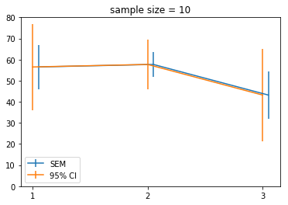
Confidence interval
Standard Error of the Mean (SEM): standard deviation / sqrt(n)
95% confidence interval: 1.96*SEM (the interval that is likely to include the real mean with 95% probability)
errorbar([1.05,2.05,3.05], mean(measures,0), SEM)
errorbar([1,2,3], mean(measures,0), SEM*1.96);

Slide 10
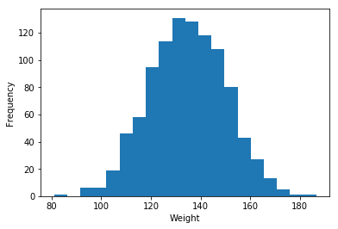
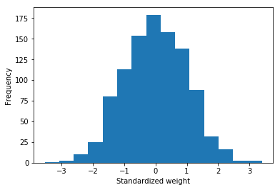
Standard score (z-score)
hist (weight)
Z_{i} = (x_{i} - μ) / σ
Z-score is unit-less, can be + or -
When distribution is approx. normal, z-score can be conveniently mapped to probabilities
hist((weight - mean(weight))/std(weight))
# weight: body weight of a certain population (in LB)
In [1024]: weight
Out[1024]: array([ 156., 140., 145., ..., 139., 140., 124.])

Slide 11
Correlation
Measures the (linear) relationship between two variables, X = [x₁, x₂, …X_{n}], and Y = [y₁, y₂, …, y_{n}]
E.g. between one’s height and weight
Between results of two tests
Problem: the two variables may be on different unit, different scale, or different distribution
Option 1: convert the measurement to standardized score (z-score)
Pearson Correlation Coefficient
Option 2: sort the values and convert the measurement to ranks
Spearman Rank Correlation Coefficient

Slide 12
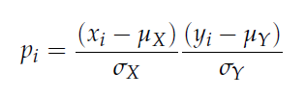

Pearson Correlation Coefficient

Slide 13
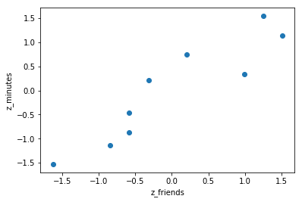
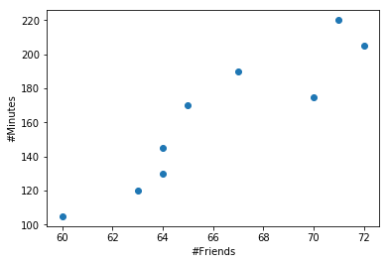
In [1076]: friends = array([ 70, 65, 72, 63, 71, 64, 60, 64, 67])
...: minutes = array([175, 170, 205, 120, 220, 130, 105, 145, 190])
...:
...: def zscore(numArray):
...: return (numArray - mean(numArray))/std(numArray)
...:
...: zfriends = zscore(friends)
...: zminutes = zscore(minutes)
...:
...: scatter(zfriends, zminutes)
...: xlabel('z_friends')
...: ylabel('z_minutes')
...:
...: zfriends.dot(zminutes) / len(friends)
...:
Out[1076]: 0.92246383021660039
# using np.corrcoef gives the same result
In [1080]: np.corrcoef(friends, minutes)
Out[1080]:
array([[ 1. , 0.92246383],
[ 0.92246383, 1. ]])

Slide 14
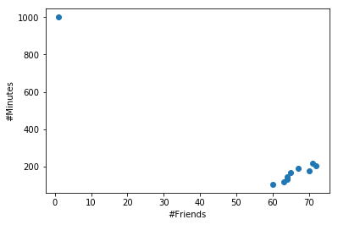
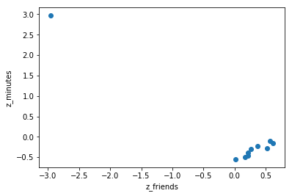
Pearson correlation coefficient is sensitive to outliers
In [1085]: friends2=np.append(friends,1)
In [1086]: minutes2=np.append(minutes,1000)
In [1091]: np.corrcoef(friends2, minutes2)[0,1]
Out[1091]: -0.95014946790238775

Slide 15
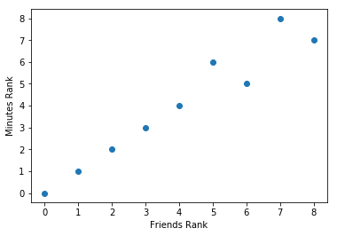
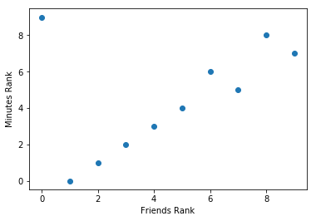
Spearman Rank Correlation Coefficient
In [1113]: friends_rank = argsort(argsort(friends))
...: minutes_rank = argsort(argsort(minutes))
...: corrcoef(friends_rank, minutes_rank)[0,1]
...:
Out[1113]: 0.96666666666666667
In [1114]: friends_rank = argsort(argsort(friends2))
...: minutes_rank = argsort(argsort(minutes2))
...: corrcoef(friends_rank, minutes_rank)[0,1]
...:
Out[1114]: 0.43030303030303024

Slide 16
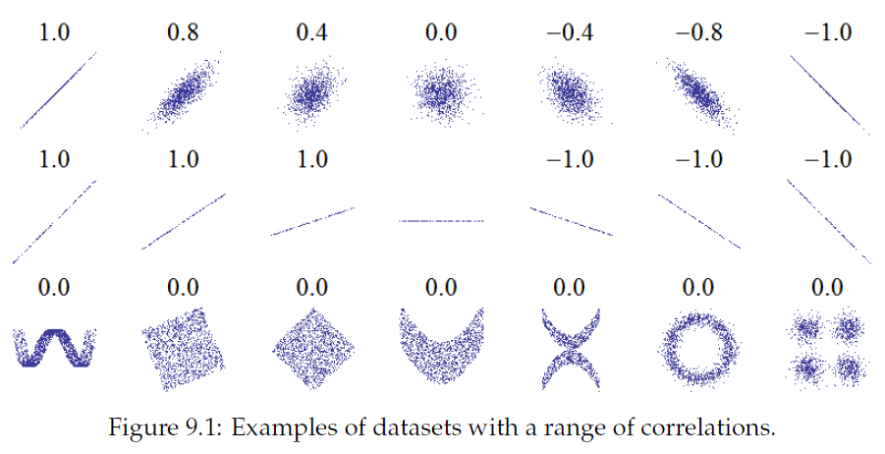
Correlation only measures linear relationship

Slide 17
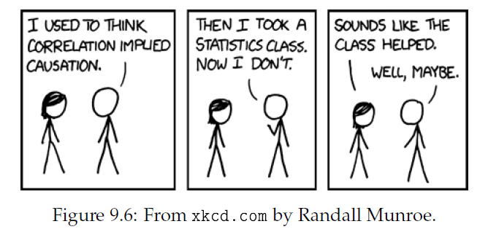
Correlation does not imply causation
In general, correlation between two variables does not tell you whether one causes the other, or the other way around or whether they might both be caused by something else altogether.
Ways to help figure out: time, randomized controlled trial, etc.

Slide 18
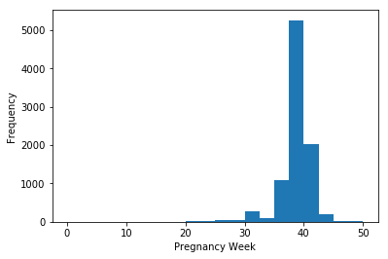
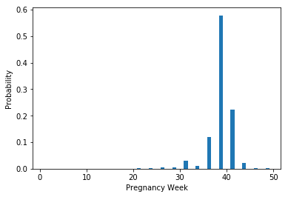
Probability Mass Function
histogram
NSFG: National Survey of Family Growth
Collected by the US Center of Disease Control and Prevention.
Downloaded from the website of ThinkStats.
Do first babies tend to come late?
# lots of preprocessing: remove NA, errors, etc.
# prglength: duration of pregnancy (in weeks)
In [1180]: counts =hist(prglength, bins=20)
...: xlabel('Pregnancy Week')
...: ylabel('Frequency')
...: show()
...: bin_center = (counts[1][1:]+counts[1][:-1])/2
...: bar(bin_center, counts[0]/sum(counts[0]))
...: xlabel('Pregnancy Week')
...: ylabel('Probability')
PMF

Slide 19
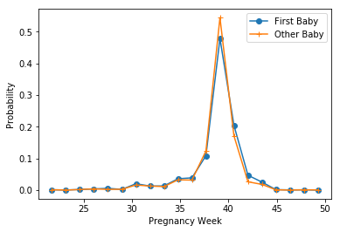
First baby vs other baby
firstbabycounts =hist(prglength[firstbaby], bins=counts[1])
show()
otherbabycounts =hist(prglength[~firstbaby], bins=counts[1])
show()
plot(bin_center, firstbabycounts[0]/sum(firstbaby), '-o', bin_center, otherbabycounts[0]/sum(~firstbaby), '-+')
xlabel('Pregnancy Week')
ylabel('Probability')
legend(('First Baby', 'Other Baby'))

Slide 20
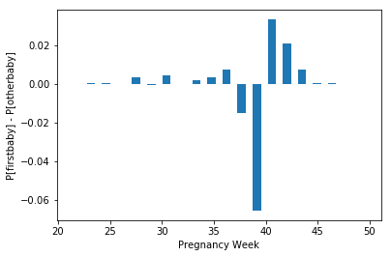
First baby vs other baby
bar(bin_center, firstbabycounts[0]/sum(firstbaby) - otherbabycounts[0]/sum(~firstbaby))
xlabel('Pregnancy Week')
ylabel('P[firstbaby] - P[otherbaby]')

Slide 21
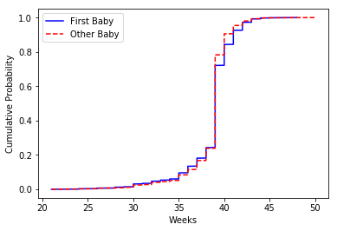
Cumulative distribution function (CDF)
In [1245]: plot(sort(prglength[firstbaby]), range(sum(firstbaby))/sum(firstbaby), '-b')
...: plot(sort(prglength[~firstbaby]), range(sum(~firstbaby))/sum(~firstbaby), 'r--')
...: legend(('First Baby', 'Other Baby'))
...: xlabel('Weeks')
...: ylabel('Cumulative Probability')
...: show()

Slide 22
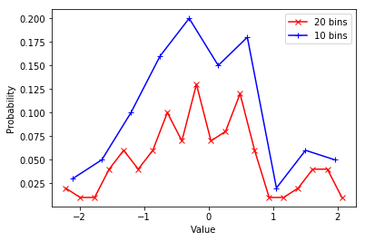
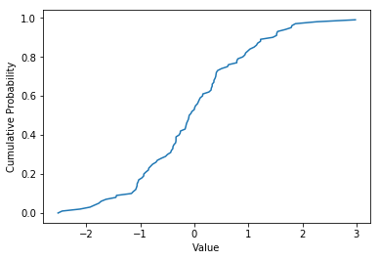
PMF vs CDF
PMF vs CDF for a random array of 100 normally distributed numbers
plot(bin_center20, counts20[0]/sum(counts20[0]), 'r-x',
bin_center10, counts10[0]/sum(counts10[0]), 'b-+')
plot(sort(a), arange(len(a))/len(a))

Slide 23
Probability Density Function (PDF) and continuous distribution
For continuous distribution, no PMF.
Instead, probability density function (PDF) is available.
PDF is the derivative of CDF
Integral of PDF = 1.0

Slide 24
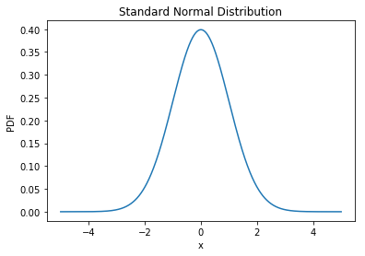
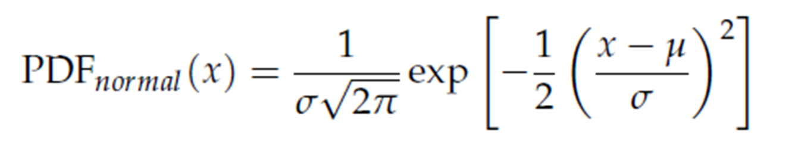
Standard normal pdf
In [1331]: x = np.linspace(-5,5,10**3)
In [1332]: y = norm.pdf(x, 0, 1)
In [1335]: plot(x, y); xlabel('x'); ylabel('PDF'); title('Standard Normal Distribution')
In [1337]: normpdf(0, 0, 1)
Out[1337]: 0.3989422804014327
What does this mean?

Slide 25

Standard normal distribution

Slide 26
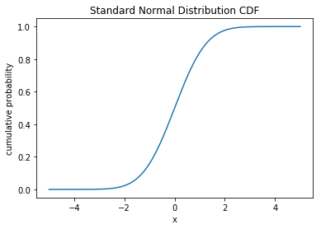
Standard normal distribution CDF
In [1351]: plot(x, norm.cdf(x)); xlabel('x'); ylabel('cumulative probability'); title('Standard Normal Distribution CDF')
In [1353]: norm.cdf(0.5)-norm.cdf(-0.5)
Out[1353]: 0.38292492254802624
In [1356]: 2*(0.5-norm.cdf(-0.5))
Out[1356]: 0.38292492254802624
In [1357]: 2*(norm.cdf(0)-norm.cdf(-0.5))
Out[1357]: 0.38292492254802624

Slide 27
Standard normal distribution CDF
In [1353]: norm.cdf(1.96) - norm.cdf(-1.96)
Out[1353]: 0.95000420970355903
In [1380]: 1-2*norm.cdf(-1.96)
Out[1380]: 0.95000420970355914
“95% confidence interval”

Slide 28
Properties of normal distribution
If the distribution of a random variable X is normal with mean μ and standard deviation σ, we usually write: X ∼ N(μ, σ²)
A linear transformation of X results in X’ = aX + b, then
X’ ∼ N(aμ+b, a ² σ²)
If X ∼ N(μ_{X}, σ_{X}²) and Y ∼ N(μ_{Y}, σ_{Y}²), then
Z = X + Y ∼ N(μ_{X} + μ_{Y}, σ_{X}² + σ_{Y}²)
If X ∼ N(μ, σ²),
Then Z = (X- μ)/ σ ∼ N(0, 1)
This is called Z-transformation or standardization. The transformed value is often called Z-score or standard score.

Slide 29
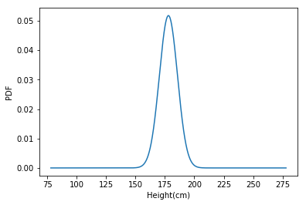
Normal distribution
The US National Center for Chronic Disease Prevention and Health Promotion surveyed >400,000 individuals for health-related info (BRFSS – Behavioral Risk Factor Surveillance System)
http://thinkstats. com/brfss.py
The distribution is roughly normal with parameter μ = 178cm and σ²=59.4cm²
σ=sqrt(59.4) = 7.707cm
What percentage of US male population is between 5’10” and 6’1”?
5’10” = 177.8cm; 6’1” = 185.4cm
N(178, 59.4)

Slide 30
Normal distribution – cont’d
Height distribution is in X ∼ N(178, 59.4)
P(177.8 ≤ X ≤ 185.4) = ?
X’ = (X – 178) / 7.707 ∼ N(0, 1)
(185.4 – 178) / 7.707 = 0.96
(177.8-178)/7.707 = -0.03
In [1374]: norm.cdf(185.4,178,7.707)-norm.cdf(177.8, 178, 7.707)
Out[1374]: 0.34186118517420605
In [1375]: norm.cdf(0.96) - norm.cdf(-0.03)
Out[1375]: 0.34343886594727485

Slide 31
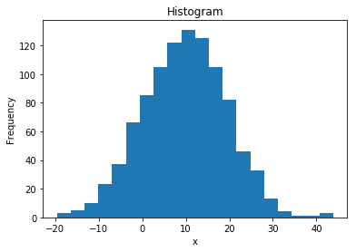
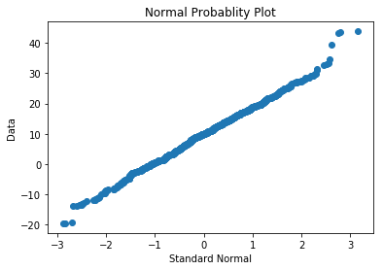
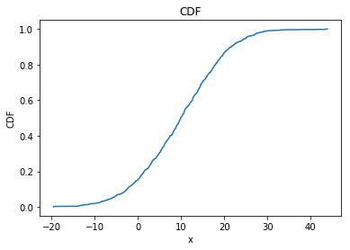
Normal probability plot
x = 10*numpy.random.randn(1000)+10

Slide 32
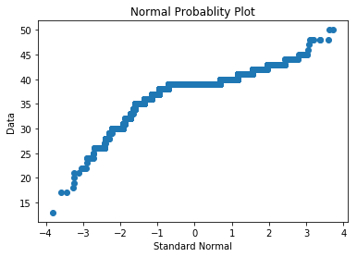
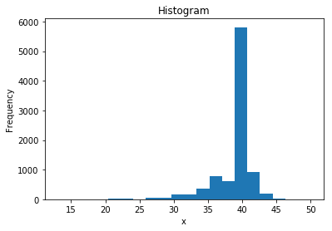
Probability distribution of pregnancy length

Slide 33
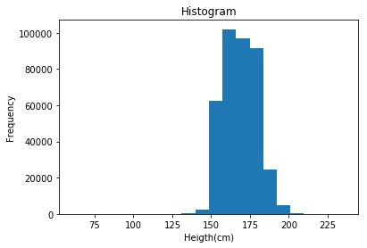
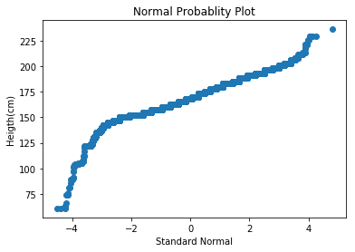
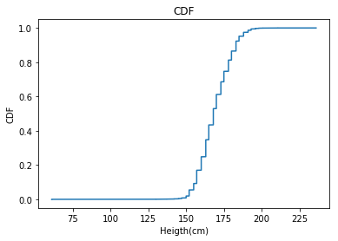
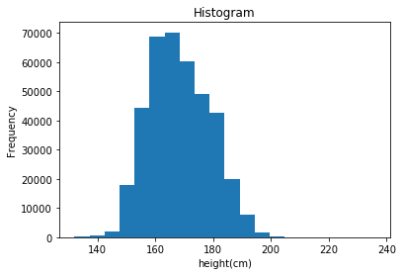
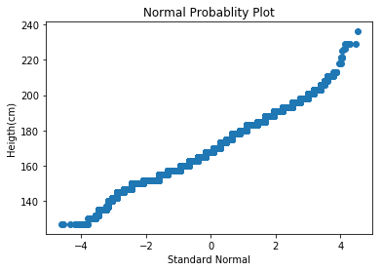
Probability distribution for BRFSS height data
Discarded height < 130

Slide 34
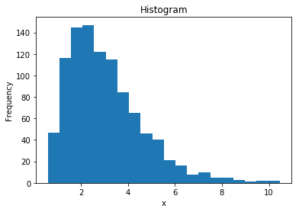
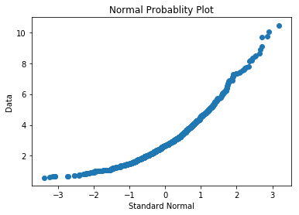
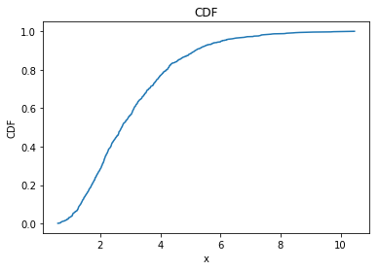
Normal probability plot for right skewed data
x = numpy.random.lognormal(mean=1, sigma=0.5, size=1000)

Slide 35
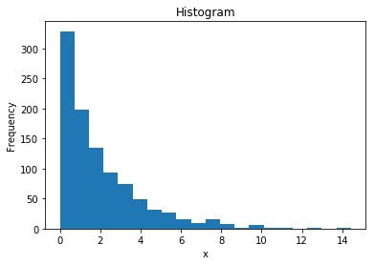
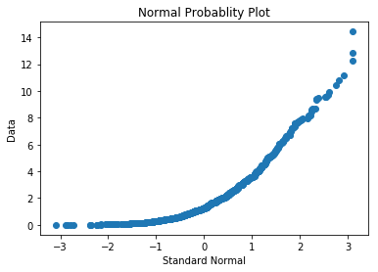
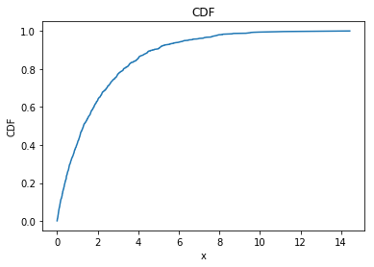
Normal probability plot for another right skewed data
x = numpy.random.exponential(scale=10,size=1000)

Slide 36
Why model
Data compression – a small set of parameters may be sufficient to summarize a large data set
Sometimes can smooth out noises
When data from a natural phenomenon fit a distribution, it can lead to insight into the physical system which can explain why the observed data has a particular form
Other commonly seen distributions:
Lognormal
Exponential
Pareto

Slide 37
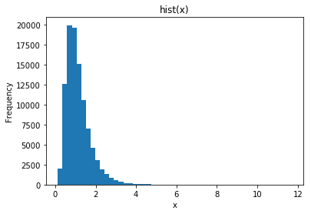
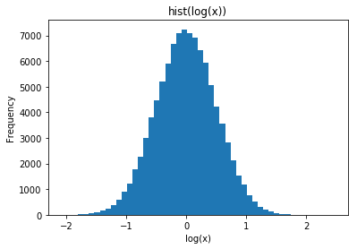
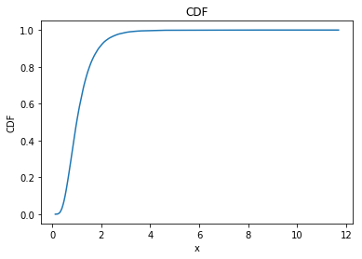
Log normal distribution
Log(x) is normally distributed.
In [1431]: x=lognormal(0, 0.5, 10**5);
In [1432]: hist(x, 50)

Slide 38
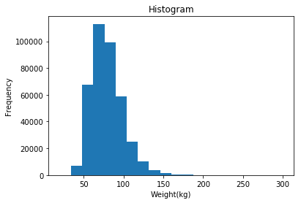
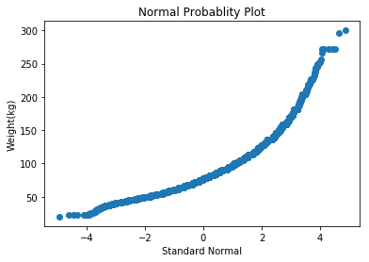
Probability distribution for BRFSS weight data

Slide 39


Probability distribution for BRFSS weight data after log transformation
In [376]: corrcoef(weight, height)[0][1]
Out[376]: 0.5110289460952534
In [377]: corrcoef(log(weight), height)[0][1]
Out[377]: 0.53405888354314057

Slide 40


Correlation between height and weight
In [376]: corrcoef(weight, height)[0][1]
Out[376]: 0.5110289460952534
In [377]: corrcoef(log(weight), height)[0][1]
Out[377]: 0.53405888354314057

Slide 41


Log normal distribution with different parameters
https://en.wikipedia.org/wiki/Log-normal_distribution

Slide 42


Exponential distribution
PDF: λ e^{−λx}
CDF: 1 − e^{−λx}
the time between events in a Poisson process,

Slide 43



Exponential distribution - 2
Often used to measure time between events – interarrival times.
arrivalTime = unique( (rand(1000) * 10**5).round());
x = diff(arrivalTime);

Slide 44


Exponential distribution CCDF
CCDF = 1 – CDF = e^{−λx}

Slide 45




Pareto distribution
PDF:
CDF:

Slide 46





Simulated data in Pareto distribution
CCDF = 1 – CDF =
d=[random.paretovariate(2.5) for i in range(10**5)]

Slide 47
Pareto distribution - 2
Occur in nature
E.g. size of cities. Distribution of wealth
Related to power-law function and scale-freeness
Data: population of every incorporated city and town in the US
In [446]: len(pops)
Out[446]: 14593
In [447]: max(pops)
Out[447]: 8008654
In [448]: min(pops)
Out[448]: 1
In [449]: median(pops)
Out[449]: 1276.0
In [450]: mean(pops)
Out[450]: 11116.203316658672
http://thinkstats.com/populations.py

Slide 48



Distribution of populations in US cities

Slide 49


Distribution of populations in US cities - 2
Lognormal actually fits better

Slide 50



Degree distribution of a network
It was believed that the degree is power-law (pareto), P(k) ∼ k^{-α}
Obtained a protein-protein interaction network in yeast (~2700 nodes) and calculated degree.
Pareto
Exponential

Slide 51
Why model
Data compression – a small set of parameters may be sufficient to summarize a large data set
Sometimes can smooth out noises
When data from a natural phenomenon fit a distribution, it can lead to insight into the physical system which can explain why the observed data has a particular form
Many machine learning methods assume certain data distribution. It is important to investigate the actual data distribution.
It is often difficult to fit an exact model.
Make reasonable approximations
Try different transformation and cleaning

Slide 52
Useful python packages / modules
Module random in standard python lib
Seed()
Shuffle(), sample(), choice()
Uniform distribution: random(), randrange(), randint(),
Generate random numbers from other popular distributions:
Exponential distribution: expovariate()
Normal distribution: normalvariate(), gauss()
Log normal distribution: lognormvariate()
Pareto distribution: paretovariate()
https://docs.python.org/3/library/random.html

Slide 53
Useful python packages / modules - 2
numpy.random
Uniform distribution:
rand(d0, d1, …) generates array of random numbers
randint(low, high, shape)
Normal distribution: randn(d0, d1, …)
binomial(n, p, size)
lognormal(mean, sigma, size)
…
numpy.corrcoef()
https://docs.scipy.org/doc/numpy-1.13.0/reference/routines.random.html

Slide 54

Useful python packages / modules - 3
scipy.stats
scipy.stats.norm
scipy.stats.binom
scipy.stats.expon
scipy.stats.ttest_1samp
scipy.stats.ttest_ind
>>> norm.cdf([-1., 0, 1])
array([ 0.15865525, 0.5, 0.84134475])
>>> import numpy as np
>>> norm.cdf(np.array([-1., 0, 1]))
array([ 0.15865525, 0.5, 0.84134475])
https://docs.scipy.org/doc/scipy/reference/tutorial/stats.html

