Slide 1
CS 3753 & 5163 Introduction to Data Science
Part 2: Plotting, basic statistics

Slide 2
2.1 Basic plotting functions
Matplotlib basics
Line chart
Bar chart
Scatter plot
Colors, markers, line styles
Ticks, titles, axis labels, legends, annotations
Saving plots

Slide 3
2.2 Basic statistics and more plots
Basic stats: Mean, median, range, standard deviation, correlation
Histogram
Error Bar
Boxplot
Imshow
Subplots
T-test and other statistical testing

Slide 4
Summary statistics of a single data set
Information (numbers) that give a quick and simple description of the data
Maximum value
Minimum value
Range (dispersion): max – min
Mean
Median
Mode
Quantile
Standard deviation
Etc.

Slide 5

Mean vs average vs median vs mode
(Arithmetic) Mean: the “average” value of the data
Average: can be ambiguous
The average household income in this community is $60,000
The average (mean) income for households in this community is $60,000
The income for an average household in this community is $60,000
What if most households are earning below $30,000 but one household is earning $1M
Median: the “middlest” value, or mean of the two middle values
Can be obtained by sorting the data first
More efficient algorithm (~linear time) exists
Does not depend on all values in the data.
More robust to outliers
Mode: the most-common value in the data
def mean(a): return sum(a) / float(len(a))
def mean(a): return reduce(lambda x, y: x+y, a) / float(len(a))
Quantile: a generalization of median. E.g. 75 percentile is the value which 75% of values are less than or equal to

Slide 6

Variance and standard deviation
Describes the spread of the data from the mean
Is the mean squared of the deviation
Standard deviation (square root of the variance): σ
Easier to understand than variance
Has the same unit as the measurement
Say the data measures height of people in inch, the unit of σ is also inch. The unit for σ² is square inch …
Corrected estimation of population standard deviation from sample
If standard deviation is estimated from sample, most likely it is an underestimate.
Can be corrected by replacing n in the above formula with n-1.
Default for many implementations
For bigger data set, effect is very small

Slide 7
Corrected estimation of population standard deviation from sample
If standard deviation is estimated from sample, most likely it is an underestimate.
Can be corrected by replacing n in the above formula with n-1.
Default for many implementations
For bigger data set, effect is very small
def var(a):
m = mean(a)
dev = [(x - m)**2 for x in a]
return mean(dev)
def std(a, correction=False):
if (not correction):
return var(a)**0.5
else:
n = len(a)
return (var(a) * n / float(n-1))**0.5

Slide 8
Population vs sample
Population: all members of a group in a study
The average height of men
The average height of living male ≥ 18yr in USA between 2001 and 2010
The average height of all male students ≥ 18yr registered in Fall’17
Sample: a subset of the members in the population
Most studies choose to sample the population due to cost/time or other factors
Each sample is only one of many possible subsets of the population
May or may not be representative of the whole population
Sample size and sampling procedure is important

Slide 9
Simulation of population/sample standard deviation
Generated an array of 1 million random numbers
Computed the population standard deviation
Randomly draw k data points from the data, compute uncorrected and corrected standard deviation. Repeat 1000 times. Compute the average.

Slide 10
Spyder Setup regarding --pylab
In spyder, select “Tools =>Preferences=>Ipython console=>Graphics”, make sure “automatically load Pylab and NumPy modules” are unchecked
This is the default in spyder 4
Need to restart kernel or start a new console after the change
“auto load” enables shortcut commands to common functions in matplotlib and numpy to be imported automatically. (MATLAB-like. Good – convenience. Bad - lose portability; a little confusing sometimes.)
E.g. plot functions, random number generator
To test whether --pylab has been set:
Without --pylab:
plot(rand(10))
import numpy as np
import matplotlib.pyplot as plt
plt.plot(np.random.rand(10))

Slide 11
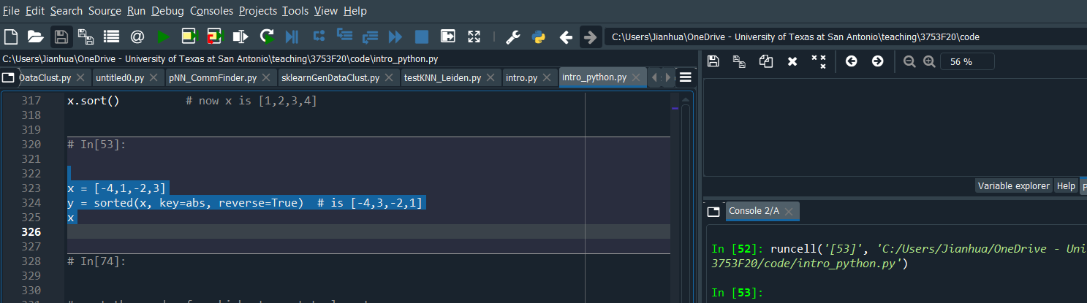
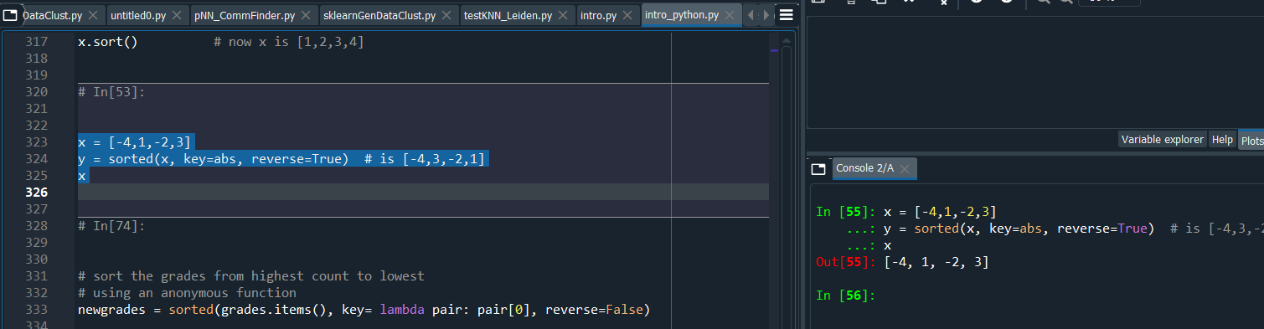
Spyder setup to display result of last line in cell
In Spyder 4, by default, result of the last line is not shown.
Tools > Preferences > Editor > Run Code, check “Copy full cell contents to the console when running code cells”

Slide 12
Inline vs automatic graphics backend
In spyder, select “Tools =>Preferences=>Ipython console=>Graphics”
Default is graphics backend is inline. This is I will be using.
Optionally, can also change “Graphics backend” from Inline to Automatic for more interactive plotting (but lose the ability to copy figure to clipboard)
Useful in experimenting different options of plotting
In inline mode, plt.show() outputs the current plot. Any further plotting instructions will not affect the figure that has already been displayed.
In automatic mode, all instructions will be applied to the current figure, until you create a new figure or switch to another existing figure (useful to work on multiple figures in parallel).
Need to restart kernel or start a new console after the change

Slide 13
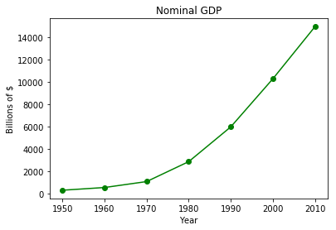
import matplotlib.pyplot as plt
years = list(range(1950, 2011, 10))
gdp = [300.2, 543.3, 1075.9, 2862.5, 5979.6, 10289.7, 14958.3]
# create a line chart, years on x-axis, gdp on y-axis
plt.plot(years, gdp, color='green', marker='o', linestyle='solid')
# add a title
plt.title("Nominal GDP")
# add a label to the y-axis
plt.ylabel("Billions of $")
# add a label to the x-axis
plt.xlabel("Year")
plt.show()
Line graph.
Good for showing trend.
Type plt.plot? to see more options, such as different marker and line styles, colors, etc.

Slide 14
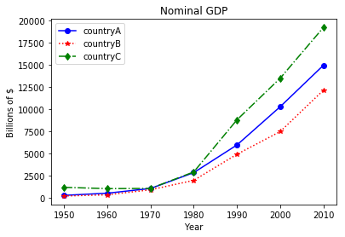
import matplotlib.pyplot as plt
years = list(range(1950, 2011, 10))
gdp1 = [300.2, 543.3, 1075.9, 2862.5, 5979.6, 10289.7, 14958.3]
gdp2 = [226.0, 362.0, 928.0, 1992.0, 4931.0, 7488.0, 12147.0]
gdp3 = [1206.0, 1057.0, 1081.0, 2940.0, 8813.0, 13502.0, 19218.0]
# create a line chart, years on x-axis, gdp on y-axis
# use format string to specify color, marker, and line style
# e.g. ‘bo-’: color=‘blue’, marker=‘o’, linestyle=‘solid’
plt.plot(years, gdp1, ‘bo-', years, gdp2, ‘r*:', years, gdp3, ‘gd-.')
# add a title
plt.title("Nominal GDP")
# add a label to the y-axis
plt.ylabel("Billions of $")
# add a label to the x-axis
plt.xlabel("Year")
# add legend
plt.legend([‘countryA', ‘countryB', ‘countryC'])
plt.show()

Slide 15
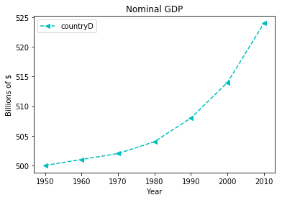
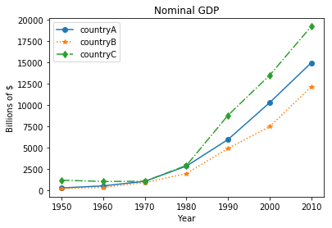
Caveat in making/interpreting line graphs
1. How does the growth rate of Country D compare with other countries?
2. How does the growth rate of the four countries during the period from 1950 to 1970?

Slide 16
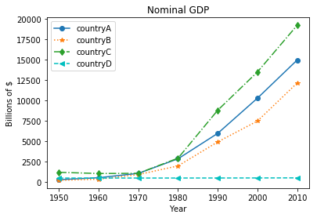
Caveat in making/interpreting line graphs
plt.plot(years, gdp1, ‘bo-', years, gdp2, ‘r*:', years, gdp3, ‘gd-.')
plt.plot(years, gdp4, 'c<--')
plt.legend(['countryA', 'countryB', 'countryC', 'countryD'])
How does the growth rate of Country D compare with other countries?
Country D has a much lower growth rate.
2. How does the growth rate of the four countries during the period from 1950 to 1970?

Slide 17
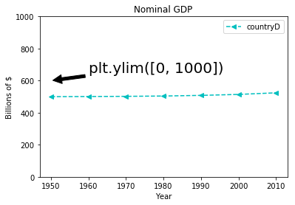
Caveat in making/interpreting line graphs
How does the growth rate of Country D compare with other countries?
Country D has a much lower growth rate.
2. How does the growth rate of the four countries during the period from 1950 to 1970?

Slide 18
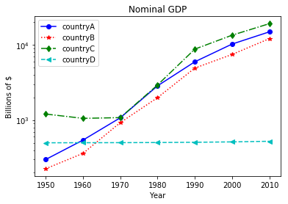
Plotting in logarithm scale
Available functions: semilogx, semilogy, loglog
Logarithm scale plotting is often preferred to visualize changes over time.
plt.semilogy(years, gdp1, 'bo-',
years, gdp2, 'r*:',
years, gdp3, 'gd-.',
years, gdp4, 'c--<')
# add a title
plt.title("Nominal GDP")
# add a label to the y-axis
plt.ylabel("Billions of $")
# add a label to the x-axis
plt.xlabel("Year")
# add legend
plt.legend(['countryA', 'countryB', 'countryC', 'countryD'])
plt.show()

Slide 19
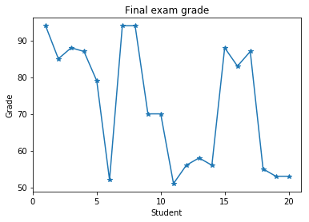
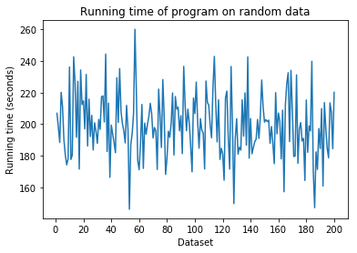
Poor usage of line graph
Line graphs are useful to display trend
plot(range(1,21), grades)
plot(range(1,201), seconds)
X – absolutely no!
X – absolutely no!

Slide 20
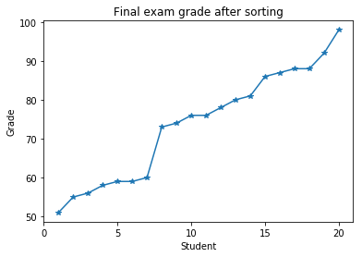
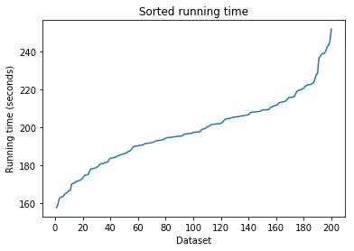
Better usage of line graph
Line graphs are useful to display trend
OK – can be improved
OK – can be improved

Slide 21
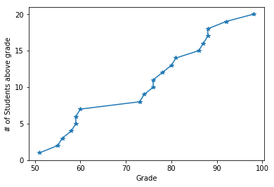
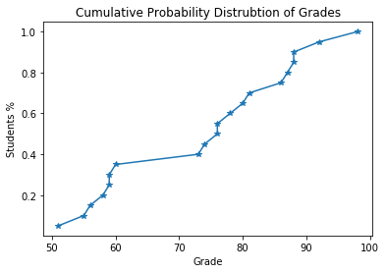
Cumulative probability distribution (CDF)

Slide 22
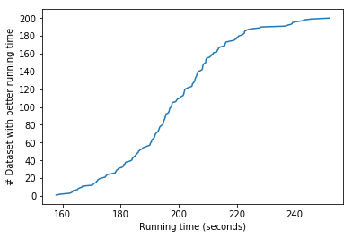
Cumulative probability distribution

Slide 23
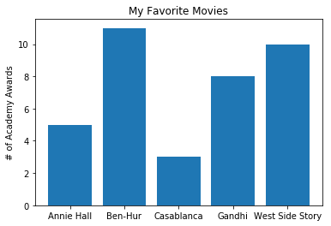
Bar charts
Good for presenting/comparing numbers in discrete set of items
movies = ["Annie Hall", "Ben-Hur", "Casablanca", "Gandhi", "West Side Story"]
num_oscars = [5, 11, 3, 8, 10]
xs = range(len(movies)) # xs is range(5)
# plot bars with left x-coordinates [xs], # heights [num_oscars]
plt.bar(xs, num_oscars)
# label x-axis with movie names at bar centers
plt.xticks(xs, movies)
# alternatively, use the following to replace # the two lines above
#plt.bar(xs, num_oscars, tick_label=movies)
plt.ylabel("# of Academy Awards")
plt.title("My Favorite Movies")
plt.show()

Slide 24
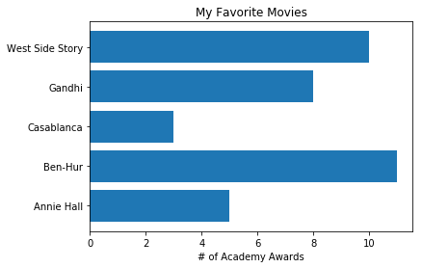
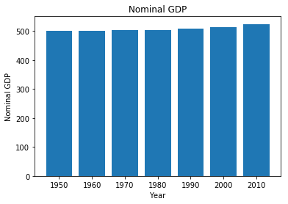
Barh vs bar
plt.barh(xs, num_oscars, tick_label=movies)
plt.xlabel("# of Academy Awards")
plt.title("My Favorite Movies")
By default, the y-axis in a bar chart (or x-axis in barh) starts from 0, in contrast to a line chart.

Slide 25
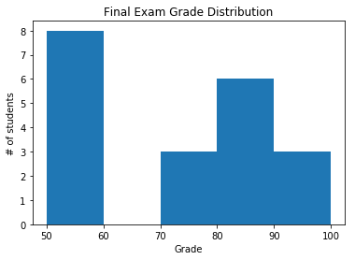
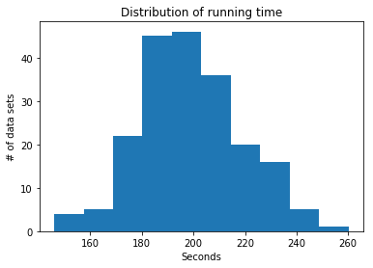
More examples of bar chart
These are also called histograms (more later)
More advanced bar charts (bar charts with multiple groups, etc.) will be discussed later in pandas.

Slide 26
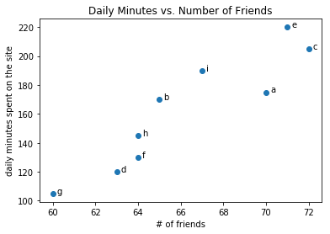
Scatterplots
Good for visualizing the relationship between two paired sets of data
friends = [ 70, 65, 72, 63, 71, 64, 60, 64, 67]
minutes = [175, 170, 205, 120, 220, 130, 105, 145, 190]
labels = ['a', 'b', 'c', 'd', 'e', 'f', 'g', 'h', 'i']
plt.scatter(friends, minutes)
# label each point
for i in range(len(friends)):
plt.annotate(labels[i], xy=(friends[i], minutes[i]),
xytext=(5, 0), textcoords='offset points')
plt.title("Daily Minutes vs. Number of Friends")
plt.xlabel("# of friends")
plt.ylabel("daily minutes spent on the site")

Slide 27
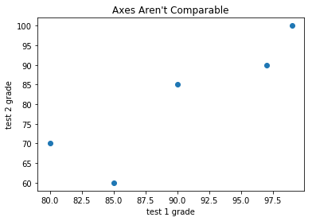
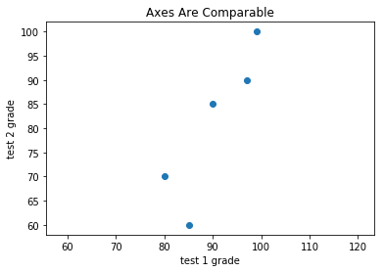
Similar to line plot, the axes of scatter plot can auto scale.
Can be set with xlim([xlow, xhigh]) or ylim([ylow, yhigh]) or axis([xlow, xhigh, ylow, yhigh])
Or force equal range with axis(‘equal’)
plt.scatter(test_1_grades, test_2_grades)
plt.axis("equal")
plt.scatter(test_1_grades, test_2_grades)

Slide 28
Other useful functions
Create figures with numbers
E.g. plt.figure(1), plt.figure(2), etc, to specify which figure to plot on
Useful when dealing with multiple figures at the same time
plt.xticks()
plt.yticks()
plt.savefig()
Type in plt.savefig? for usage or search matplotlib documentation for more details
https://matplotlib.org/users/pyplot_tutorial.html
https://matplotlib.org/api/pyplot_summary.html

