Slide 1
A DBTL-based Bioinformatics Pipeline for Comparative
Metabolic Pathway Annotation in Microalgae
Dunaliella salina vs Nannochloropsis gaditana
José Campos
University of Minho · School of Engineering
Supervisor: Óscar Dias
2026

Slide 2
Context and Motivation
Dunaliella salina FACHB435
Nannochloropsis gaditana B-31
Halotolerant green microalga
β-carotene > 10% dry weight under salt stress
No cell wall → easier extraction
~17,000 proteins (Chen et al., 2024)
Marine eustigmatophyte
High EPA (omega-3) — up to 38% of lipids
Target for biofuels and nutraceuticals
~10,929 proteins (strain B-31)
Problem: Annotations are fragmented across heterogeneous databases (NCBI, KEGG, UniProt), produced with different tools and without a shared benchmark. GEM approaches require extensive manual curation. No automated, reproducible pipeline exists for cross-species comparison.
2

Slide 3
DBTL Framework
DESIGN
BUILD
Tool survey (≥ 6)
Species selection
Target pathways
Architecture
Snakemake workflow
KofamScan (KO)
DIAMOND
reCOGnyzer
LEARN
TEST
Sensitivity / F1
Swiss-Prot standard
Validation vs Cunha
Cross-species
Pathway gaps
Coverage analysis
Shared genes
Recommendations
Adapted from Carbonell et al. (2018)
3

Slide 4
SMART Objectives
1
Tool survey
Evaluate ≥ 6 annotation and pathway-prediction tools. Build a comparison matrix: scope, I/O, licence, API, containerisation.
2
Reproducible pipeline
Integrate two tools (KofamScan + DIAMOND) into a Snakemake workflow. Deposit in a public GitHub repository.
3
Comparative annotation
Compare the metabolic repertoires of both species, focusing on carotenoids (ko00906) and omega-3 (ko01040).
4
Benchmarking
Assess accuracy with sensitivity, specificity and F1 vs a Swiss-Prot gold standard. Validate against Cunha et al. (2025).
4

Slide 5
Pipeline Architecture
Protein
FASTAs
KofamScan
(KO numbers)
KEGG
Pathway coverage
DIAMOND
vs Swiss-Prot
Benchmarking
Orchestrated by Snakemake · Two annotation tools · Public GitHub repository
16,697
10,929
3,366
3,199
397
proteins
D. salina
proteins
N. gaditana
KOs
D. salina
KOs
N. gaditana
KEGG pathways
5

Slide 6
Tool Comparison
Tool | DBTL Phase | Function | Open-source
KofamScan | Design/Build | KO assignment (HMM) | Yes
DIAMOND | Test | Homology vs Swiss-Prot | Yes
reCOGnyzer | Build | COG annotation | Yes
KEGGCharter | Test/Learn | Pathway maps | Yes
Snakemake | Build | Workflow management | Yes
Two annotation tools (KofamScan + DIAMOND) integrated into the Snakemake workflow.
6

Slide 7
Results: Functional Annotation
KofamScan — KO assignment
D. salina: 3,366 KOs (20.2% of 16,697 proteins)
N. gaditana: 3,199 KOs (29.3% of 10,929 proteins)
DIAMOND vs Swiss-Prot — homology annotation
D. salina: 42.2% annotated
N. gaditana: 51.8% annotated
Cross-species comparison
1,709
907
823
Shared KOs
D. salina only
N. gaditana only
7

Slide 8
Results: KEGG Pathway Coverage
Coverage | D. salina | N. gaditana
Complete (≥ 50%) | 11 | 8
Partial (10–49%) | 198 | 187
Absent (< 10%) | 188 | 202
Total evaluated | 397 | 397
Target pathways
Carotenoids (ko00906): Partial
Omega-3 (ko01040): Partial
Glycolysis (ko00010): Complete
Partial coverage is biologically expected: the KEGG reference KO sets include genes from bacteria, plants and fungi that microalgae do not possess.
8

Slide 9
Results: Desaturase Validation
Validated against Cunha et al. (2025) — PUFA / omega-3 enzymes
KO | Enzyme | D. salina | N. gaditana
K00507 | Δ9-desaturase | present | present
K10255 | ω6-desaturase | present | present
K10257 | ω3-desaturase | present | absent
K12418 | Δ4-desaturase | present | absent
Key finding: D. salina has the complete desaturase set. The gaps in N. gaditana B-31 are confirmed present in strain CCMP1894 — a strain annotation limitation, not a true biological absence.
9

Slide 10
Results: Benchmarking
Gold standard: Swiss-Prot hits with ≥ 30% identity and ≥ 50% coverage
Metric | D. salina | N. gaditana
Sensitivity | 0.53 | 0.61
Specificity | 0.93 | 0.88
Precision | 0.72 | 0.70
F1 score | 0.61 | 0.65
Complementary profiles: N. gaditana shows higher sensitivity and F1, while D. salina has higher specificity and precision — both annotators perform comparably, with strengths in different metrics..
Values are placeholders — replace with the final notebook output.
10

Slide 11
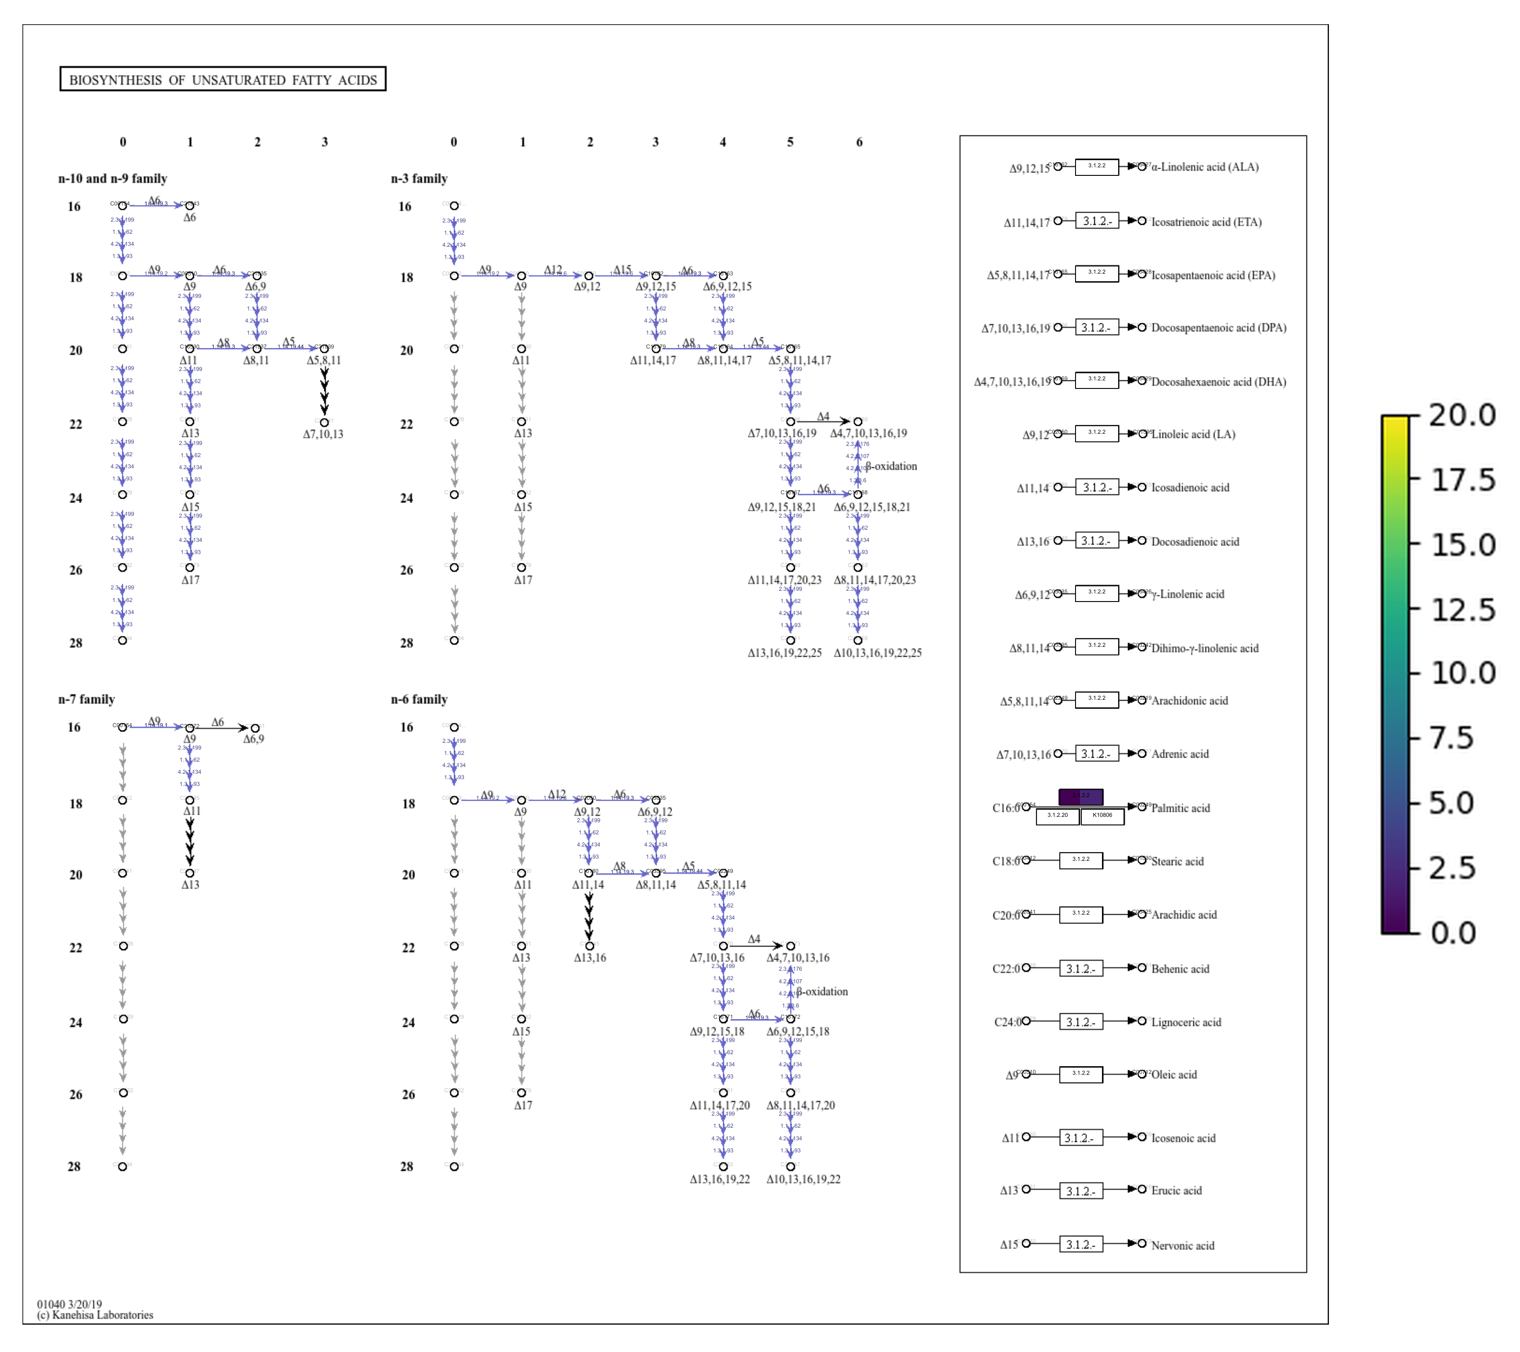
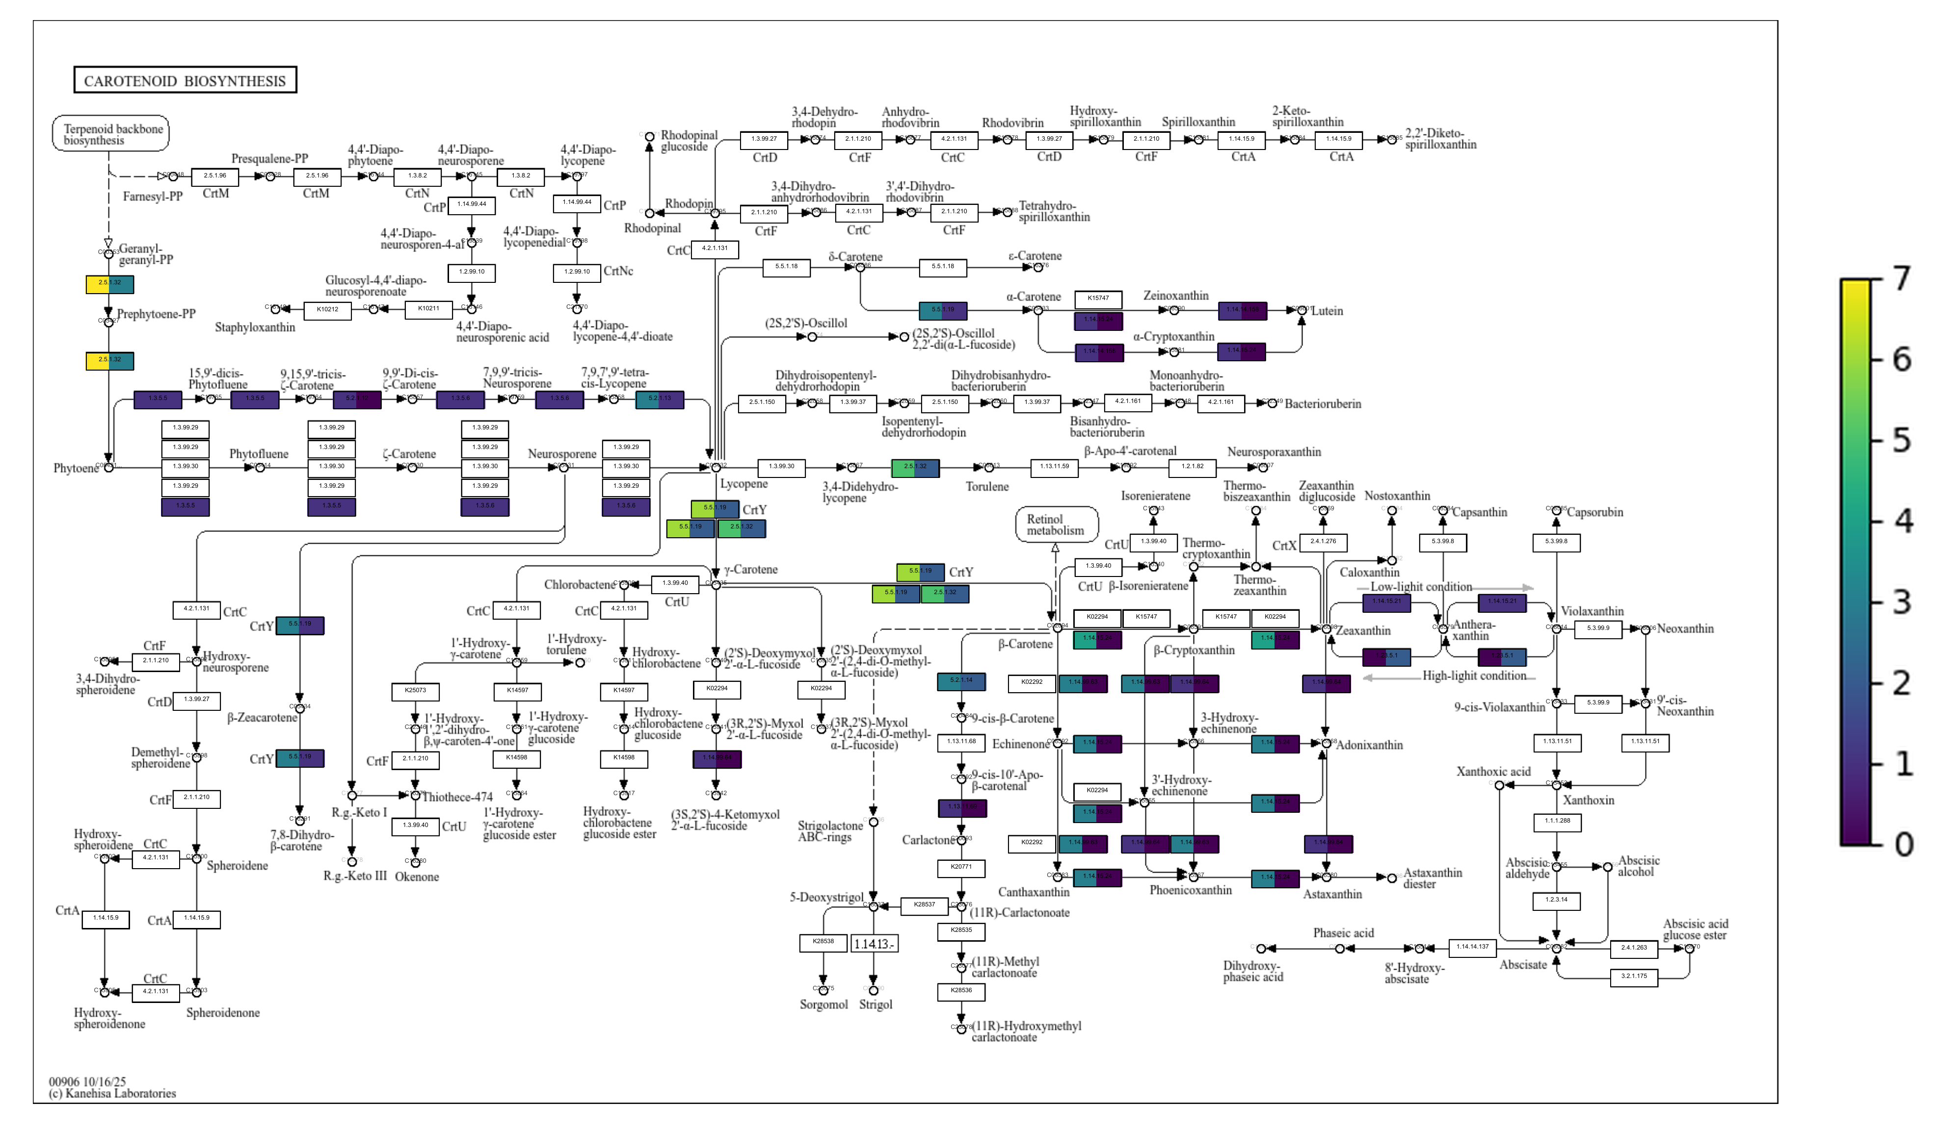
Results: Pathway Maps (KEGGCharter)
Comparison: differential Biosynthesis of unsaturated fatty acids
Comparison: differential Carotenoid biosynthesis
11

Slide 12
Conclusions and Future Work
Key conclusions
Reproducible, open-source pipeline built in Snakemake
D. salina has a complete PUFA desaturase set; N. gaditana B-31 shows strain-level gaps
Partial coverage of carotenoid and omega-3 pathways is biologically expected
Results validated against Cunha et al. (2025)
Future work
Use strain CCMP1894 for N. gaditana
Add transcriptomics and Docker containerisation
12

