Slide 1

Ru23 project one
Crystal Burkhardt
Elias Hagos
Jose Eneas da Silva Maria
Darrell Reives

Slide 2
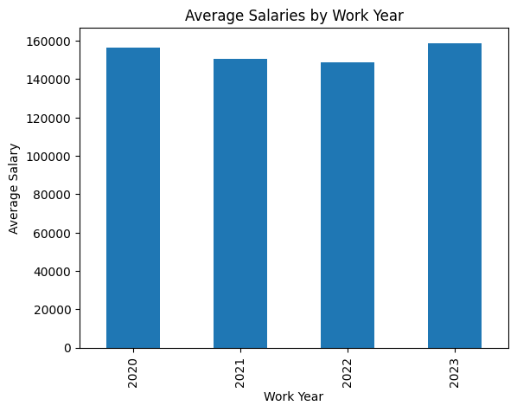
RU23 – Project One – Group 4 - Results
Question: Based on the available data, what is the average salaries per year for Data Science Professionals?
We selected information from companies and workers located in the USA only.
The national average is around 61K/year
There are variations from year to year, but we can speculate that this could be caused by the Pandemic and its effects.
(JE)

Slide 3
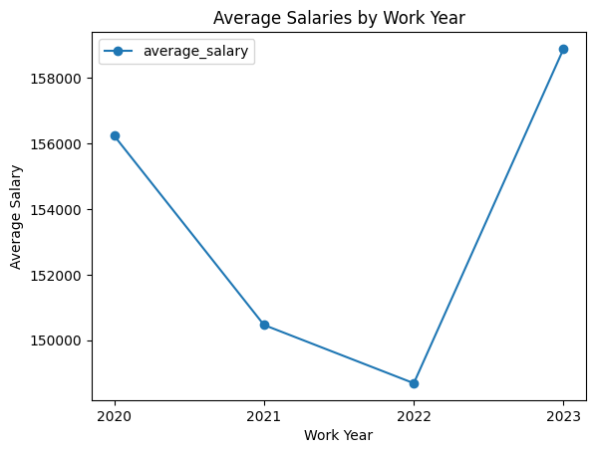
RU23 – Project One – Group 4 - Results
Question: What happens if we present the same information in a different format?
It seems that in 2022 salaries suffered a major impact and decreased substantially, but is it?
Different graph formats may at first convey different messages, even with the same data.
The major difference between the two formats is the Y axis granularity.
As with the bar graph, the average salary across this 4-year time span did not fluctuate very much, ranging from $145,000-$160,000. However, during the height of the COVID-19 pandemic, the average salary took a sharp decline in 2021 to 2022 and began to rise again this year.
(JE)

Slide 4
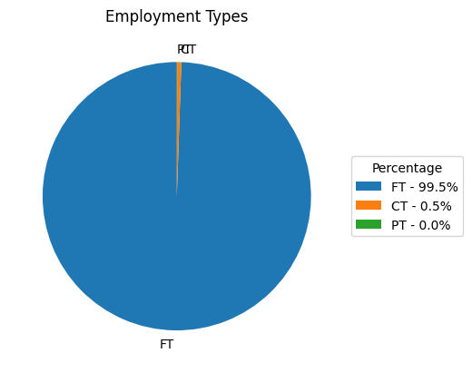
RU23 – Project One – Group 4 - Results
Question: What is the distribution of the different types of employment
Based on the provided sample, most people who work in the Data Science and Analysis fields are employed full-time (99.5%). Contract work is reported as slightly higher than part-time work. Sample Size Limitation: The analysis is based on a relatively small sample size of 2,218 data scientists & analysts which may limit the generalizability of the findings to a larger population.
(EH)

Slide 5
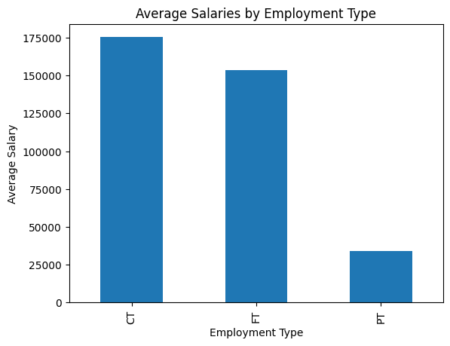
RU23 – Project One – Group 4 - Results
Question: What is the average salary of the different types of employment
Now instead of FT, we see that CT is higher and there is an explanation for that: as CT usually doesn’t include much benefits in the package, they tend to pay more, so that the employee covers alone for things like health insurance.
(EH)

Slide 6
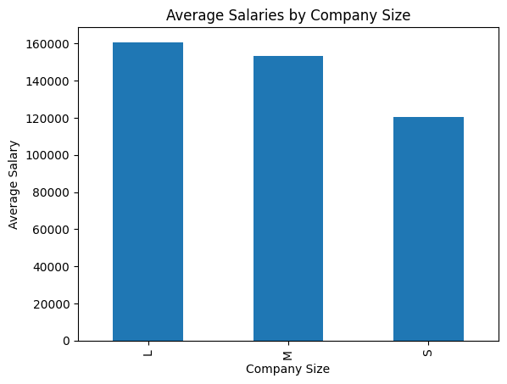
RU23 – Project One – Group 4 - Results
Question: Does the size of the company matter?
Data confirms that in average bigger companies pay more.
(DR)

Slide 7
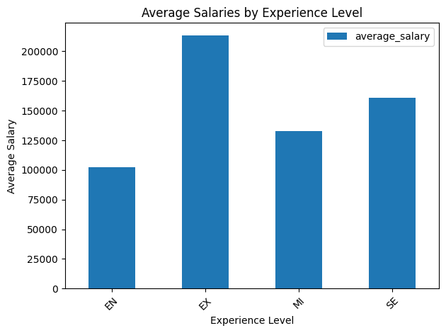
RU23 – Project One – Group 4 - Results
Question: Does the average salary varies according to the experience level ?
Data confirms that yes salary varies according to the experience level, and it is interesting to observe that even for the entry level the average salary is higher than the national average.
(DR)

Slide 8
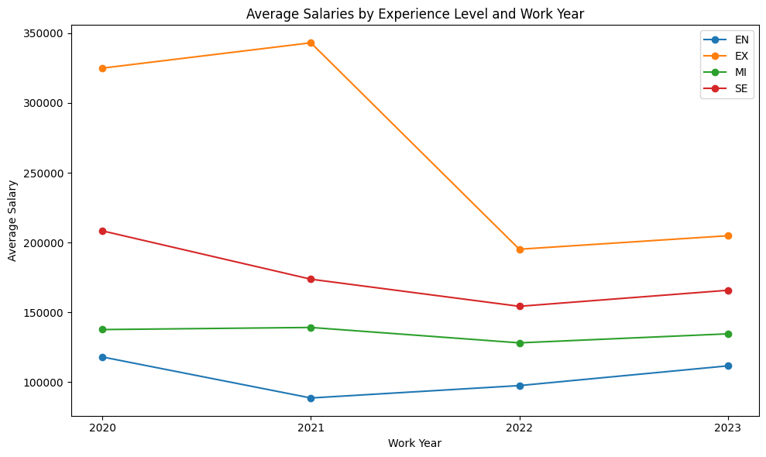
RU23 – Project One – Group 4 - Results
Question: How did the average salary varies thru the years for each experience level?
The variation per experience level and year is consistent with the overall salary average.
There is a substantial decrease in the experienced segment and that could be explained by “the higher they make, easier would be to support the impact”
(DR)

Slide 9
RU23 – Project One – Group 4 - Results
General Comments
Average salary across this 4-year time span did not fluctuate very much, ranging from $145,000-$160,000. However, during the height of the COVID-19 pandemic, the average salary took a sharp decline in 2021 to 2022 and began to rise again this year.
Data analysis limitations and Assumptions
Time Limitation: The analysis is based on data collected at the start of the pandemic up until 2023. Therefore, the findings may not capture potential changes or trends occurring outside of that time frame, limiting the temporal generalizability.
Sample Size Limitation: The analysis is limited by the small sample size, which may affect the generalizability of the findings to a larger population.
Data Quality Limitation: The analysis is dependent on the accuracy and reliability of the data collected. Inaccurate or incomplete data may lead to biased or misleading results.
Data Collection Bias: The data used in the analysis may suffer from selection bias, where certain groups or characteristics are over- or underrepresented, leading to potential distortions in the findings.
(CB)

Slide 10
RU23 – Project One – Group 4 - Results
Data analysis limitations and Assumptions
Assumption Violation: The analysis relies on certain assumptions, such as normal distribution or independence of observations, which may not hold true in the given dataset. Violations of these assumptions can affect the validity of the results.
Missing Data: The presence of missing data in the dataset may introduce bias or reduce the representativeness of the analysis. The method used to handle missing data can also impact the results.
Causality Inference: The analysis may identify associations or correlations between variables, but it cannot establish causal relationships due to the observational nature of the data. Additional experimental or quasi-experimental designs would be needed for causal inference.
Confounding Variables: The analysis may not account for all potential confounding variables, which could lead to spurious relationships or biased estimates. Unmeasured or uncontrolled factors may influence the observed associations.
Scope Limitation: The analysis focuses on a specific aspect or subset of the data, potentially neglecting other relevant factors or dimensions that could impact the overall understanding of the phenomenon.
Methodological Constraints: The analysis is subject to the limitations of the chosen statistical techniques, algorithms, or models. These limitations could include assumptions made, simplifications used, or constraints on the complexity of the analysis.
It is important to recognize these limitations when interpreting the results of a data analysis and to be cautious about the conclusions drawn from the findings.
(CB)

