Slide 1
Data Cleaning Process
Tools Used to Clean the Data:
Python
Pandas
Jupyter Notebook

Slide 2
1950-2013 Data Diagram
Data Cleaning Pipeline
Merged different tables to get all the data’s required
Dropped unnecessary columns using the .drop function
Cleaned
Dataframe
Cleaned
.CSV
.CSV Source file
Python
Panda
Dataframe
Sorted the data by year
Decoded the foreign names

Slide 3
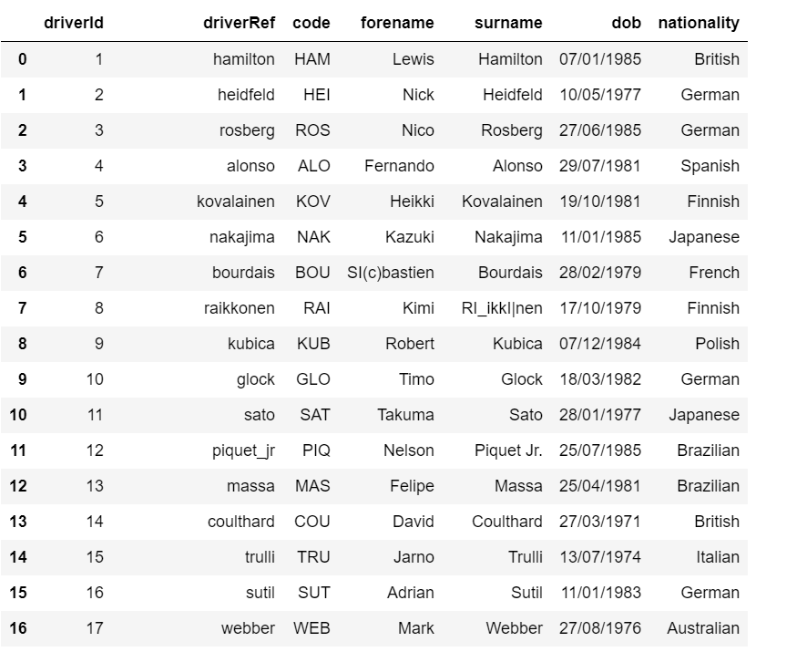

Slide 4
2013-2022 Data Diagram
Data Cleaning Pipeline
Dropped columns to remove unnecessary data
Decoded the foreign names
Cleaned
Data frame
Cleaned
.CSV
.CSV Source file
Python
Panda
Data frame
Filter out non-integer values in the multiple columns
Filtered the top 10 drivers

Slide 5
